Slide 1
CSE414: WEB ENGINEERING
Daffodil International University

Slide 2

You Will Be Able To
Understand the HTTP
Understand HTML5 elements
Choose the right tools
Know about different character set

Slide 3
Contents
HTTP
Tools to use
HTML Elements
HTML Characters

Slide 4
WEB
World Wide Web [New]
An infrastructure that allows to easily develop, deploy, and use distributed systems
Distributed systems
A system in which components located on networked computers communicate and coordinate their actions by passing messages in order to achieve a common goal
The web uses the Hypertext Transfer Protocol to communicate (Communication) protocol
A defined system that allows two or more entities to transmit information via any kind of variation of a physical quantity
It defines the rules, syntax, semantics and synchronization of communication

Slide 5
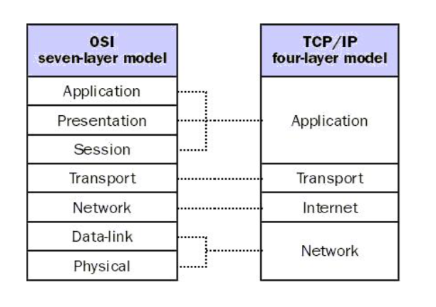
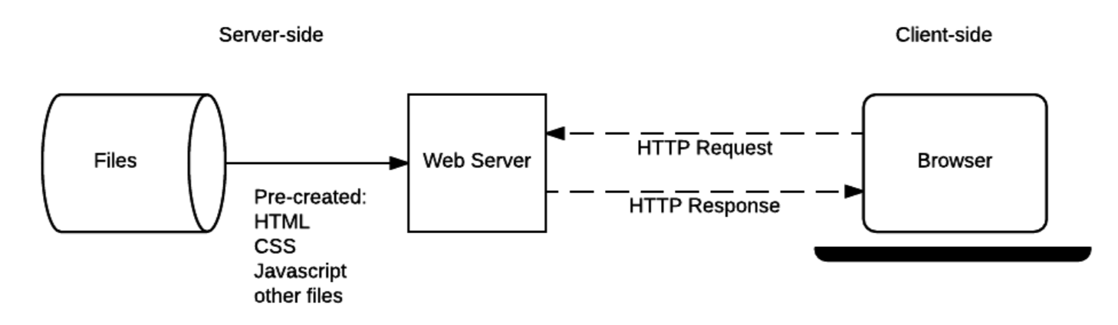
HTTP
From CSE313 we already know,
Web clients (web browsers) and web servers use HTTP (Hypertext Transfer Protocol) to communicate with each other.
More generally, HTTP is an application-layer protocol for distributed systems

Slide 6
History of HTTP
1991 – HTTP 0.9
1996 – HTTP/1.0
1997 – HTTP/1.1
1997-2014
Minor improvements and clarifications of HTTP/1.1 are developed
2015 – HTTP/2
Major revision of HTTP with focus on efficiency and privacy improvements
HTTP/2 allows a server to push resources to client even before they are requested
HTTP/2 puts more emphasis on encrypted connections

Slide 7
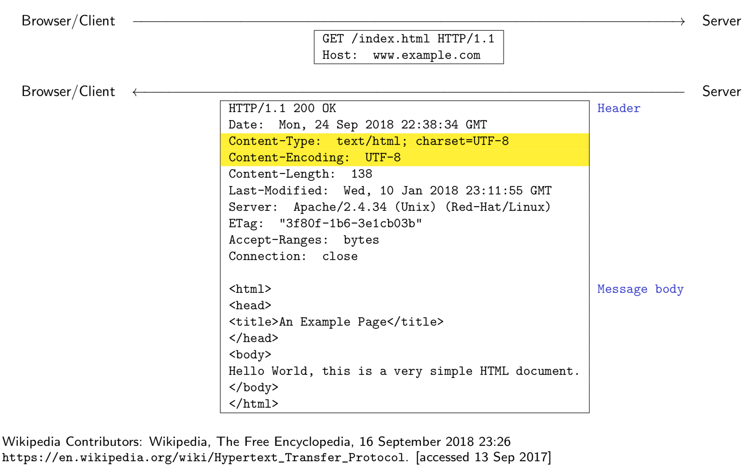
HTTP Requests

Slide 8
Hypertext and HTML
The HTML specifies the static part/ elements of a web page
Hypertext documents contain links to other hypertext documents, creating an associative trail that readers can choose to follow
Markup , more general term for tags which provide additional information about document structure, content type, formatting, etc.
Notes:
The terms ‘hypertext’ and ‘hypermedia’ were coined by Ted Nelson in 1963 as part of a model he developed for creating and using linked content
The idea of hypertext is attributed to Vannevar Bush who in in 1945 described a hypothetical hypertext device called Memex in a magazine article

Slide 9
HTML is an evolving…
HTML is an evolving standard (as new technology/tools are added)
HTML 1 (Berners-Lee, 1989): very basic, limited integration of multimedia
in 1993, Mosaic added many new features (e.g., integrated images)
HTML 2.0 (IETF, 1994): tried to standardize these & other features, but late
in 1994-96, Netscape & IE added many new, divergent features
HTML 3.2 (W3C, 1996): attempted to unify into a single standard
but didn't address newer technologies like Java applets & streaming video
HTML 4.0 (W3C, 1997): current standard
attempted to map out future directions for HTML, not just react to vendors
XHTML 1.0 (W3C, 2000): HTML 4.01 modified to conform to XML standards
XHTML 1.1 (W3C, 2001): “Modularization” of XHTML 1.0

Slide 10
In this course…
You should design your webpages to the XHTML 1.0 Strict standard (or better).
I will be enforcing this standard in your assessments (as much as possible).
More will be said when I discuss Document Type Declarations (soon).

Slide 11
Web Development Tools
Many high-level tools exist for creating Web pages
e.g., Microsoft FrontPage, Netscape Composer, Adobe PageMill, Macromedia DreamWeaver, HotDog, … also, many applications have "save to HTML" options (e.g., Word)
…for most users who want to develop basic, static Web pages, these are fine (but they still may produce poorly structured HTML code)
Assembly language vs. high-level language analogy
So, why are we learning low-level HTML using a basic text editor?
may want low-level control
may care about size/readability of pages
may want to "steal" page components and integrate into existing pages
may want dynamic features such as scripts or applets
remote editing of web pages may only be possible using a basic text editor

Slide 12
Choosing the right tools?
What Not To Use in this course:
Any drag and drop website
‘Save as html’ – this generates poor html code
No software that can convert your design to code
What To Use:
Any Text-editors and/or IDEs. ie, Notepad, Notepad++, SublimeText, PHP Storm, VSCode etc.
You CAN NOT use CSS frameworks like Bootstrap
You can if and only if you get approval for a higher level projects ( you are already a developer!)

Slide 13
Elements and Attributes(1/5)
The HTML5 specification defines a set of elements, attributes, and attribute values and their meanings (semantics)
(there are more than 100 different elements alone)
Authors of HTML documents should not use elements, attributes, or attribute values for purposes other than their intended semantic purpose
otherwise documents might not be processed correctly (still, most authors violate this rule)

Slide 14
Elements and Attributes(2/5)
HTML5 follows the separation of concerns design principle:
a system should be divided into parts with functionality that overlaps as little as possible
in HTML5 semantics and presentation are (mostly) separated
For the full specification of the most recent version see
S. Faulkner, A. Eicholz, T. Leithead, A. Danilo, S. Moon, editors: HTML 5.2. W3C Recommendation, 14 December 2017. https://www.w3.org/TR/html52/ (accessed 09 September 2019)

Slide 15
Elements and Attributes(3/5)
Most elements consist of a start tag and a matching end tag, with some content in between
The general form of a start tag
<tagName attrib1="value1" ... attribN="valueN">
A end tag / closing tag takes the form
</tagName>
Examples:
<title >My first HTML document </title > <a href="http://cgi.csc.liv.ac.uk/">CS Website </a>

Slide 16
Elements and Attributes(4/5)
HTML Attributes
All HTML elements can have attributes
Attributes provide additional information about an element
Attributes are always specified in the start tag
Attributes usually come in name/value pairs like: name="value"
Example
<a href="https://www.w3schools.com">This is a link</a>

Slide 17
Elements and Attributes(5/5)
Nested HTML Elements
HTML elements can be nested (elements can contain elements).
All HTML documents consist of nested HTML elements.
Suggestion
Use Lowercase Attributes
Quote Attribute Values

Slide 18
Character Encodings
Computers operate on bits (0/1) and sequences of bits
To store a text, it needs to be encoded as a sequence of bits
To retrieve a text, a sequence of bits needs to be decoded back to a sequence of characters
Early examples of such encodings are
7-bit ASCII (American Standard Code for Information Interchange)
8-bit ANSI (American National Standards Institute)
8-bit Windows-1252
8-bit Mac OS Roman
However these allow to encode at most 256 characters
the languages of the world contain many more characters

Slide 19
Character Encodings
UTF-8 is a modern solution to this problem:
(Almost?) every known character is mapped to a sequence of 1x8 bits to 4x8 bits
Within UTF-8, ANSI characters retain their encoding
When two systems exchange texts, then they need to know / agree which encoding they are using
A HTTP header uses ASCII
A HTTP message body can use an arbitrary encoding
Char | ASCII | ANSI | UTF-8 | Mac OS Roman
a ˆa ̈a α | 1100001 | 01100001 11100010 11100100 | 01100001 11100010 11100100 11001001:10100011 | 01100001 10001001 10001010

Slide 20
HTML Characters
The HTML5 specification defines a large number of named characters with the general format &name;
allows access to non-ASCII and reserved characters
Named char, &lt; &gt; rendered as ‘<‘ and ‘>’ respectively
Arbitrary characters can also be accessed using &#dec; and &#xhex; where dec and hex are decimal and hexadecimal encodings for a character
&#x0003C; rendered as ‘<’
&#x00026; as ‘&’

Slide 21
Exercise
Why do we need protocols?
Write two applications of HTTP.
READINGS
M Schafer: Ch. 1, 2, 3, 4
HTTP
Kurose: Ch 2 [Page 98-114]
https://www.w3schools.com/html

Slide 22
Acknowledgement
This module is designed and created with the help from following sources-
https://cgi.csc.liv.ac.uk/~ullrich/COMP519/
http://www.csc.liv.ac.uk/~martin/teaching/comp519/

