Slide 1
খোঁজ - THE DOCTOR
Galib, Md. Amanullah 15-30188-2
Islam Raisul 15-29534-2
Zarin, Israt 15-30245-2

Slide 2

WELCOME PAGE

Slide 3
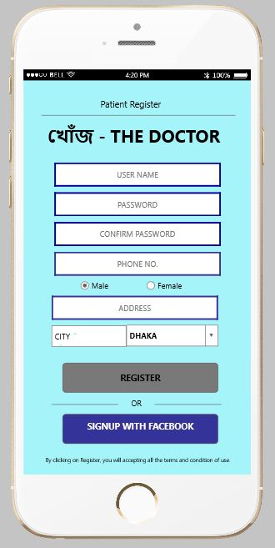
USER REGISTRATION (PATIENT)

Slide 4
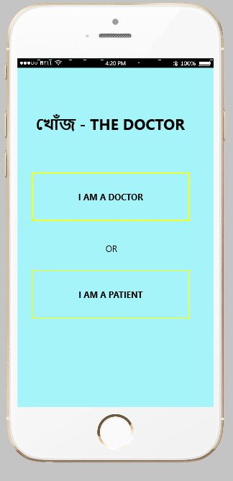
SELECT USER

Slide 5
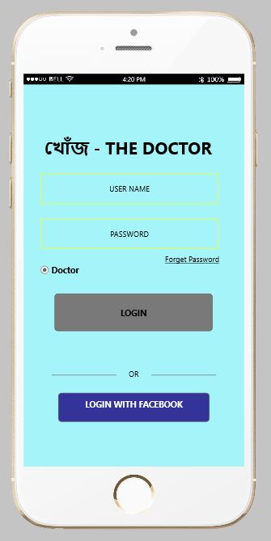
LOGIN DOCTOR

Slide 6
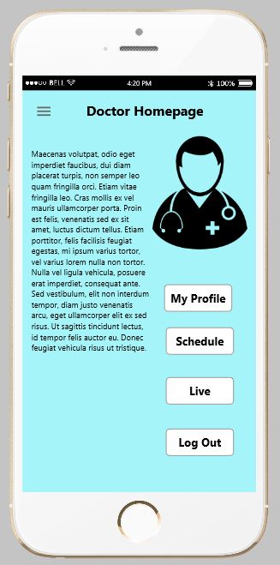
DOCTOR HOMEPAGE

Slide 7
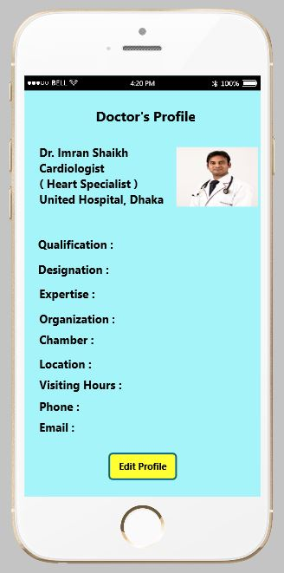
DOCTOR PROFILE

Slide 8
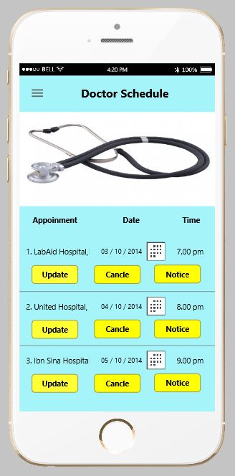
DOCTOR SCHEDULE
+
NOTICE

Slide 9
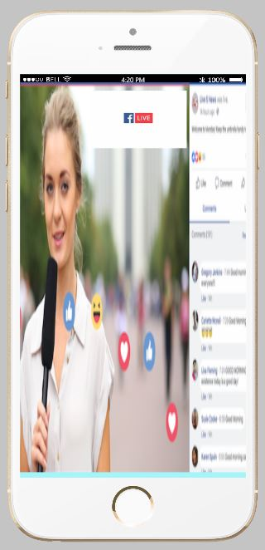
DOCTOR LIVE

Slide 10
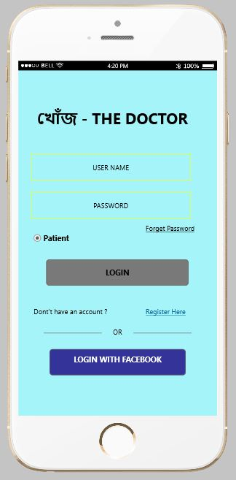
LOGIN PATIENT

Slide 11
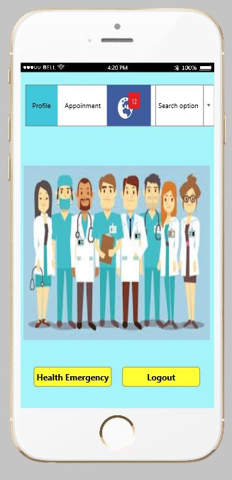
PATIENT HOME PAGE

Slide 12
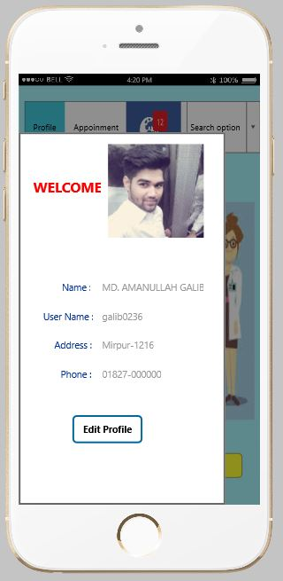
PATIENT PROFILE

Slide 13
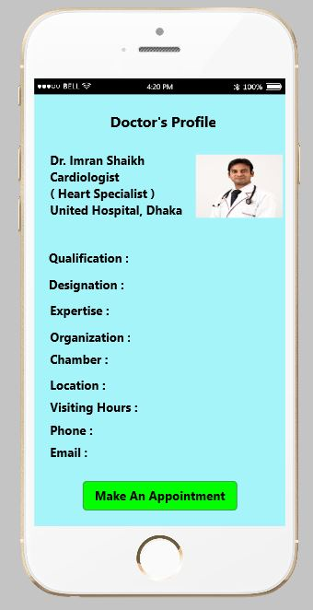
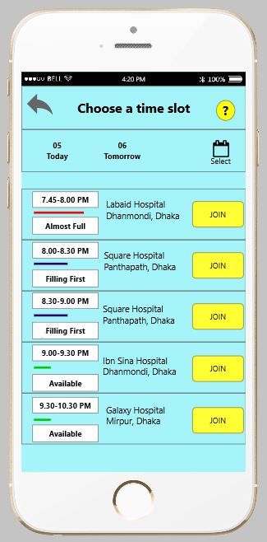
APPOINTMENT TIME CHOOSE
APPOINTMENT

Slide 14
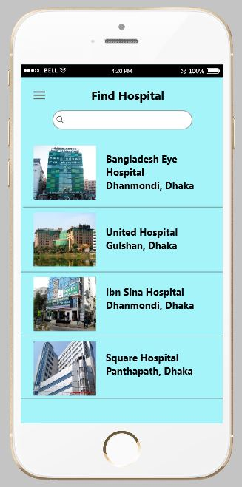
SEARCH HOSPITAL

Slide 15
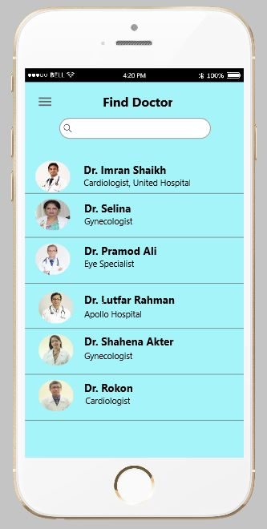
SEARCH DOCTOR

Slide 16
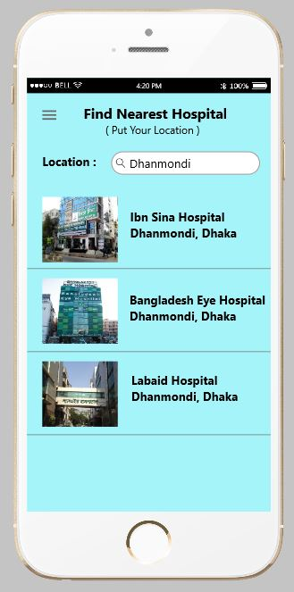
NEAREST HOSPITAL

Slide 17
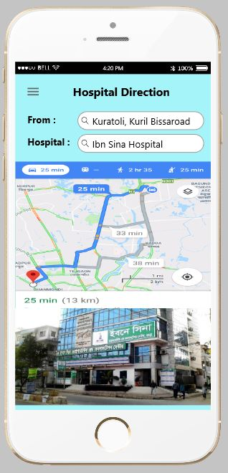
HOSPITAL DIRECTION

Slide 18
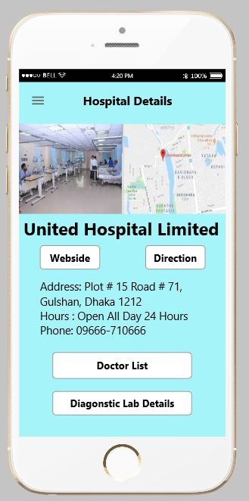
HOSPITAL DETAILS

Slide 19
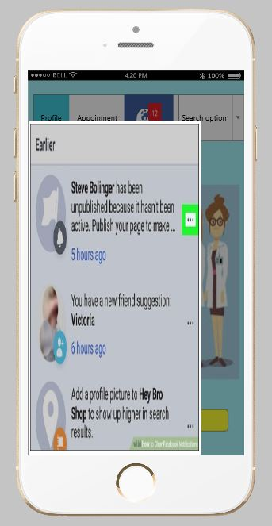
PATIENT NOTIFICATION

Slide 20
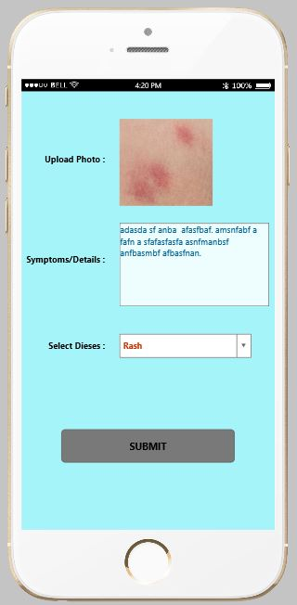
HEALTH EMERGENCY

Slide 21
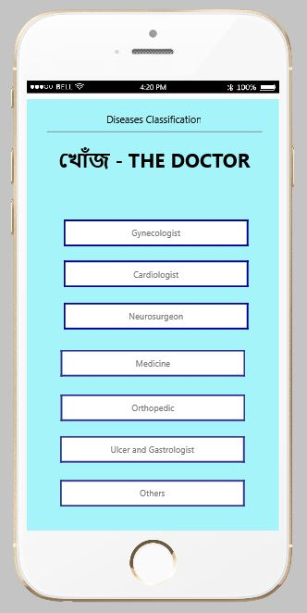
DISEASES CLASSIFICATION

Slide 22
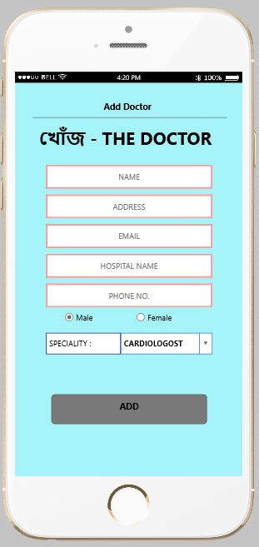
ADD DOCTOR

