Slide 1
CSE LEARNVEST
Presentation On
-----Online educational portal & course provider for computer
Science pupils

Slide 2
PRESENTED BY
Sabrina Binte Haider
Registration No: 16502000
Group No: 10
PRESENTED BY
Rifa Tasfia
Registration No: 16502000430
Group No: 10
Supervised By
Sabiha Sultana
Associate Professor
Department of CSE
Dhaka City College

Slide 3
Objectives
Providing a total educational system which supply academic update and a guideline to build a career.
Sourcing of different career material of different platforms in on place.
Creating a built-in reporting system where students are obliged to report about their progress of career and academic section.
Providing an online notice board with automatic mailing system.

Slide 4
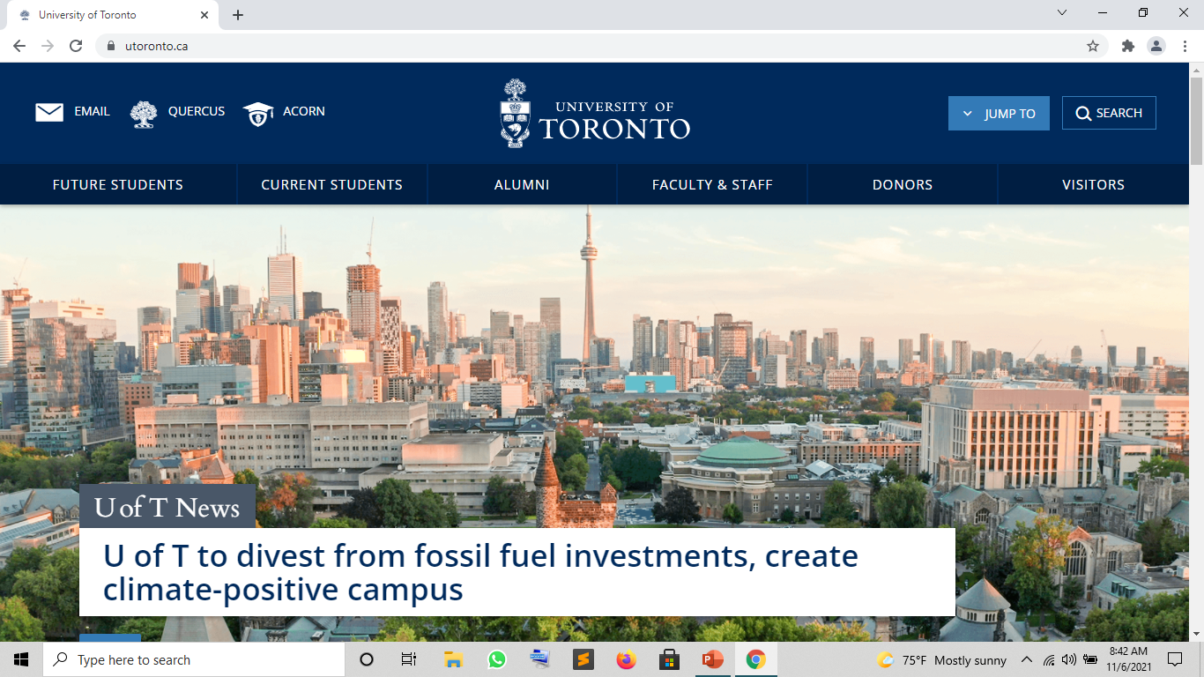
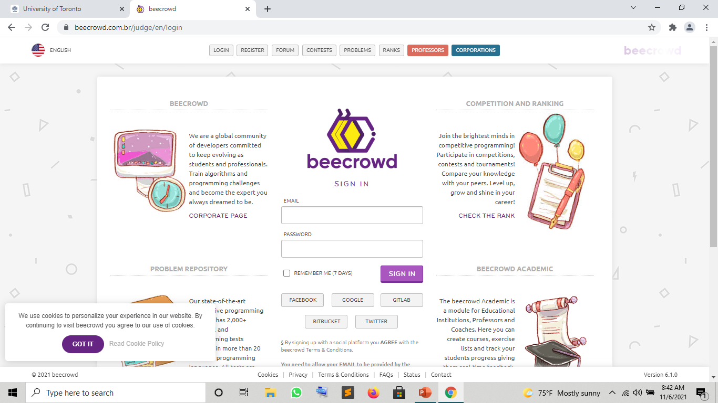
Existing System
•There are several websites working as an institutions information center. Having information about faculty, subjects and departments. They don’t provide the students update and career improvement environment.
•Some individual websites only provide language based test but they don’t give the proper guideline from experts or who are working on the section for years.

Slide 5
Drawbacks of Existing System
• There is always a communication gap between the institutional system with the teachers and regarding student’s career concern.
•Students cant get any update about any professor doing a project or research according to the interest. So that there creates academical lag for students.

Slide 6
CSE Learnvest Features
• Section based notice board with automatic mailing area.
• Weekly reporting system of progress.
• Online assignment submission.
• Fully secured log-in system using (#) hash encryption.
• Career developing and grooming for future work place from seniors and trainers.
• Collection of research papers from institution’s professor as well as scholars from different institutes of the world.
• Free lecture source from authentic sources.
• Multiple dashboard for different category users.

Slide 7
Project Environment
Hardware Requirements:
Processor : Core i5.
Ram : 8 GB Minimum, 16 GB Recommended.
Software Requirements:
Text-Editor: Sublime Text editor
Browser: Mozilla Firefox.
Local Apache Server: XAMP
PHP my admin (For Database)
Resources Used:
Bootstrap, Google fonts, Font Awesome, Canva ( block diagram, UI ), PHP (Laravel)

Slide 8

Project Model
We are using MVC ( Model View Control) model for our project. It is one of the best and most used model for PHP developers for its huge benefits:
• It is reusable . A model can be used in different project.
• Easily maintainable.
• It has faster development process having rapid and parallel development.
• It returns the data without formatting.
• The modification doesn’t affect the entire model.

Slide 9
Design
Our basic structure contains navigation bar and a search panel. Navigation bar contains career development, academic development, notices, log-in and registration. Search panel holds a search bar which will provide student information as well as resource information.

Slide 10
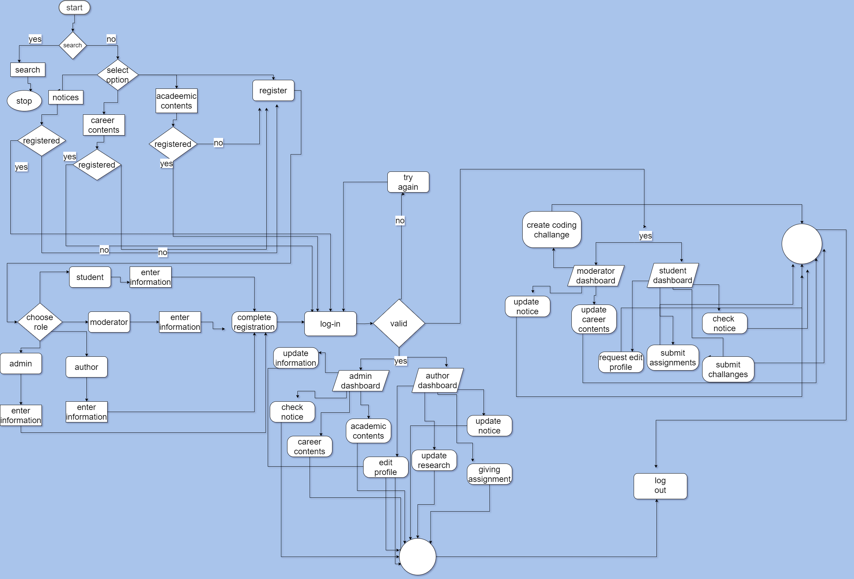
Flowchart

Slide 11
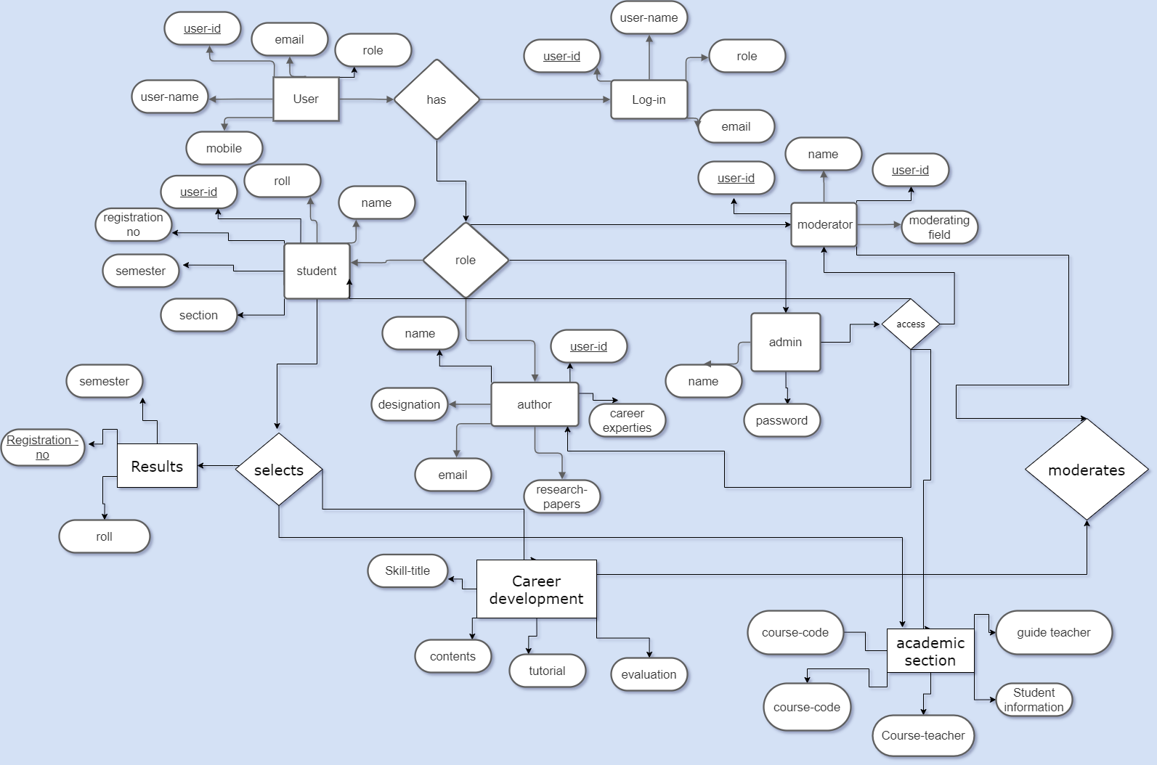
E-R Diagram

Slide 12
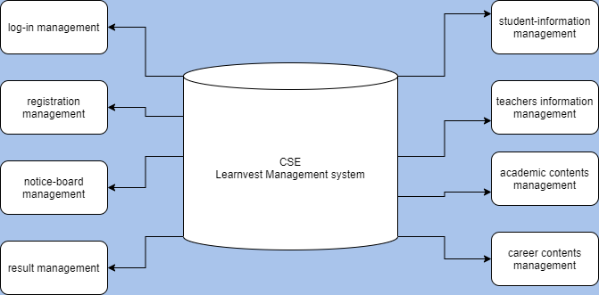
Data Flow Diagram

Slide 13
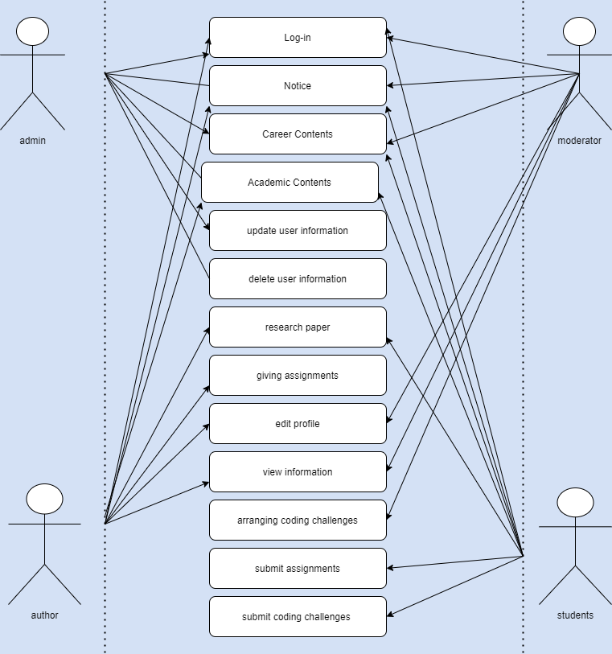
Use Case Diagram

Slide 14
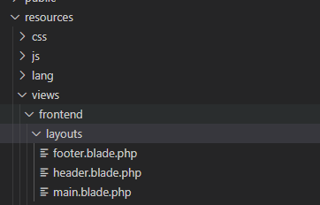
Implementation
For implementing our project we basically divide our whole front end design in
Header.blade.php : ( It shows the header , mainly navigation ,which is for every pages)
Footer.blade.php : ( It shows the footer, mainly Java script part and traditional footer options.)
Main.blade.php : ( It is the body of the web page, which is further extended by other pages)

Slide 15
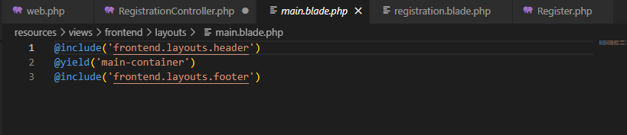

Main.blade.php
Here Main.blade.php holds the php instruction for extending the code for each of the pages.
main.blade.php holds the main container of the body and each of the page extends main .

Slide 16
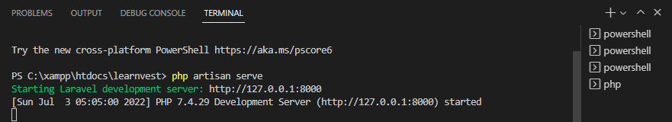
Port Connection
For port connection and hosting port we are using XAMPP localhost.
127.0.0.1:80000 this is the port number , where our project is launched.

Slide 17
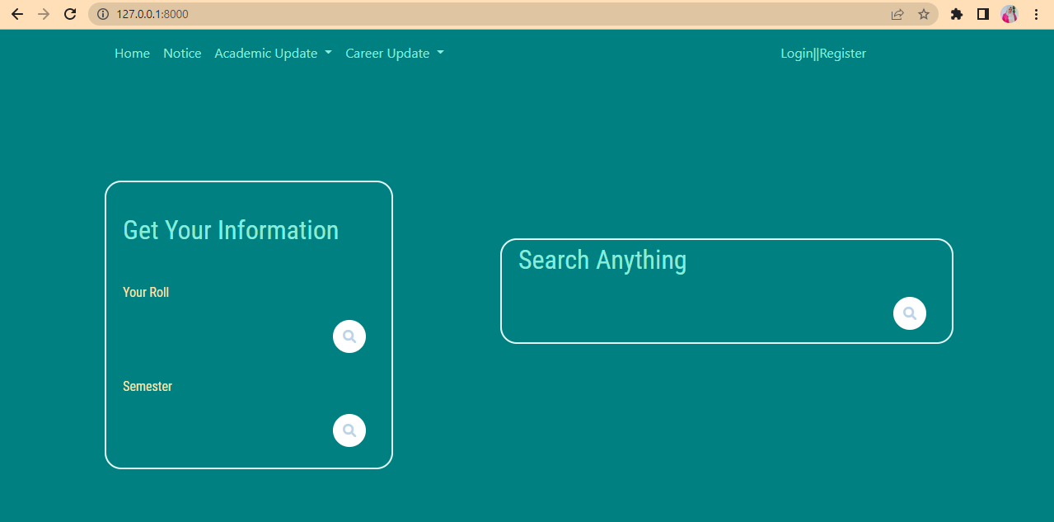
Home Page
This is the basic home page which is being showed in the port of localhost. This is going to be our landing page of the website.

Slide 18
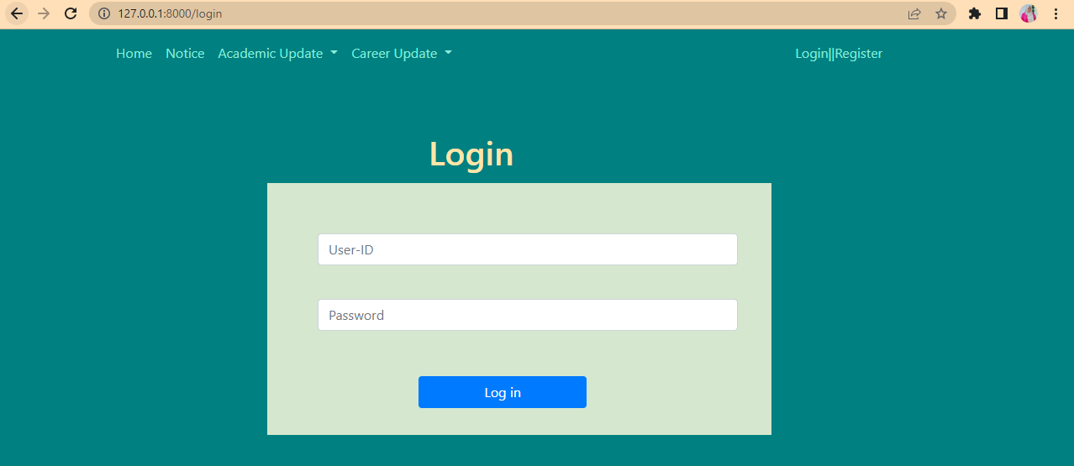
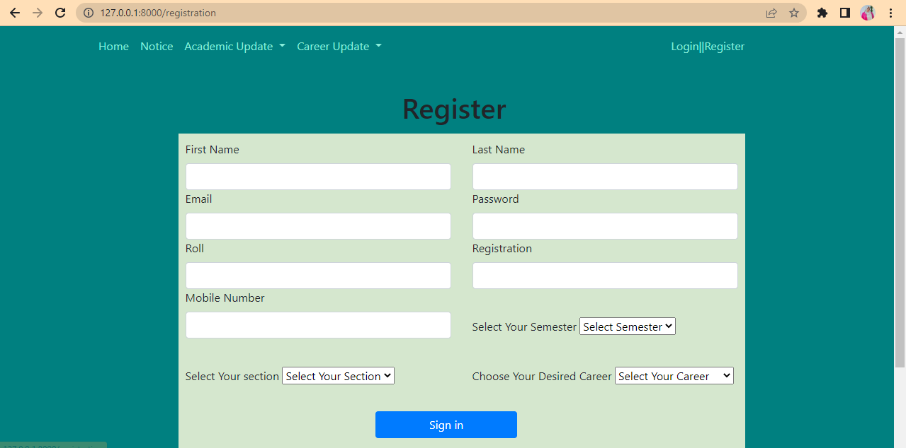
Login- Registration
• Our login system will be connected to the dashboard.
• There will be admin who will have all ascendency over author, moderator and user.
• After sign in process admin will allocate the role of the user according to the information.

Slide 19
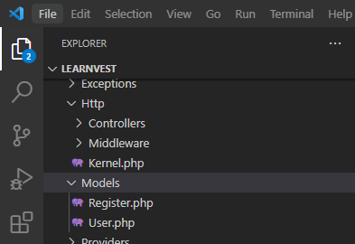
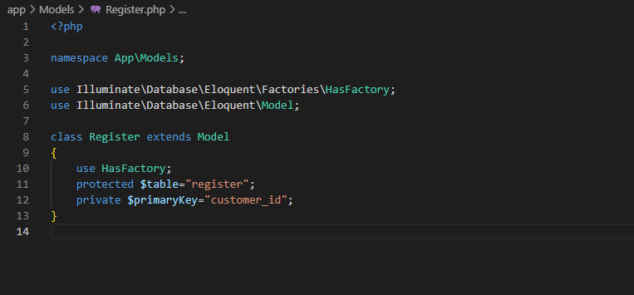
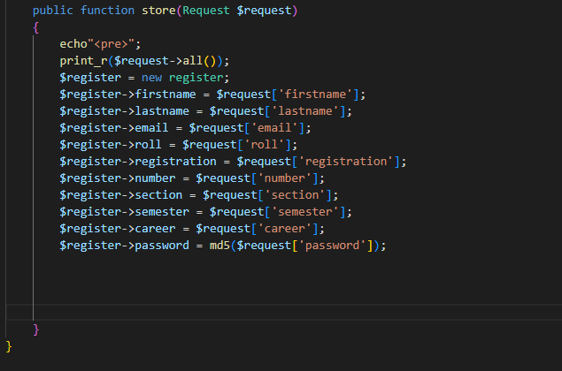
Login- Registration Database
In MVC model , model is the database holder for the website. We have used registration model to connect the database and take the information from the user

Slide 20
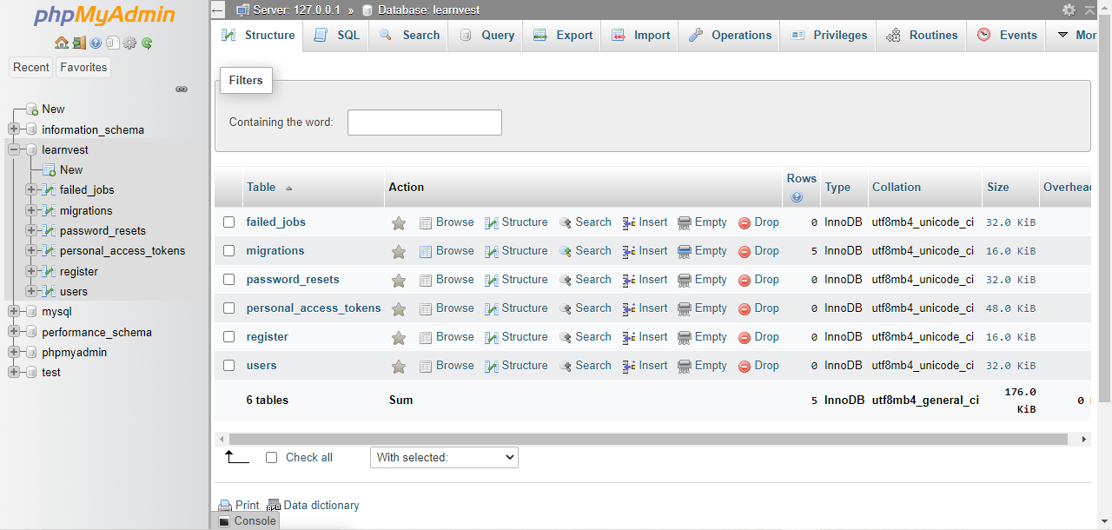
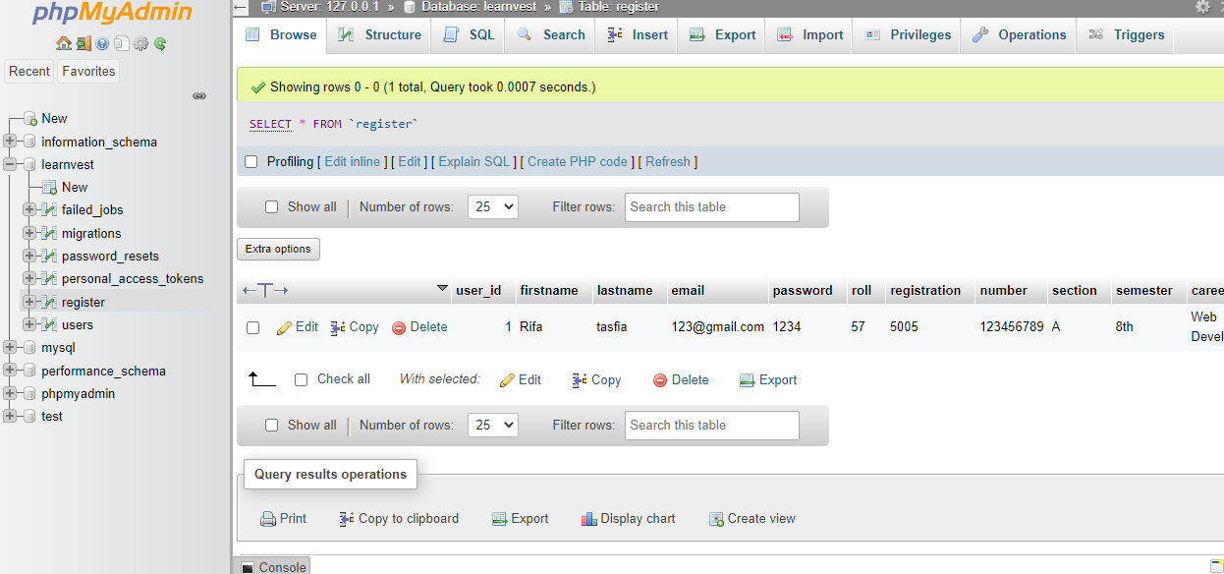
Login- Registration Database

Slide 21
Admin Panel
• After enrolling admin will recheck the information and will accept the request.
• We divided the panel :
1) Admin- controller of the website.
2) Author- Trainers of the institution.
3) User- The learners.

Slide 22
Academic Section
This section will contain all the information of academic updates of students, class based teacher list and student details. This section will be controlled by author / moderator.

Slide 23
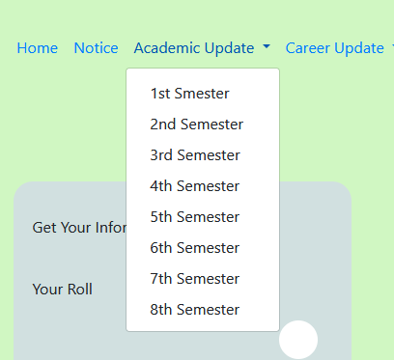
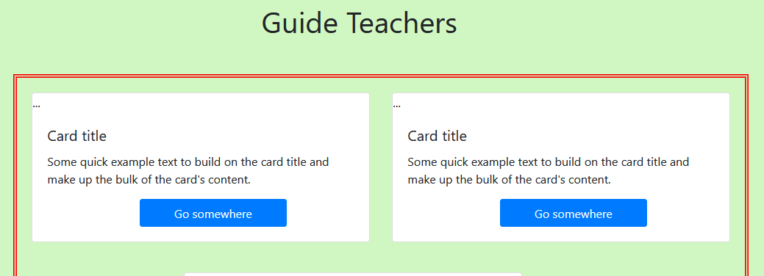
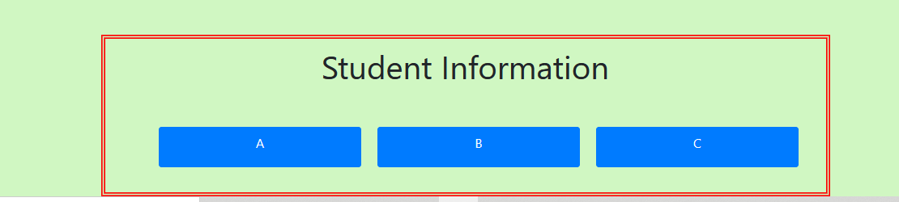

Slide 24
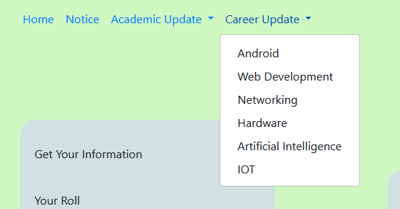
Career Update
This section will contain all the information of career related subjects. Lectures from different source, guideline for any particular sector, any new research materials will be supplied by the authors , moderators . User will be updated according to any addition of information.

Slide 25
Thanks……
That’s all for today

