Slide 1
HRMS
Asif Imran
Course Instructor, MIS-602
IIT, University of Dhaka

Slide 2

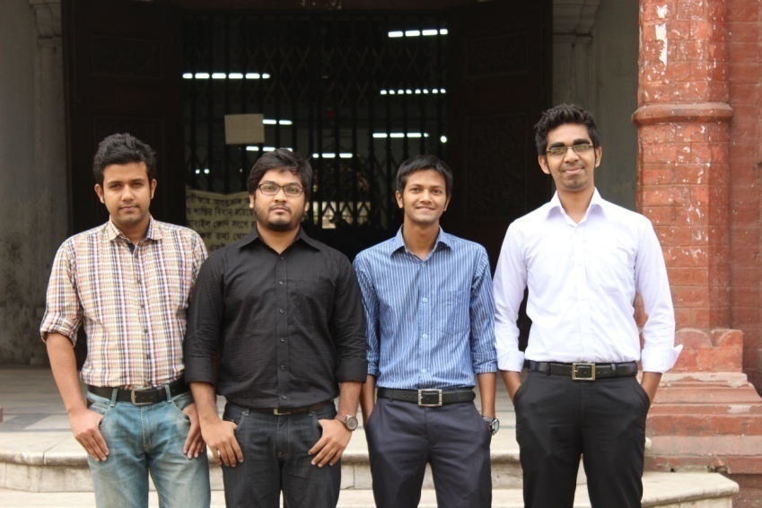
Team DUNITE
Morshedur Rahman
Master’s in Petroleum Geology
Department of Geology
Md. Masudur Rahman
Roll No. – BSSE 0413
Abdus Satter Rifat
Bachelor’s of Science in Software & Engineering
Institute of Information and Technology
Md Faridul Hassan Bafi
Bachelor’s of Science in Software & Engineering
Institute of Information and Technology
University of Dhaka
3

Slide 3
Agenda
Success Factor
Business Intelligence
Benefits
Live Demo
Features
5

Slide 4
HRMS
Employee Information Management
Salary Calculation
Attendance Management
Leave Management
Report Generation
Performance

Slide 5
Access control and security
Profiling and personalizing
Look-n-Feel
Reliability
Content and catalog management
Performance and service

Slide 6
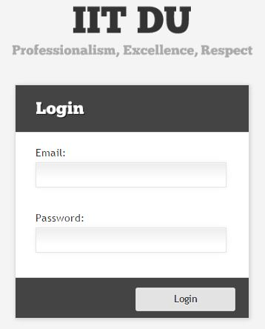
Access Control and Security
Authentication
Admin
Employee
Admin Activities
Employee Activities

Slide 7
Profiling and Personalizing

Slide 9
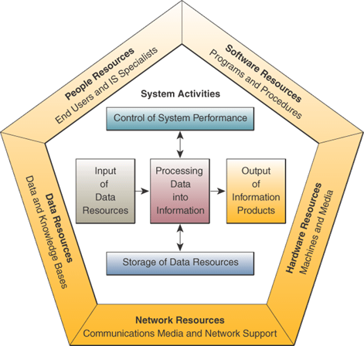
EIMS as a System

Slide 10
Information System Resources
People Resources
CEO (Admin)
Employees
Hardware Resources
Machines
Media
Software Resources
Programs
Procedures
Data Resources
Employee files, Database
Network Resources
Communications media, communications processors, network access and control software
Information Resources
Management reports and business documents using text and graphics displays

Slide 11
Measuring IT Success
Efficiency
Minimize cost, time, and use of information resources
Effectiveness
Support business strategies
Enable business processes
Enhance organizational structure and culture
Increase customer and business value

Slide 12
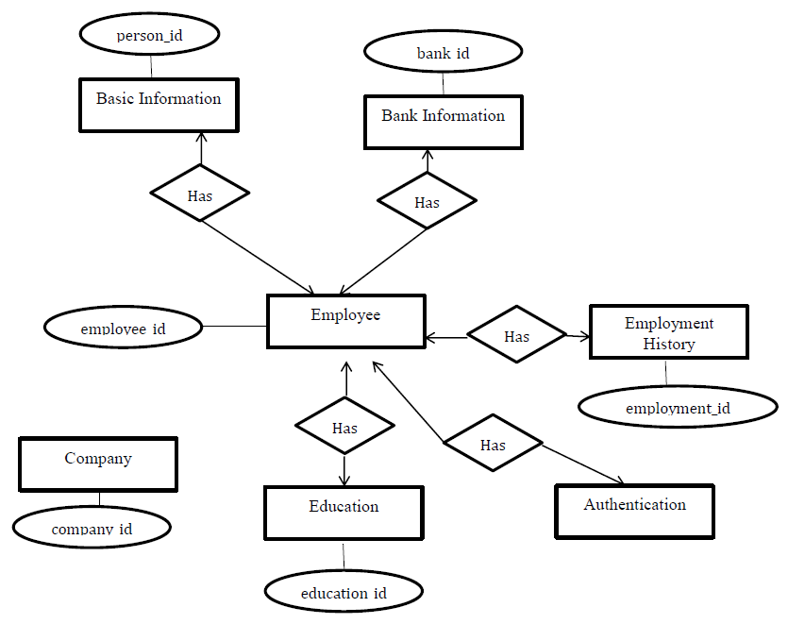
ER Diagram of EIMS

Slide 13
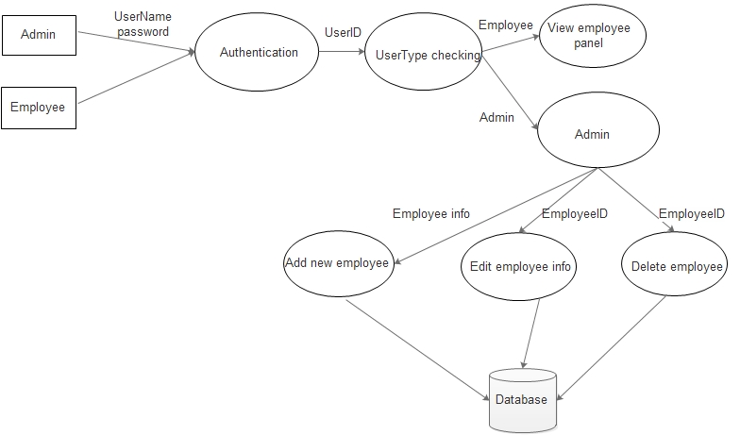
User Interaction Within the System

Slide 14
Benefits

Slide 15
SWOT Analysis

Slide 16
Live Demo

