Slide 1
Human Resource Management System
MIS-602
Course Instructor
Asif Imran IIT, University of Dhaka

Slide 2
© 2014 Schlumberger. All rights reserved. An asterisk is used throughout this presentation to denote a mark of Schlumberger. Other company, product, and service names are the properties of their respective owners.

Slide 3


Team DUNITE
Morshedur Rahman
Master’s in Petroleum Geology
Department of Geology
Md Atik Ullah Bulbul
Master’s in Geophysics
Department of Geology
Abdus Satter Rifat
Bachelor’s of Science in Software & Engineering
Institute of Information and Technology
Md Faridul Hassan Bafi
Bachelor’s of Science in Software & Engineering
Institute of Information and Technology
University of Dhaka
3

Slide 4
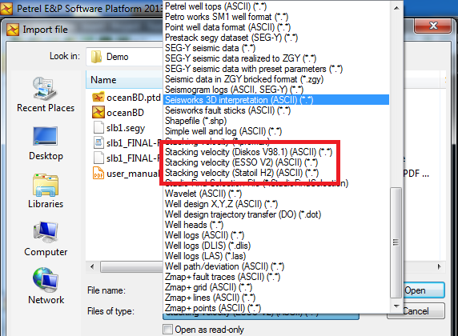
Business Problem
Only 3 types of stacking velocity data format in Petrel
Difficult to load directly other stacking velocity data format
4

Slide 5
Agenda
Solution
Plug-in concept
Plug-in features
Promax data loader demo
Results
Value of the plug-in
Way forward
5

Slide 6
Solution
Workflow in approach to the Plug-in:
3
2
1
1
Preview existing work
2
Formula for converting Promax format to ASCII format
3
Formula for rearranging ASCII format as ESSO V2 format
Coding
Developing Algorithm
Successful
Testing
Output
6

Slide 7
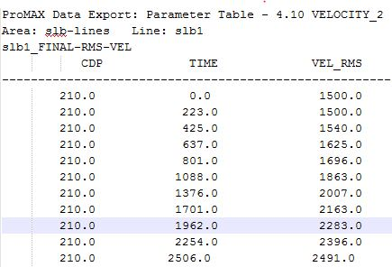
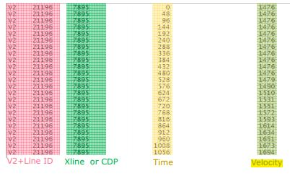
Plug-in Concept
Stacking velocity data loading directly in Petrel from Promax data format
Promax format
ESSO V2 format
7

Slide 8
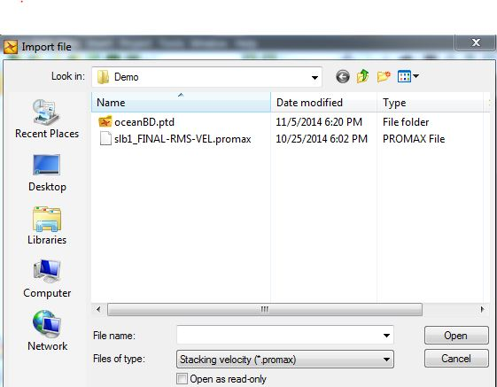
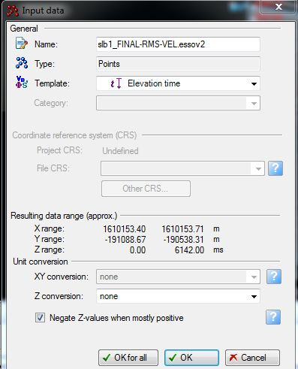
Plug-in Features
Input Promax Data
Input converted Promax Data as ESSO V2 data
8

Slide 9

Promax Data Loader Demo
9

Slide 10
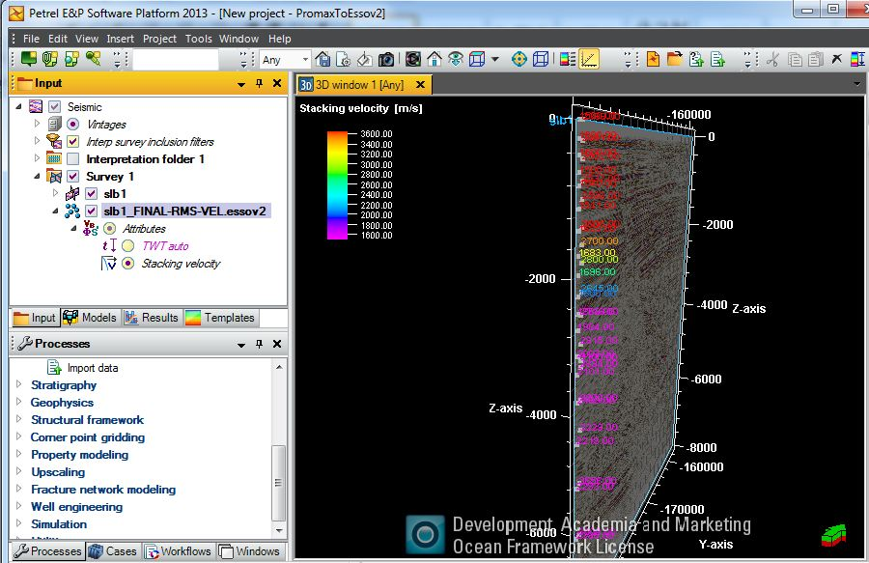
Results
10

Slide 11
Value of the plugin
Promax data can be directly imported
Reduce other software dependency
Promax data can be used in:
-- Velocity modeling
-- Depth conversion
11

Slide 12
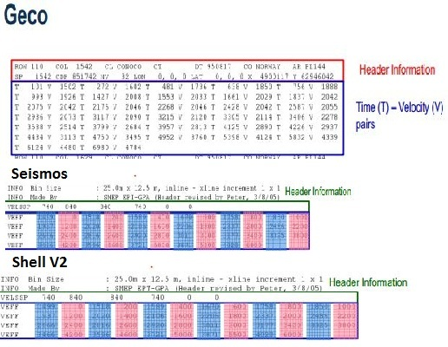
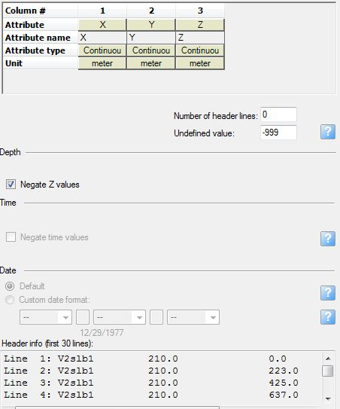
Way Forward
Develop a Plug-in independent of any format
Petrel point with attributes
12

Slide 13
References
Ocean Developers Guide
Schlumberger Intouch document: General Velocity Formats
Velocity Reformat Output, ProMAX® Reference
13

Slide 14


