Slide 1
HRMS
Asif Imran
Course Instructor, MIS-602
IIT, University of Dhaka

Slide 2

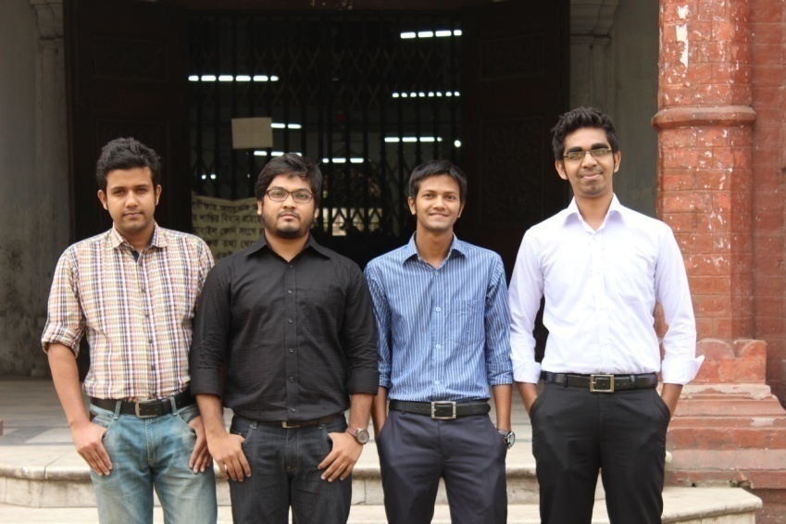
Team DUNITE
Morshedur Rahman
Master’s in Petroleum Geology
Department of Geology
Md Atik Ullah Bulbul
Master’s in Geophysics
Department of Geology
Abdus Satter Rifat
Bachelor’s of Science in Software & Engineering
Institute of Information and Technology
Md Faridul Hassan Bafi
Bachelor’s of Science in Software & Engineering
Institute of Information and Technology
University of Dhaka
3

Slide 3
Agenda
Success Factor
Business Intelligence
Benefits
Live Demo
Features
5

Slide 4
HRMS
Employee Information Management
Salary Calculation
Attendance Management
Leave Management
Report Generation
Performance

Slide 5
Access control and security
Profiling and personalizing
Look-n-Feel
Reliability
Content and catalog management
Performance and service

Slide 6
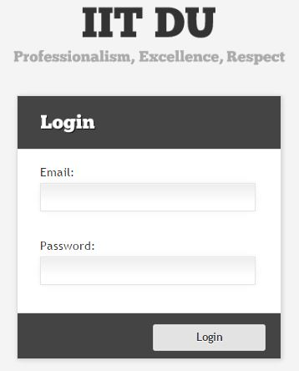
Access Control and Security
Authentication
Admin
Employee
Admin Activities
Employee Activities

Slide 7
Profiling and Personalizing

