Slide 1

Sequenced Collections

Slide 2
Evolution of Collection API
Collection
Map
Notes:
One for collections and another for maps

Slide 3
Collection API
Collection
Unordered
No Duplicates
Set
List
Indexed
Internally Ordered
Sorted Set
Externally Ordered
Notes:
What is sorted and what is ordered?

Slide 4
Sorting vs Ordering
Sorted elements means you need to use a comparator. ( Internally ordered )
What can you do with sorted collections?
AB
ABC
ABC
A
Notes:
Sorting elements means you need to use a comparator.
What you can do with sorted collections?
Get element from given position
Remove element from given position
Adding ? Inserting a specific position not possible / it may land anywhere in your set based on your comparator. So we don’t have direct control on this

Slide 5
Sorting vs Ordering
Ordering elements means each elements has its own index. ( Externally ordered )
What can you do with ordered collections?
ABC
A
AB
2
1
0
Index
Notes:
This is what lists are doing btw its most widely used implementation Array list
In a list you have an internal integer series starting from 0
What you can do with list?
If you add an element to list, it will take the next index
Operations:
You can get and remove element like we can do in sorted collections
Something you cannot do with sorted sets is adding an element to the given position

Slide 6
Collections History and Overview
What is missing?
Externally ordered but not indexed
Externally ordered with no duplicates
A List with unique elements; or a Set that is externally ordered
LinkedHashSet/Map (JDK 1.4 2002)
Does it have all properties of a Set?
Does it have all properties of a List?
Notes:
LinkedHashSet class is an implementation of Set and
it has a property of lists, which you always iterate over its elements in the same order
This internal linked list gives us the stability of the encounter order
We can get element add element and iterate elements in the same order
We cannot add an element to a given position because it may ends up to a duplicated element problem.
LinkedHashSet does not implement java util List.

Slide 7
Before Java 21
Collection
Set
List
Sorted Set
LinkedHashSet
Notes:
We have ordered collections List
We have sorted collections Set, Sorted Set and Naviagable Set
We have in middle of both (sorted and ordered collections) LinkedHashSet
There is nothing in the collection API to model this shared behavior.
:D I will be honest for me, this seems like an urgent feature request :D

Slide 8
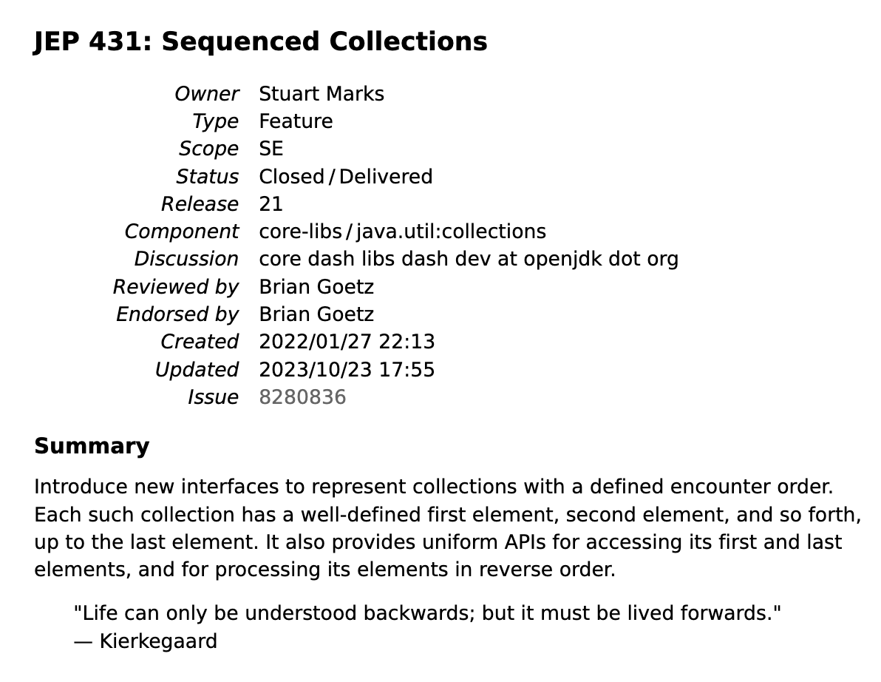
JEP 431: Sequenced Collections
Introduced three new Interfaces:
SequencedCollection
SequencedSet
SequencedMap
Essentials
Main semantics are specified encounter order (internal and external)
Provide add/get/remove operations at each end (first, last)
Provide reverse iteration via a reverse-ordered view
https://openjdk.org/jeps/431
Notes:
First major collection changes after 2006
"Encounter order" means the order in which you go through the elements in a collection, usually matching the order they were added.
Why usually? Because Sorted sets has encounter order based on comparator
The aim, Sequenced collections are modelling a common behavior shared by ordered collections and sorted collections.
CLICK NEXT PAGE
2) a collection can have a finite number of elements and if its ordered, there should be first and last
3) you could do reverse with many ways example : collections.reverse for list but here they want to introduce a reverse ordered view of the original collection.

Slide 9
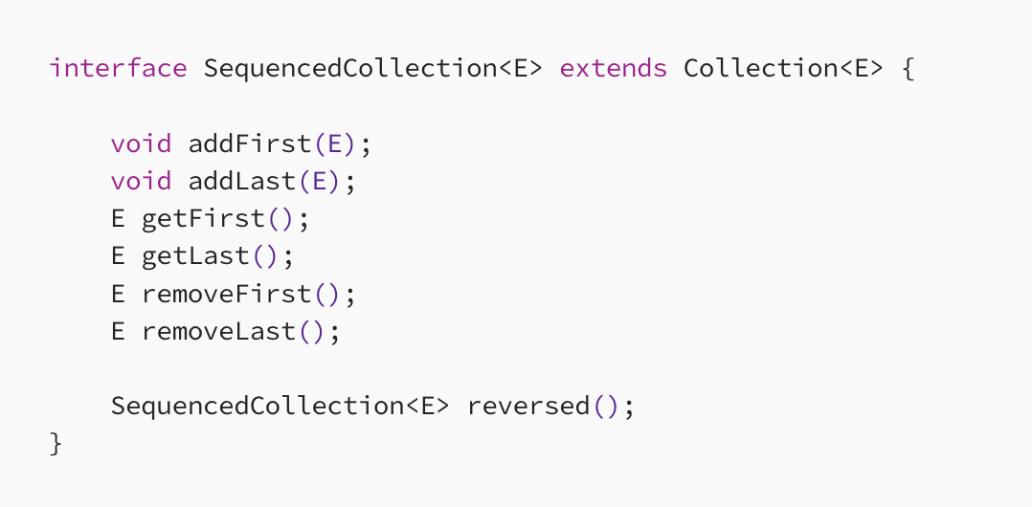
SequencedCollection Interface
Promoted from Deque
Promoted from NavigableSet.decendingSet()
Notes:
The new reversed() method provides a reversed-order view of the original collection.

Slide 10
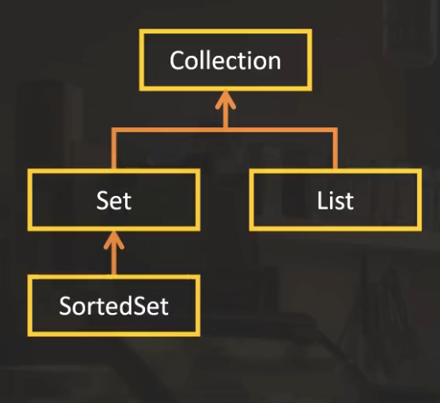
Collection before Java 21

Slide 11
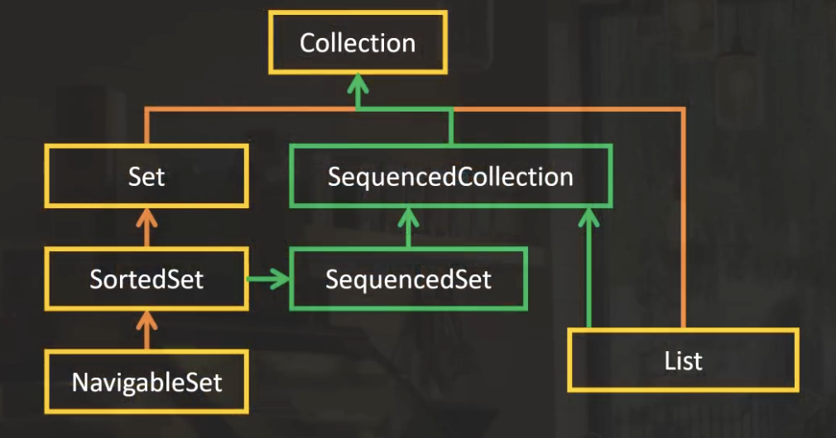
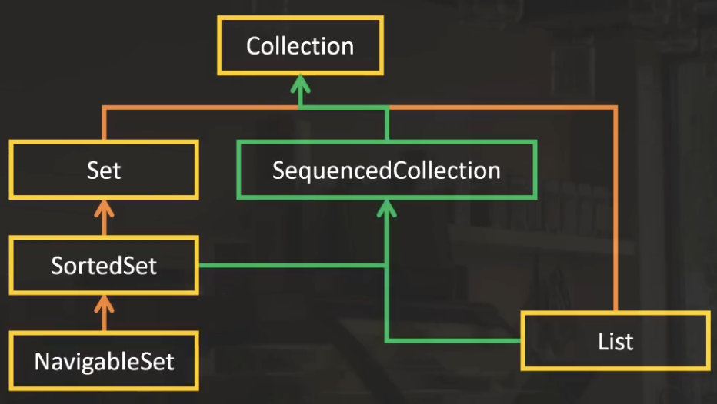
Collection after Java 21
Notes:
SequencedCollection has a reversed method that returns a sequenced collection
So to have a sortedset as an output of reversed method another interface added and called as SequencedSet

Slide 12
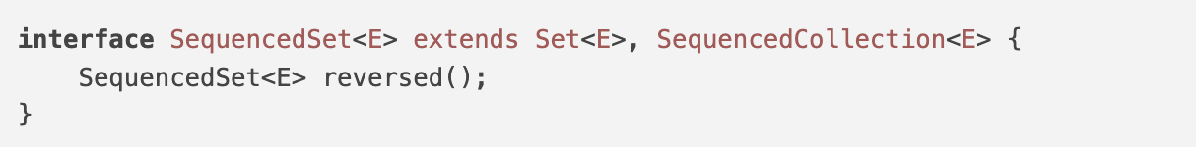
SequencedSet Interface
In the SequencedSet interface, the reversed() method is a covariant override because it returns a more specific type than SequencedCollection.
This ensures the reversed view keeps set properties like uniqueness and order.
Notes:
SequencedSet interface provides a more specific contract, indicating that the reversed view will maintain set properties like uniqueness, while also preserving the sequenced nature.

Slide 13
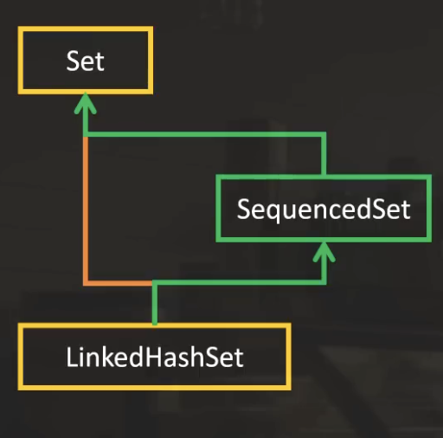
LinkedHashSet after Java 21
Notes:
The behaviour of LinkedHashSet was not matching with any interface before.
Now it implements SequencedSet

Slide 14
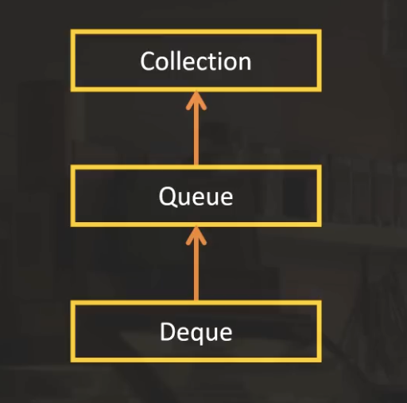
Deque before Java 21
Basic Operations on Queue: Push, Pop and Peek
The Deque interface supports both FIFO queues and LIFO stacks, with different behaviors for empty or full states.
It does this with the help of more than 20 methods
Notes:
Same in any languages

Slide 15
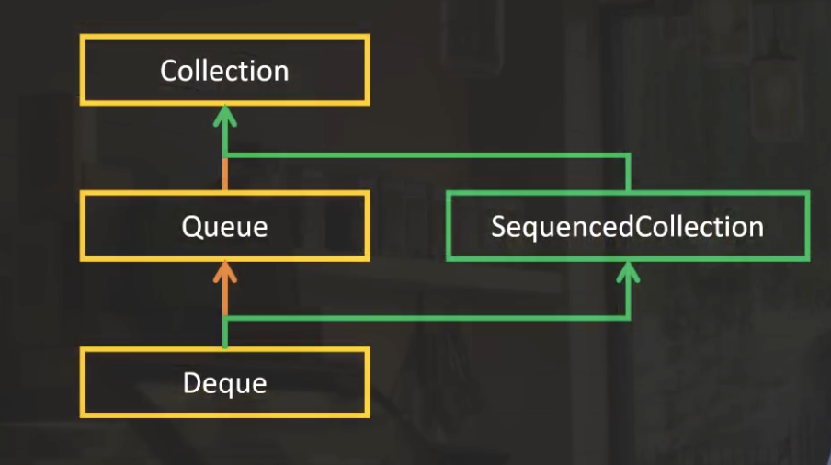
Deque after Java 21

Slide 16
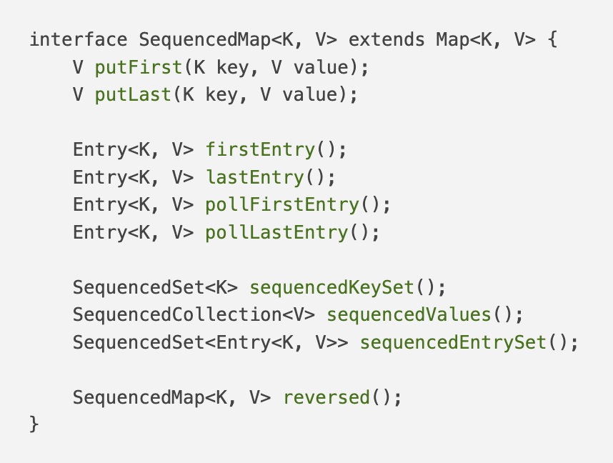
SequencedMap Interface
New add methods
Promoted from NavigableMap
New sequenced map views

Slide 17
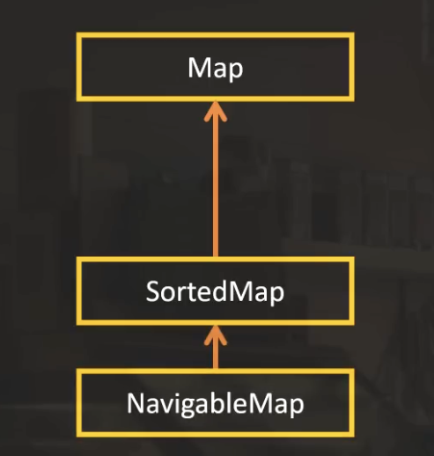
MAP before Java 21

Slide 18
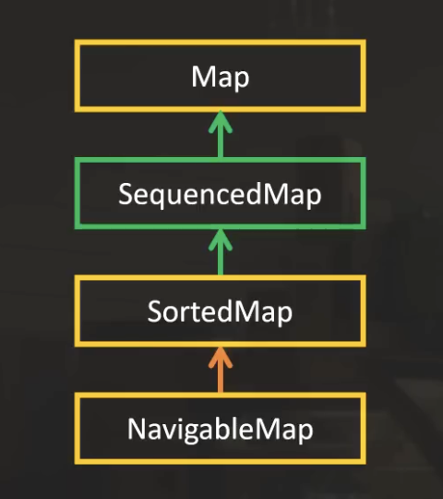
MAP after Java 21

Slide 19
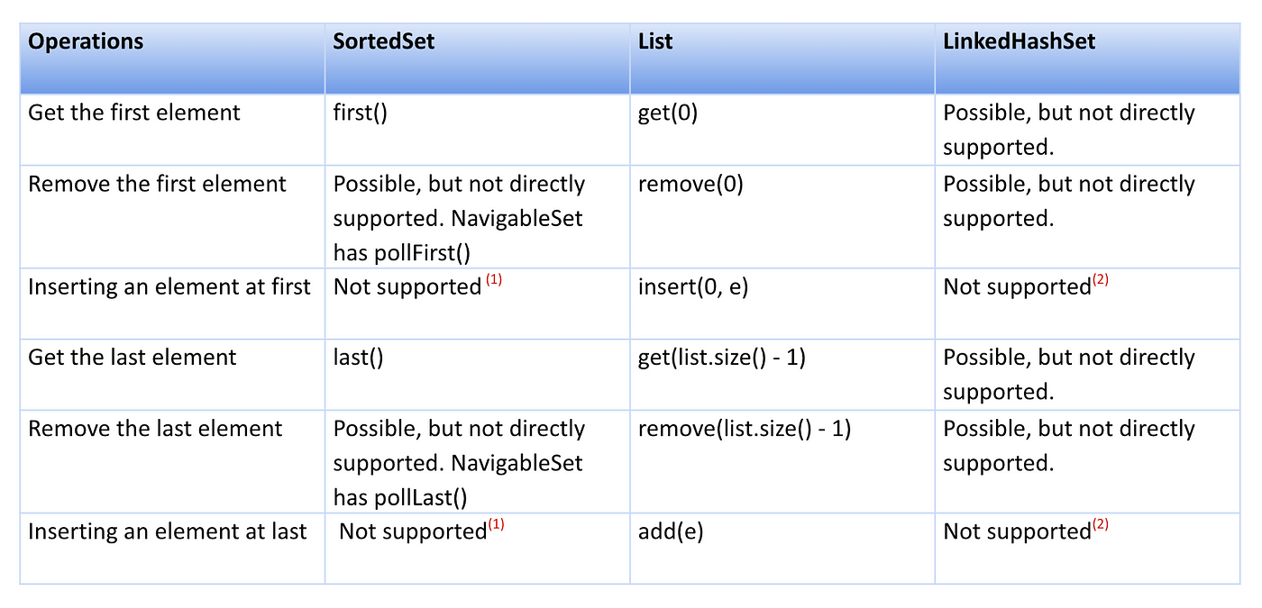
Collection API before Java 21
Notes:
You don’t see deque here because sequenced collections is already using same naming so it will stay as it is

Slide 20
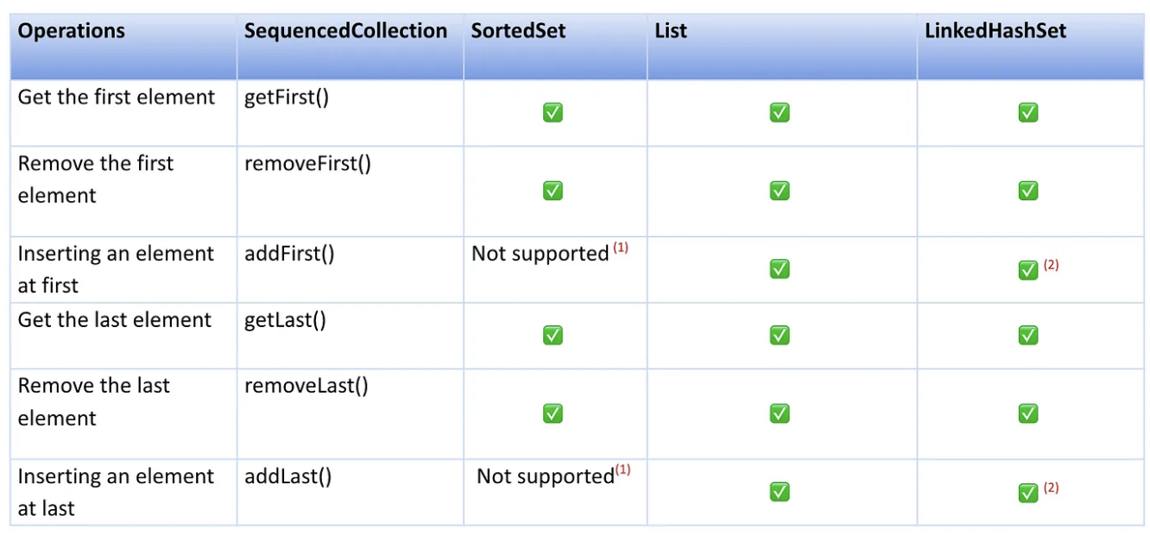
Collection API after Java 21
addFirst and addLast() cannot be supported in collections like SortedSet and will throw UnsupportedOperationException.
Adding element at first and last are now supported in LinkedHashSet now as part of the SequencedCollection feature. If the element is already present in the set then it is moved to the appropriate position.

Slide 21
Reverse iteration
 | Before Java 21 | After Java 21
List | for (var it = list.listIterator(list.size()); it.hasPrevious();) // use it.previous () | list.reversed()
Deque | for (var it = deque.descendingIterator(); it.hasNext();) // use it.next() | deque.reversed()
LinkedHashSet | ??? | lhset.reversed()
NavigableSet | For(var e: navset.decendingSet()) | navset.reversed()

Slide 22
Demos
How effective new changes? ( Playlist Manager )
What does reversed() return? ( Social media content )
Stream of reverse Iterator or just reversed() ? ( Stock Market )
Notes:
UnmodifiableCollections for the second example

Slide 23
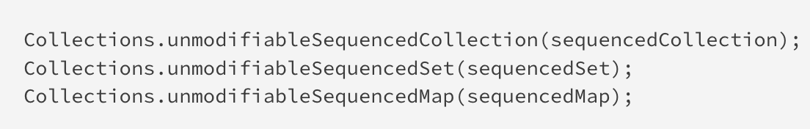
New Methods in Collections Class
The Collections class is a utility class that contains methods for common operations on collection types. One such operation is converting a mutable collection to an immutable one.

Slide 24
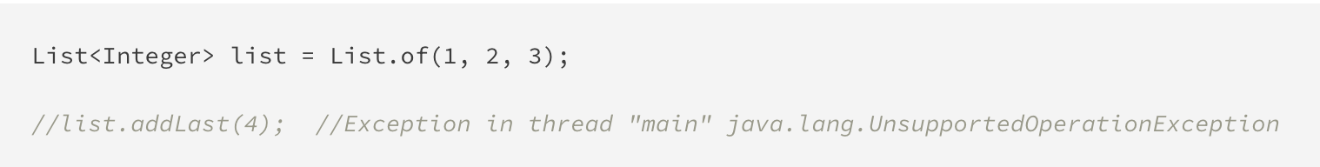
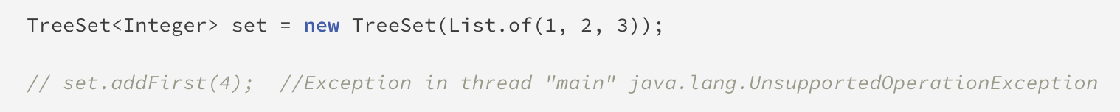
UnsupportedOperationException
The new interfaces also affect the collection types that are unmodifiable. If we attempt to use the new add or remove operations in an unmodifiable collection, we will encounter the UnsupportedOperationException.

Slide 25
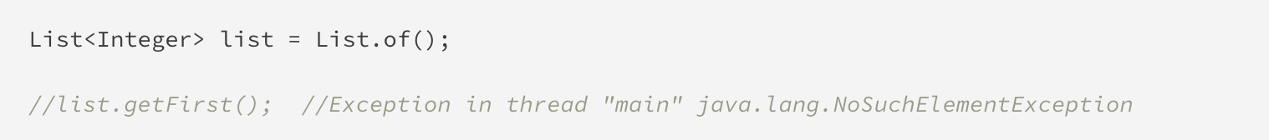
NoSuchElementException
If we try to use the sequenced methods on an empty collection, we will get the NoSuchElementException, because there is no element present to return from the method.
Notes:
Do you guys remember what was the error before java 21?
Get(0) =>Index 0 out of bounds for length 0

Slide 26
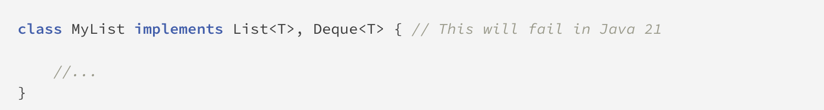
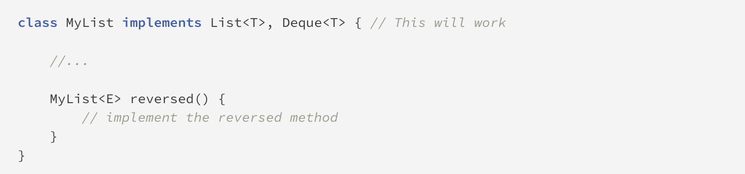
Pitfall Example
List and Deque interface both provide covariant overrides of the reversed() method. The first method is returning List and the other returning Deque.
The solution to fix this error is to define a new method reversed()
Notes:
Do you guys remember what was the error before java 21?
Get(0) =>Index 0 out of bounds for length 0

Slide 27

Questions or Additions

Slide 28

Thank you

