Slide 1
Introduction to C

Slide 2
Reference
Teach Yourself C
Herbert Schildt
The C Programming Language
Brian W. Kernighan
Dennis M. Ritchie

Slide 3
Why Programming Language?
To communicate with a machine/computer
Robotics
Microcontrollers: automobiles and airplanes
Embedded processors: phones, portable electronics
DSP (Digital Signal Processing) processors: digital audio and TV systems

Slide 4
About C
C was originally developed by Dennis Ritchie between 1969 and 1973 at Bell Labs
C was used to re-implement the Unix operating system
It has since become one of the most widely used programming languages of all time
C has been standardized by the American National Standards Institute (ANSI) since 1989 (ANSI C) and subsequently by the International Organization for Standardization (ISO)

Slide 5
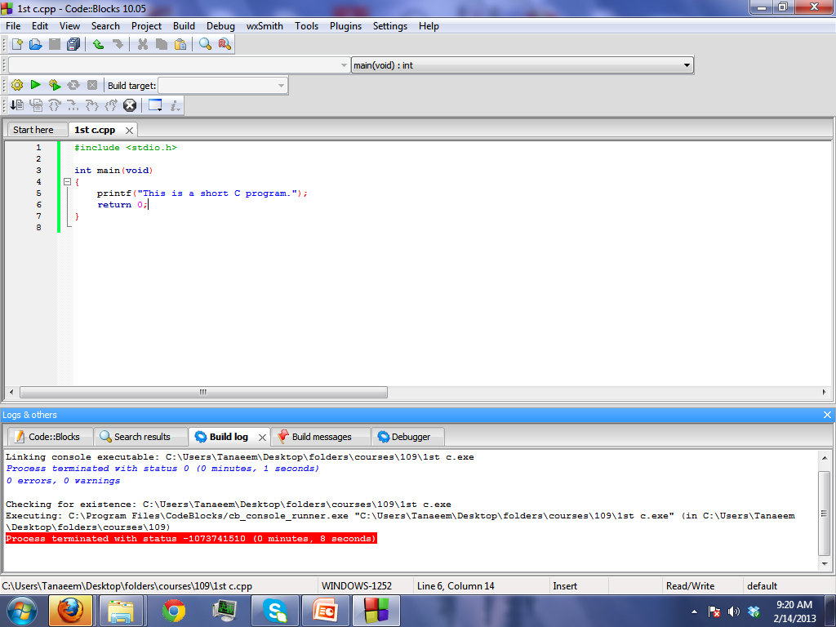
A first look at C
header file
return type
function
start of program
statement
parameter
end of program
Library function

Slide 6
A first look at C
#include <stdio.h>
int main()
{
printf(“This is a short C program”);
return 0;
}
# include
# symbol indicates a preprocessor
It means it has to be done before compilation
#include to include the contents of the header file

Slide 7
A first look at C
# include <stdio.h>
int main()
{
printf(“This is a short C program”);
return 0;
}
<stdio.h>
Name of the header file
Header files: constants, functions, other declarations
You must know which header you need
Use help and documentation to find out

Slide 8
A first look at C
# include <stdio.h>
int main()
{
printf(“This is a short C program”);
return 0;
}
<stdio.h>
Enclosed in < > (header in default place)
May be enclosed in “ ” (header is in the same folder as the source)
stdio.h : standard input/output header file
Needed for the function: printf()
Notes:
math.h, string.h, stdlib.h etc

Slide 9
A first look at C
# include <stdio.h>
int main()
{
printf(“This is a short C program”);
return 0;
}
main
Every C program must have a ‘main’ function
Program starts from the 1st line in ‘main’
Parameter type none or void
Return type int
int main()

Slide 10
A first look at C
# include <stdio.h>
int main()
{
printf(“This is a short C program”);
return 0;
}
{ } curly braces
The curly braces are like containers
The code between two braces are called a block
Missing either brace will generate compile error

Slide 11
A first look at C
# include <stdio.h>
int main()
{
printf(“This is a short C program”);
return 0;
}
{ } curly braces
Left curly brace {
Begin the body of function
Right Curly brace }
End of the function

Slide 12
A first look at C
# include <stdio.h>
int main()
{
printf(“This is a short C program”);
return 0;
}
printf
A function given in stdio.h
Prints the text given as the parameter

Slide 13
A first look at C
# include <stdio.h>
int main()
{
printf(“This is a short C program”);
return 0;
}
; (semicolon)
Every C statement must end with a ;
Otherwise compiler will generate an error
Statement Missing

Slide 14
A first look at C
# include <stdio.h>
int main()
{
printf(“This is a short C program”);
return 0;
}
return 0
Indicate how the program exited
return 0 means that execution was successful and there was no error.
abnormal termination is usually signaled by a non-zero return
but there is no standard for how non-zero codes are interpreted.
When a program is called by another program

Slide 15
A first look at C

Slide 16
Programming Tools
Compiler
Standard Library
Help files & documentations
IDE

Slide 17
Compilers
What does it do?
Match syntax
Find Errors
Prepare object code
instructions in a computer language, usually a machine code

Slide 18
Standard Library
What does it do?
Provide implementations of some basic and important functions
Usually these functions are very efficient
Programmers should use library functions to improve performance and portability

Slide 19
IDE - Integrated Development Environment
Helps to Write
Use different color to highlight different type of code
Sometimes shows hints
Helps to Compile
Helps to Run
Helps to Debug

Slide 20
Help Files and Documentation
Provide details about
Syntax
Keywords
Library functions
Examples
Etc.

Slide 21
Acknowledgement
Thanks to Johra Muhammad Moosa, Assistant Professor, CSE, BUET for the initial slides.
Thanks to Wikipedia for the history of C.

