Slide 1
Reference Counting

Slide 2
Reference Counting vs. Tracing
Advantages
Immediate
Object-local
Overhead distributed
Very simple Trivial implementation for naïve RC
Disadvantages
Maintain count Time and space overheads
Cycles Can’t be collected
Complex High performance implementation about as complex as tracing

Slide 3
Garbage collection is ubiquitous
Two ideas underpin large literature:
Tracing [McCarthy60]
Reference Counting [Collins60]
However
Tracing used in all high performance GCs
Reference counting only in non-performance critical settings
Notes:
Reference counting is used in non-performance critical systems like PHP, Perl and Python

Slide 4
Reference counting [Collins 1960]
Associate a reference count field with each object
how many pointers reference this object
When nothing points to an object, it can be deleted
Decrement count for all descendants of dead objects

Slide 5
Basic Reference Counting
1
1
0
1
1
2
3
2
A
B
C
D
E
1
1
E
F
Notes:
A set of objects and references. Objects with their reference count.
Reference update – inc of new and dec of old
Reference delete – dec of old and if zero then collect
Reference delete – dec of old, two objects only pointing to each other, circular references

Slide 6
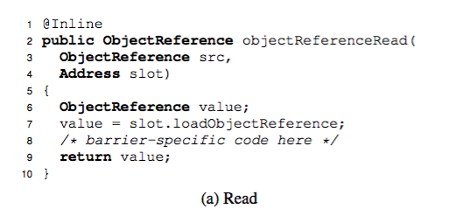
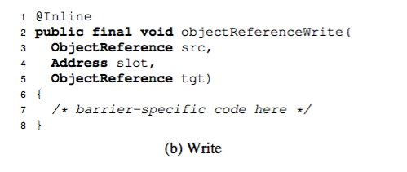
Write Barriers
Small piece of code
Used to intercept pointer writes
Generated by the compiler

Slide 7
Cycles?
[Harold-McBeth 1963] Reference counting algorithm does not reclaim cycles!
But, it turns out that “typical” programs do not use too many cyclic structures
This is correct also for modern benchmarks (including SPECjbb2000)
So, other methods are used “seldom” to collect the cycles

Slide 8
Lazy Freeing [Weizenbaum, 1963]
Problem: uneven processing overheads.
Cost of deleting last pointer to an object O depends on size of sub-graph rooted at O
Solution: lazy freeing
Free lazily with a stack
When last pointer to O deleted: push O to stack
During allocation: pop O from stack, free O, decrement rc for children of O
If any got down to 0 – push it to the stack

Slide 9
Lazy Freeing Properties
Advantage
Splitting the costs of deletion evenly throughout the computation
Efficiency (almost) unchanged: deletion is just spread into many allocation operations
Disadvantages:
Complication of the allocation process
It may take time to realize that a large consecutive space has been freed

Slide 10
Sticky reference counts
Problem: Space overhead for ref counters
Theoretically, large enough to hold number of pointers in the heap
Idea: use small rc fields (may overflow)
When rc overflows, think of it as stuck
Stuck rc’s are not decremented/incremented
To reclaim objects with stuck rc, their rc values must be restored

Slide 11
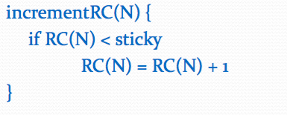
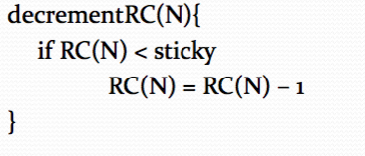
Sticky reference counts

Slide 12
Restoring reference counts
Auxiliary data structures
to store count of the overflowed objects
Hash Table can be used
Cycle collector
Ignore them (let backup tracing collect stuck objects)
Restore them (let backup tracing restore stuck counts)

Slide 13
Deferred Reference Counting
Problem: overhead on updating changes to stacks and registers is too high
Solution [Deutch & Bobrow, 1976]
Don’t update rc for stacks and registers
rc’s reflect only references from heap objects not from stack
We can’t delete objects whose rc drops to zero
Instead objects with rc = 0 are pushed to ZCT (Zero Count Table)
“Once in a while”: collect all objects with rc=0 that are not referenced from stacks and registers

Slide 14
Deferred RC Properties
Advantages:
Deferred RC reduces overhead by 80%.
Disadvantages:
Immediacy of collection lost !
Space overhead for ZCT.
Used in most modern RC systems

Slide 15
Deferral [Deutsch and Bobrow 1976, Bacon et al. 2001]
Stacks & Registers
1
2
1
1
0
1
1
2
2
1
B
C
D
E
2
A
F
++
--
--'
GC: move deferred decs
GC: apply decrements
GC: apply increments
mutator activity
GC: scan roots
D++
A--
F--
A--
F--
GC: collect
A--
A++
F++
B--
Notes:
Bottom of left hand side
IncBuffer
DecBuffer

Slide 16
Coalescing [Levanoni and Patrank 2001]
C++
D++
E++
F++
B--
C--
D--
E--
A
B
C
D
E
F
Remember A
Ignore intermediate
mutations
Compare A, A_{old}
B--, F++
Notes:
When it is first changed remember

Slide 17
Cycles in Reference Counting Systems
Reference counting collectors employ one of 2 avenues to collect garbage cycles:
A backup tracing collector
Trace all live objects and sweep the entire heap
Can also restore reference counts
A cycle collector
Known as trial deletion

Slide 18
Cycle Collection Basic Idea - 1
Observation 1:
Garbage cycles can only be created when a rc is decremented to a non-zero value
Objects whose rc is decremented to a non-zero value become candidates

Slide 19
Cycle Collection Basic Idea - 2
Sub-graph of O
graph of objects reachable from O
External pointer (to a sub-graph)
a pointer from a non sub-graph object to a sub-graph object
Internal pointer (of a sub-graph)
a pointer between 2 sub-graph objects
a
o
o1
o2
o3
o4
o5

Slide 20
Cycle Collection Basic Idea - 2
Observation 2:
In a garbage cycle all the reference counts are due to internal pointer of the cycle
For each candidate’s sub-graph, check if external pointers point to this sub-graph

Slide 21
Counts for External Pointers Only
r
r
r
1
1
1
2
1
0
a garbage cycle
a
a
a
b
b
b
1
1
0
Not a garbage cycle
c
d
c
d
c
d
2
2
2
2
0
1
edge r->a deleted
rc’s when ignoring internal edges

Slide 22
Implementing the Cycle Collector Idea
Object is colored black/gray/ white.
Whenever rc of an object ‘a’ is decremented to a non-zero, perform local traversals over the graph of objects of ‘a’.
Mark: Updates rc’s to reflect only pointers that are external to the graph of ‘a’, marking nodes in gray
Scan: Restores rc’s of the externally reachable objects, coloring them in black. Rest of the nodes are white.
Collect: collects garbage objects (the white ones).
r
1
1
1
0
0
2
a
b
0
0
1
c
d
2
2
1
0
0
1
2
1
1

