Slide 1
Introduction to Garbage Collection

Slide 2
Garbage Collection
It automatically reclaims memory occupied by objects that are no longer in use
It frees the programmer from manually dealing with memory deallocation
The benefits of garbage collection
increased reliability
decoupling of memory management from other software engineering concerns
Less developer time spent chasing memory management errors

Slide 3
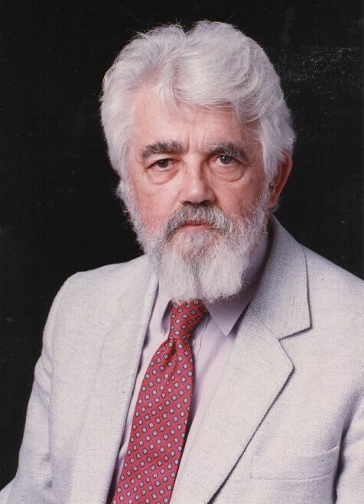
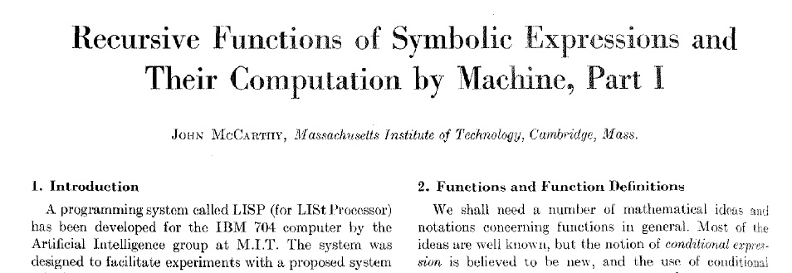

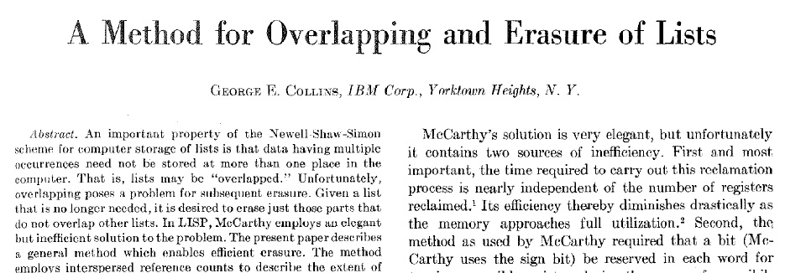
The Birth of GC (1960)
Notes:
2 fundamental branches to GC
GC was born in 1960.
At the top, first paper on tracing by McCarthy.
At the bottom, first paper on RC by Collins.
Tracing by McCarthy – Communications of the ACM, April 1960
Reference Counting by Collins – Communications of the ACM, December 1960

Slide 4
Garbage Collection
Garbage collection was introduced in LISP [McCarthy, 1960] and it has gained popularity through Java and .NET
It is also included in languages such as Haskell, JavaScript, PHP, Perl, Python, and Smalltalk
Today garbage collection is ubiquitous
Garbage collection is an integral part of modern programming languages

Slide 5
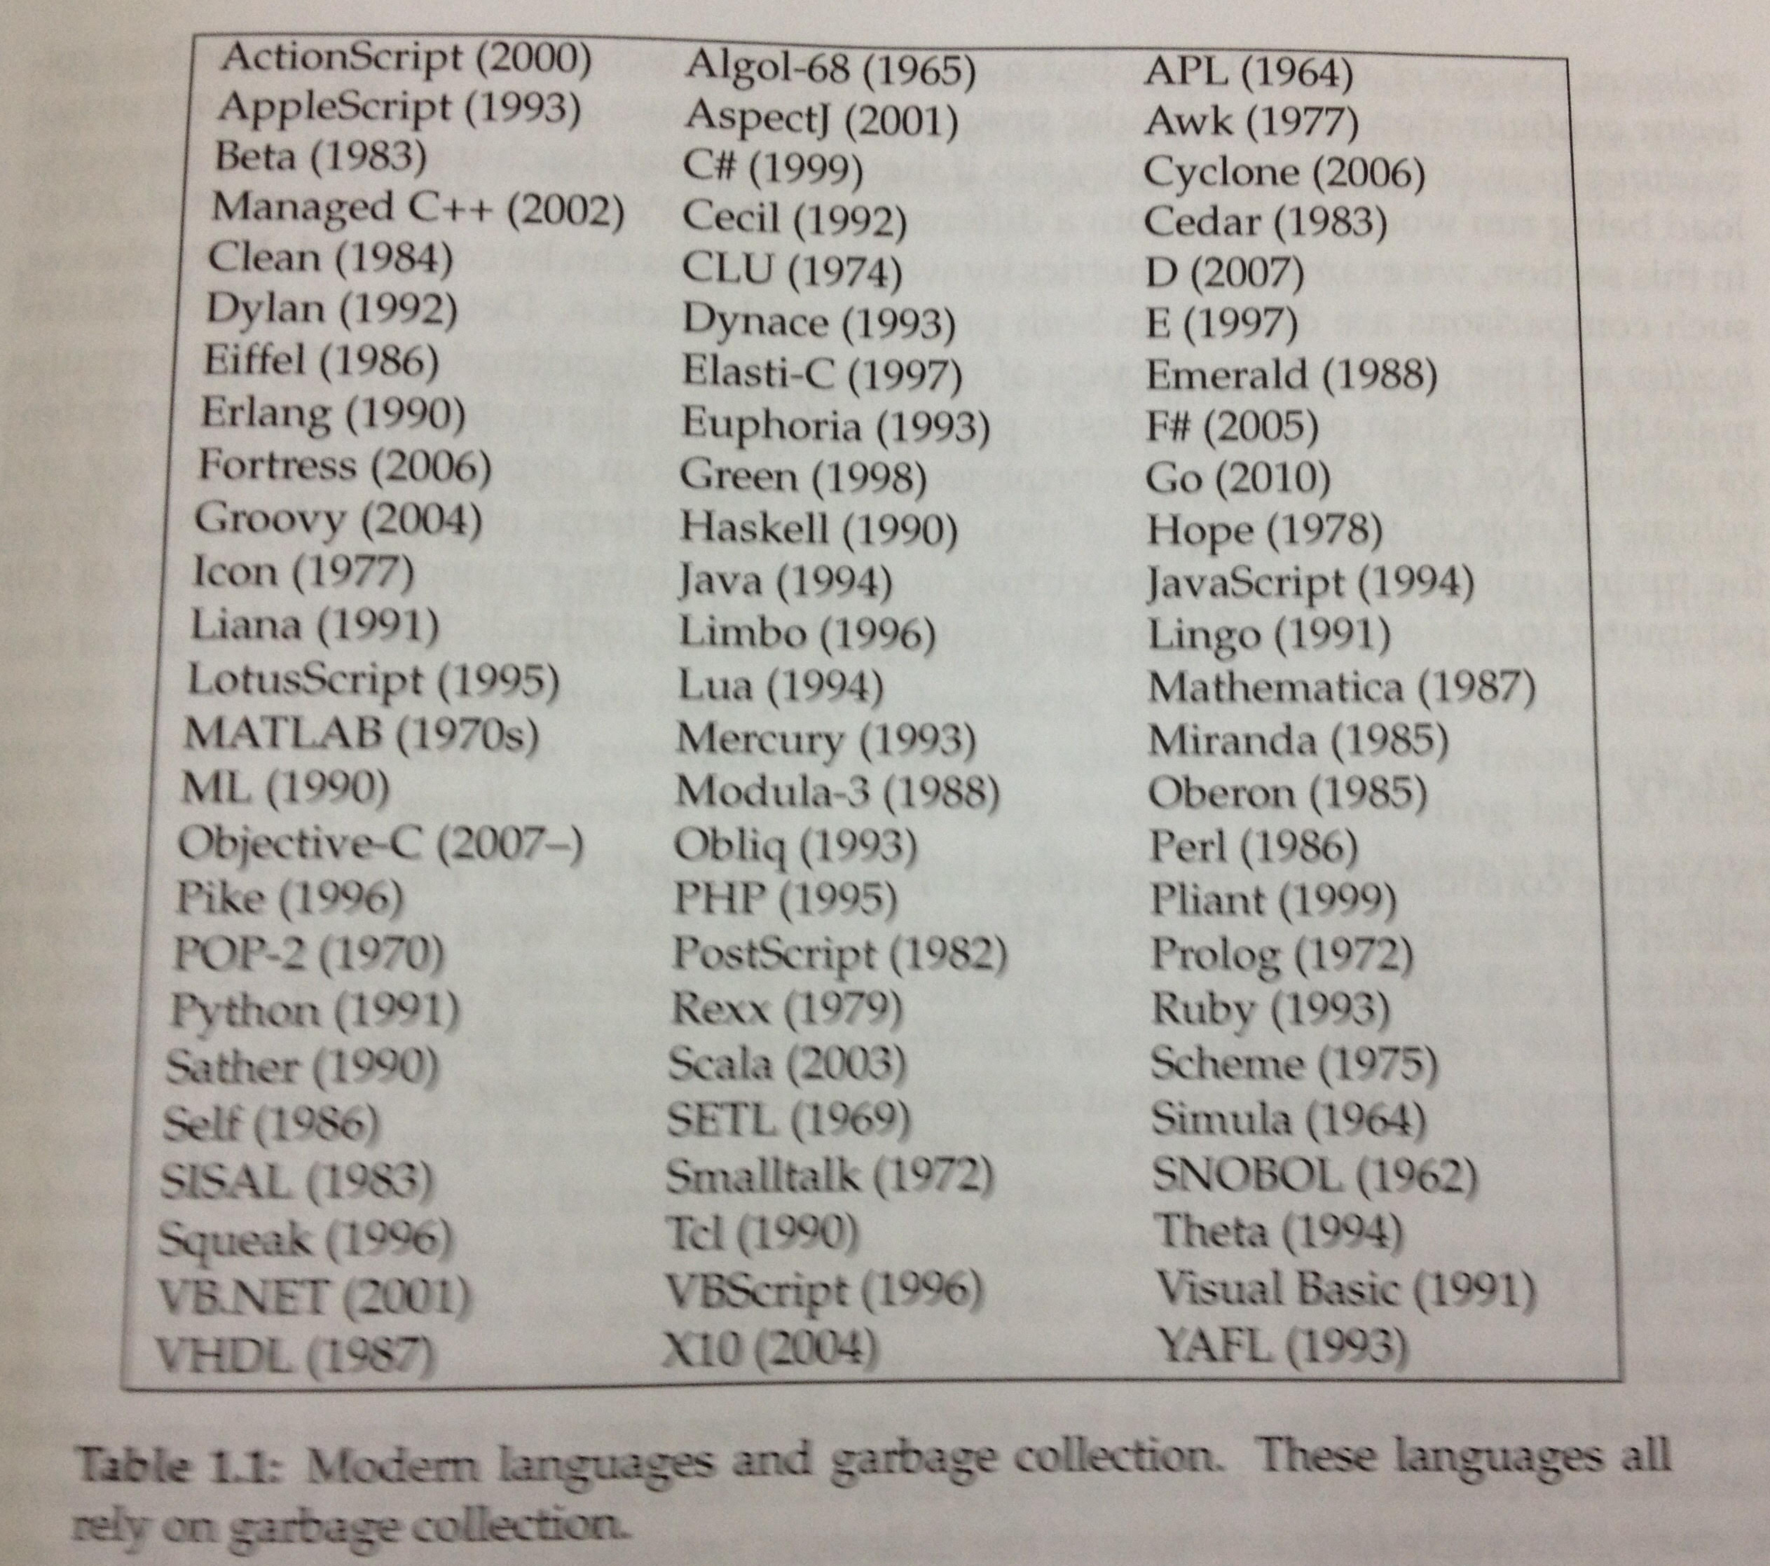
Garbage Collected Languages

Slide 6
Memory Management
Programs require data to execute and this data is typically stored in memory
Memory can be allocated
statically where memory requirements for the data are fixed ahead-of-time
on the stack where the lifetime of the data is tightly bound with the currently executing method
dynamically, where memory requirements are determined during execution – potentially changing between individual executions of the same program

Slide 7
Memory Management
Dynamically allocated memory can be managed either explicitly or automatically by the program
Popular programming languages, such as C/C++ require the programmer to explicitly manage memory through primitives
malloc and free for C
tedious and error-prone.
Managed languages, such as Java/.NET use a garbage collector to automatically free memory

Slide 8
Terminology
The area of memory used for dynamic object allocation is known as the heap
The process of reclaiming unused memory is known as garbage collection, a term coined by McCarthy
Following Dijkstra, from the point of view of the garbage collector, the term mutator refers the application or program that mutates the heap
Mutator time - the time when the mutator is running
GC time - the time when the garbage collector is running

Slide 9
Terminology
Collectors that must stop the mutator to perform collection are known as stop the world collectors
Concurrent collectors reclaim objects while the application continues to execute
Collectors that employ more than one thread to do the collection work are parallel collectors. A parallel collector can either be stop the world or concurrent
Some collectors require knowledge of the runtime roots, all references into the heap held by runtime including stacks, registers, statics

Slide 10
Simple Example

Slide 11
GC Fundamentals Algorithmic Components
Allocation
Identification
Reclamation
`
Sweep-to-Free
Tracing
(implicit)
Free List
Compact
Reference Counting
(explicit)
Bump Allocation
Evacuate
3
1
Notes:
A GC algorithm can be broken down into of three algorithmic components. How objects are allocated, how garbage is identified, and how space is reclaimed.

Slide 12
Contiguous Allocator
Increment a bump pointer by the size of the object
Better cache locality
Contemporaneously allocated objects on same/nearby cache lines
Touches memory sequentially priming the prefetcher
Fewer instruction per allocation
Efficient bulk zeroing to pre-initialize objects

Slide 13
Free list Allocator
Organize memory into k size free lists
Allocate into a free cell in the smallest size class that fits
Suffers from fragmentation
Internal (objects not matched to size of their cell)
External (free cells of particular size exists but requires different size)
Poor cache locality
Contemporaneously allocated objects often on different cache lines
Higher instruction per allocation
Object by object zeroing to pre-initialize objects

Slide 14
Tracing [McCarthy1960]
Roots
A
B
D
C
✗
✗
E
F

Slide 15
Reference Counting [Collins 1960]
Roots
1
1
✗
1
2
1
0
1
2
1

Slide 16
GC Fundamentals Canonical Garbage Collectors
Mark-Sweep [McCarthy 1960]
Free-list + trace + sweep-to-free
`
Sweep-to-Free
Mark-Compact [Styger 1967]
Bump allocation + trace + compact
Compact
Evacuate
Semi-Space [Cheney 1970]
Bump allocation + trace + evacuate

Slide 17
GC Fundamentals The Time–Space Tradeoff

Slide 18
Mark-Sweep (Free List Allocation + Trace + Sweep-to-Free)
Space efficient
✓
Poor locality
✓
Simple, very fast collection
Notes:
On this and the following slides, we contrast the three fundamental collectors, starting with mark-sweep. We do this by presenting four perspectives on collector performance: mutator, collector, minimum heap size, and total performance. Garbage collection people see the application as an adversary, hence the term “mutator” is used in the literature to characterize the application (in exclusion to the collector). It is often underappreciated that collection policies can affect mutator performance. The poor locality of the free list allocator gives mark-sweep poor mutator locality. However mark-sweep collection is fast and simple, and it is space efficient.

Slide 19
Mark-Compact (Bump Allocation + Trace + Compact)
Good
locality
Space efficient
✓
✓
Expensive multi-pass collection

Slide 20
Semi-Space (Bump Allocation + Trace + Evacuate)
Good locality
Space inefficient
✓
Space inefficient

Slide 21
Sweep-To-Region and Mark-Region
Reclamation
Mark-Sweep
Free-list + trace + sweep-to-free
Sweep-to-Free
`
Compact
Mark-Compact
Bump allocation + trace + compact
Evacuate
Semi-Space
Bump allocation + trace + evacuate
Mark-Region
Bump alloc + trace + sweep-to-region
Sweep-to-Region
Notes:
We do this by identifying a fourth reclamation strategy, sweep-to-region. It works by dividing the space into regions, and freeing any region with no live objects in it. Regions can then be used for contiguous bump allocation. Mark-region is a canonical collector combining contiguous bump allocation with tracing and sweep-to-region reclamation. Before we look more closely at mark-region let me give you a sneak preview of how it performs.

Slide 22
Mark-Region (Bump Allocation + Trace + Sweep-to-Region)
Good locality
Space efficient
✓
✓
Excellent
performance
✓
Simple, very fast collection
✓

Slide 23
Naïve Mark-Region
0
Contiguous allocation into regions
Excellent locality
For simplicity, objects cannot span regions
Simple mark phase (like mark-sweep)
Mark objects and their containing region
Unmarked regions can be freed

Slide 24
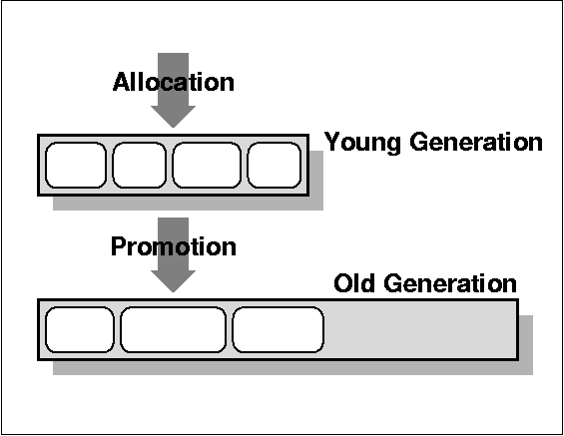
Generational [Ungar 1984]
Most objects die young
Nursery space
Mature space

Slide 25
Immix [Blackburn and McKinley 2008]
object mark
recyclable lines
line mark
block
0
line
Contiguous allocation into regions
256B lines and 32KB blocks
Objects span lines but not blocks
Simple mark phase
Mark objects and containing regions
Free unmarked regions
Recycled allocation and defragmentation

