Slide 1
Just In Time Compilation
CSE 6305: Programming Languages and Systems

Slide 2
JIT Compilation: What is it?
Compilation done during execution of a program (at run time) rather than prior to execution
Seen in today’s JVMs and elsewhere

Slide 3
Outline
Traditional Java Compilation and Execution
What JIT Compilation brings to the table
Optimization Techniques
JIT Compilation in JRockit/HotSpot JVMs
JRockit Breakdown Optimization Example
JIT Compilation elsewhere

Slide 4
Outline
Traditional Java Compilation and Execution
What JIT Compilation brings to the table
Optimization Techniques
JIT Compilation in JRockit/HotSpot JVMs
JRockit Breakdown Optimization Example
JIT Compilation elsewhere

Slide 5
Traditional Java Compilation and Execution
2 steps
A Java Compiler compiles high level Java source code to Java bytecode readable by JVM
JVM interprets bytecode to machine instructions at runtime

Slide 6
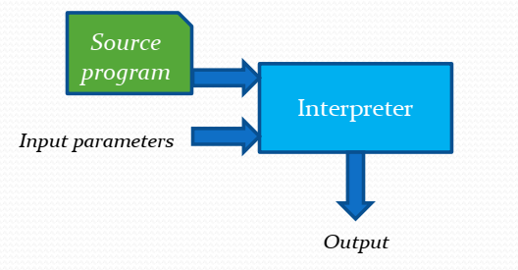
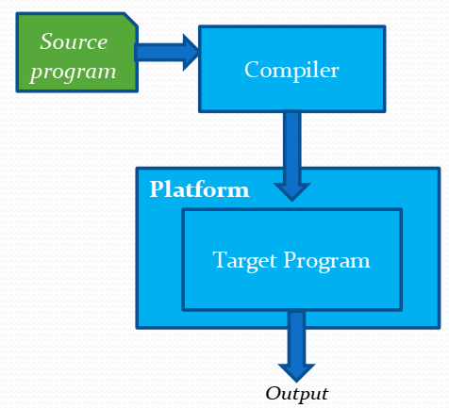
Interpreter vs. Compiler

Slide 7
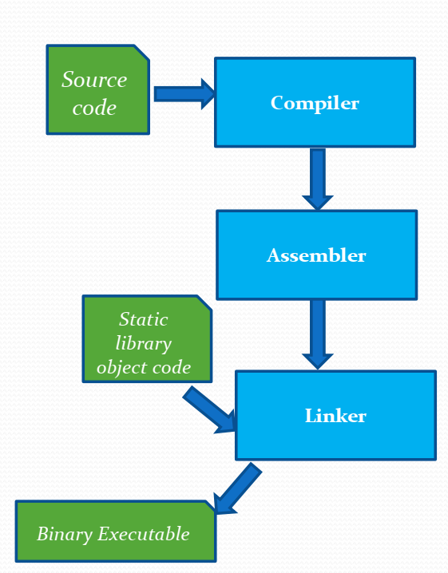
Static Compilation

Slide 8
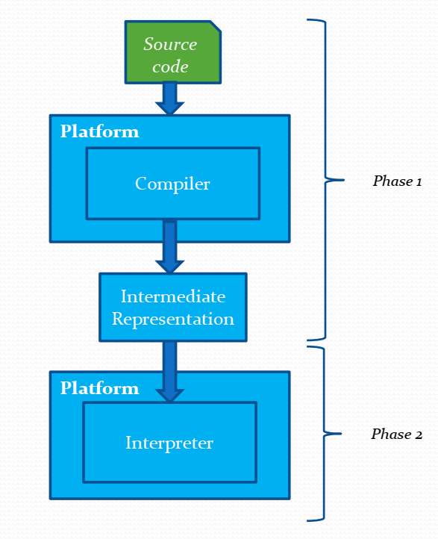
Hybrid Compilation

Slide 9
Traditional Java Compilation and Execution
Advantages
Platform independence (JVM present on most machines)
Drawbacks
not as fast as running pre-compiled machine instructions

Slide 10
Outline
Traditional Java Compilation and Execution
What JIT Compilation brings to the table
Optimization Techniques
JIT Compilation in JRockit/HotSpot JVMs
JRockit Breakdown Optimization Example
JIT Compilation elsewhere

Slide 11
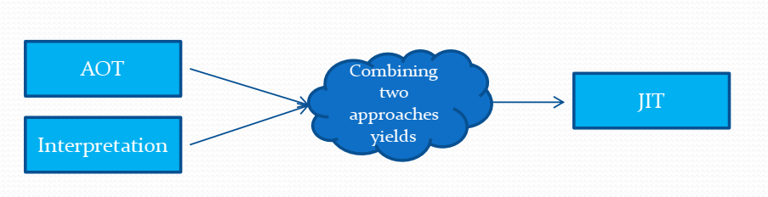
JIT Compilation

Slide 12
Goals in JIT Compilation
combine speed of compiled code with the flexibility of interpretation
Goal
surpass the performance of static compilation
maintaining the advantages of bytecode interpretation

Slide 13
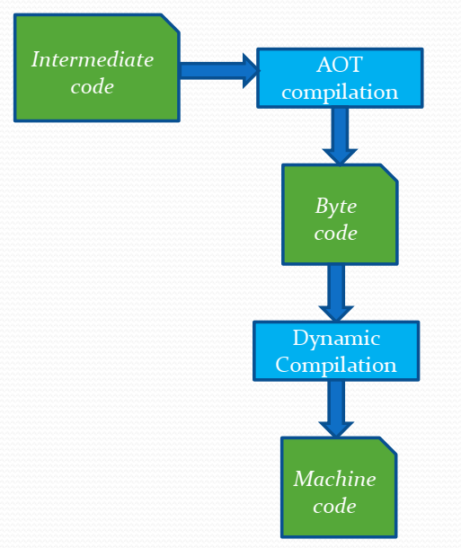
JIT Compilation

Slide 14
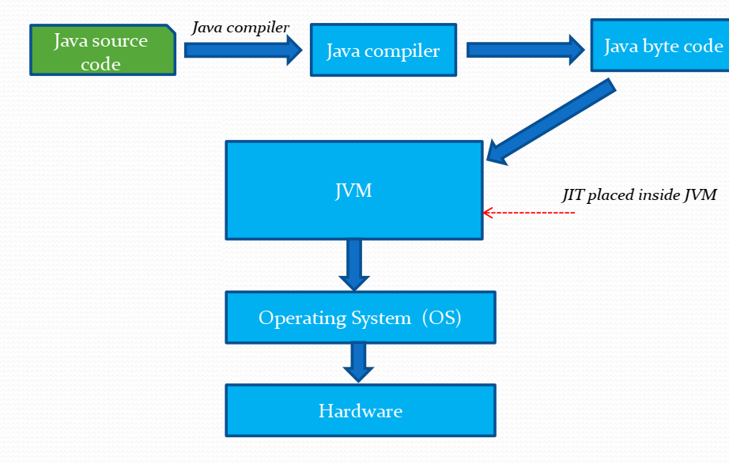
JIT Compilation in Java

Slide 15
JIT Compilation (in JVM)
Builds off of bytecode idea
A Java Compiler compiles high level Java source code to Java bytecode readable by JVM
JVM compiles bytecode at runtime into machine readable instructions as opposed to interpreting
Run compiled machine readable code
Seen in many JVM implementations today

Slide 16
Advantages of JIT Compilation
Compiling: can perform AOT optimizations
Compiling bytecode (not high level code), so can perform AOT optimizations faster
Can perform runtime optimizations
Executing machine code is faster than interpreting bytecode

Slide 17
Drawbacks of JIT Compilation
Startup Delay
must wait to compile bytecode into machine- readable instructions before running
bytecode interpretation may run faster early on
Limited AOT optimizations b/c of time
Compilers for different types of architectures
for some JITs like .NET

Slide 18
Security issues
Executable space protection
Bytecode compiled into machine instructions that are stored directly in memory
Those instructions in memory are run
Have to check that memory

Slide 19
Outline
Traditional Java Compilation and Execution
What JIT Compilation brings to the table
Optimization Techniques
JIT Compilation in JRockit/HotSpot JVMs
JRockit Breakdown Optimization Example
JIT Compilation elsewhere

Slide 20
Optimization techniques
Detect frequently used bytecode instructions and optimize
# of times a method executed
detection of loops
Combine interpretation with JIT Compilation
method used in popular Hotspot JVM incorporated as of Java8’s release

Slide 21
Optimization techniques
Server & Client specific optimizations
More useful in longer running programs
have time to reap benefits of compiling/optimizing
Compilation and optimizations are performed on java bytecode in the JVM.

Slide 22
Outline
Traditional Java Compilation and Execution
What JIT Compilation brings to the table
Optimization Techniques
JIT Compilation in JRockit/HotSpot JVMs
JRockit Breakdown Optimization Example
JIT Compilation elsewhere

Slide 23
A look at a traditional JVM
HotSpot JVM (pre Java 8)
straight bytecode interpretation
JIT with limited optimizations

Slide 24
JRockit JVM
The industry’s highest performing JVM as claimed by Oracle
Currently integrated with Sun’s (now Oracle’ s) HotSpot JVM
Why?
JIT

Slide 25
When to use which?
Hotspot
Desktop application
UI (swing) based application
Fast starting JVM
JRockit
Java application server
High performance application
Need of a full monitoring environment

Slide 26
HotSpot’s JRockit Integration
Launched with Java8
By default interprets
Optimizes and compiles hot sections
Runs compiled code for hot sections
HotRockit

Slide 27
Outline
Traditional Java Compilation and Execution
What JIT Compilation brings to the table
Optimization Techniques
JIT Compilation in JRockit/HotSpot JVMs
JRockit Breakdown Optimization Example
JIT Compilation elsewhere

Slide 28
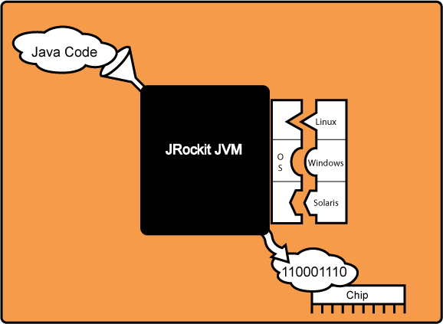
JRockit JVM

Slide 29
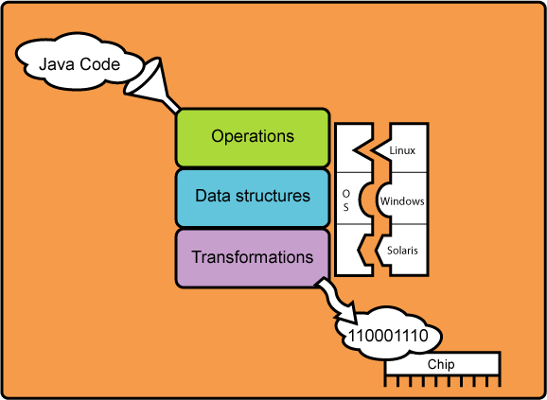
JRockit JVM

Slide 30
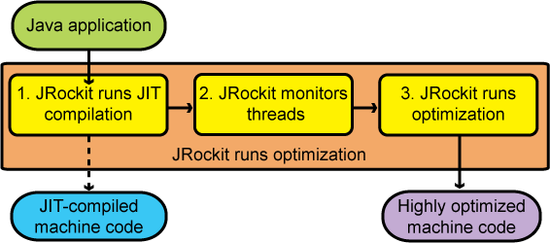
JRockit JIT Compilation

Slide 31
JRockit Step 1: JIT Compilation
When section of instructions called
compile bytecode into machine code just in time
run compiled machine code
Not fully optimized
May be slower than bytecode interpretation
JVM Startup may be slower than execution
Notes:
The first step of code generation is the Just-In-Time (JIT) compilation.
This compilation allows your Java application to start and run while the code that is generated is not highly optimized for the platform. Although the JIT is not actually part of the JVM standard, it is, nonetheless, an essential component of Java. In theory, the JIT comes into use whenever a Java method is called, and it compiles the bytecode of that method into native machine code, thereby compiling it “just in time” to execute.
After a method is compiled, the JRockit JVM calls that method’s compiled code directly instead of trying to interpret it, which makes the running of the application fast. However, during the beginning of the run, thousands of new methods are executed, which can make the actual start of the JRockit JVM slower than other JVMs. This is due to a significant overhead for the JIT to run and compile the methods. So, if you run a JVM without a JIT, that JVM starts up quickly but usually runs slower. If you run the JRockit JVM that contains a JIT, it can start up slowly, but then runs quickly. At some point, you might find that it takes longer to start the JVM than to run an application.
Compiling all of the methods with all available optimizations at startup would negatively impact the startup time. Thus the JIT compilation does not fully optimize all methods at startup.

Slide 32
JRockit Step 2: Monitor Threads
Identify which functions merit optimization
Sampler thread
checks status of active threads
Hot methods are ear-marked for optimization
Optimization opportunities occur early on
Notes:
During the second phase, the JRockit JVM uses a sophisticated, low-cost, sampling-based technique to identify which functions merit optimization: a “sampler thread” wakes up at periodic intervals and checks the status of several application threads. It identifies what each thread is executing and notes some of the execution history. This information is tracked for all the methods and when it is perceived that a method is experiencing heavy use—in other words, is “hot”—that method is earmarked for optimization. Usually, a flurry of such optimization opportunities occur in the application’s early run stages, with the rate slowing down as execution continues.

Slide 33
JRockit Step 3: Optimization
In background, run compilation of optimized hot methods
Compile optimized bytecode into machine readable instructions
Notes:
During the third phase, the JVM runs an optimization round of the methods that it perceives to be the most used—“hot”—methods. This optimization is run in the background and does not disturb the running application.

Slide 34
JRockit Optimization Example

Slide 35
Step 1: Starting Point
public void foo() {
y = b.get();
// do stuff
z = b.get();
sum = y + z;
}

Slide 36
Step 2: Inline Final Method
public void foo() {
y = b.value;
// do stuff
z = b.value;
sum = y + z;
}
swap b.get() with get() method’s contents

Slide 37
Step 3: Remove Redundant Loads
public void foo() {
y = b.value;
// do stuff
z = y;
sum = y + z;
}
swap z=b.value(); with z=y;

Slide 38
Step 4: Copy Propagation
public void foo() {
y = b.value;
// do stuff
y = y;
sum = y + y;
}
no use for z

Slide 39
Step 5: Eliminate Dead Code
public void foo() {
y = b.value;
// do stuff
// nothing
sum = y + y;
}
y=y does nothing, delete it

Slide 40
JRockit Optimization Example

Slide 41
Step 6: Choose Instruction
public void foo() {
y = b.value;
// do stuff
sum = y << 1;
}

Slide 42
Outline
Traditional Java Compilation and Execution
What JIT Compilation brings to the table
Optimization Techniques
JIT Compilation in JRockit/HotSpot JVMs
JRockit Breakdown Optimization Example
JIT Compilation elsewhere

Slide 43
JIT Elsewhere: More bytecode langs
JIT in JVM has been driving force in movement of more languages to compile to java byte code
Jython
JRuby
Groovy

Slide 44
JIT Elsewhere: C++ like languages
By default, C++ uses AOT
C#
MSIL == java bytecode
JIT
CLANG
Uses LLVM on backend
can benefit from JIT Compilation of bytecode

Slide 45
JIT Elsewhere: Web Browsers
Goal: optimize JavaScript
Seen today in
Mozilla’s Tamarin
Safari’s WebKit
Chrome’s V8
all browsers except IE8 and earlier

