Slide 1
AN APP IN NEED IS AN APP INDEED
Name of application: An App in Need
Team members: Rifat Sabbir Mansur, Tahmid Muttaki, Taufiq Humayun Chowdhury, Labiba Labanya

Slide 2
Problem Statement:
To provide faster support to victims in emergency cases such as fire, shooting, earthquake etc.
Goals:
Detect hazardous situations
Keep track of users during emergency
Quick communication with authorized parties with a simplified UI
Informing rescue team
Locate persons stuck in critical conditions

Slide 3
Technologies Used:
Android Studio
Java
Python
Django
SQlite

Slide 4
Use Case Scenario 1:
Suppose, in Vt Hacks VI, everyone is coding at 2 am in the morning and suddenly a fire broke out in one side of the building. One volunteer saw it and pushed emergency button in his AppInNeed app. This notification goes to the admin(e. g., organizer) , then they quickly go there and verify a fire. The admin triggers a panic mode through his app and every student with the app gets notification. They quickly evacuate the building and mark themselves as safe. After the situation comes under control, the admin turns off panic mode.

Slide 5
Use Case Scenario 2:
Suppose in a concert of around thousand people. Some people see a suspicious person with gun. They immediately push the alert button through the app. Since there is quite a few alert pushed within a short time, the system automatically turns on the panic mode without the need of approval from an admin and everyone gets alerted. They take necessary safety measures.

Slide 6



System Architecture
Admin
Public
Web API
Database

Slide 7
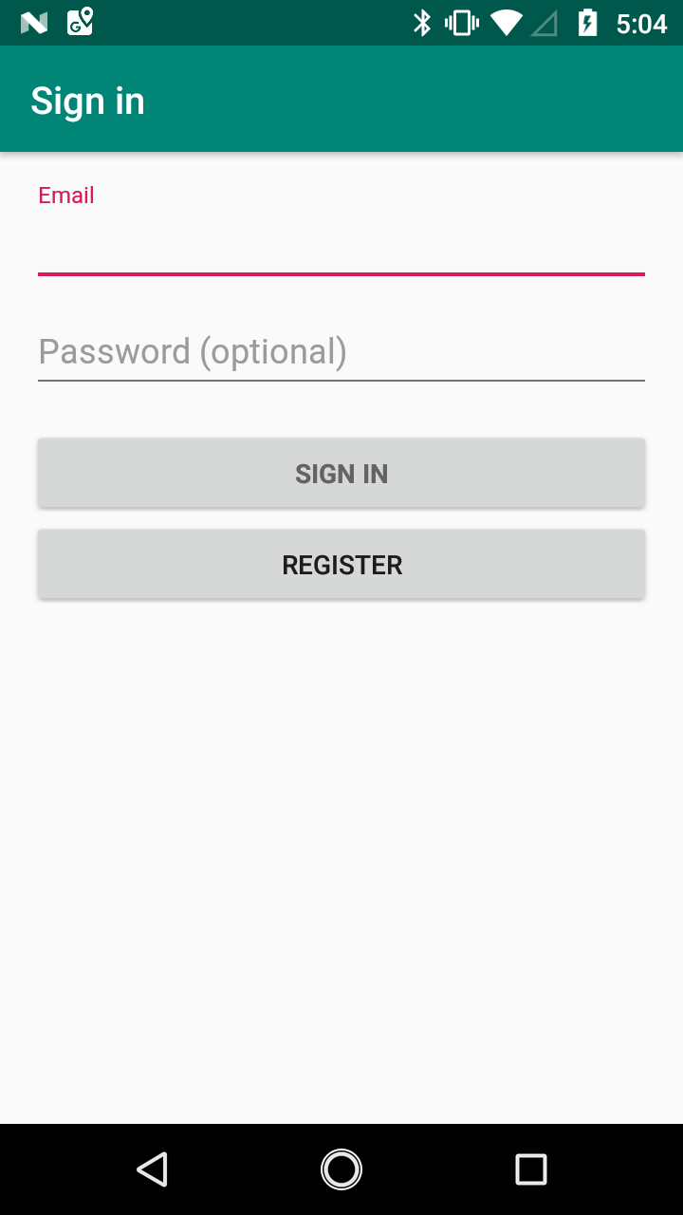
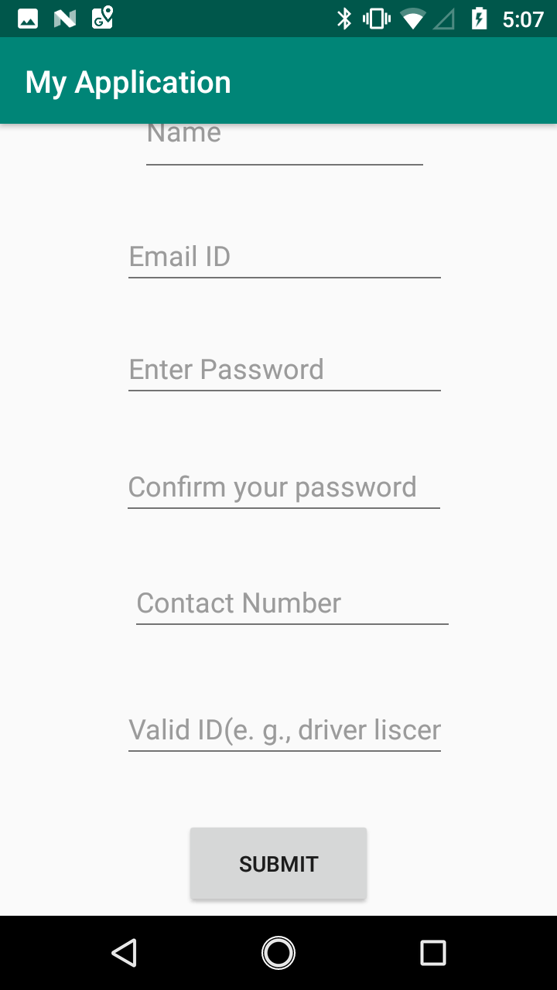
Sign-In Page
Registration Page

Slide 8
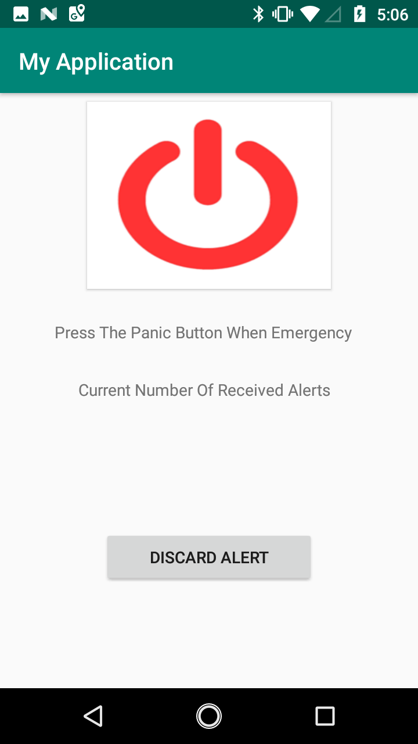

Triggering Panic Mode
Admin Page to Trigger and/or Discard False Alert

Slide 9
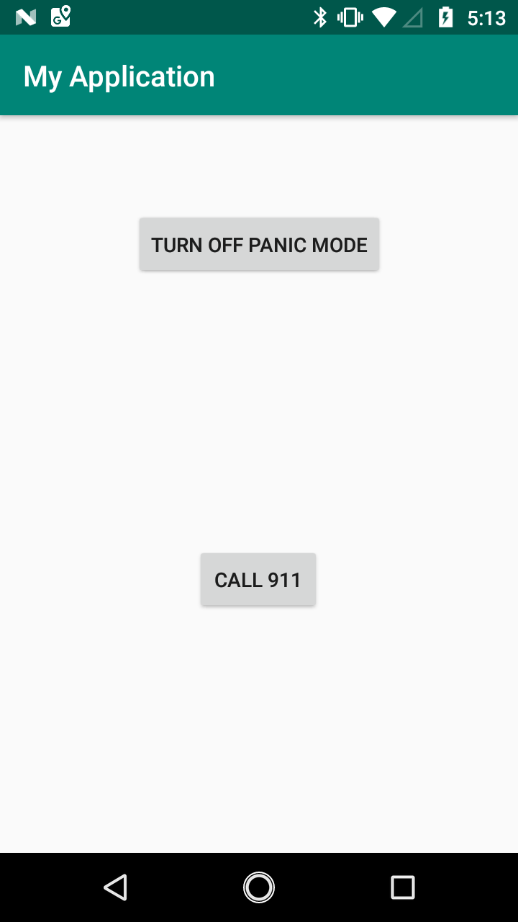
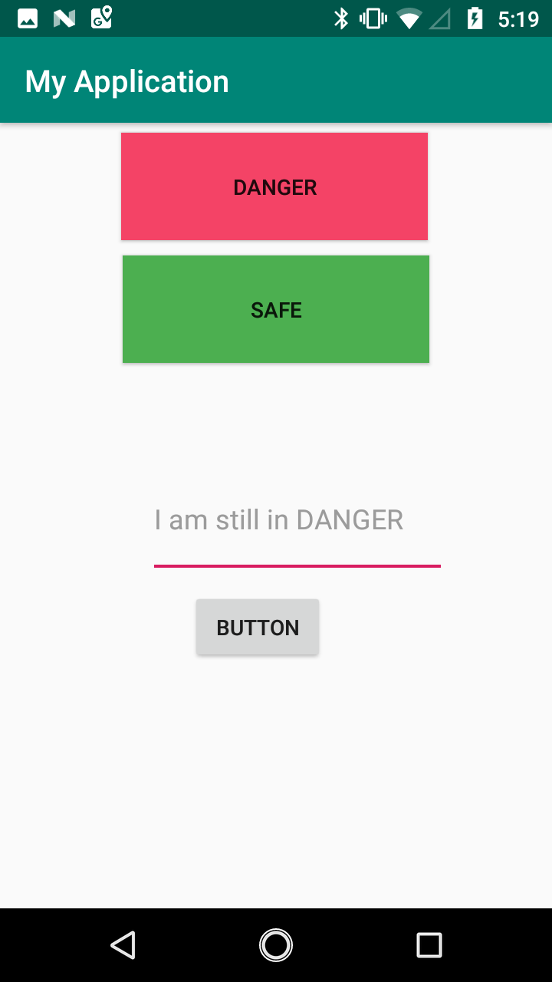
Turn off Panic Mode (when situation is under control)
Mark Yourself Safe Option

