Slide 1
Behavior Analysis of the Components of a Variational Quantum Classifier in Its Optimization Process
Rifatul Islam Himel
ID: 193-31-279
Dept.: Electronics and Telecommunication Engineering
Prof. Dr. A. K. M. Fazlul Haque,
Professor, Department of ETE, Daffodil International University
20 April, 2022

Slide 2
Presentation Outline
Title Slide: «backstory»
Presentation Outline
Research Question
Introduction
Background
Study Goal and Objectives
Methods and Results
Discussion
Recommendations
Conclusion

Slide 3
Research Question
What are the impacts of VQC elements in constructing an optimized VQC model for lower dimensional dataset? Is it possible to build an optimized model that performs equally or better than any classical machine learning algorithm?

Slide 4
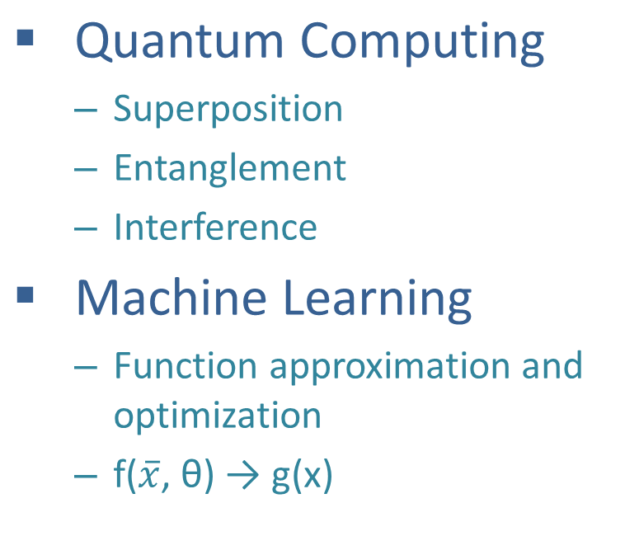
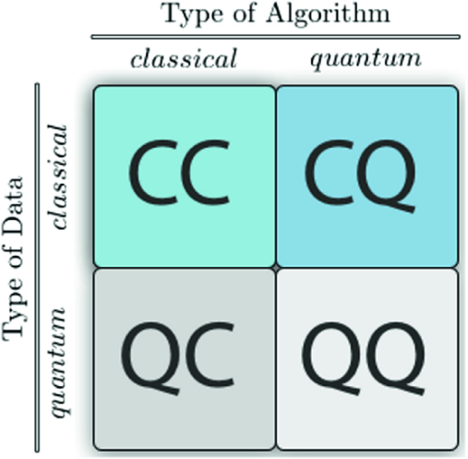
Quantum Machine Learning
Introduction

Slide 5
Significance of Quantum Computation
Background
Exponentially powerful computational model
Inherent parallelism
Energy efficient computation
Computational Resource Optimization
Novel approach to formalize research problems

Slide 6
Advantages of Quantum Classifiers
Background
Quicker information processing
Quantum feature space is exponentially large
Automatically mapped into higher dimensional feature space
Quantum Classifiers and Machine learning algorithms are mathematical similar

Slide 7
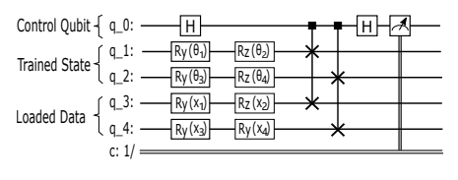
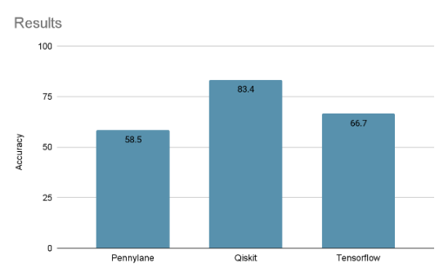
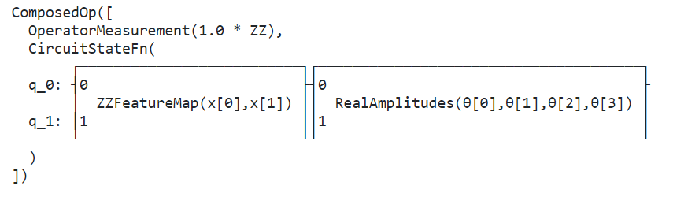
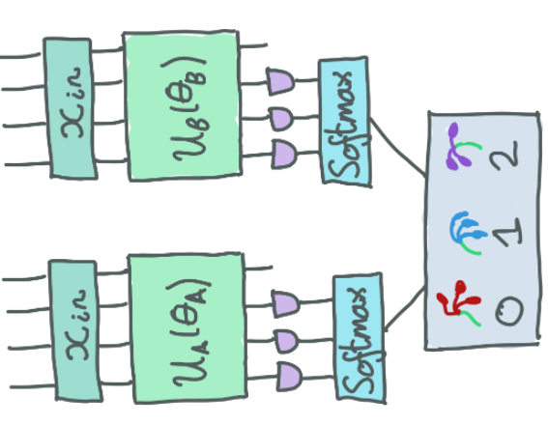
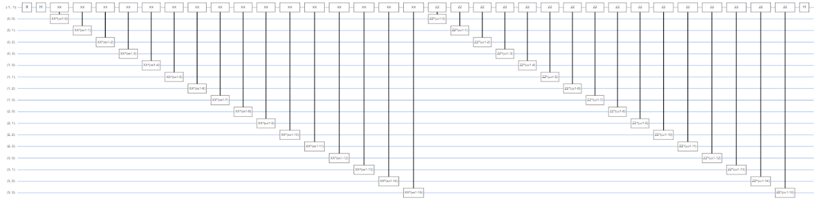
Previous Approaches and Studies
Background

Slide 8
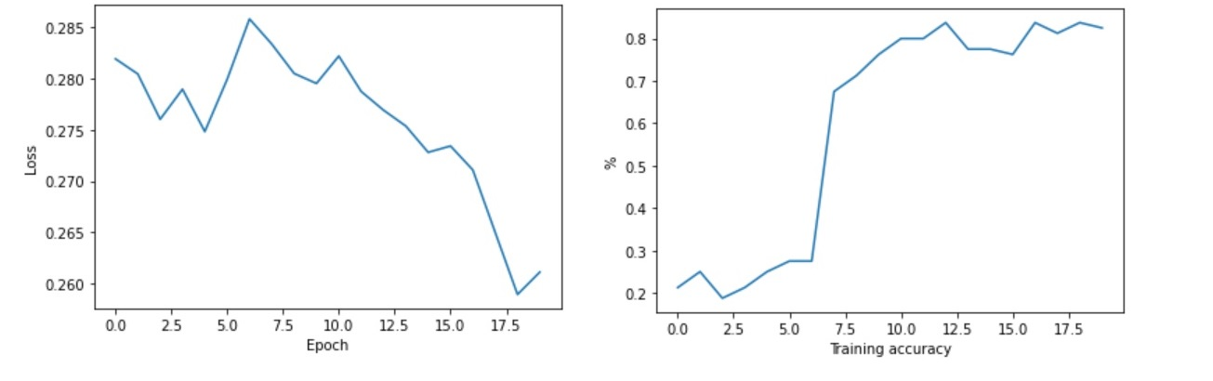
Previous Approaches and Studies
Background
Figure: Implementation of quantum Classifier on IRIS dataset[1]
Using Feature Maps from the Terra Circuit Library circuit depth, entanglement and gates can be modified [2]
Ref:1. https://github.com/rifat19331279/files/blob/main/Quantum%20Image%20Classification-Iris.ipynb, 2. https://github.com/Qiskit-Challenge-India/2020/blob/master/Day%206%2C%207%2C8/VQC_notebook.ipynb

Slide 9
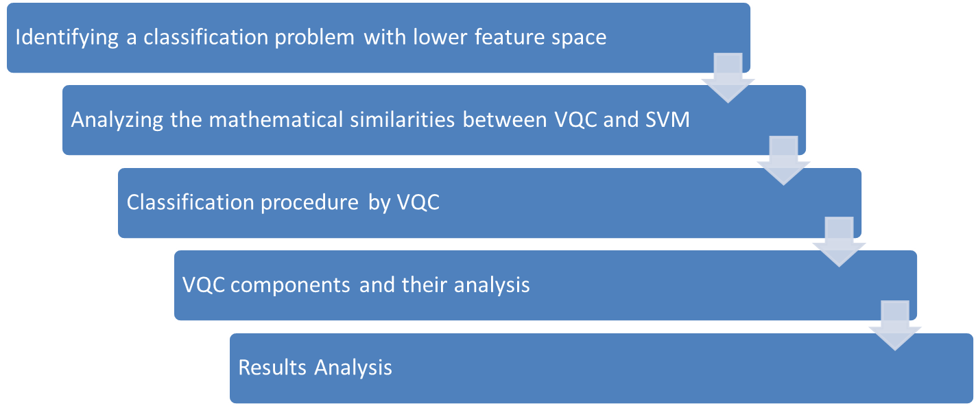
Study Goal and Objectives
Explore the mathematical similarity between quantum and classical classifier and investigate VQC elements for optimal solution for the lower dimensional dataset

Slide 10
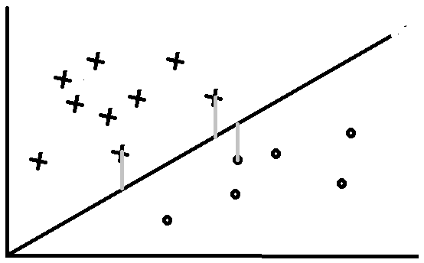


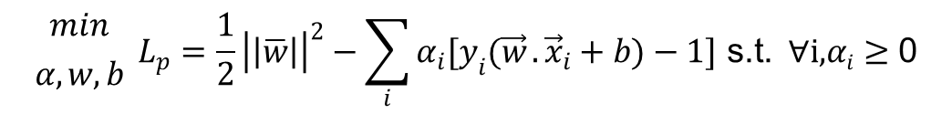
Identifying the problem
Methods and Results
:
Define the hyperplanes H such that
The primal form of the convex optimization problem:

Slide 11

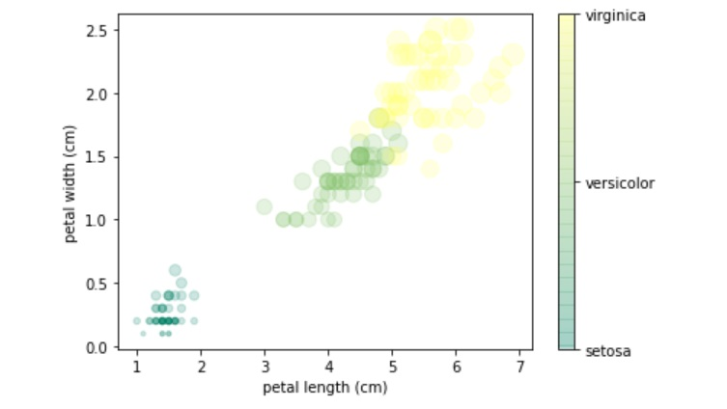
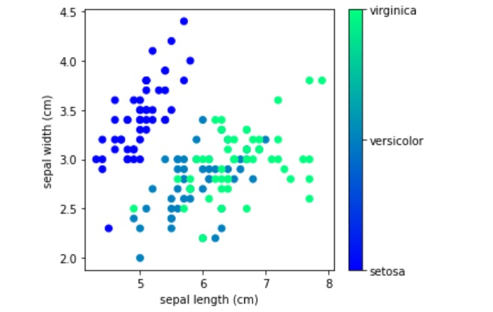
Identifying the problem
Methods and Results

Slide 12
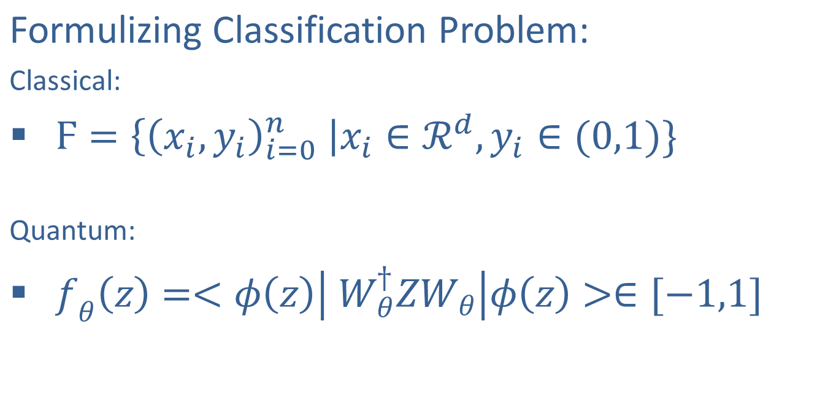
Analyzing Mathematical Similarities
Methods and Results

Slide 13
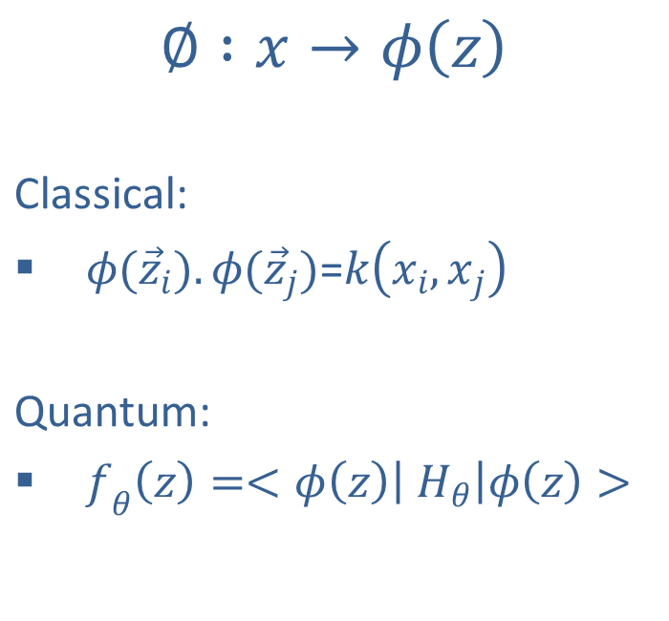
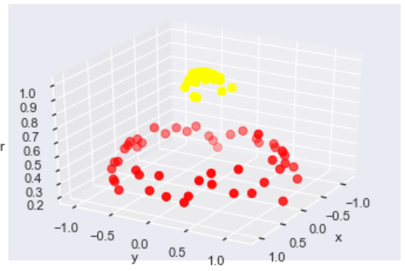
Analyzing Mathematical Similarities
Methods and Results

Slide 14
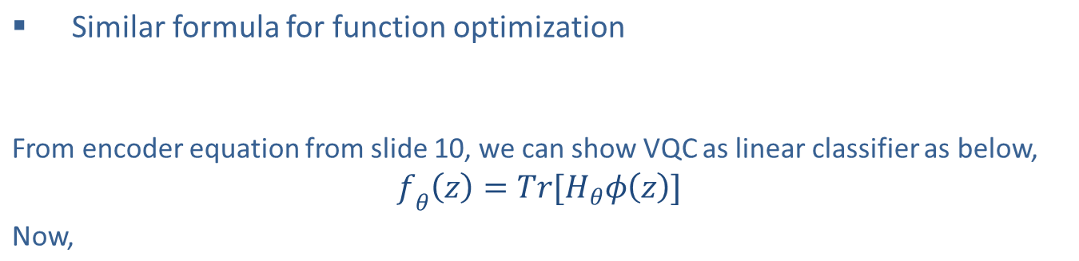
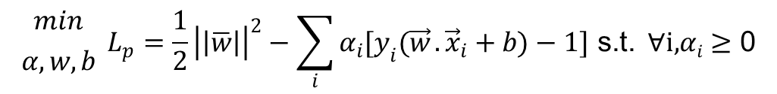
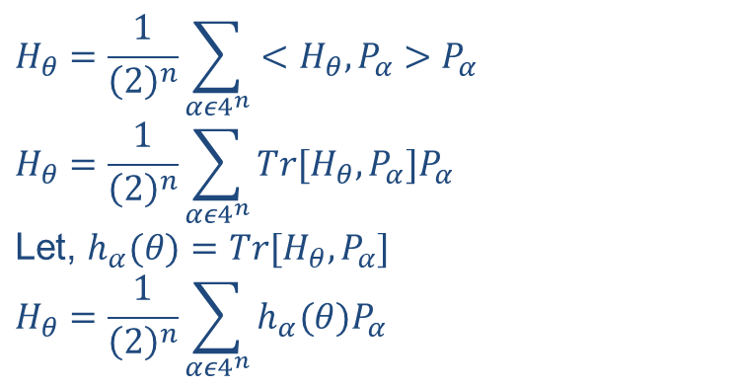
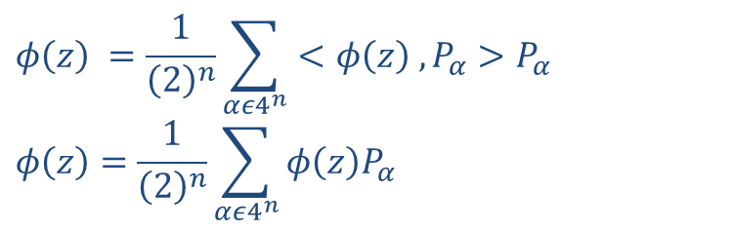
Analyzing Mathematical Similarities
Methods and Results

Slide 15
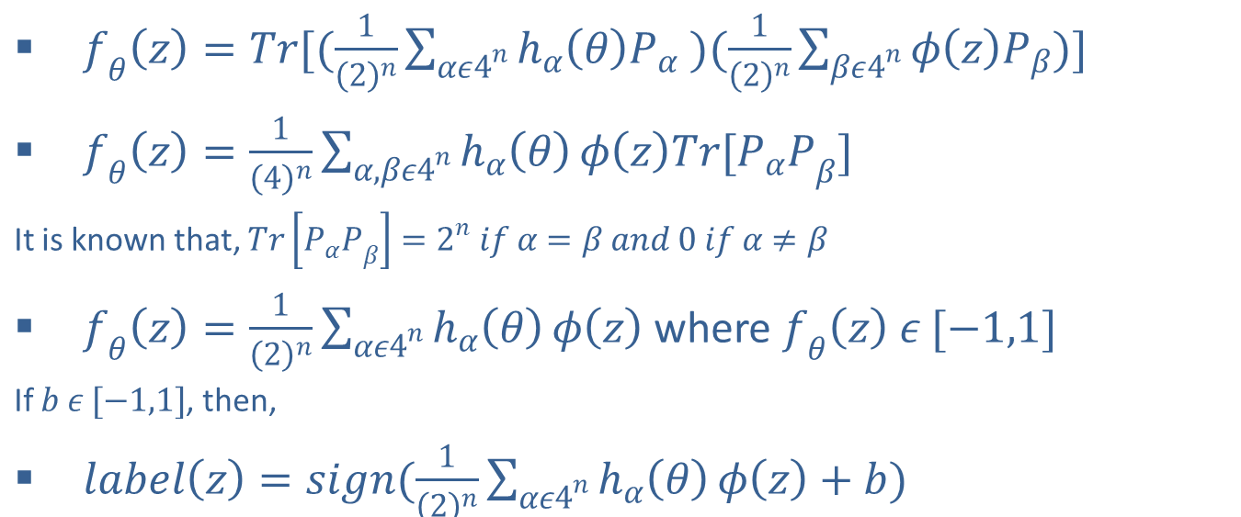
Analyzing Mathematical Similarities
Methods and Results

Slide 16

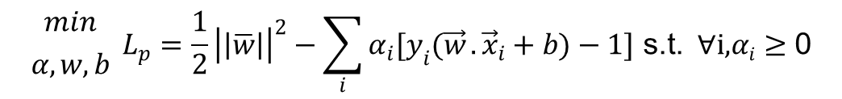
Analyzing Mathematical Similarities
Methods and Results
The primal form of the convex optimization problem:

Slide 17
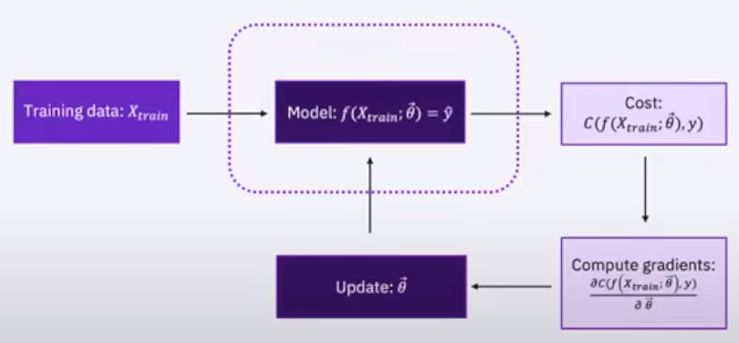
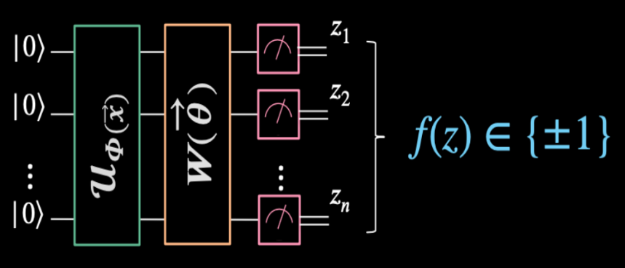
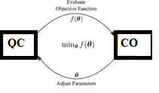
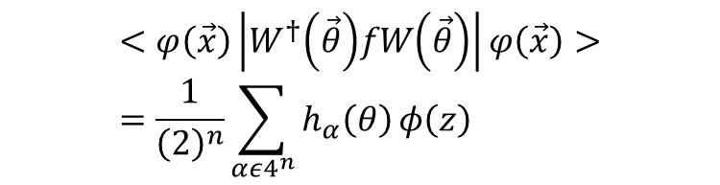
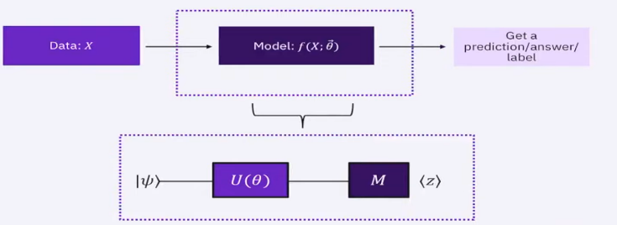
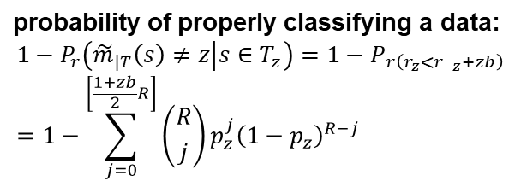
Classification procedure by VQC
Methods and Results

Slide 18
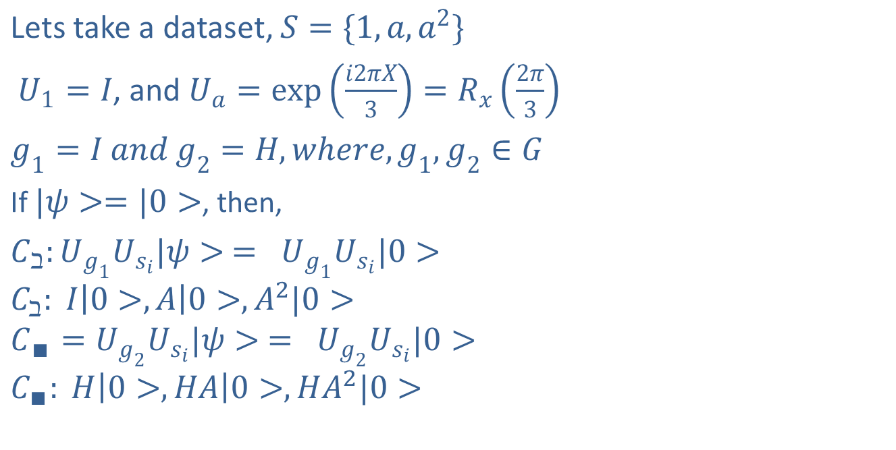
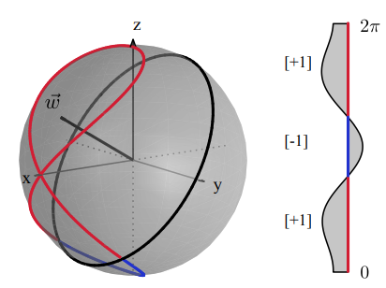
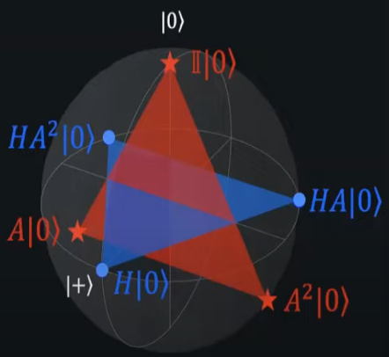
Classification procedure by VQC
Methods and Results

Slide 19
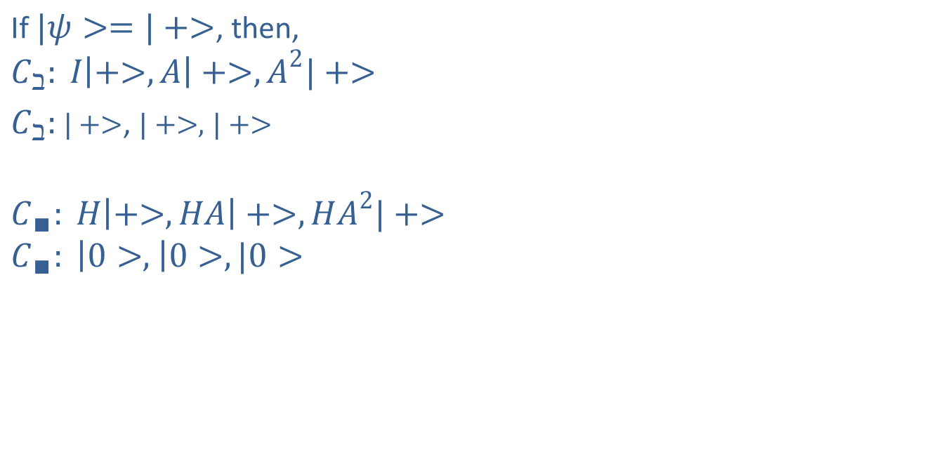
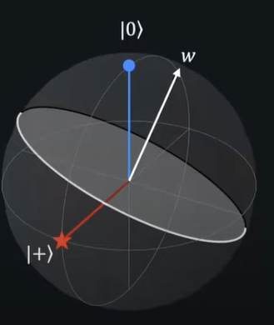
Classification procedure by VQC
Methods and Results

Slide 20
VQC components and their analysis
Methods and Results
Encoder
Ansatz
Measurement
Cost function
Optimizers

Slide 21
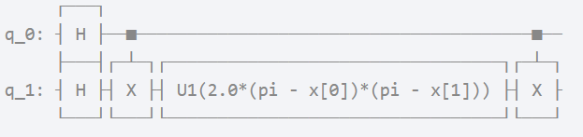
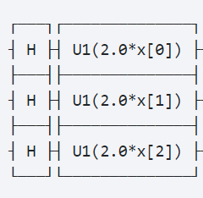
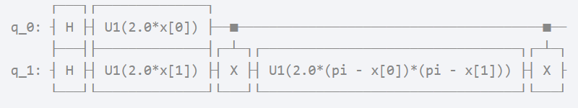
VQC components and their analysis
Methods and Results
Encoder
  Pauli Feature Map
  Z Feature Map
  ZZ Feature Map

Slide 22
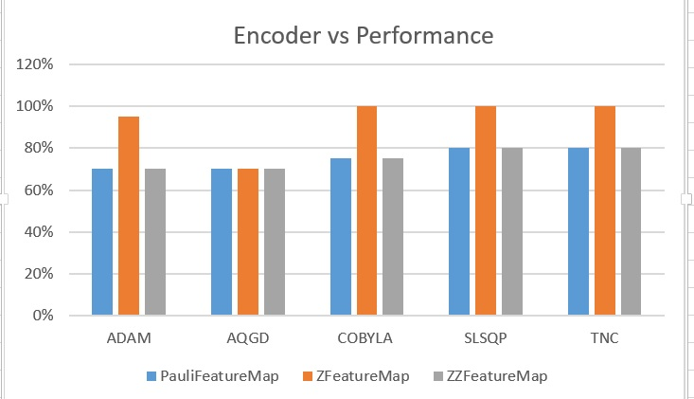
VQC components and their analysis
Methods and Results
Encoder Performance Analysis:
Table: Performance of Encoder Circuit, (Z Feature Map)
Encoding Circuit Depth | Performance on Test Dataset
 | ADAM | AQGD | COBYLA | SLSQP | TNC
1 | 95% | 70% | 100% | 100% | 100%
2 | 75% | 90% | 100% | 100% | 100%
3 | 70% | 80% | 75% | 80% | 85%

Slide 23
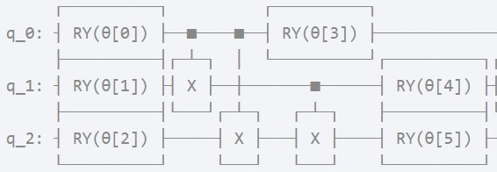
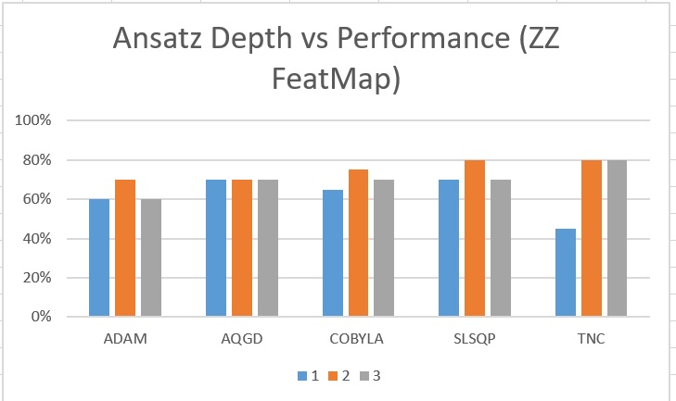
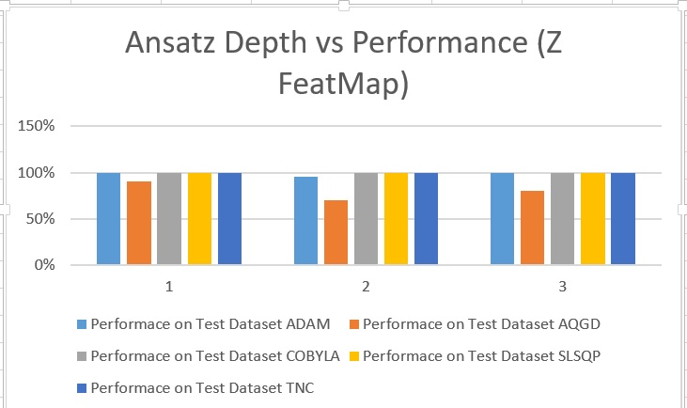
VQC components and their analysis
Methods and Results
Ansatz/Parameterized Circuit Performance Analysis:

Slide 24
VQC components and their analysis
Methods and Results
Measurement and Cost Function Analysis:
 | Performace on Test Dataset
Measurement | ADAM | AQGD | COBYLA | SLSQP | TNC
All Qubit | 100% | 90% | 100% | 100% | 100%
 | Performace on Test Dataset
Cost function | ADAM | AQGD | COBYLA | SLSQP | TNC
Sigmoid | 100% | 90% | 100% | 100% | 100%

Slide 25
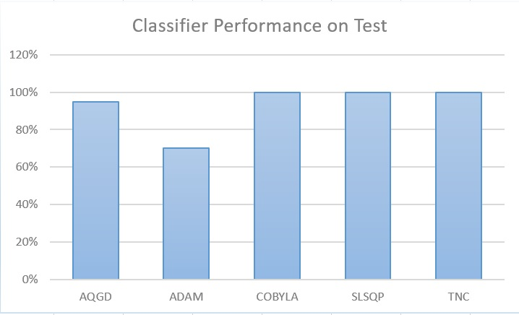
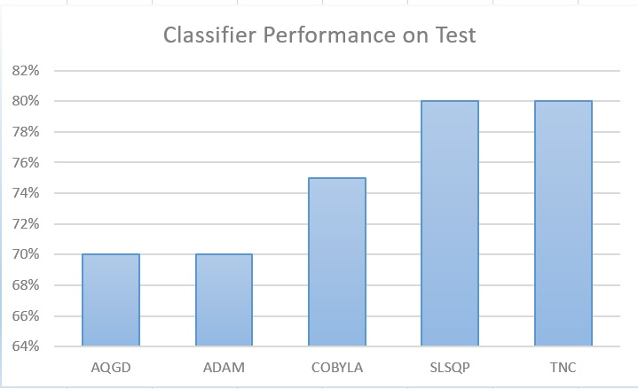
VQC components and their analysis
Methods and Results
Optimizers Performance Analysis:
Figure: Optimizer performance (ZZ Feature map and ansatz with depth 1)
Figure: Performance analysis of optimizer (Z Feature Map, Ansatz and both depth=2)

Slide 26
VQC components and their analysis
Methods and Results
Optimum values:
opt_params [6.47534855 -1.11200387 3.34001454 5.37309336 2.57341714 3.70006039 5.29063351 -0.27497174 5.58621329 2.66845098 4.9311402 4.31889917 4.76254717 4.40608396 4.81049839 0.03453597]

Slide 27
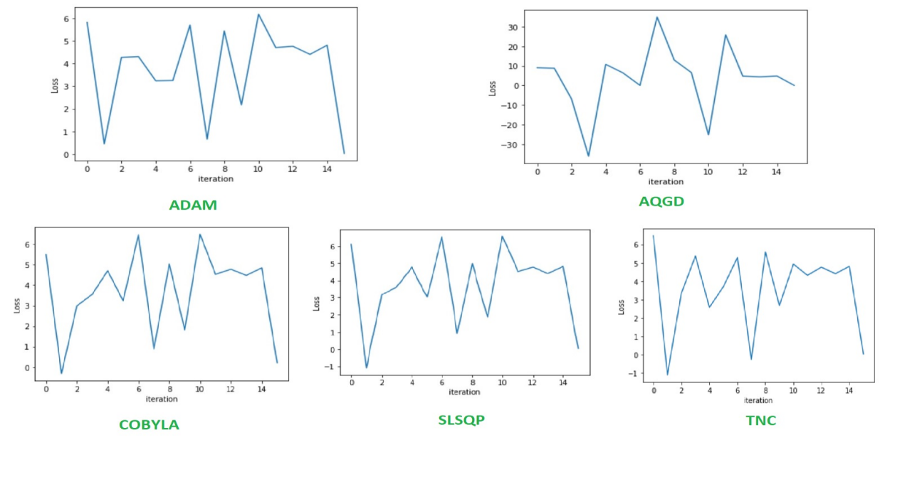
VQC components and their analysis
Methods and Results
Optimizers Performance Analysis:
opt_value 0.010566505534852494

Slide 28
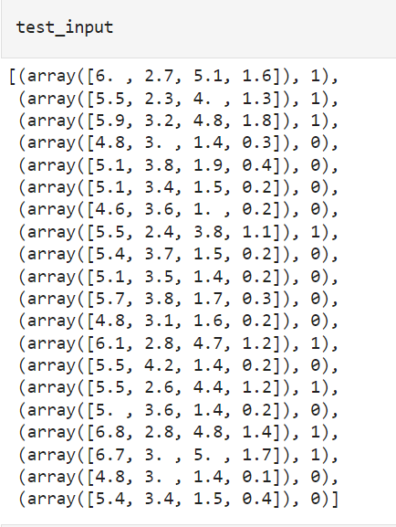
Results Analysis
Methods and Results
Sample Results:
Given Data point: [6. 2.7 5.1 1.6]
Actual Label: versicolor
Assigned by VQC: versicolor
Probabilities [{'setosa': 0.20541954372067434, 'versicolor': 0.7945804562793256}]
Classification Result CORRECT
Given Data point: [5.5 2.3 4. 1.3]
Actual Label: versicolor
Assigned by VQC: versicolor
Probabilities [{'setosa': 0.20326505867487413, 'versicolor': 0.7967349413251257}]
Classification Result CORRECT
Correctly classified = 100.0 % of test data

Slide 29
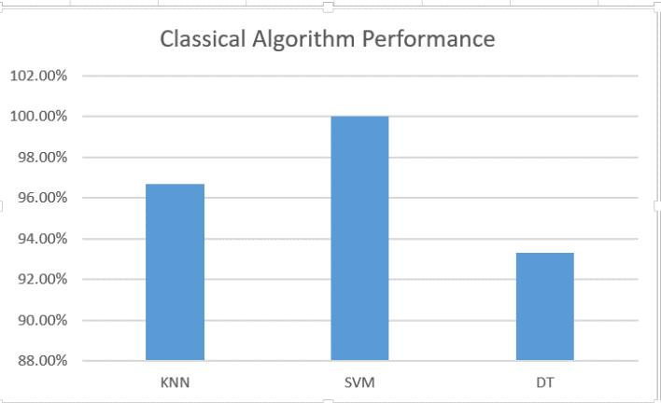
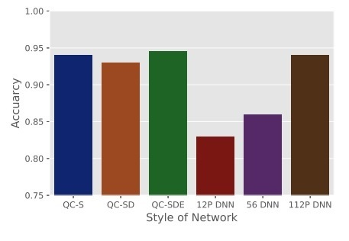
Results Analysis
Methods and Results
Correctly classified = 100.0 % of test data

Slide 30
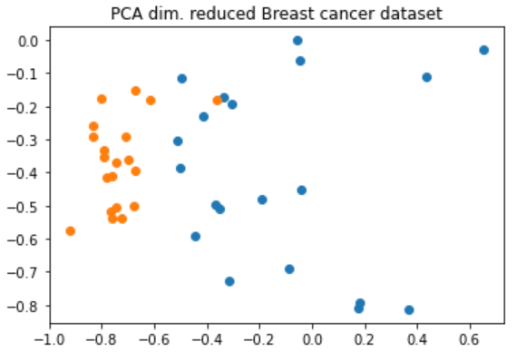
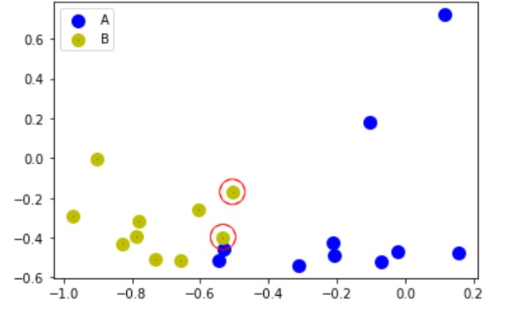
Validity Test of this study
Discussion
IBM LAB Document:
 | SVM | QSVM
Breast Cancer Analysis | 85% | 90%
Optimized VQC | ADAM | AQGD | COBYLA | SLSQP | TNC
Breast Cancer Analysis | 50% | 85% | 90% | 50% | 90%

Slide 31
Comparative Analysis of VQC and ML Algorithms
Discussion
 | Variational Quantum Classifier | Classical Machine Learning Algorithm
Performance | Better/ Similar Accuracy | Similar/Lower Accuracy
Algorithm Execution | More | Less
Operation Execution Time | More | Less
Computational Speedup Expectation | Expected due to inherent parallel computing characteristics | Need to develop the state-of-the-art algorithm
Problem Solving Restriction | Quiet restricted, Need to meet certain conditions | Capable of solving many existing problems

Slide 32
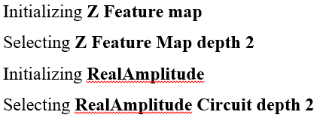
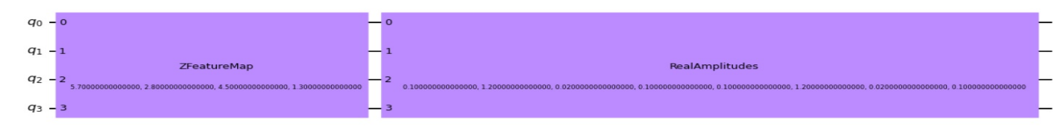

Quantum Classifier Circuit
Recommendations

Slide 33
Limitations
Conclusion
1. This optimized VQC is only tried on lower dimensional training data sets.
2. The investigation is only performed on publicly available data.
3. In this experiment, the number of trials of the experiment is comparatively lower because of the limitation of time.
4. Measurement can be performed on single qubit or any number of qubits. It is arbitrarily chosen from the experiments of researchers.
5. There are other ansatz or parameterized circuits available which need to be investigated
6. The study is limited to only on three classes and four feature values.

Slide 34
Further Study
Conclusion
Different quantum classifier approaches can also be compared
Higher dimensional and private datasets should be studied for more generalization
Encoder circuit and ansatz can be redesigned or remodeled to construct robust classifiers

Slide 35
Thank you very much
Questions?
20 April, 2022

