Slide 1

CHITTAGONG UNIVERSITY OF ENGINEERING AND TECHNOLOGY COURSE TITLE: INTERNET PROGRAMMING(SESSIONAL) COURSE CODE: 326 PROJECT NAME: Doctor Appointment System
PRESENTERS:
SUPERVISED BY:
Name: Khairul Islam
ID:1804076
Name: Md. Fahim Hossain Saikat
ID:1804077
Name: Rifatur Rana
ID: 1804098
Dr. Md. Iqbal Hasan Sarker
Associate professor,CSE,CUET
Md. Atiqul Islam Rizvi
Lecturer,CSE,CUET
Sabiha Anan
Lecturer,CSE,CUET

Slide 2
Introduction
The “Doctor Appointment System” has been developed to overcome the difficulties regarding traditional system. This system will be very much user friendly as it does not need complex knowledge to use the system. This system is supported to eradicate and, in some cases, reduce the hardship faced by the existing system.

Slide 3
Objectives
To manage the detail of doctor appointment, patient, booking, doctor schedule.
To manage all the information about doctor fees, doctor schedule.
To reduce the manual work for managing the doctor, appointment, doctor fees.

Slide 4
Overview
Quick overview of what this presentation is all about:
Visitor pages
Authentication
Patient Panel
Doctor Panel
Admin panel
Appointment Procedure

Slide 5
Practical Application
To manage the information of doctor.
To increase efficiency of managing the doctor, appointment.
To manage the information of appointment.
To store all records about doctor and patient.

Slide 6
Used Technology
Frontend
Backend:
HTML
JavaScript
ReactJs
CSS
Bootstrap
MongoDB
NodeJs
Express
Postman

Slide 7
For live experience visit Book Doctor (bookdoctoronline.herokuapp.com)

Slide 8


Page Layout
Header:
Footer:

Slide 9
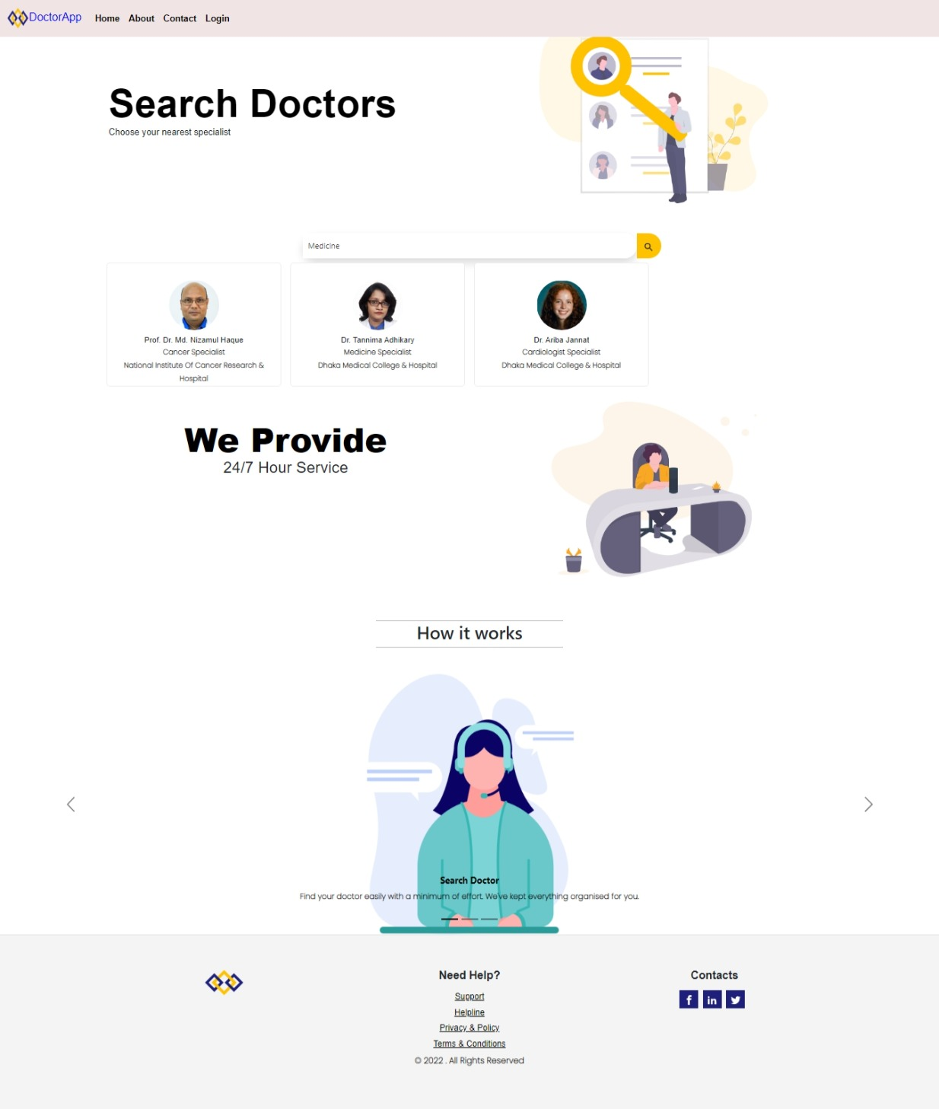
Home Page

Slide 10
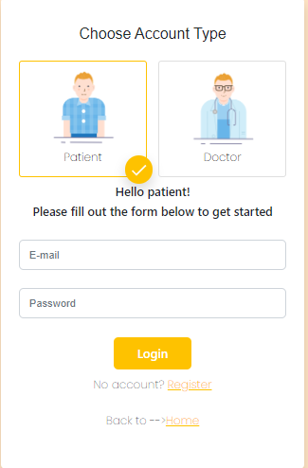
Login Page:

Slide 11
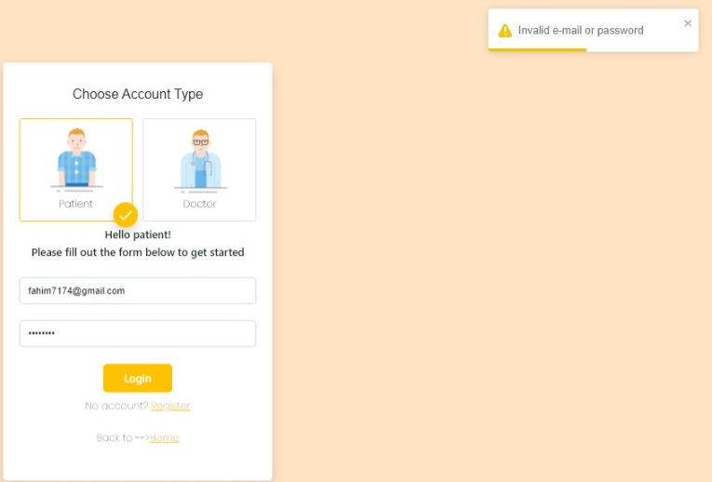
Login Fail

Slide 12
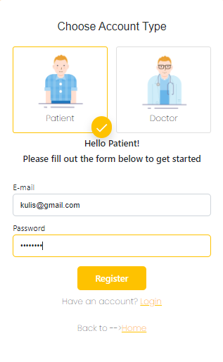
Registration For Patient

Slide 13
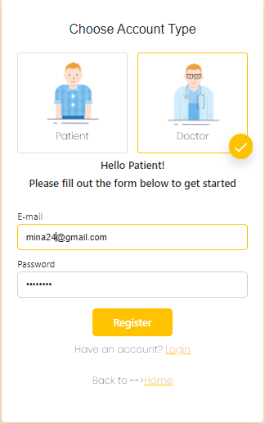
Registration For Doctor

Slide 14
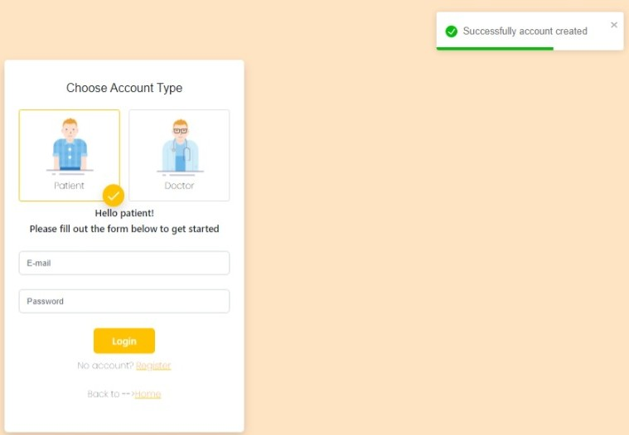
After Registration

Slide 15
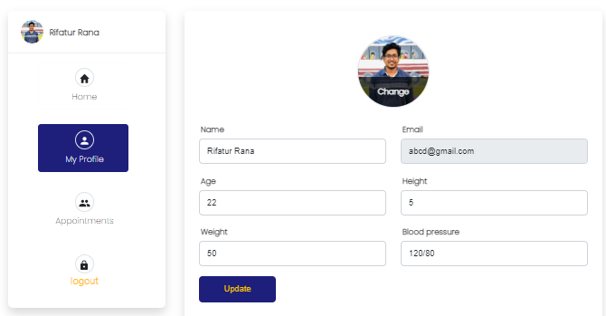
Patient Profile

Slide 16
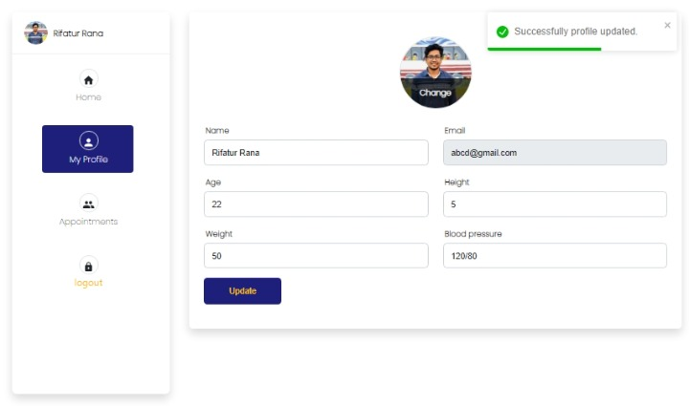
Patient Profile Update

Slide 17
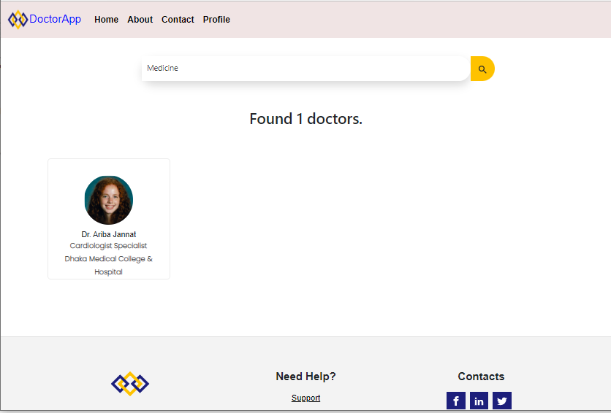
Search For Doctor

Slide 18
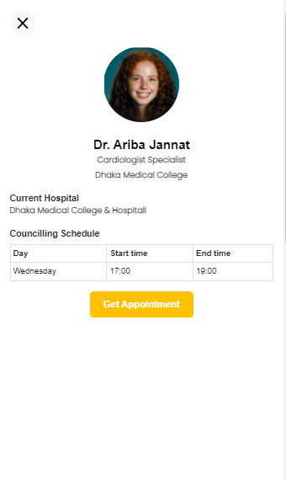
Get Appointment

Slide 19
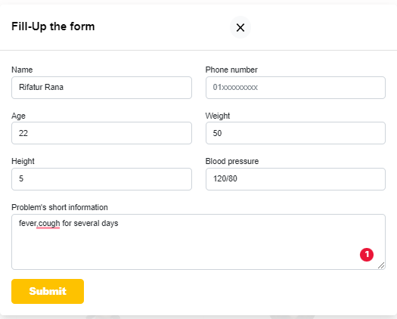
Form For Getting Appointment

Slide 20
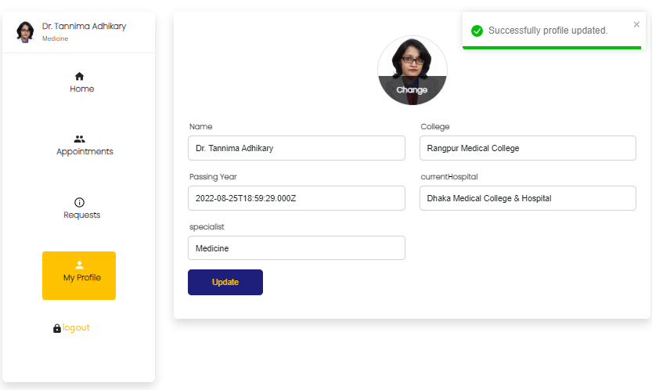
Doctor Profile :

Slide 21
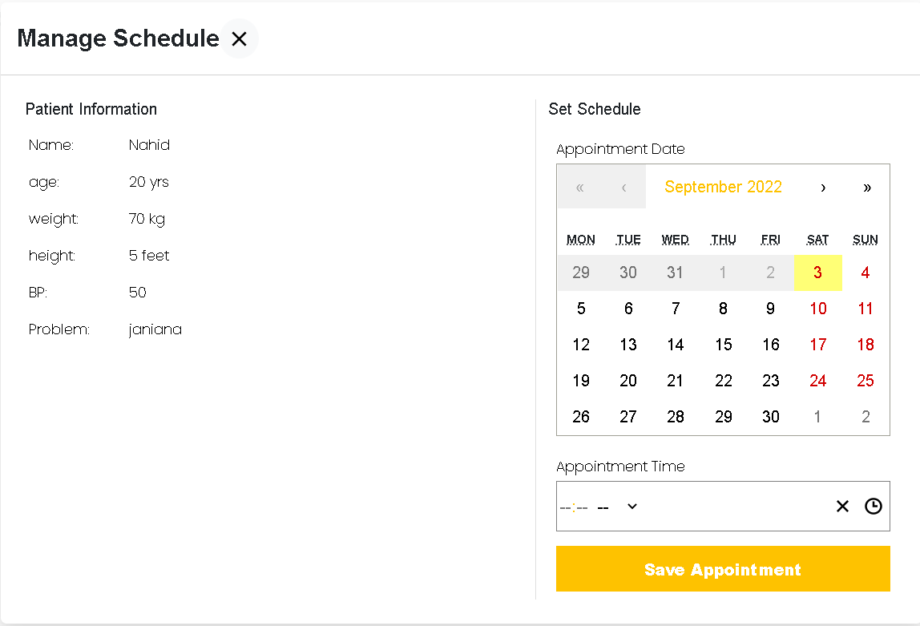
Manage Schedule Of Doctor:

Slide 22
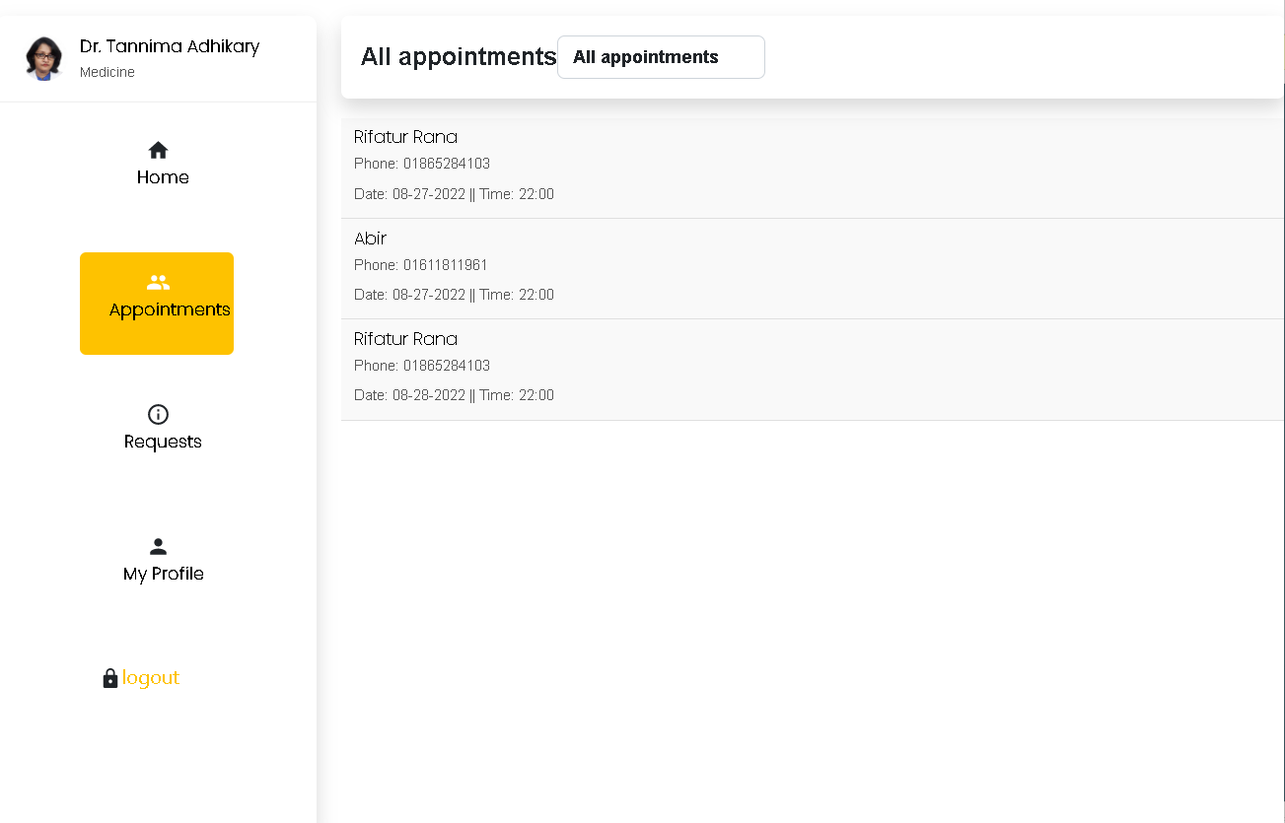
ALL Appointments Of Doctor:

Slide 23
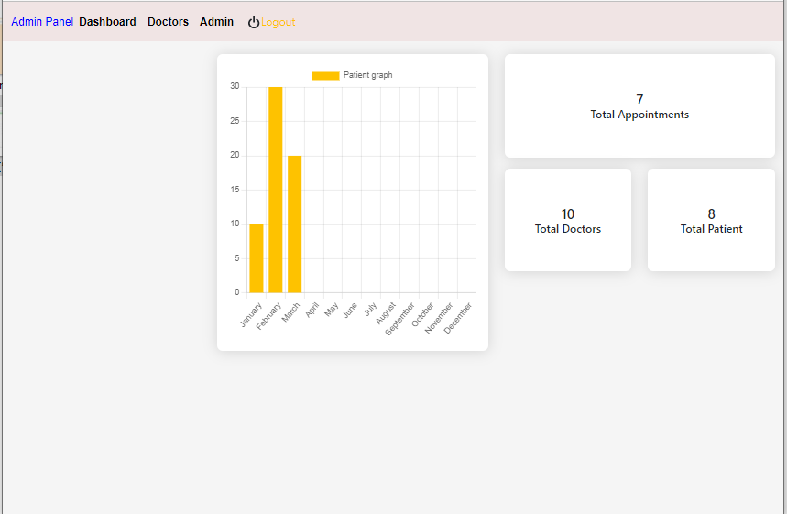
Admin Dashboard:

Slide 24
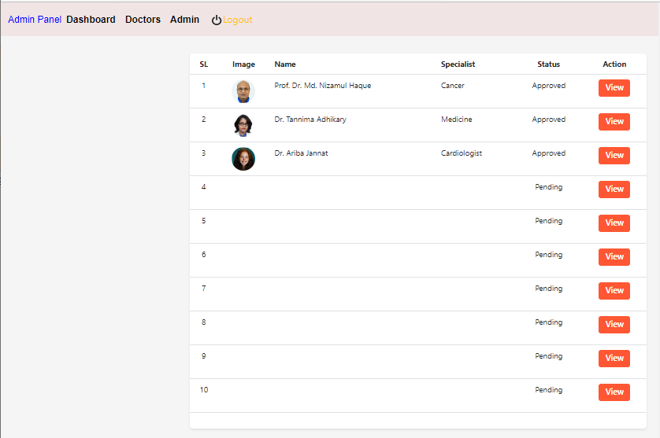
Admin Approval Of Doctor:

Slide 25
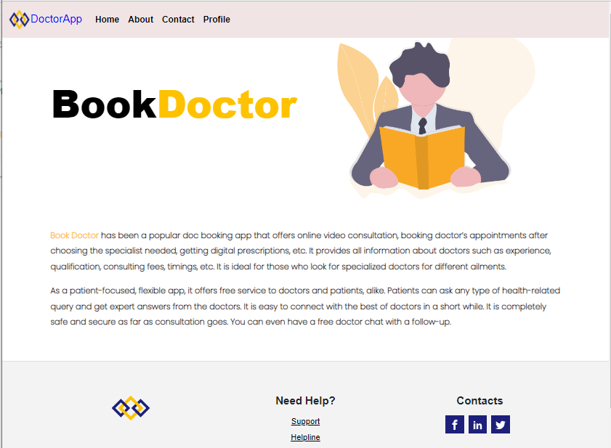
About Us:

Slide 26
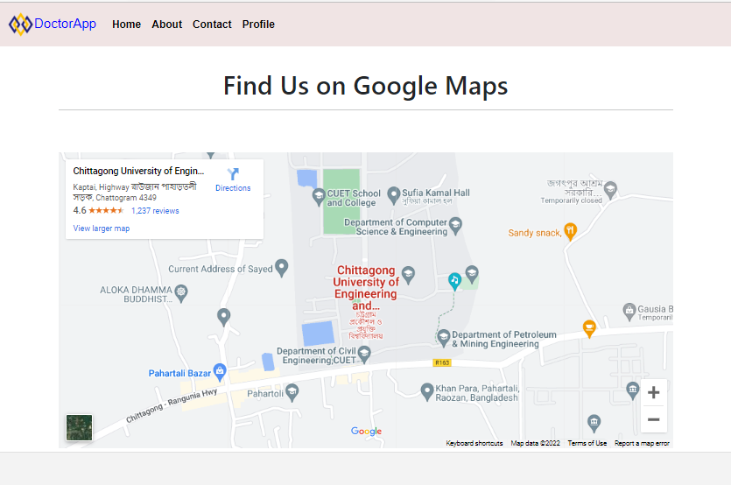
Contact Us:

Slide 27
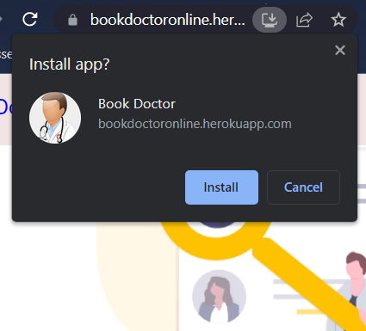
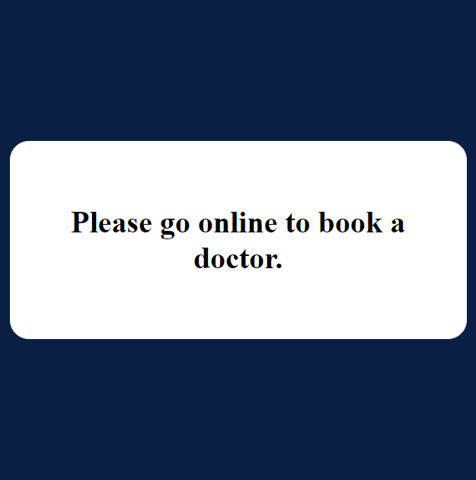
Special Feature

Slide 28
Conclusion:
“Doctor Appointment System” project focuses on providing facilities and flexibilities in order to find desirable doctors for patients in Bangladesh. We have tried our best to make the interface easy and attractive to the users.
To conclude we have worked a step forward to build a 24/7 easy reliable customer web service system.

Slide 29
Thank you

