Slide 1
Django E-Commerce Project
Building a Successful Online Store

Slide 2
Rifatuzzaman Rifat
Roll : 452048
Reg : 1502063844
Session : 19-20
Semester : 8th
Shift : 2nd

Slide 3
Project Overview
The Django e-commerce project is aimed at developing a robust online store using the Django web framework. Our goal is to create a platform that provides a seamless and secure shopping experience for users.

Slide 4
Before we get into the visuals, a quick overview of my project. Over the past internship. I've been focused on Django web framework. Now, let's dive into the visual representation to see the progress and key highlights.

Slide 5
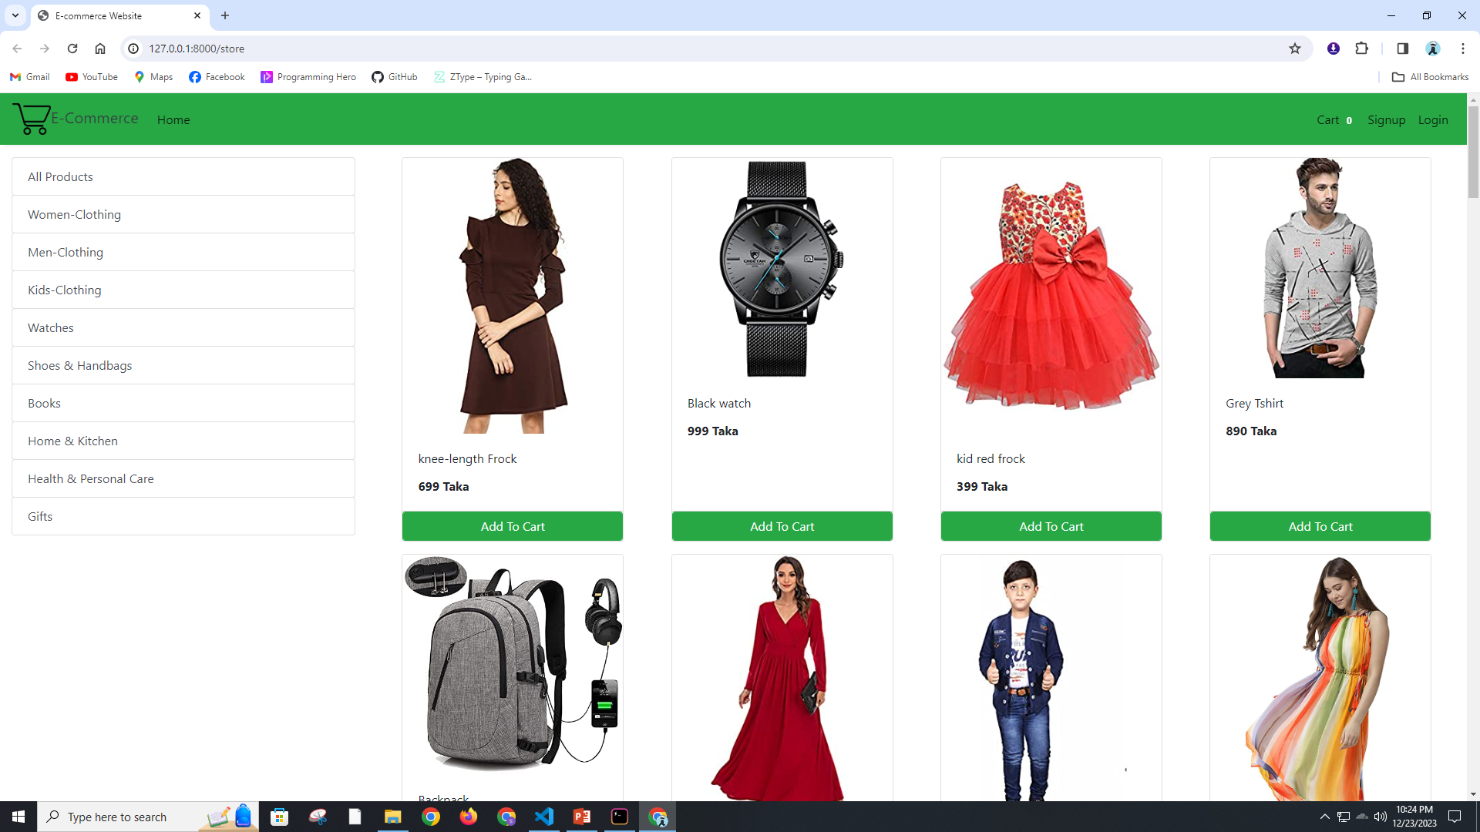

Slide 6
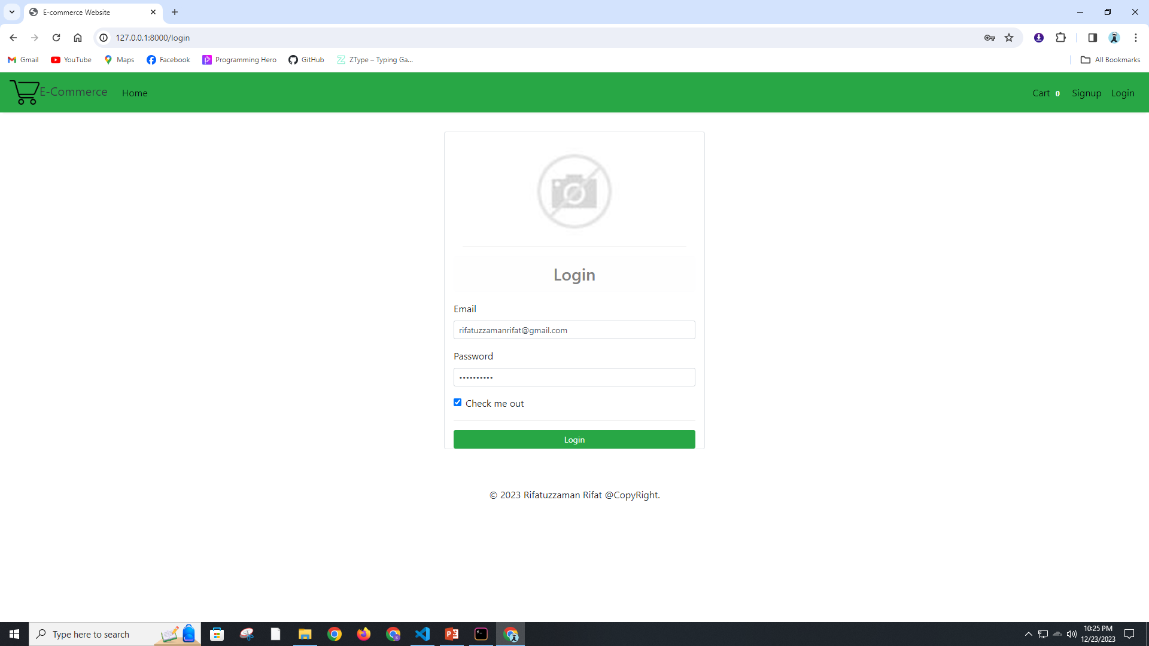

Slide 7
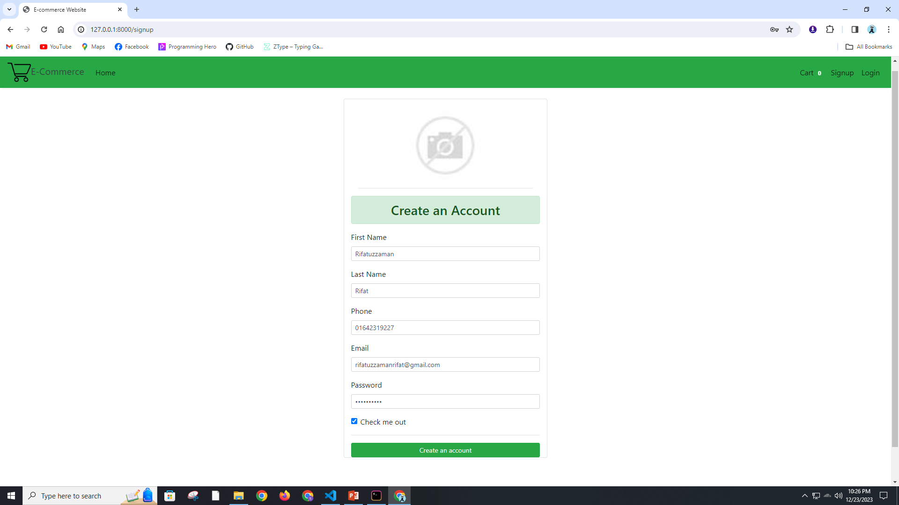

Slide 8
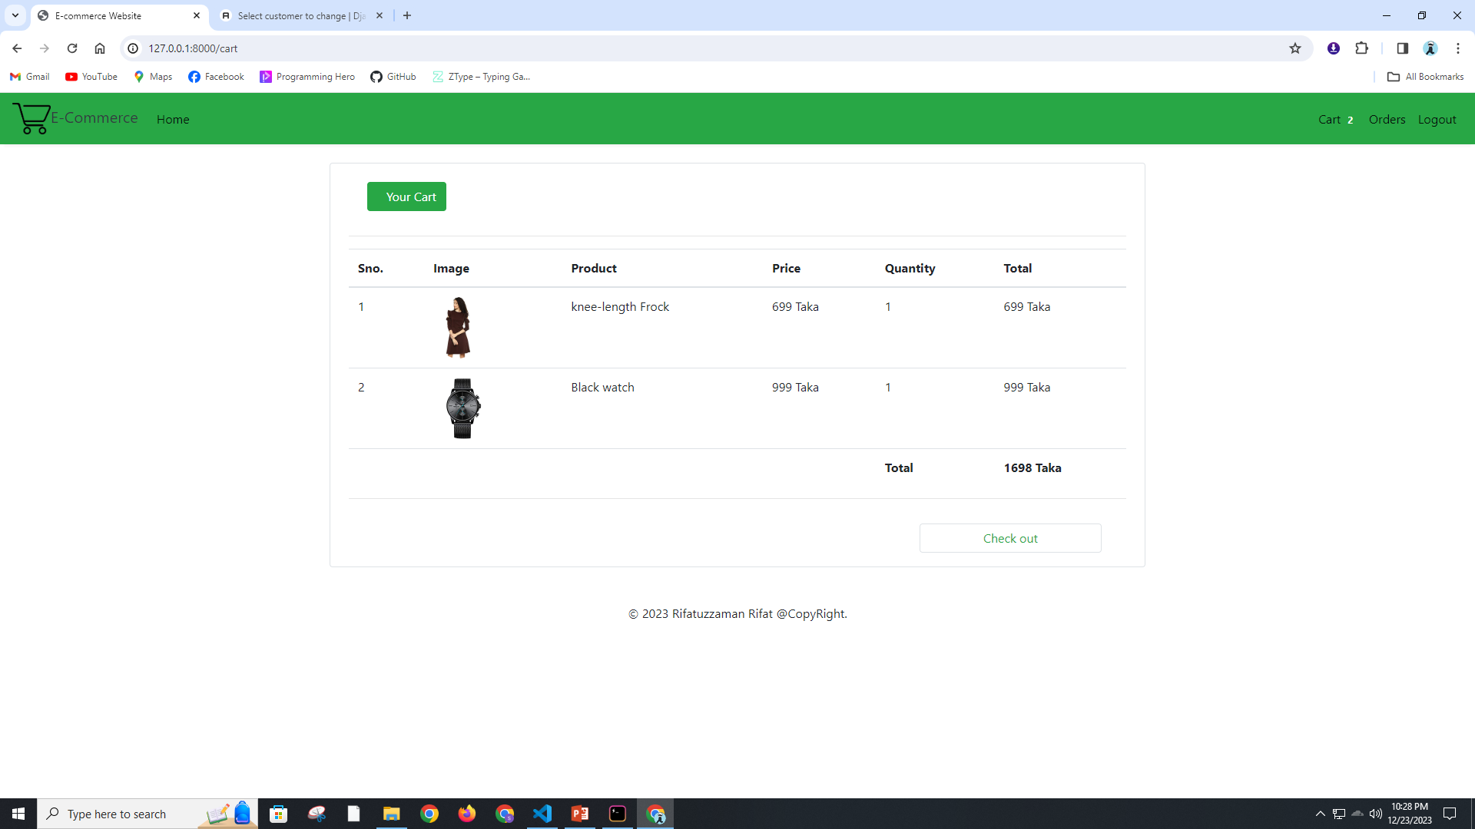

Slide 9
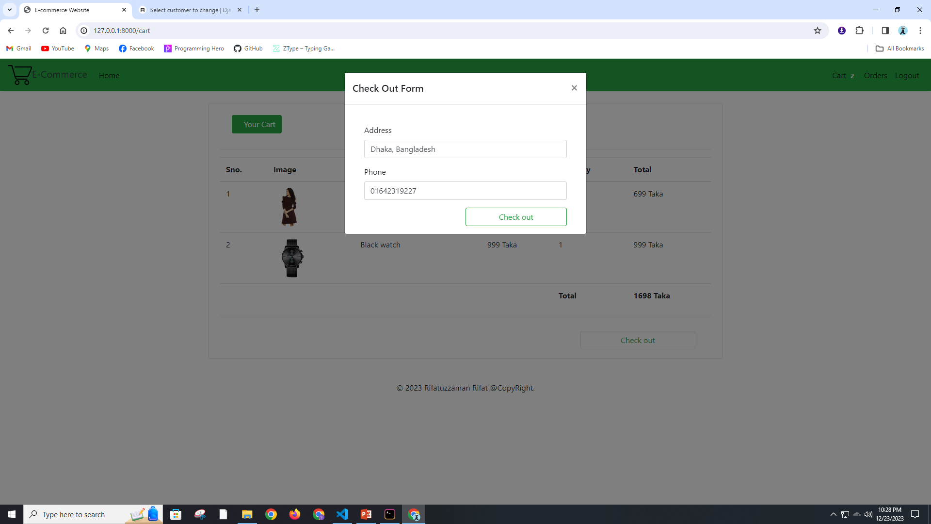

Slide 10
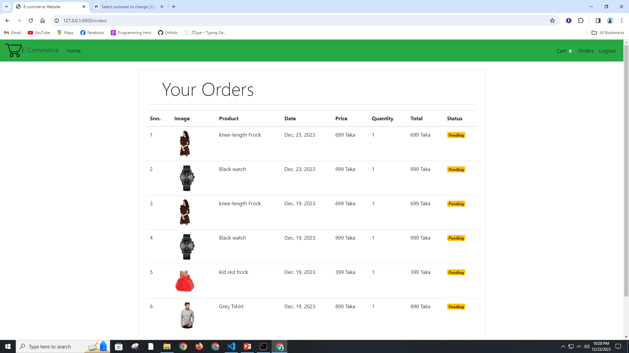

Slide 11
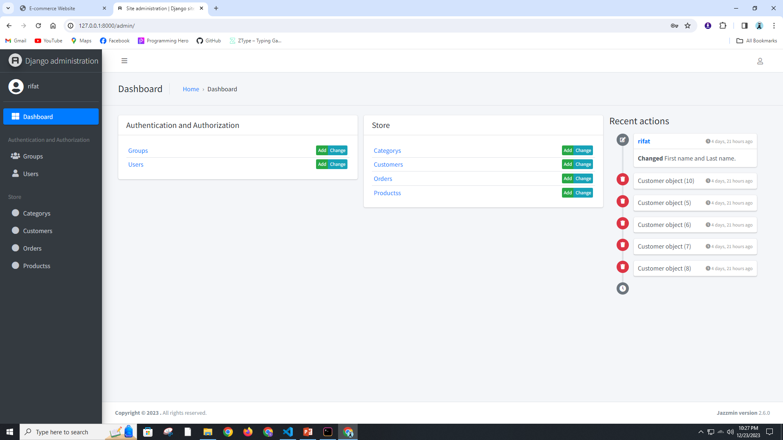

Slide 12
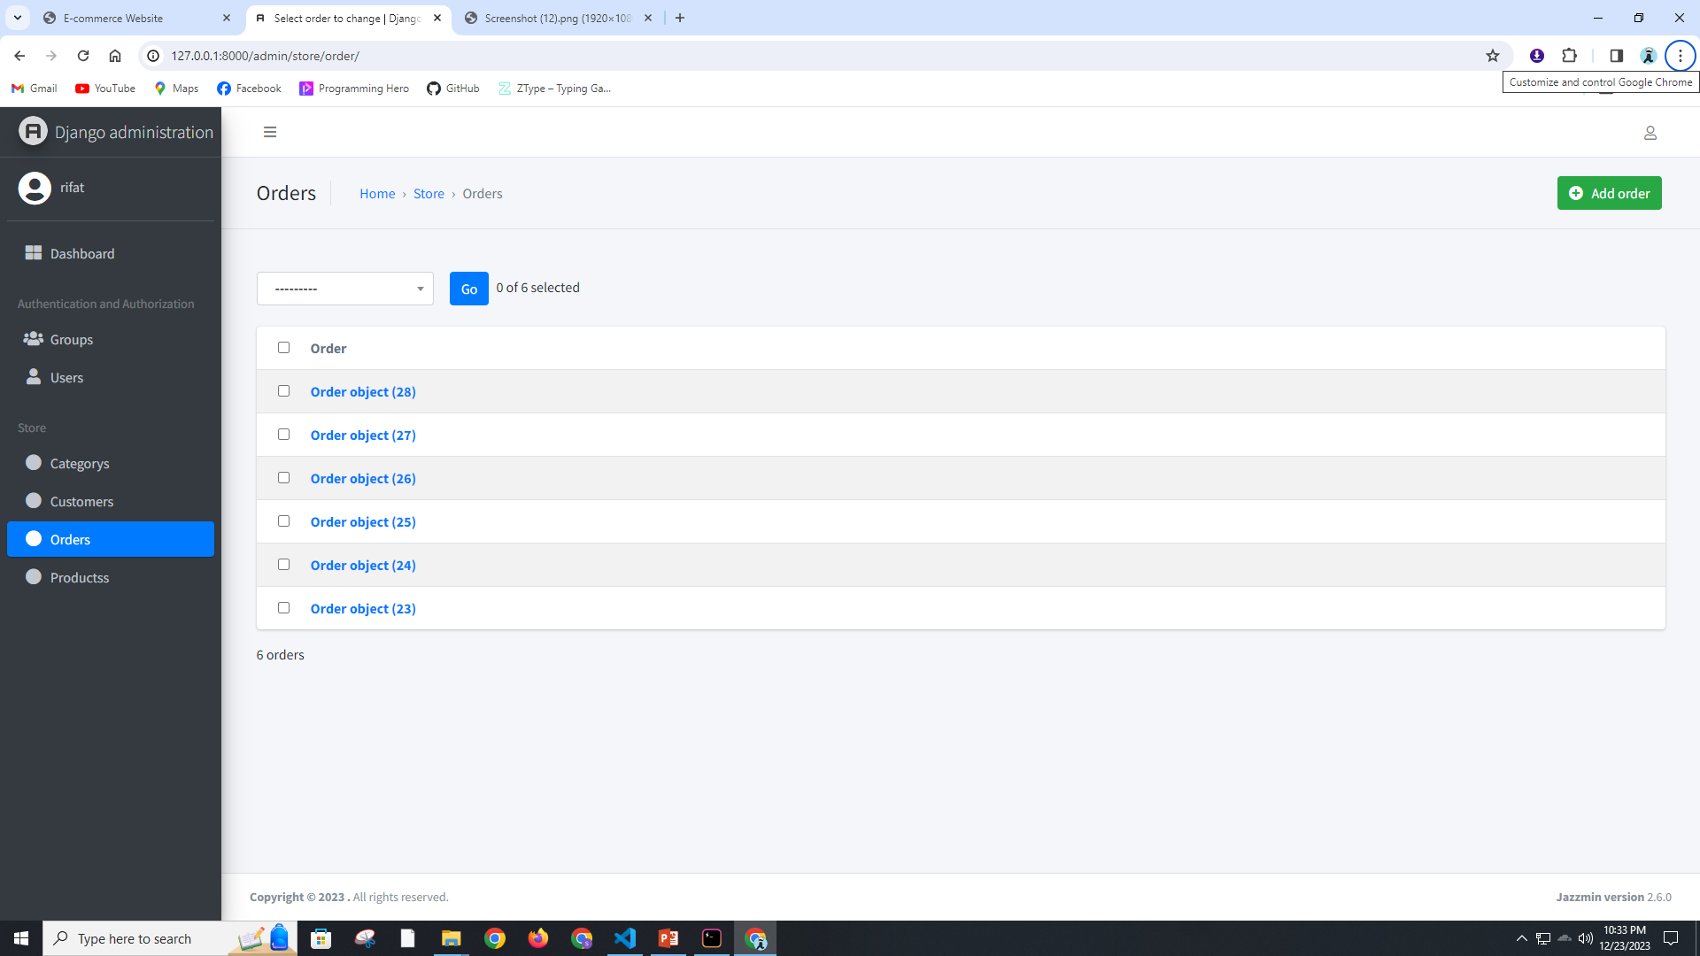

Slide 13
Objectives
1. Develop a feature-rich e-commerce website with Django.
2. Implement essential functionalities such as product management, user authentication, and secure payment processing.

Slide 14
Technologies Used
The project leverages the Django web framework for backend development, HTML/CSS for frontend, and a relational database for efficient data management. We prioritize the use of modern technologies to ensure scalability and maintainability.

Slide 15
Development Progress
The development phase has seen significant progress. Core functionalities such as user authentication, product catalog management, and shopping cart implementation have been successfully integrated. My focus is now on refining and optimizing the codebase for a seamless user experience.

Slide 16
Challenges Faced
While developing the e-commerce website, I faced challenges related to optimizing performance, ensuring data security, and handling concurrent user interactions. These challenges have been addressed through collaborative problem-solving.

Slide 17
Testing and Quality Assurance
A rigorous testing process is underway to ensure the reliability and security of the website. This includes unit testing, integration testing, and user acceptance testing. Quality assurance practices are followed to meet industry standards.

Slide 18
Conclusion
In conclusion, the Django e-commerce project is progressing well, and I dedicated to delivering a high-quality online store. The development, testing, and future enhancement plans position my project for success in the ever-evolving e-commerce landscape.

Slide 19
Thank You

