Slide 1
Word Vectorization
- Implementing “word2vec”
using PyTorch -

Slide 2
Brought to you by
Md. Ishtiak Hossain
011 152 056
Rifaz Nahiyan
011 152 054
Md. Golam Farzad
011 152 0548
A. M. Ishtiaque Ali
011 152 059
<number>

Slide 3
Word Vectorization
… what?

Slide 4
The alchemy of making very useful vectors from words

Slide 5
Why?

Slide 6
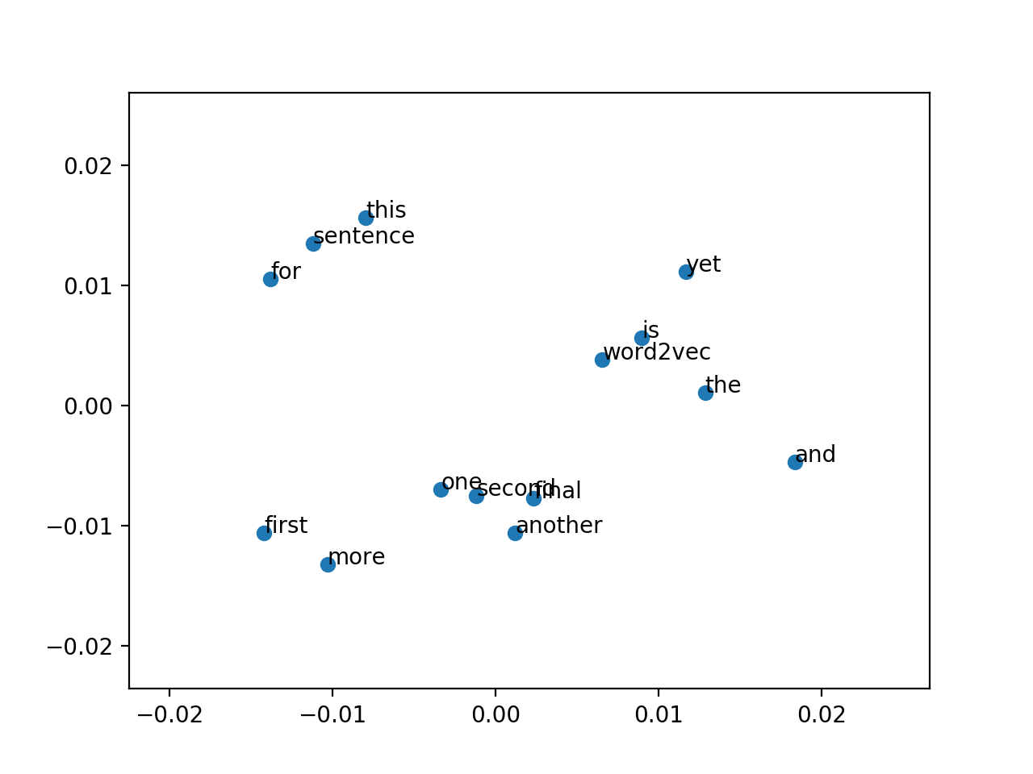
So that words can float in a geometric plane...

Slide 7
But why…

Slide 8
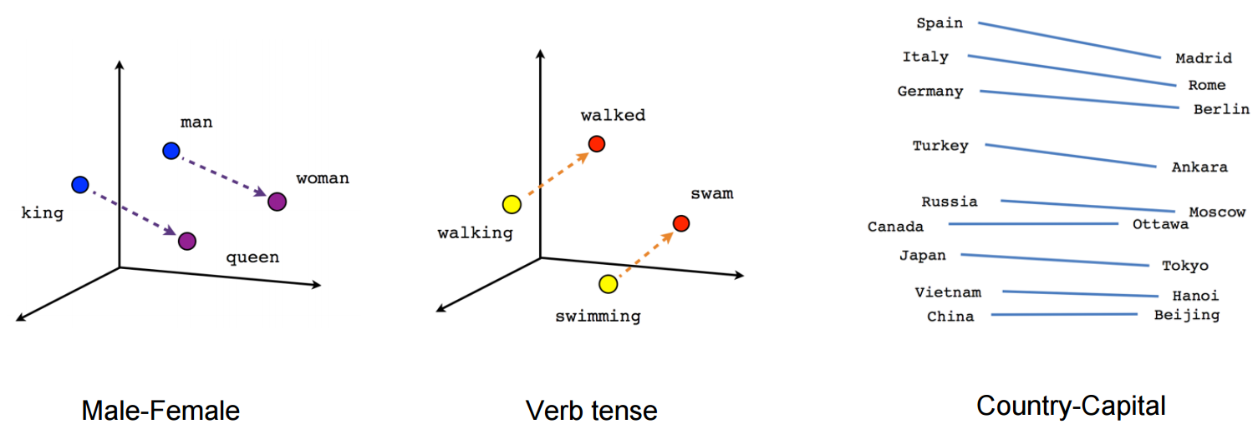

Slide 9
Also because words are powerful
And when they can be used at the speed of computers they become even more powerful.

Slide 10
With all that covered…
Now we get to the details

Slide 11
Converting Words to Vectors

Slide 12
Vocabulary
Tokens
Make center, context pairs using
Skip-Gram
Probability P(Context|Center) Using Softmax Function
Loss calculation Using Negative log Likelihood
Gives us weights for our Neural Network
Prediction

Slide 13
Models:
Skip-Gram

Slide 14
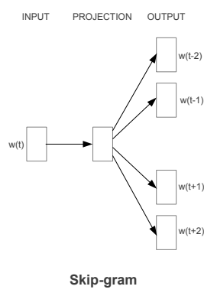
Skip-gram gives you the surrounding words to a given center word.

Slide 15
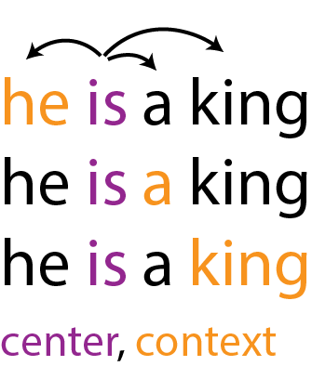
Skip-gram closer look

Slide 16

Probability P(Context|Center) Using Softmax:

Slide 17

Loss function: Negative Log Likelihood

Slide 18
And the process repeats
to give us weights like…

Slide 19
W1
W2

Slide 20
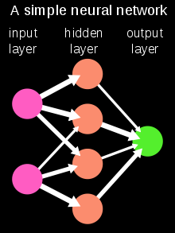

Slide 21
Now comes the coding part

Slide 22
The code

Slide 23
Python/numpy data structures like:
Numpy ndarray
Lists
Dictionaries
PyTorch Tensors

Slide 24
Python/numpy data structures like:
Numpy ndarray
Lists
Dictionaries
PyTorch Tensors
…?

Slide 25
PyTorch
Extremely powerful library for
Data Science
Neural Networks
Provides Tensors
Can use also steroids GPU

Slide 26
Tensors
The muscles for PyTorch
Basically… multi-dimensional vectors
Vectors
Tensor
x₁
x₂
x₃
.
.
.
x_{n}
x₁₁ x₁₂ … x_{mn}
X₂₁ x₂₂ … x_{mn}
X₃₁ x₃₂ … x_{mn}

Slide 27
Demo

Slide 28
Thank you for your patience...
<number>

Slide 29
Questions?
We prefer none
<number>

