Slide 1

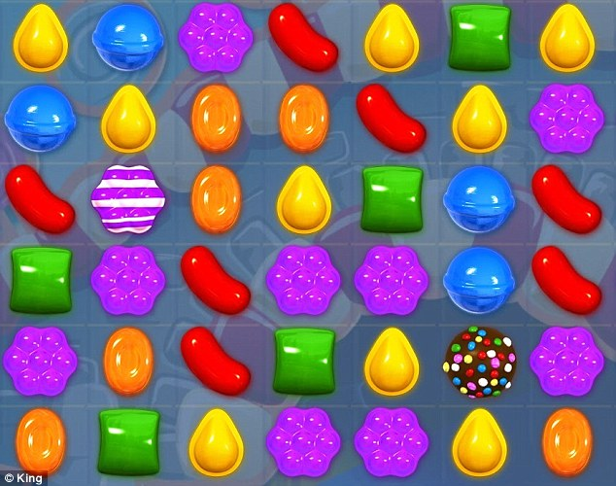
ACS 560
Candy Crush Project
Suma Kancherla
Michael Riff

Slide 2
Overview
A square grids with different candies
Can use in mobile or desktop computer
Game that moves vertical or horizontal when three or more same candies
Very addicting game that keeps you playing when scoring high and moving up levels continuously

Slide 3
functional requirements
user authentication
play the game
record high score
show top 10 high scores
add a new user
Notes:
user authentication
the user should either create a new user account or login with an existing user account
play the game
on the game grid, generate a random game board
clicking 3 horizontal or vertical matches clears those elements
each column above the cleared elements will drop down and new elements will be added at the top of the grid
record a score each time elements are cleared
have a randomize button to reshuffle the grid
make the randomize button only able to be used a limited number of times until the game ends
when there are no more available moves and no more randomize available send the score to the golang server
display a high score page
record high score
send the high score to the golang server and store in the database
show top 10 high scores
query the database for the top 10 scores, send to C# for display
add a new user
when trying to log in with a user not in the database add that user

Slide 4
non functional requirements
c# on windows client
golang on linux server
postgres database
connect with C# client to golang server on AWS

Slide 5
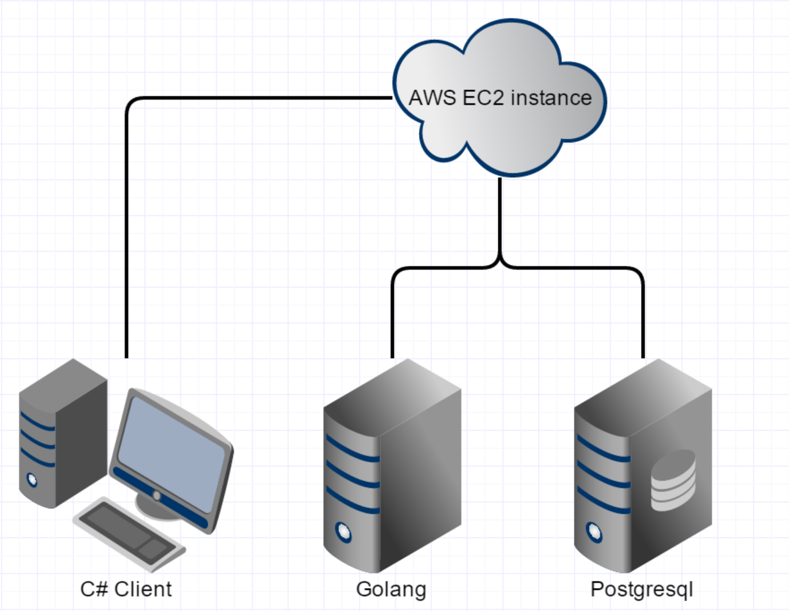
Architecture
AWS EC2
micro instance
ubuntu 14.04
GoLang
Postgresql 9.3

Slide 6
Next Steps of Action
If user has not have account or unable to log, he/she can sign up which database can be stored in account
User can login with username and password
The game starts out randomalized
User plays by moving mouse horizontal or vertical by one block

Slide 7
Next Steps of Action cont…
If the candies are same three in either vertical or horizontal, it will clear and score goes up
If four same, it produce into one striped candy and score goes up
If five same, it produces into one big brown candy
There be either clock countdown from 1 minute or number moves required, Ex. 40

