Slide 1

Candy

Slide 2
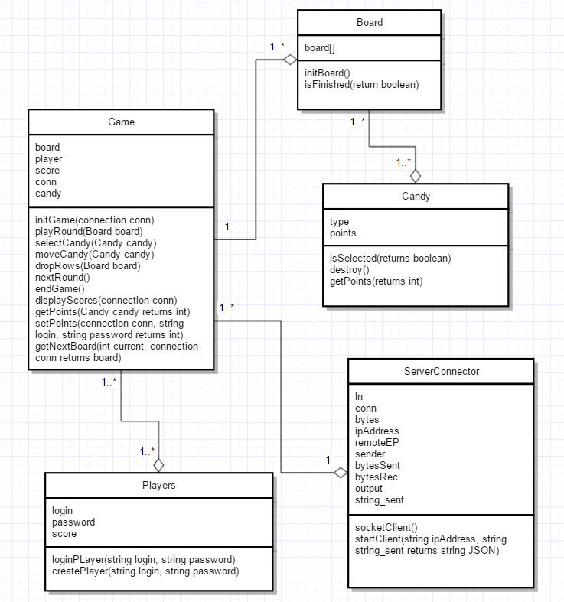
Client Class Diagram

Slide 3
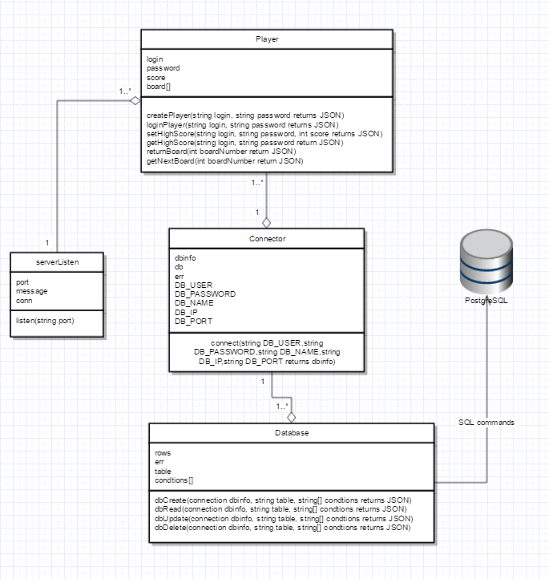
Server Class Diagram

Slide 4
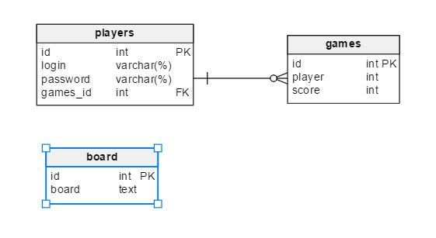
Database schema
Players table
Games table
Board table

Slide 5
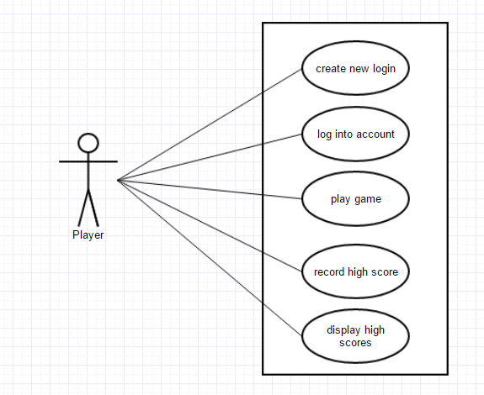
Use Case

Slide 6
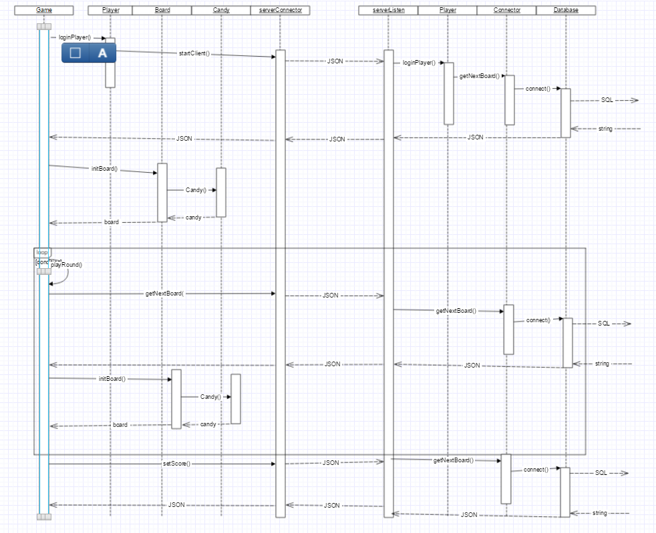
LoginPlayer gameplay Sequence

Slide 7
Classes
Board – to implement by using either 8x8 or 10x10
Candy – using enumerator to store diff types of candy
Player(s) – players based on user login and password
ServerConnector – to connect to server
Game – game will be on and after game is done, to keep score will be stored in database

Slide 8
Classes
ServerListener- listens for new connection requests and executes message passing to client
Player – stores player information and message passing logic
Connector- initiates connection to the database
Database- CRUD methods to query the database

