Slide 1
Comparing Paid and Volunteer Recruitment in Human Computation Games
Anurag Sarkar and Seth Cooper
College of Computer and Information Science
Northeastern University
Notes:
In this presentation, I’ll be talking about this work where we compared the effect of different player recruitment strategies on engagement within the context of HCGs

Slide 2

Crowdsourcing
Paid crowdsourcing platforms like Amazon Mechanical Turk are popular for recruiting participants
Notes:
Over the past decade, crowdsourcing platforms such as AMT have become very popular

Slide 3
Crowdsourcing
Paid crowdsourcing platforms like Amazon Mechanical Turk are popular for recruiting participants
In games, used for recruiting participants for playtesting, design experiments, user research (Khajah et al., 2016; Sarkar et al., 2017; Sharek and Weibe, 2014; Birk and Mandryk, 2016; Weibe et al. 2014; Birk et al., 2017; Williams et al., 2017)

Slide 4
Recruitment Strategy
Behaviors and motivations of paid participants may differ from those who play voluntarily (i.e. through banner ads, web search, social media posts etc.) (Cooper and Farid, 2016; Crump et al., 2013; Paolacci et al., 2010; Sprouse, 2011; Krause and Kizilcec, 2015; Mao et al., 2013)

Slide 5
Recruitment Strategy
Behaviors and motivations of paid participants may differ from those who play voluntarily (i.e. through banner ads, web search, social media posts etc.) (Cooper and Farid, 2016; Crump et al., 2013; Paolacci et al., 2010; Sprouse, 2011; Krause and Kizilcec, 2015; Mao et al., 2013)
Often, we wish to understand volunteers but end up studying paid participants

Slide 6
Recruitment Strategy
Behaviors and motivations of paid participants may differ from those who play voluntarily (i.e. through banner ads, web search, social media posts etc.) (Cooper and Farid, 2016; Crump et al., 2013; Paolacci et al., 2010; Sprouse, 2011; Krause and Kizilcec, 2015; Mao et al., 2013)
Often, we wish to understand volunteers but end up studying paid participants
Wanted to compare the impact of recruitment strategy (i.e. paid vs volunteer) on player’s engagement and subjective experience in the context of human computation games (HCGs)

Slide 7
Research Questions
RQ1 – Does recruitment strategy impact participant behavior and experience in HCGs?

Slide 8
Research Questions
RQ1 – Does recruitment strategy impact participant behavior and experience in HCGs?
RQ2 – Does recruitment strategy impact how changes to the game affect participant behavior and experience in HCGs?

Slide 9
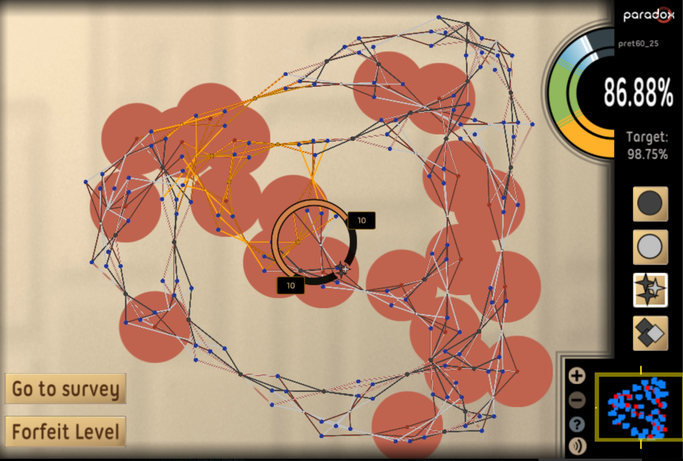
Paradox
2D puzzle game for crowdsourced formal verification of software
Each level represents a MAX-SAT problem
Used same matchmaking system

Slide 10
Participant Recruitment and Study
Paid players recruited using Amazon Mechanical Turk
Notes:
For our study, we recruited…
2 phases
For both phases, we used Glicko2 for matchmaking
And both phases had 9 …

Slide 11

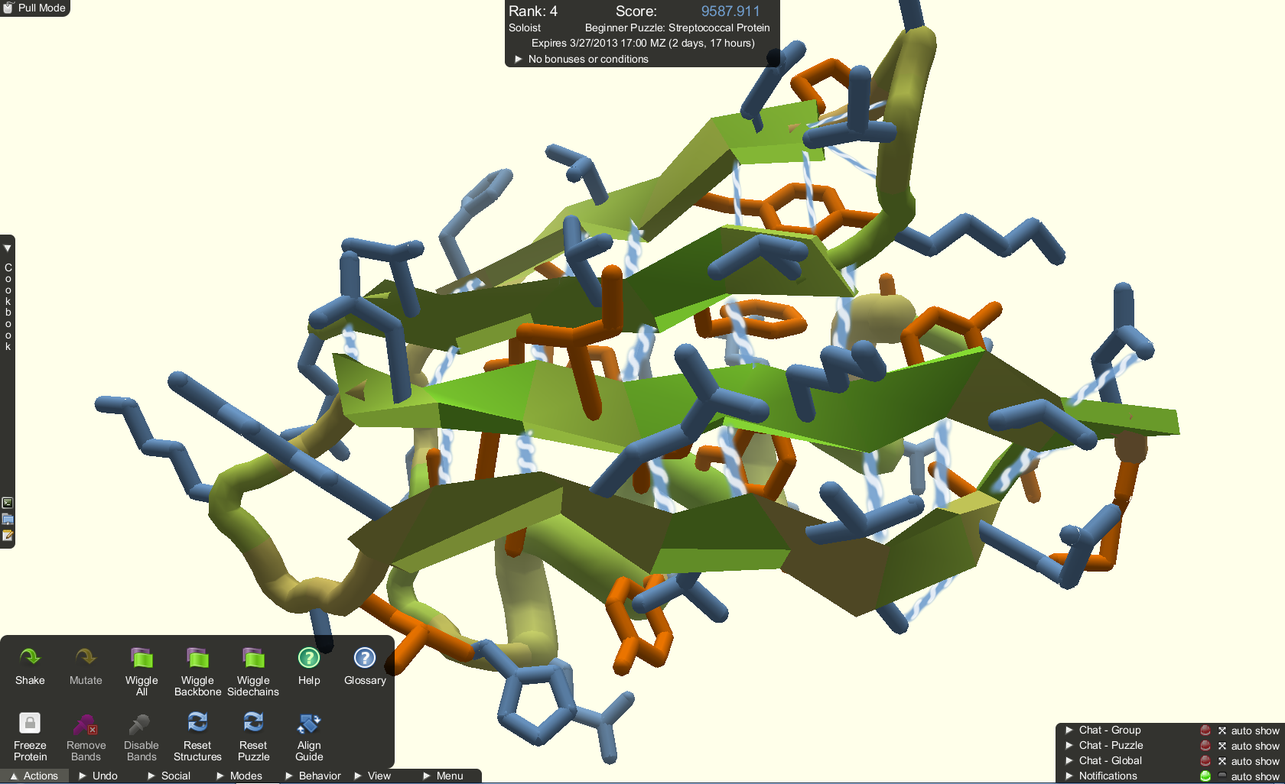
Participant Recruitment and Study
Paid players recruited using Amazon Mechanical Turk
Volunteers recruited using banner ad on the website for the HCG Foldit (http://fold.it)
Notes:
For our study, we recruited…
2 phases
For both phases, we used Glicko2 for matchmaking
And both phases had 9 …

Slide 12
Participant Recruitment and Study
Paid players recruited using Amazon Mechanical Turk
Volunteers recruited using banner ad on the website for the HCG Foldit (http://fold.it)
Two experiments
RQ1: Effect of volunteer vs paid recruitment on engagement
RQ2: Effect of change in design on paid vs voluntary players
Notes:
Examined if paid and volunteer players were affected differently by design changes, by introducing a loading delay between levels

Slide 13
Experiment Flow
Mechanical Turk
Mechanical
Turk
Consent
Payment
Code
Instructions
Game
Survey
Banner
Ad
Banner
Consent
Notes:
So here we have the experimental flow for our study
should mention here that participation after starting was voluntary, even for mturk

Slide 14

Recruitment vs Participation
Paid
Voluntary

Slide 15

Recruitment vs Participation
Voluntary
Voluntary
Notes:
Intrinsic → tasks performed for the inherent satisfaction in them
Extrinsic → tasks performed for some separate, external outcome
SDT states that extrinsic motivation can vary in degree of autonomy and internalization
Since participation was voluntary in both cases, paid players who continued after payment may have experienced greater autonomy and internalization

Slide 16
Measures
Behavioral Engagement
Play Time
Levels Attempted
Levels Completed
Player Rating (Player’s Glicko-2 rating after completing the game)
Highest Level Rating (Highest Glicko-2 rating of any level completed by the player)

Slide 17
Measures
Behavioral Engagement
Play Time
Levels Attempted
Levels Completed
Player Rating (Player’s Glicko-2 rating after completing the game)
Highest Level Rating (Highest Glicko-2 rating of any level completed by the player)
Intrinsic Motivation Inventory
Interest/Enjoyment
Perceived Competence
Perceived Choice
Effort/Importance

Slide 18
Experiment One: Recruitment Strategy
Does recruitment strategy impact participant behavior and experience in HCGs?

Slide 19
Experiment One: Recruitment Strategy
Does recruitment strategy impact participant behavior and experience in HCGs?
Three conditions
BANNER

Slide 20
Experiment One: Recruitment Strategy
Does recruitment strategy impact participant behavior and experience in HCGs?
Three conditions
BANNER
MTURK-SM ($0.10)

Slide 21
Experiment One: Recruitment Strategy
Does recruitment strategy impact participant behavior and experience in HCGs?
Three conditions
BANNER
MTURK-SM ($0.10)
MTURK-LG ($1.00)

Slide 22
Experiment One: Recruitment Strategy
Does recruitment strategy impact participant behavior and experience in HCGs?
Three conditions
BANNER
MTURK-SM ($0.10)
MTURK-LG ($1.00)
177 players recruited through the banner
225 players recruited through each MTurk condition
162 (72%) played in MTURK-SM after being paid
194 (86%) played in MTURK-LG after being paid

Slide 23
Experiment One: Recruitment Strategy
Does recruitment strategy impact participant behavior and experience in HCGs?
Three conditions
BANNER
MTURK-SM ($0.10)
MTURK-LG ($1.00)
177 players recruited through the banner
225 players recruited through each MTurk condition
162 (72%) played in MTURK-SM after being paid
194 (86%) played in MTURK-LG after being paid
“A requester on mturk giving away free money… that truly is a paradox!”

Slide 24
Experiment One Results
Variable | BANNER | MTURK-SM | MTURK-LG
Player Rating | 1808 | 1509 | 1636
Highest Level Rating | 1625 | 1222 | 1367
Levels Attempted | 3 | 3 | 4
Levels Completed | 3 | 3 | 4
Statistical Tests: Omnibus Kruskal-Wallis Test, post-hoc Wilcoxon Rank-Sum Test
No significant differences across conditions for Play Time
Notes:
For measures related to player skill and level difficulty, BANNER outperformed both MTURK-SM and MTURK-LG.
Volunteer players significantly outperformed paid players in terms of Player Rating and Highest Level Rating
For measures related to amount of levels played, MTURK-LG outperformed both MTURK-SM and BANNER

Slide 25
Experiment One Results
Variable | BANNER | MTURK-SM | MTURK-LG
Effort/Importance | 46% | 63% | 74%
Interest/Enjoyment | 53% | 56% | 65%
Perceived Competence | 43% | 48% | 60%
Statistical Tests: Omnibus Kruskal-Wallis Test, post-hoc Wilcoxon Rank-Sum Test
No significant differences across conditions for Perceived Choice
Notes:
For the survey measures, MTURK-LG also outperformed the other conditions
MTURK-LG players had significantly higher values for Effort/Importance
Players’ sense of the amount of effort they put in increases with payment
Players paid less felt less obliged to put in effort and reported it as such
MTURK-LG did better in terms of Interest/Enjoyment and Perceived Competence
Players paid more derived more interest and felt more competent

Slide 26
Experiment One Results
Variable | BANNER | MTURK-SM | MTURK-LG
Effort/Importance | 46% | 63% | 74%
Interest/Enjoyment | 53% | 56% | 65%
Perceived Competence | 43% | 48% | 60%
Statistical Tests: Omnibus Kruskal-Wallis Test, post-hoc Wilcoxon Rank-Sum Test
No significant differences across conditions for Perceived Choice
Only 6% of BANNER completed the survey compared to 70% of MTURK-SM and 82% of MTURK-LG
Notes:
For the survey measures, MTURK-LG also outperformed the other conditions
MTURK-LG players had significantly higher values for Effort/Importance
Players’ sense of the amount of effort they put in increases with payment
Players paid less felt less obliged to put in effort and reported it as such
MTURK-LG did better in terms of Interest/Enjoyment and Perceived Competence
Players paid more derived more interest and felt more competent

Slide 27
Experiment One Discussion
If goal is to maximize task volume, then paid recruitment may be preferred
Notes:
Take home message for exp1 is that each type of recruitment has its own benefit

Slide 28
Experiment One Discussion
If goal is to maximize task volume, then paid recruitment may be preferred
If goal is to maximize task quality, then volunteer recruitment may be preferred

Slide 29
Experiment Two: Recruitment Strategy vs Delay
Does recruitment strategy impact how changes to the game affect participant behavior and experience in HCGs?

Slide 30
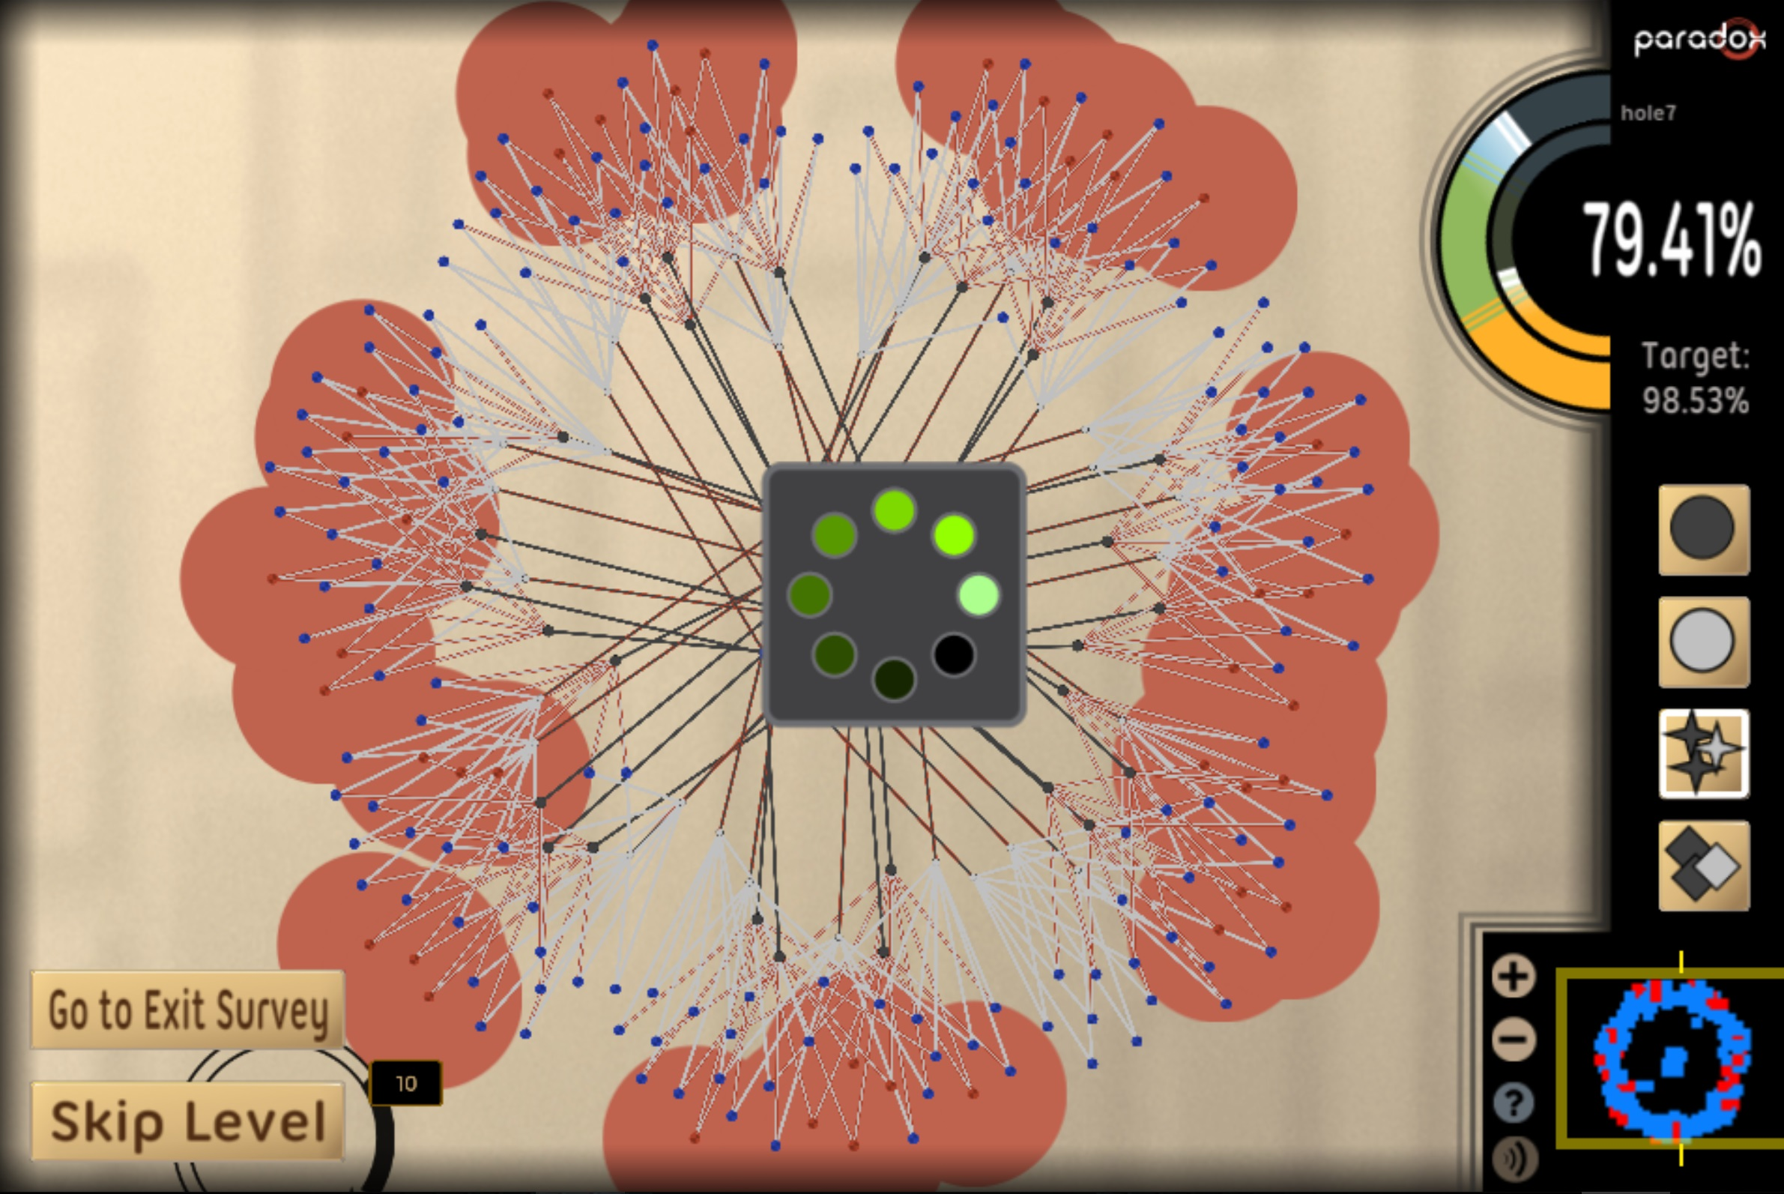
Experiment Two: Recruitment Strategy vs Delay
Does recruitment strategy impact how changes to the game affect participant behavior and experience in HCGs?
Added an artificial loading delay of 20-seconds between levels (Card et al., 1991; Miller, 1968; Sharek and Wiebe, 2014)
Notes:
Previous work has shown that delays of over 10-15 seconds can cause disengagement
Interruptions of 30 seconds have been found to impact crowdsourcing tasks on MTurk

Slide 31
Experiment Two: Recruitment Strategy vs Delay
Does recruitment strategy impact how changes to the game affect participant behavior and experience in HCGs?
Added an artificial loading delay of 20-seconds between levels
2x2 between-subjects design with four conditions
RECRUITMENT
BANNER

Slide 32
Experiment Two: Recruitment Strategy vs Delay
Does recruitment strategy impact how changes to the game affect participant behavior and experience in HCGs?
Added an artificial loading delay of 20-seconds between levels
2x2 between-subjects design with four conditions
RECRUITMENT
BANNER
MTURK-LG
Notes:
picked MTURK-LG since it was the most different from banner in exp 1

Slide 33
Experiment Two: Recruitment Strategy vs Delay
Does recruitment strategy impact how changes to the game affect participant behavior and experience in HCGs?
Added an artificial loading delay of 20-seconds between levels
2x2 between-subjects design with four conditions
RECRUITMENT
BANNER
MTURK-LG
DESIGN
DELAY

Slide 34
Experiment Two: Recruitment Strategy vs Delay
Does recruitment strategy impact how changes to the game affect participant behavior and experience in HCGs?
Added an artificial loading delay of 20-seconds between levels
2x2 between-subjects design with four conditions
RECRUITMENT
BANNER
MTURK-LG
DESIGN
DELAY
NO-DELAY

Slide 35
Experiment Two: Recruitment Strategy vs Delay
Does recruitment strategy impact how changes to the game affect participant behavior and experience in HCGs?
Added an artificial loading delay of 20-seconds between levels
2x2 between-subjects design with four conditions
RECRUITMENT
BANNER
MTURK-LG
DESIGN
DELAY
NO-DELAY
260 players were recruited through the banner
300 players were recruited through MTurk with 244 (81.3%) proceeding to play the game

Slide 36
Experiment Two Results
Variable | BANNER | MTURK-LG | DELAY | NO-DELAY
Play Time | 119s | 206.5s | 129s | 162s
Levels Attempted | 3 | 4 | 2 | 4
Levels Completed | 3 | 4 | 2 | 4
Player Rating | 1657 | 1627 | 1636 | 1646
Effort/Importance | 57% | 71% | 66% | 71%
Statistical Test: Aligned Rank Transform (ART)
No interaction effects for any response variable
No significant differences across conditions for Highest Level Rating, Interest/Enjoyment, Perceived Competence and Perceived Choice
Notes:
No interaction effects between recruitment strategy and delay for any response variable
i.e. different recruitment strategies didn’t impact effects of adding the delay

Slide 37
Experiment Two Results
Variable | BANNER | MTURK-LG | DELAY | NO-DELAY
Play Time | 119s | 206.5s | 129s | 162s
Levels Attempted | 3 | 4 | 2 | 4
Levels Completed | 3 | 4 | 2 | 4
Player Rating | 1657 | 1627 | 1636 | 1646
Effort/Importance | 57% | 71% | 66% | 71%
Statistical Test: Aligned Rank Transform (ART)
Main effect of recruitment and delay
Notes:
Main effect of both recruitment and delay was significant on Play Time, Levels Attempted and Levels Completed

Slide 38
Experiment Two Results
Variable | BANNER | MTURK-LG | DELAY | NO-DELAY
Play Time | 119s | 206.5s | 129s | 162s
Levels Attempted | 3 | 4 | 2 | 4
Levels Completed | 3 | 4 | 2 | 4
Player Rating | 1657 | 1627 | 1636 | 1646
Effort/Importance | 57% | 71% | 66% | 71%
Statistical Test: Aligned Rank Transform (ART)
Main effect of only recruitment
Notes:
Main effect of only recruitment strategy was significant on Player Rating and Effort/Importance
Reinforced findings of exp1
Can consider main effect of recruitment in exp2 as similar to difference between BANNER and MTURK-LG in exp1
In general, as in exp1, found in exp2 that paid recruitment is better for Levels Attempted, Effort/Imp and volunteer is better for Player Rating

Slide 39
Experiment Two Discussion
Different recruitment strategies did not observably impact the effects of changing the game’s design

Slide 40
Experiment Two Discussion
Different recruitment strategies did not observably impact the effects of changing the game’s design
As in experiment one, a measure of task volume was higher for paid recruitment and a measure of task quality was higher for volunteer recruitment

Slide 41
Conclusion
Paid player recruitment results in a higher volume of tasks being completed

Slide 42
Conclusion
Paid player recruitment results in a higher volume of tasks being completed
Volunteer player recruitment results in a higher quality of completed tasks

Slide 43
Conclusion
Paid player recruitment results in a higher volume of tasks being completed
Volunteer player recruitment results in a higher quality of completed tasks
Effects of recruitment strategies remain consistent with changes to the game’s design

Slide 44
Future Work
Interaction effects of other changes to the game’s design

Slide 45
Future Work
Interaction effects of other changes to the game’s design
Alternate methods of gathering self-reported experience metrics from more players without compromising voluntary nature of participation

Slide 46
Contact
Anurag Sarkar Northeastern University sarkar.an@husky.neu.edu
Acknowledgments
This material is based upon work supported by the National Science Foundation under grant no. 1652537. We would like to thank the University of Washington's Center for Game Science for initial Paradox development.

