Slide 1
Blending Levels from Different Games using LSTMs
Anurag Sarkar and Seth Cooper
College of Computer and Information Science
Northeastern University
Notes:
In this presentation, I’ll be talking about some work that started out as a project for my ML class where we generated levels that were blends of levels from 2 different games using LSTMs that had been trained on original levels from the games
And in somewhat the spirit of EXAG

Slide 2
Motivation
Recent work on training models on existing levels to generate new levels
Notes:
So what was the motivation behind this
There has been a lot of recent work in applying ML techniques to generate content using trained models and just as 2 example most related to this work

Slide 3
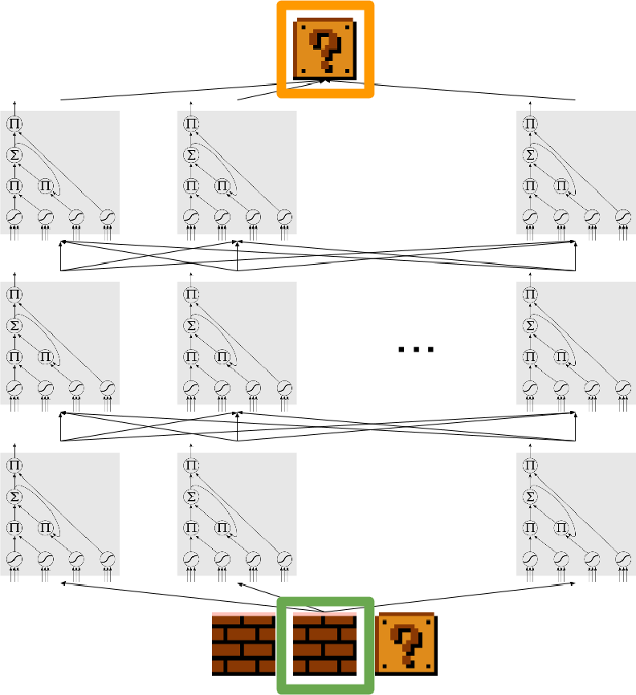
Motivation
Recent work on training models on existing levels to generate new levels
Sequence Prediction using LSTMs
Summerville and Mateas, 2016
Notes:
There’s work that Summerville and Mateas did where they generated Mario levels by sequence prediction using LSTMs

Slide 4
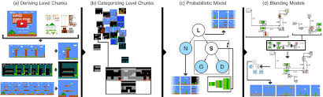
Motivation
Recent work on training models on existing levels to generate new levels
Sequence Prediction using LSTMs
Conceptual blending
Summerville and Mateas, 2016
Guzdial and Riedl, 2016
Notes:
And work by Guzdial and Riedl where they used the notion of conceptual blending with graphical models to blend together Mario levels

Slide 5
Motivation
Recent work on training models on existing levels to generate new levels
Sequence Prediction using LSTMs
Conceptual blending
Gow and Corneli proposed generating new games by blending entire games
Notes:
Relatedly, Gow and Corneli proposed a framework for generating new games by blending not just levels but entire games together

Slide 6
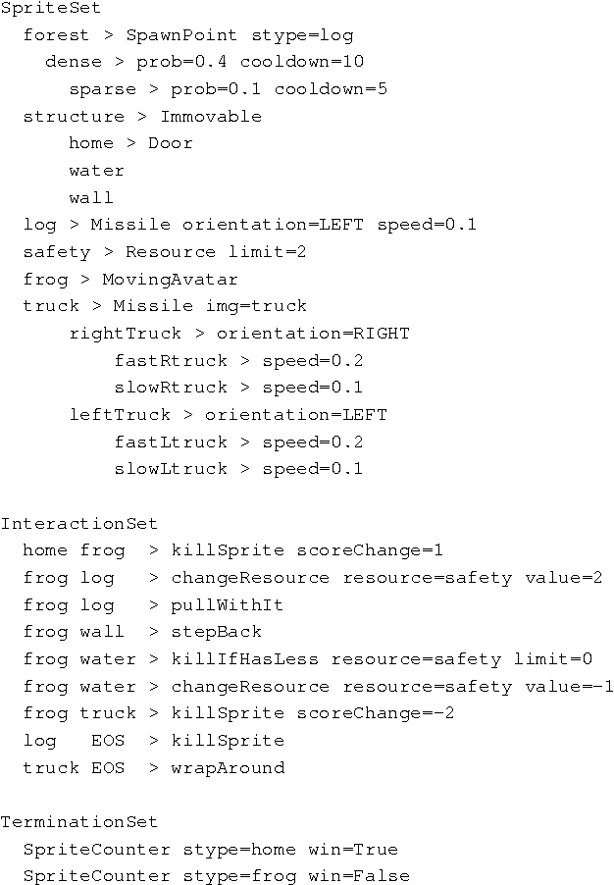
Motivation
Recent work on training models on existing levels to generate new levels
Sequence Prediction using LSTMs
Conceptual blending
Gow and Corneli proposed generating new games by blending entire games
VGDL Frogger
Notes:
So what they did was take the VGDL specification for Frogger

Slide 7
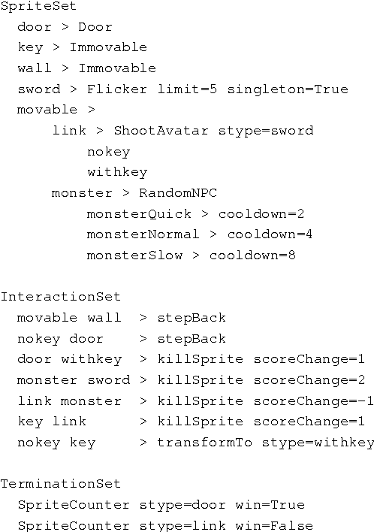
Motivation
Recent work on training models on existing levels to generate new levels
Sequence Prediction using LSTMs
Conceptual blending
Gow and Corneli proposed generating new games by blending entire games
VGDL Frogger
VGDL Zelda
Notes:
VGDL specification for Zelda
Manually combined the two to come up with

Slide 8
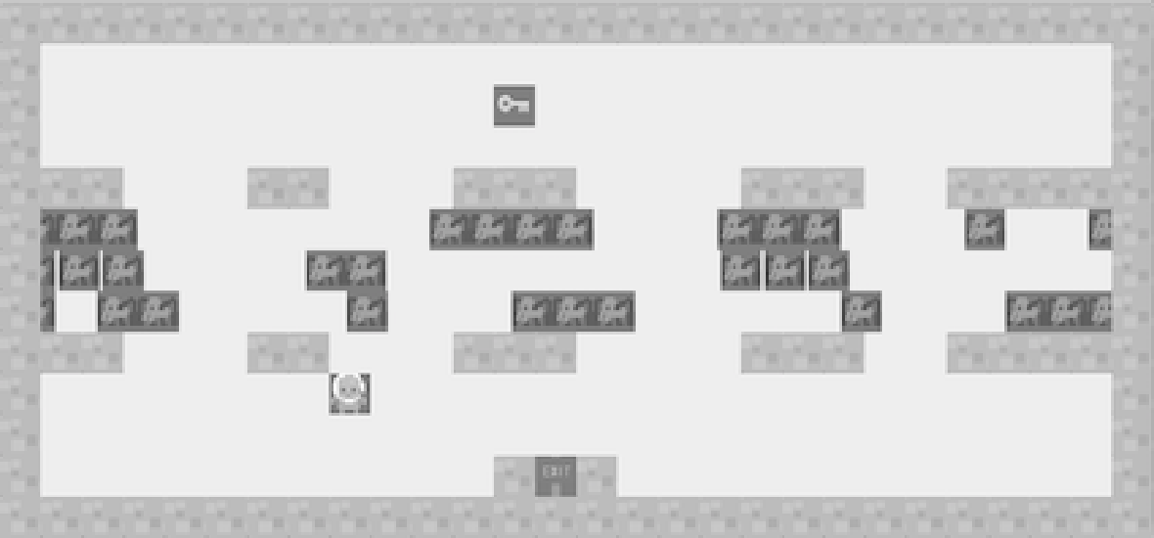
Motivation
Recent work on training models on existing levels to generate new levels
Sequence Prediction using LSTMs
Conceptual blending
Gow and Corneli proposed generating new games by blending entire games
VGDL Frogger
VGDL Zelda
Frolda
Notes:
Frolda!
[describe]
But this was all done manually

Slide 9
Motivation
Recent work on training models on existing levels to generate new levels
Sequence Prediction using LSTMs
Conceptual blending
Gow and Corneli proposed generating new games by blending entire games
IDEA: PCGML techniques + Game Blending
VGDL Frogger
VGDL Zelda
Frolda
Notes:
So our idea was basically could we leverage PCGML techniques in order to perform this kind of game blending
So that instead of manually constructing this kind of a blended game we could use trained models that contain information about actual levels from the games

Slide 10
Overview
Train LSTMs on existing levels of Super Mario Bros. and Kid Icarus
Notes:
So as a basic overview of the process, we trained LSTMs on existing levels of SMB and KI

Slide 11
Overview
Train LSTMs on existing levels of Super Mario Bros. and Kid Icarus
Sample from the trained models to generate new levels that contain properties of levels from both games
Notes:
Sample from the trained models to generate new levels that encode properties of levels from both games
We thus create a level generator that can produce levels for a third game whose levels contain properties of levels from the 2 games used for training.

Slide 12
Overview
Train LSTMs on existing levels of Super Mario Bros. and Kid Icarus
Sample from the trained models to generate new levels that contain properties of levels from both games
Used weights to control approximate amount of each game
Notes:
We also implement a weighted version of the generator that allows a designer to control the approx. amount of each original game desired in the final blended levels
Worth mentioning that in the interest of time, I will describe things at a super high level

Slide 13
Dataset
Video Game Level Corpus (VGLC)
Super Mario Bros. (15)
Kid Icarus (6)
Notes:
We trained on levels from SMB and KI taken from the VGLC. Both are 2D platformers with SMB levels going from L to R while KI going from D to U
Thus both are platformers with similar features which make them suitable for blending but also have different orientations which may result in interesting blends

Slide 14
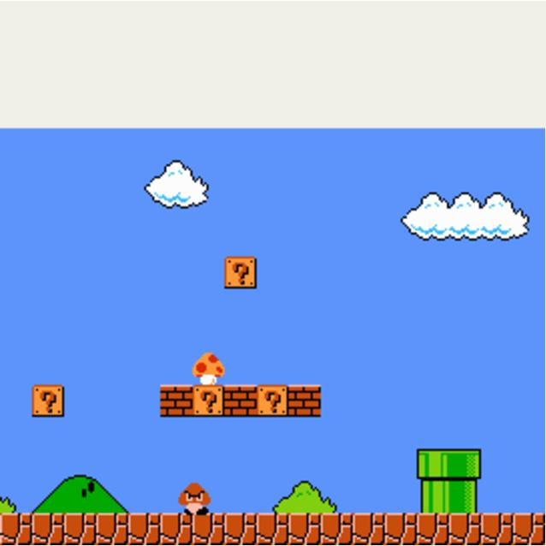
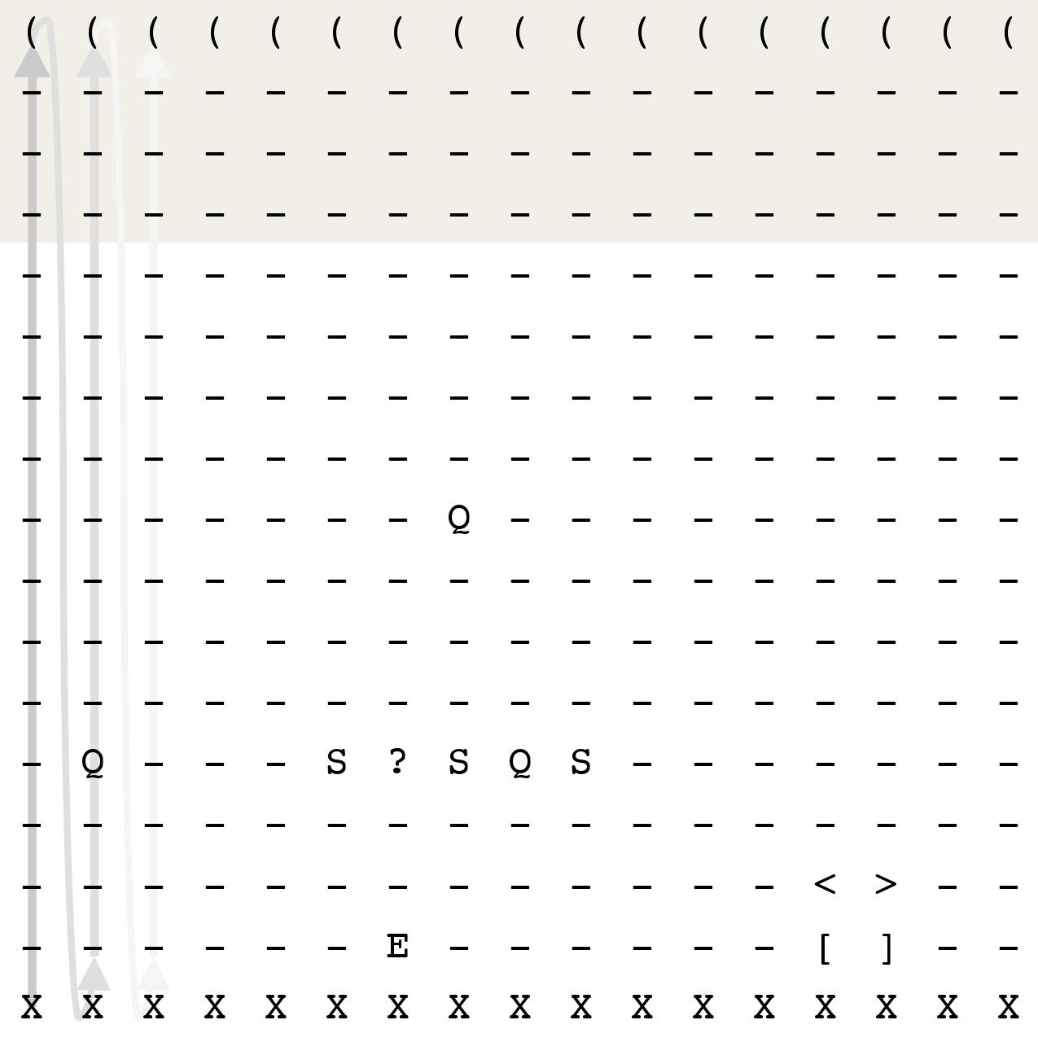
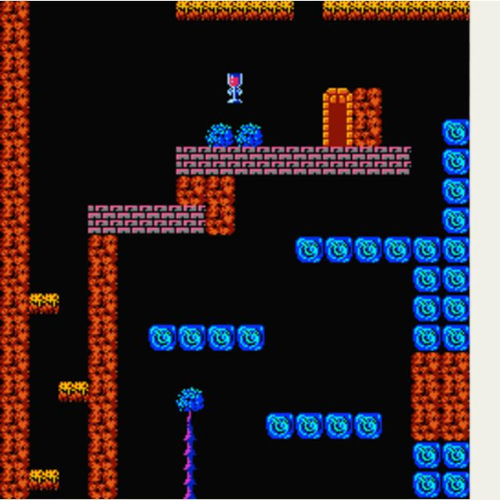
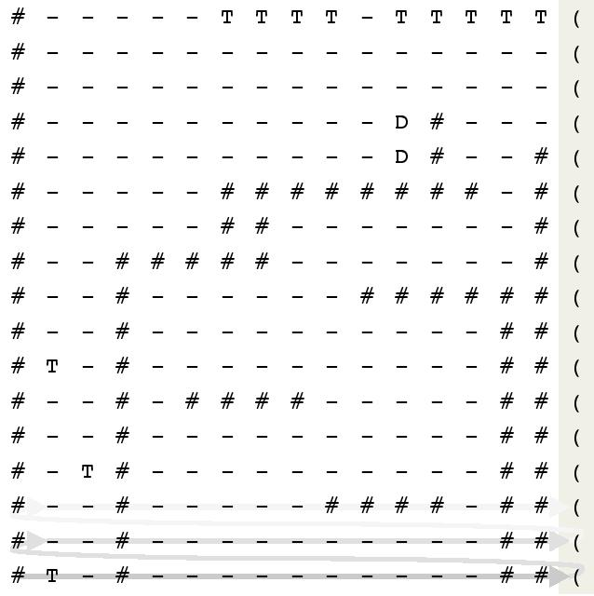
Dataset
Video Game Level Corpus (VGLC)
Super Mario Bros. (15)
Kid Icarus (6)
Levels are represented as text files with each character mapping to a specific tile
SMB Level 1-1
KI Level 1
Notes:
Mario and Icarus levels in the VGLC are represented as text files

Slide 15
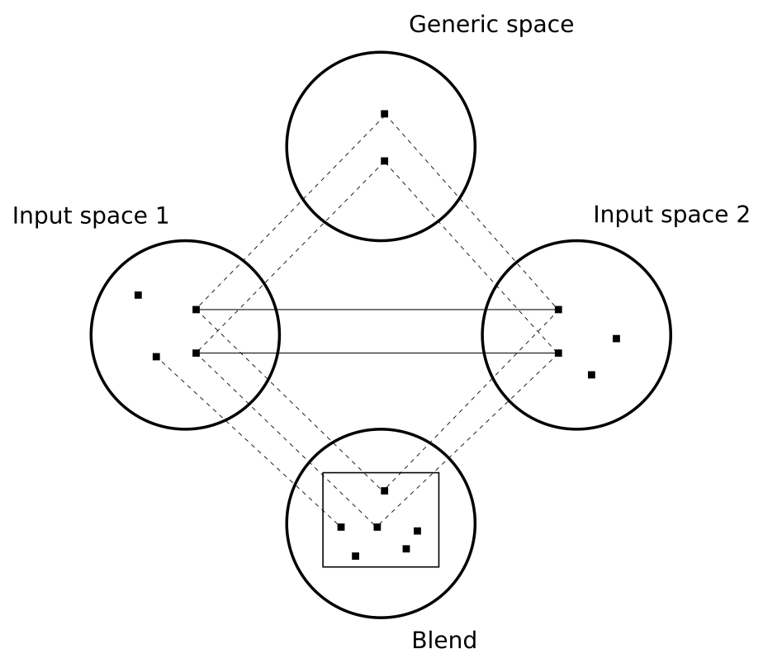
Blending
Conceptual blending
Two input spaces
A generic space
A blend space
Notes:
Conceptual blending states that novel concepts can be produced by combining elements of existing concepts – four space theory
2 input spaces – constituting concepts prior to being combined
Generic space – into which input concepts are projected to find equivalence points
Blend space –equivalent points from the generic space are projected and new concepts are evolved

Slide 16
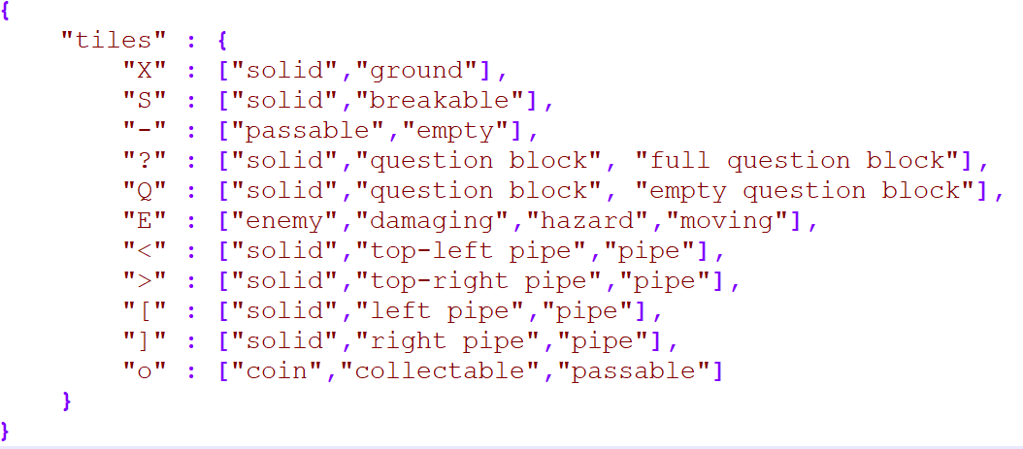
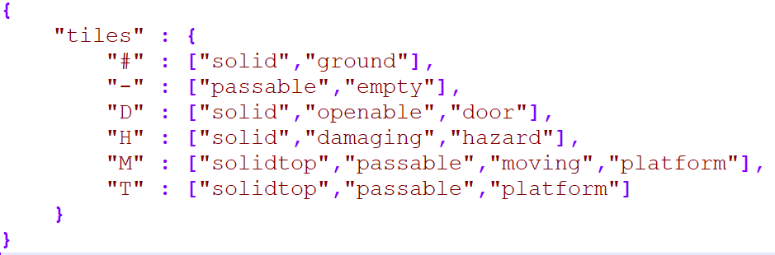
Blending
Conceptual blending
Two input spaces
A generic space
A blend space
Input spaces were VGLC SMB and KI corpora
SMB Mapping
KI Mapping

Slide 17
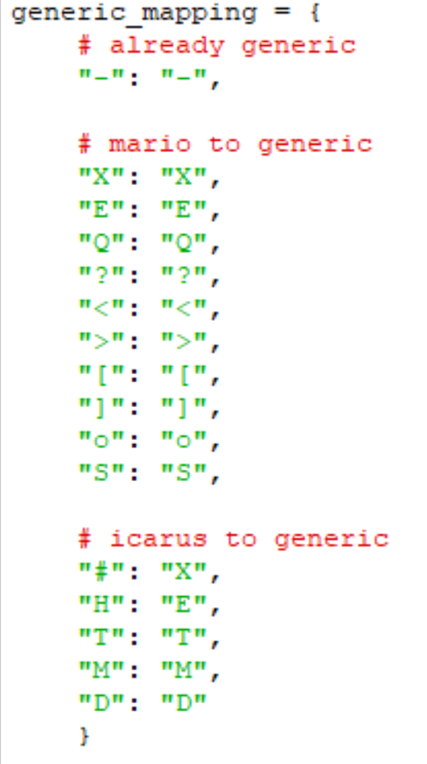
Blending
Conceptual blending
Two input spaces
A generic space
A blend space
Input spaces were VGLC SMB and KI corpora
For generic space, mapped semantically common elements to a uniform representation and preserved unique elements
Generic Mapping

Slide 18
Blending
Conceptual blending
Two input spaces
A generic space
A blend space
Input spaces were VGLC SMB and KI corpora
For generic space, mapped semantically common elements to a uniform representation and preserved unique elements
Common elements were solid ground, enemy/hazard and the background character
Generic Mapping

Slide 19
Training on Level Data
Used Long Short Term Memory networks (LSTMs) for training
Notes:
Used LSTMs for training

Slide 20
Training on Level Data
Used Long Short Term Memory networks (LSTMs) for training
Predicts next item in a sequence given the
sequence thus far using learned probability distribution
Summerville and Mateas, 2016
Notes:
And so the way these networks work is during training they learn a probability distribution for the next item in a sequence given the sequence so far and then during generation use this learned prob dist to predict the next character in the sequence

Slide 21
Training on Level Data
Used Long Short Term Memory networks (LSTMs) for training
Predicts next item in a sequence given the
sequence thus far using learned probability distribution
Past success in generating SMB levels
Summerville and Mateas, 2016
Notes:
Past success in generating SMB levels and there was a lot of freely available code

Slide 22
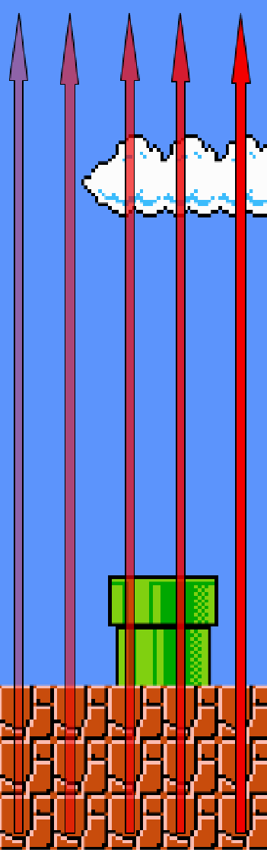
Training on Level Data
Each level is a collection of sequences and each tile is a point in a sequence
Summerville and Mateas, 2016
Notes:
Each level is treated as a collection of sequences with each individual tile being a point in a sequence. Concretely a level is a 2D array of chars with each tile being a char in the array

Slide 23
Training on Level Data
Each level is a collection of sequences and each tile is a point in a sequence
SMB → feed in sequences of columns from left to right KI → feed in sequences of rows from bottom to top
Summerville and Mateas, 2016
Notes:
For SMB, we feed in sequences of cols from left to right since levels progress horizontally and for LSTM to learn the patterns, we need to induce the appropriate ordering for the sequences. Similarly, KI levels were fed in sequences of rows from bottom to top

Slide 24
Training on Level Data
Each level is a collection of sequences and each tile is a point in a sequence
SMB → feed in sequences of columns from left to right KI → feed in sequences of rows from bottom to top
LSTM was trained on sequences of 16 characters
Summerville and Mateas, 2016
Notes:
For uniformity, SMB levels were padded with empty space on top to have columns of height 16 to match KI rows which were of width 16. Thus the LSTM was trained on sequences of 16 characters, irrespective of the game. To tell the LSTM when 1 row/col ends and the next begins, we added a delimiter ‘(‘ after every row/col so the LSTM learns via training to generate this char after every 16 chars so that generated levels can be laid out properly

Slide 25
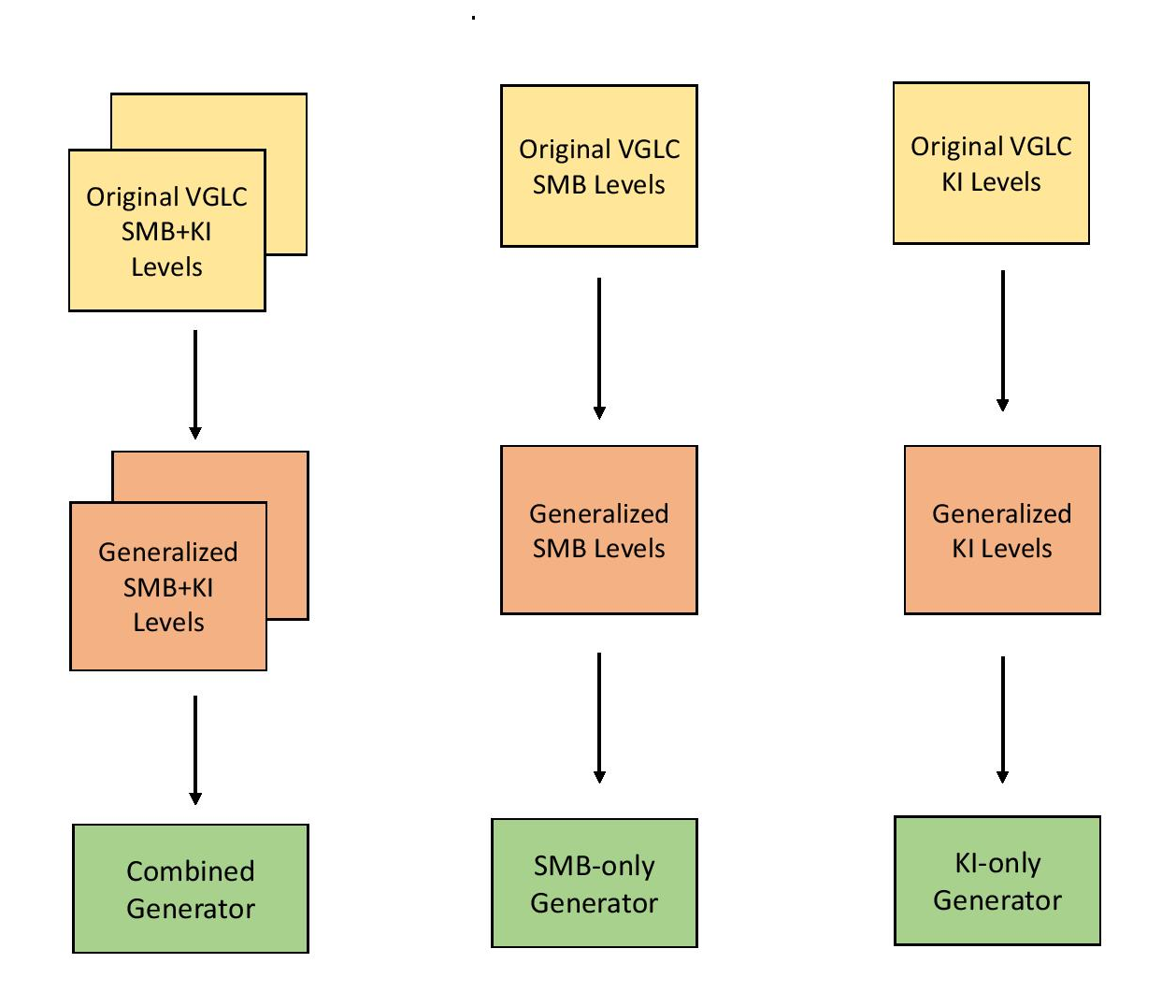
Models
Notes:
We trained 3 different LSTMs
A combined dataset of SMB+KI levels
Only SMB levels
Only KI levels

Slide 26
Models
Notes:
We trained 3 different models
A combined dataset of SMB+KI levels
Only SMB levels
Only KI levels

Slide 27
Models
Notes:
We trained 3 different models
A combined dataset of SMB+KI levels
Only SMB levels
Only KI levels

Slide 28
Models
Notes:
We trained 3 different models
A combined dataset of SMB+KI levels
Only SMB levels
Only KI levels

Slide 29
Models
Should a generated sequence be laid out like an SMB column or a KI row?
Notes:
Since SMB and KI levels differ in orientation, an issue in generating levels was determining how to layout generated sequences i.e. should a generated 16-character sequence be laid out like an SMB col or a KI row?

Slide 30
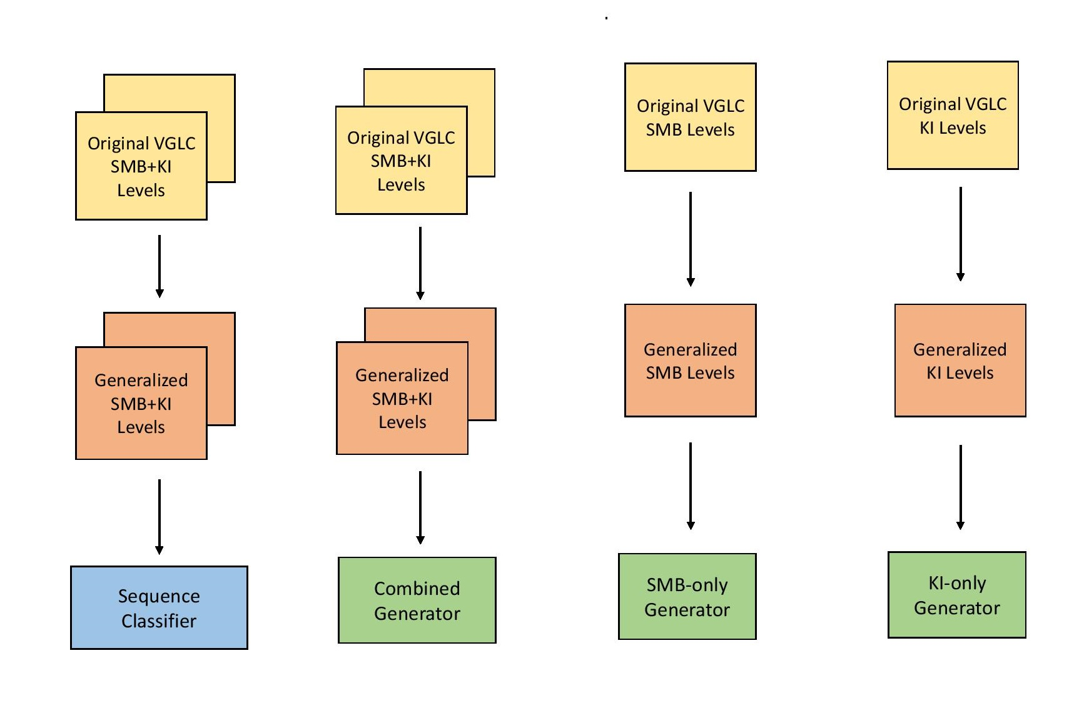
Models
Notes:
Thus, trained a classifier on the training corpus and then used it determine if a generated sequence was more SMB-like or KI-like
Sequential model consisting of 1 hidden layer and 256 neurons in the input and hidden layers, 1 neuron in output layer, dropout rate of 50%, used the Relu on first 2 layers and as igmoid on the output layer alog with the rmsprop optimizer and a learning rate of 0.0005

Slide 31
Level Generation
Forward an initial level seed through the LSTM which repeatedly predicts next most likely character given previous characters in the string until full level is generated
Notes:
Involves forwarding an initial level seed through the trained models repeatedly until the desired amount of output is generated. Starting seed is the initial substring of a level string. Trained LSTM repeatedly predicts next most likely character given previous characters in the string until enough chars have been predicted to form a level of desired size

Slide 32
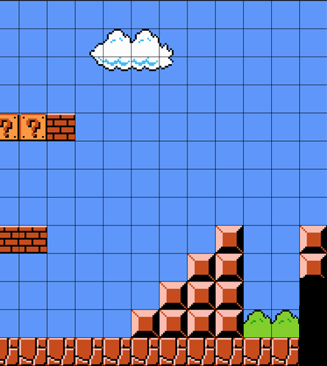
Level Generation
Forward an initial level seed through the LSTM which repeatedly predicts next most likely character given previous characters in the string until full level is generated

Slide 33
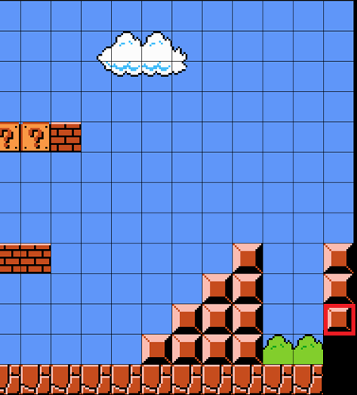
Level Generation
Forward an initial level seed through the LSTM which repeatedly predicts next most likely character given previous characters in the string until full level is generated
Notes:
Involves forwarding an initial level seed through the trained models repeatedly until the desired amount of output is generated. Starting seed is the initial substring of a level string. Trained LSTM repeatedly predicts next most likely character given previous characters in the string until enough chars have been predicted to form a level of desired size

Slide 34
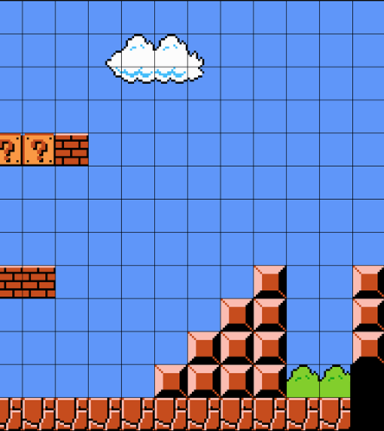
Level Generation
Forward an initial level seed through the LSTM which repeatedly predicts next most likely character given previous characters in the string until full level is generated
Notes:
Involves forwarding an initial level seed through the trained models repeatedly until the desired amount of output is generated. Starting seed is the initial substring of a level string. Trained LSTM repeatedly predicts next most likely character given previous characters in the string until enough chars have been predicted to form a level of desired size

Slide 35
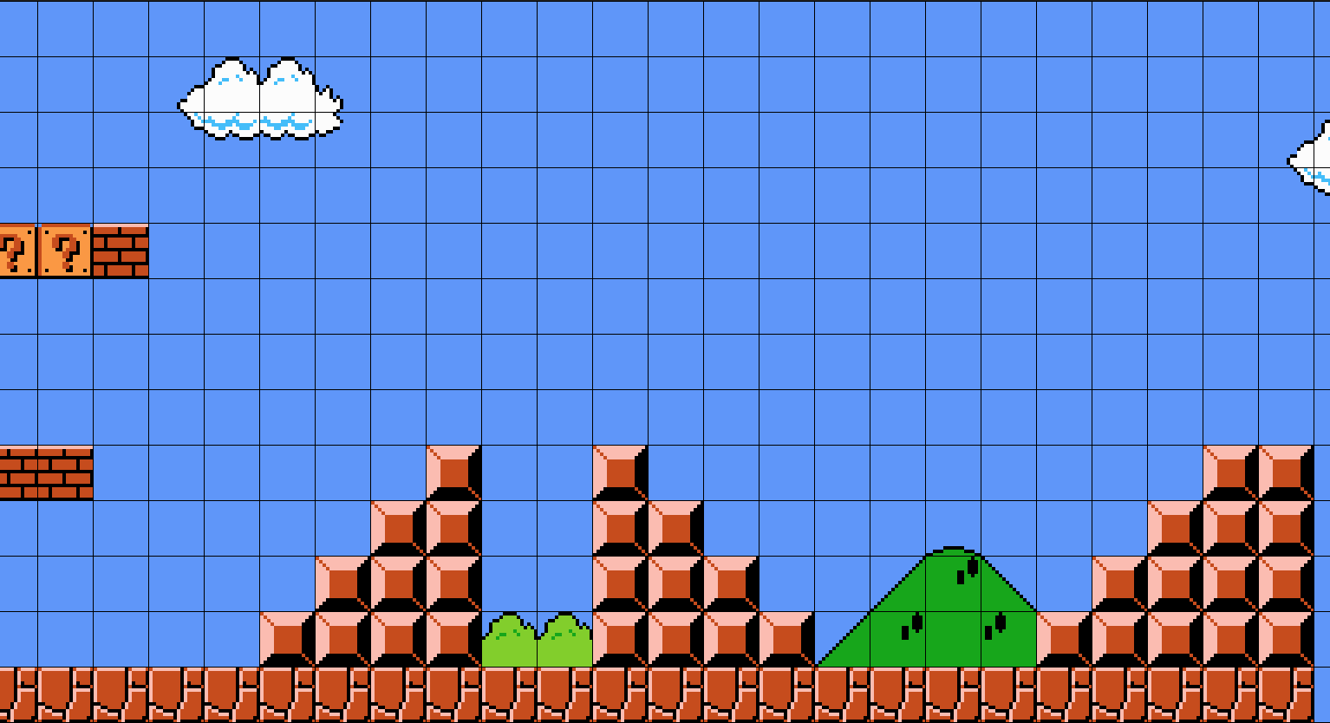
Level Generation
Forward an initial level seed through the LSTM which repeatedly predicts next most likely character given previous characters in the string until full level is generated
Credit: Adam Geitgey, Medium
Notes:
Involves forwarding an initial level seed through the trained models repeatedly until the desired amount of output is generated. Startig seed is the initial substring of a level string. Trained LSTM repeatedly predicts next most likely character given previous characters in the string until enough chars have been predicted to form a level of desired size

Slide 36
Level Generation
Three generators
Notes:
Using the models, we defined 3 different level generators

Slide 37
Level Generation
Three generators
Unweighted generator UW that used model trained on combined dataset
Notes:
Unweighted generator UW involved sampling from the combined model and using one of 2 starting seeds (SMB or KI)

Slide 38
Level Generation
Three generators
Unweighted generator UW that used model trained on combined dataset
Weighted generator WC that used model trained on combined dataset

Slide 39
Level Generation
Three generators
Unweighted generator UW that used model trained on combined dataset
Weighted generator WC that used model trained on combined dataset
Weighted generator WS that used the models trained separately i.e. consisted of an SMB-only sub generator and a KI-only sub generator
Notes:
Using the models, we defined 3 different level generators

Slide 40
Level Generation
Three generators
Unweighted generator UW that used model trained on combined dataset
Weighted generator WC that used model trained on combined dataset
Weighted generator WS that used the models trained separately i.e. consisted of an SMB-only sub generator and a KI-only sub generator
For UW, generated levels consisting of 200 sequences
Notes:
Using the models, we defined 3 different level generators

Slide 41
Level Generation
Three generators
Unweighted generator UW that used model trained on combined dataset
Weighted generator WC that used model trained on combined dataset
Weighted generator WS that used the models trained separately i.e. consisted of an SMB-only sub generator and a KI-only sub generator
For UW, generated levels consisting of 200 sequences
For both WC and WS, generated levels consisting of 10 segments of 20 sequences each
Notes:
Using the models, we defined 3 different level generators

Slide 42
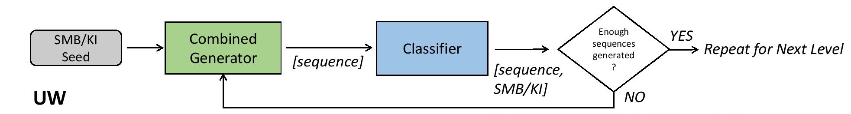
Level Generation
Unweighted Generator
Notes:
For UW, we feed in the starting seed and then iterate until the generator has predicted enough characters to form the entire level with the classifier used to decide which game a generated sequence belongs to

Slide 43
Level Generation
Unweighted Generator
Notes:
For UW, we feed in the starting seed and then iterate until the generator has predicted enough characters to form the entire level with the classifier used to decide which game a generated sequence belongs to

Slide 44
Level Generation
Unweighted Generator
Notes:
For UW, we feed in the starting seed and then iterate until the generator has predicted enough characters to form the entire level with the classifier used to decide which game a generated sequence belongs to

Slide 45
Level Generation
Unweighted Generator
Notes:
For UW, we feed in the starting seed and then iterate until the generator has predicted enough characters to form the entire level with the classifier used to decide which game a generated sequence belongs to

Slide 46
Level Generation
Unweighted Generator
Notes:
For UW, we feed in the starting seed and then iterate until the generator has predicted enough characters to form the entire level with the classifier used to decide which game a generated sequence belongs to

Slide 47
Level Generation
Unweighted Generator
Notes:
For UW, we feed in the starting seed and then iterate until the generator has predicted enough characters to form the entire level with the classifier used to decide which game a generated sequence belongs to

Slide 48
Level Generation
Unweighted Generator
Notes:
For UW, we feed in the starting seed and then iterate until the generator has predicted enough characters to form the entire level with the classifier used to decide which game a generated sequence belongs to

Slide 49
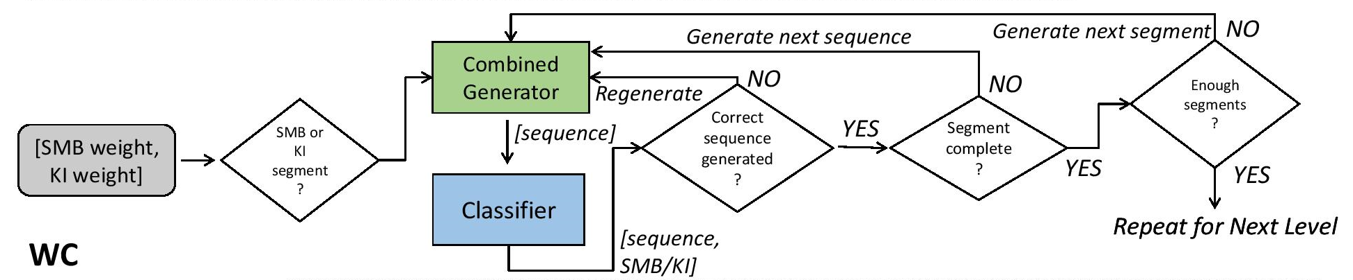
Level Generation
Weighted Generator 1
Notes:
For weighted generators, generation took place in segments, prior to generating each segment we used the weights to determine if segment should be SMB-like or KI-like
For WC, the combined gen was used to create sequences of the predetermined game for that segment until it had been fully created using the classifier to discard any generated sequences that were not for the current segment.

Slide 50
Level Generation
Weighted Generator 1
Notes:
For weighted generators, generation took place in segments, prior to generating each segment we used the weights to determine if segment should be SMB-like or KI-like
For WC, the combined gen was used to create sequences of the predetermined game for that segment until it had been fully created using the classifier to discard any generated sequences that were not for the current segment.

Slide 51
Level Generation
Weighted Generator 1
Notes:
For weighted generators, generation took place in segments, prior to generating each segment we used the weights to determine if segment should be SMB-like or KI-like
For WC, the combined gen was used to create sequences of the predetermined game for that segment until it had been fully created using the classifier to discard any generated sequences that were not for the current segment.

Slide 52
Level Generation
Weighted Generator 1
Notes:
For weighted generators, generation took place in segments, prior to generating each segment we used the weights to determine if segment should be SMB-like or KI-like
For WC, the combined gen was used to create sequences of the predetermined game for that segment until it had been fully created using the classifier to discard any generated sequences that were not for the current segment.

Slide 53
Level Generation
Weighted Generator 1
Notes:
For weighted generators, generation took place in segments, prior to generating each segment we used the weights to determine if segment should be SMB-like or KI-like
For WC, the combined gen was used to create sequences of the predetermined game for that segment until it had been fully created using the classifier to discard any generated sequences that were not for the current segment.

Slide 54
Level Generation
Weighted Generator 1
Notes:
For weighted generators, generation took place in segments, prior to generating each segment we used the weights to determine if segment should be SMB-like or KI-like
For WC, the combined gen was used to create sequences of the predetermined game for that segment until it had been fully created using the classifier to discard any generated sequences that were not for the current segment.

Slide 55
Level Generation
Weighted Generator 1
Notes:
For weighted generators, generation took place in segments, prior to generating each segment we used the weights to determine if segment should be SMB-like or KI-like
For WC, the combined gen was used to create sequences of the predetermined game for that segment until it had been fully created using the classifier to discard any generated sequences that were not for the current segment.

Slide 56
Level Generation
Weighted Generator 1
Notes:
For weighted generators, generation took place in segments, prior to generating each segment we used the weights to determine if segment should be SMB-like or KI-like
For WC, the combined gen was used to create sequences of the predetermined game for that segment until it had been fully created using the classifier to discard any generated sequences that were not for the current segment.

Slide 57
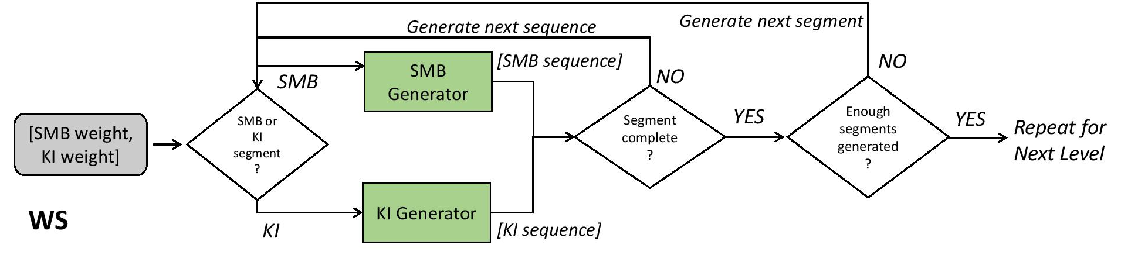
Level Generation
Weighted Generator 2
Notes:
For WS, depending on if the next segment should be SMB-like or KI-like, the appropriate sub-generator was used to generate a fixed-size segment until enough segments had been generated to create the full level

Slide 58
Level Generation
Weighted Generator 2
Notes:
For WS, depending on if the next segment should be SMB-like or KI-like, the appropriate sub-generator was used to generate a fixed-size segment until enough segments had been generated to create the full level

Slide 59
Level Generation
Weighted Generator 2
Notes:
For WS, depending on if the next segment should be SMB-like or KI-like, the appropriate sub-generator was used to generate a fixed-size segment until enough segments had been generated to create the full level

Slide 60
Level Generation
Weighted Generator 2
Notes:
For WS, depending on if the next segment should be SMB-like or KI-like, the appropriate sub-generator was used to generate a fixed-size segment until enough segments had been generated to create the full level

Slide 61
Level Generation
Weighted Generator 2
Notes:
For WS, depending on if the next segment should be SMB-like or KI-like, the appropriate sub-generator was used to generate a fixed-size segment until enough segments had been generated to create the full level

Slide 62
Level Generation
Weighted Generator 2
Notes:
For WS, depending on if the next segment should be SMB-like or KI-like, the appropriate sub-generator was used to generate a fixed-size segment until enough segments had been generated to create the full level

Slide 63
Level Generation
Weighted Generator 2
Notes:
For WS, depending on if the next segment should be SMB-like or KI-like, the appropriate sub-generator was used to generate a fixed-size segment until enough segments had been generated to create the full level

Slide 64
Layout
Generated sequences are laid out using a basic algorithm
Notes:
Once generated, the sequences forming the levels are laid out using a basic algorithm

Slide 65
Layout
Generated sequences are laid out using a basic algorithm
Three cases:
Column after column/Row after row
Row after column
Column after row

Slide 66
Layout
Generated sequences are laid out using a basic algorithm
Three cases:
Column after column/Row after row
Stack one after another
Row after column
Column after row

Slide 67
Layout
Generated sequences are laid out using a basic algorithm
Three cases:
Column after column/Row after row
Row after column
Align row with topmost point of column on which player can stand
Column after row
Notes:
To place a row after a column, we align its y-coord with that of the topmost position in the column on which the player can stand

Slide 68
Layout
Generated sequences are laid out using a basic algorithm
Three cases:
Column after column/Row after row
Row after column
Column after row
Align topmost point of column on which player can stand with the row
Notes:
To place a column after a row, we align the y-coord of the topmost point on which the player can stand in the column with the y-coord of the previous row

Slide 69
Layout
Generated sequences are laid out using a basic algorithm
Three cases:
Column after column/Row after row
Row after column
Column after row
Layout function separate from generation
Notes:
Layout func is separate from the gen and thus many diff layouts are possible, each necessarily impacting playability

Slide 70
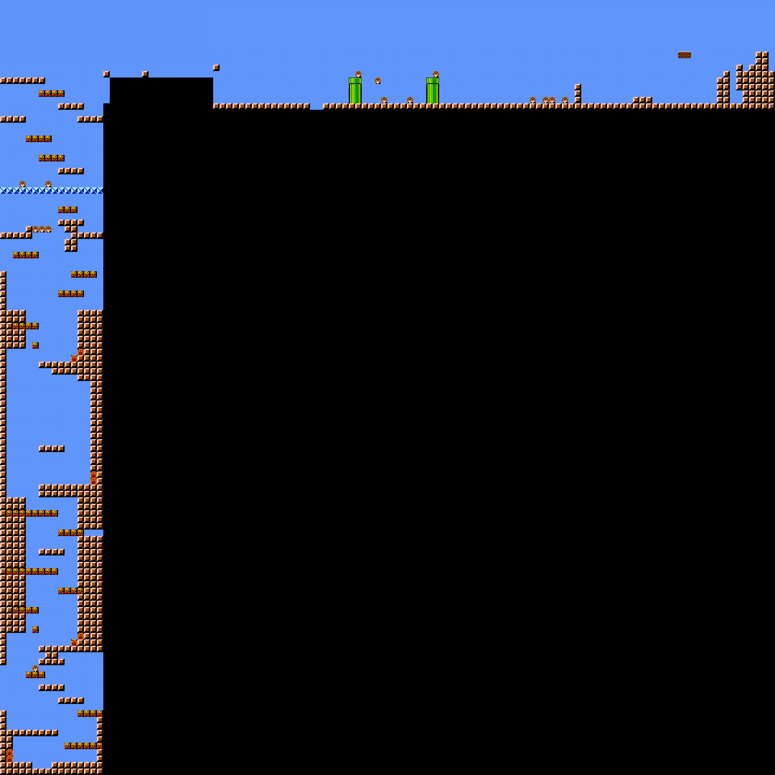
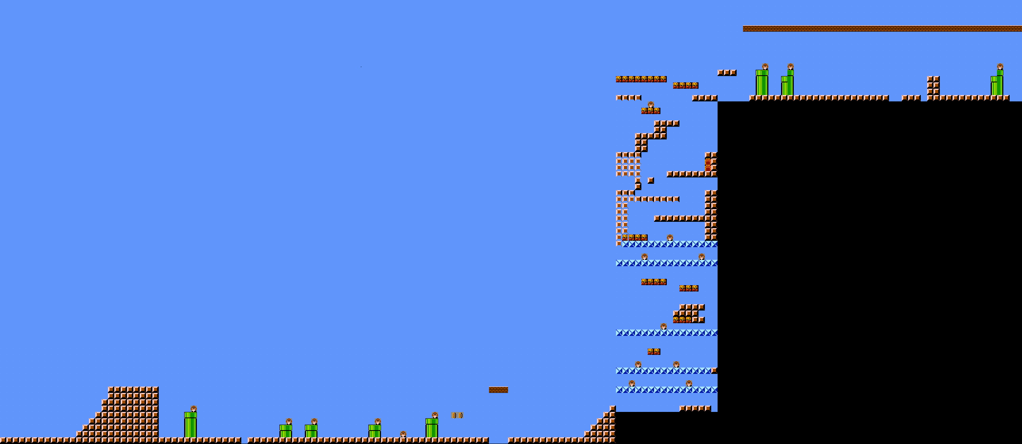
Example Levels
Unweighted Generation

Slide 71
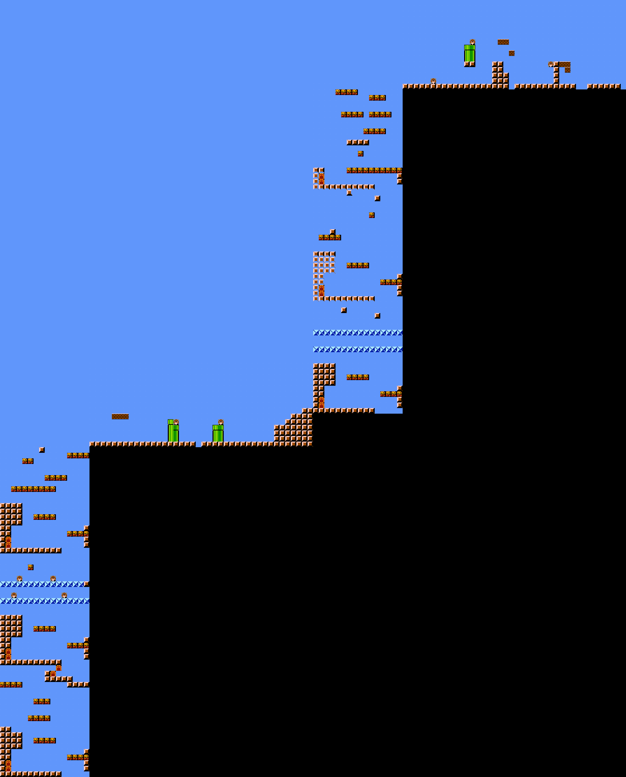
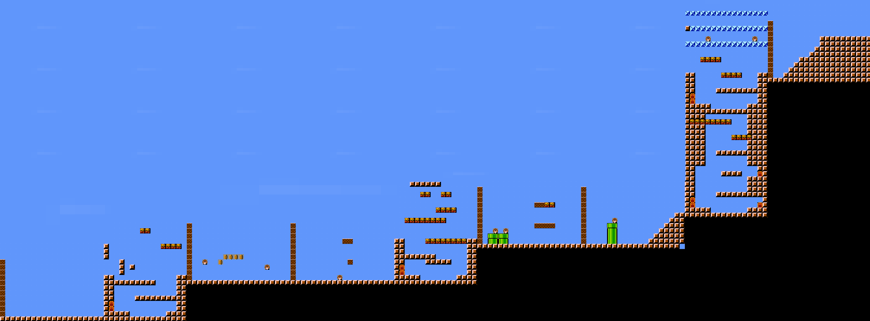
Example Levels
WC
WS
Weighted Generation (0.5, 0.5)

Slide 72
Weighted Generation

Slide 73
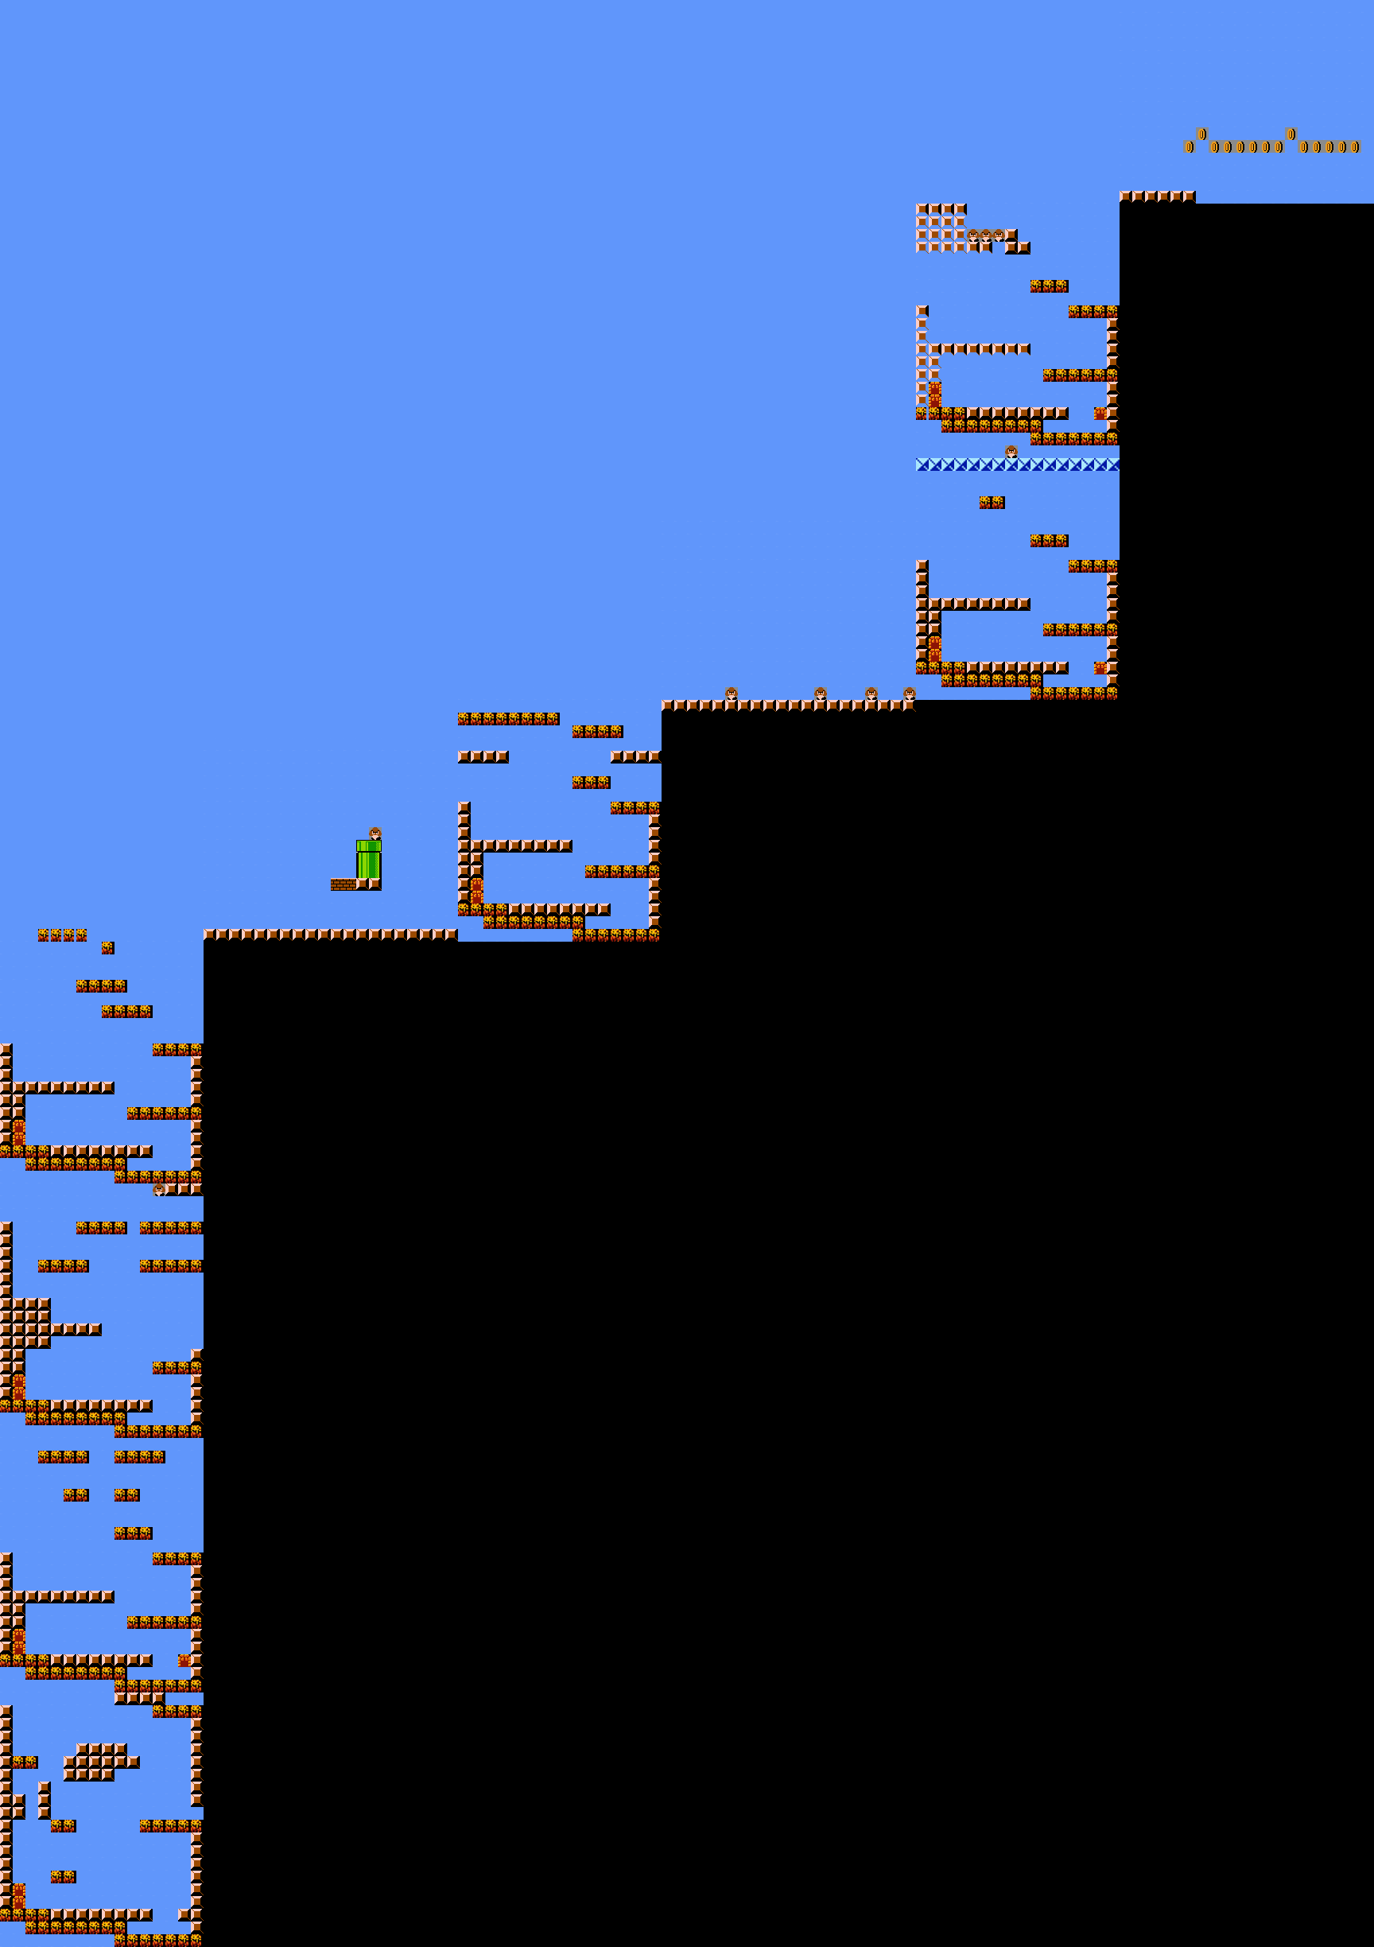
Weighted Generation
(SMB=0.2, KI=0.8)

Slide 74
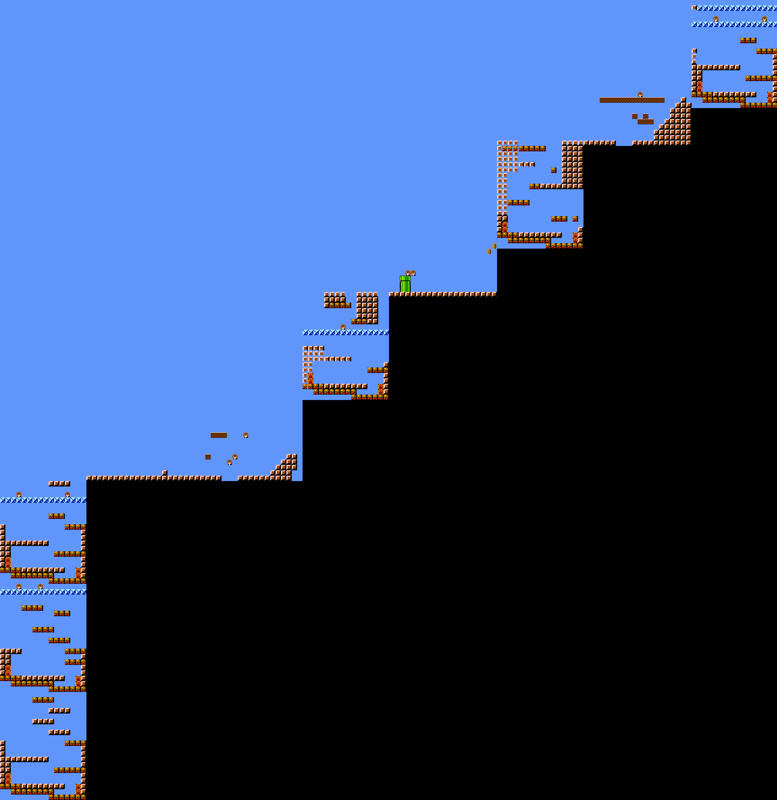
Weighted Generation
(SMB=0.2, KI=0.8)
(SMB=0.4, KI=0.6)

Slide 75
Weighted Generation
(SMB=0.5, KI=0.5)
(SMB=0.2, KI=0.8)
(SMB=0.4, KI=0.6)

Slide 76
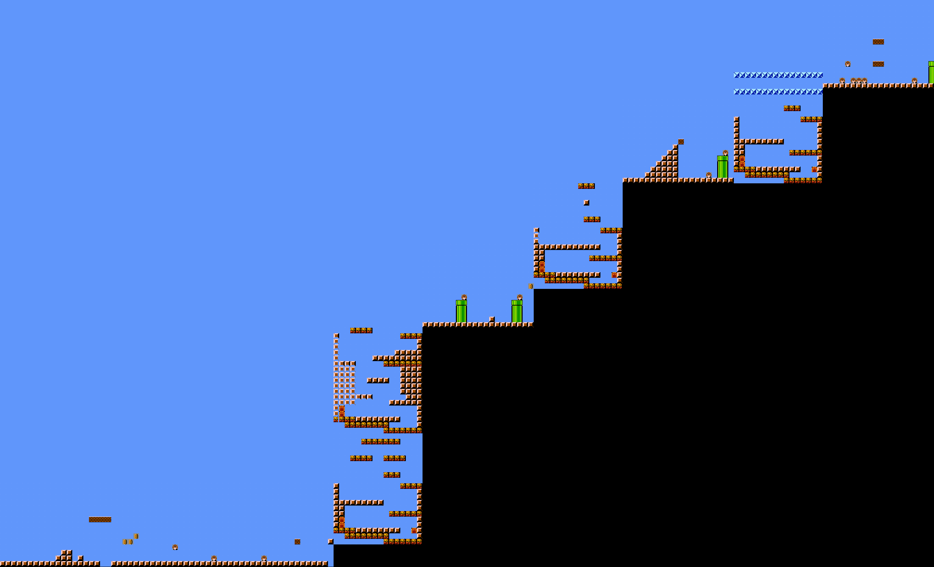
Weighted Generation
(SMB=0.5, KI=0.5)
(SMB=0.6, KI=0.4)
(SMB=0.2, KI=0.8)
(SMB=0.4, KI=0.6)

Slide 77
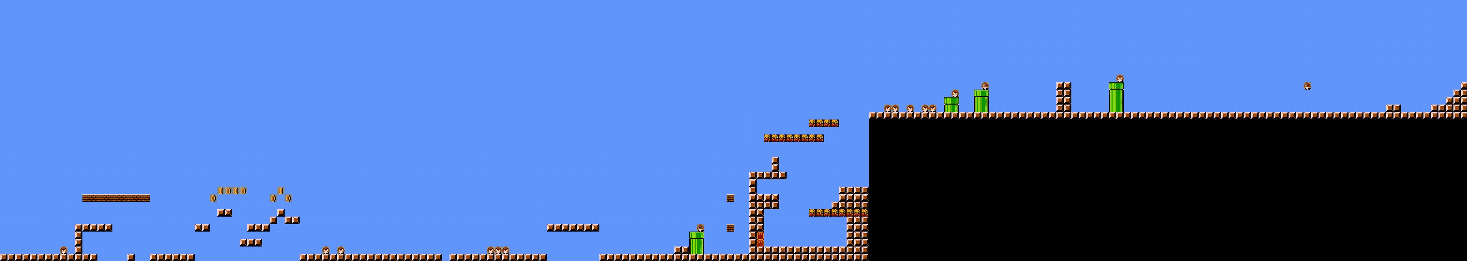
Weighted Generation
(SMB=0.5, KI=0.5)
(SMB=0.6, KI=0.4)
(SMB=0.2, KI=0.8)
(SMB=0.4, KI=0.6)
(SMB=0.8, KI=0.2)

Slide 78
Measures
Notes:
Leniency – captures sense of level difficulty by summing the number of enemy sprites in the level and half the number of empty sequences (i.e. gaps), negating the sum and dividing it by the total number of sequences in the level

Slide 79

Measures
Leniency
$$\frac{−(\# Enemy Sprites+\left(0.5 ∗\# Gaps\right))}{\# Sequences in Level}$$
Notes:
Leniency – captures sense of level difficulty by summing the number of enemy sprites in the level and half the number of empty sequences (i.e. gaps), negating the sum and dividing it by the total number of sequences in the level

Slide 80

Measures
Leniency
Density
$$\frac{−(\# Enemy Sprites+\left(0.5 ∗\# Gaps\right))}{\# Sequences in Level}$$
$$\frac{(\# Ground+\# Platform)}{\# Sequences in Level}$$
Notes:
Density – how much of the level can be occupied by the player; number of ground and platform sprites in the level and divided it by the total number of sequences in the level

Slide 81


Measures
Leniency
Density
$$\frac{−(\# Enemy Sprites+\left(0.5 ∗\# Gaps\right))}{\# Sequences in Level}$$
$$\frac{(\# Ground+\# Platform)}{\# Sequences in Level}$$
Sequence Density
Sequence Variation
$$\frac{\# Sequences in level in training set}{\# Sequences in Level}$$
$$\frac{\# Unique Sequences in level in training set}{\# Sequences in Level}$$
Notes:
SD/SV – relate to how different the generated levels are from the training set.
SD counts the number of sequences in a level that also exist in the training set and then divides it by the total number of sequences in the level
SV is similar but counts each occurrence of a training sequence in a generated level
AR – number of rows (height) in a level by the number of cols (width)

Slide 82

Measures
Leniency
Density
$$\frac{−(\# Enemy Sprites+\left(0.5 ∗\# Gaps\right))}{\# Sequences in Level}$$
$$\frac{(\# Ground+\# Platform)}{\# Sequences in Level}$$
Sequence Density
Sequence Variation
$$\frac{\# Sequences in level in training set}{\# Sequences in Level}$$
$$\frac{\# Unique Sequences in level in training set}{\# Sequences in Level}$$
Aspect Ratio
$$\frac{\# Rows in Level}{\# Columns in Level}$$
Notes:
AR – number of rows (height) in a level by the number of cols (width)

Slide 83
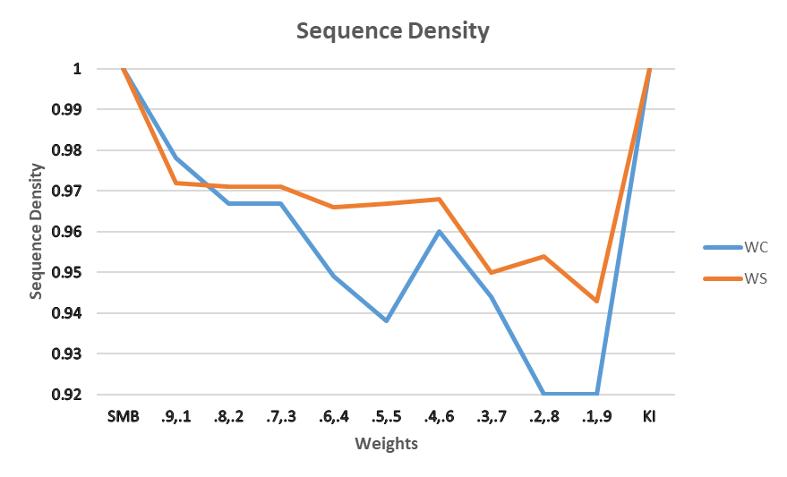
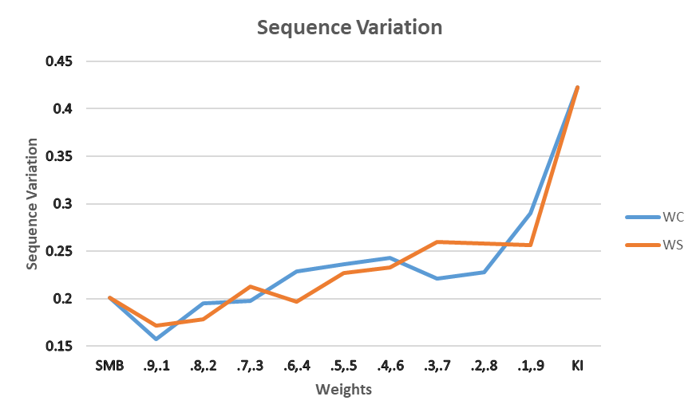
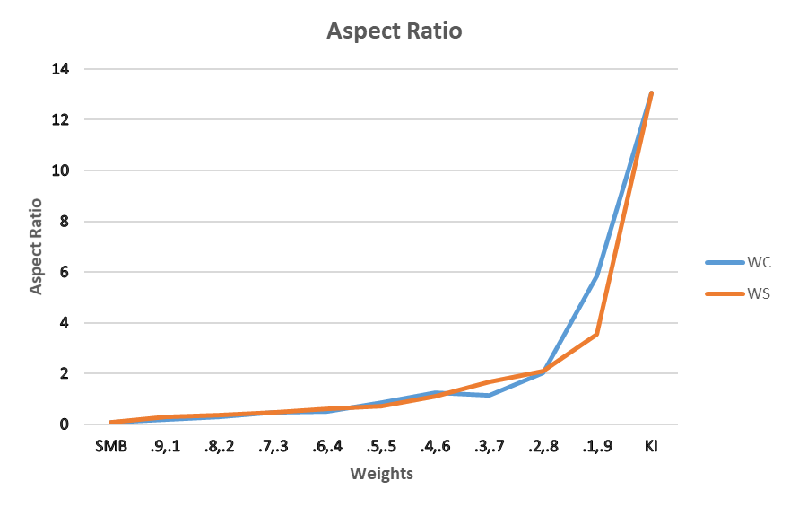
Results
Sequence Density
Sequence Variation
Aspect Ratio
Notes:
For both Aspect Ratio and Sequence Variation, as we move from (high SMB, low KI) to (low SMB, high KI), values move from being closer to SMB corpus to being closer to KI corpus as expected
Sequence Density decreases slightly as the value of KI is increased in the blend
Comparing WC and WS, WS adheres more closely to the range of values between those of SMB and KI while WC generates more novel sequences as evidenced by the lower values of Sequence Density

Slide 84
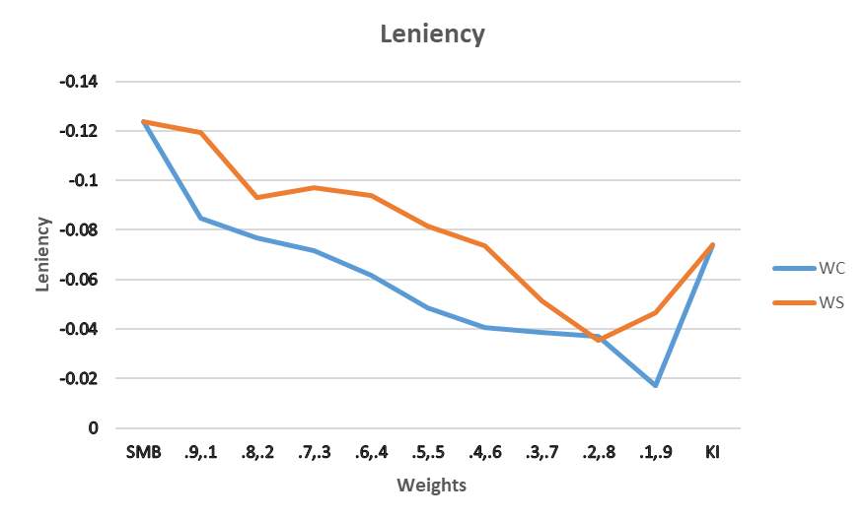
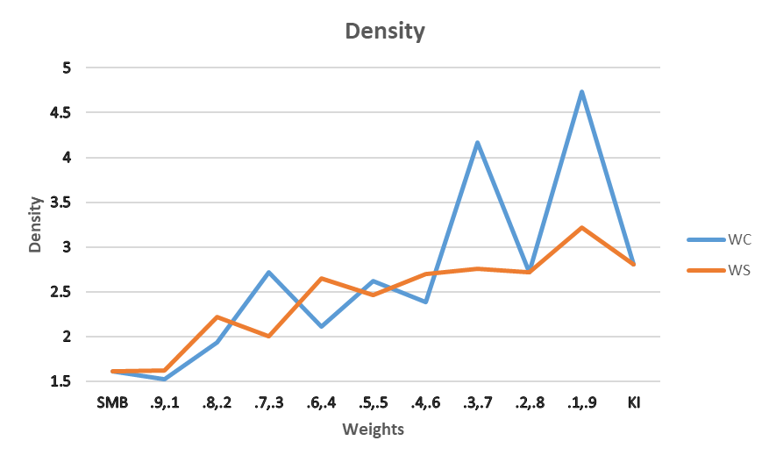
Results
Leniency
Density
Notes:
Mostly true for Leniency and Density though interestingly, values follow the same trend but blends with higher amount of KI seem to have higher values than the KI corpus itself

Slide 85
Discussion
Altering weights impacted the type of levels generated and roughly interpolated between SMB and KI
Notes:
Altering weights does impact the type of levels generated and allows the designer to roughly interpolate between SMB and KI

Slide 86
Discussion
Altering weights impacted the type of levels generated and roughly interpolated between SMB and KI
Possible to generate levels that are a mix of levels from 2 games but can also be made to be more like one than the other
Notes:
Overall, results suggest that by using this methodology, it is possible to generate levels that are a mix of levels from 2 games but can also be made to be more like one than the other

Slide 87
Discussion
Altering weights impacted the type of levels generated and roughly interpolated between SMB and KI
Possible to generate levels that are a mix of levels from 2 games but can also be made to be more like one than the other
Deviations suggest that these methods can also produce some novelty
Notes:
Deviations highlighted suggest that in addition to emulating training data and capturing its inherent properties, these methods can also produce novelty as evidenced by some blended levels having properties outside of the xpected range within the 2 input games

Slide 88
Future Work

Slide 89
Future Work
No playability tests were run nor playability/path-based information used in training, thus levels are currently not completable; using an agent to carve-out a path post-generation or encoding path info into training corpus could help

Slide 90
Future Work
No playability tests were run nor playability/path-based information used in training, thus levels are currently not completable; using an agent to carve-out a path post-generation or encoding path info into training corpus could help
Blended levels necessitate blended mechanics to be fully playable

Slide 91
Future Work
No playability tests were run nor playability/path-based information used in training, thus levels are currently not completable; using an agent to carve-out a path post-generation or encoding path info into training corpus could help
Blended levels necessitate blended mechanics to be fully playable
Other techniques such as evolutionary algorithms to evolve game mechanics

Slide 92
Contact
Anurag Sarkar Northeastern University sarkar.an@husky.neu.edu

