Slide 1
Controllable Level Blending between Games using Variational Autoencoders
Anurag Sarkar¹, Zhihan Yang² and Seth Cooper¹
¹Northeastern University
²Carleton College

Slide 2
(Towards) Controllable Level Blending between Games using Variational Autoencoders
Anurag Sarkar¹, Zhihan Yang² and Seth Cooper¹
¹Northeastern University
²Carleton College

Slide 3


(Towards) Controllable Level Blending between Games using Variational Autoencoders
Still no playability!
Promising results and future directions!

Slide 4
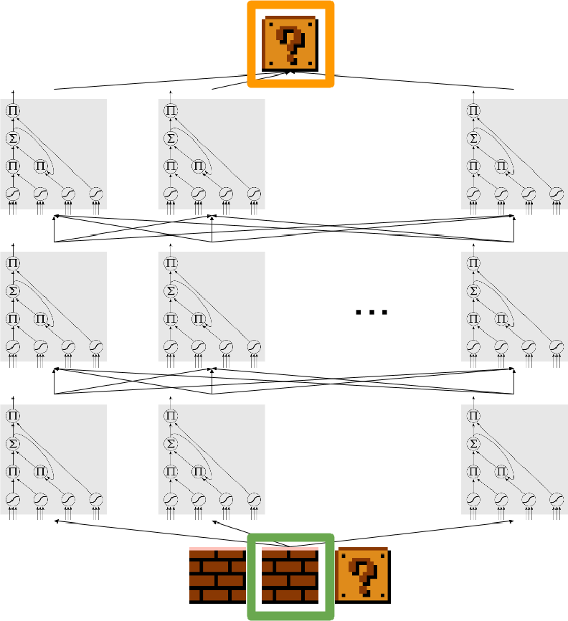
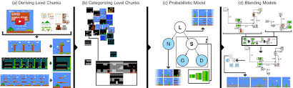
Motivation
Past work on training models on existing levels to generate new levels
Sequence prediction using LSTMs
Conceptual blending using graphical models
Summerville and Mateas, 2016
Guzdial and Riedl, 2016
Notes:
So what was the motivation behind this
There has been a lot of recent work in applying ML techniques to generate content using trained models and just as 2 example most related to this work

Slide 5
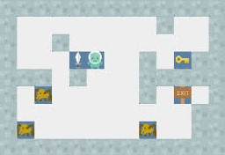
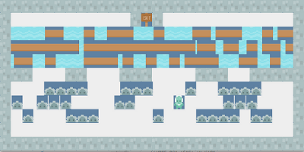
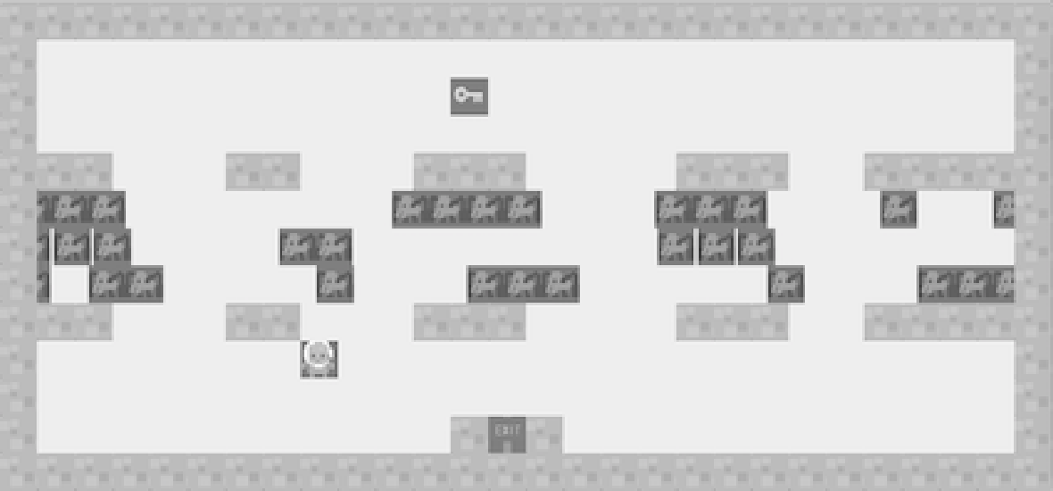
Motivation
Past work on training models on existing levels to generate new levels
Sequence prediction using LSTMs
Conceptual blending using graphical models
Gow and Corneli proposed generating new games by blending entire games
VGDL Frogger
VGDL Zelda
Frolda
Notes:
Additionally, we were also inspired by the work of Gow and Corneli who proposed a framework for not just blending levels but entire games together
But they required manually blending the games
And was also restricted to using the VGDL

Slide 6
Motivation
Past work on training models on existing levels to generate new levels
Sequence prediction using LSTMs
Conceptual blending using graphical models
Gow and Corneli proposed generating new games by blending entire games
IDEA: PCGML techniques + Game Blending
Notes:
So our idea was to apply PCGML techniques to be able to do this blending in a more automated manner and not be restricted by using the VGDL

Slide 7
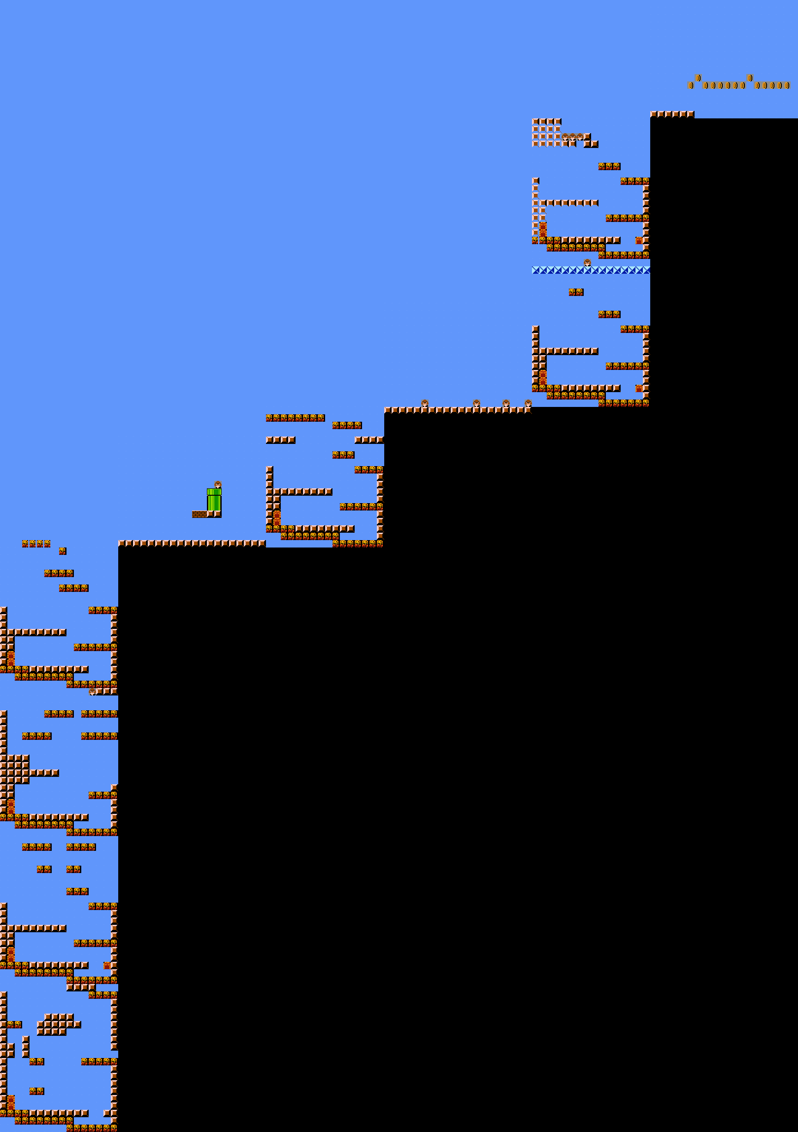
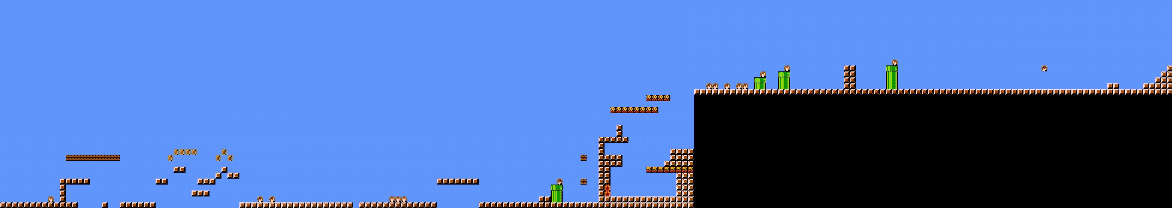
Blending Levels using LSTMs
Trained LSTMs on levels of Super Mario Bros. and Kid Icarus
Sampled from trained models to generate levels containing properties of both games
Parametrized generator with weights to control approximate percentage of each game in blended level
(SMB=0.2, KI=0.8)
(SMB=0.8, KI=0.2)

Slide 8
Drawbacks
Blended levels by taking turns between Super Mario Bros. and Kid Icarus
Allowed control of proportion of each game in blended level but no control over more fine-grained tile-based properties
Notes:
While successful in demonstrating the feasibility of generating blended levels using models trained on data from separate games, the LSTM approach did blending by taking turns in generating segments of the 2 games. This allows generation of blended levels but not more fine-grained blending of elements from different games within a level segment
Also though it let designers specify the proportion of each game to blend in the levels it does not let them control different level properties in the blending and generation process or specify other constraints such as difficulty or topology of a segment

Slide 9
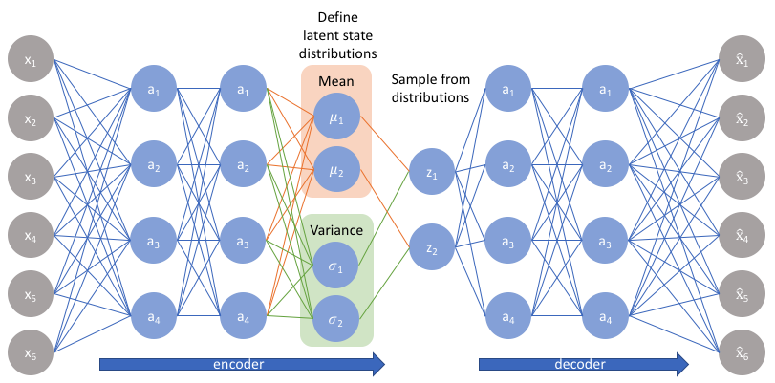
Solution: Variational Autoencoder (VAE)
Enables more holistic blending of level properties by capturing latent space across both games
Allows generation of segments satisfying specific properties
More conducive to co-creative level design
Notes:
To address these issues we use VAEs instead of LSTMs to blend levels from different games
And what VAEs can do is capture these latent representations of data, which enables more holistic blending of level properties, allows for the generation of level segments that optimize certain functions and satisfy specific properties and is more conducive to co-creative level design

Slide 10
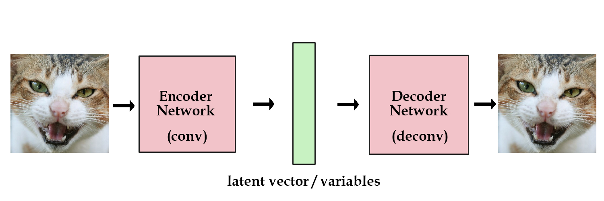
Variational Autoencoder
Autoencoders are neural nets that learn lower-dimensional data representations
Encoder → input data to latent space
Decoder → latent space to reconstructed data
Vanilla Autoencoder
Notes:
Autoencoders are neural nets that learn lower-dim representations of data
They consist of an encoder which converts the data into the hidden representation known as latent space
And a decoder which reconstructs the original data from it

Slide 11
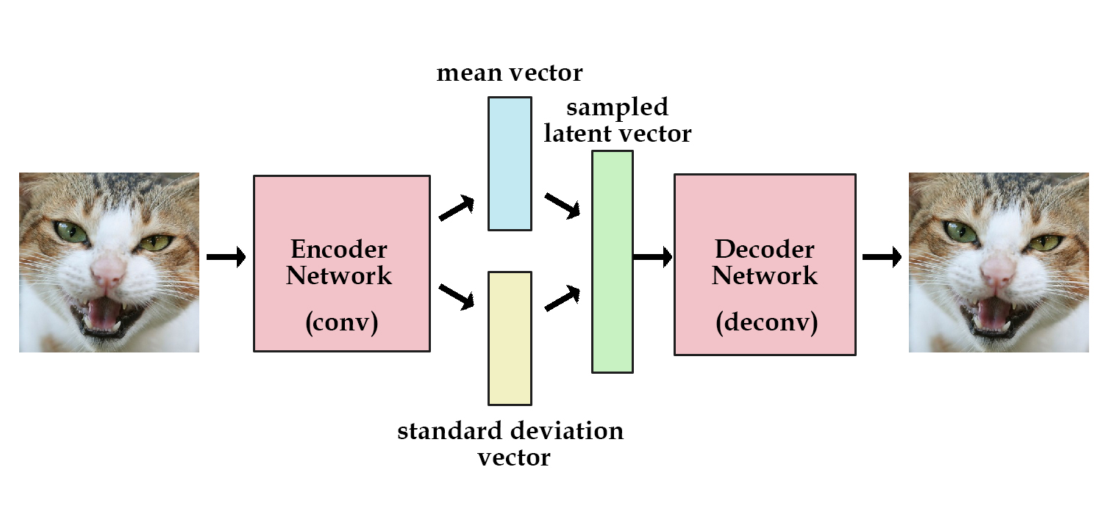
Variational Autoencoder
Autoencoders are neural nets that learn lower-dimensional data representations
Encoder → input data to latent space
Decoder → latent space to reconstructed data
VAEs make latent space model a probability distribution (e.g. Gaussian)
Allows learning continuous latent spaces
Enables generative abilities similar to those of GANs
Vanilla Autoencoder
Variational Autoencoder
Notes:
VAEs augment vanilla autoencoders by making the latent space model a specific probability distribution such as Gaussian which allows learning a continuous latent space which thus enables random sampling of outputs as well as interpolation of inputs, which is similar to GANs

Slide 12
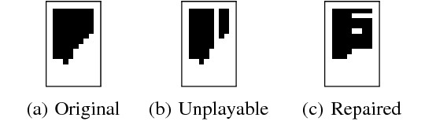
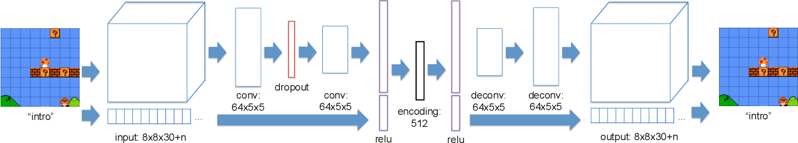
Motivation for VAE
Past work in using autoencoders for Mario level generation
Autoencoders for Level Generation, Repair and Recognition, Jain et al. (2016)
Explainable PCGML via Design Patterns, Guzdial et al. (2018)
Jain et al. (2016)
Guzdial et al. (2018)
Notes:
Work of Jain et al in using autoencoders for Mario level generation and repair
As well as the work of Guzdial et al. for generating Mario structures using design patterns

Slide 13
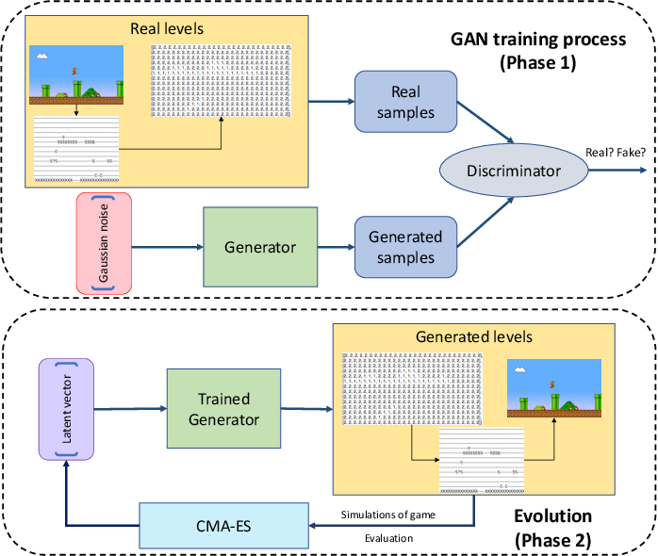
Motivation for VAE
Past work in using autoencoders for Mario level generation
Autoencoders for Level Generation, Repair and Recognition, Jain et al. (2016)
Explainable PCGML via Design Patterns, Guzdial et al. (2018)
Evolving Mario Levels in the Latent Space of a DCGAN (i.e. MarioGAN), Volz et al. (2018)
Volz et al. (2018)
Notes:
MarioGAN used GANs for generating Mario levels by training the GAN on a level from Mario which allowed the model to learn this latent space
And then they also applied an evolutionary search technique called Covariance Matrix adaptation (CMA) to evolve levels with specific characteristics within this latent space

Slide 14
Motivation for VAE
Past work in using autoencoders for Mario level generation
Autoencoders for Level Generation, Repair and Recognition, Jain et al. (2016)
Explainable PCGML via Design Patterns, Guzdial et al. (2018)
Evolving Mario Levels in the Latent Space of a DCGAN (i.e. MarioGAN), Volz et al. (2018)
Use MarioGAN-based approach to capture latent space of 2 games instead of 1
Volz et al. (2018)
Notes:
So our idea was instead of training a generative model on 1 game, if we were to train it on 2, we could then have the model capture a latent space spanning both games and because this space is continuous it should lend itself to operations like blending and interpolating between games more naturally than our previous LSTM approach for example

Slide 15
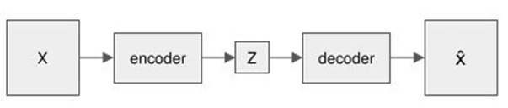
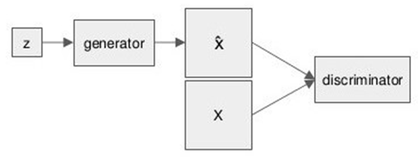
Why VAE over GAN?
VAE architecture more conducive to co-creative level design
Designers don’t have to directly use latent space vectors
More explicit control in defining inputs to the system
More useful to blend/interpolate between known segments rather than latent vectors
VAE Architecture
GAN Architecture
Notes:
And so if we were inspired by MarioGAN, why did we use a VAE over a GAN?
Due to the nature of VAE, designers can also specify the segments they want to blend or generate variations of without having to use the latent representation directly
Allows designers more explicit control in defining the inputs to the system and designers may find it more useful to blend or interpolate between segments they define or know the appearance of rather than do so by evolving latent vectors

Slide 16
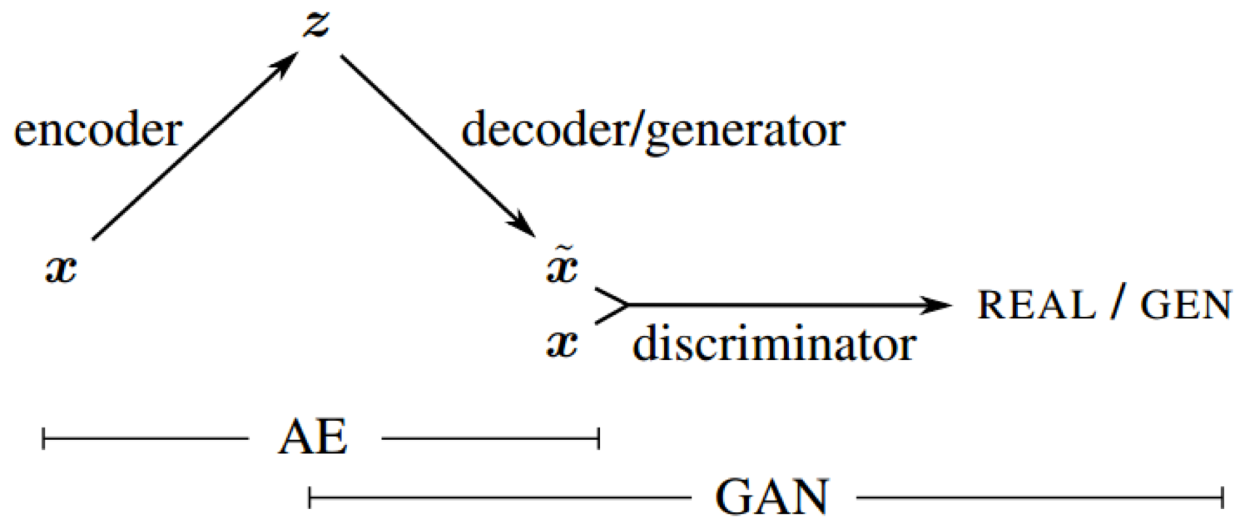
VAE vs GAN vs VAE-GAN
Trained a GAN and a VAE-GAN in addition to the VAE to compare generative capabilities in a level blending context
VAE-GAN is a hybrid generative model
Combines VAE and GAN by collapsing VAE decoder into a GAN generator
VAE
GAN
VAE-GAN (Larsen et al. 2016)
Notes:
So, even though the VAE has this extra affordance because of which we picked it, GANs still might have better generative performance

Slide 17
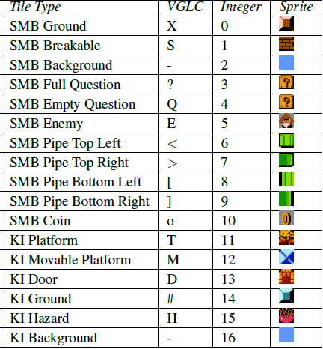
Dataset and Training
Trained on a level each from SMB (Level 1-1) and KI (Level 5) taken from the Video Game Level Corpus (VGLC)
Each level is a 2D character array
Each tile type was encoded using an integer and then with one-hot encoding for training
Notes:
For training, level data was taken from the VGLC and consisted of data from 1 level (level 1-1) of SMB and Level 5 of KI
We used only 1 level due to the exploratory nature of the work where we were hoping for quick promising results rather than optimal ones which we leave for future work
Each level in the VGLC is a 2D character array with each tile represented by a specific character
For training, each tile type was encoded first with an integer as shown in the table and then again with a one-hot encodin

Slide 18
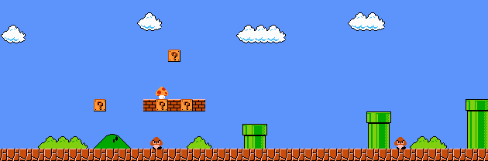
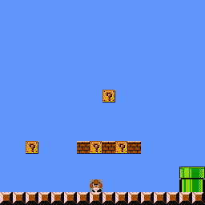
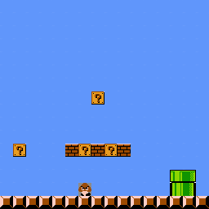
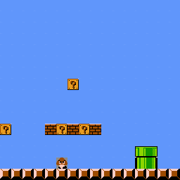
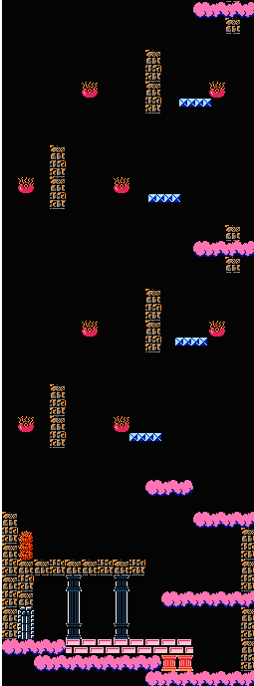
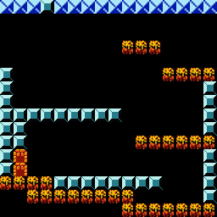
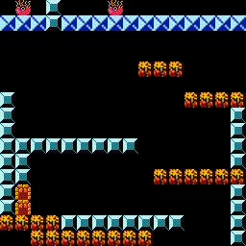
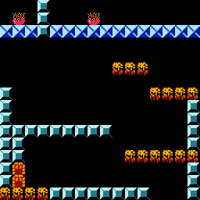
Dataset and Training
To account for orientation, used 16x16 sliding window
187 segments of SMB + 191 segments of KI = 378 total segments
Models learned to generate 16x16 blended level segments
VAE, GAN and VAE-GAN all trained using same number of segments and with similar training conditions
Notes:
To account for the fact that the dimensions and orientation of the 2 games differ, we used a 16x16 window slid horizontally across the SMB level and vertically across the KI level and thus ended up with 16x16 training segments
So the VAE learned to generate 16x16 level segments rather than entire levels
187 SMB and 191 KI training segments = 378

Slide 19
Generation
Trained models generate 16x16 segments in combined SMB-KI latent level design space
Generation involves feeding a latent vector into the VAE’s decoder which outputs a one-hot encoded array which is converted to the 16x16 level segment
Two generation methods
Like GANs, use random latent vectors or evolve optimal vectors using search
Unlike GANs, generate segments based on input segments
Notes:
The trained models generate 16x16 segments within the combined SMB-KI latent level design space
Generation involves feeding a 64-dim latent vector into the VAE’s decoder which outputs a one-hot encoded array which can then be converted to the 16x16 level segment
Like MarioGAN, VAE can generate segments by using random latent vectors or by using CMA to evolve vectors that optimize given fitness functions
Unlike GANs, the VAE can also generate segments based on those supplied by

Slide 20

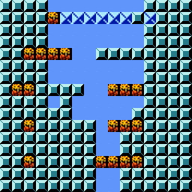
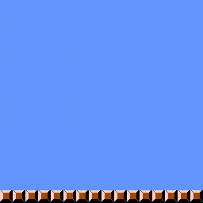
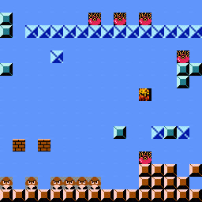
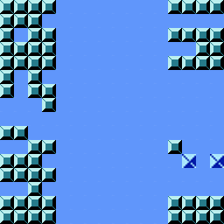
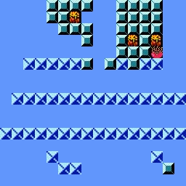
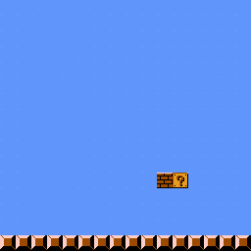
Evaluation
0%
100%
Used four metrics for evaluation
Density
Difficulty
Non-Linearity
SMB Proportion
Density
Difficulty
Non-Linearity
SMB Proportion
Notes:
To evaluate our approach, we defined 4 metrics
Density – the number of solid tiles in a 16x16 segment – a segment with density of 100% has all 256 tiles as solid
Difficulty – the number of enemies plus hazards in a 16x1 segment based on the dimensions we defined a segment with 100% difficulty to have 16 total enemies and hazards
Non-linearity – measures how well segment topology fits to a line f- MSE of running linear regression on the highest point of each of the 16 columns of a segment - zero value indicates perfectly horizontal or linear topology
SMB prop – the percentage of non-background SMB tiles in a segment – a segment with 100% SMB prop has only SMB tiles while 0% has only KI tiles

Slide 21
Evaluation
0%
100%
Used four metrics for evaluation
Density
Difficulty
Non-Linearity
SMB Proportion
Compared generative performance of VAE with that of GAN and VAE-GAN
How well models capture latent space spanning both games → computed above metrics for 10K random latent vectors
Accuracy of evolving desired segments using CMA-ES → evolved 100 segments with target values of 0%, 25%, 50%, 75%, 100% for each metric
Density
Difficulty
Non-Linearity
SMB Proportion
Notes:
For comparing the VAE’s gen perf with that of GAN and VAE-GAN
compared models in terms of capturing the latent space spanning both games for this we computed the above metrics for segments generated from 10k latent vectors drawn uniformly at random from a Gaussian distribution
Compared in terms of accuracy in evolving desired segments by using CMA-ES to evolve 100 level segments with target values of 0, 25, 50, 75 and 100 for each of 4 metrics

Slide 22
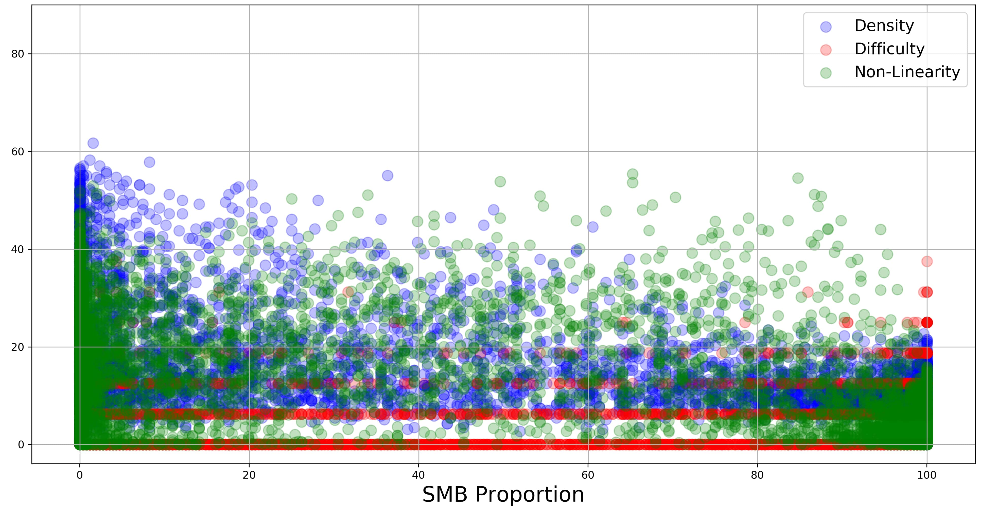
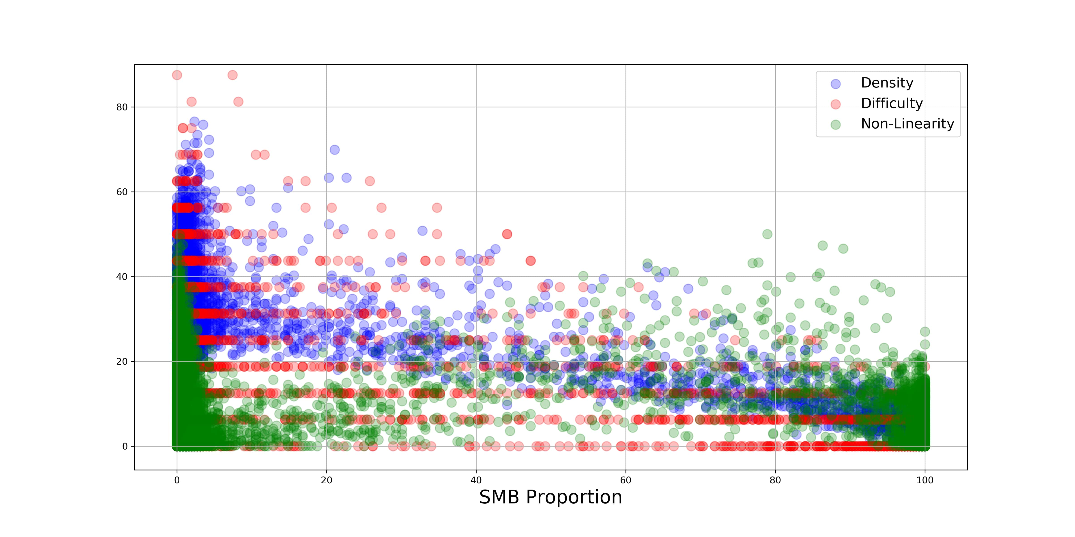
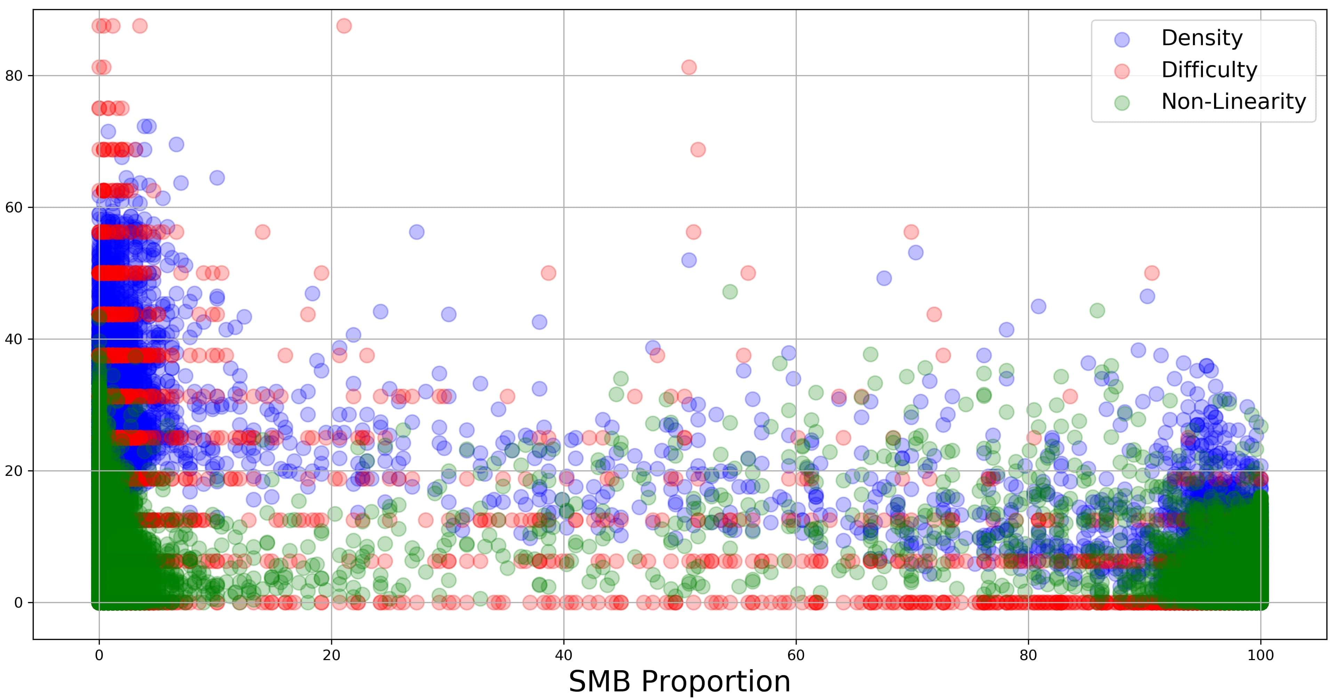
Results
VAE does best at generating segments that are a mix of either game while GAN and VAE-GAN generate segment with mostly SMB or mostly KI elements
VAE
GAN
VAE-GAN
Notes:
VAE seems to be best at generating segments whose elements are a mix of those from either game while both the GAN and the VAE-GAN generate segments with mostly SMB or mostly KI elements as evidenced by their plots being sparser in the middle than the VAE plot

Slide 23
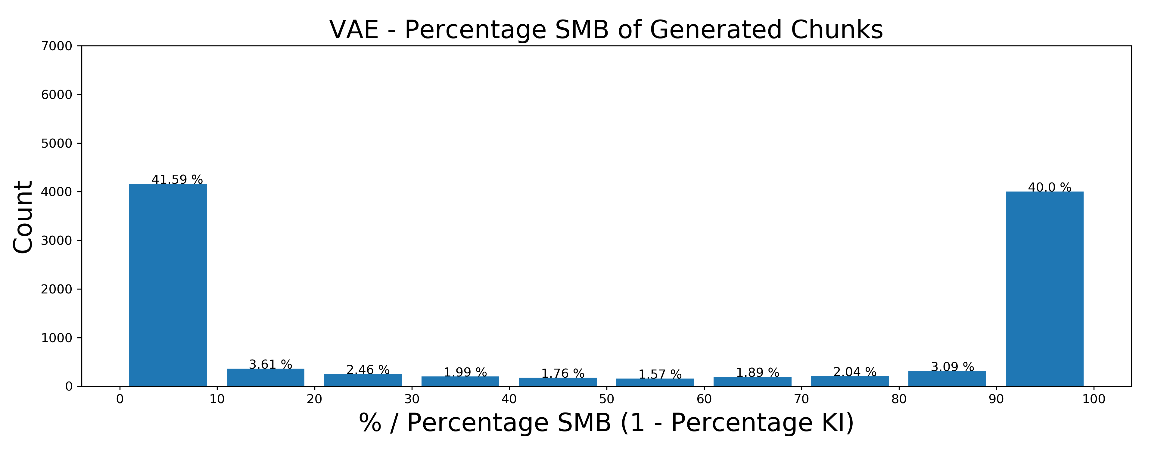
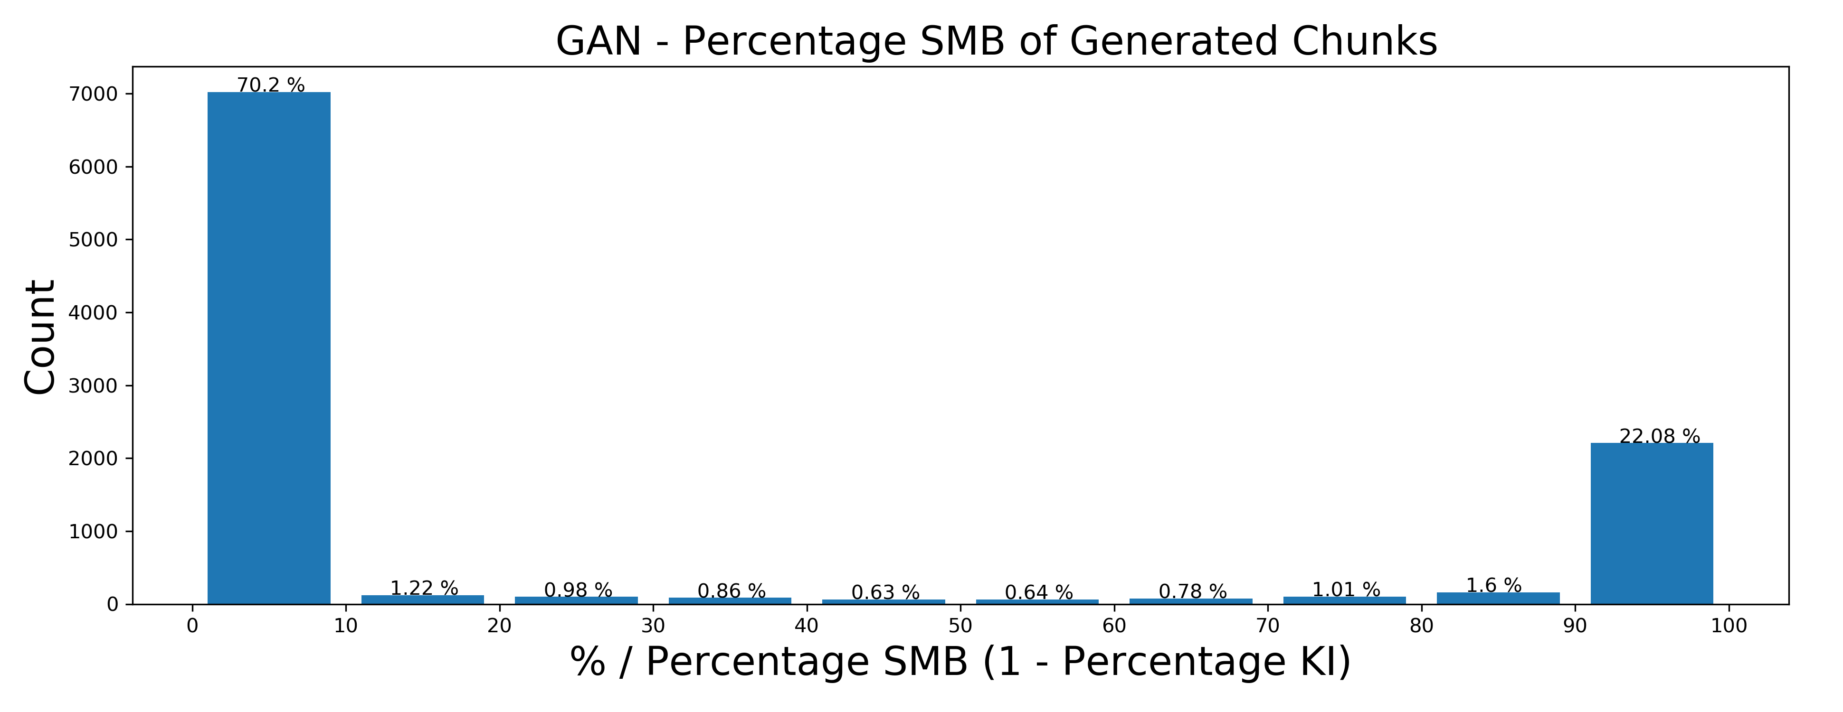
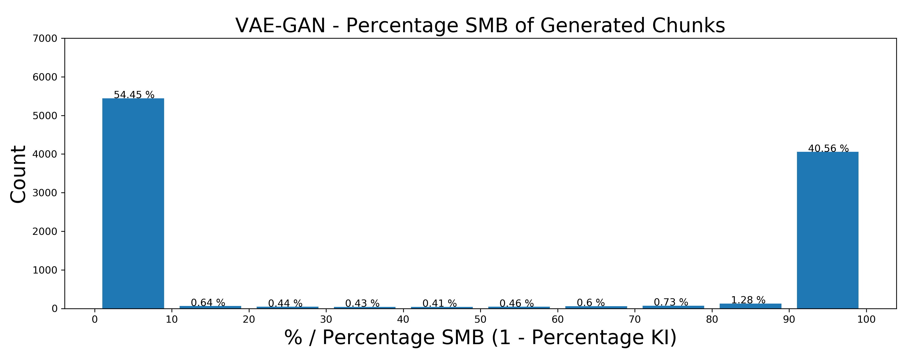
Results
VAE does best at generating segments that are a mix of either game while GAN and VAE-GAN generate segment with mostly SMB or mostly KI elements
VAE is better at capturing the latent space spanning both games as well as the space in between
18% of VAE segments have elements of both games
8% for GAN
5% for VAE-GAN
Notes:
These plots look at the percentage of generated segments that have a specific proportion of SMB and KI elements
And according to these, approximately 18% of VAE-generated segments have elements of both games where as this drops to 8% for GAN and 5% for VAE-GAN
Implies that VAE is better than the other models at capturing the latent space spanning both games as well as the space in between, thus making it the best choice among the 3 for generating blended segments

Slide 24
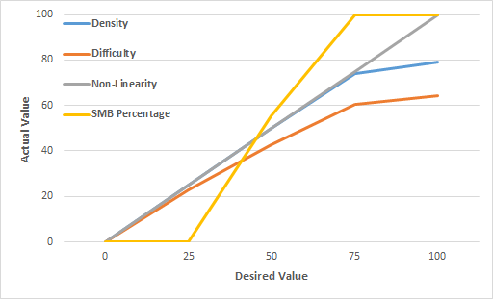
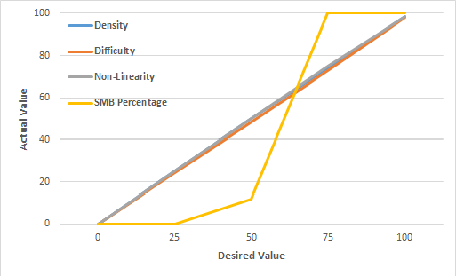
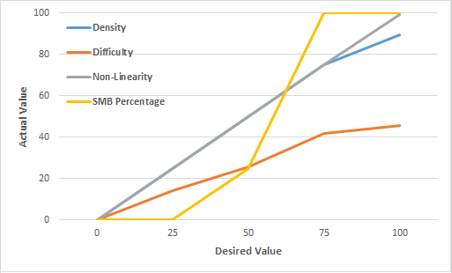
Results
GAN does better than VAE only for 100% Density and 75% and 100% Difficulty
VAE
GAN
VAE-GAN
Notes:
Results of testing accuracy of evolving segments based on properties
Initially GAN seems to be best but note that the GAN does better than the VAE only for 100% density and 75% and 100% difficulty

Slide 25
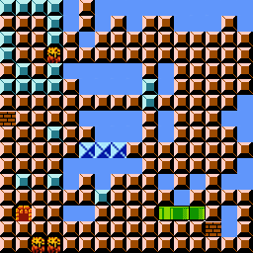
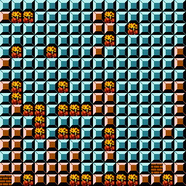
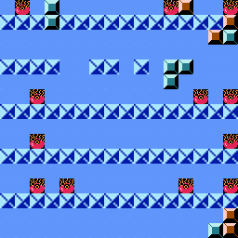
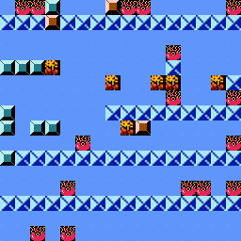
Results
75%
100%
GAN does better than VAE only for 100% Density and 75% and 100% Difficulty
Ignore structures in training levels since actual segments would not be 100% solid nor have 16 enemies and hazards
Density
Difficulty
VAE
GAN
VAE-GAN
Notes:
Such values ignore the structures in training levels since actual SMB and KI segments would have neither 100% solid tiles nor 16 enemies and hazards
Suggests that VAEs latent space captures the nature of the training data better than the GAN thereby struggling to find segments while the GAN can do so more easily
Of course possible that the GAN wasn’t trained enough but since we used the same training conditions, this suggests that the VAE exhibits better performance with similar training conditions
But this highlights that metrics are nice for evaluating the space of your generator, but you don’t want to blindly trust them

Slide 26
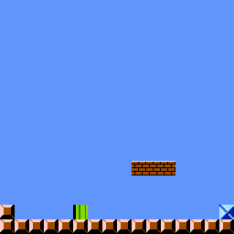
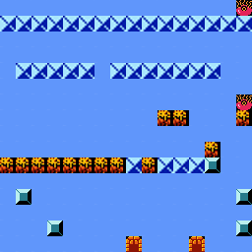
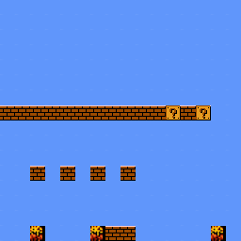
Results
No model does particularly well in blending desired SMB and KI proportions but VAE does well for the 50% case
With similar training, VAE learns a latent space that is more representative while having more variation to enable better blending
VAE
GAN
VAE-GAN
VAE
GAN
VAE-GAN
Notes:
In terms of blending desired SMB and KI props, none of the models do particularly well in evolving segments neither 100% KI nor 100% SMB. VAE does well at least for 50% but others do much worse
Thus with similar training the VAE learns a latent space that is more representative of the game data while having more variation to enable better blending
Addition to enable encoding of segments, VAEs also seem to be better at generation than GANs in the context of level blending

Slide 27
Application in Co-Creative Design
Notes:
VAEs trained on levels from multiple games could inform co-creative level design systems that let designers make levels by generating and blending level segments representative of all games used for training via a number of affordances

Slide 28
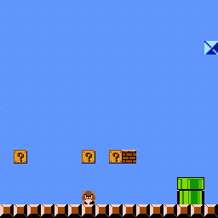
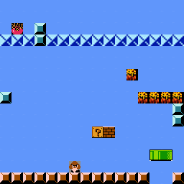
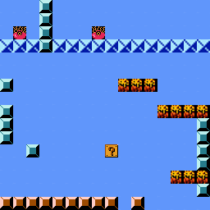


Application in Co-Creative Design
Interpolation between games
SMB 1-1 Segment
KI Level 5 Segment
Notes:
By encoding level segments into latent vectors, VAEs enable interpolation between vectors representing segments from different games and generation of segments that lie between the latent space of either game, thus having properties of both games i.e. blended segments. As in this example, one could interpolate between an SMB segment and a KI segment

Slide 29





Application in Co-Creative Design
Alternate connections between segments
SMB 1-1 Segment 1
SMB 1-1 Segment 2
Notes:
Interpolating between segments from the same level can generate alternate connections between them. This can help designers edit existing levels by interpolating between 2 segments from the level to generate new segments that can be combined to form new links between the original two

Slide 30





Application in Co-Creative Design
Generating segments satisfying specific properties
KI Hazards
SMB ?-Marks
SMB Enemies
KI Doors
KI Platforms
Notes:
Search within the VAE’s latent space can be used to evolve vectors and thus level segments satisfying specific properties. We saw Difficulty, Density and Non-Linearity, but other optimizations are possible such as maximizing the distribution of certain tiles

Slide 31


Application in Co-Creative Design
Generating segments with desired proportions of different games
0% SMB
25% SMB
50% SMB
75% SMB
100% SMB
Notes:
In addition to optimizing for tile-specific properties, we can also optimize for desired proportions of level elements from each game

Slide 32
Future Work
Playability
Notes:
Main limitation of this work is that it ignores playability
While designers could assemble generated segments such that levels are playable they should ideally be able to query the generator for playable segments
Blended levels possibly requiring new or blended mechanics to be playable

Slide 33
Future Work
Playability
Vector math in level design space
Notes:
Besides interpolation, other vector ops like addition and subtraction can be used in the latent space
Such vector arithmetic could enable feature transfer between games by for example adding a vector representing a game 1 feature to a vector representing a game 2 segment
Likely require more sophisticated VAE architectures like infoVAE and betavAE

Slide 34
Future Work
Playability
Vector math in level design space
Co-Creative Level Design Tool
Notes:
Implement a co-creative level design tool using the VAE as its foundation

Slide 35
Future Work
Playability
Vector math in level design space
Co-Creative Level Design Tool
Multiple Games and Genres
Notes:
Finally future work could consider blended level design space spanning more than 2 games as well as multiple genres
How would one blend a platformer with an action-adventure game?
What games genres mechanics and levels exist within the latent space between Mario and Zelda for example?

Slide 36
Future Work
Playability
Vector math in level design space
Co-Creative Level Design Tool
Multiple Games and Genres
Contact
Anurag Sarkar Northeastern University sarkar.an@husky.neu.edu

