Slide 1
Transforming Game Difficulty Curves using Function Composition
Anurag Sarkar and Seth Cooper
Northeastern University
Notes:
I’ll be presenting Transforming …
And this work presents a formal approach that uses function composition to define as well as transform difficulty curves within games
And what this allows us to do is to describe changes to difficulty curves in a more precise way

Slide 2
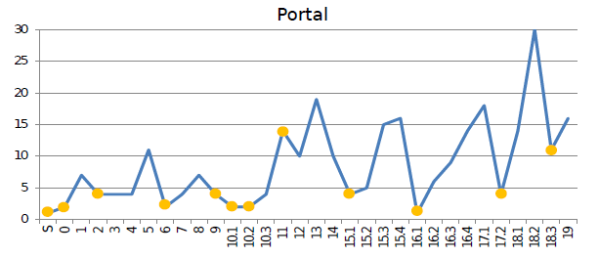
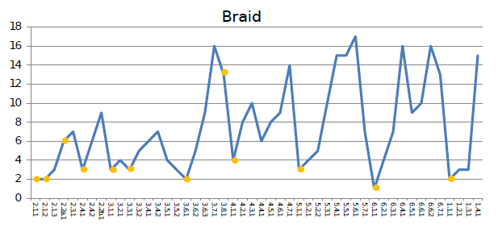
Difficulty Curve
Defines how a game’s difficulty changes over the course of gameplay
Linehan et al., 2014
Notes:
So first just a brief overview of difficulty curves, the difficulty curve of a game defines how the game’s difficulty changes over the course of gameplay
And they’re usually depicted as the examples given on the slide
So on the x-axis you tend to have some sense of gameplay progression, in this example it’s the levels as the player encounters them chronologically
And on the y-axis you normally have some indicator of difficulty and in this example we have the number of actions that are needed to solve the corresponding level on the x-axis
So as the game progresses, this number gradually goes up and so the games gradually get harder

Slide 3
Difficulty Curve
Defines how a game’s difficulty changes over the course of gameplay
Curves can be viewed as functions mapping from progression to difficulty
Linehan et al., 2014
Notes:
Difficulty curves can be viewed as functions mapping from some sense of progression to some sense of difficulty

Slide 4
Difficulty Curve
Defines how a game’s difficulty changes over the course of gameplay
Curves can be viewed as functions mapping from progression to difficulty
In-game difficulty affects player engagement and so should be compatible with player skill
Linehan et al., 2014
Notes:
Now in most situations, the in-game difficulty should ideally be compatible with the player’s current skill level so that player is neither overwhelmed nor bored
Thus defining an optimal difficulty curve that presents challenges commensurate with player skill is an important game design problem

Slide 5
Difficulty Curve
Defines how a game’s difficulty changes over the course of gameplay
Curves can be viewed as functions mapping from progression to difficulty
In-game difficulty affects player engagement and so should be compatible with player skill
Traditional methods of defining curves involve manual refinement through iterative playtesting
Linehan et al., 2014
Notes:
Traditional methods of finding such a curve involve the designer creating an initial curve which is then refined using an iterative process of playtesting
And so we do we already have techniques for adjusting difficulty curves, but they lack a precise way of capturing what it means to modify curves to affect difficulty.

Slide 6
Difficulty Curve
Defines how a game’s difficulty changes over the course of gameplay
Curves can be viewed as functions mapping from progression to difficulty
In-game difficulty affects player engagement and so should be compatible with player skill
Traditional methods of defining curves involve manual refinement through iterative playtesting
IDEA: Use Function Composition to Define and Transform Difficulty Curves
Linehan et al., 2014
Notes:
And so our idea to address this problem was to tap into the fact that these curves are functions …

Slide 7
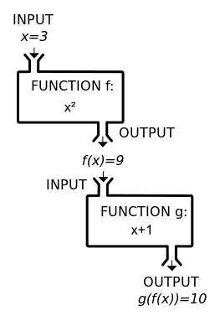
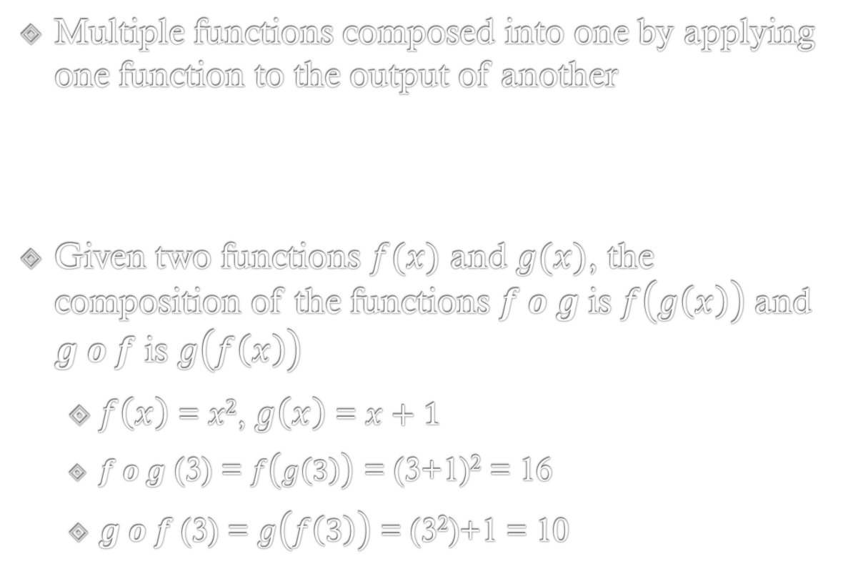
Function Composition
Multiple functions composed into one by applying one function to the output of another
Given two functions $f(x)$ and $g(x)$, the composition of the functions $f o g$is $f\left(g\left(x\right)\right)$ and $g o f$ is $g\left(f\left(x\right)\right)$
$f\left(x\right)$ = $x2$, $g\left(x\right)$ = $x+1$
$f o g$ (3) = $f\left(g\left(3\right)\right)$ = (3+1)² = 16
$g o f$ (3) = $g\left(f\left(3\right)\right)$ = (3²)+1 = 10
Notes:
function composition is a technique in which multiple functions are composed into one by using the output of one function as the input of another
Given 2 functions f(x) and g(x) we have 2 possible compositions namely f of g and g of f and depending on the order in which the functions are applied, we get different outputs given the same initial input as shown in the example on the slide

Slide 8

Motivation
Precisely describe relative difficulty curves and transformations e.g. formalize a ‘steep’ curve
Notes:
Our primary motivation in using function composition to model diff curves was to move towards formalizing and providing a more precise vocabulary of how difficulty curves are changed and how such changes affect player behavior.
In particular, we were inspired by Steve Swink’s work in formalizing the notion of “game feel” where he tackled such questions as what do we mean precisely when we say a game feels better …
Using function composition allows us to similarly formalize what it means to for example steepen or smooth a game’s difficulty curve

Slide 9
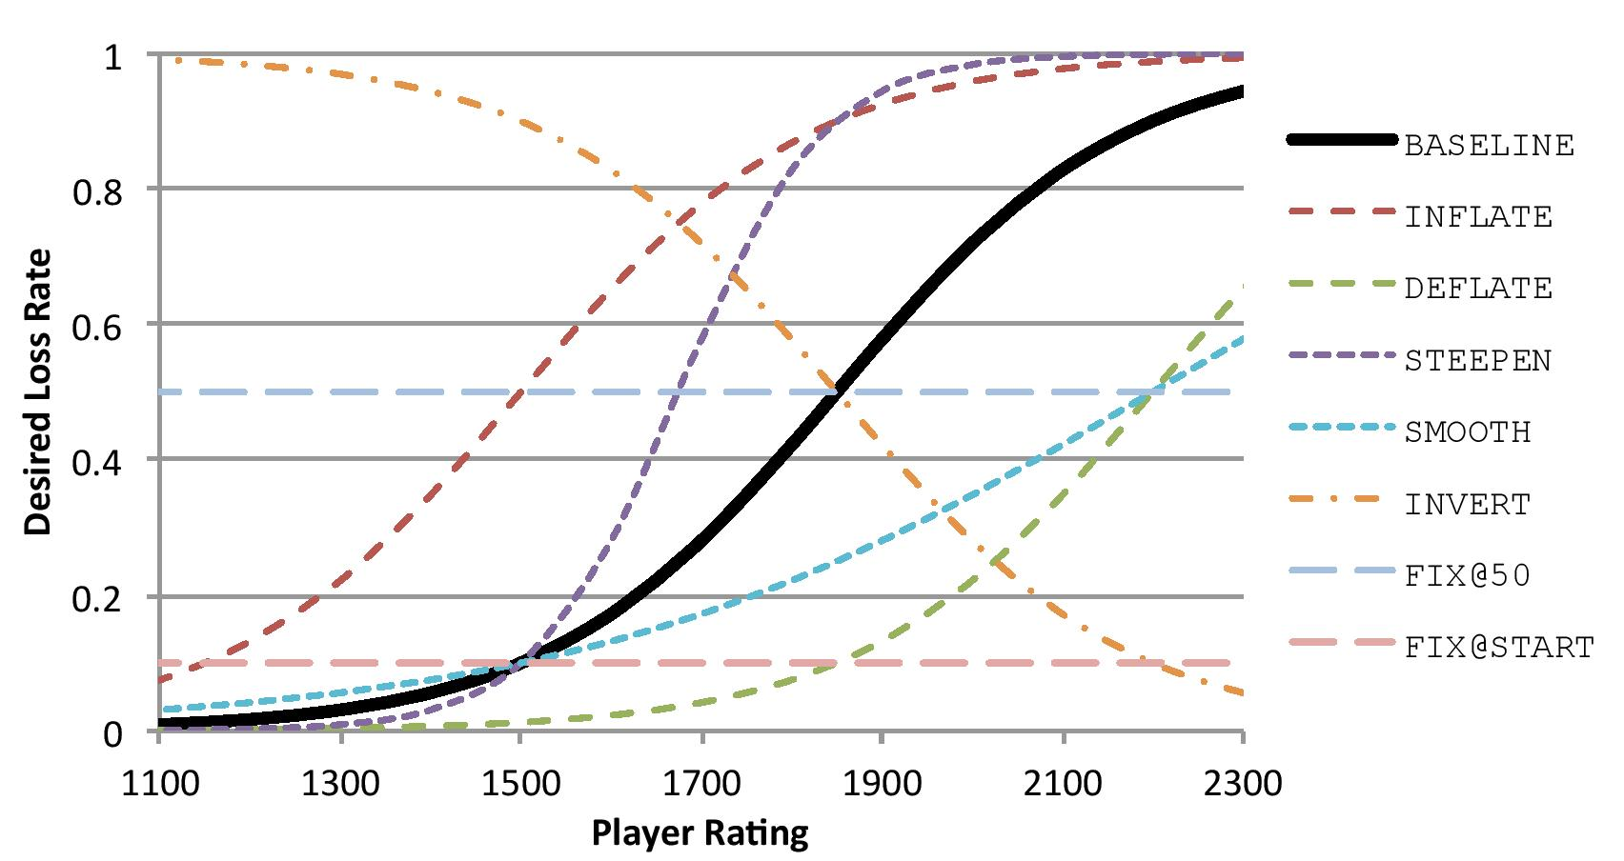
Motivation
Precisely describe relative difficulty curves and transformations e.g. formalize a ‘steep’ curve
Functions (vs. manual refinement) capture a space of possible curves that can be explored
Notes:
Additionally, using functions to transform curves (as opposed to manual refinement) helps capture a potential space of possible difficulty curves that can then be explored by applying transformations
So as a brief preview of what’s to come, this plot shows the different curves that we used in our experiment
And this sort of space of curves can allow games to trade off different design goals.

Slide 10
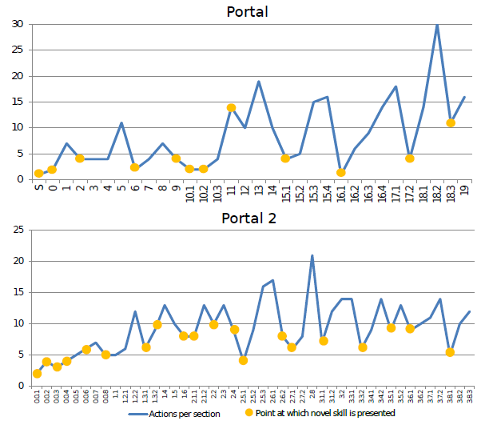
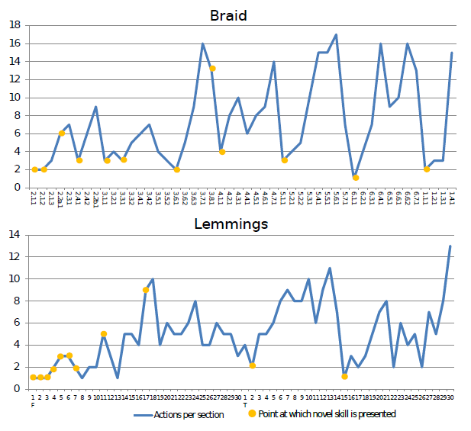
Motivation
Precisely describe relative difficulty curves and transformations e.g. formalize a ‘steep’ curve
Functions (vs. manual refinement) capture a space of possible curves that can be explored
Compare curves across games
Linehan et al., 2014
Notes:
Such transformations could also give us an approach to considering changes to difficulty curves in a game-independent manner
Once you have a common vocabulary of functions for describing and transforming curves, you can then apply that to multiple games and compare difficulties across games

Slide 11
Motivation
Precisely describe relative difficulty curves and transformations e.g. formalize a ‘steep’ curve
Functions (vs. manual refinement) capture a space of possible curves that can be explored
Compare curves across games
Empirically evaluate impact of changing difficulty curves
Linehan et al., 2014
Notes:
And finally, this technique also allows us to empirically evaluate the impact that transforming the difficulty curves has on player behavior, which is what we studied in our experiment

Slide 12
Experiment
Applied function composition to transform the difficulty curve of the human computation puzzle game Paradox and tested:
if different transformations caused any changes in engagement/behavior
if such transformations could improve engagement benefits of the existing curve
Notes:
We applied function composition to transform the difficulty curve of the human computation puzzle game Paradox to see what changes in engagement would be caused by different transformations and if any such transformation could further improve the engagement benefits that the game’s existing curve had demonstrated

Slide 13
Experiment
Applied function composition to transform the difficulty curve of the human computation puzzle game Paradox and tested:
if different transformations caused any changes in engagement/behavior
if such transformations could improve engagement benefits of the existing curve
HYPOTHESIS:
Transforming the difficulty curve using function composition impacts player behavior and experience with different transformations leading to different behavior and experience
Notes:
And for our experiment we formulated the following hypothesis, namely that
Transforming the difficulty curve of a game using function composition impacts player behavior and experience with different transformations leading to different player behavior and experience

Slide 14
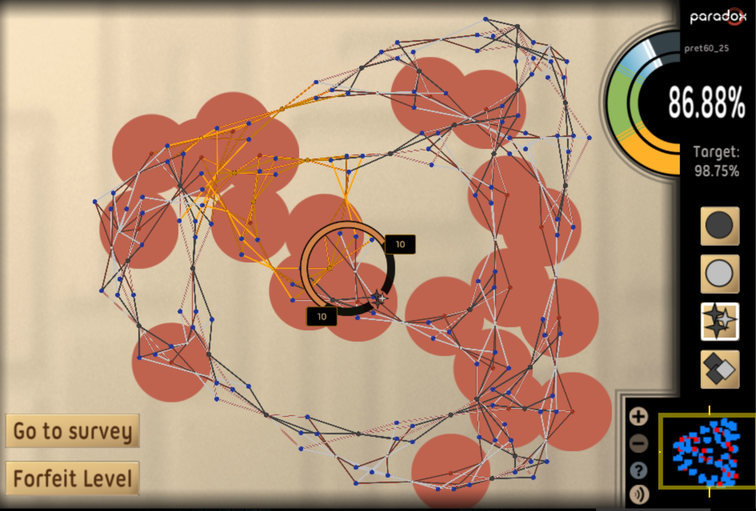
Paradox
2D human computation puzzle game
Each level is a boolean constraint satisfaction problem
Players assign values to variables to solve constraints
Score: percentage of satisfied constraints
Target score reached → Level Completed
Notes:
So for the experiment, we used a game called Paradox which is a human computation puzzle game and each level represents a Boolean maximum satisfiability problem
Players attempt to solve these constraints by using one of the tools on the right side of the image to assign values to the variables
And a player’s score as indicated in the top right corner is the percentage of constraints they are able to satisfy
The goal of each level is to reach the target score for that level and if they are able to do that the player is considered to have completed the level
And if they make at least 1 move in the level with or without eventually completing it, then that is considered as an attempt by the player

Slide 15
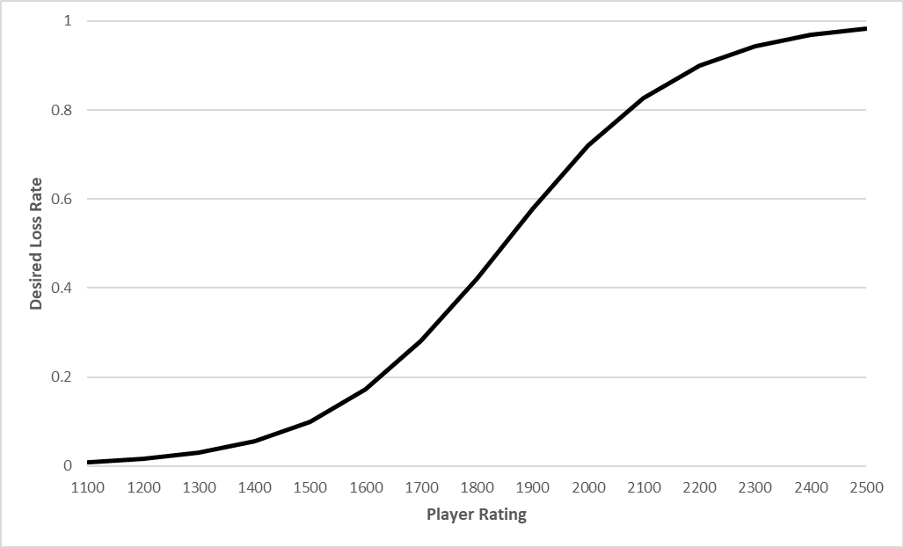
Player-vs-Level Matchmaking
Difficulty curve-based matchmaking system using Glicko-2 ratings to serve levels to players
Paradox
Notes:
So that brings us to how the game’s difficulty progression works and on this slide we have the difficulty curve of Portal from the previous slide and below we have the baseline difficulty curve for Paradox
The game uses a difficulty curve-based player vs level matchmaking system to determine the next level that is served to a player as they progress through the game and in particular uses the Glicko-2 rating system

Slide 16
Player-vs-Level Matchmaking
Difficulty curve-based matchmaking system using Glicko-2 ratings to serve levels to players
Player and levels assigned ratings
Player rating → Skill
Level rating → Difficulty
Paradox
Notes:
Under this system, each player and level is assigned a rating and you can look at it as a player’s rating indicating their skill level and a level’s rating indicating that level’s difficulty

Slide 17
Player-vs-Level Matchmaking
Difficulty curve-based matchmaking system using Glicko-2 ratings to serve levels to players
Player and levels assigned ratings
Player rating → Skill
Level rating → Difficulty
Compare ratings to compute player’s chance of losing level i.e. level difficulty for that player
Paradox
Notes:
And by comparing the ratings of a player and level, we can compute the player’s probability of losing that level which we can consider as an estimate of how hard that level is for that player

Slide 18
Player-vs-Level Matchmaking
Difficulty curve-based matchmaking system using Glicko-2 ratings to serve levels to players
Player and levels assigned ratings
Player rating → Skill
Level rating → Difficulty
Compare ratings to compute player’s chance of losing level i.e. level difficulty for that player
Use ratings-based loss estimates to determine next level as given by curve
Paradox
Notes:
We can then use these ratings-based loss estimates to determine next level as given by the curve as shown in the image
And as we shall see it is by varying this mapping from player skill as given by the rating to level difficulty as given by the loss rate that we get different curves

Slide 19
Player-vs-Level Matchmaking
Difficulty curve-based matchmaking system using Glicko-2 ratings to serve levels to players
Player and levels assigned ratings
Player rating → Skill
Level rating → Difficulty
Compare ratings to compute player’s chance of losing level i.e. level difficulty for that player
Use ratings-based loss estimates to determine next level as given by curve
Difficulty of game adapts to player’s skill
Paradox
Notes:
And just going back to these curves, the distinction between them is that Portal follows a fixed difficulty order and so the sense of progression is chronological where as Paradox follows a dynamic difficulty order and so the sense of progression is based on the player’s skill and so the difficulty of the game adapts to the player’s skill at any given point through the course of gameplay

Slide 20
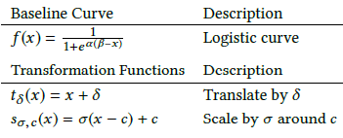
Curve Functions
Difficulty curve is a function mapping player skill (Glicko-2 rating) to difficulty (desired loss rate)
Notes:
So that brings us to the curves themselves
We consider a difficulty curve as a function that maps from player skill to difficulty

Slide 21
Curve Functions
Difficulty curve is a function mapping player skill (Glicko-2 rating) to difficulty (desired loss rate)
Notes:
And so the curve is given by the function f(x) where the input x corresponds to the player rating and the output corresponds to the desired loss rate
And in addition, we have 2 transformation functions – 1 for translation, 1 for scaling – which will be used in function composition as we’ll see in the next slides

Slide 22
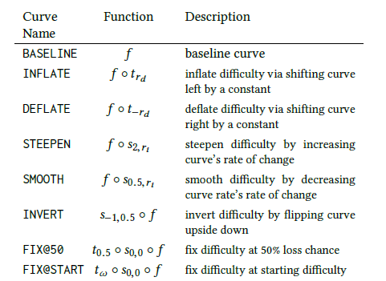
Curve Transformations
Notes:
For our baseline curve, we used a logistic function similar to one used in past work involving Paradox that smoothly increases difficulty as a player’s rating increases
And regarding the transformations, the name of each new curve indicates how it transforms the difficulty progression relative to the BASELINE
which is done by applying the transformation functions to either the input to the baseline as in INFLATE, DEFLATE, STEEPEN, SMOOTH or its output as in INVERT, FIX@50 and FIX@START

Slide 23
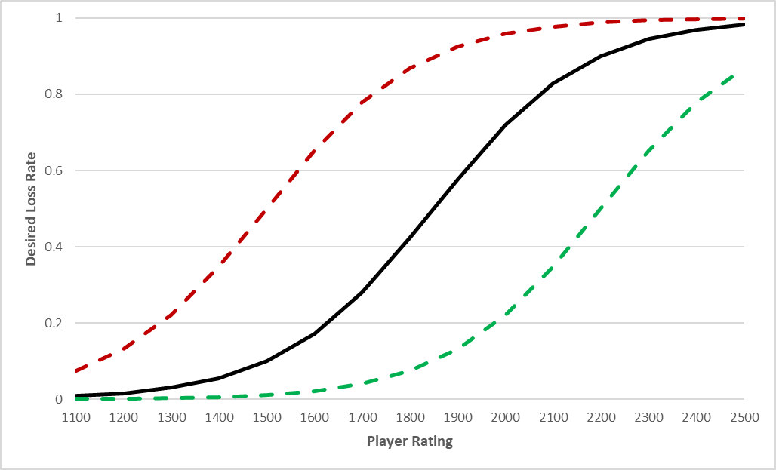
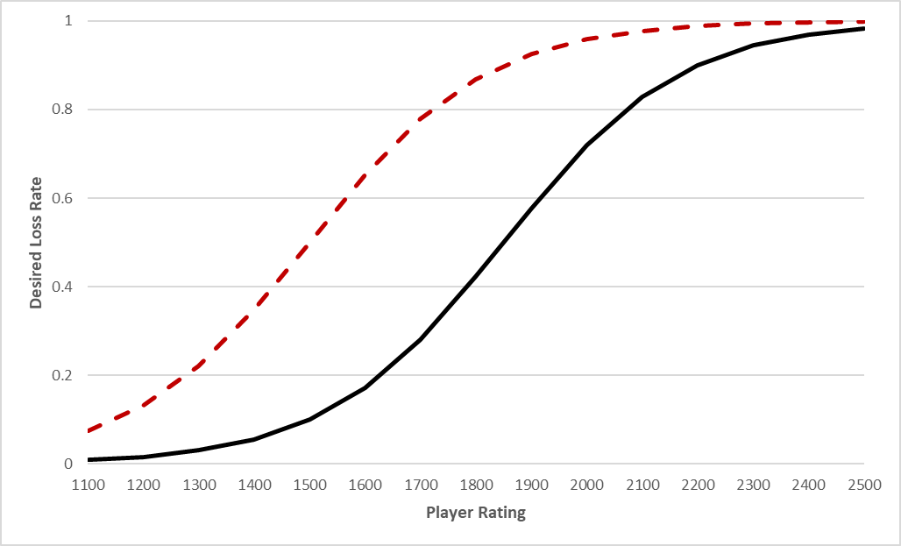
Curve Transformations
Notes:
To obtain INFLATE and DEFLATE, we translate the baseline curve along the x-axis (i.e. shift the player rating to the left and right respectively); this causes the player’s desired loss rate to be higher and lower respectively for the same rating thereby inflating (making the game harder) or deflating (making the game easier) the base curve.

Slide 24
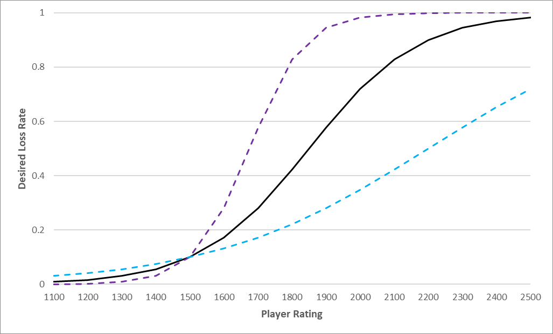
Curve Transformations
Notes:
Similarly, for STEEPEN and SMOOTH, the player rating is scaled to double and half, causing the base curve to be steeper (i.e. increasing the rate at which the game gets harder) or smoother (i.e. decreasing this rate) respectively

Slide 25
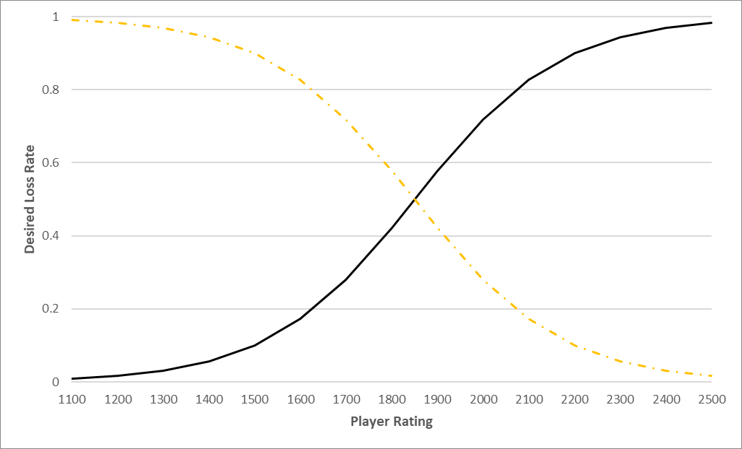
Curve Transformations
Notes:
INVERT simply flips the base curve upside down

Slide 26
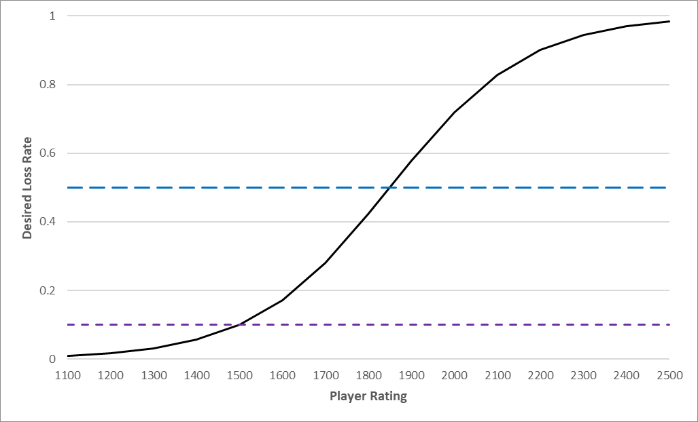
Curve Transformations
Notes:
And finally, FIX@50 and FIX@START always serve levels that the player has a 50% and 10% chance of losing, respectively

Slide 27
Curve Transformations

Slide 28

Participant Recruitment and Study
Players recruited using Mechanical Turk
400 players randomly assigned to one of the 8 difficulty curves
8 tutorial levels (static order)
50 challenge levels (dynamic difficulty order)
Post-game Intrinsic Motivation Inventory (IMI)
Notes:
For the experiment, we used Amazon MT to recruit 400 players

Slide 29
Measures of Engagement
Behavioral Engagement
Challenge Time
Levels Attempted
Levels Completed
Player Rating
(Player’s Glicko-2 rating after finishing playing)
Highest Level Rating
(Highest Glicko-2 rating of any level completed by the player)
Intrinsic Motivation Inventory
Interest/Enjoyment
Perceived Competence
Effort/Importance

Slide 30
Results
 | Play Time | Levels Attempted | Levels Completed | Perceived Competence | Highest Level Rating
INVERT | 516 | 4 | 0 | 23 | 1880
INFLATE | 433 | 4 | 2 | 17 | 1517
FIX@50 | 527 | 5 | 3 | 16 | 1587
FIX@START | 413 | 6 | 5 | 26 | 1222
STEEPEN | 618 | 7 | 4.5 | 25 | 1587
BASELINE | 610 | 10 | 7 | 25 | 1260
SMOOTH | 762 | 10 | 8 | 28 | 1416
DEFLATE | 682 | 15 | 14 | 28 | 1328
Statistical Tests: Aligned Rank Transform, post-hoc Wilcoxon Rank-Sum Test
No significant omnibus difference across curves for Player Rating and Effort/Importance
No post-hoc differences for Interest/Enjoyment
Notes:
So on to the results
And we found significant differences across curves for all of these variables

Slide 31
Results
 | Play Time | Levels Attempted | Levels Completed | Perceived Competence | Highest Level Rating
INVERT | 516 | 4 | 0 | 23 | 1880
INFLATE | 433 | 4 | 2 | 17 | 1517
FIX@50 | 527 | 5 | 3 | 16 | 1587
FIX@START | 413 | 6 | 5 | 26 | 1222
STEEPEN | 618 | 7 | 4.5 | 25 | 1587
BASELINE | 610 | 10 | 7 | 25 | 1260
SMOOTH | 762 | 10 | 8 | 28 | 1416
DEFLATE | 682 | 15 | 14 | 28 | 1328
Statistical Tests: Aligned Rank Transform, post-hoc Wilcoxon Rank-Sum Test
Some ramp-up in difficulty may be more engaging than a fixed, low level of difficulty
Notes:
Looking at Time, players spent the most time playing a SMOOTH difficulty curve and the least time playing curve that had a FIX@START ‘easy’ difficulty. This may indicate that some ram-up in difficulty is more engaging

Slide 32
Results
 | Play Time | Levels Attempted | Levels Completed | Perceived Competence | Highest Level Rating
INVERT | 516 | 4 | 0 | 23 | 1880
INFLATE | 433 | 4 | 2 | 17 | 1517
FIX@50 | 527 | 5 | 3 | 16 | 1587
FIX@START | 413 | 6 | 5 | 26 | 1222
STEEPEN | 618 | 7 | 4.5 | 25 | 1587
BASELINE | 610 | 10 | 7 | 25 | 1260
SMOOTH | 762 | 10 | 8 | 28 | 1416
DEFLATE | 682 | 15 | 14 | 28 | 1328
Statistical Tests: Aligned Rank Transform, post-hoc Wilcoxon Rank-Sum Test
Levels Attempted, Levels Completed and Perceived Competence increased by making curve ‘easier’
Notes:
For Levels Completed, Levels Attempted and Perceived Competence, the general trend appears to be that these were increased by making the curve ‘easier’; DEFLATE was always significantly greater than INFLATE

Slide 33
Results
 | Play Time | Levels Attempted | Levels Completed | Perceived Competence | Highest Level Rating
INVERT | 516 | 4 | 0 | 23 | 1880
INFLATE | 433 | 4 | 2 | 17 | 1517
FIX@50 | 527 | 5 | 3 | 16 | 1587
FIX@START | 413 | 6 | 5 | 26 | 1222
STEEPEN | 618 | 7 | 4.5 | 25 | 1587
BASELINE | 610 | 10 | 7 | 25 | 1260
SMOOTH | 762 | 10 | 8 | 28 | 1416
DEFLATE | 682 | 15 | 14 | 28 | 1328
Statistical Tests: Aligned Rank Transform, post-hoc Wilcoxon Rank-Sum Test
Levels Attempted, Levels Completed and Perceived Competence increased by making curve ‘easier’
Highest Level Rating increased by making curve ‘harder’
Notes:
On the other hand, the trend for Highest Level Rating seems to be that it was increased by making the curve ‘harder’
These trends make some intuitive sense as in an easier game, players would be expected to attempt and complete more levels while feeling more competent, but the levels they completed would have lower ratings. This suggests that players are more engaged and play for longer when the game is easier

Slide 34
Results
 | Play Time | Levels Attempted | Levels Completed | Perceived Competence | Highest Level Rating
INVERT | 516 | 4 | 0 | 23 | 1880
INFLATE | 433 | 4 | 2 | 17 | 1517
FIX@50 | 527 | 5 | 3 | 16 | 1587
FIX@START | 413 | 6 | 5 | 26 | 1222
STEEPEN | 618 | 7 | 4.5 | 25 | 1587
BASELINE | 610 | 10 | 7 | 25 | 1260
SMOOTH | 762 | 10 | 8 | 28 | 1416
DEFLATE | 682 | 15 | 14 | 28 | 1328
Transforming difficulty curves did impact player engagement thus supporting our hypothesis that different curve transformations would affect player behavior and experience
Statistical Tests: Aligned Rank Transform, post-hoc Wilcoxon Rank-Sum Test
Notes:
Our analyses revealed that transforming difficulty curves did impact player engagement in terms of the variables that we measured, thereby supporting our hypothesis that different curve transformations would affect player behavior and experience differently

Slide 35
Pareto Efficiency
HCGs try to maximize the number and/or quality of in-game tasks that players complete
Trade off between amount of work done (Levels Completed) and its quality (Highest Level Rating)
Notes:
HCGs are games that try to get players to solve hard problems
And so they aim to enable players to maximize the number and quality of in-game tasks that they complete.
Thus HCG designers may wish to trade off between the amount of work done and its quality (in our case, level ratings, since higher rated levels are harder and thus may be less amenable to being solved by automated methods)

Slide 36
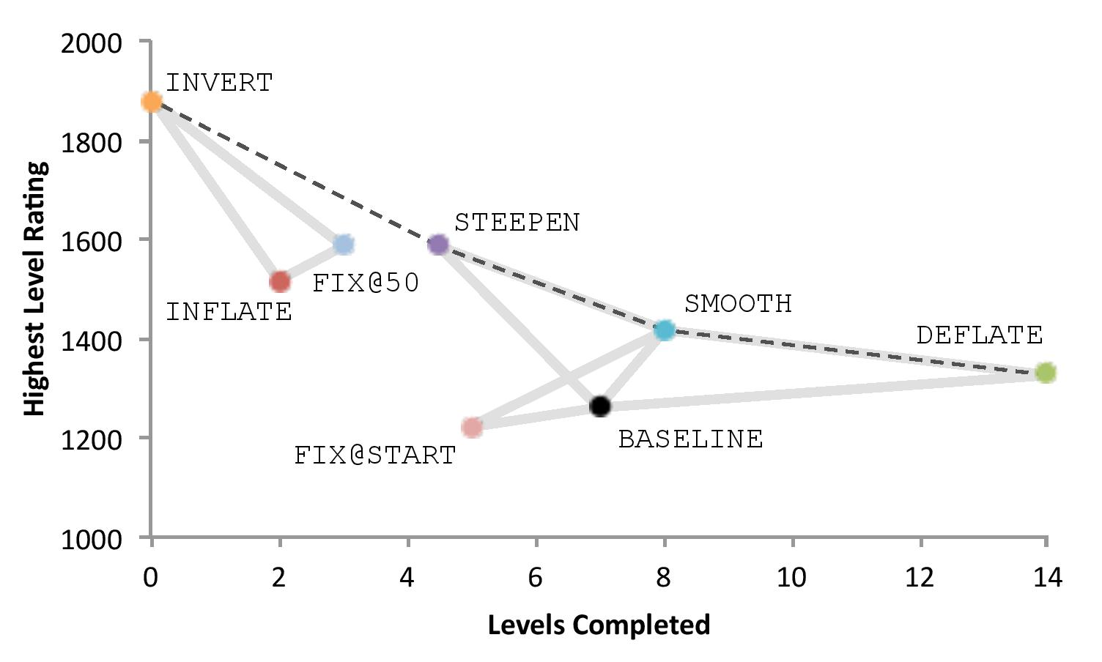
Pareto Efficiency
HCGs try to maximize the number and/or quality of in-game tasks that players complete
Trade off between amount of work done (Levels Completed) and its quality (Highest Level Rating)
Found the curves INVERT, STEEPEN, SMOOTH, DEFLATE to be Pareto efficient for Levels Completed and Highest Level Rating
Notes:
From our analyses, comparing Levels Completed and Highest Level Rating revealed 4 of the difficulty curves (INVERT, STEEPEN, SMOOTH, DEFLATE) to be Pareto efficient for these 2 variables
For each of these curves you can’t improve upon one of the 2 measures without making the other one worse
And the take home for this analysis is that it enables designers to do something like say if we have a smooth difficulty curve and we want players to do more work, we should deflate the curve; or if we want players to solve harder levels, we should consider making the curve more steep

Slide 37
Pareto Efficiency
HCGs try to maximize the number and/or quality of in-game tasks that players complete
Trade off between amount of work done (Levels Completed) and its quality (Highest Level Rating)
Found the curves INVERT, STEEPEN, SMOOTH, DEFLATE to be Pareto efficient for Levels Completed and Highest Level Rating
Original BASELINE was outperformed by SMOOTH and DEFLATE suggesting that these might be better curves for Paradox
Notes:
Interestingly though differences weren’t significant, the original BASELINE was outperformed by SMOOTH and DEFLATE in terms of both variables, suggesting that these might be better difficulty curves for Paradox in the future and speaking to the potential usefulness of this technique for exploring the space of difficulty curves

Slide 38
Conclusion
A formal approach to transforming a game’s difficulty curve using function composition
Notes:
We demonstrated a formal approach to transforming a game’s difficulty curve by modeling it as function composition.

Slide 39
Conclusion
A formal approach to transforming a game’s difficulty curve using function composition
Modified curve of Paradox to generate new curves and precisely defined transformations
Notes:
This enabled us to modify the existing curve of the game Paradox to generate new curves for the game and give mathematically precise definitions to how each curve modified the original curve.

Slide 40
Conclusion
A formal approach to transforming a game’s difficulty curve using function composition
Modified curve of Paradox to generate new curves and precisely defined transformations
Transformed curves impacted gameplay and some improved engagement
Notes:
Our experiment revealed that the transformed curves impact gameplay significantly and that some of them improve player engagement compared to the game’s existing difficulty curve

Slide 41
Conclusion
A formal approach to transforming a game’s difficulty curve using function composition
Modified curve of Paradox to generate new curves and precisely defined transformations
Transformed curves impacted gameplay and some improved engagement
Contact
Acknowledgments
Anurag Sarkar Northeastern University sarkar.an@husky.neu.edu
This material is based upon work supported by the National Science Foundation under grant no. 1652537. We would like to thank the University of Washington's Center for Game Science for initial Paradox development.
Notes:
Our experiment revealed that the transformed curves impact gameplay significantly and that some of them improve player engagement compared to the game’s existing difficulty curve

