Slide 1
Build Your Image using KIWI. Customize what You want!
Let's rock with openSUSE and KIWI!
Rifki Affandi
openSUSE
rifkiaz@opensuse.org/id

Slide 2
Let’s rock with openSUSE And KIWI

Slide 3
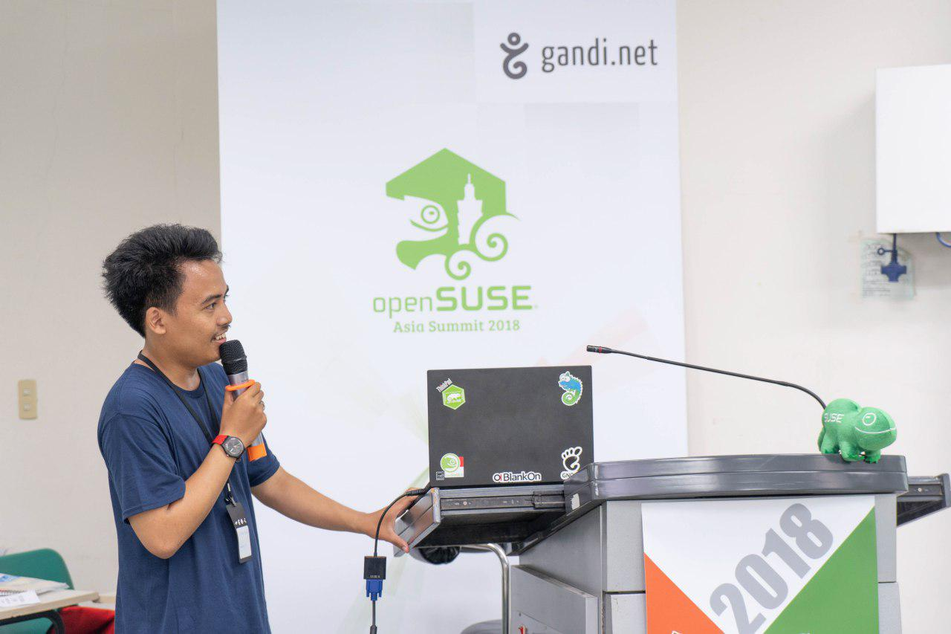
About Me
openSUSE-ID
openSUSE Member
Mahasiswa
FLOSS enthusiast
Contact : rifkiaz@opensuse.org/id
Telegram : @rifkiaz

Slide 4

What is KIWI?

Slide 5
KIWI is…..
KIWI is a command line tool, written in Perl, for building images for Linux. It supports a variety of image formats. KIWI is used as a back-end for the appliance builder SUSE Studio. It is also used to build images in the openSUSE Build Service, among them images for all SUSE products.

Slide 6
KIWI Support for
ISO
Live CD/DVD
PXEBoot
Hard disk
USB
Amazon EC2(.ami)
Docker
Google Cloud Format(..gce)
PXEBoot
KVM/Qemu (.qcow2)
Open Virtualization Format (.ovf)
Etc

Slide 7
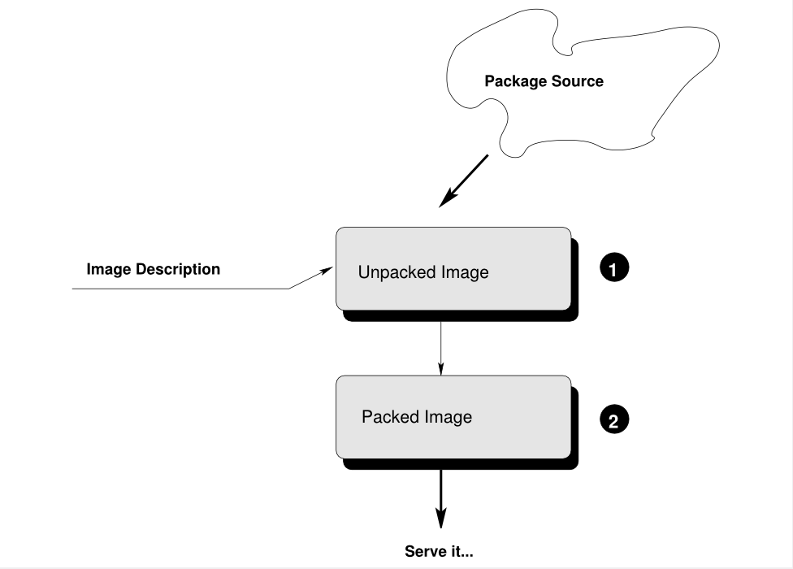
Workflow KIWI

Slide 8
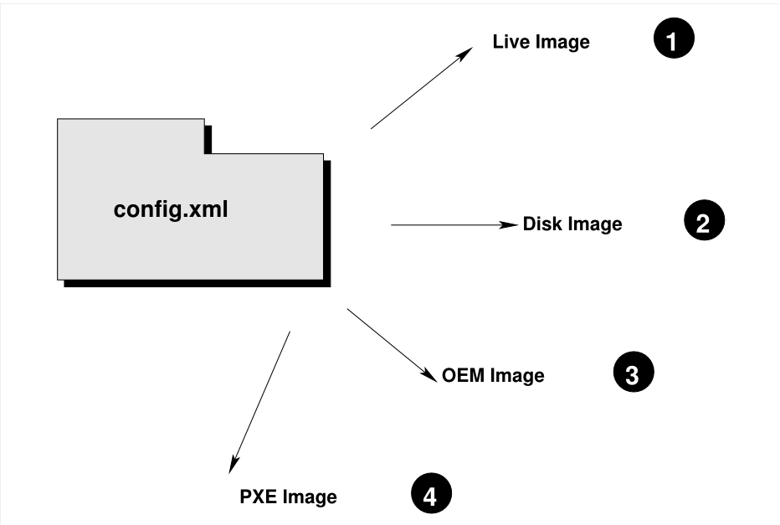

Slide 9
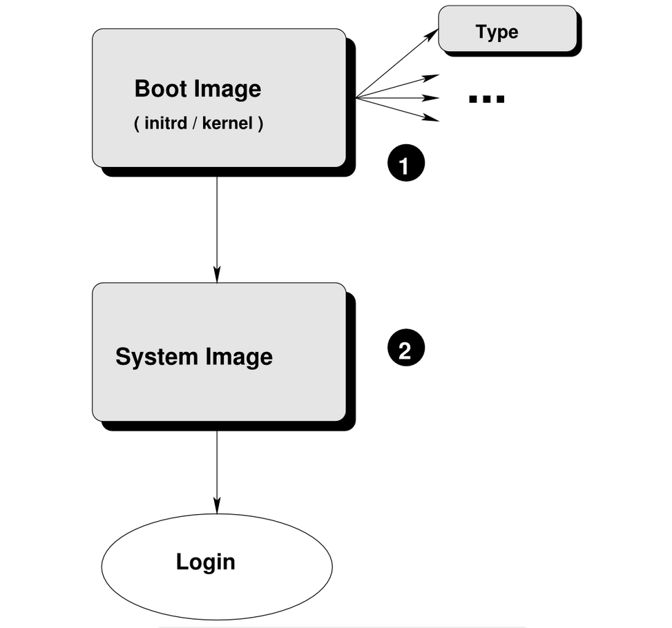

Slide 10
What We Need?
Folder and any file (kiwi-description)
Internet connection
Coffe
Pray

Slide 11
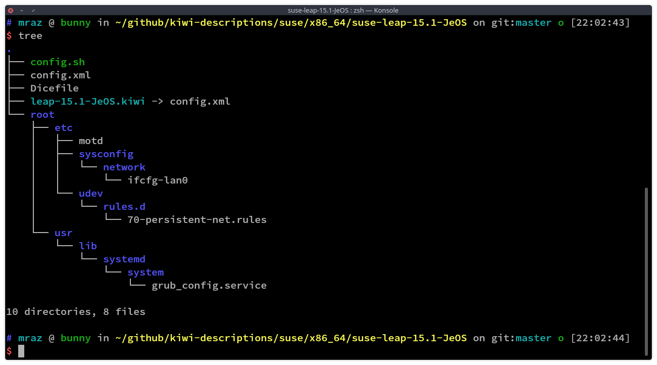

Slide 12
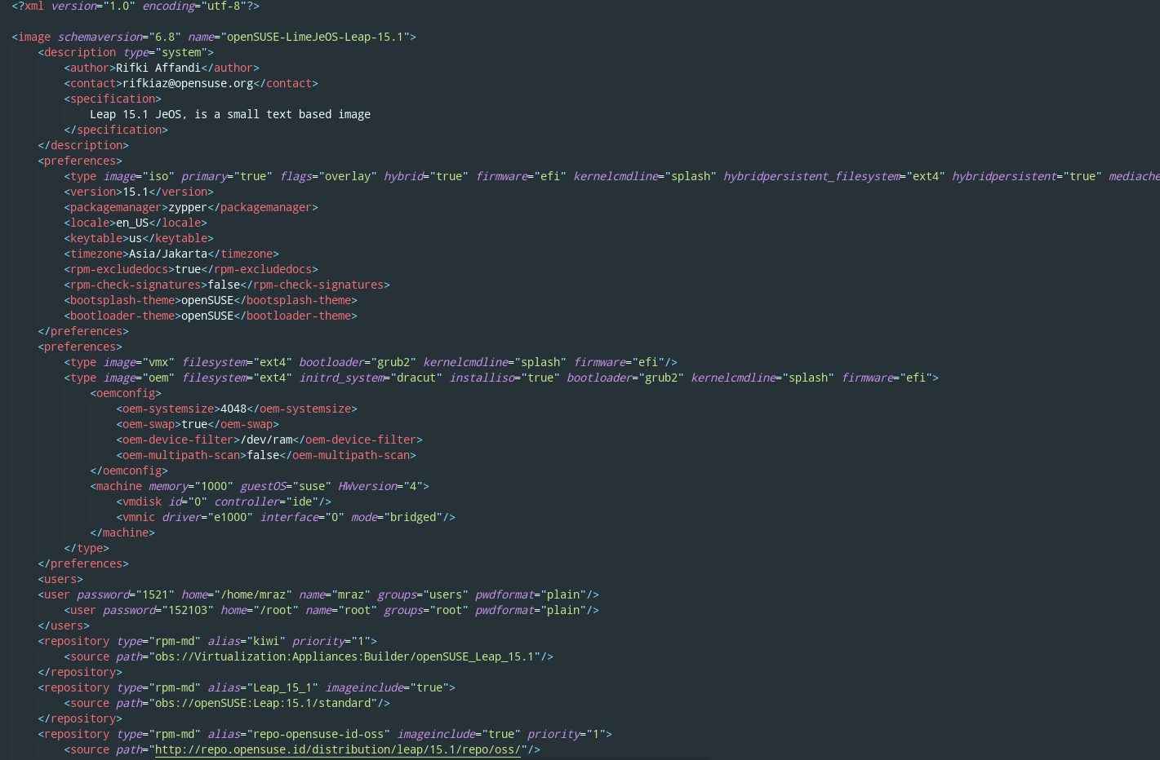

Slide 13
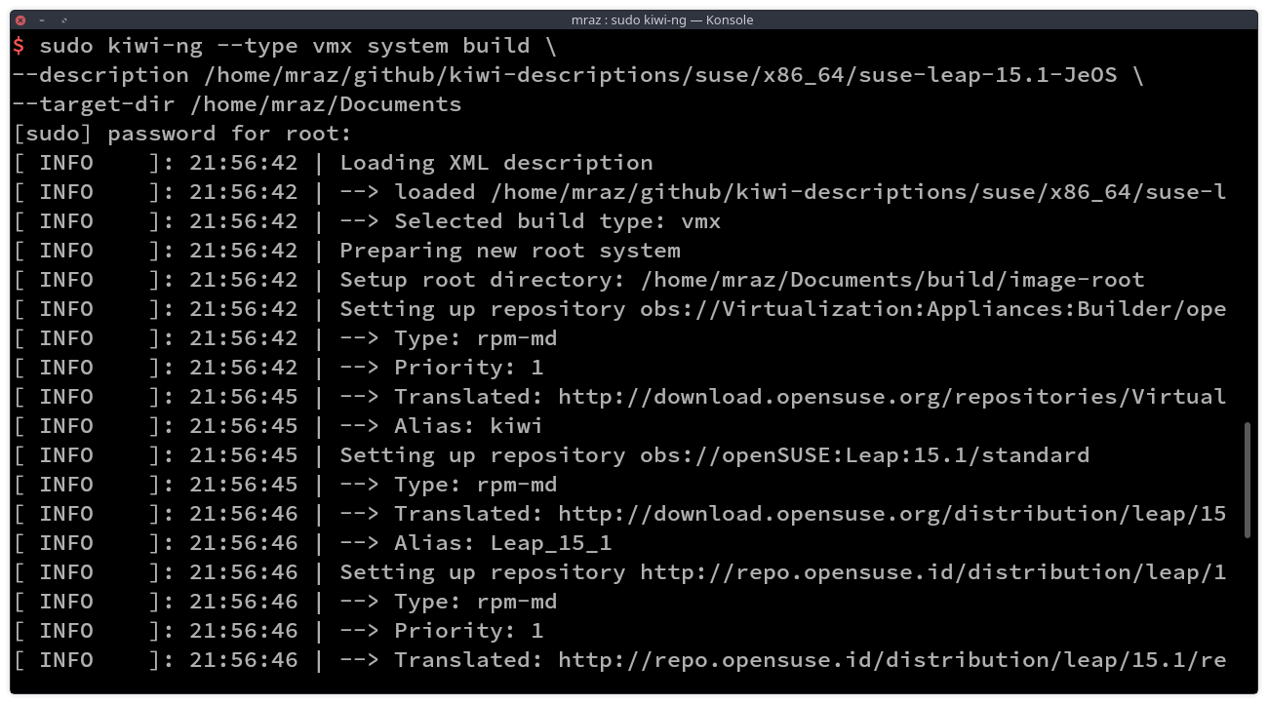
Process Build Image using KIWI (ISO and RAW)

Slide 14
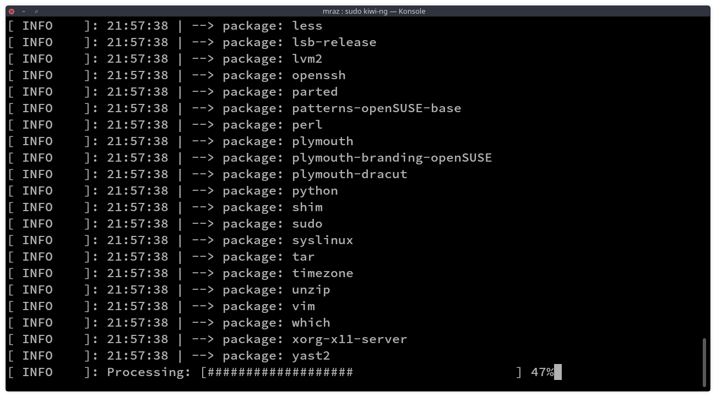

Slide 15
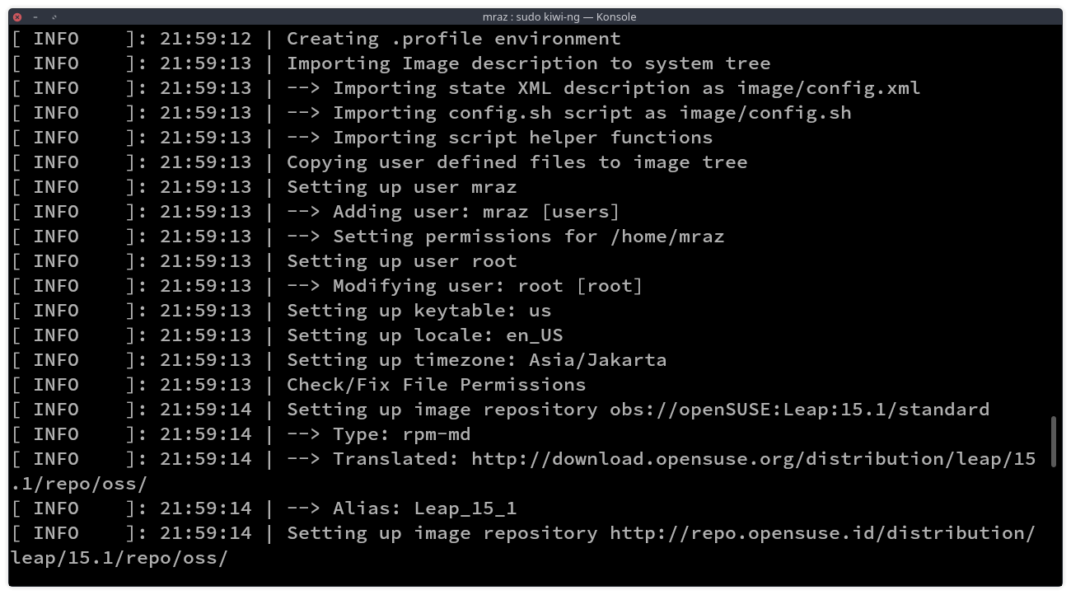

Slide 16
