Slide 1

Case Studies
Inception network motivation
deeplearning.ai

Slide 2
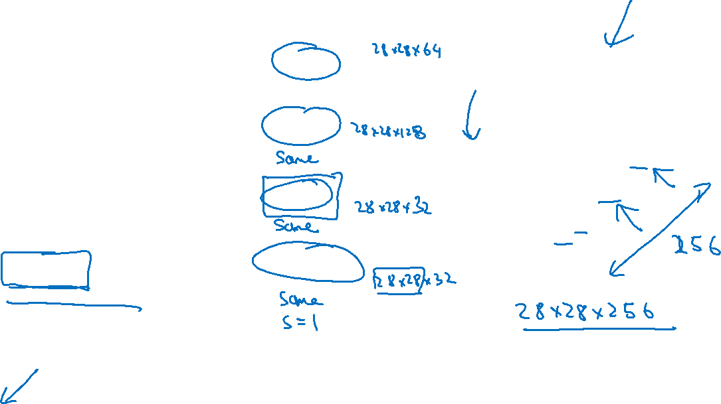
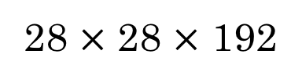
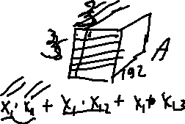
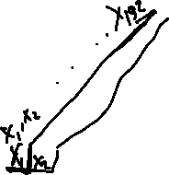
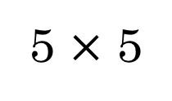
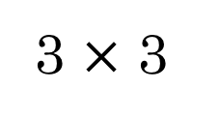

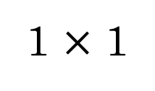

Motivation for inception network
1 $×$ 1
3 $×$ 3
64
5 $×$ 5
128
28
32
32
28
28 $×$ 28 $×$ 192
MAX-POOL
[Szegedy et al. 2014. Going deeper with convolutions]
Note: the colors are intended to correspond to the stacked small hand drawn cube

Slide 3
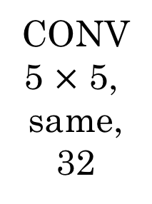
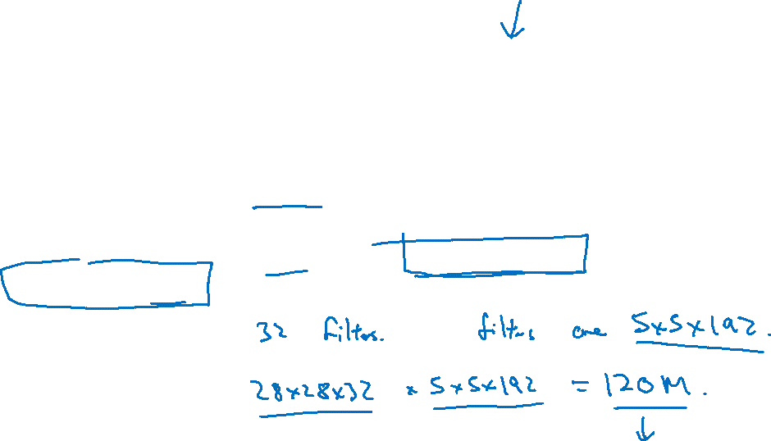
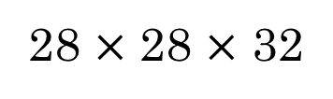
The problem of computational cost
CONV
5 $×$ 5,
same,
32
28 $×$ 28 $×$ 32
28 $×$ 28 $×$ 192

Slide 4



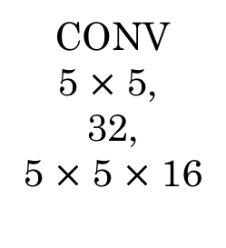

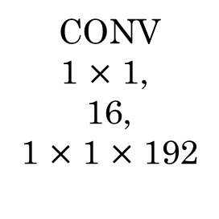
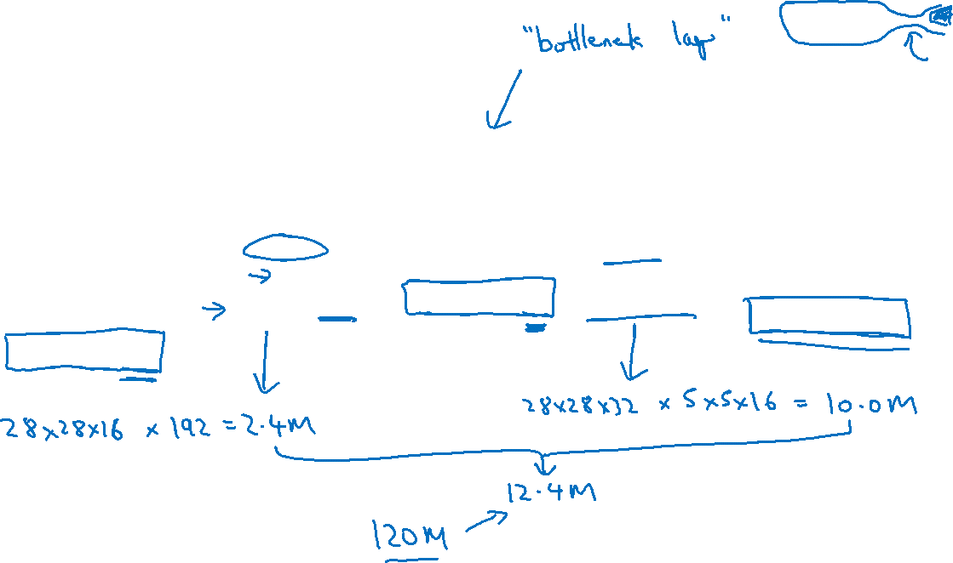
Using 1$×$1 convolution
CONV
1 $×$ 1,
16,
1 $×$ 1 $×$ 192
CONV
5 $×$ 5,
32,
5 $×$ 5 $×$ 16
28 $×$ 28 $×$ 16
28 $×$ 28 $×$ 32
28 $×$ 28 $×$ 192

