Slide 1

SharePoint/Office 365 Governance Questions
September 10, 2019
http://tiny.cc/SharePointGovQuestions
©2019 SUSAN HANLEY LLC

Slide 2
How to use this document
The key to successful plans for Office 365 governance starts with having the right conversations with the right individuals at the right time.
If you start with the right questions, you can build your governance content from the answers.
This document is designed to help guide you through the questions in a series of conversations, designed to cover the “big questions” first and then make more detailed decisions after the big decisions are made.
Note: As of June 2019, this document no longer includes questions and guidance relevant for only SharePoint 2013. If you would like a copy of the “legacy” version of this document, please send a request to sue@susanhanley.com.

Slide 3
Governance Framework Meeting Topics
 | Overview and Key Decisions | Roles and Responsibilities | Enterprise Decisions | Records Management | Individual User Content | Enterprise Social | Development and Ops
Date | Typically requires two meetings
Topic | Vision “Up front” General Governance | Roles and Responsibilities | Detailed decisions about Guiding Principles Compliance Themes and Designs IA | Records Management | Individual Content: User Profile and OneDrive | Enterprise Social (Yammer) | Standards and guidelines for customization
Key Goals | Get on the same page with regard to outcomes. Key decisions: Security and privacy External sharing Provisioning Naming conventions Compliance/ enforcement | Define key roles for the organization. Identify roles that may need to be added or up-skilled. Training and Expectations for each role. | Define guidelines for detailed enterprise decisions. Define key expectations for IA and site designs, including themes and brand compliance. Team collaboration governance. | Understand how records requirements impact content management, IA, site creation and de-commissioning, and compliance. | Define expectations and content requirements. | Define expectations and responsibilities. | Determine what approaches and standards need to be established for customizations to SharePoint (particularly for contracted development teams).
Who attends? | Governance Core Team | Governance Core Team (may need input from HR re: job descriptions) | Governance Core Team + Comms Team (if there is no Comms rep already on the Governance Core Team) | Governance Core Team + Team responsible for Records Management | Governance Core Team + Comms + HR + (possibly) Legal | Governance Core Team Service Owners for Yammer Possibly: Legal and HR | Technical members of the Governance Core Team Key IT development leaders
Note: the order of the meetings (other than the first one) doesn’t really matter. Choose the order that makes sense for your core team and organization.

Slide 4
Governance Core Principle: Our digital workplace includes several “services” offered to users. The vision and goals may be different for each type – along with the governance policies and guidelines.
Me
We
Us
Audience: OneDrive (Me); Profile (Organization)
Focus: Collaboration and Communication
Model: I am the owner
Governance: Depends on the content and organizational objectives
Audience: Team
Focus: Collaboration
Model: Contributors = Consumers
Governance: May be important when external parties are involved or knowledge management is a desired outcome; may be less important for teams with a narrow reach
Audience: Organization
Focus: Communications
Model: Small number of content publishers; larger number of consumers
Governance: Most Important
OneDrive for Business Personal Library
Team
Collaboration:
“Modern” Team Sites
“Classic” Team Sites
Teams
Home Page/Site
Functional Portals and Hubs – e.g. HR
Divisional/Regional Portals or Hubs
Enterprise Social Networks (Yammer)
User Profile
Communication Sites
Yammer Communities

Slide 5
Overview and Key Decisions
Understand Business Outcomes and Guiding Principles

Slide 6
Vision and Overview
Key Governance Question | Decision/Answer | Reference (in governance/training content)
How do is the scope of the digital workplace defined for our organization?
How do we define the role of Office 365 in this context?
Are there specific terms that should be used in governance and training documentation?
What are the guiding principles that align with the vision? | (See examples on the following pages)

Slide 7
Governance Planning Decisions
Key Governance Question | Decision/Answer | Reference (in governance/training content)
Who will have responsibilities for maintaining the “governance plan” (or the artifacts, training, and other processes where governance information is “consumed” by key stakeholders)?
Where will governance information “live”?
How will it be communicated to users?

Slide 8
Content Governance Summary (example)
Solution Area | Ownership/ Accountability | Who Can Create? | External Access Allowed? | Frequency/Type of Review | Governance Overview
Intranet Home | Internal Communications |  |  | Ongoing review for news All documents and pages reviewed at least monthly | Tightly controlled Formal content management processes Content managed by Internal Communications
Enterprise-facing Portals and Communication Sites
Divisional Portals
Topic-focused Communication Sites (micro-sites)
Yammer Communities
Team Collaboration Workspaces
Personal Libraries on OneDrive for Business
Enterprise Video (Office 365 Video or Stream)

Slide 9
“Up front” Decisions
Critical Conversations for Office 365 (General)

Slide 10
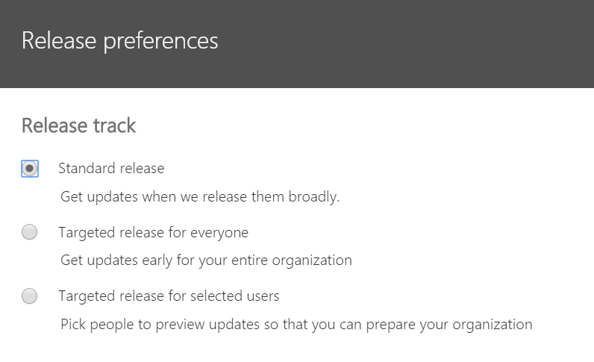
General Settings | Office 365
Key Governance Question | Decision/Answer | Reference (in governance/training content)
What type of release track do we want for the organization? Set this preference in the Office 365 Admin Center in Settings > Organization profile. Do we want to identify selected users to be in Targeted release? Note: If you identify selected users for targeted release, be sure that these users also have access to an account that is in standard release if you want to be able to test different experiences for new features. |  | N/A
Notes:
Note: there will be other decisions for IA, but the one that typically “bites” organizations if they haven’t thought about this first is site naming!

Slide 11
Provisioning
Key Governance Question | Decision/Answer | Reference (in governance/training content)
Who can provision new collaboration sites and groups? Team Sites/Office 365 Groups Teams Communication Sites Yammer Groups Stream Groups Options (see license requirements) Admin only (no special license required) Specific group of people (Azure AD Premium P1 for members of the group) Anyone (no special license required) | Review: https://support.office.com/article/manage-who-can-create-office-365-groups-4c46c8cb-17d0-44b5-9776-005fced8e618#why Generally recommended: something between only IT and everyone in the organization.
Who can provision new enterprise-facing communication sites? (Note: this can be effectively disabled with a SharePoint Admin setting.
If provisioning is “open,” what types of checks and balances and guidance should be considered to guide site owners and prevent the “wild, wild west?”
If provisioning is not “open,” how will provisioning be managed? (Service Desk request, form, etc.)
Once sites have been provisioned, who is responsible and accountable for managing security on the individual site?
Should sub-sites be disabled for the tenant?

Slide 12
Provisioning – Office 365 Groups
Key Governance Question | Decision/Answer | Reference
Do we want to restrict who can create new Office 365 Groups? (If so, be sure that you have the right licenses for your users. See: https://support.office.com/en-us/article/Learn-about-Office-365-Groups-b565caa1-5c40-40ef-9915-60fdb2d97fa2#ID0EAADAAA=Feature_availability_and_licensing and https://docs.microsoft.com/en-gb/office365/admin/create-groups/manage-creation-of-groups?view=o365-worldwide
Does we require some groups to be created dynamically based on user attributes, such as department? (See: https://docs.microsoft.com/en-gb/azure/active-directory/users-groups-roles/groups-dynamic-membership)
Are naming policies needed for Groups? (including blocked words) (Prefix/Suffix and blocked words) - if enabled, requires Azure AD Premium P1 license required) See: https://docs.microsoft.com/en-gb/office365/admin/create-groups/groups-naming-policy?view=o365-worldwide
Are people outside the organization allowed to email the Group? (this is a setting for the Group) By default, this setting is turned off for each group but can be enabled by the Group owner.
Are internal non-members allowed to email the group? This can be restricted via PowerShell: Set-UnifiedGroup groupname -AcceptMessagesOnlyFromSendersOrMembers groupname. To hide the group from the GAL, you can use: Set-UnifiedGroup -Id Group -HiddenFromAddressListsEnabled $True. However, the group may appear in a few other places – like Planner. For more information, see: https://techcommunity.microsoft.com/t5/Office-365-Groups/Hide-Group-email-from-global-address-list/m-p/4569#M160
What type of classification is required for groups?
Notes:
Resource: https://docs.microsoft.com/en-us/office365/admin/create-groups/plan-for-groups-governance?view=o365-worldwide
Detailed overview of governance planning for Office 365 Groups: https://docs.microsoft.com/en-us/office365/admin/create-groups/plan-for-groups-governance?view=o365-worldwide

Slide 13
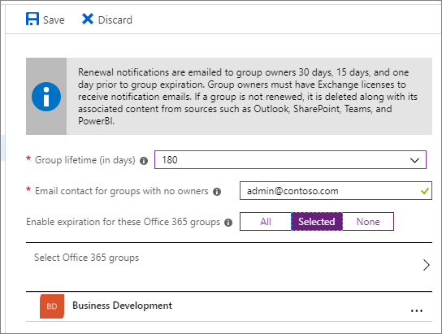
Provisioning – Office 365 Groups
Key Governance Question | Decision/Answer | Reference
Is an expiration policy required for Groups? https://docs.microsoft.com/en-us/office365/admin/create-groups/office-365-groups-expiration-policy?view=o365-worldwide Note: Group expiration is an Azure Active Directory (Azure AD) Premium feature. You must have a subscription to Azure AD Premium in order to have this feature available. The administrator who configures the settings, and the members of the affected groups, need to have Azure AD Premium licenses assigned to them.

Slide 14
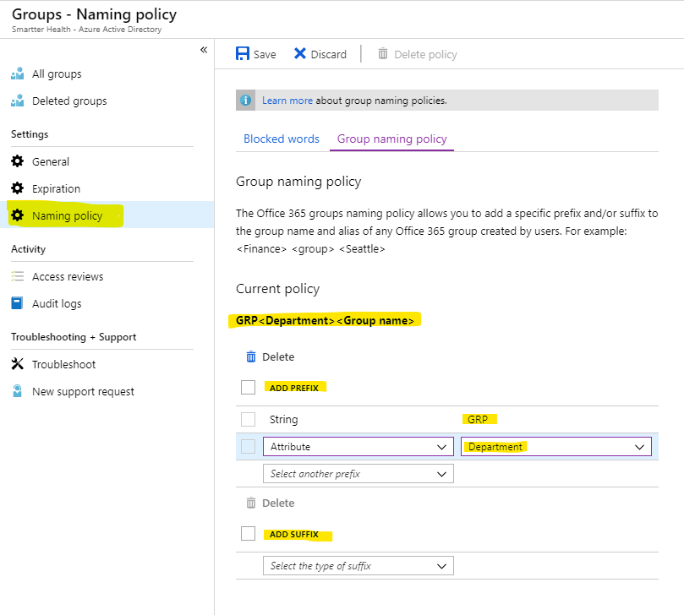
Naming Policy Examples
For an “All IT” Team
GRP – IT – All IT (Prefix – Dept – Name)
Team – All IT – Corp (Prefix – Name – location)
All It – Corp (Name – location)
For an “Onboarding” Team in HR
GRP - HR – Onboarding (Prefix – Dept – Name)
Team – Onboarding – West (Prefix – Name – Location)
Onboarding – West (Name – Location)
These settings are very simple and can be configured in Azure Active Directory (AAD) under groups.

Slide 15
Provisioning models for Office 365 Groups
Model | Advantages
Open (default) | Users can create their own groups as needed without needing to wait for IT
IT-led | Users request a group from IT. IT can guide them in selecting the best collaboration tools for their needs.
Controlled | Group creation restricted to specific people, teams or services. (See: Control who can create Office 365 Groups)
To manage who creates Office 365 Groups, the following people need Azure AD Premium licenses or Azure AD Basic EDU licenses assigned to them:
The admin who configures these group creation settings
The members of the security group who are allowed to create Office 365 Groups
The following people don't need Azure AD Premium or Azure AD Basic EDU licenses assigned to them:
People who are members of Office 365 groups and who don't have the ability to create other Office 365 groups.
Notes:
See: https://docs.microsoft.com/en-gb/office365/admin/create-groups/manage-creation-of-groups?redirectSourcePath=%252fen-us%252farticle%252fcontrol-who-can-create-office-365-groups-4c46c8cb-17d0-44b5-9776-005fced8e618&view=o365-worldwide

Slide 16
Understanding the relationship between a Group’s policy settings and SharePoint create site experience
How to establish settings for managing site creation in SharePoint:
https://support.office.com/en-us/article/Manage-site-creation-in-SharePoint-Online-e72844a3-0171-47c9-befb-e98b23e2dcf9?ui=en-US&rs=en-US&ad=US
 | Site Creation Enabled for the Tenant | Site Creation Disabled
Group Creation Enabled | Show “Create site” command on SharePoint home with the new site creation experience | If AAD property EnableGroupCreation is: True – Show “Create site” command False – Only show “Create site” command if the users is in the security group assigned to the GroupCreationAlowedGroupid AAD property
Group Creation Disabled | Only show the “classic” create site form OR Show a custom form if there is a custom form URL specified in the Site Creation settings. | “Create site” command is hidden for all users.
Notes:
By default, if group creation is enabled in the tenant, the “Create site” command will appear on SharePoint home, and if a user is permitted to create groups they will get the site creation experience. If the user is *not* permitted to create groups, they will get the classic self service provisioning experience that results in the creation of a subsite.
The current user is considered to have group creation permissions if the AAD property EnableGroupCreation is true, or it is false but the user is a member of the security group assigned to the GroupCreationAllowedId AAD property.
Site creation is enabled via SharePoint Admin Center under Site creation settings.

Slide 17
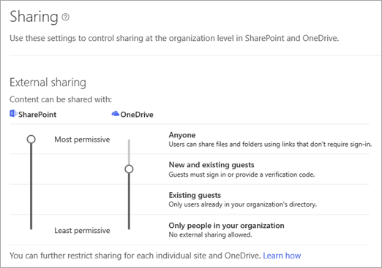
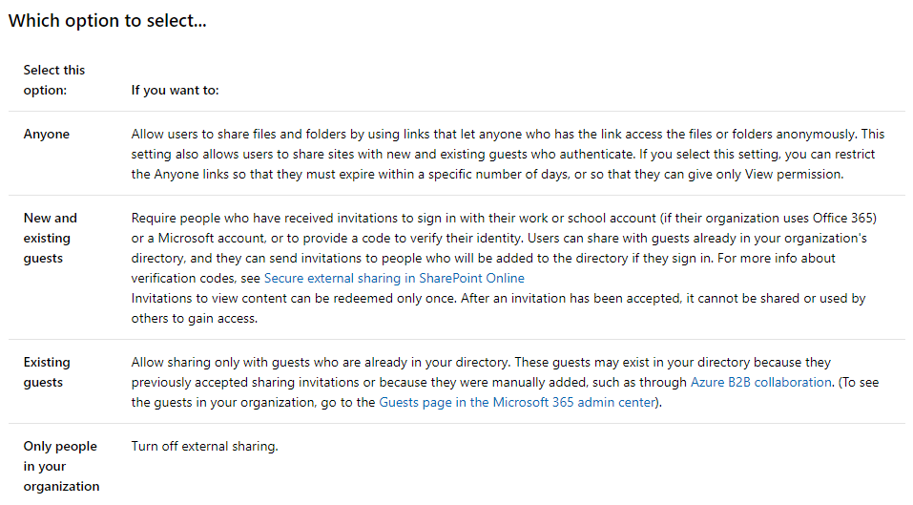
External Sharing
Key Governance Question | Decision/Answer | Reference (in governance/training content)
Should users be able to add new guests to the organization? This is the setting that allows/disallows users to be able to collaborate with people from outside your organization. | In general, you probably don’t want to disable this at the tenant level.
For more information, see: https://docs.microsoft.com/en-us/sharepoint/turn-external-sharing-on-or-off
Notes:
Guest access information: https://support.office.com/en-us/article/guest-access-in-office-365-groups-bfc7a840-868f-4fd6-a390-f347bf51aff6?redirectSourcePath=%252farticle%252f7c713d74-a144-4eab-92e7-d50df526ff96&ui=en-US&rs=en-US&ad=US

Slide 18
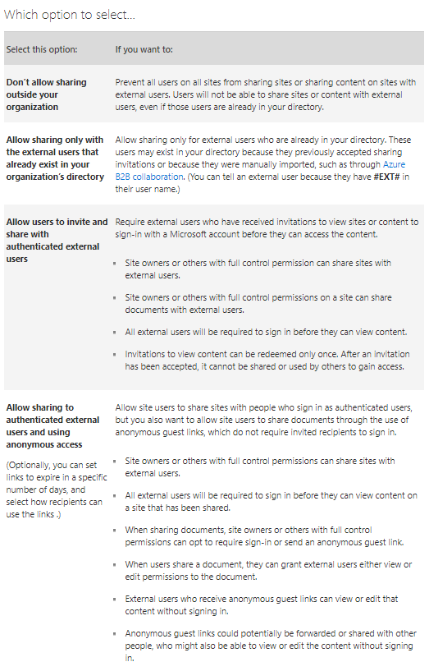
Understanding External Sharing
For more information, see: https://support.office.com/en-us/article/Turn-external-sharing-on-or-off-for-SharePoint-Online-6288296a-b6b7-4ea4-b4ed-c297bf833e30#ID0EAABAAA=Tenant_(global)
UNDERSTAND THE IMPLICATIONS
The external sharing settings for individual site collections cannot be less restrictive than whatever is allowed at the tenant level, but these settings can be more restrictive.
For example, if external sharing is turned on at the tenant level, but it is limited to allowing only authenticated users, then that will be the only kind of external sharing you can allow in a specific site collection.
If external sharing through both sign-in and anonymous guest links is allowed at the tenant level, then those options are also available for each site collection.

Slide 19
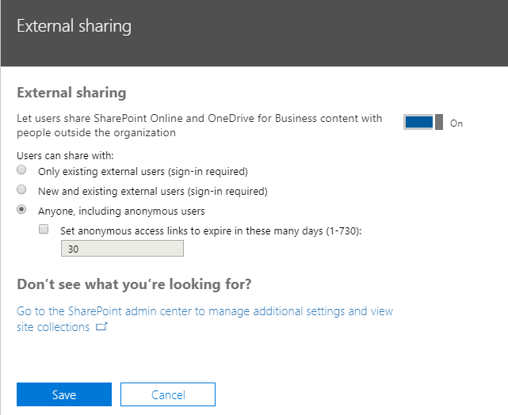
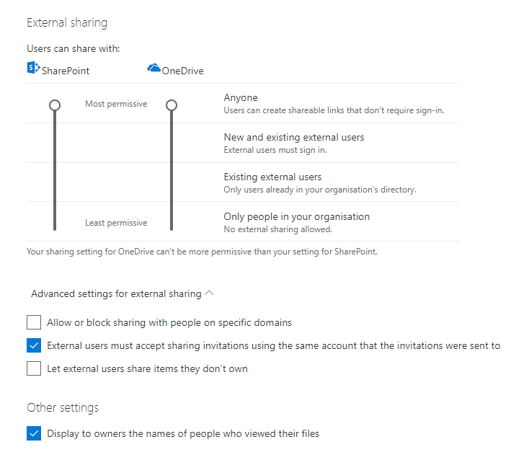
External Sharing in SharePoint and OneDrive
Key Governance Question | Decision/Answer | Reference (in governance/training content)
SharePoint and OneDrive: What should the default settings be for external sharing?
General Settings in the SharePoint Admin Center
General Settings in the OneDrive Admin Center
Notes:
https://docs.microsoft.com/en-gb/onedrive/manage-sharing

Slide 20
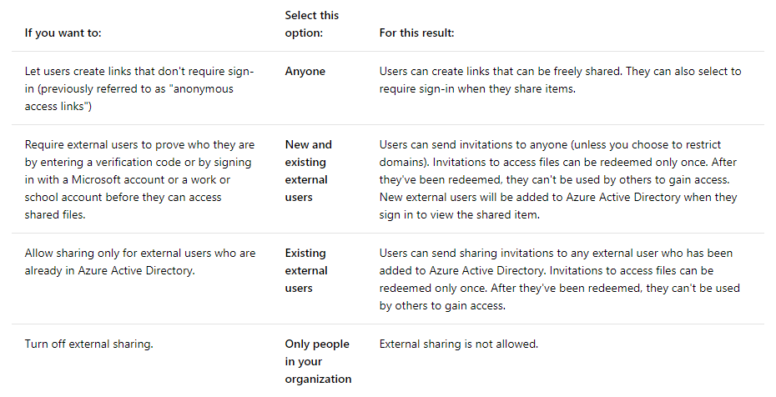
Details to support the discussion

Slide 21
External Access Decisions for Office 365 Groups
Key Governance Question | Decision/Answer | Reference
Do we need to allow or block guest access to any specific domains? For example, your business (Contoso) has a partnership with another business (Fabrikam). You can add Fabrikam to your Allow list so your users can add those guests to their groups. Or, you want to block personal email address domains. You can set up a Block list that contains domains like Gmail.com and Outlook.com. See more: https://technet.microsoft.com/library/a86bb46f-0e5b-43a3-b6ef-7394f344a8da See also: Adding guests to Office 365 Groups: https://support.office.com/en-gb/article/adding-guests-to-office-365-groups-bfc7a840-868f-4fd6-a390-f347bf51aff6

Slide 22
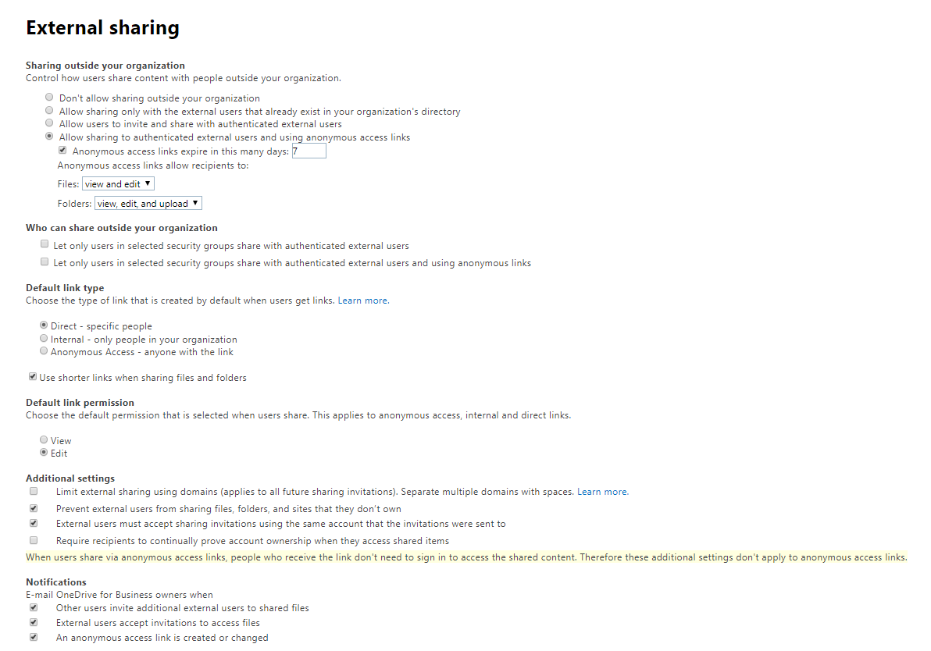
External Sharing
Key Governance Question | Decision/Answer | Reference (in governance/training content)
Additional settings: Do business needs require updates to any of these additional default External Sharing settings.
Notes:
https://docs.microsoft.com/en-gb/onedrive/manage-sharing

Slide 23
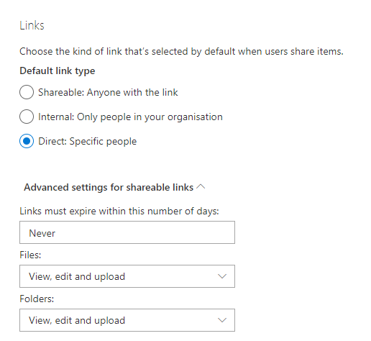
Sharing Links
Key Governance Question | Decision/Answer | Reference (in governance/training content)
What advanced settings do we want for shareable links? | For team collaboration, usually Edit links are preferred. But for communication sites, the default link should almost always be View. If the default link is Edit, Communication Site owners must be trained to select the appropriate link when sharing or publishing document links to avoid accidentally giving away the keys to the castle!
https://docs.microsoft.com/en-gb/onedrive/manage-sharing

Slide 24
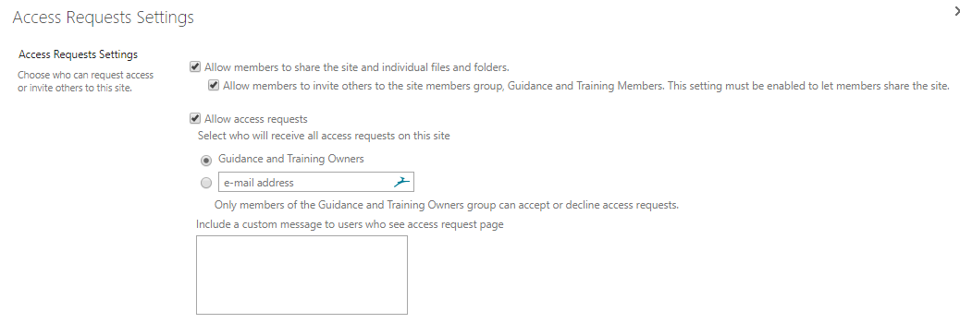
SharePoint Site Sharing and Access
Key Governance Question | Decision/Answer | Reference (in governance/training content)
Should all members or just site owners be able to share individual documents and folders? (site-specific setting)
Default Settings – set at the site collection level:

Slide 25
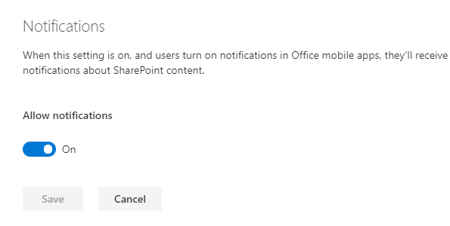
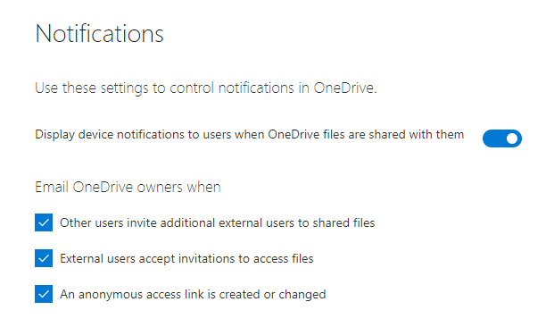
SharePoint and OneDrive | Notifications
Key Governance Question | Decision/Answer | Reference (in governance/training content)
SharePoint Notifications: What settings do we want for SharePoint notifications?
OneDrive Notifications: What settings do we want for OneDrive notifications?
Notes:
https://docs.microsoft.com/en-gb/onedrive/manage-sharing

Slide 26
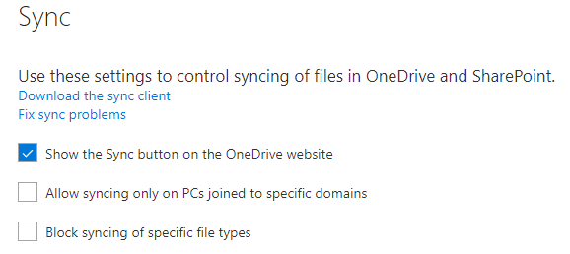
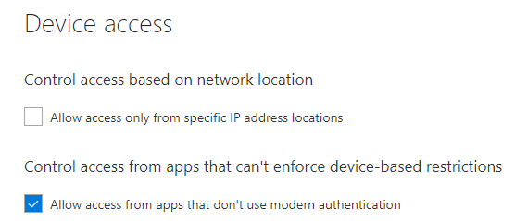
Sync and Access Decisions
Key Governance Question | Decision/Answer | Reference (in governance/training content)
Do you need to control Sync of files in OneDrive and SharePoint?
Do you need to control Access from specific devices or device locations?

Slide 27
Mobile Application Management (if enabled)
Key Governance Question | Decision/Answer | Reference (in governance/training content)
The following settings may be available based on which features are enabled/licensed for your tenant: Block downloading files in the apps Block taking screenshots in the apps (Android only) Block copying files and content within files Block printing files in the apps Block backing up app data Require app passcode Block opening OneDrive and SharePoint files in other apps Encrypt app data when device is locked Require Office 365 sign-in every 7 days.
Other settings: Number of minutes to verify user access after? ____ Days to wipe app data after? _____

Slide 28
Team Collaboration
Key Governance Question | Decision/Answer | Reference (in governance/training content)
Can all teams include external participants? (some or all)
Are there different types of team environments? For example, highly secure and cannot include some external participants, mission critical, ad hoc or temporary?
Do the same governance rules for different types of teams? Do we need to assign specific classifications to team sites?
Do all teams need to use the same solution for teamwork or can each team decide how they want to collaborate? (i.e. Should all teams use Teams?)

Slide 29
Other Office 365 Services
Key Governance Question | Decision/Answer | Reference
Emerging Services: Can users take advantage of new, pilot or emerging services if they are available in your tenant? What kind of specific guidance do we want to provide about new or emerging services – for example, can they be used for business-critical applications while they are in “preview?
Are there any services that need to be blocked? If so, what is the business reason for doing so?
Specialized services (Planner, PowerBI, Flow, PowerApps): What types of guidance is needed for other services that will be made available to users?
Flow and PowerApps Governance: What type of DLP considerations need to be made with regard to Flow and connecting information services inside and outside the company. Do you need to create “data zones” for business and non-business data. Review DLP considerations: https://flow.microsoft.com/en-us/documentation/prevent-data-loss/ and FAQs in the PowerApps and Flow blog post: https://techcommunity.microsoft.com/t5/SharePoint/GA-Microsoft-PowerApps-and-Flow/m-p/25921
Notes:
Microsoft recommends that Office 365 Admins review the data loss prevention (DLP) capabilities for Microsoft Flow. All Office 365 Admins can sign into the Flow administration site without the need for any additional licenses and set up rules that determine how data can flow between different Office 365 components (such as SharePoint, Outlook, Yammer) and other Microsoft and third-party services. If you need more specific guidance on DLP and controlling user access to Flow, review FAQs in: https://techcommunity.microsoft.com/t5/SharePoint/GA-Microsoft-PowerApps-and-Flow/m-p/25921

Slide 30
Information Architecture
Key Governance Question | Decision/Answer | Reference (in governance/training content)
Are there any organizational, industry, or regulatory concerns that need to govern Office 365 in terms of records retention, compliance (e.g. HIPAA), that need to be incorporated in to the solution design architecture?
What types of site naming conventions do we want to recommend? (See Naming Conventions) (Note: file naming conventions may also be needed.) See: https://docs.microsoft.com/office365/admin/create-groups/groups-naming-policy. Note licensing requirements.
Do we need to enforce a naming policy across all services? https://docs.microsoft.com/en-us/azure/active-directory/users-groups-roles/groups-naming-policy
Are there metadata values (term sets) that should be implemented to ensure consistency and “findability” across the enterprise? For example: office locations, organizational units. | It is not necessarily critical to resolve this question immediately – but it is helpful to start thinking about shared metadata as early as possible in the deployment.
Notes:
Note:
To use the Groups naming policy feature, the following people need an Azure Active Directory Premium P1 license or Azure AD Basic EDU license:
Everyone who is a member of the group.
The person who creates the group.
The admin who creates the Groups naming policy

Slide 31
Questions Admins often ask (from Joanne Klein)
https://joannecklein.com/2019/08/29/questions-from-the-field-for-admins-new-to-office-365/

Slide 32
“Up front” Decisions for Microsoft Teams
Critical Conversations for Microsoft Teams

Slide 33
Key “up front” decisions | Microsoft Teams Provisioning
Key Governance Question | Decision/Answer | Reference (in governance/training content)
Do we need a naming convention for Teams? You can use Prefix-Suffix–based and Custom Blocked Words. (See license requirements.) | See Groups naming
Do team creators need to be able to assign organization-specific classification to Teams? (See license requirements)
Do we need to restrict the ability to add guests to Teams on a per-Team basis? See: https://docs.microsoft.com/en-us/MicrosoftTeams/guest-access | Helpful blog post with PowerShell examples of numerous Teams governance scenarios: https://www.jijitechnologies.com/blogs/microsoft-teams-governance

Slide 34
Teams provisioning license implications
Capability Required | Details | Azure AD Premium License Required?
Team naming policy | Use Prefix-Suffix–based, Custom Blocked Words. | P1
Team classification | Assign classifications to teams. | P1
Team guest access | Allow or prevent guests from being added to teams. | No
Team creation | Limit team creation to administrators | No
Team creation | Limit team creation to the members of a specific security group | P1

Slide 35
Key “up front” decisions | Microsoft Teams Retention
Key Governance Question | Decision/Answer | Reference (in governance/training content)
Is there a requirement to specify an expiration date for Teams? (see retention license requirements) https://docs.microsoft.com/en-us/office365/admin/create-groups/office-365-groups-expiration-policy?view=o365-worldwide
Is there a specific data retention policy required for Teams? (see retention license requirements) Retention policies to consider: Teams Chat – this setting applies to how long you want chat history to be stored Teams Conversation – this setting applies to how long you want the channel conversations to be kept and stored O365 Group content – this setting applies to all the content in the team, the group mailbox, the SharePoint site and the document library | Each retention policy can be the same or different, they have no dependencies on each other. Retention is not the same as expiration though. Just because a team is expired does not mean the content is deleted. For ex: if your expiration is 6 months and retention is 2 years, the team will be deleted after 6 months (if not renewed) but the content will be retained for 2 years.
Do we need to require the ability to archive inactive teams to preserve the content in a read-only state? (see license requirements)

Slide 36
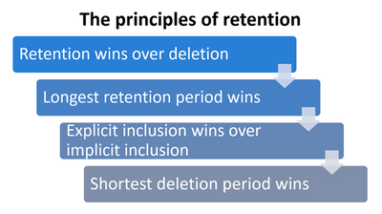
Retention Principles

Slide 37
Teams retention license implications
Capability Required | Details | Azure AD Premium License Required?
Expiration policy | Manage the lifecycle of Office 365 groups by setting an expiration policy. Group expiration is an Azure AD Premium feature. For this feature to be available, your tenant must have a subscription to Azure AD Premium and licenses for the administrator who configures the settings and the members of the affected groups. | P1
Retention policy | Retain or delete data (Teams channel messages and channel files) for a specific time period by setting retention policies for Teams in the Security & compliance center. Note: Using this feature requires licensing of Office 365 Enterprise E3 or above. | No
Archive and restore | Archive a team when it’s no longer active but you want to keep it around for reference or to reactivate in the future. | No
For additional information about governance for Microsoft Teams, see:
https://docs.microsoft.com/en-us/microsoftteams/plan-teams-governance

Slide 38
Key “up front” decisions | Microsoft Teams DLP
Key Governance Question | Decision/Answer | Reference (in governance/training content)
Is it required to protect confidential or sensitive data in Teams? (Data Loss Prevention) See: https://docs.microsoft.com/en-us/office365/securitycompliance/dlp-microsoft-teams
Data loss prevention capabilities were recently added to Microsoft Teams chat and channel messages for users licensed for Office 365 Advanced Compliance, which is available as a standalone option and is included in Office 365 E5 and Microsoft 365 E5 Compliance. Office 365 and Microsoft 365 E3 include DLP protection for SharePoint Online, OneDrive, and Exchange Online. This also includes files that are shared through Teams because Teams uses SharePoint Online and OneDrive to share files. Support for DLP protection in Teams Chat requires E5. To learn more about licensing requirements, see Microsoft 365 Tenant-Level Services Licensing Guidance.

Slide 39
Key “up front” decisions | Microsoft Teams External Chat
Key Governance Question | Decision/Answer | Reference (in governance/training content)
Do users need to be able to chat with people outside the company? If so, you will need to take advantage of Teams Federation/External Access: https://docs.microsoft.com/en-us/microsoftteams/manage-external-access
External access (federation) and guest access are different:
Guest access gives access permission to an individual.
External access gives access permission to an entire domain.
Guest access, once granted by a team owner, allows a guest to access resources, such as channel discussions and files, for a specific team, and chat with other users in the team they have been invited to. With external access (federated chat), the external chat participants have no access to the inviting organization’s teams or team resources. They can only participate in one-on-one federated chat. Tenant admins can choose between the two communication options depending on which level of collaboration is desirable with the external party. Admins can choose either approaches or both, depending on their organizational needs, but we recommend enabling guest access for a fuller, collaborative Teams experience.

Slide 40
Key “up front” decisions | Microsoft Teams Features
Key Governance Question | Decision/Answer | Reference (in governance/training content)
Do we need to limit Teams features (default and external apps) for the entire tenant? See: https://docs.microsoft.com/en-us/MicrosoftTeams/enable-features-office-365 See: Manage meeting policies in Teams
Do we need to limit Teams features for specific users?
Admins and team owners can control whether private teams can be discovered by Microsoft Teams users in your organization. When a private team is discoverable, it shows up in search results and is included in suggestions in the team gallery alongside public teams in Teams. This makes it easy for users to search for and find the private teams that they want to join. Users can request to join a private team which a team owner can then approve or deny. Do you need to control which users in the organization are allowed to discover private teams (for which team discovery setting is enabled)? (For a given team to be discoverable for a given user, that team’s setting would need to be set to be discoverable and discovery would need to be enabled for the user through policy.) | See: https://docs.microsoft.com/en-us/microsoftteams/manage-discovery-of-private-teams

Slide 41
Key “up front” decisions | Microsoft Teams Features
Key Governance Question | Decision/Answer | Reference (in governance/training content)
Do we need to prevent communications in Microsoft Teams between specific groups of people? (This is particularly helpful for organizations that need to adhere to ethical wall requirements and other related industry standards and regulations.) Scenarios in which this might be needed: A team must be prevented from communicating or sharing data with a specific other team. A team must not communicate or share data with anyone outside of the team For more information, see: https://docs.microsoft.com/en-us/office365/SecurityCompliance/information-barriers https://docs.microsoft.com/en-us/MicrosoftTeams/information-barriers-in-teams (preview feature)

Slide 42
Other Teams Deployment Decisions
Migration to Teams with Skype in place: Review setting your coexistence and upgrade settings: https://docs.microsoft.com/en-us/microsoftteams/setting-your-coexistence-and-upgrade-settings
Moving existing DL’s to Teams: Migrate traditional Distribution Groups to Office 365 Groups: https://techcommunity.microsoft.com/t5/Exchange-Team-Blog/Migrate-traditional-Distribution-Groups-to-Office-365-Groups/ba-p/605289

Slide 43
Roles and Responsibilities
Who will do what?

Slide 44
Roles and Responsibilities | General Decisions
Key Governance Question | Decision/Answer | Reference (in governance/training content)
Who is responsible for technical management of the environment?
Who is the Office 365 Admin?
Who is the SharePoint Admin?
Who is the Yammer Admin? If you are implementing Yammer, who will have overall responsibility for engaging community leaders/managers, monitoring creation of new groups, working with community managers to delete (or revive) inactive groups, promote and manage the use of Yammer across the enterprise?
Which role(s) will be responsible for the various change management aspects required to keep on top of changes to Office 365? Note: as of February 2018 you can add up to two additional people besides the Office 365 Admin to receive notifications about updates from the Office 365 Admin Message Center.

Slide 45
Ongoing Change Management
Office 365 roadmap – This is where Microsoft publishes what features are in development, rolling out, launched, etc.
Blogs.office.com – General blog site for Microsoft
Office 365 Blogs – SharePoint, Yammer, OneDrive, etc.
Office 365 Message Center (for the Office 365 Admin for your Organization). This is where Microsoft posts not only service status information, but also any upcoming features that require your attention.
Microsoft Tech Community – this is the public network community supported and managed by Microsoft. This is the best place post things you are noticing in your environment or questions you might have. Members of the network include the Microsoft product team, MVPs, and a large community of engaged and interested people all over the world. Be sure to follow the Change Alerts space in the network, another really good source of upcoming and just released change information. Below are links to communities that you will likely want to follow. Check out the Communities page to find a complete list of communities you can join.
SharePoint Community
OneDrive Community
Office 365 Community
Office 365 Groups Community
Yammer Community
Delve Community
UserVoice for Office 365 – This is a place to provide feedback that Microsoft pays attention to and uses to prioritize updates. You can add your request or “vote” on updates requested by other people. There are also separate user voice areas for some of the products and services within Office 365. For example:
OneDrive UserVoice
SharePoint UserVoice
Yammer UserVoice

Slide 46
Roles and Responsibilities | General Decisions
Key Governance Question | Decision/Answer | Reference (in governance/training content)
Who is the Business Owner of the Intranet/Digital Workplace? (Note: Successful intranets need business ownership. IT alone should not be the “owner” of the intranet.
Office 365 solutions are made up of multiple sites. Does each site need a Business Sponsor? Is the Business Sponsor also the Site Owner? Does the Site Owner have to be an employee? Do Site Owners have full control privileges? Who is ultimately accountable for content, organization, and user experience on sites?
If self-service site provisioning is not enabled, which role will provision sites? Will there be a team of people? Centrally located or distributed across the organization? Note that there are implications to restricting access to who can create Office 365 Groups. Be sure to review Manage who can create Office 365 Groups to understand these implications.
Who will be responsible for ongoing evaluation to ensure that each site continues to meet business and technical expectations?

Slide 47
Roles and Responsibilities | General Decisions
Key Governance Question | Decision/Answer | Reference (in governance/training content)
Who can grant access to each site? (Some organizations do not allow individual site owners to manage security on their sites. If this is something you decide to do, who will be responsible for managing security?)
If the governance plan says that page and site owners are responsible for content management, will there be a process to de-commission sites where no one in the organization will step up to page ownership responsibilities? Who will be responsible for making these decisions?

Slide 48
Roles and Responsibilities | Information Management
Key Governance Question | Decision/Answer | Reference (in governance/training content)
Is there any enterprise metadata that needs to be managed for the entire organization? Who is responsible for managing enterprise metadata?
In individual sites, who can set up or request new content types or site columns? How much central control do you want to have over the values in site columns within each site collection?

Slide 49
Roles and Responsibilities | Skills and Training
Key Governance Question | Decision/Answer | Reference (in governance/training content)
How do the existing organizational roles map to the roles required for the new solution? Are there additional skills that people need to acquire? Are there additional resources that need to be hired?
What are the expectations around user training (who takes which training)? For example, are new Site Owners expected to take any type of training before they get their “super powers”?
Who will be accountable to ensure that lessons learned in various implementations across the organization are effectively shared with the rest of the organization?

Slide 50
Enterprise Roles (roles found in many organizations – consider the roles you have today and which might be applicable)
Leadership and Direction
Executive Sponsor
Steering Committee
Technology Support
Application Development
Infrastructure Support
Help Desk
Key Office 365 Administration Roles: https://support.office.com/en-us/article/About-Office-365-admin-roles-da585eea-f576-4f55-a1e0-87090b6aaa9d
Ongoing Management
Business Owner
IT Owner
Business Outcomes and Adoption
Information Architect
Training
Communications
Yammer “Champion”
Power Users/Evangelists Community
Notes:
Evangelists/Champions and/or Power Users Community – could be the same thing – alternate terms or different groups depending on community.
Note: these are roles, not necessarily individual people. The same person could play multiple roles.
Training and Comms may include different organizational groups.
Consider whether there needs to be a separate “owner” for enterprise video – and possibly also Channel Managers for video channels.

Slide 51
Intranet and Collaboration Roles
Common Intranet Roles
Intranet Steering Committee
Home Page/Home Site Owner(s)
For each communication site:
Business Sponsor
Site Owners/Content Managers
Content Authors/Editors (Members)
Visitors
Hub Site Owners
Common Team Collaboration Roles
Group Owner
Group Members
Community Roles (Yammer Groups) - Enterprise social communities often require more nurturing than a team collaboration site to get started and sustain value. Consider establishing both roles and guidance for Yammer communities.
Community Sponsor
Community Manager
Community Members

Slide 52
Detailed Enterprise Decisions | Compliance
Who is accountable and how will we manage compliance?

Slide 53
Enterprise Policy Decisions – Governance Compliance
Key Governance Question | Decision/Answer | Reference
What types of overall corporate policies for information management, business, or technology management apply to the solution? Are there existing legal, regulatory, IT and information management policies that SharePoint/Office 365 solutions must follow? Use of IT Resources Electronic Communications Social Media Policy (For examples of social media policies, see: http://socialmediagovernance.com/policies/) Protection of Personally Identifiable Information Records Management Other policies? | Suggested: Create a page called [Org Name] Policies Governing Office 365. Link to this page from the “Getting Started with Office 365” page or the landing page.
Is content subject to data protection or regulatory requirement such as GDPR? If so, determine the applicability and how Compliance Manager can be used to meet these requirements with Office 365.
Is there any type of content that cannot or shouldn’t be stored in SharePoint without specific guidance? (e.g. regulated documents? Official records?)
How are these policies enforced in other systems? (Look for opportunities to leverage existing processes and have the conversation about how governance within SharePoint/Office 365 can be aligned with governance in other systems.)

Slide 54
Enterprise Policy Decisions – Governance Compliance
Key Governance Question | Decision/Answer | Reference
Is there an expectation around how often content or entire sites need to be reviewed to ensure that information is kept up-to-date and is reliable? Is it required that all sites or solutions be “re-certified”? If so, how often? How will compliance be evaluated? By whom? Is it required that individual documents be reviewed on an annual or more frequent basis? Do the same review requirements apply to all types of content? What about re-certifying the site owner? What happens if there is a new owner?
Do we need to automate Group expiration? (Requires Azure AD Premium licenses for all members of the groups to which the expiration policy applies.) See: https://docs.microsoft.com/en-us/azure/active-directory/users-groups-roles/groups-lifecycle

Slide 55
Enterprise Policy Decisions – Governance Compliance
Key Governance Question | Decision/Answer | Reference
What types of processes are needed to ensure that critical content is created and maintained? Who is responsible for content life-cycle management, including management of inactive content?
If a team site appears to be inactive, what is the process to review?
If a communication site appears to be inactive, does there need to be a process to review? Who is accountable?
Are there any overall requirements for dealing with inactive content? Does it get archived? (If so, how?) Does it get deleted? (Is this dependent on the type of site?)
Are there specific policies for document versions, including how many versions should be retained?
What are the required retention policies and labels needed to manage content? (align with records management decisions)

Slide 56
Enterprise Policy Decisions – Governance Compliance
Key Governance Question | Decision/Answer | Reference
Is there a penalty for non-compliance? If so, how will it be enforced? Are the penalties different for different types of sites/solutions? If the governance plan says that page and site owners are responsible for content management, what will happen if no one in the organization will step up to page ownership responsibilities? Who will be responsible for making these decisions?
What tools or processes are needed to help ensure and manage compliance?
What kind or types of reporting is available or needs to be created to monitor compliance?
Are there any specific requirements for some or all types of content – e.g. must be deleted after X date, cannot be deleted, cannot be emailed outside the organization, cannot be downloaded on non-approved machines, cannot be accessed outside the network, cannot be shared with external parties? Understanding these requirements impacts both environment settings and how you design solutions.
Notes:
Things you may want to know:
Has anyone been given access without being added to a security group?
Which documents have been shared externally?
Which sites have external access enabled?

Slide 57
Guiding Principles
Design and Content Principles

Slide 58
Example Guiding Principles – Design
Principle | Implication | Summary
Provide a consistent user experience - users should be able to consistently find key information on any collaboration site and search for the content they need. | All sites will also follow a consistent baseline design template to ensure consistency and usability across collaboration sites. | Hey—it’s not about you, it’s about the user!
Design to minimize training requirements for end users – use the best (and simplest) feature for each business objective. | Any user with site design privileges will be encouraged to participate in training to ensure that they use the most appropriate Web Parts and lists for each task. | Just because you can, doesn’t mean you should. You don’t really need to try every new feature!
Site designers must understand the objectives of the recommended site design standards and make changes only when they can be justified with a valid business need. | Even though site designers may have permissions that allow them to make changes to site “templates” and other “controlled” site areas, they agree not to arbitrarily make changes to the basic site designs based on personal preference. Suggestions for changes to the standard site templates should be elevated to the Governance/Steering Committee. | It’s all about Spiderman: “With great power comes great responsibility.” Use your powers wisely.
Ensure that “findability” governs design decisions – optimize metadata and site configuration to provide the best value for the end user audience, not just the content contributor. | In situations where design trade-offs must be considered (more metadata versus less, information above or below “the fold,” duplicating links in multiple places), decisions should be made to make it easier for end users rather than content contributors. “Findability” means designing sites so that important information is easily visible and that navigational cues are used to help users easily find key information. It also means using metadata to improve accuracy of search results. Both the “browse” and “search” experience for users will guide design decisions in initial site development and modification over time. | Avoid building the “roach motel”—where content “checks in” but it never “checks out.”
All sites/pages must have a clearly identified content “owner.” | Users need to know who to contact if information on a page or site is out of date or inaccurate. | Make it obvious who owns the content on all pages and sites.
Leverage out-of-the-box capabilities before customization. | Customizations should be limited and where necessary, follow Microsoft Patterns and Practices. Out-of-the-box “native” functionality and approved third-party products should be used to solve the majority of business goals. | Stay inside the box!

Slide 59
Example Guiding Principles – Content
Principle | Implication | Summary
Apply security at the site level wherever possible. | Individual item permissions should be avoided where possible to make it as easy as possible to manage security on sites and content. | Site, then library, then folder permissions. Item level permissions should be a rare exception.
All content is posted in just one place. Users who need access to content should create links to the document to access the content from its “authoritative” location. | All documents are posted once by the content owner (which may be a department, not necessarily an individual). Use links to reference content that is not managed by your team. Do not post copies of documents to personal hard drives or OneDrive if they exist elsewhere. | One copy of a document.
Edit in place – don’t delete documents to create new versions. | Version control is enabled in document libraries. If prior versions need to be retained permanently for legal purposes, “old” versions of documents should be stored in an archive location or library. Review in the context of records management policies. | Don’t contribute to “versionitis” – update, don’t delete or re-name!
Site Sponsors/Owners are accountable, but everyone owns the responsibility for content management. | All content posted to a site shared by more than a small team will be governed by a content management process that ensures content is accurate, relevant, and current. Site Sponsors/Owners are responsible and accountable for content quality and currency and archiving old content on a timely basis, but site users are responsible for making Site Sponsors/Owners aware of content that needs updating. | We’re all responsible for content management.
Send links instead of email attachments. | Send links to content whenever possible rather than email attachments. | No more email attachments!
Copyrighted material will not be added to the portal without the proper licensing or approval. | Copyright violations can be very costly. Make sure we have the right to publish content and images we didn’t create. | Don’t publish what we don’t own.

Slide 60
Detailed Enterprise Decisions | Design and Branding
What types of design standards do we need?

Slide 61
Enterprise Policy Decisions – Site Naming and Design
Key Governance Question | Decision/Answer | Reference
Do we need to develop custom site designs for new sites? Can users choose the default design or can they only choose from the ones created for the organization?
Does the layout of each communication site home page have to be consistent? Can owners of sites make changes to the layout and lists and libraries on the site?
If Site Owners can make changes to home pages, can they use any available web part or app or is there a specific list?
If there are no templates/designs, how will training about page layout best practices be communicated to users who are empowered with permissions to add content and web parts to pages?
Are there specific page templates that site owners/solution analysts must leverage? (e.g. for News)
Do we need to think about Naming Conventions for sites? For example, who gets to create a site called IT? Is that the private communication site for the IT organization or the IT site that is for communicating to everyone?

Slide 62
Site Naming Convention Examples
Note: it is just as important to communicate about your naming conventions as to have them. Naming conventions alone don’t help users unless they are aware of what they are!
Site Type​ | Purpose​ | Audience​ | Naming Guidance​ | Site URL Examples​ | Corresponding Site Title​
Communication​ Site | To ”broadcast” to a broad group. A space where only a few authors can contribute content.​ | Organization-wide​ | Use the formal function or initiative name​. The title of the site should make sense to the majority of users. | HR​ IT AccountsPayable | Human Resources​​ Information Technology Accounts Payable
Team Site​ or Microsoft Team | To get work done. A shared space where everyone in the group can contribute.​ | A named group of people​ | Project, Team, or Initiative Name. Use the informal name in case a communication site is needed to broadcast information to a wider audience at a later time. Be as specific as possible. For clarity, consider adding Team to the end of the name.​ | HRLeadership QualityLeadershipTeam​ HRIS-Upgrade-Team AccountsPayableTeam | HR Leadership Quality Leadership Team​ HRIS Upgrade Team Accounts Payable Team
Partner Site​ | A place to share with external guest users.​ | Internal and External users working together on a project​ | Partner Collaboration Sites MUST be prefixed with “Partner-”​ | Partner-ProjectATeam​ | Partner Project A Team​
Test Site​ (Private)​ | To learn or practice building sites – not to be shared or deployed in production.​ | A few individuals at most, often just the owner | Use an informal name, preceded by the word “Test.”​ | TestHumanResources​ TestFuelingGrowth​ TestMikeG08022109​
Yammer Community | To converse informally with a cross-functional group or with a community focused on a specific topic or interest​. | A group of people with a shared interest​ | Use a name that reflects the membership of the group or the topic of the community​. |  | Intranet Champions Network Project Managers Network
Notes:
Consider grabbing the names for key functions before you launch since Team Sites and Comm Sites share the same naming “pool.” That way, an IT team won’t “claim” the name /sites/IT when you really want that name for the Communication Site for IT.
Note: if you have naming policies implemented for Teams, you may not need to provide Team naming conventions since your naming policies will add a Prefix or Suffix based on your decisions.

Slide 63
Enterprise Policy Questions – Intranet Navigational Architecture
Key Governance Question | Decision/Answer | Reference
Do we need to provide a site that provides overall “global” navigation? (or do we want to implement custom global navigation?)
Who is responsible for managing the navigational architecture for the intranet as a whole?
What is the process for requesting new “nodes” in the global navigational architecture?
How will the effectiveness of the navigational architecture be evaluated over time?
Who is responsible for the main “home” site for the intranet?
What is the process for requesting “promotion” on the SharePoint home site?

Slide 64
Enterprise Policy Decisions – Site Architecture
Key Governance Question | Decision/Answer | Reference
Who will determine the strategy for hubs? Currently 2,000 hubs per tenant are supported.
How do you want to manage the association of sites to hub sites? Will this be an “open” or “restricted” process?
Do you want to establish guidance for managing the navigation for hub sites? For example, do you want to encourage shared permissions for sites in the shared navigation? Do you want to use a naming or grouping convention to point to restricted access sites in the shared navigation (until audience targeting is available)?

Slide 65
Enterprise Policy Decisions – Branding, Images, and Themes
Key Governance Question | Decision/Answer | Reference
Is there an overall design style guide that all sites are required to follow?
Who is responsible for branding/theming decisions?
Will there be organization-specific custom themes that site owners need to use?
Can users with permissions change the theme for a communication site?
Can users with permissions change the theme for a team site?
Will there be a library of acceptable/approved site logos? If not, can users with permissions add a logo/icon of their choice?
Is there a library of approved images and logos to be used on sites? Are these the only images that can be used? What types of image guidance do we need? Do we need to create an Organizational Assets site? If so, who will maintain the content?

Slide 66
Enterprise Policy Decisions – Content Organization
Key Governance Question | Decision/Answer | Reference
Are there enterprise content types?
Who is responsible for maintaining enterprise content types and how will users request changes?
Is there any enterprise-wide mandatory core metadata? (for example, records retention codes)
Are there enterprise-wide shared terms? (managed metadata in the term store)
Is responsibility for managing enterprise-wide shared terms divided among multiple people or is there a central IA or team responsible?
Is there a formal process or guidance about deprecating or deleting terms in the term store? (This type of guidance is important if responsibility is divided. For example, in general, terms should be deprecated if they have been used historically rather than deleted, but there may be situations where deletion is OK.)
Can users request new terms? If so, what is the process?
Do all site owners have to use these terms where they are relevant? If so, how will information about enterprise terms be communicated?

Slide 67
Enterprise Policy Questions – Content Management
Key Governance Question | Decision/Answer | Reference
Do we have file naming conventions or recommendations at the enterprise level?
Are there specific policies or guidance for non-document types of content? News Links Discussion Posts Data Files Video - If a video or other multi-media content was produced more than X years ago, does it need to be re-made? Other multi-media Content Images Yammer posts Email conversations List items
Are there any specific content requirements for user’s personal content on OneDrive for Business?

Slide 68
Detailed Team Collaboration Decisions
Governance Decisions for Teamwork

Slide 69
Collaboration Sites | Detailed Decisions
Key Governance Question | Decision/Answer | Reference
Do we need/want to provision specific site designs for team sites?
Do we need/want to provision a specific Team configuration template?
Other resources for Teams governance:
Manage Teams during the transition to the new Microsoft Teams and Skype for Business Admin Center
Manage meeting policies in Teams

Slide 70
Collaboration Sites | Detailed Decisions
Key Governance Question | Decision/Answer | Reference
Can anyone create a modern team site not connected to a group?
Can users create subsites in modern team sites?
Who is accountable for determining and assigning permissions to access the site?
Is there a requirement for training to have specific permissions?
Who is accountable for ensuring that the content on the site follows governance policies and guidelines?
Who determines when the site is no longer needed?
What is the process for decommissioning a team site? Does content need to be preserved? Does selected content need to be moved to a “permanent” location before a site is deleted? Who determines what needs to be preserved?

Slide 71
Collaboration Sites | Content Life-cycle Management
Key Governance Question | Decision/Answer | Reference
What types of processes are needed to ensure that critical content is created and maintained?

Slide 72
Records & Retention

Slide 73
Enterprise Policy Decisions – Records Management
Key Governance Question | Decision/Answer | Reference
How do the corporate records and discovery policies address: Intranet pages Intranet documents Document versions (Updates announced at SPC19 will allow you to declare specific document versions to be a record in Office 365) Intranet news articles Intranet page images Team site documents Team site news and announcements Team site lists and images Discussion forums in Yammer Group conversations in email Team chats Individual user content in OneDrive for Business
Are there specific events in SharePoint/Office 365 that need to be logged for audit purposes? Are the right reporting and auditing capabilities enabled to ensure that this can happen?
If applicable, can regulated content be stored in Office 365/SharePoint? If so, what are the scenarios or restrictions?

Slide 74
Enterprise Policy Decisions –Social Conversations (Yammer)
Key Governance Question | Decision/Answer | Reference
Are there any types of Yammer conversations that are considered business records? If so, how will they be identified?
Do you need to implement a way to archive conversations that are business records? If so, is there a plan to do so? (Note that there is no current way to automate this for Yammer without writing some custom processes or using a third-party archiving tool like Smarsh.)
What type of retention policy is required for conversations that are not considered records? Will enterprise social content be kept indefinitely or deleted after a specific time period? What archiving or preservation policies need to be applied to Enterprise Social conversations?
Notes:
See additional questions in the section about personal sites and social features.

Slide 75
Enterprise Policy Questions – Records Management
Key Governance Question | Decision/Answer | Reference
Are there data protection and/or regulatory requirements for content? If so, determine how Compliance Manager may apply (for example, for GDPR). Review Use Compliance Manager to help meet data protection and regulatory requirements when using Microsoft cloud services.
Do you need to leverage Labels to enable records management outcomes? Review: https://support.office.com/en-us/article/Overview-of-labels-af398293-c69d-465e-a249-d74561552d30. Labels are a form of metadata that should become part of your IA planning.

Slide 76
Enterprise Policy Decisions – Retention
Key Governance Question | Decision/Answer | Reference
How will site collections be de-commissioned? Are there implications for sites that have records or where the site is subject to legal hold? What are the implications for sub-sites? If you've deleted an Office 365 group, by default it's retained for 30 days. This 30-day period is called "soft-delete" because you can still restore the group. After 30 days, the group and associated content is permanently deleted and cannot be restored. See: https://docs.microsoft.com/office365/securitycompliance/retention-policies
Do we require that certain assets be archived for long term storage? What is the plan for content archiving when sites or groups are de-commissioned? (Review in the context of Records Management.)
Do we need to have classification policies for Office 365 Groups? See: https://docs.microsoft.com/en-us/office365/enterprise/manage-office-365-groups-with-powershell#create-classifications-for-office-groups-in-your-organization

Slide 77
Current State: Labels and Retention in Microsoft 365 (5/8/2019)
Is it possible yet to take an action based on classification labels on groups?
You can create classifications that the users in your organization can set when they create an Office 365 group. For example, you can allow users to set "Standard", "Secret", and "Top Secret" on groups they create. Group classifications aren't set by default and you need to create it in order for your users to set it. Use Azure Active Directory PowerShell to point your users to your organization's usage guidelines for Office 365 groups. See: https://docs.microsoft.com/en-gb/office365/enterprise/powershell/manage-office-365-groups-with-powershell#create-classifications-for-office-groups-in-your-organization
At the moment there is still no automatic policy that will trigger based on site classifications - but this is on the roadmap. So, it makes sense to classify now so that once that feature is enabled, you have sites that are classified and to which the policy can be applied. Roadmap ID: https://www.microsoft.com/en-ca/microsoft-365/roadmap?filters=&searchterms=50293
What is available today?
Sensitivity Labels are applied to content to restrict actions on documents (like emailing outside the organization). See https://docs.microsoft.com/en-us/office365/securitycompliance/sensitivity-labels
Labels are about retention of content. See https://docs.microsoft.com/en-gb/office365/securitycompliance/retention-policies and https://docs.microsoft.com/en-gb/office365/securitycompliance/labels

Slide 78
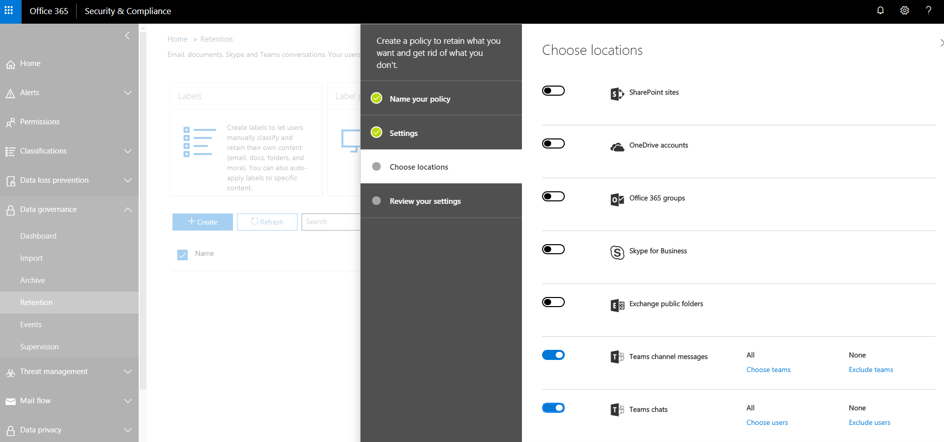
Enterprise Policy Questions – Retention (Office 365)
Key Governance Question | Decision/Answer | Reference
Do you want to set up retention policies for content? If so, what are the policies?
SharePoint Sites
OneDrive accounts
Office 365 Groups
Skype for Business
Exchange public folders
Teams channel messages
Teams chats
Yammer conversations
Office 365 Admin Center >
Security & Compliance >
Data Governance >
Retention
Create a policy to see the options.
Notes:
As of June 2018, the minimum number of days for a retention policy is 30.

Slide 79
Reference Information
Overview of retention policies

Slide 80
Individual Content | User Profile

Slide 81
User Profile Review Approach
For the conversation about the User Profile, make sure that representatives from HR as well as Corporate Communications are available to participate.
Consider the following: Do you want to promote the use of the User Profile for expertise location? If so, what practices and guidance do you want or need to provide to users to encourage the creation and maintenance of profile information?
For each attribute, identify whether it will be entered by the user or “sourced” from an authoritative system. Review how you will source the values and how the synchronization will occur.
If you are not satisfied with the quality of information in Active Directory, check out Hyperfish (https://www.hyperfish.com/), a third-party tool that can help improve the quality of people information in AD.

Slide 82
User Profile Decisions
Attribute Name | User Instructions | Considerations | Sample Guidance
Picture | Upload a new photo | Do you want users to be able to upload their own picture? What kind of picture is acceptable? See guidance. Can users “opt out”? | We encourage you to upload a picture to your profile. Choose a picture in which you are the only subject. The picture should only show your head and shoulders. Crop your photo to a square shape.
Birthday | No instructions provided – Attribute has two fields – one for month and one for day. | Is it OK to ask for this information even if it is optional? Some organizations feel that it is not a good idea to leave this field in the profile. | Sharing your birthday (month/day) is optional. Enter your birthday only if you wish to share this information.
About Me | This is me in a few words. | This statement is displayed to all people who look at the user’s profile. It should be brief and “consumable.” It can be engaging to add personal information that people are comfortable sharing – and might encourage users to complete their profile. Does this align with your organizational culture? | Use the About me statement to talk about your current role and responsibilities. Write in the first person. Keep the message brief so that others can “consume” it quickly. Use the 90/10 rule as you create content – about 90% professional and 10% personal (if you are comfortable sharing personal information). For example: I joined the organization in x. I’m responsible for y. I like working here because … For some examples of About me descriptions, check out the profiles of [Link to Name] and [Link to Name].
Projects | Here are some projects I’ve worked on | How many past projects? Will users be expected to keep this information up to date? If so, how will you make that happen? Will asking for it add value? | Optionally list the names of projects you have worked on.

Slide 83
User Profile Decisions
Attribute Name | User Instructions | Considerations | Sample Guidance
Skills and expertise | Here are some of my professional skills | Will users be expected to keep this information up to date? If so, how will you make that happen? How much guidance do you want to include about how facile you are with that skill? Does it mater? Is there another system from which this information can be sourced, e.g., your HRIS? Values are stored in the enterprise Keywords list. | List skills used to perform your job or skills for previous projects. If you speak or read a language other than English, list it in this section. You can list any skill you wish to share – even if it may not be related to your current job. Enter values in “Title Case.” Capitalize each word.
 | You can also ask me about This value is stored in the Ask Me About (Responsibilities) attribute in the user profile. | There is no duplicate checking with this attribute – users can enter the same value in both Skills and Topics fields as both fields are sourced from the enterprise Keywords list in the term store. Note that there can be a significant time delay from when the user enters a topic in this attribute and when it is surfaced in the Delve profile, which can be very confusing to users because it seems like the attributes aren’t “sticking.” You get a warning when you enter the values in the legacy profile pages but not in the immersive Delve experience. | Use this area to identify up to five or so professional (work related) topics that you can help people with, such as your responsibilities or areas of expertise. In addition to those areas that are your primary areas of responsibility, list topics where you have extensive experience and can assist or educate others.

Slide 84
User Profile Decisions
Attribute Name | User Instructions | Considerations | Sample Guidance
Schools and education | These are the schools I’ve gone to |  | List schools you have attended.
Interests and hobbies | Here’s what I like doing in my free time | Do you want to provide guidance regarding the type of acceptable interests? Is it OK to share personal interests and hobbies in your type of organization/industry/geographic area? Will users be expected to keep this information up to date? If so, how will you make that happen? Is it important for the business outcomes? | Share any personal interests that you wish to share.

Slide 85
User Profile Decisions
Attribute Name | User Instructions | Considerations | Sample Guidance
Mobile phone | No guidance | Does your organization provide staff with mobile phones? Can this be sourced from an authoritative source? Are there any privacy issues associated with mobile phones?
Fax | No guidance | Is this attribute relevant in your organization?
Home Phone | No guidance | How do your privacy policies affect asking users to enter their home phone number?

Slide 86
Individual Content | OneDrive for Business

Slide 87
User Content (OneDrive for Business)
Key Governance Question | Decision/Answer | Reference
Will all users have OneDrive for Business?
Are there any restrictions on types of content that users can store in OneDrive for Business?
What type of guidance will be provided regarding content that can be stored in OneDrive for Business vs. team collaboration spaces vs. Yammer, etc. (or locations outside Office 365/SharePoint)?
What should happen with files stored in OneDrive when someone leaves? A notification can be configured to be sent to the manager but depending on the guidance about what can be stored in OneDrive, the manager may not know what should be done with the content. Be sure to think about content that a user may have created and shared with others. If a shared file is deleted or removed after the user leaves, it will no longer be available to others who may be using it. A key is thinking about guidance about what should be in OneDrive to begin with!

Slide 88
OneDrive for Business: Sample Guidance
Save to your personal library in OneDrive for Business when …
Save to a shared library in a Team or Department site when …
You don't plan to share the document.
Documents you place in OneDrive for Business are private by default, unless you share them with someone.
This makes OneDrive for Business your best option for draft documents or personal documents that no one else needs to see.
You plan to share the document but it has a limited scope or life-cycle (work in progress).
You may sometimes work on documents that aren't related to an ongoing project, which are important mostly to you, but that you still want to share.
For example, perhaps you're writing an article to appear in a blog and you'd like to ask selected colleagues to review and edit it before you post. You can invite colleagues to view the document in your personal OneDrive library and remove their permissions when you have collected all of the feedback.
You can't identify an existing team site where your document belongs, and you don't think the purpose of the document warrants creating a new one.
The document is relevant to an ongoing project or a team or function.
You may want to draft your content in OneDrive and move it to the team site when you are ready to share it more broadly.
Move your file from OneDrive to your team site if you want to retain all versions of the document.
Copy the file (and then delete from OneDrive) if you only want the most recent version in the team site.
You want to spread ownership and permissions across a wider collection of people. If a document is important to the success of a project, it's a good idea for there to be people other than yourself who can control what happens to the document.

Slide 89
Enterprise Social Decisions
Decisions related to Yammer and Enterprise Social Tools

Slide 90
Enterprise Social Vision and Key Governance Questions
What are the specific business objectives and strategic drivers for enterprise social?
What are the business-specific “moments of engagement” where social collaboration will drive value?
Is there an existing intranet social media policy that applies or can be adapted to cover your internal social network?
Is the organization aligned on the risk versus reward trade-off associated with open and collaborative conversations?
Have these expectations been communicated?

Slide 91
Enterprise Policy Questions – Enterprise Social
Key Governance Question | Decision/Answer | Reference
Want type of guidance do you want to provide about what types of conversations are appropriate for the Newsfeed or Yammer versus other ways to communicate? (for example, email, discussion forums, instant messaging, etc.) (i.e. “what goes where?”) (The legal and compliance departments in some organizations, especially regulated ones, are often concerned about eDiscovery issues associated with enterprise social content.)
Do you want to provide guidance about mentioning someone in the activity feed using an @mention or posting a photo of someone without asking permission? (for example, not excessively @mentioning the same person)
Is there an existing policy for social media that applies to internal social content (or needs to be updated)?
Are there specific subjects or content that should not be included in posts? For example, in one legal implementation, attorneys were advised not to mention any specifics of open cases in enterprise social posts.

Slide 92
Enterprise Policy Questions – Enterprise Social
Key Governance Question | Decision/Answer | Reference
Topics and hashtags are an important way to make posts more visible. However, with “folksonomies,” you get the problem of variations due to multiple spellings, different abbreviations, singular vs. plural words, hyphens vs. underscores to separate words. Do you need to establish any guidelines around the use of topics or hashtags? Plan to look for variations and reduce them?
Do you need to monitor the use of particular terms or words in conversations to ensure compliance? (both good and bad)
What specific decisions need to be in the Yammer Usage Policy that users must accept before accessing?
Notes:
You can use tools (such as OpenQ or Feedcop) to look for the use of sensitive or restricted terms.
You can also monitor for words like Created to look for the creation of new groups and invite new group admins into a group for group owners. You can then enlist group owners to help enforce governance policies and make group owners aware of their responsibilities. This can help distribute the responsibility for compliance.

Slide 93
Enterprise Policy Questions – Enterprise Social
Key Governance Question | Decision/Answer | Reference
Will enterprise social content be kept indefinitely or deleted after a specific time period? What archiving or preservation policies need to be applied to Enterprise Social conversations?
Are external users permitted to be part of your internal enterprise social conversations?
How will enterprise social policies and guidance be enforced and communicated?
Do you need to have a review process when new Yammer groups are created?
Should all groups be open or should private groups be allowed? If so, under what conditions?
Should multiple groups on similar topics be encouraged or discouraged? How narrow or focused should a group be?

Slide 94
Enterprise Policy Questions – Enterprise Social
Key Governance Question | Decision/Answer | Reference
Do all communities/groups need a community moderator or manager?
Are there standard policies that need to be included in each Community/group site?
Do community/group moderators need special training?
Is there a documented list of expectations for community/group moderators?
Do community moderators have to be employees?

Slide 95
Development and Operations Decisions
Example Questions – Details by Dev Team. Typically, these are IT decisions. Record the outcomes, but it is usually not necessary to have a meeting with the Core Team to Discuss

Slide 96
Development Decisions
Key Governance Question | Decision/Answer | Reference
What processes need to be in place to request new features or capabilities (or provide feedback in general)?
Who will be accountable to review and manage enhancement requests?
What will the policy be for installing third-party apps? For one site or group? For the enterprise? Who determines which apps can be installed? How will the process be reviewed?
What is the process for requesting, approving, and deploying third-party tools?
Can scripting be enabled on sites? If so, for what purposes?
Are classic sites allowed/supported?
What type of review is required for SPFx code and apps?
Other specific decisions/standards?

Slide 97
Enterprise Policy Decisions – Operations and Support
Key Governance Question | Decision/Answer | Reference
For each type of content or collection of sites: What type of availability is required? What are the expectations for disaster recovery and backup? What are the expectations for response time? What is the impact on storage, network infrastructure, or other elements of the IT backbone?
What type of environments are needed to support the business outcomes (for example, development, QA, and production)?
What types of processes are needed to ensure that the solution infrastructure is maintained and monitored? For Office 365 environments, who will be responsible for monitoring the Office 365 roadmap and evaluating how upcoming changes will affect your users? How will this information be communicated to users? Do you need to deploy a First Release tenant or identify selected users to be in First Release? (see next page)
How will migration be supported from one environment to another?

Slide 98
Enterprise Policy Decisions – Operations and Support
Key Governance Question | Decision/Answer | Reference
How will performance or infrastructure issues be escalated and resolved?
What type of support infrastructure will be available to support end users and Site Owners/Solution Analysts?

