Slide 2
APIs, APIs Everywhere!
Sébastien Levert

Slide 3


Hi! I’m Seb!
@sebastienlevert | http://sebastienlevert.com | Product Evangelist & Partner Manager at

Slide 4




Agenda
SharePoint REST APIs
Microsoft Graph & Custom APIs
PnP JS Core
Next Steps

Slide 5
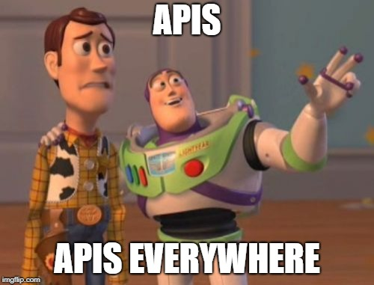
Agenda
SharePoint REST APIs
Microsoft Graph & Custom APIs
PnP JS Core
Next Steps

Slide 6

SharePoint REST APIs

Slide 7
Our Scenario
Building a SharePoint Framework webpart that connects to a SharePoint list to play with its data
Using a single Interface to define our Data Access services to enable easy on-the-fly switch of data sources
Mocking Service for swapping and local Workbench development

Slide 8
Data Service Architecture
import { IHelpDeskItem } from "./../models/IHelpDeskItem";
import { WebPartContext } from "@microsoft/sp-webpart-base";
export default interface IDataService {
getTitle(): string;
isConfigured(): boolean;
getItems(context: WebPartContext): Promise<IHelpDeskItem[]>;
addItem(context: WebPartContext, item: IHelpDeskItem): Promise<void>;
updateItem(context: WebPartContext, item: IHelpDeskItem): Promise<void>;
deleteItem(context: WebPartContext, item: IHelpDeskItem): Promise<void>;
}
export default class SharePointDataService implements IDataService {
//…
}

Slide 9
Using the SharePoint REST APIs?
Enable almost all your CRUD scenarios in the solutions you are building on SharePoint Online and SharePoint On-Premises
When called from a SharePoint context, no authentication required as it’s all cookie based
It follows the OData standards, making it easy to query your content

Slide 10
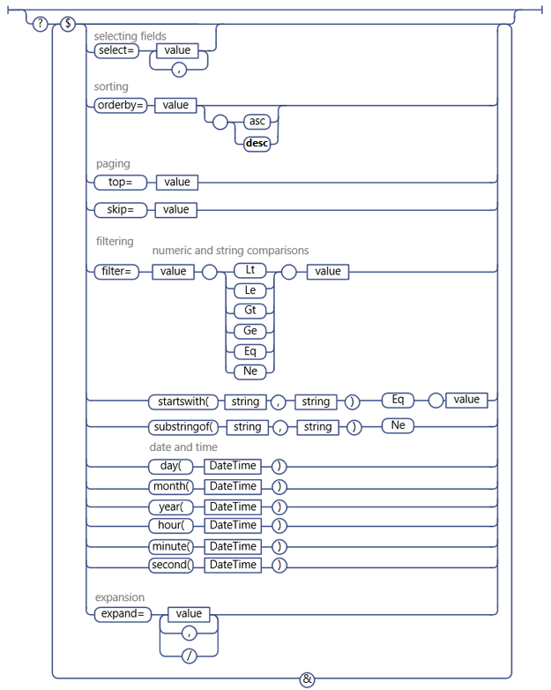
OData URI at a glance

Slide 11
OData URI at a glance

Slide 12
Creating a new SPFx Project
# Creating a new SPFx Project
yo @Microsoft/sharepoint --skip-install
# Installing all dependencies
npm install
# Opening the newly created project
code .

Slide 13
Retrieving Data
// Getting all the sessions of the specified list using SharePoint REST APIs
public getItems(context: WebPartContext): Promise<IHelpDeskItem[]> {
return new Promise<IHelpDeskItem[]>((resolve, reject) => {
context.spHttpClient.get(
`${absoluteUrl}/_api/web/lists/GetById('${this._listId}')/items` +
`?$select=*,HelpDeskAssignedTo/Title&$expand=HelpDeskAssignedTo`,
SPHttpClient.configurations.v1)
.then(res => res.json())
.then(res => {
let helpDeskItems:IHelpDeskItem[] = [];
for(let helpDeskListItem of res.value) {
helpDeskItems.push(this.buildHelpDeskItem(helpDeskListItem));
}
resolve(helpDeskItems);
}).catch(err => console.log(err));
});
}

Slide 14
Creating Data
// Creating a new session in the specified list
public addItem(item: IHelpDeskItem): Promise<void> {
return new Promise<void>((resolve, reject) => {
//… return this._webPartContext.spHttpClient.post(
`${currentWebUrl}/_api/web/lists/GetById('${this._listId}')/items`,
SPHttpClient.configurations.v1, {
headers: { "Accept": "application/json;odata=nometadata",
"Content-type": "application/json;odata=verbose",
"odata-version": "" },
body: body
});
}).then((response: SPHttpClientResponse): Promise<any> => {
return response.json();
}).then((item: any): void => {
resolve();
});
});
}

Slide 15
Deleting Data
// Deleting a specific item from the specified list
public deleteItem(id: number): Promise<void> {
return new Promise<void>((resolve, reject) => {
if (!window.confirm(`Are you sure?`)) { return; }
return this._webPartContext.spHttpClient.post(
`${currentWebUrl}/_api/web/lists/GetById('${this._listId}')/items(${id})`,
SPHttpClient.configurations.v1, {
headers: { "Accept": "application/json;odata=nometadata",
"Content-type": "application/json;odata=verbose",
"odata-version": "",
"IF-MATCH": "*",
"X-HTTP-Method": "DELETE" }
}).then((response: SPHttpClientResponse): void => {
resolve();
});
});
}

Slide 16
Using SharePoint Search
Using search allows you to query content in multiple lists or multiple sites or site collections
Uses a totally other query language (KQL or Keyword Query Language)
Very performant and optimized for fetching a lot of data, but has a 15 minutes-ish delay in terms of data freshness
Does not support any data modification

Slide 17
KQL Crash Course
See Mickael Svenson blog series “SharePoint Search Queries Explained”
https://www.techmikael.com/2014/03/sharepoint-search-queries-explained.html

Slide 18
Retrieving Data
// Getting all the sessions of the specified list using SharePoint Search
public getItems(context: IWebPartContext): Promise<IHelpDeskItem[]> {
return new Promise<IHelpDeskItem[]>((resolve, reject) => {
context.spHttpClient.get(`${absoluteUrl}/_api/search/query?` +
`querytext='ContentTypeId:0x0100…* AND ListID:${this._listId}'` +
`&selectproperties='…'` +
`&orderby='ListItemID asc'`, SPHttpClient.configurations.v1, {
headers: { "odata-version": "3.0" }
}).then(res => res.json()).then(res => {
let helpDeskItems:IHelpDeskItem[] = [];
if(res.PrimaryQueryResult) {
for(var row of res.PrimaryQueryResult.RelevantResults.Table.Rows) {
helpDeskItems.push(this.buildHelpDeskItem(row));
}
} resolve(helpDeskItems);
});
}

Slide 19
Notes on legacy APIs support
SharePoint APIs cover a wide-range of options, but not everything
You “might” have to revert to JSOM for some scenarios (Managed Metadata, etc.)
Or even to the ASMX Web Services for more specific scenarios (Recurring Events in Calendars, etc.)
The SharePoint Framework supports those scenarios, but will require some extra work

Slide 20

Microsoft Graph and Custom APIs

Slide 21







What is the Microsoft Graph?
Insights
Conversations
People
Groups

Slide 22

Microsoft Graph is all about you
If you or your customers are part of the millions of users that are using Microsoft cloud services, then Microsoft Graph is the fabric of all your data
It all starts with /me

Slide 23
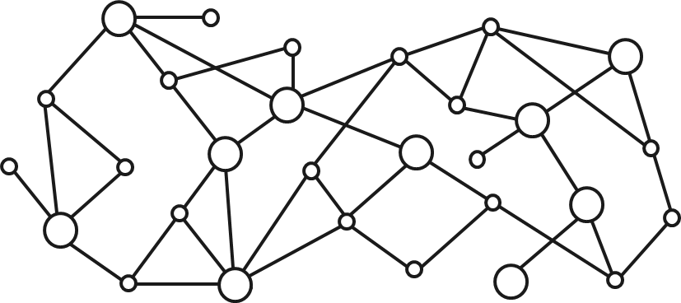
Gateway to your data in the Microsoft cloud
Your app
Web Apps
Device & Native
Apps
Bots
Background
processes
1
Gateway
Microsoft Graph
Office 365
Windows 10
Enterprise Mobility + Security
Your or your customer’s data
Microsoft identity
Rich content
Deep insights
Real-time updates

Slide 24
Microsoft Graph
https://graph.microsoft.com
ALL
your data across Microsoft 365
Office 365
Windows 10
EMS
ALL
types of users
Corporate (@contoso.com)
Consumer (@outlook.com)
ONE
way to access it
One endpoint
One auth key
One set of docs
One SDK

Slide 25
Microsoft 365 Platform
Extend Microsoft 365 experiences
web, device, and service apps
Build your experience
Documents
Pages
Conversations
Timeline
iOS/Android/Windows/Web
1
Microsoft Graph

Slide 26
Options for the Microsoft Graph
Using the built-in MsGraphClient class that takes care of the entire authentication flow and token management for you
Using a custom implementation using ADAL or MSAL

Slide 27
Are there any limitations?
Every scope will have to be defined beforehand and could open some security challenges
Authentication challenges could bring a broken experience to your users depending on the platform and browser used

Slide 28
Enabling Graph in your solution
// In your package-solution.json
{
// …
"webApiPermissionRequests": [
{
"resource": "Microsoft Graph",
"scope": "Sites.ReadWrite.All"
},
// …
]
// …
}

Slide 29
Retrieving Data
// Getting all the sessions of the specified list using the Microsoft Graph
public getItems(context: WebPartContext): Promise<IHelpDeskItem[]> { let graphUrl: string = `https://graph.microsoft.com/v1.0` +
`/sites/${this.getCurrentSiteCollectionGraphId()}` +
`/lists/${this._listId}` +
`/items?expand=fields(${this.getFieldsToExpand()})`;
return new Promise<IHelpDeskItem[]>((resolve, reject) => {
this._client.api(graphUrl).get((error, response: any) => { let helpDeskItems:IHelpDeskItem[] = [];
for(let helpDeskListItem of response.value) {
helpDeskItems.push(this.buildHelpDeskItem(helpDeskListItem));
}
resolve(helpDeskItems);
});
});
}

Slide 30
Creating Data
// Creating a new item in the specified list
public addItem(item: IHelpDeskItem): Promise<void> {
let graphUrl: string = `https://graph.microsoft.com/v1.0` +
`/sites/${this.getCurrentSiteCollectionGraphId()}` +
`/lists/${this._listId}` +
`/items`;
return new Promise<void>((resolve, reject) => {
const body: any = { "fields" : {
"Title": item.title,
"HelpDeskDescription": item.description,
"HelpDeskLevel": item.level
}};
this._client.api(graphUrl).post(body, (error, response: any) => {
resolve();
});
});
}

Slide 31
Deleting Data
// Deleting the specified item form the specified list
public deleteItem(id: number): Promise<void> {
let graphUrl: string = `https://graph.microsoft.com/v1.0` +
`/sites/${this.getCurrentSiteCollectionGraphId()}` +
`/lists/${this._listId}` +
`/items/${id}`;
return new Promise<void>((resolve, reject) => {
this._client.api(graphUrl).delete((error, response: any) => {
resolve();
});
});
}

Slide 32
Custom APIs
Using the built-in AadGraphClient class that takes care of the entire authentication flow and token management for you
Using a custom implementation using ADAL or MSAL
You can use user impersonation (or not) to query SharePoint content based on user permissions

Slide 33
Retrieving Data
// Getting all the sessions of the specified list using the AAD Client
public getItems(context: WebPartContext): Promise<IHelpDeskItem[]> { return new Promise<IHelpDeskItem[]>((resolve, reject) => {
let apiUrl: string = "<url>/api/GetHelpDeskItems";
this._client
.get(apiUrl, AadHttpClient.configurations.v1)
.then((res: HttpClientResponse): Promise<any> => {
return res.json();
}).then((res: any): void => {
let helpDeskItems:IHelpDeskItem[] = []; for(let helpDeskListItem of res) {
helpDeskItems.push(this.buildHelpDeskItem(helpDeskListItem));
}
resolve(helpDeskItems);
});
});
} }

Slide 34

Patterns & Practices JS Core

Slide 35
What is PnP JS Core?
PnPJS is a fluent JavaScript API for consuming SharePoint and Office 365 REST APIs in a type-safe way. You can use it with SharePoint Framework, Nodejs, or JavaScript projects. This an open source initiative that complements existing SDKs provided by Microsoft offering developers another way to consume information from SharePoint and Office 365.
https://github.com/pnp/pnpjs

Slide 36
Benefits of PnP JS Core
Type safe so you get your errors while you code and not when you execute and test
Works on all versions of SharePoint (On-Premises, Online, etc.)
Offers built-in caching mechanisms
Heavily used in the SharePoint Development Community

Slide 37
Sample – Setup PnP JS for SharePoint
import { sp } from "@pnp/sp";
// ...
public onInit(): Promise<void> {
return super.onInit().then(_ => {
// other init code may be present
sp.setup({
spfxContext: this.context
});
});
}
// ...

Slide 38
Retrieving Data
// Getting all the sessions of the specified list using PnP JS Core
public getItems(context: WebPartContext): Promise<IHelpDeskItem[]> {
return new Promise<IHelpDeskItem[]>((resolve, reject) => {
sp.web.lists.getById(this._listId).items
.select("*", "HelpDeskAssignedTo/Title")
.expand("HelpDeskAssignedTo").getAll().then((sessionItems: any[]) => {
let helpDeskItems:IHelpDeskItem[] = [];
for(let helpDeskListItem of sessionItems) {
helpDeskItems.push(this.buildHelpDeskItem(helpDeskListItem));
}
resolve(helpDeskItems);
}); });
}

Slide 39

Next Steps

Slide 40
Resources
https://docs.microsoft.com/en-us/sharepoint/dev/spfx/web-parts/guidance/connect-to-sharepoint-using-jsom
https://www.techmikael.com/2014/03/sharepoint-search-queries-explained.html
https://github.com/pnp/pnpjs
https://github.com/sebastienlevert/apis-apis-everywhere

Slide 41
Share your experience
Use hashtags to share your experience
#Office365Dev
#MicrosoftGraph
#SPFx
Log issues & questions to the GitHub Repositories

Slide 42
Thanks!
@sebastienlevert | http://sebastienlevert.com | Product Evangelist & Partner Manager at

