Slide 1
DotVVM Hands on Labs
<DATE>
<PLACE>

Slide 2
What Is DotVVM
Open Source framework for web
MVVM Design Pattern
Uses C# and HTML/CSS
No need to write tons of JavaScript
First Step
Install the “DotVVM for Visual Studio” extension
https://www.dotvvm.com

Slide 3
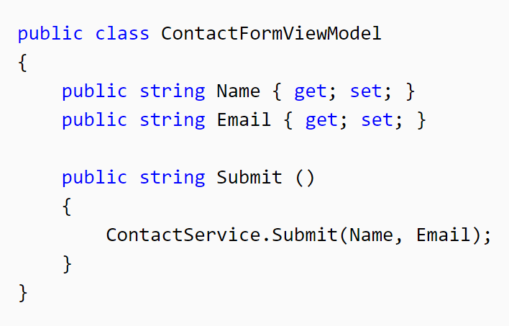
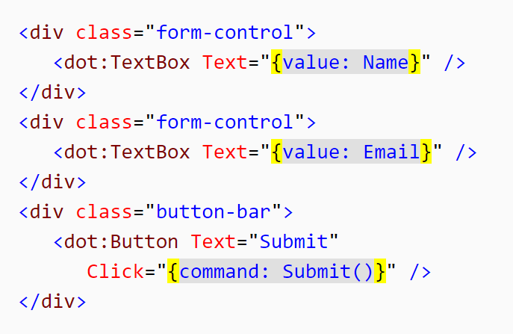
Basic Principles

Slide 4
DotVVM Products
Free
Framework with built-in controls
Visual Studio extension
(that’s all you will need today)
Commercial
Bootstrap for DotVVM
DotVVM Business Pack
Visual Studio extension (with more features)
Sign Up for 30-Days Trial at https://www.dotvvm.com/login

Slide 5
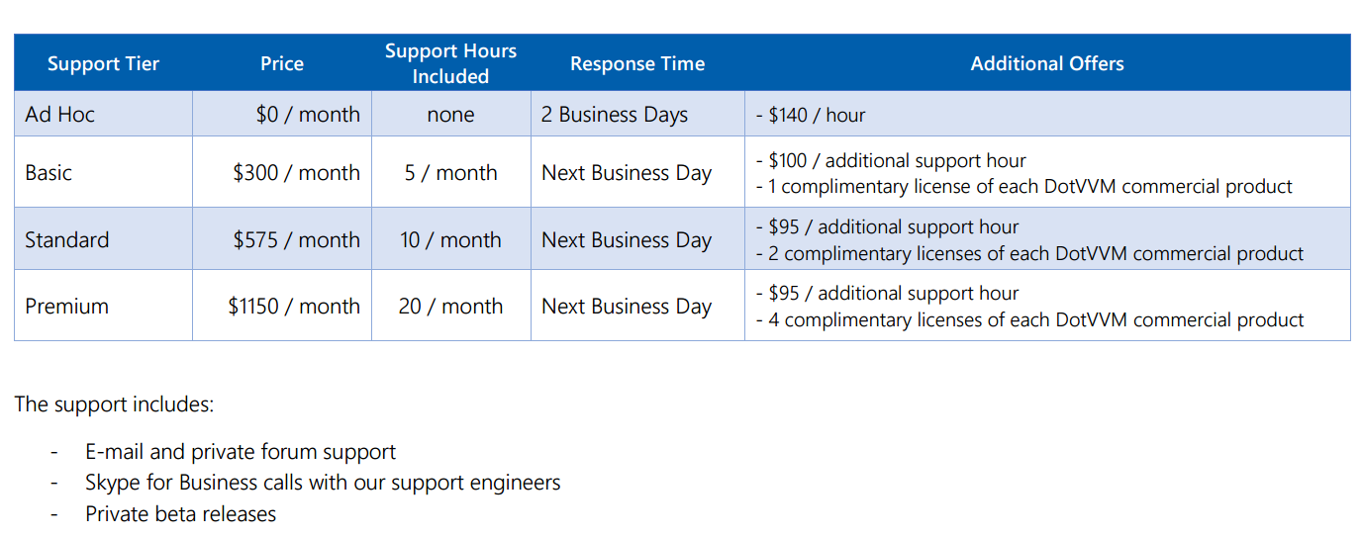
DotVVM Support Plans

Slide 6
Hands on Lab
Create a simple blog website with admin section
Technologies
DotVVM 1.1
.NET Framework 4.5.1
Entity Framework 6
Bootstrap
https://github.com/riganti/dotvvm-hands-on-lab

Slide 7
Objectives
Understand basic principles of DotVVM
Try to build a non-trivial web app
Working with database
Validation
Error handling
Custom controls
See whether DotVVM is a good idea for your next web app

Slide 8
Hands on Lab
Install the “DotVVM for Visual Studio” extension
https://www.dotvvm.com
Follow the instructions on the website
https://github.com/riganti/dotvvm-hands-on-lab

Slide 9
Resources
Documentation
https://www.dotvvm.com/docs
Gitter chat
https://gitter.im/riganti/dotvvm
GitHub
https://github.com/riganti/dotvvm
Follow us on Twitter! @dotvvm

