Slide 1
Automated Bee Hummingbird Call Detection
Rigas Simos
12/3/2020
Audio Signal Processing

Slide 2
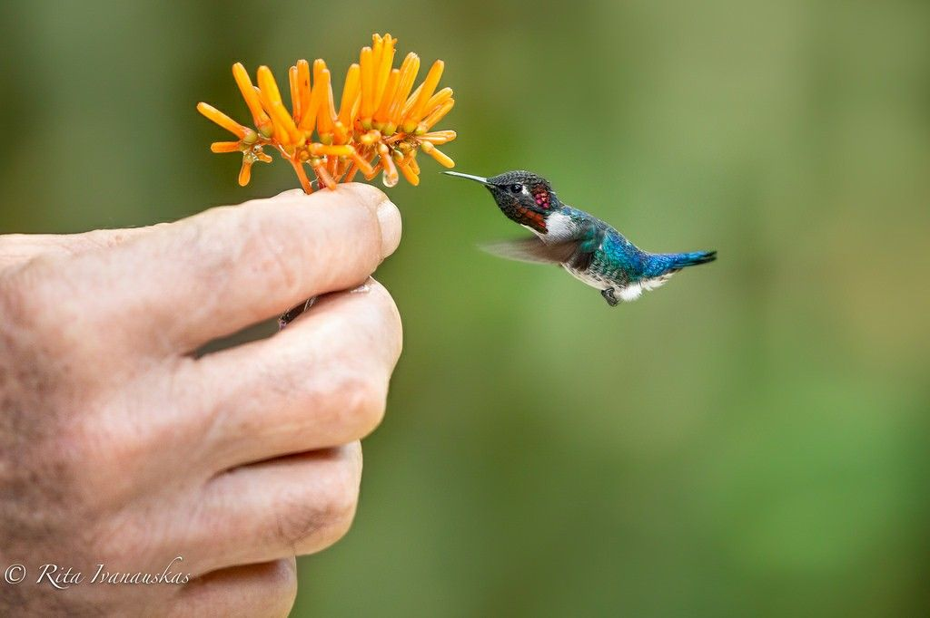
BH Background information
Smallest known bird species in the world
Wing flapping – “Humming”
Male Mating Calls (focus sound of the project)
Cuban native (exclusively found there)

Slide 3
Problem and solution
Conservation status: Near Threatened
Urgent need for protection and conservation
Suggestion: BH detection through automated sound analysis

Slide 4
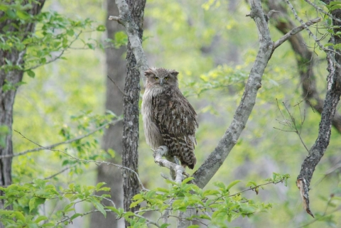
inspiration
“Protecting Endangered Owl Species with MATLAB Audio Processing Algorithms” by Fujitsu Kyushu Network Technologies Ltd.

Slide 5
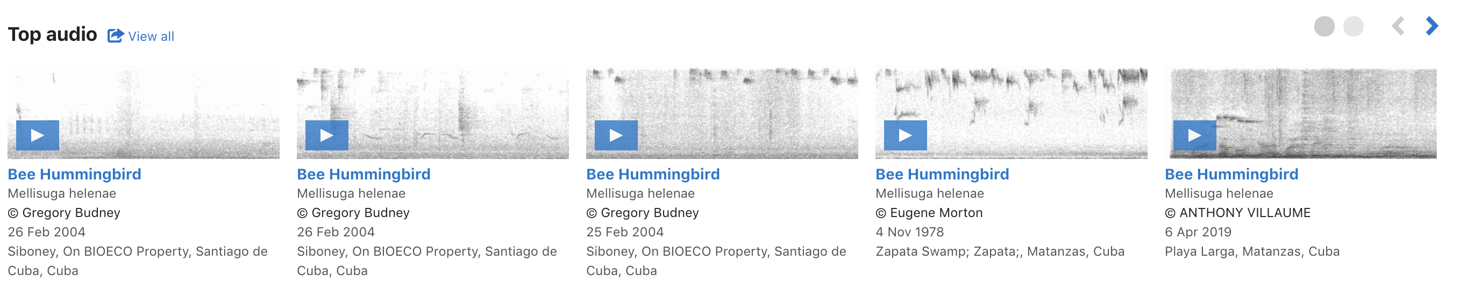
Dataset preparation
Database: eBird by Cornell lab ofOrnithology
Sunflower extension for quality recording
10 recordings of variable length used for preprocessing and analysis

Slide 6
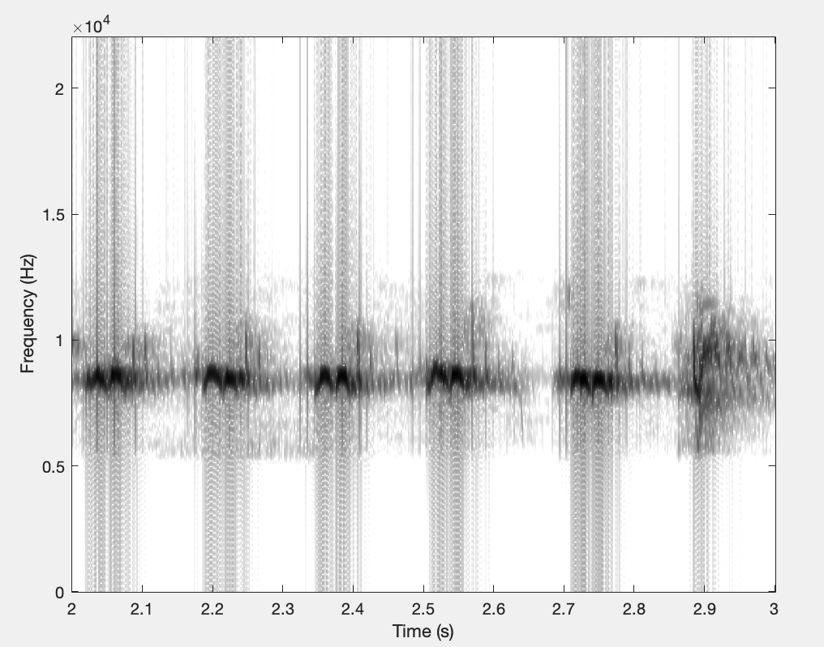
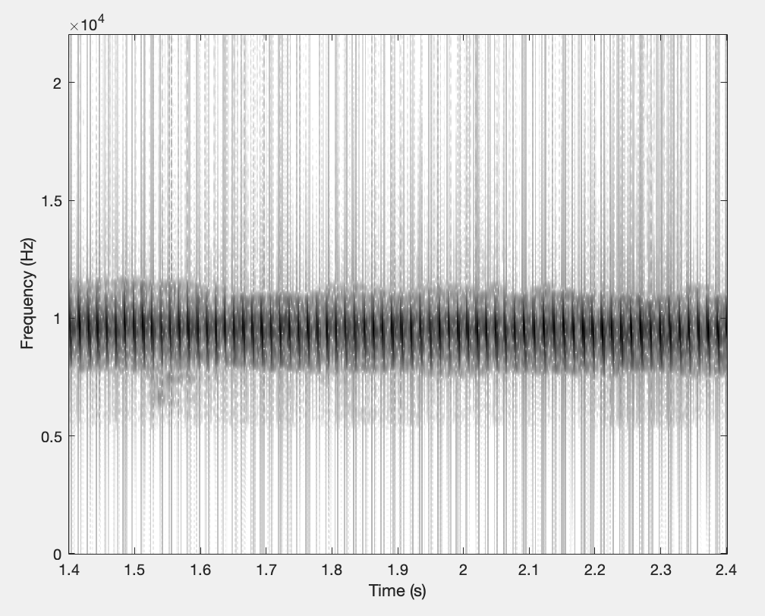
Pre-processing of dataset
Spectral subtraction
High-pass filtering

Slide 7
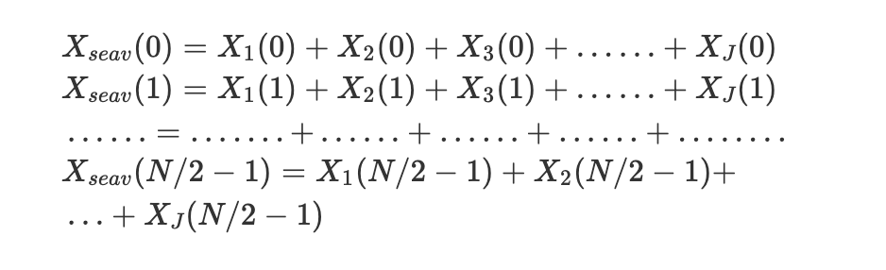
Seav approach
Existing method: H. Tyagi, R. M. Hegde, H. A. Murthy and A. Prabhakar, "Automatic identification of bird calls using Spectral Ensemble Average Voice Prints," 2006 14th European Signal Processing Conference, Florence, 2006, pp. 1-5.
Two one-second exemplary templates derived from sounds from previous slide
For J frames in a second,

Slide 8
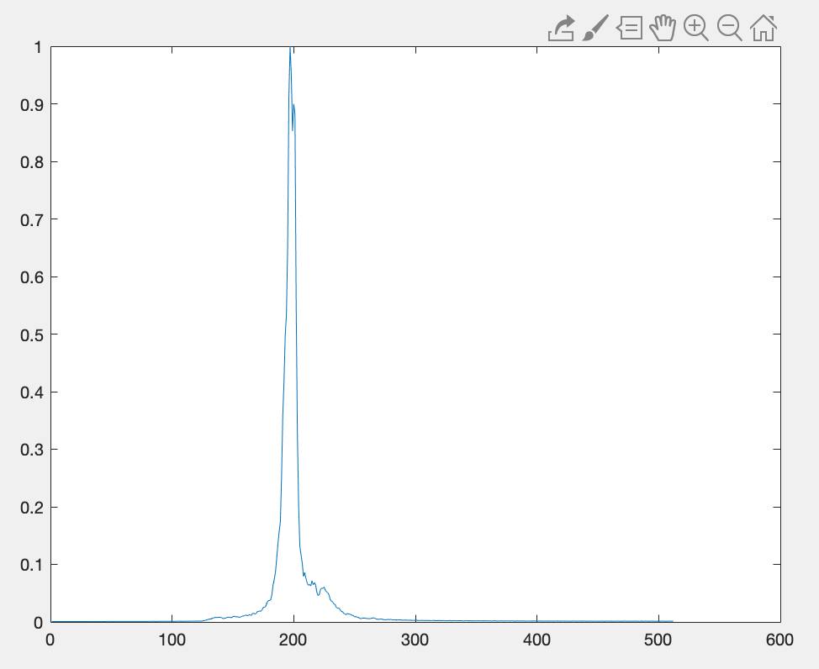
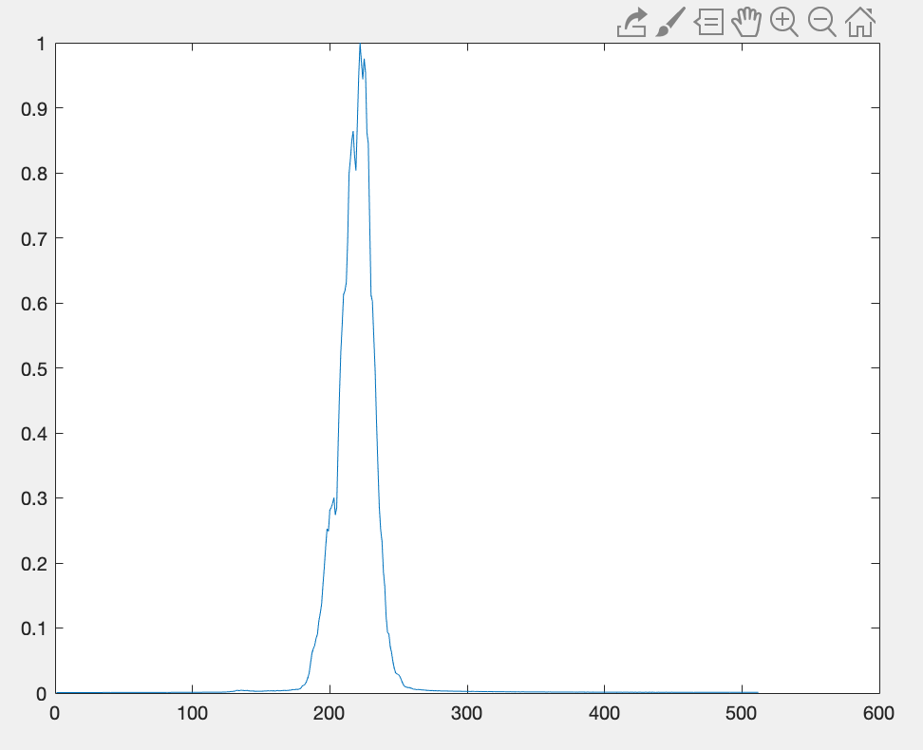
Seav approach
Templates for identification
Determine similarity threshold
(Euclidean distance)

Slide 9
Final testing
3 different datasets:
BH sound recordings (~92 % detection of BH sound patterns)
Other Cuban bird recordings (No detection)
Random recordings (music, human speech) (No detection)
Future testing (white noise addition to BH recordings)

Slide 10
Other approaches
Dynamic Time Warping (DTW)
Hidden Markov Model (HMM)
Gaussian Measuring Models (GMM)
Several other Spectral and Cepstral analysis feature extraction techniques

Slide 11
Lessons learned
More complex is not always better
Importance of noise removal in speech and sound recognition techniques

Slide 12
Thank you
Questions?

