Slide 1
Magnetism III: Magnetic Ordering
Physics 355

Slide 2
So far...
Magnetic moments originate, on an atomic scale, from the orbit and spin of electrons. These effects are also influenced by the particular electronic configuration of the different elements.
Electrons in matter have two contributing properties - spin and orbit.
In materials, the largest magnetic effects are due to the spins of electrons rather than their orbital moments.
The orbital moments play a part as well, but when there are uncompensated spins present in a molecule, the orbital contribution is negligible.

Slide 3
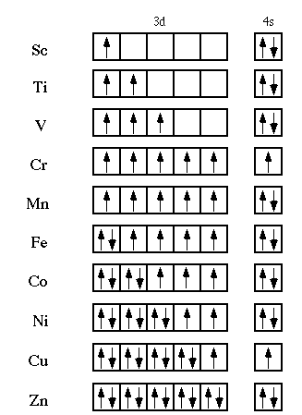
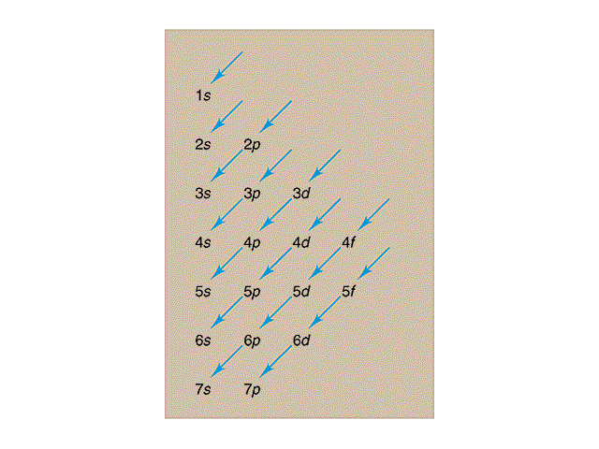
Transition Metals

Slide 4

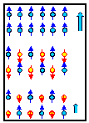
Spontaneous Magnetization
ferromagnetic
A paramagnetic material has an
unordered magnetic structure, which fluctuates in time.
Averaging over time yields no permanent magnetization.
antiferromagnetic
ferrimagnetic

Slide 5
Spontaneous Magnetization
elements | low T | room T | high T
transition metals | FM: Fe, Ni, Co | FM: Fe, Ni, Co | paramagnetic
rare earths | FM: Gd, Tb (below RT) and all others at very low Ts | AFM, except Gd | paramagnetic

Slide 6
Ferromagnetism
Ferromagnetism may be thought of as a special case of paramagnetism in which the individual spin magnetic moments interact (i.e. the moments are coupled).
The uncompensated spins in individual atoms of a ferromagnetic material may couple either directly (direct exchange) or through an intermediate anion - usually oxygen (super exchange).
In crystals of a ferromagnetic material, this gives rise to a net magnetic moment due to the coupling of spins in a preferred orientation (keep in mind that this coupling is quantum mechanical in nature and not purely due to the magnetic forces acting between neighboring atoms).
As with paramagnets, ferromagnets have strong, positive magnetic susceptibility.
Unlike paramagnets, when the applied field is removed, they retain a component of magnetization in the direction of the applied field - they are "permanently" magnetized (they do have hysteresis).
Also, their susceptibility is not dependent upon temperature in a way that follows the Curie Law.

Slide 7
Ferromagnetism
Temperature Dependence of Ferromagnetism:
Since ferromagnetism results from the interaction of atomic moments in materials, there is an exchange energy associated with coupling the spin moments.
At room temperature, this exchange energy is much greater than the energy due to randomizing thermal effects (k_{B}T).
If thermal energy exceeds the spin coupling (exchange) energy, the coupling breaks down and the material behaves as a paramagnet.
This temperature is dependent on the material and is called the Curie temperature (or, in the case of antiferromagnetic materials, the Neél temperature).

Slide 8
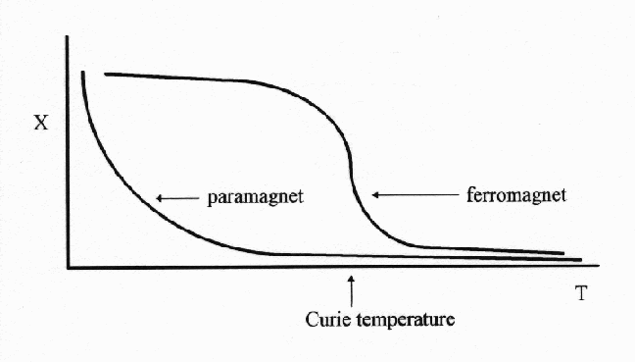
Ferromagnetism
χ
T
T_{Curie}

Slide 9
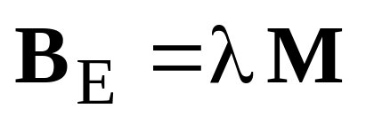
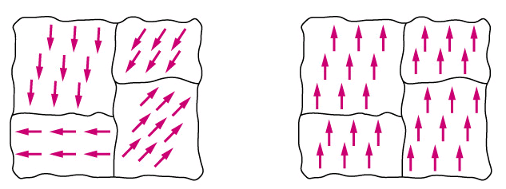
Exchange and the Curie Temperature
Start with a paramagnet consisting of N ions of spin S.
Suppose there is some local interaction going on that behaves like a local magnetic field B_{E}– the Exchange Field (or the Weiss Field).
Mean-field approximation:
Notes:
The exchange field can be as high as 1000 T.
The magnetization is defined as the magnetic dipole moment per unit volume.
If domains are present in the material, the magnetization refers to the value within that region.
Domains are regions within the solid in which the dipole moments are aligned in a particular direction.
Lambda is a temperature-independent constant. According to the equation, each ion experiences the average magnetization due to the average of the other dipole moments from the other ions. In reality, this may be limited to nearest neighbors.

Slide 10
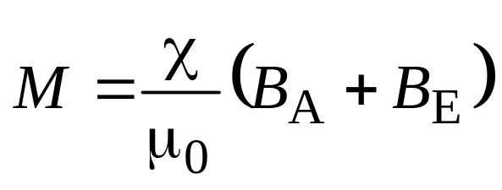
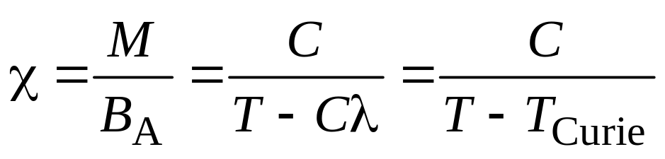
Exchange and the Curie Temperature
Continuing with a solid in the paramagnetic phase: If a magnetic field B_{A} is applied, a finite magnetization will occur, which, in turn, creates a finite exchange field.
The magnetization will then be:
For the paramagnet, we have the Curie law: χ=C/T, so
Curie-Weiss Law
Notes:
The susceptibility has a singularity at T = Cλ. At this temperature (and below), there is a spontaneous magnetization, which allows a finite M for a zero B.

Slide 11
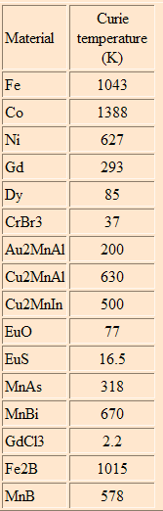
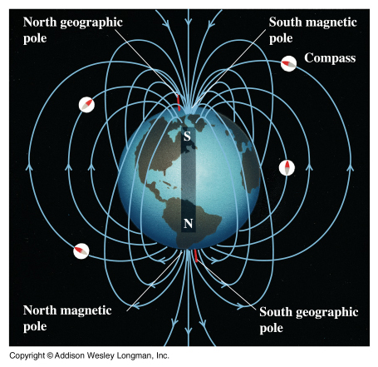
Exchange and the Curie
Temperature
The Curie Temperature for iron is about 700 °C. This temperature is reached at about 20 km below the surface of the
Earth, whereas at the outer boundary of the Core (about 2900 km depth) the temperature is about 2000 °C. This is well above the Curie temperature, so although the core is largely iron, that iron is no longer ferromagnetic, and the Earth's core cannot be a permanent magnet.

Slide 12
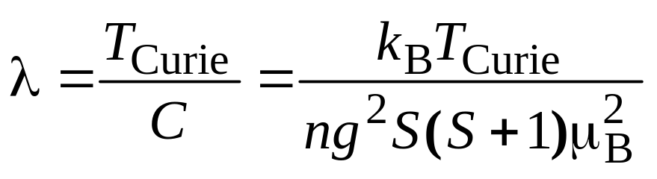
Exchange and the Curie Temperature
The curie constant can be now written in terms we’ve used before:
For Fe, T_{Curie} is about 1000 K, g is about 2, S is 1, so λ is about 5000. The saturation magnetization for iron is about 1700 units, so B_{E} = (1700)(5000)=10 million Gauss = 1000 T, a field stronger than that due to the other ions in the crystal (about 0.1 T for a near neighbor). So, B_{E} is not really a magnetic field, but it acts like one.

Slide 13
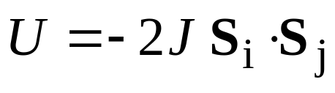
Exchange and the Curie Temperature
The exchange field is an approximation for the more correct exchange interaction determined via quantum mechanics.
If ions i and j have spins S_{i} and S_{j}, the energy of interaction contains a term:
where J is called the exchange integral and is related to the overlap of the charge distributions for the two ions. This is fully developed in QM in what is called the Heisenberg Model.

Slide 14
Exchange and the Curie Temperature
The exchange interaction depends on the spin orientation.
Pauli prevents electrons of the same spin from getting
too close to each other.
Pauli allows two electrons of opposite spin to be in
the same place.
The result of this is that the electrostatic energy of the system depends on the relative orientation of the spins: the difference in energy defines the Exchange Energy.

Slide 15
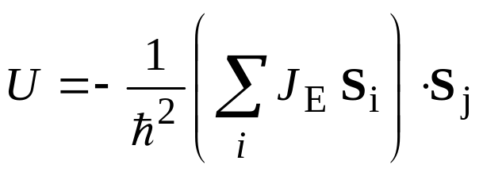
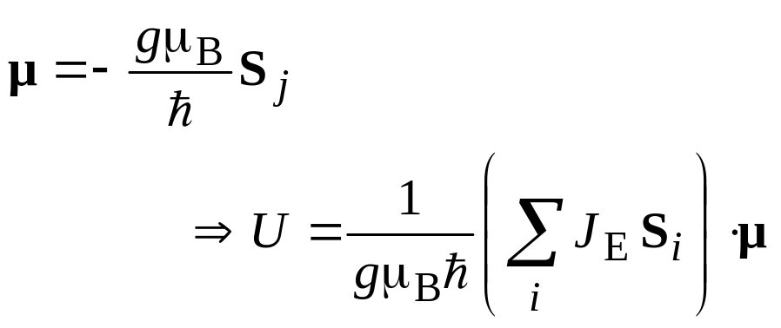
Heisenberg Exchange Parameter
The exchange energy of atom j is
where the sum is over all atoms except atom j.
The dipole moment of atom j is
so the exchange interaction has been replaced by the interaction between a spin dipole moment and the Weiss field:

Slide 16
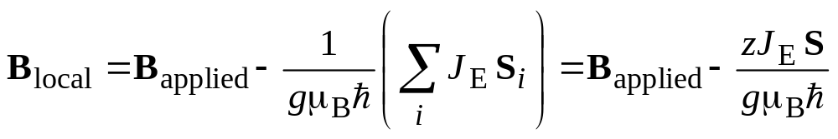
Heisenberg Exchange Parameter
The local field at atom j is
where B_{appied} is the applied field and the sum is over all of the atoms, except j.
The form on the right is valid of all of the atoms have the same spin.
J_{E} only includes z nearest neighbors.

Slide 17
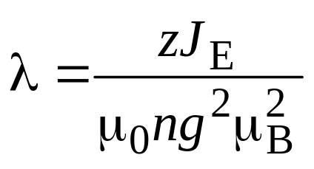
Heisenberg Exchange Parameter
Since M = Nμ, the effective exchange field can be expressed as (zJ_{E}/ng² μ_{B}²)M.
The Curie constant is then given by

Slide 18
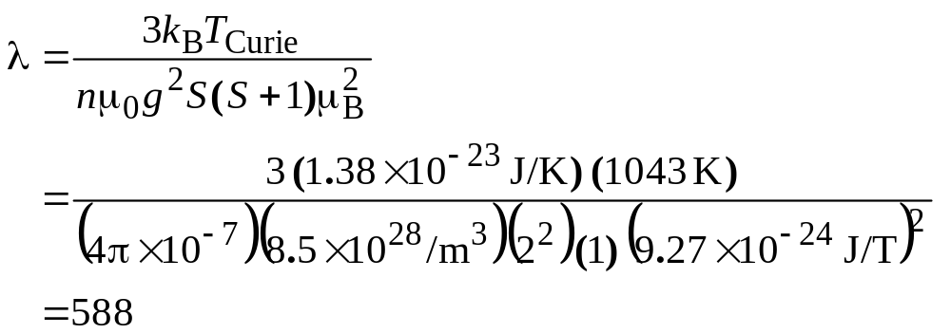
Exchange: Example
Use the experimental value of the Curie temperature to estimate the Heisenberg exchange integral for iron. The concentration of iron atoms is 8.5 × 10²⁸ atoms/m³ and each iron atom has 12 nearest neighbors.
Iron
The experimental value for the Curie temperature is 1043 K.
g = 2 and S′ = 1

Slide 19
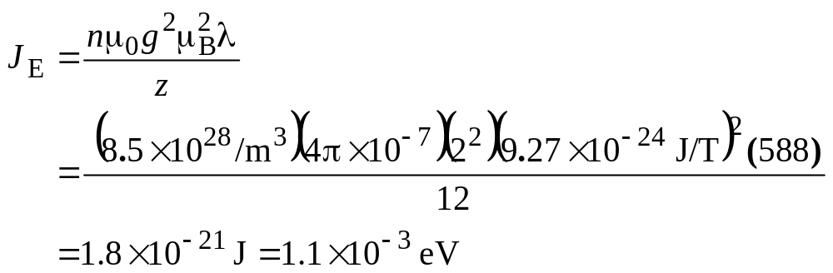
Exchange: Example
Iron
The experimental value for the Curie temperature is 1043 K.
g = 2 and S′ = 1
λ = 588

Slide 20
Exchange in Rare Earths
Band overlap is small in f electron atoms – weak exchange field.
At low temperatures, exchange occurs between the f electrons and nearly free electrons that gives rise to FM in these materials.
Indirect exchange occurs in these atoms:
  If f electrons around one atom are spin down, then an exchange interaction will lower the energies of nearby spin up free electrons.
  These free electrons then move to other atoms, where exchange tends to lower the energy of spin down f electrons.

Slide 21


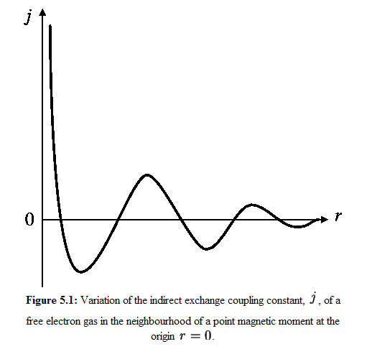
RKKY Interaction
Indirect exchange couples moments over relatively large distances. It is the dominant exchange interaction in metals where there is little or no direct overlap between neighboring magnetic electrons. It therefore acts through an intermediary which in metals are the conduction electrons (itinerant electrons). This type of exchange was first proposed by Ruderman and Kittel and later extended by Kasuya and Yosida to give the theory now generally know as the RKKY interaction.
Notes:
The interaction is characterized by a coupling coefficient, j...
where k_{F} is the radius of the conduction electron Fermi surface, R_{l} is the lattice position of the point moment, E_{F} is the Fermi energy and F(x) is...
The RKKY exchange coefficient oscillates from positive to negative as the separation of the ions changes and has the damped oscillatory nature shown in the figure. Therefore, depending upon the separation between a pair of ions their magnetic coupling can be ferromagnetic or antiferromagnetic. A magnetic ion induces a spin polarization in the conduction electrons in its neighborhood. This spin polarization in the itinerant electrons is felt by the moments of other magnetic ions within range, leading to an indirect coupling.

Slide 22
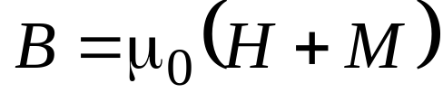
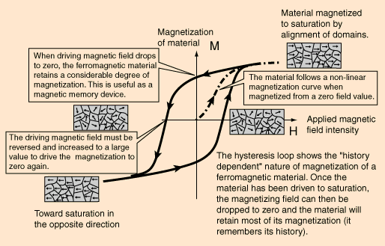
Hysteresis
Notes:
When a ferromagnetic material is magnetized in one direction, it will not relax back to zero magnetization when the imposed magnetizing field is removed. It must be driven back to zero by a field in the opposite direction. If an alternating magnetic field is applied to the material, its magnetization will trace out a loop called a hysteresis loop. The lack of retraceability of the magnetization curve is the property called hysteresis and it is related to the magnetic domains in the material. Once the magnetic domains are reoriented, it takes some energy to turn them back again. This property of ferrromagnetic materials is useful as a magnetic "memory". Some compositions of ferromagnetic materials will retain an imposed magnetization indefinitely and are useful as "permanent magnets". The magnetic memory aspects of iron and chromium oxides make them useful in audio tape recording and for the magnetic storage of data on computer disks.

Slide 23
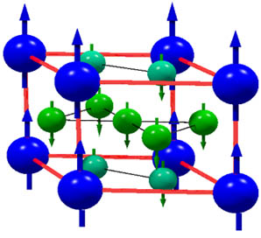
Ferrimagnets and Antiferromagnetism
Ions in most ferrimagnets and antiferromagnets are positioned on two sublattices, such that the spins on each sublattice tend to be aligned with each other, but spins on different sublattices tend be to oriented in opposite directions.
Unit cell and magnetic structure of the ferrimagnetic intermetallic compound GdCo5. The magnetic moments of Gd (blue) are directed antiparallel to the moments of Co (green).

Slide 24
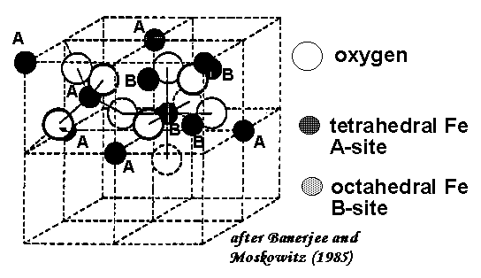
Ferrimagnets and Antiferromagnetism
Crystal Structure of Magnetite
Magnetite, Fe₃O₄ crystallizes in the spinel structure. Large oxygen ions are close packed in a cubic arrangement and the smaller iron ions fill in the gaps.
The lattice sites come in two flavors:
tetrahedral site: Fe ion is surrounded by 4 oxygen ions
octahedral site: Fe ion is surrounded by 6 oxygen ions
The tetrahedral and octahedral sites form the two magnetic sublattices, A and B, respectively. The spins on the A sublattice are antiparallel to those on the B sublattice. The two crystal sites are very different and result in complex forms of exchange interactions of the iron ions between and within the two types of sites.

Slide 25
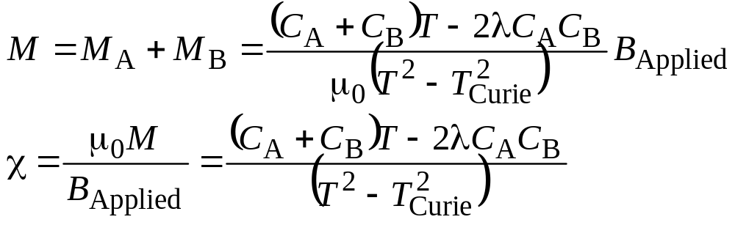
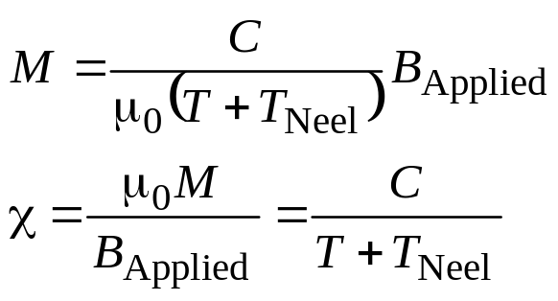
Magnetization & Susceptibility
Paramagnetic State of Two Sublattices
Antiferromagnets

Slide 26
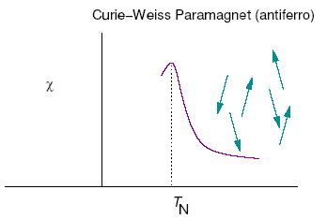
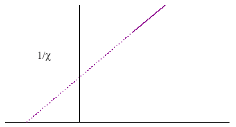
Antiferromagnets
Some Examples: Cr, Mn, Cr₂O₃, CoO, Fe₂O₃

