Slide 1
Fundamentals of Magnetism
T. Stobiecki, Katedra Elektroniki AGH
2 wykład 18.10.2004

Slide 2
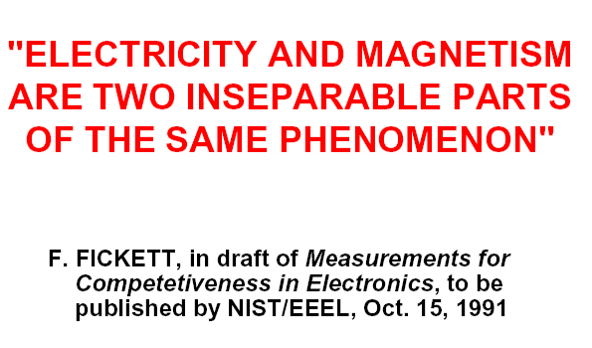

Slide 3
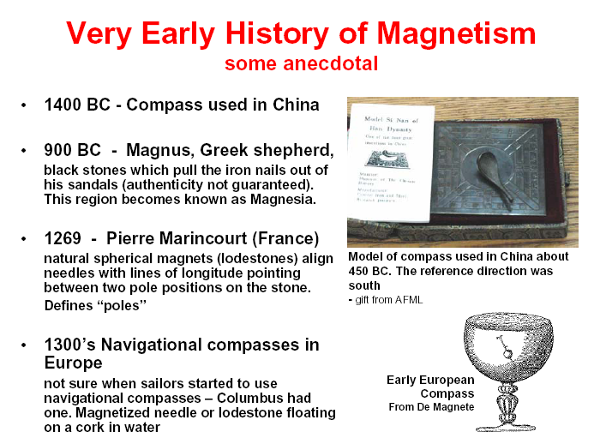

Slide 4
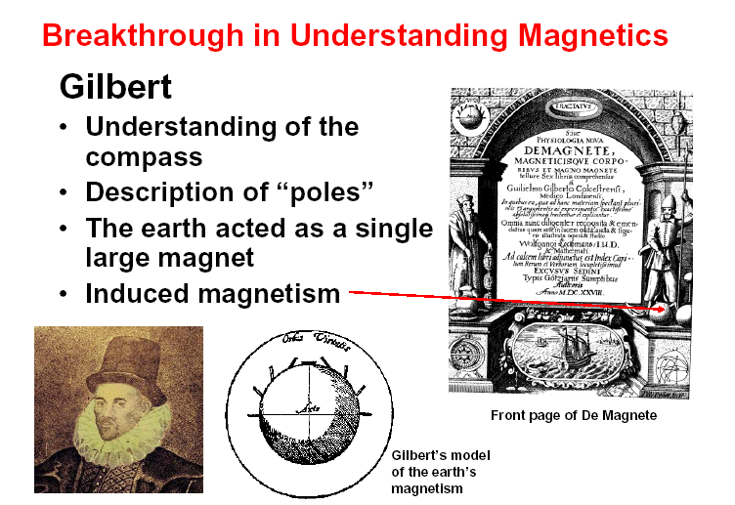

Slide 5
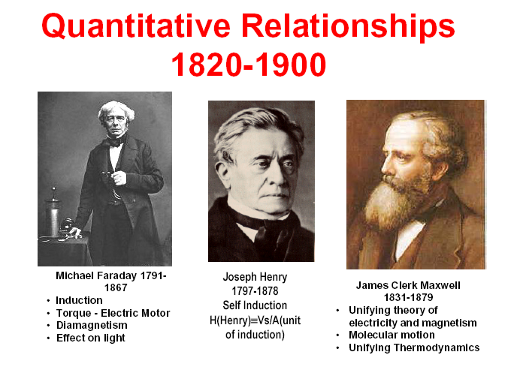

Slide 6
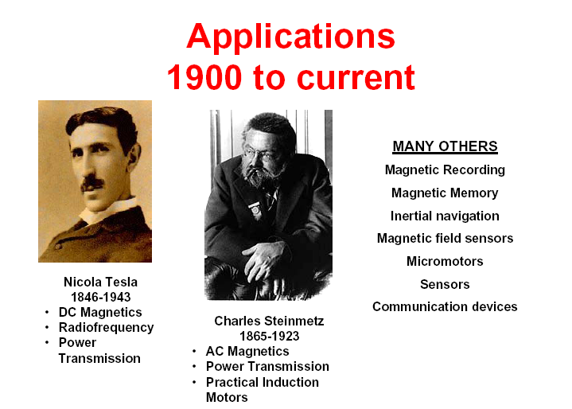

Slide 7
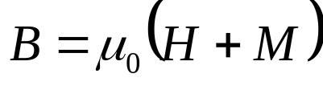



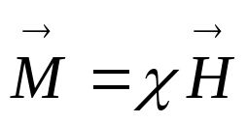
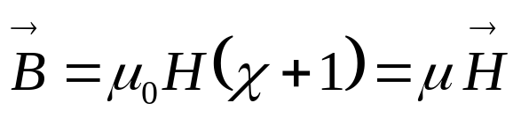

Definitions of magnetic fields
Induction:
External magnetic field:
Magnetization
average magnetic moment of magnetic material
Susceptibility
tensor representing anisotropic material
where:
permability of the material

Slide 8
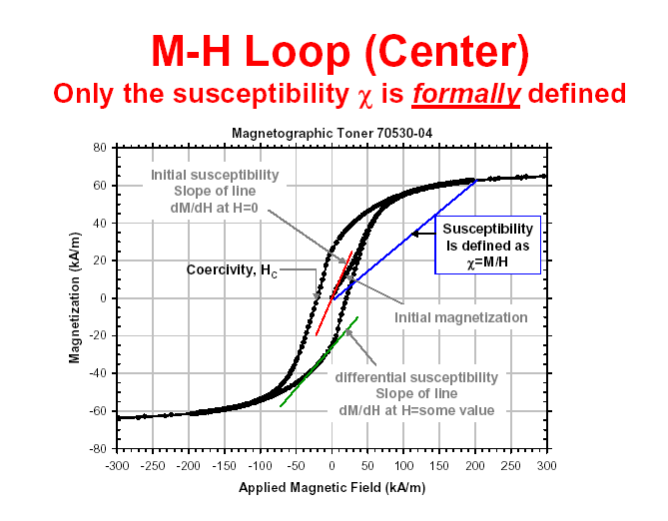

Slide 9
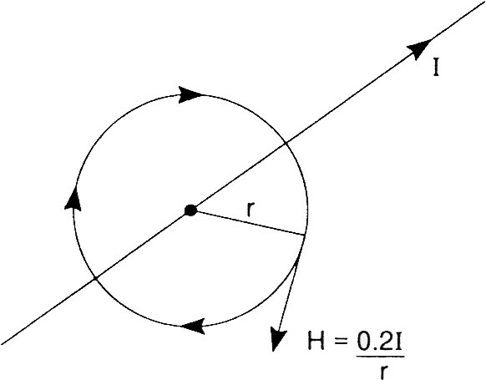

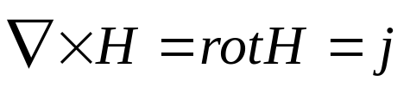
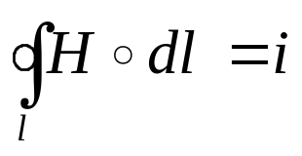
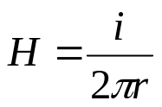
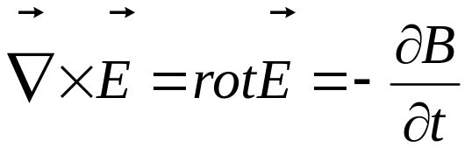
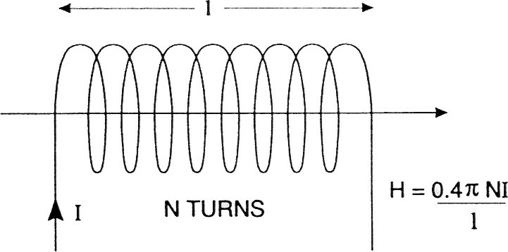
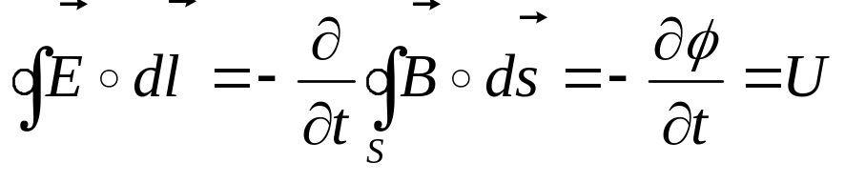
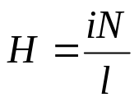
Maxwell’s equations
[oe]
[A/m]
[oe]
[A/m]

Slide 10
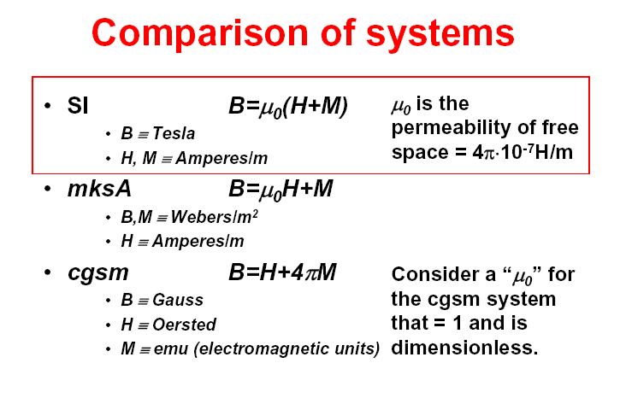

Slide 11
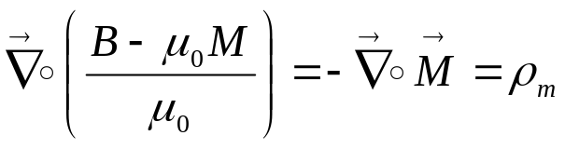
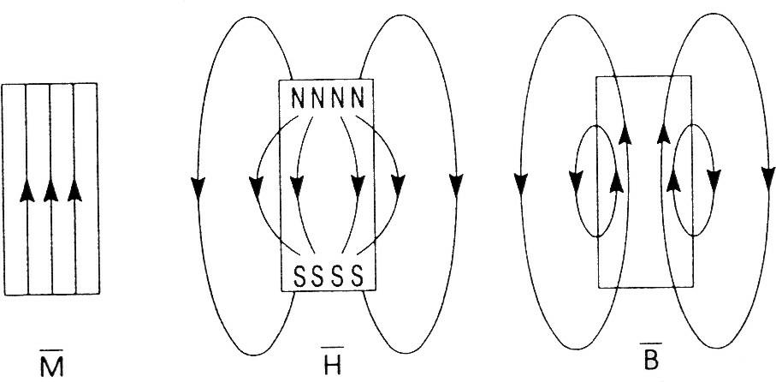
Demagnetization field
poles density, magnetic „charge” density

Slide 12
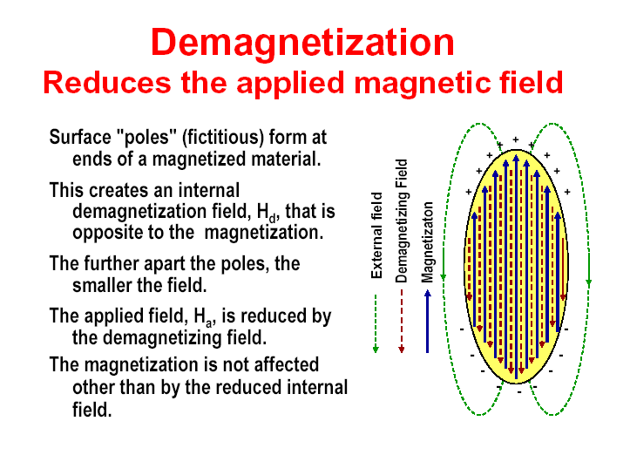

Slide 13
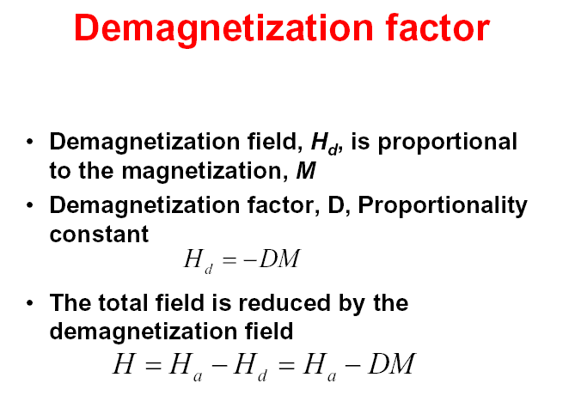

Slide 14

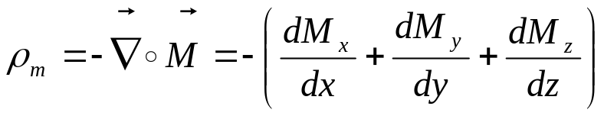
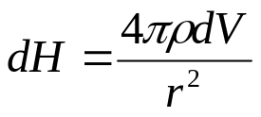
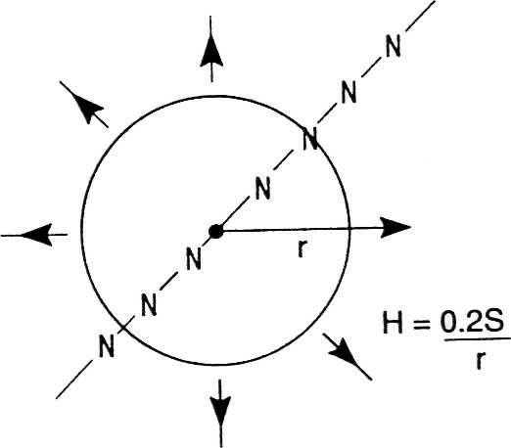

Demagnetization field
when magnetic materials becomes magnetized by application of external magnetic field, it reacts by generating an opposing field.
To compute the demagnetization field, the magnetization at all points must be known.
[emu/cm⁴]
The magnetic field caused by magnetic poles can be obtained from:
The fields points radially out from the positive or north poles of long line. The s is the pole strength per unit length [emu/cm²]
[oe= emu/cm³]

Slide 15
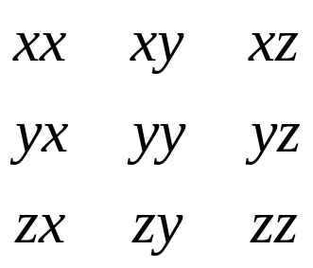
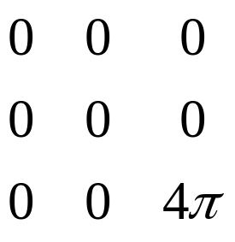
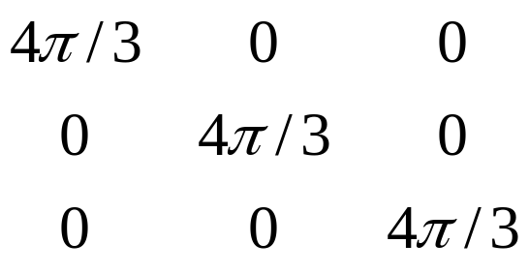
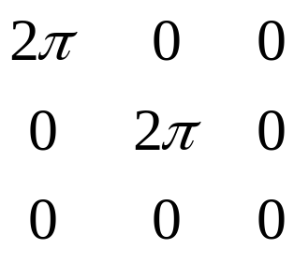

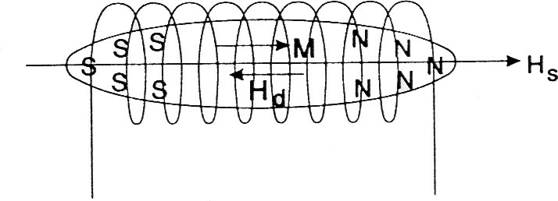
Demagnetization tensor N
For ellipsoids, the demagnetization tensor is the same at all the points within the given body. The demagnetizing tensors for three cases are shown below:
The flat plate has no demagnetization within its x-y plane but shows a 4π demagnetizing factor on magnetization components out of plane. A sphere shows a 4/3 π factor in all directions. A long cylinder has no demagnetization along its axis, but shows 2π in the x and y directions of its cross sections.
H_{S} - the solenoid field

Slide 16
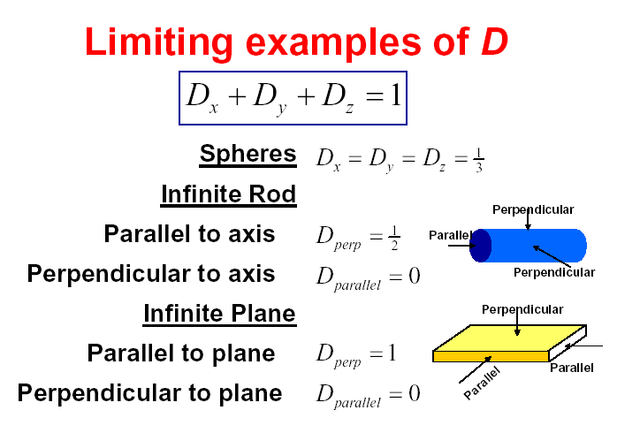
(4π)

Slide 17
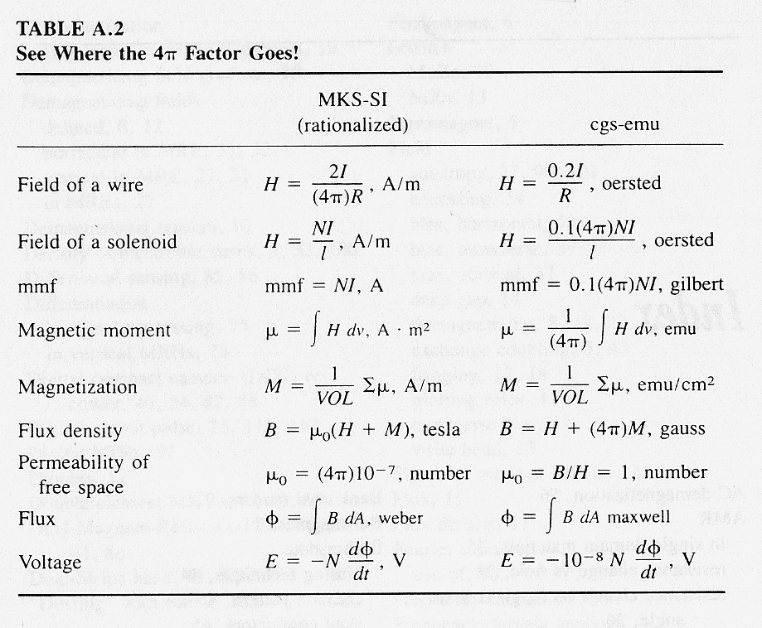

Slide 18
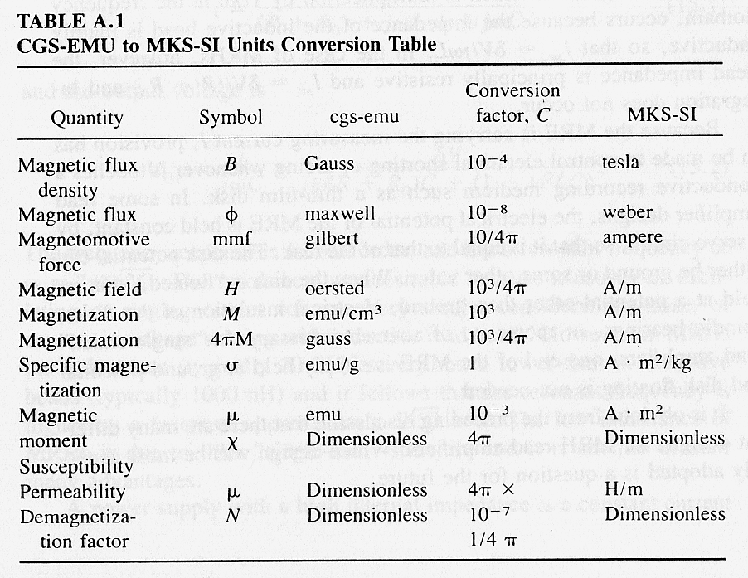

Slide 19


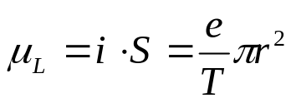
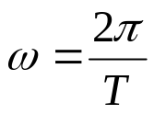
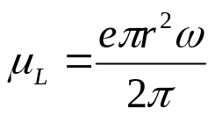
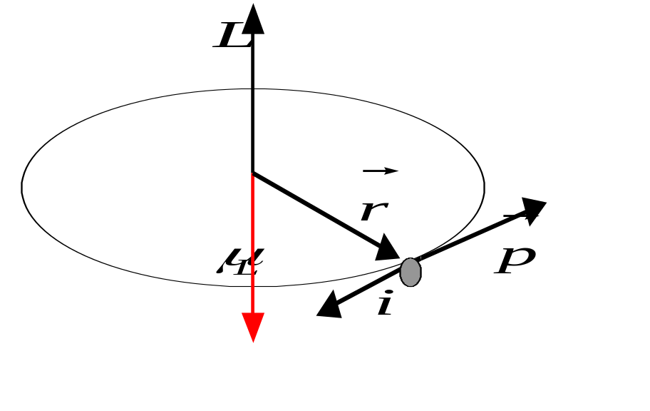
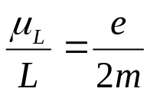
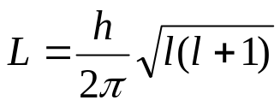
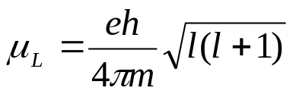
Electron spin
Orbital momentum
Magnetic moment of electron

Slide 20
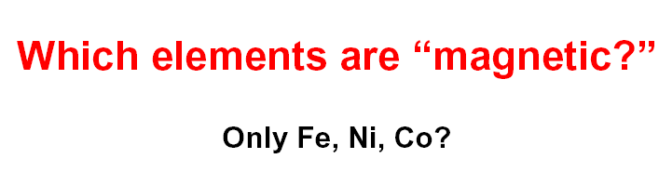
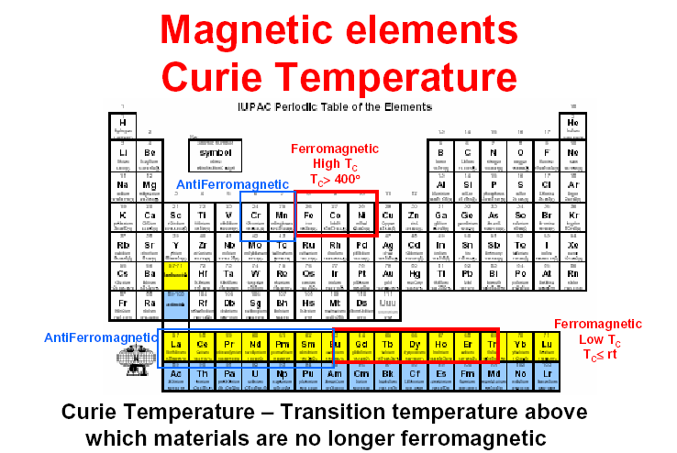

Slide 21
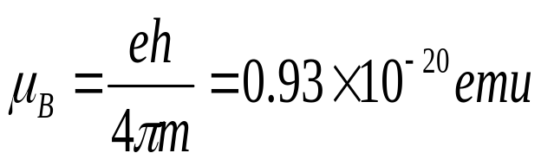
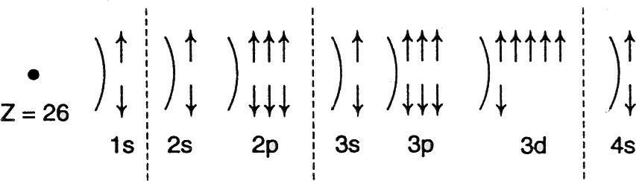
Electron Spin
The magnetic moment of spining electron is called the Bohr magneton
3d shells of Fe are unfilled and have uncompensated electron spin magnetic moments
when Fe atoms condense to form a solid-state metallic crystal, the electronic distribution (density of states), changes. Whereas the isolated atom has 3d: 5+, 1-; 4s:1+, 1-, in the solid state the distribution becomes 3d: 4.8+, 2.6-; 4s: 0.3+,0.3-. Uncompensated spin magnetic moment of Fe is 2.2 μ_{B} .

Slide 22
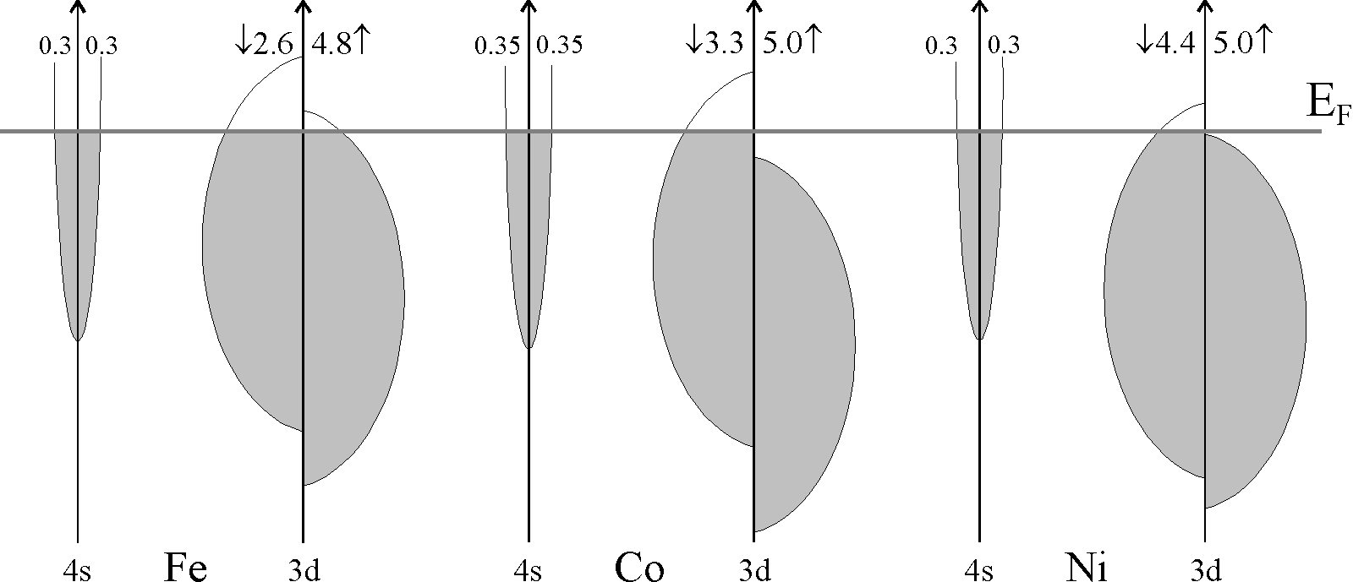
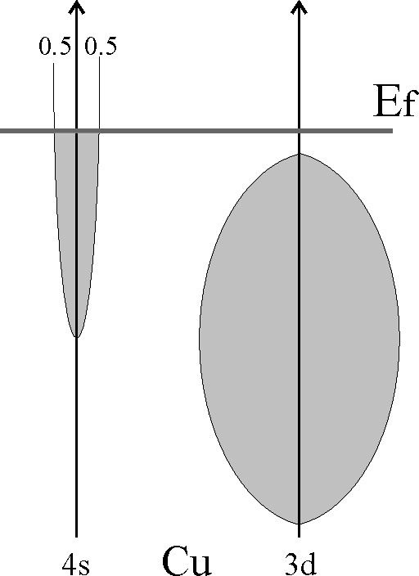
Electron spin

Slide 23
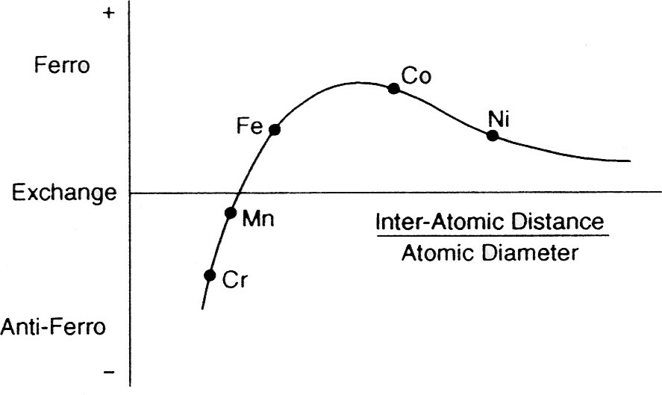
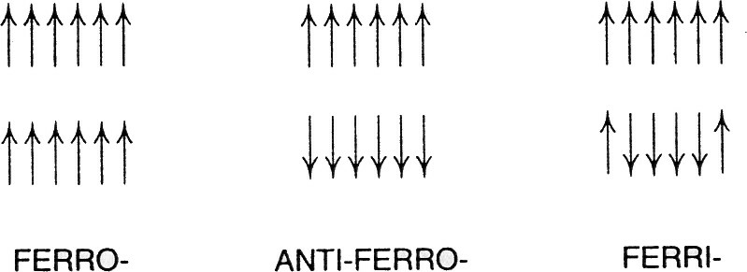
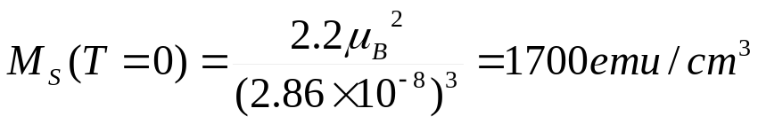
Exchange coupling
The saturation of magnetization M_{S} for body-centered cubic Fe crystal can be calculated if lattice constant a=2.86 Å and two iron atoms per unit cell.

Slide 24
