Slide 1

ABCs of Disk Drives
Sudhanva Gurumurthi

Slide 2
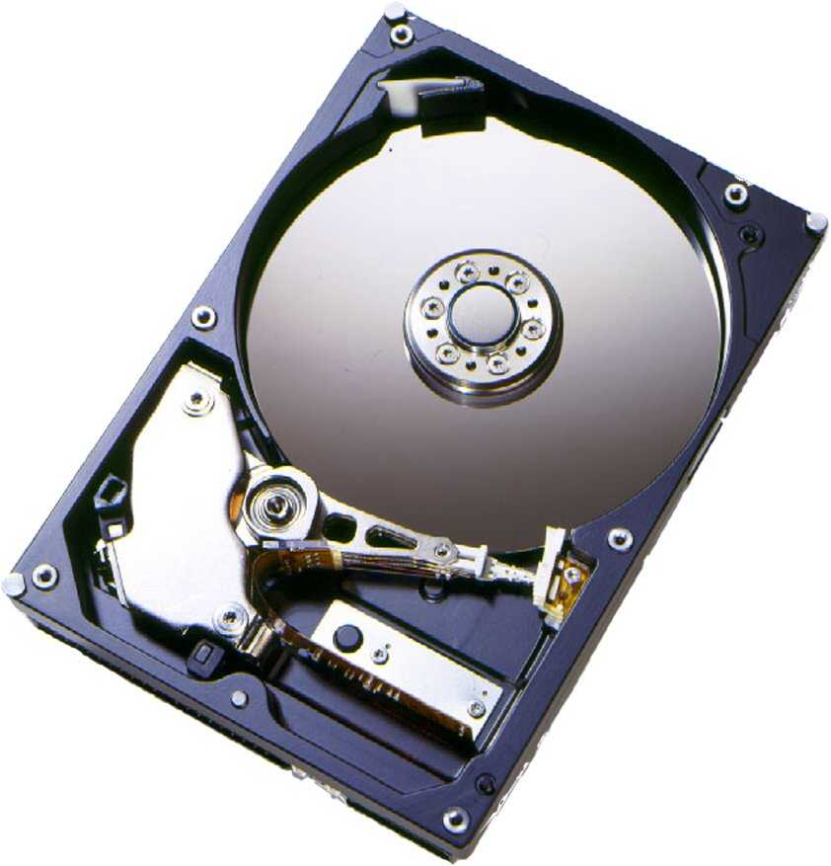
Hard Disk Drive (HDD) Components
Electromechanical
  Rotating disks
  Arm assembly
Electronics
  Disk controller
  Cache
  Interface controller

Slide 3
HDD Organization
Arm Assembly
Spindle
Cylinder
Arm
Head
Platter
Track

Slide 4
HDD Organization
Typical configurations seen in disks today
  Platter diameters: 3.7”, 3.3”, 2.6”
  RPMs: 5400, 7200, 10000, 15000
    0.5-1% variation in the RPM during operation
  Number of platters: 1-5
  Mobile disks can be as small as 0.75”
Power proportional to: (# Platters)*(RPM)^{2.8}(Diameter)^{4.6}
  Tradeoff in the drive-design
Read/write head
  Reading – Faraday’s Law
  Writing – Magnetic Induction
Data-channel
  Encoding/decoding of data to/from magnetic phase changes

Slide 5
Disk Medium Materials
Aluminum with a deposit of magnetic material
Some disks also use glass platters
  Eg. Newer IBM/Hitachi products
  Better surface uniformity and stiffness but harder to deposit magnetic material
Anti-Ferromagnetically Coupled media
  Uses two magnetic layers of opposite polarity to reinforce the orientation.
  Can provide higher densities but at higher manufacturing complexity

Slide 6
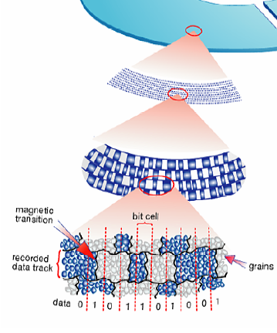
A Magnetic ‘Bit’
Bit-cell composed of magnetic grains
  50-100 grains/bit
‘0’
  Region of grains of uniform magnetic polarity
‘1’
  Boundary between regions of opposite magnetization
Source: http://www.hitachigst.com/hdd/research/storage/pm/index.html

Slide 7
Storage Density
Determines both capacity and performance
Density Metrics
  Linear density (Bits/inch or BPI)
  Track density (Tracks/inch or TPI)
  Areal Density = BPIxTPI
BPI
TPI

Slide 8
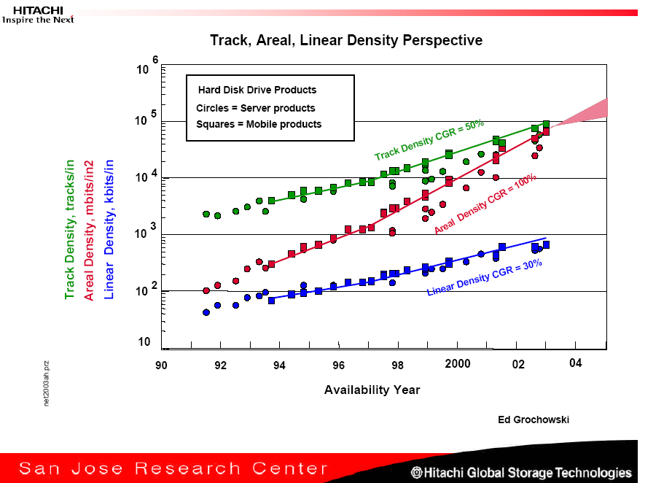
Superparamagnetic Limit
Source: Hitachi GST Technology Overview Charts, http://www.hitachigst.com/hdd/technolo/overview/storagetechchart.html

Slide 9
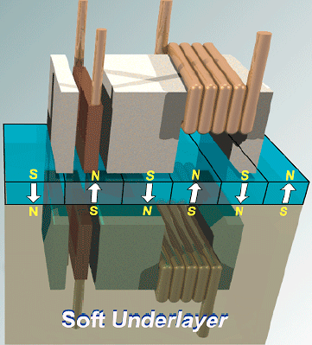
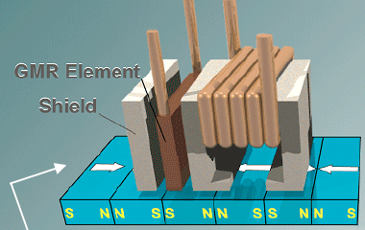
For Reading
Perpendicular Recording:
Soft underlayer (mirrors) write field
and allows domains to be closer.
Longitudinal Recording:
Magnetic domains oriented in the
direction in which head travels
For Writing

Slide 10
New Recording Technologies
Longitudinal Recording now expected to extend above 100 Gb/sq-in.
Perpendicular Recording expected to extend to 1 Tb/sq-in
Beyond that:
  Heat-assisted recording (HAMR)

Slide 11
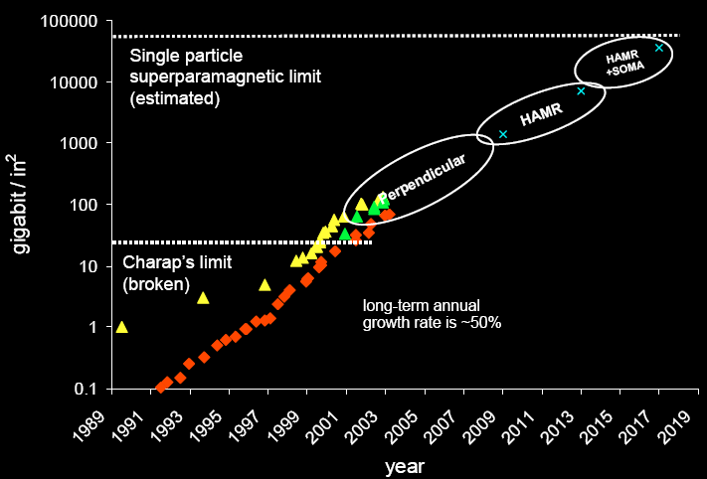
Anticipated Density Growth

Slide 12
Tracks and Sectors
Bits are grouped into sectors
Typical sector-size = 512 B of data
Sector also has overhead information
  Error Correcting Codes (ECC)
  Servo fields to properly position the head

Slide 13
Internal Data Rate (IDR)
Rate at which data can be read from or written to the physical media
  Expressed in MB/s
IDR is determined by
  BPI
  Platter-diameter
  RPM

Slide 14
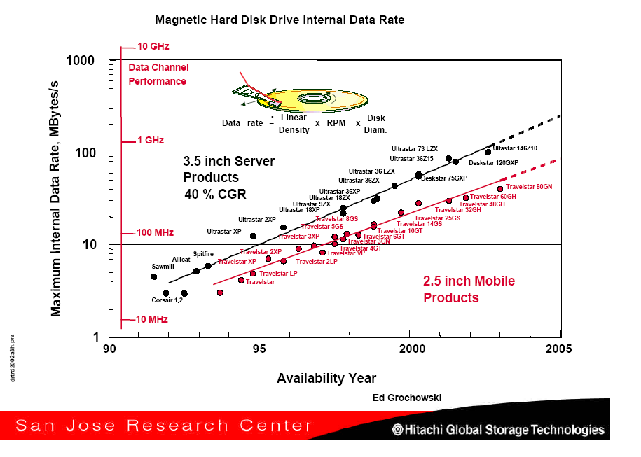
Source: Hitachi GST Technology Overview Charts, http://www.hitachigst.com/hdd/technolo/overview/storagetechchart.html

Slide 15
Seeking
Seek time depends on:
  Inertial power of the arm actuator motor
  Distance between outer-disk recording radius and inner-disk recording radius (data-band)
    Depends on platter-size
Components of a seek:
  Speedup
    Arm accelerates
  Coast
    Arm moving at maximum velocity (long seeks)
  Slowdown
    Arm brought to rest near desired track
  Settle
    Head is adjusted to reach the access the desired location

Slide 16
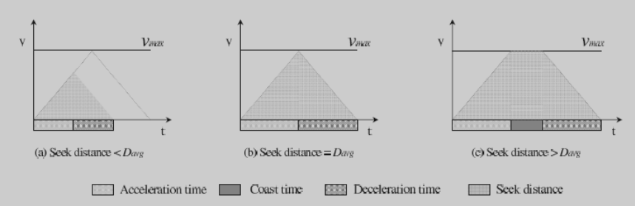
Physical Seek Operations

Slide 17
Seeking
[Speedup, Coast, Slowdown, Settle]
Very short seeks (2-4 cylinders)
  Settle-time dominates
Short seeks (200-400 cylinders)
  Speedup/Slowdown-time dominates
Longer seeks
  Coast-time dominates
With smaller platter-sizes and higher TPI
  Settle-time becoming more important

Slide 18
Performing the Seek
Amount of power to apply to the actuator motor depends on seek distance
Encoded in tabular form in disk controller with interpolation between ranges.
Servo information used to guide the head to the correct track
  Not user-accessible
  Gray code for fast sampling
  Dedicated servo surface vs. embedded servo
    Disks might use combination of both

Slide 19
Head Switch
Process of switching the data channel from one surface to the next in the same cylinder
Vertical alignment of cylinders difficult at high TPI
  Head might need to be repositioned during the switch
  Can be one-third to a half of the settle-time

Slide 20
Track Switch
When arm needs to be moved from last track of a cylinder to first track of the next cylinder
Takes almost same amount as the settle-time
At high TPI, head-switching and track-switching times are nearly the same

Slide 21
Optimizing for settle-time
Attempt reading as soon as head is near the desired track
ECC and sector ID data used to determine if the correct data was read
Not done for settle that immediately precede a write

Slide 22
Data Layout
Logical blocks mapped to physical sectors on the disk drive.
Low-Level Layout Factors
  Zoned-Bit Recording
  Track Skewing
  Sparing

Slide 23
Zoned-Bit Recording
Outer tracks can hold more sectors due to larger perimeter
Per-track storage-allocation requires complex channel electronics
Tradeoff:
  Group tracks in zones
  Outer zones allocated more sectors than inner ones
  Due to constant angular velocity, outer zones experience higher data rates.
Modern disks have about 30 zones

Slide 24
Track Skewing
To provide faster sequential access across track and cylinder boundaries
Skew logical sector zero of each track by worst-case head/track switch-time
Each zone has different skew factors

Slide 25
Sparing
There can be defective sectors during the manufacture of disks
References to them are remapped to other sectors
Slip sparing
  References to flawed sectors are slipped by a sector/track
Stroke efficiency
  Fraction of the overall disk capacity that is not used for sparing, recalibration tracks, head landing-zones etc.
  Around 2/3 for modern disks

Slide 26
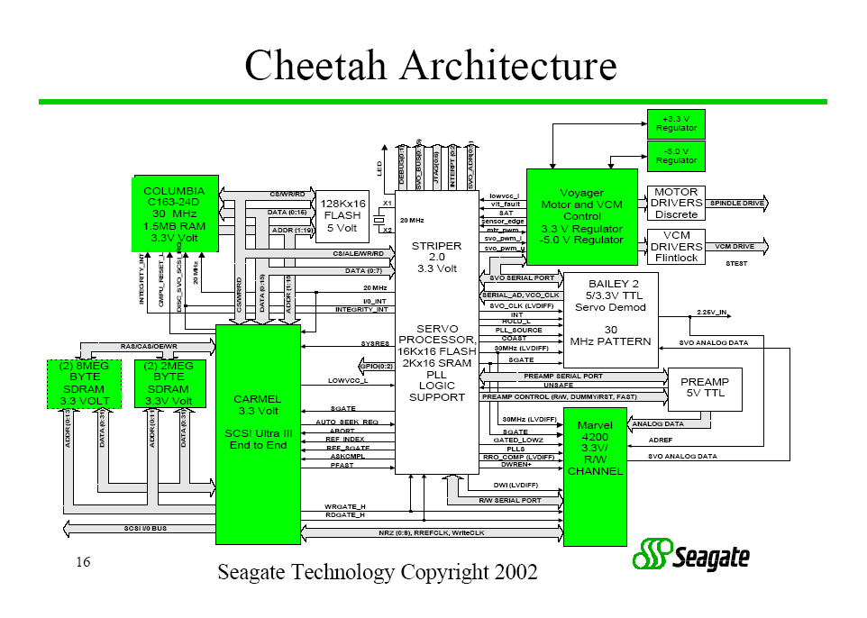
Drive Electronics
Common blocks found:
  Host Interface
  Buffer Controller
  Disk Sequencer
  ECC
  Servo Control
  CPU
  Buffer Memory
  CPU Memory
  Data Channel

Slide 27
Drive Electronics
Host Interface
  Implements the protocol between host and disk-drive eg. SCSI, ATA.
Buffer Controller
  To control access to the buffer memory between host interface, disk sequencer, ECC, and CPU.
  Also controls data movement to and from host

Slide 28
Drive Electronics
Disk Sequencer
  To manage transfer between disk interface and buffer memory.
  Also ensures that servo sectors are not over-written by user data
  Controls timing of operations to/from disk to ensure constant data-rate

Slide 29
Drive Electronics
ECC
  Appends ECC symbols, performs error-handling operations
  Current disks employ Reed-Solomon codes
Servo Control
  For necessary signal-processing for disk-rotation and head positioning
  Needed due to motor variation, platter waviness (circumferentially and radially), stacking tolerances, vibrations, etc.
  Additional spindle/actuator motor drivers are present for motion control
CPU
  DSPs to control the overall system
  Typically the highest gate-count
  Seagate uses 200 MHz ARM-based cores

Slide 30
Drive Electronics
Buffer Memory/Disk Cache
  Cache for data transferred between host and disk
  Typically around 8-16 MB for modern disks
    Use a single DRAM chip
  Might also be used by the disk CPU as a data/code store
CPU Memory
  Could be ROM, SRAM, Flash, or DRAM
  For storing CPU instruction op-codes
  Could use a combination of volatile and non-volatile memory
Data Channel
  To transfer bits between controller and physical media

Slide 31
Read-Ahead Caching
Actively reading disk data and placing in cache
Variations:
  Partial-hits
  Large requests might bypass the cache
  Discarding data after its had been read from cache
  Read-ahead in 0
    Disk continues to read where last request left-off
    Good for sequential reads
    Read-ahead could cross track/cylinder boundaries
    Can degrade performance for intervening random accesses
Could support multiple sequential read-streams by segmenting the disk cache

Slide 32
Write Caching
Immediate Reporting
    File-system can flag writes as being “done” as soon as they are written into the cache.
    Immediate reporting disabled for metadata describing disk layout
Use NVRAM
    Provides write-coalescing for better utilization of disk bandwidth
    The presence of many write requests allows for good disk scheduling opportunities

Slide 33
Other Issues in Disk Drive Design
Rotational Vibration
Reliability
  Duty-Cycle
  Temperature
Power Consumption

Slide 34
Rotational Vibration
Caused by moving components near the drive eg. Bunch of disks in a enclosure
Can cause off-track errors that can delay I/O activities or even prevent any operation to be reliably performed
More of a problem at high TPI due to smaller tolerances
Server-disks designed for a higher amount of vibration tolerance

Slide 35
Reliability
Key metric – Mean-Time Between Failures (MTBF)
Typical MTBF for SCSI disk = 1,200,000 hours
  This is typically the first-year reliability
  Assumes “nominal” operating conditions

Slide 36
Factors Affecting Reliability
Duty Cycle
  The amount of mechanical work required eg. Seek activity
  Lower duty-cycles reduce the failure-rate
    For a 4-platter disk, reducing duty-cycle from 100% to 40% halves the failure-rate
  Disks with more platters also increase mechanical stresses
    For 10% duty-cycle, failure rates for 1-platter and 4-platter disks are about 50% and 80% respectively

Slide 37
Factors Affecting Reliability
Temperature
  Reliability decreases with increase in temperature
  Includes drive temperature + heat transferred to it from external components
  A 15 C rise from room-temperature can double the failure-rate of the drive
  Drives are required to operate within a thermal-envelope for a given temperature and humidity
    Usually 50-55 C with an external wet-bulb temperature of about 28 C

Slide 38
Power Consumption
Disk power =~ (# Platters)*(RPM)^{2.8}(Diameter)^{4.6}
Designers trade-off between them to achieve performance/capacity/power targets.
Server disks have a higher power budget
  Constrained only by the thermal-envelope
  Bigger platters, faster RPMs, higher platter-counts
Laptop disks
  Need to be conscious of battery-energy
    Lower power budget
  Also might employ aggressive power-management to further reduce power consumption

Slide 39
Metrics for Drives
Traditional
  RPM
  Seek time
  Capacity
New Metrics
  Acoustics (drives in living rooms)
  Power (battery, cooling, …)
  Idle/Standby modes (Watts saved)
  Shock/Vibration (cabinets, other drives, jogging)
  Reliability (end-to-end protection)

Slide 40
Reading Material
Required:
  C. Ruemmler and J. Wilkes, “An Introduction to Disk Drive Modeling”, IEEE Computer, 27(3):17-29, March, 1994.
  D. Anderson, J. Dykes, and E. Riedel, “More Than An Interface – SCSI vs. ATA”, FAST 2003.
Supplemental:
  James Jeppesen et al., “Hard Disk Controller: The Disk Drive’s Brain and Body”, ICCD 2001.
  E. Grochowski and R.D. Halem, “Technological Impact of Magnetic Hard Disk Drives on Storage Systems”, IBM Systems Journal, 42(2):338-346, 2003.
  D.A. Thompson and J.S. Best, “The Future of Magnetic Data Storage Technology”, IBM Journal of R & D, 44(3):311-322, May 2000.

