Slide 1

Topics in Magnetism
II. Models of Ferromagnetism
Anne Reilly
Department of Physics
College of William and Mary

Slide 2
After reviewing this lecture, you should be familiar with:
1. General source of ferromagnetism
2. Curie temperature
3. Models of ferromagnetism: Weiss, Heisenberg and Band
Material from this lecture is taken from Physics of Magnetism by Chikazumi

Slide 3
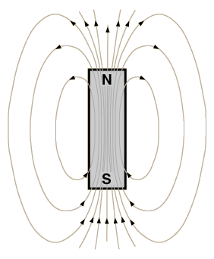
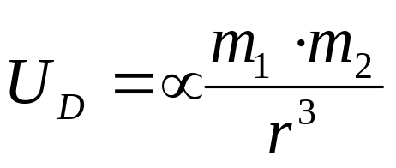
In ferromagnetic solids, atomic magnetic moments
naturally align with each other.
N
However, strength of ferromagnetic fields
not explained solely by dipole interactions!
S
N
S
Estimating m ~ 10⁻²⁹ Wb m and r ~ 1 Ǻ, U_{D}~10⁻²³ J (small, ~1.3K)
(see Chikazumi, Chp. 1)

Slide 4
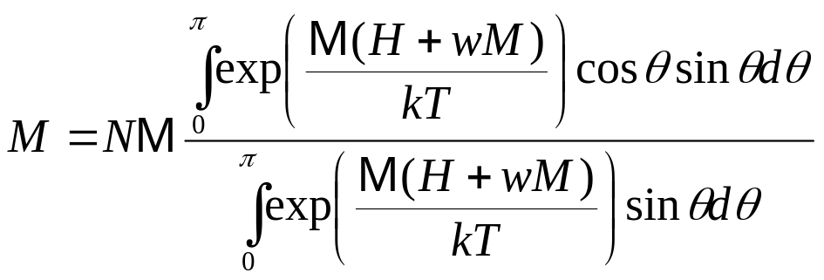
In 1907, Weiss developed a theory of effective fields
Magnetic moments (spins*) in ferromagnetic material aligned in an
internal (Weiss) field:
H_{w}
H_{W} = wM
w=Weiss or molecular field coefficient
Average total magnetization is:
H (applied)
M = atomic magnetic dipole moment
*Orbital angular momentum gives negligible contribution to magnetization in solids (quenching)

Slide 5
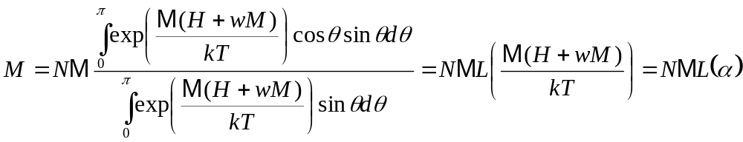
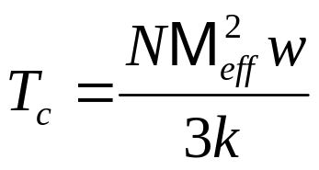
Weiss Theory of Ferromagnetism
Langevin function
Consider graphical solution:
M/M_{s}
T_{c} is Curie temperature
1
At T_{c}, spontaneous magnetization
disappears and material become
paramagnetic
0
T/T_{c}
1
(see Chikazumi, Chp. 6)

Slide 6
Weiss Theory of Ferromagnetism
For Iron (Fe), T_{c}=1063 K (experiment), M=2.2μ_{B} (experiment),
And N=8.54 x 10²⁸m⁻³
Find w=3.9 x 10⁸
And H_{w}=0.85 x 10⁹ A/m (10⁷ Oe)
Other materials:
Cobalt (Co), T_{c}=1404 K
Nickel (Ni), T_{c}= 631K

Slide 7
Weiss theory is a good phenomenological theory of magnetism,
But does not explain source of large Weiss field.
Heisenberg and Dirac showed later that ferromagnetism is
a quantum mechanical effect that fundamentally arises from
Coulomb (electric) interaction.

Slide 8
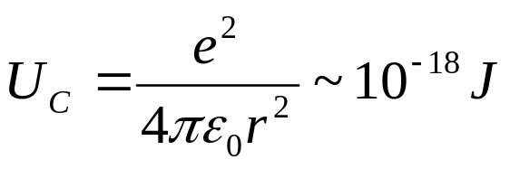
Key: The Exchange Interaction
Central for understanding magnetic interactions in solids
Arises from Coulomb electrostatic interaction and
the Pauli exclusion principle
Coulomb repulsion
energy high
Coulomb repulsion
energy lowered
(10⁵ K !)

Slide 9
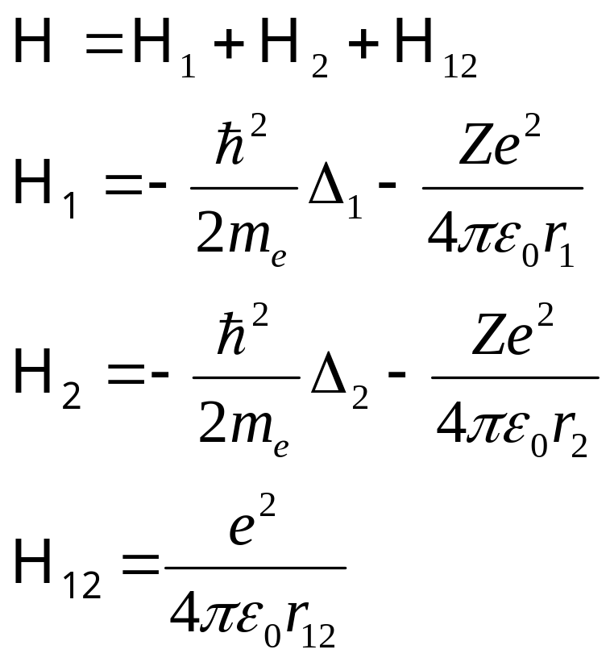
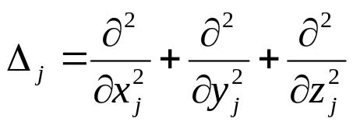
The Exchange Interaction
Consider two electrons in an atom:
r₁₂
Hamiltonian:
1
e⁻
e⁻
2
r₁
r₂
+
Ze

Slide 10
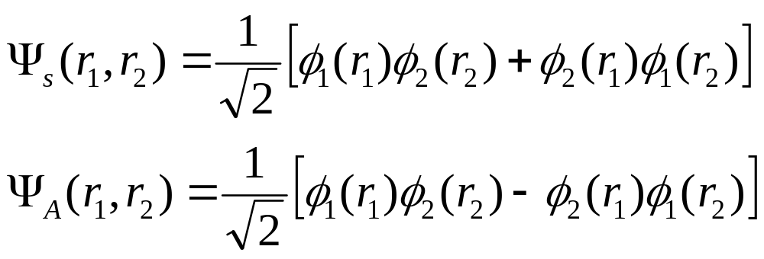
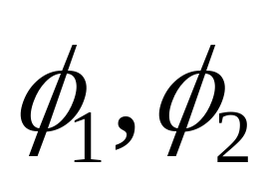
Using one electron approximation:
singlet
triplet
are normalized spatial one-electron wavefunctions

Slide 11
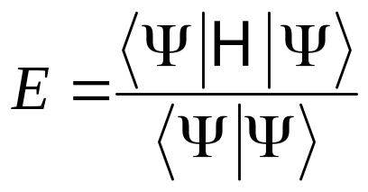
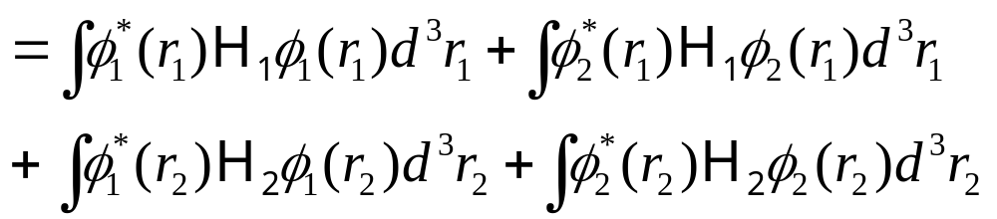
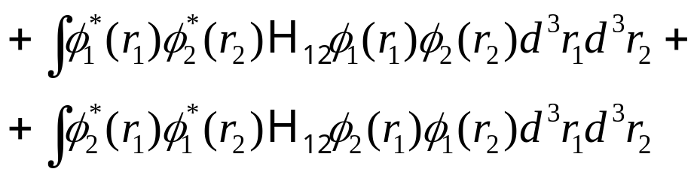
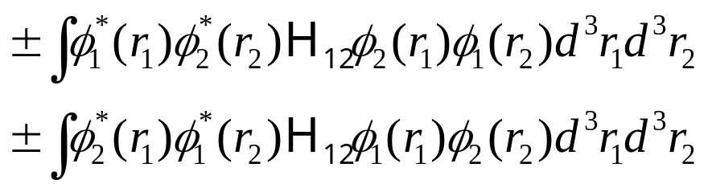
We can write energy as:
Individual energies (ionization) = 2I₁ + 2I₂
Coulomb repulsion = 2K₁₂
Exchange terms =2 J₁₂

Slide 12


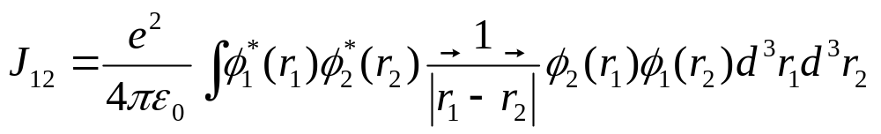
We can write energy as:
Lowest energy state is for triplet, with
Parallel alignment of spins lowers energy by:
(if J₁₂ is positive)

Slide 13
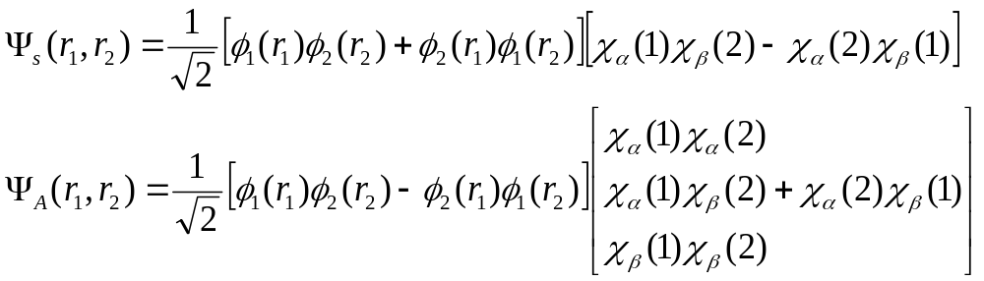
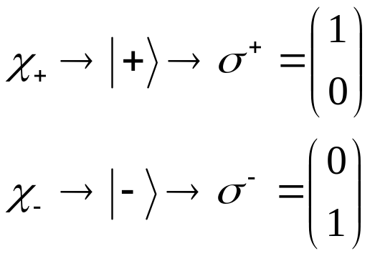
You can add spin wavefunctions explicitly into previous definitions:
(singlet)
(triplet)
Spin +1/2
Spin -1/2

Slide 14
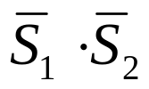
You can add spin wavefunctions explicitly into previous defintions.
(singlet)
Spin +1/2
(triplet)
Spin -1/2
Heisenberg and Dirac showed that the 4 spin states above are eigenstates
of operator

Slide 15
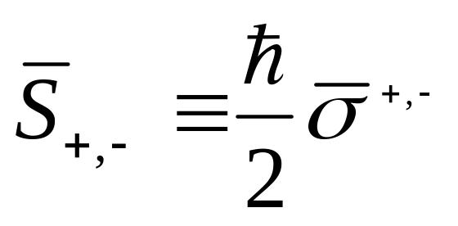
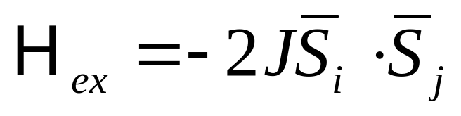
Heisenberg Model
Heisenberg and Dirac showed that the 4 spin states above are
Eigenstates of operator
(Pauli spin matrices)
Hamiltonian of interaction can be written as (called exchange
energy or Hamiltonian):
J is the exchange parameter (integral)

Slide 16
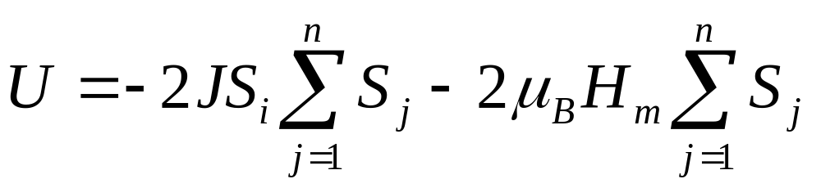
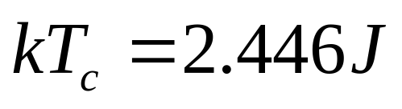
Assume a lattice of spins that can take on values +1/2 and -1/2
(Ising model)
The energy considering only nearest-neighbor interactions:
average molecular field due
to rest of spins
Find, for a 3D bcc lattice:

Slide 17
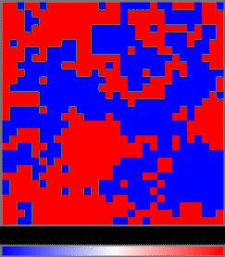
For more on Ising model, see
http://www.physics.cornell.edu/sss/ising/ising.html
http://bartok.ucsc.edu/peter/java/ising/keep/ising.html

Slide 18
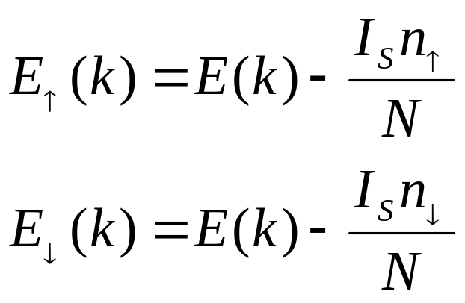
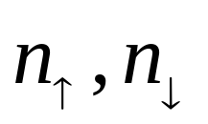
Band (Stoner) Model
Heisenberg model does not completely explain ferromagnetism in
metals. A band model is needed.
Assumes:
I_{s} is Stoner parameter and describes energy
reduction due to electron spin correlation
is density of up, down spins

Slide 19
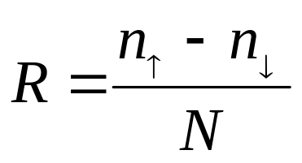
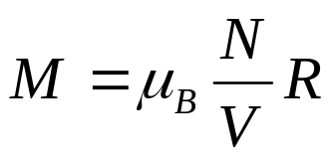
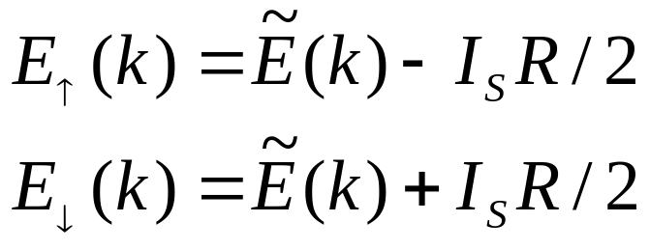
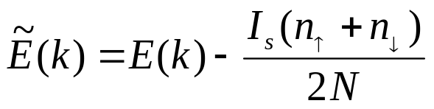
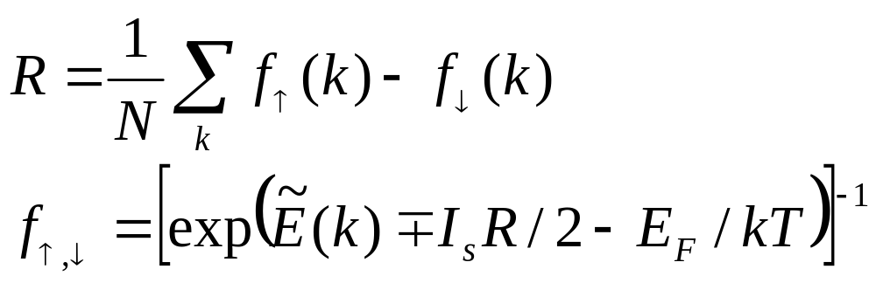
Band (Stoner) Model
Define
(spin excess)
note:
Then
Spin excess given by Fermi statistics:

Slide 20
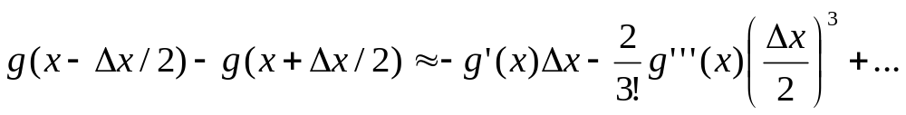

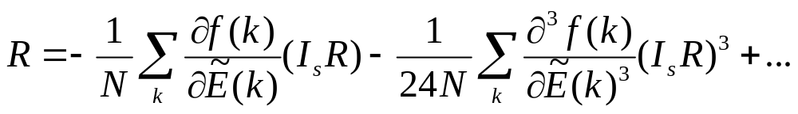
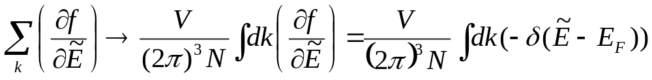
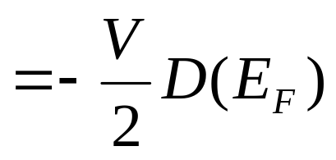
Band (Stoner) Model
Let R be small, use Taylor expansion:
with
(at T=0)
f(E)
D.O.S.: density of states at Fermi level
E_{F}
E

Slide 21
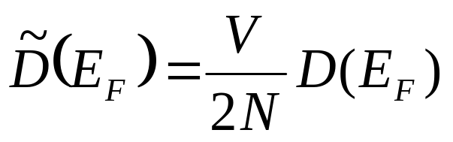
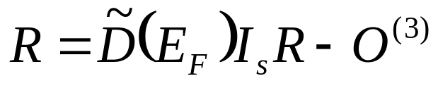
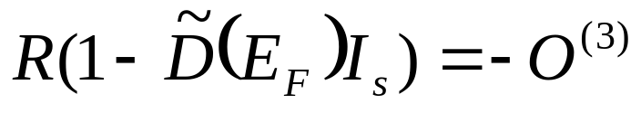
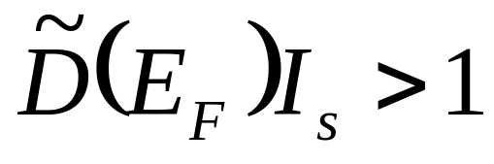
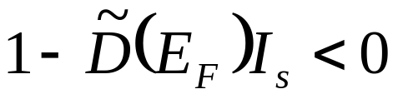
Band (Stoner) Model
Let
Density of states per atom per spin
Third order terms
Then
When is R> 0?
or
Stoner Condition for Ferromagnetism
For Fe, Co, Ni this condition is true
Doesn’t work for rare earths, though

Slide 22
Heisenberg versus Band (itinerant or free electron) model
Both are extremes, but are needed in metals such as Fe,Ni,Co
Band theory correctly describes magnetization because it assumes
magnetic moment arises from mobile d-band electrons.
Band theory, however, does not account for temperature dependence of magnetization: Heisenberg model is needed
(collective spin-spin interactions, e.g., spin waves)
To describe electron spin correlations and electron transport properties (predicted by band theory) with a unified theory is still an unsolved problem in solid state physics.

