Slide 1
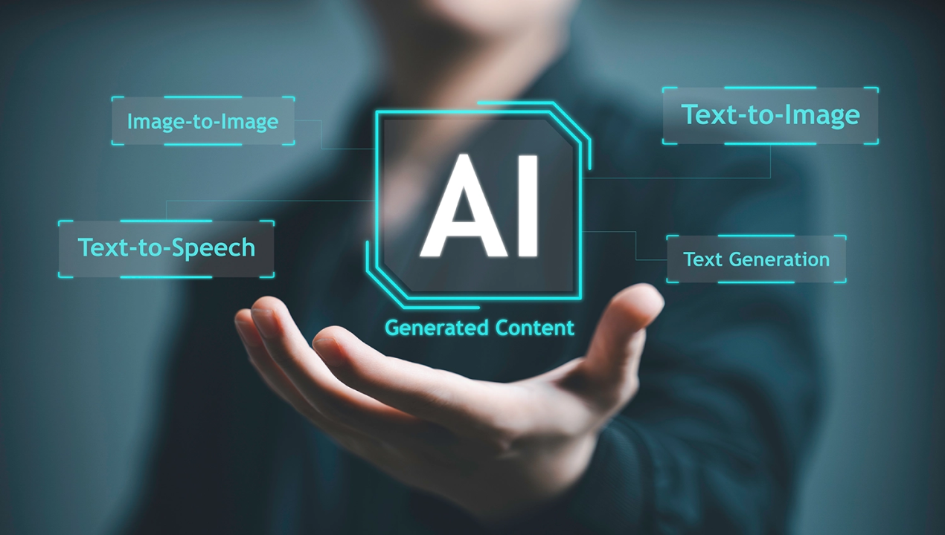
Text to Audio Converter
"A Speech Synthesis System for Textual Input"

Slide 2

Port City International University
Submitted To :
Fatema Jannat Dihan
Department of CSE,
Port City International University
Submitted By :
Rigen Das
Batch : CSE 30 (E-A)
Roll : CSE 030 07915

Slide 3
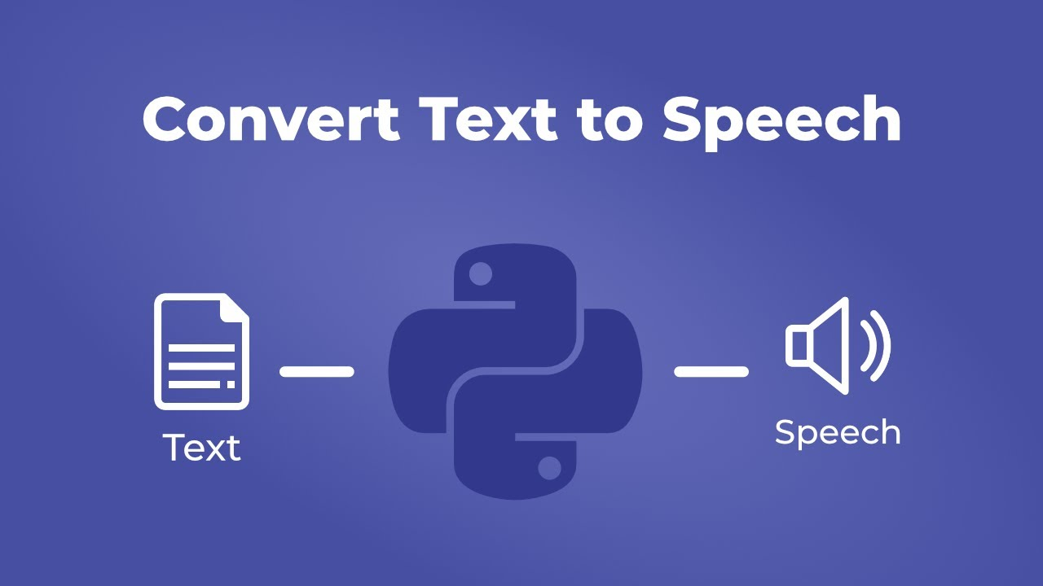
Text to Audio Converter

Slide 4
Text to Audio Converter
Title: Text-to-Audio Converter
Subtitle:“Turning written words into spoken sound”

Slide 5
Introduction
Purpose: Convert written text into spoken audio for better accessibility and interaction.
Visual Idea: A person listening with 🎧 headphones while text flows into sound waves.

Slide 6
Category
Software Type: Desktop & Mobile Application
Domain: Accessibility, Education, Productivity
Technology: Text-to-Speech (TTS), Human-Computer Interaction

Slide 7
Purpose
To convert written text into spoken audio using text-to-speech technology.
To make text more accessible for visually impaired users, learners, and people on-the-go.
To provide interactive controls like pause, stop, rewind, and re-listening to words.

Slide 8
Advantages
Improves accessibility for visually impaired users
Helps students and language learners understand better
Saves time by listening instead of reading
Works on both desktop and mobile devices
Simple, user-friendly, and interactive interface

Slide 9
Scope
Users can type text or upload files
System converts text → speech
Playback: pause, stop, rewind
Replay any specific word

Slide 10
Target Audience
🎓 Students & learners
‍🦯 Visually impaired users
💻 Developers
🧪 Testers & evaluators

Slide 11
Key Features
✍ Text Input – Type manually
📂Upload File – Supports .txt, .docx
🎧 Speech Output – Natural voice playback
⏯ Playback Controls – Pause, stop, rewind
🔁 Replay Word – Listen to any selected word again

Slide 12
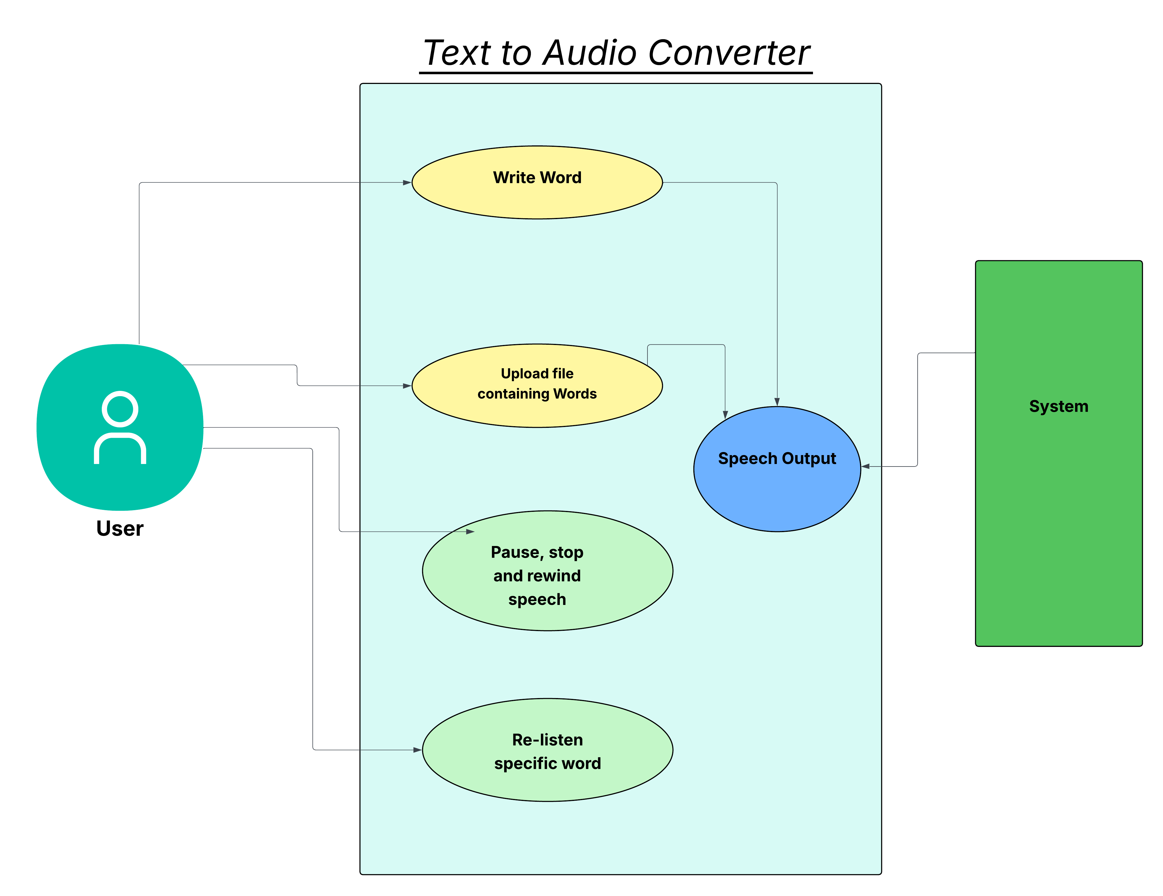
Use Case Diagram

Slide 13
System Design
Inputs: Manual text, file uploads
Process: Text-to-Speech engine
Outputs: Audio playback (.mp3, .wav)

Slide 14
Constraints & Assumptions
Supports only .txt and .docx
Audio format: .mp3 / .wav
Works on desktop + mobile
Offline mode supported

Slide 15
Non-Functional Requirements
⚡ Fast conversion (< 2s short text)
🔒 Secure file handling
🛠 Reliable (99% uptime)
🧩 Easy to update & maintain
👥 User-friendly & accessible

Slide 16
Functional Requirements
Text Input: Users can type words or sentences.
File Upload: Supports .txt and .docx files.
Speech Output: Converts text into natural-sounding audio.
Playback Controls: Pause, stop, and rewind.
Replay Word: Select and replay specific words.
Error Handling: Invalid input/file shows error messages.

Slide 17
Software Tools
Programming Language: Python / Java / PHP (depends on implementation choice)
Frameworks & Libraries:
Google TTS / Amazon Polly / pyttsx3 (for speech generation)
Tkinter / JavaFX / HTML-CSS-JS (for UI)
File handling libraries for .txt and .docx
Audio libraries for .mp3 / .wav playback
Database (optional): SQLite (if storing history or logs)

Slide 18
Deployment
Platform: Desktop (Windows, Linux), Mobile (Android/iOS)
Mode: Standalone application or web-based version
Deployment Options:
Local installation (offline mode)
Cloud API integration (online mode with TTS services)

Slide 19
Hardware Specifications
Minimum Requirements:
Processor: Dual-core 1.8 GHz
RAM: 2 GB
Storage: 200 MB free space
Audio: Speaker / Headphone
Device: PC or Smartphone
Recommended Requirements:
Processor: Quad-core 2.5 GHz or higher
RAM: 4 GB or more
Storage: 500 MB free space
Audio: High-quality speaker/headset
Device: Modern PC/Laptop or Android/iOS phone

Slide 20
Project Timeline
Gantt Chart :
July 1–7 → Requirements
July 8–14 → System Design
July 15–Aug 10 → Implementation
Aug 11–20 → Testing
Aug 21–28 → Deployment

Slide 21
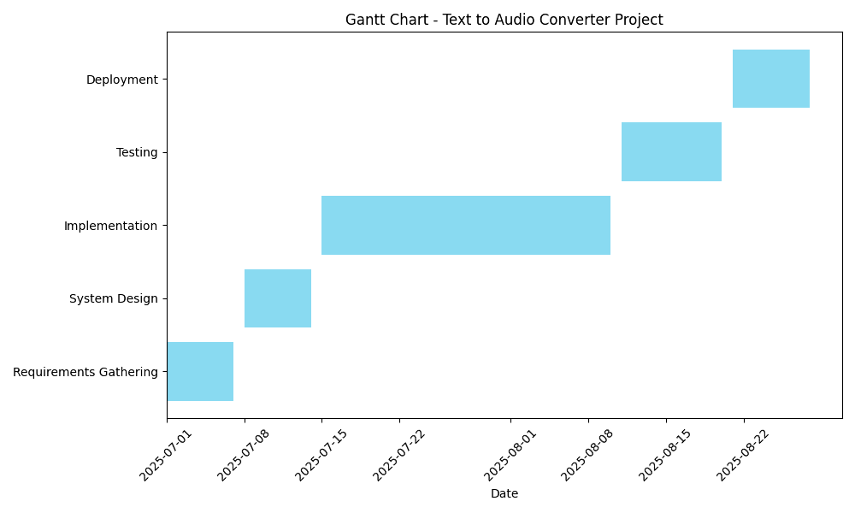
Gantt Chart

