Slide 1
Uber Orders vs. Time of Year
Questions of Interest:
Does the season / time of year affect the rate of Uber orders?
Which season / time of the year has the highest amount of orders?
Both of these questions feature heavily into the effective use of Uber both for customers and drivers. Knowing when there are more orders per day can benefit a driver looking to focus on more efficient use of their time, whereas a customer might want to know when Uber wait times and prices were lower due to lower demand.

Slide 2
Where and How the Data Was Found
A quick search of Google revealed that Kaggle had a large trove of user-submitted location data from Uber drivers in New York City.
This data had information on latitude and longitude of order, date, and Base ID for the region.

Slide 3
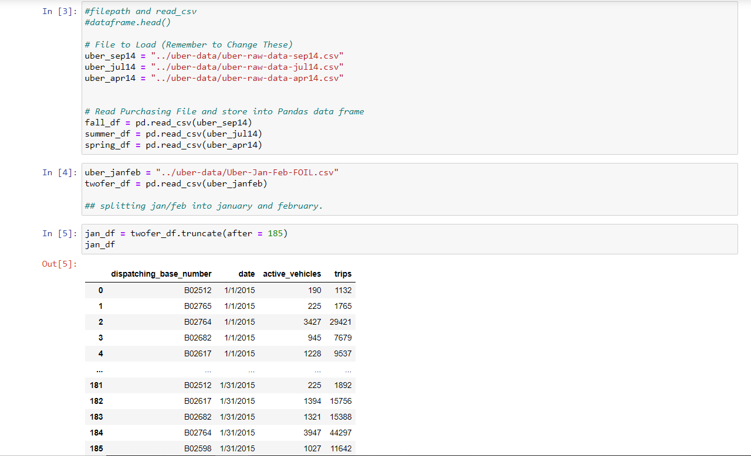
Data Exploration and Cleanup:
Information from a
sample month from
each season was
read in from csv
files, then converted
to dataframes for
ease of access.

Slide 4
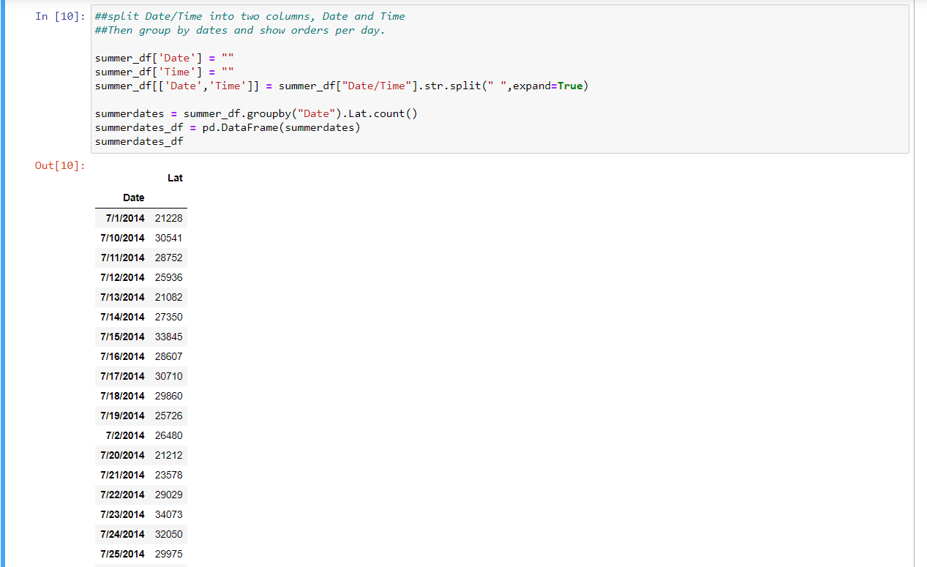
Date/Time needed
to be split into two
columns, in order
to group all the
orders by date to
find the amount
per day.

Slide 5
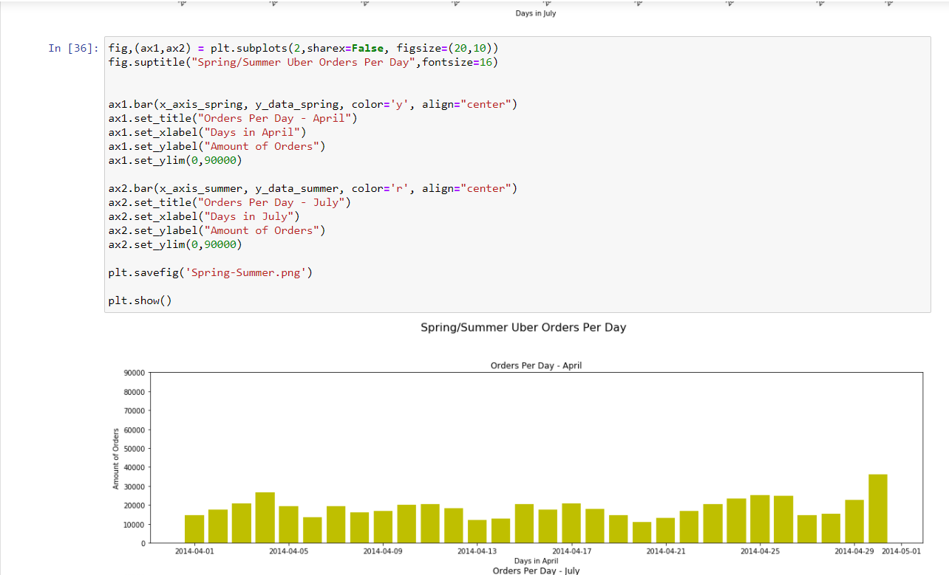
Once data has
been prepared,
it’s just a matter
of saving the data
and plotting both
sample months
into seasonal
facet plots.

Slide 6
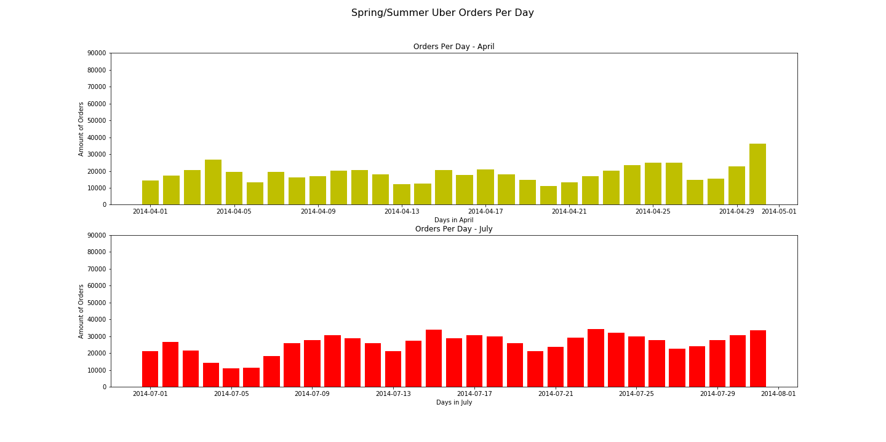

Slide 7
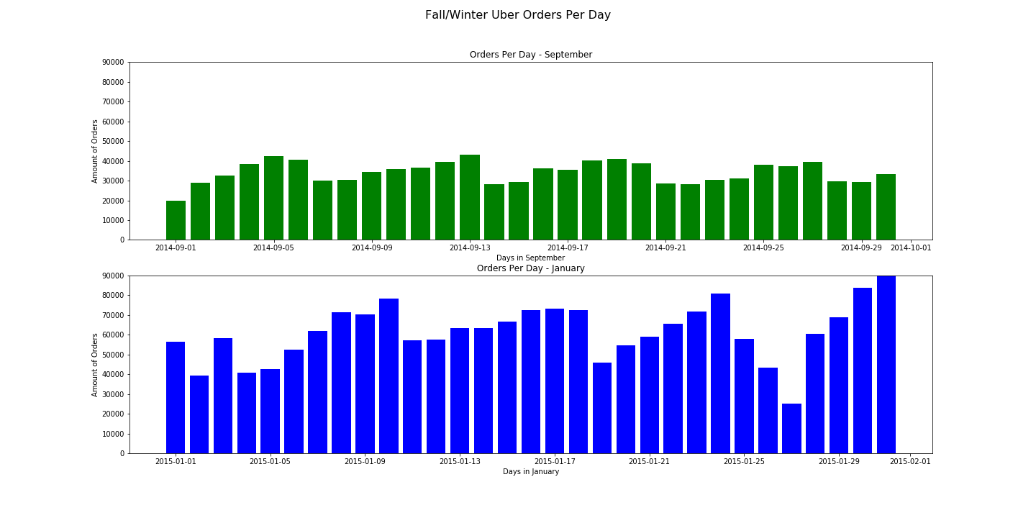

Slide 8
Conclusions, Observations, and Implications
Conclusion: Fall and Winter, the cold weather seasons, both saw a large uptick in order amount for Uber in New York City. This answers both initial questions : season / time of year absolutely does make a difference, and Winter in particular has the heaviest volume of orders.
Of particular note is the scale of the graphs – initially they all looked similar, but I noticed how much bigger the winter numbers are and so adjusted all the graphs to winter’s order numbers. This dramatically reveals the difference in order amount.
The implication behind the observation seems clear enough – in the cold weather with rain and snow more frequent, there’s less desire to go out of the house oneself, and so there’s a noticeable uptick in deliveries.

