Slide 1

GeoProcessing Batch Script: Feature & Raster Analysis
By: Amanda L. Riggs
April 30, 2024
GEOG 6400: Seminar in Geographic Information and Analysis
East Carolina University

Slide 2

Introduction
Created out of a need for preprocessing a significant amount of data simultaneously
The data is required to run models in InVEST®
Data required includes rasters, feature layers, CSV files, and a variety of tables.

Slide 3
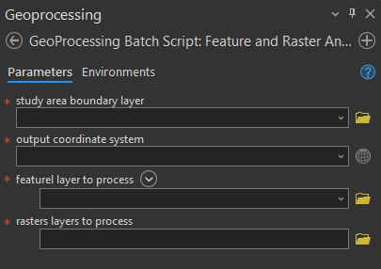
Tool Description
My tool uses a feature layer to clip and mask multiple feature and raster layers, based on a study area boundary feature layer and projects them to the desired coordinate system, then deposits them into the user's default geodatabase.
Input parameters:
  study_area_boundary_param = arcpy.GetParameter(0) # Study area boundary parameter
  output_coordinate_system_param = arcpy.GetParameter(1) # Output coordinate system parameter
  feature_layers_to_process_param = arcpy.GetParameter(2) # Feature layers parameter
  raster_layers_to_process_param = arcpy.GetParameter(3) # Raster layers parameter

Slide 4
Input Datasets
Data
Models
 | Urban Stormwater Retention | RouteDEM | Delineatelt | Urban Flood Risk Mitigation | Sediment Delivery Ratio | Nutrient Delivery Ration
Area of Interest (Boundary Feature) | X |  |  | X |  | X
Built Infrastructure (Feature) |  |  |  | X |  | X
Digital Elevation Model (Raster) |  | X | X |  | X
Drainages (Raster) |  |  |  |  | X | X
Erosivity (Raster) |  |  |  |  | X
Land Use/Land Cover (Raster) | X |  |  | X | X
Local Recharge (Raster) |  |  |  |  |  | X
Precipitation (Raster) | X
Soil Erodibility (Raster) |  |  |  |  | X
Soil Hydrologic Group (Raster) | X |  |  | X |  | X
Sub-Watersheds (Feature) | X
Watershed Outlets (Feature)
Watersheds (Feature) |  |  |  |  | X | X

Slide 5
Tool Workflow
# Set the workspace
# Define the default intermediate and default geodatabase output paths
# Give the OK to overwrite existing files
  # Define input parameters
  # Retrieve the study area boundary layer
  # Set the output coordinate system
  # Process feature classes
    # Define a temporary output path for projected feature layer
    # Perform the projection
    # Define the output path for clipped feature layer
    # Perform the clip operation
    # Convert feature to geodatabase
    # Delete temporary projected feature layer
# Define the study area boundary
# Convert the boundary to raster
# Process rasters using study area raster
  #Iterate over raster layers parameter
    # Define a temporary out path for projected rasters
    # Perform the projection
    # Perform the extract by mask operation using the boundary raster
    # Save the clipped rasters
    # Import the clipped rasters into the default geodatabase
    # Delete temporary projected raster layers

Slide 6







Key Geoprocessing Tools

Slide 7
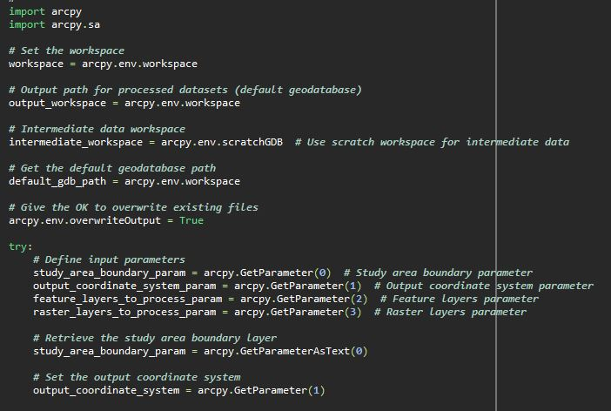
Snippet 1
1.The script starts by importing the ArcPy module.
This function sets workspace parameters, such as the output workspace, intermediate workspace, and default geodatabase path.
It allows overwriting existing files if needed.
Then defines the input parameters. The parameters include the boundary layer, output coordinate system, feature layers to process, and raster layers to process.

Slide 8
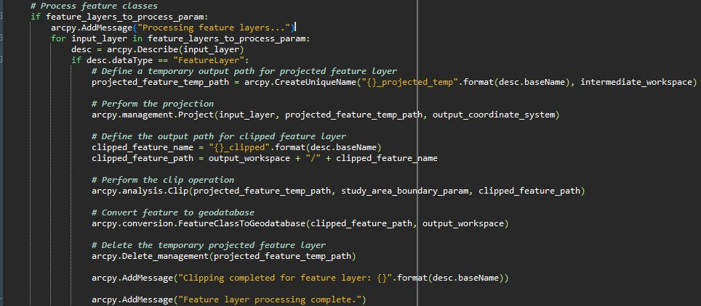
Snippet 2
5.The script iterates through each layer.
6.Projects the input feature layers to the output coordinate system.
7.Clips the projected feature layers using the study area boundary.
8.Converts the clipped feature layers to the default geodatabase.
9.Deletes the temporary projected feature layers.

Slide 9
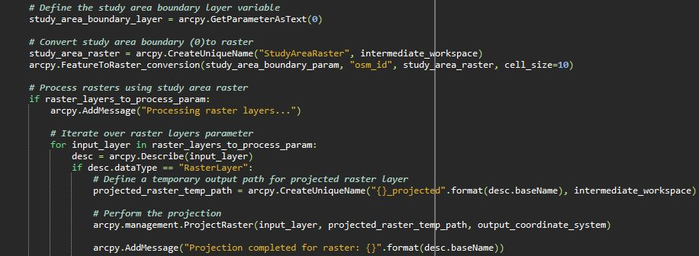
Snippet 3
10. It converts the study area boundary feature to a raster format.
11. It then iterates through each raster layer.
12. Then projects the input raster layers to the output coordinate system.

Slide 10
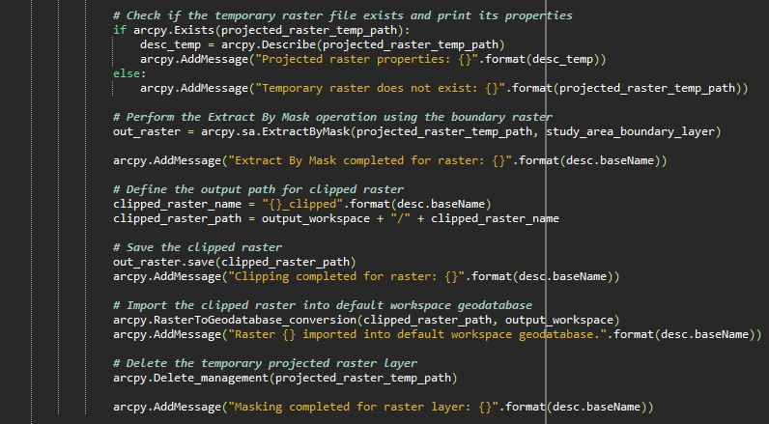
Snippet 4
  12.Next, it checks if the temporary raster file exists and prints its properties for error handling.
  13.Extracts the portion of the projected raster layers that falls within the study area boundary.
  14.Defines and saves the clipped raster layer.
  15.Imports the clipped raster layers into the default workspace geodatabase.
  16.Deletes the temporary projected raster layers.

Slide 11
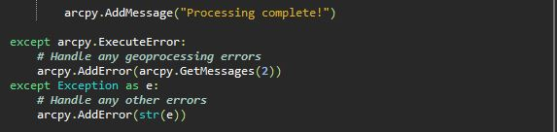
Snippet 5
17.It includes exception handling to manage errors that may occur during geoprocessing.
18.Throughout the script, arcpy.AddMessage() provides information messages about the script's progress.
19.Once all processing is complete, a completion message is displayed.

Slide 12
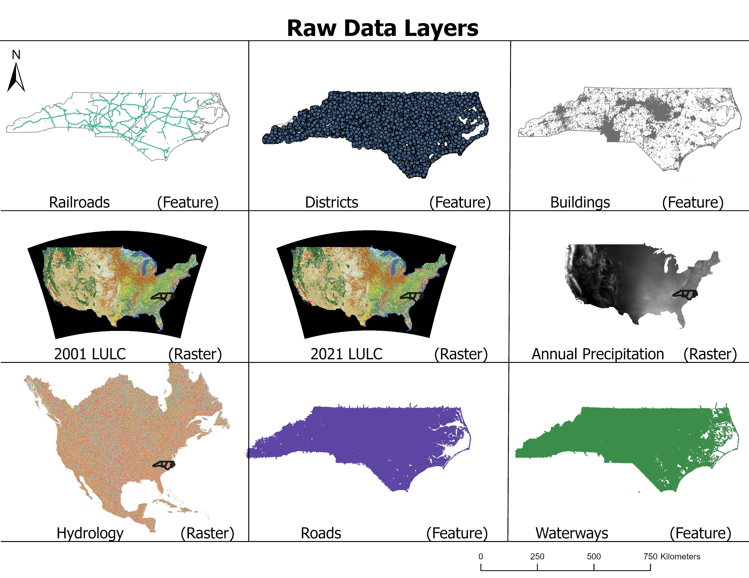
Demonstration

Slide 13
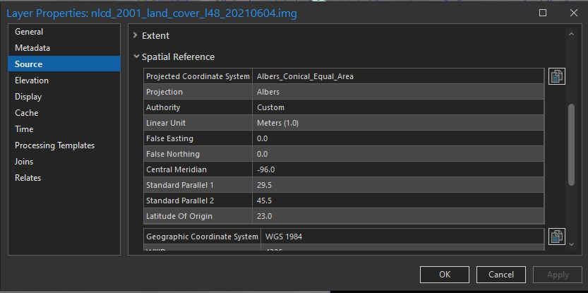
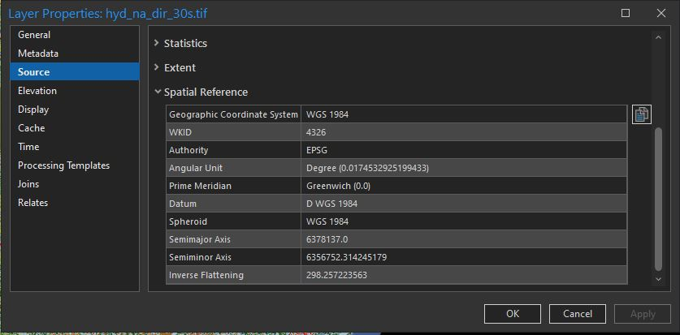
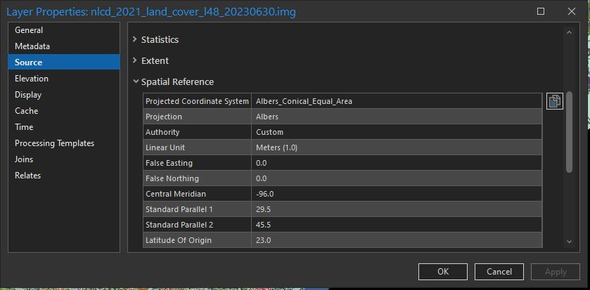
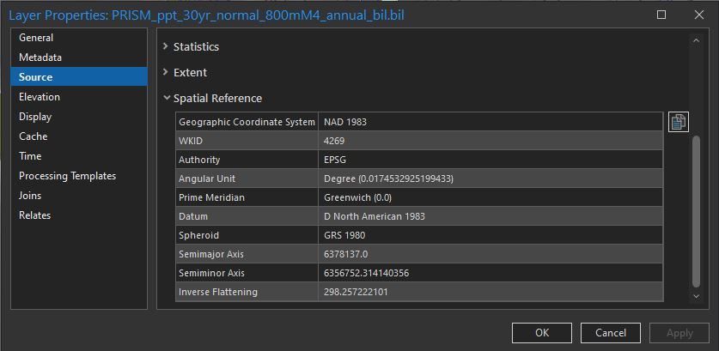
Raw Raster Spatial References

Slide 14
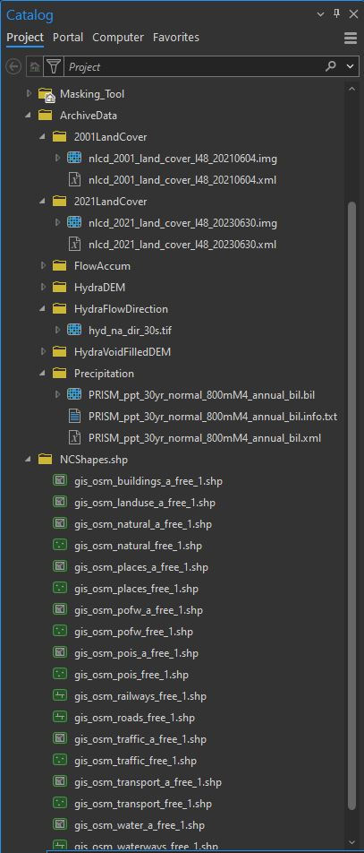
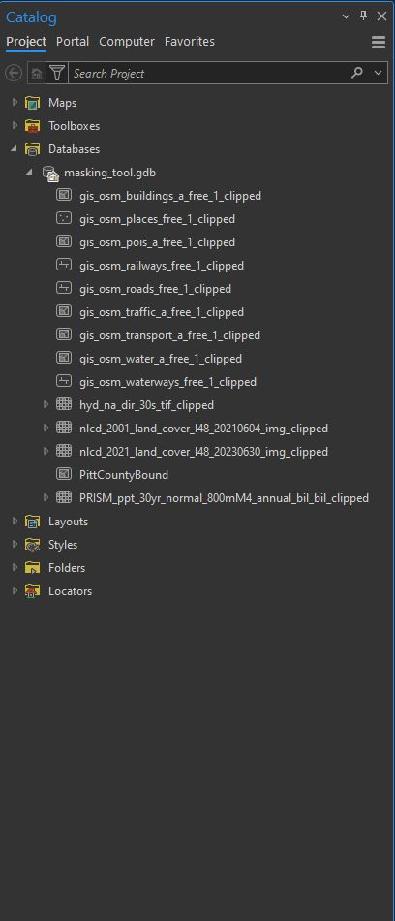
Raw Data Locations
Processed Data Locations
* I used the arcpy Create Unique Name function to give all outputs their respective names

Slide 15
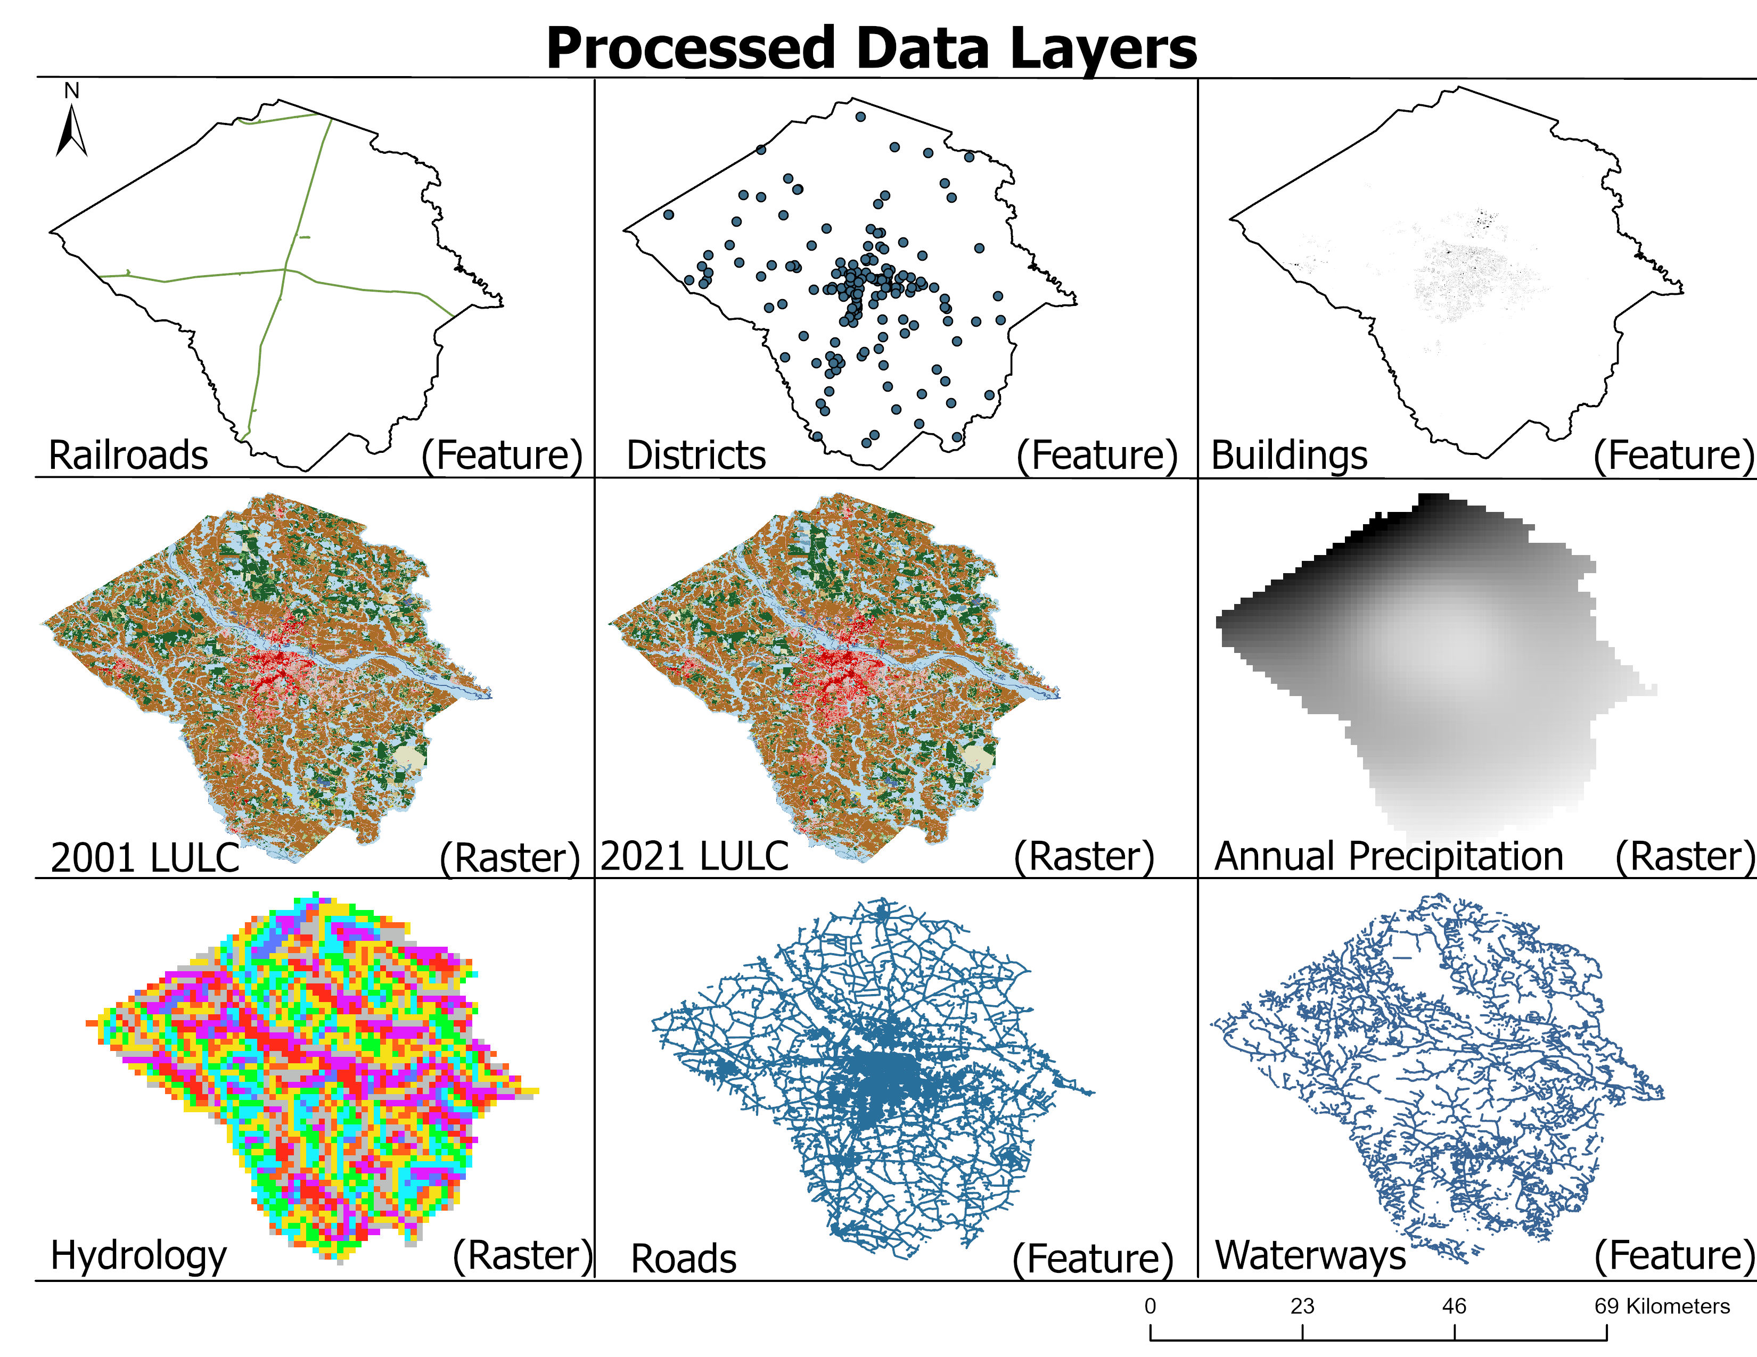
Results

Slide 16
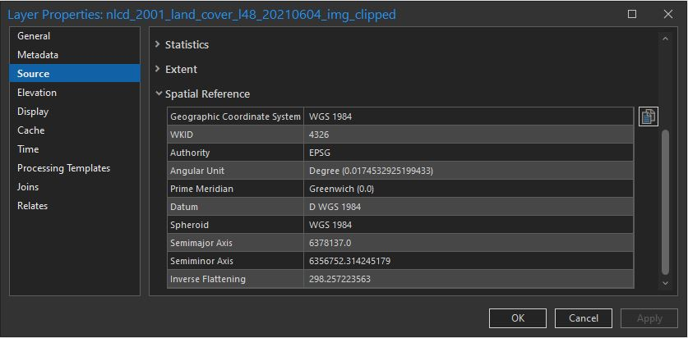
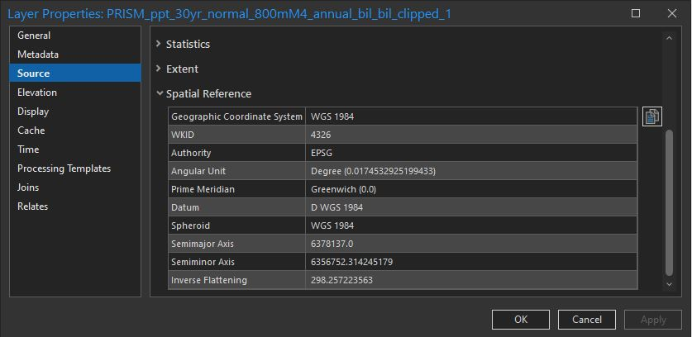
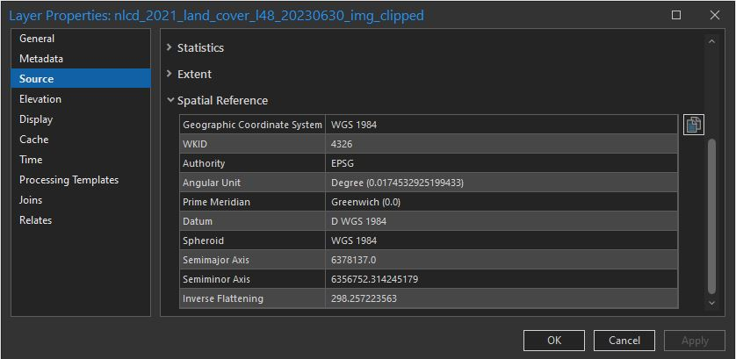
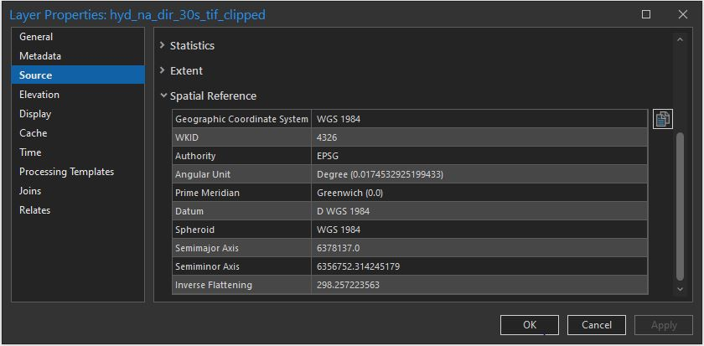
Processed Raw Raster Spatial References

Slide 17
Use Limitations
Input Data Compatibility:
The script requires a boundary feature layer for parameter (0) that includes an osm_id field in the attribute table.
The tool may require specific input data formats or data structures, limiting its compatibility with certain datasets or data sources.
Processing Speed:
Large datasets or complex processing tasks may lead to longer processing times, affecting overall efficiency, especially when processing multiple layers in batch mode.
Memory Usage:
The tool's memory usage may increase significantly when processing large datasets, potentially leading to memory-related errors or slowdowns on systems with limited resources.
Output Size:
Depending on the input data and processing operations, the tool may generate large output files, which could consume storage space and impact file management.
Unsupported Data Types:
Certain types of data or data structures may not be supported by the tool, restricting its applicability to a subset of GIS data types.

Slide 18
Conclusion
The GeoProcessing Batch Script: Feature and Raster Analysis tool will be essential for my thesis research processing demands.
Other users with similar processing needs will benefit from the script by saving time and cutting repetitive processing tasks.
Future improvements include:
  An append tool to confirm that all attributes transfer over with the new layers,
  Tools that will delineate watersheds and fill sinks,
  As well as an attempt to transform the script to be used in other software suits to enhance its versatility.

Slide 19
References
OpenStreetMap. [Data]. Open Data Commons Open Database License (ODbL0 by the OpenStreetMap Foundation. Copyright Creative Commons Attribution-ShareAlike 2.0 . https://www.openstreetmap.org/#map=5/38.007/-95.844
USGS. (n.d.). National land cover database. U.S. Geological Survey U.S. Department of the Interior. https://www.usgs.gov/centers/eros/science/national-land-cover-database
USAFacts. (2024). Our changing population: Pitt County, North Carolina. USAFacts. Pitt County, NC population by year, race, & more | USAFacts

