Slide 1

GeoProcessing Batch Script: Feature & Raster Analysis

Slide 2

Introduction
Created out of a need for preprocessing a significant amount of data simultaneously
The data is required to run models in InVEST®
Data required includes rasters, feature layers, CSV files, and a variety of tables.

Slide 3
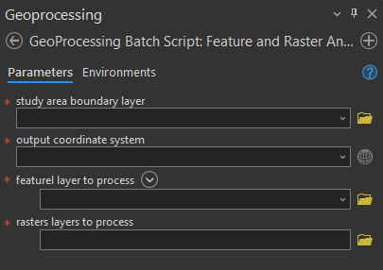
Tool Description
My tool uses a feature layer to clip and mask multiple feature and raster layers, based on a study area boundary feature layer and projects them to the desired coordinate system, then deposits them into the user's default geodatabase.
Input parameters:
  study_area_boundary_param = arcpy.GetParameter(0) # Study area boundary parameter
  output_coordinate_system_param = arcpy.GetParameter(1) # Output coordinate system parameter
  feature_layers_to_process_param = arcpy.GetParameter(2) # Feature layers parameter
  raster_layers_to_process_param = arcpy.GetParameter(3) # Raster layers parameter

Slide 4
Input Datasets
Data
Models
 | Urban Stormwater Retention | RouteDEM | Delineatelt | Urban Flood Risk Mitigation | Sediment Delivery Ratio | Nutrient Delivery Ration
Area of Interest (Boundary Feature) | X |  |  | X |  | X
Built Infrastructure (Feature) |  |  |  | X |  | X
Digital Elevation Model (Raster) |  | X | X |  | X
Drainages (Raster) |  |  |  |  | X | X
Erosivity (Raster) |  |  |  |  | X
Land Use/Land Cover (Raster) | X |  |  | X | X
Local Recharge (Raster) |  |  |  |  |  | X
Precipitation (Raster) | X
Soil Erodibility (Raster) |  |  |  |  | X
Soil Hydrologic Group (Raster) | X |  |  | X |  | X
Sub-Watersheds (Feature) | X
Watershed Outlets (Feature)
Watersheds (Feature) |  |  |  |  | X | X

Slide 5


Tool Workflow
# Set the workspace
# Output path for processed datasets (default geodatabase)
# Output path for processed datasets (default geodatabase)
# Get the default geodatabase path
# Give the OK to overwrite existing files
  # Define input parameters
  # Retrieve the study area boundary layer
  # Set the output coordinate system
  # Process feature classes
    # Define a temporary output path for projected feature layer
    # Perform the projection
    # Define the output path for clipped feature layer
    # Perform the clip operation
    # Convert feature to geodatabase
    # Delete the temporary projected feature layer

Slide 6







Key Geoprocessing Tools

Slide 7
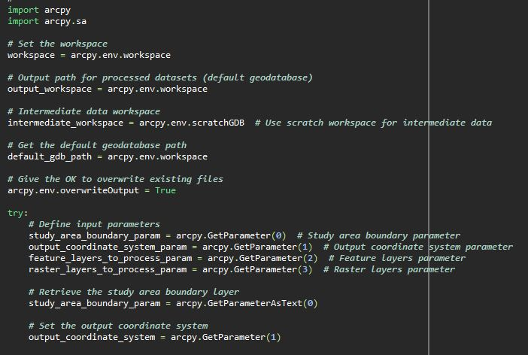
Snippet 1
1.The script starts by importing the ArcPy module, which provides access to ArcGIS functionality.
This function sets workspace parameters, such as the output workspace, intermediate workspace, and default geodatabase path.
It allows overwriting existing files if needed.
The script defines input parameters provided by the user. The parameters include the boundary layer, output coordinate system, feature layers to process, and raster layers to process.

Slide 8
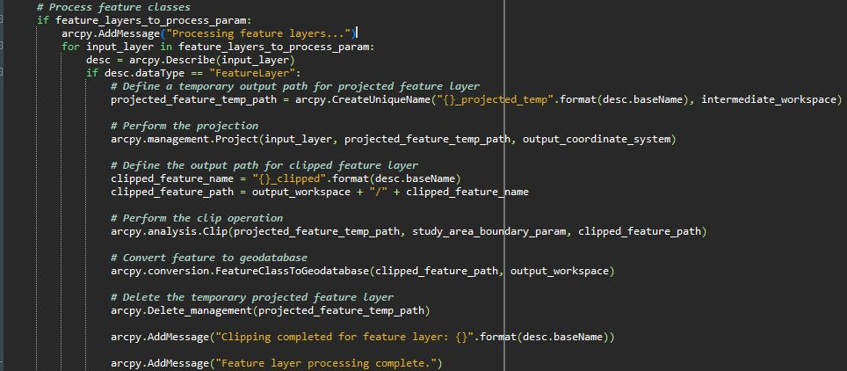
Snippet 2
5.The script iterates through each layer.
6.Project the input feature layer to the output coordinate system.
7.Clip the projected feature layer using the study area boundary.
8.Convert the clipped feature layer to a geodatabase format.
9.Delete the temporary projected feature layer.

Slide 9
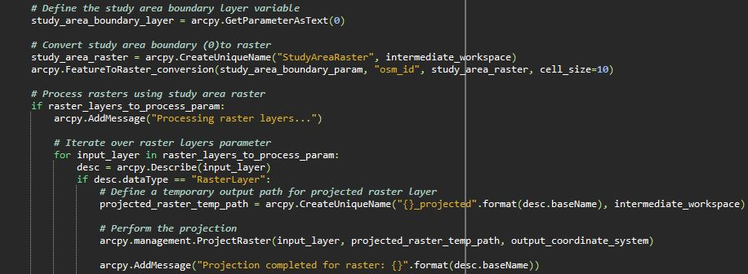
Snippet 3
10. It converts the study area boundary feature to a raster format.
11. It iterates through each layer
12. Project the input raster layer to the output coordinate system.

Slide 10
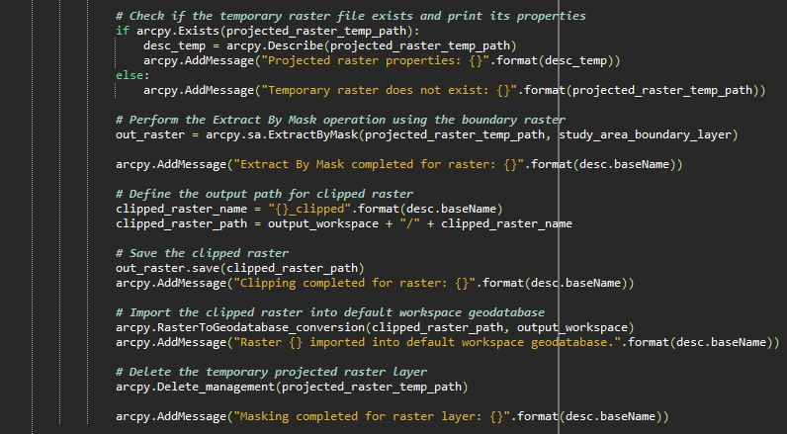
Snippet 4
  12.Checks if the temporary raster file exists and prints its properties for error handling.
  13.Extract the portion of the projected raster layer that falls within the study area boundary.
  14.Define and save the clipped raster layer.
  15.Import the clipped raster layer into the default workspace geodatabase.
  16.Delete the temporary projected raster layer.

Slide 11
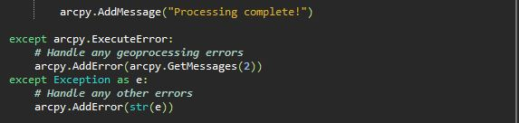
Snippet 5
17.It includes exception handling to manage errors that may occur during geoprocessing.
18.Throughout the script, arcpy.AddMessage() provides information messages about the script's progress.
19.Once all processing is complete, a completion message is displayed.

Slide 12
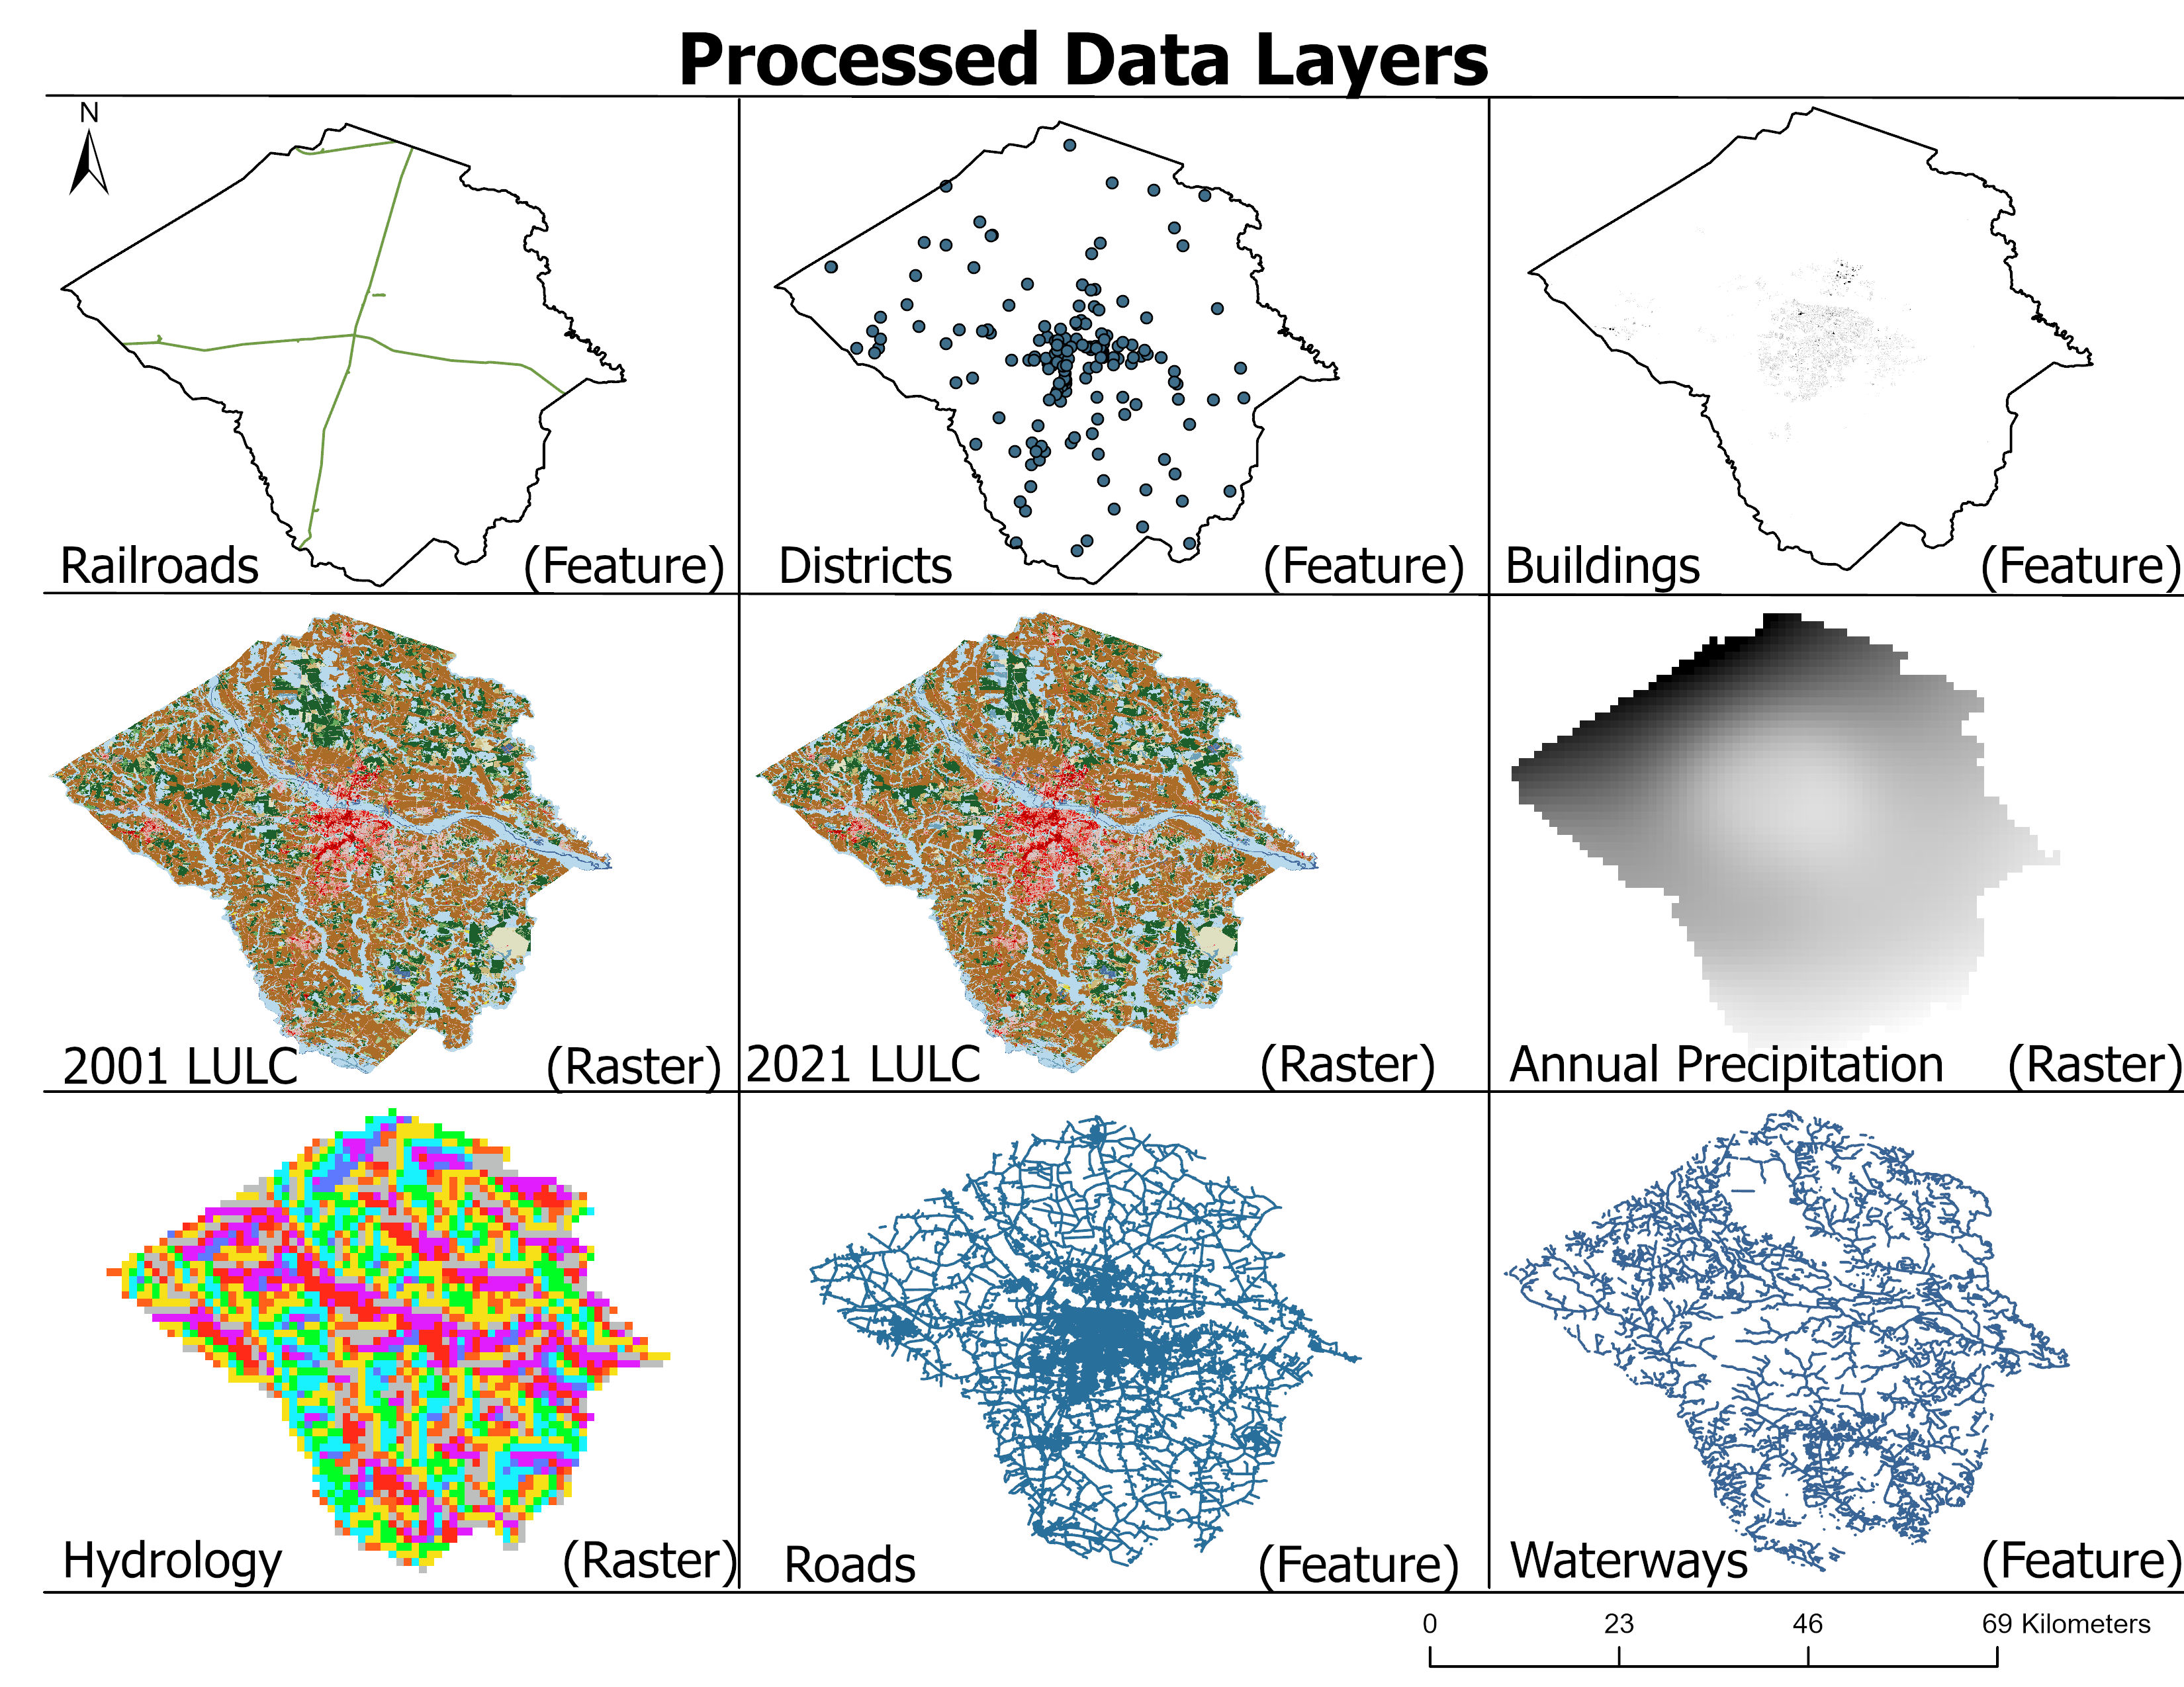
Results

Slide 13
Use Limitations
Input Data Compatibility:
The tool may require specific input data formats or data structures, limiting its compatibility with certain datasets or data sources.
Processing Speed:
Large datasets or complex processing tasks may lead to longer processing times, affecting overall efficiency, especially when processing multiple layers in batch mode.
Memory Usage:
The tool's memory usage may increase significantly when processing large datasets, potentially leading to memory-related errors or slowdowns on systems with limited resources.
Output Size:
Depending on the input data and processing operations, the tool may generate large output files, which could consume storage space and impact file management.
Unsupported Data Types:
Certain types of data or data structures may not be supported by the tool, restricting its applicability to a subset of GIS data types.

Slide 14
References
OpenStreetMap. [Data]. Open Data Commons Open Database License (ODbL0 by the OpenStreetMap Foundation. Copyright Creative Commons Attribution-ShareAlike 2.0 . https://www.openstreetmap.org/#map=5/38.007/-95.844
USGS. (n.d.). National land cover database. U.S. Geological Survey U.S. Department of the Interior. https://www.usgs.gov/centers/eros/science/national-land-cover-database
USAFacts. (2024). Our changing population: Pitt County, North Carolina. USAFacts. Pitt County, NC population by year, race, & more | USAFacts

