Slide 1


Handle authorization security issues with testing automation
Dominique Righetto
@righettod
#automate_authz_testing
Notes:
Visual hint:
Pony in bottom right corner mean that I have explanation to give and information has been added in slide notes section
Timeframe:
25 minutes
Speech: 20 minutes
Q & R: 5 minutes
Review history:
29/04/2018 : Jim Manico, feedback is tracked using this issue https://bitbucket.org/righettod/voxxeddays2018-talk/issues/1
11/06/2018: Update template to one provided by the organizer
12/06/2018: First dry run (global time taken 16m 30 sec)
16/06/2018: Second dry run (global time taken 17m 30 sec)
21/06/2018: Last dry run (global time taken 22m 05 sec)

Slide 2
What is an authorization?
Characterize the access to a resource.
Composed by several elements often named Dimensions.
Dimensions often used are the Feature and the Logical role.
Sometimes a Data dimension is used to filter access at data level.
Will focus here on the Feature and the Logical role dimensions.
 Authorization will be named Authz in the rest of the presentation.

Slide 3
Authz matrix?
Features \ Logical roles | ANONYMOUS | BASIC | ADMIN
ReadSingleMessage | Grant | Grant | Grant
ReadAllMessages | Grant | Grant | Grant
CreateMessage | Deny | Grant | Grant
DeleteMessage | Deny | Deny | Grant
One feature x One logical role = One Authz
List of features x List of logical roles = Authz matrix

Slide 4
Issues at Authz level? Consequences?
Illegal access to a resource with create, read or modify operations.
Real life impact, do you feel comfortable if:
Bank: I can access to your account? Your Credit card?
Healthcare: I can access to your medical profile?
Mobile: I can access to all your phone Call/SMS with content details?
Exchange: I can access to all your private and professional emails?
Authz issues can lead to data breaches!

Slide 5
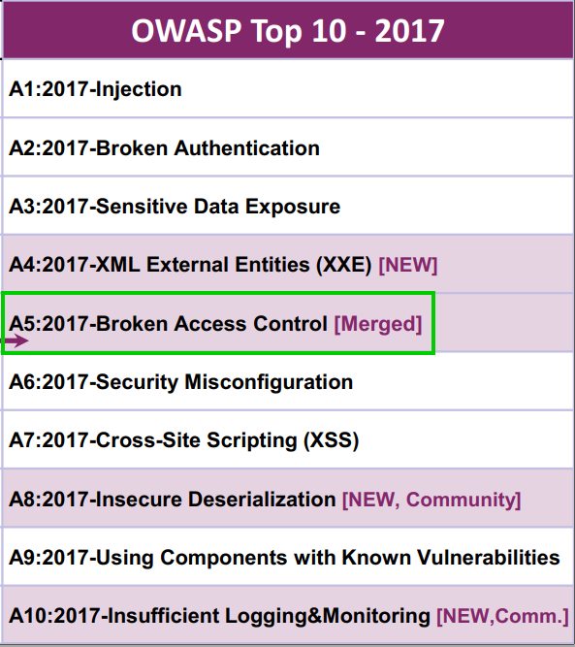
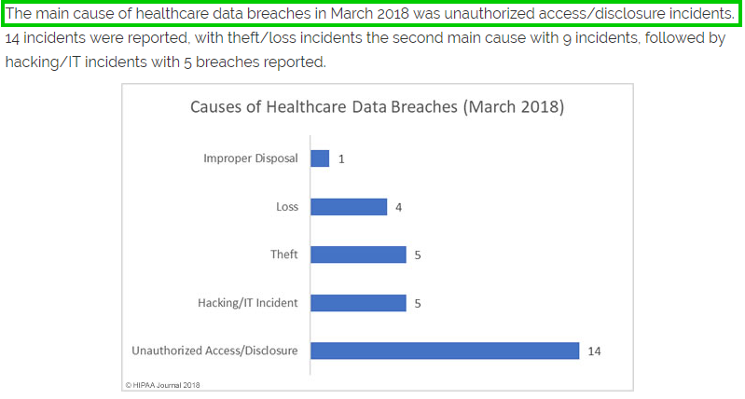

Authz issues occurs often?
https://www.hipaajournal.com/march-2018-healthcare-data-breaches/
Notes:
Here we show through different example that Authz are an important threats (explains orally):
Fifth position in the OWASP Top 10 2017 so it's the fifth most important common issue
In US healthcare sector for march 2018, access control issue is the first source of incidents (it’s difficult to find the same stats for Europe)
Images sources:
Left: OWASP site directly
Right: https://www.hipaajournal.com/march-2018-healthcare-data-breaches/

Slide 6
Why does Authz issues happen often?
Hard to define a stable Authz matrix (Features x Logical roles) on the application life time (new feature, teammates change…).
Vulnerability scanner, Web Application Firewall, Intrusion Detection System…Can’t help here because they can’t identify a lawful from an unlawful access → Stream is legit!
Most Authz matrix are tested manually by functional test team, it’s hard to test all combinations (time-consuming & mental tiredness) before every release, moreover in Agile/CD project…
Notes:
CD = Continuous Delivery

Slide 7
Why does Authz issues happen often?
With time, Authz matrix loss the sync with the real Authz matrix implemented in the application, moreover in maintenance life phase.
Hard to quickly provide an up-to-date representation of the Authz matrix to an external/internal security auditor.

Slide 8

Notes:
Site used is https://makeameme.org/meme/so-dude-you

Slide 9
Why leverage Authz testing automation?
Continuously ensure that the Authz matrix is in sync with its implementation in the application → Spot desync quickly!
Tests all combinations of the Authz matrix at every Authz matrix test round.
Be able to generate a representation of the Authz matrix according to the target recipient: Security auditor, CISO, security architect…
Notes:
CISO = Chief Information Security Officer (RSSI in French)

Slide 10
Why leverage Authz testing automation?
Versioning of the Authz matrix with the application code in the SCM: Authz matrix become an asset of the project code baseline.
Any update on Authz matrix can be back-traced through the SCM log history.
Gain time in Authz matrix test round and reduce risk of human error during manual testing.
Notes:
SCM = Source Code Management system (git, svn…)

Slide 11
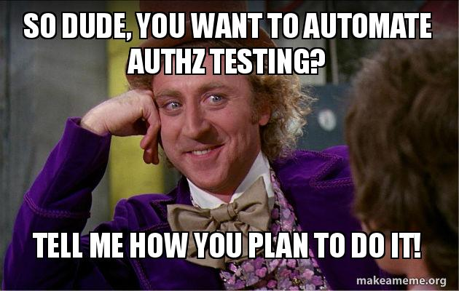
Notes:
Site used is https://makeameme.org/meme/so-dude-you

Slide 12
Authz testing: Context
I will show an example of approach for an application exposing a REST API but the concepts/codes shown can be used for others application types.
The sample REST API use JSON Web Token to hold authentication.
Why have I choose a REST API application types for the proposed approach?
The application which I meet, expose very often a REST (like) API .
It’s the most popular application topology meet today in the context of Single Page Application or Micro Services based system.

Slide 13
Authz testing: Guidelines
Represent the Authz matrix in a pivot file that will allow us to derivate it in different others representations (HTML, Excel…).
Tests cases will use this pivot file to determine each test context and expected behaviour.
Test code will be reusable for other projects/technologies.
Test code will be simple and use standard API/framework in order to:
Be integrated in popular IDE and Continuous Integration Platform.
Generate test reports in a format already used by dev team.

Slide 14




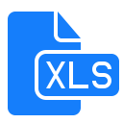

Authz testing: Overview
Representation of the Authz matrix
Test cases reports
Pivot file
Authz test cases
Proof that the Authz matrix implementation is OK

Slide 15






Authz testing: Toolbox
Representation of the Authz matrix
Test cases reports
Pivot file
Authz test cases
Proof that the Authz matrix implementation is OK

Slide 16
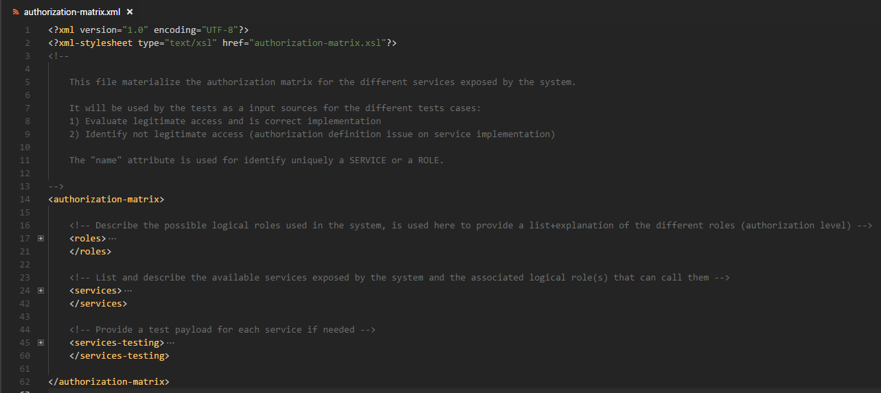
Authz testing: Pivot file
Notes:
We explains here the different main sections of the pivot file used to represent the Authz matrix and what they deserve:
Roles
Services
Services Testing
We kept sections Services + Services Testing in the same file in order to ensure the sync and a central update point when service implementation changes.

Slide 17
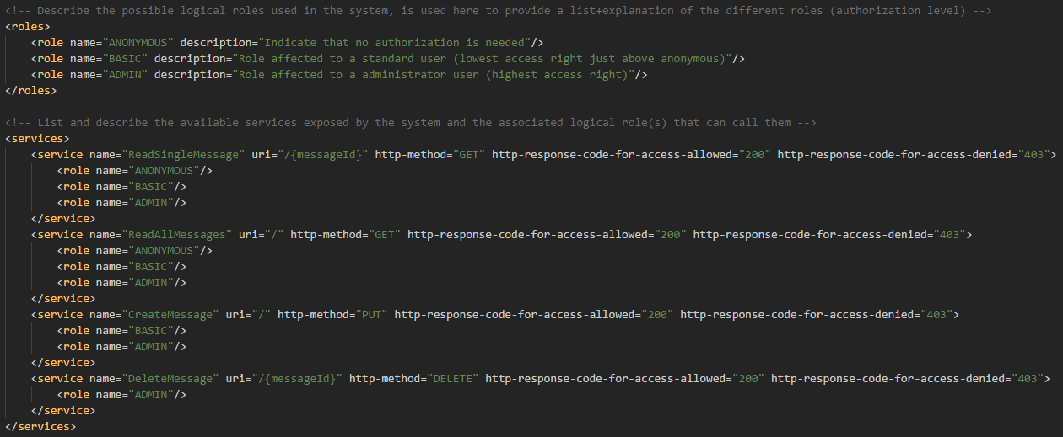
Authz testing: Pivot file example
Notes:
We explains here how we materialize the Roles, the Services and then the representation of the Authorization matrix via all the combinations

Slide 18
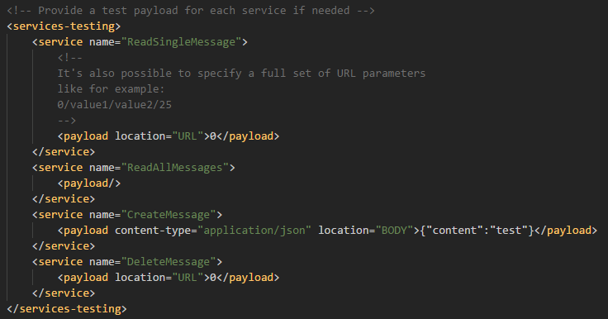
Authz testing: Pivot file example
Notes:
We explains here how we store the testing data needed by each service in order to perform functional calls to the service:
For each service identified by is name (remember name is the unique identifier for a Service or a Role) then we can add a custom payload for which we can specify:
Is location (request BODY or URL)
Is content type (only used if payload is targeted to be set in the request BODY)

Slide 19
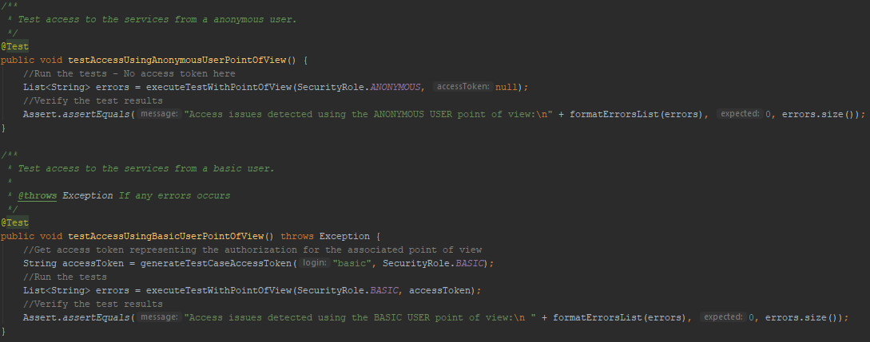
Authz testing: Tests example
Notes:
We explains here that we have one test case by Point Of View (a POV = a Logical role) in order to clearly identify in test results in which POV there authorization issues.
Code executing tests has been factorized and centralized.
The execution phases are the following:
We forge a JWT token representing the user profile
We execute the test using the Authz matrix information and the access token
We check if errors has been meet and according to that we decide if the test case pass or fail

Slide 20
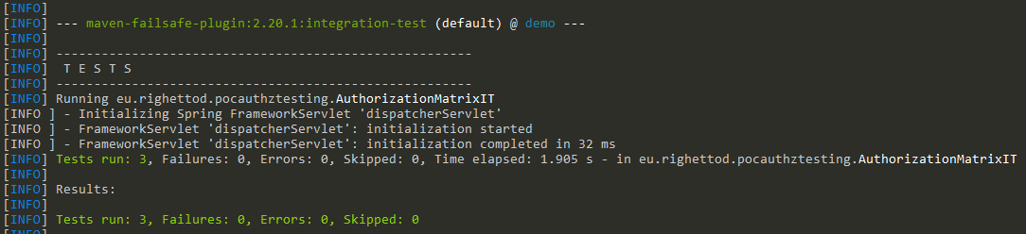
Authz testing: Tests run example no issue
Notes:
We show here what is the result when no error has been found and then mean that the Authz matrix is in phase with is implementation

Slide 21
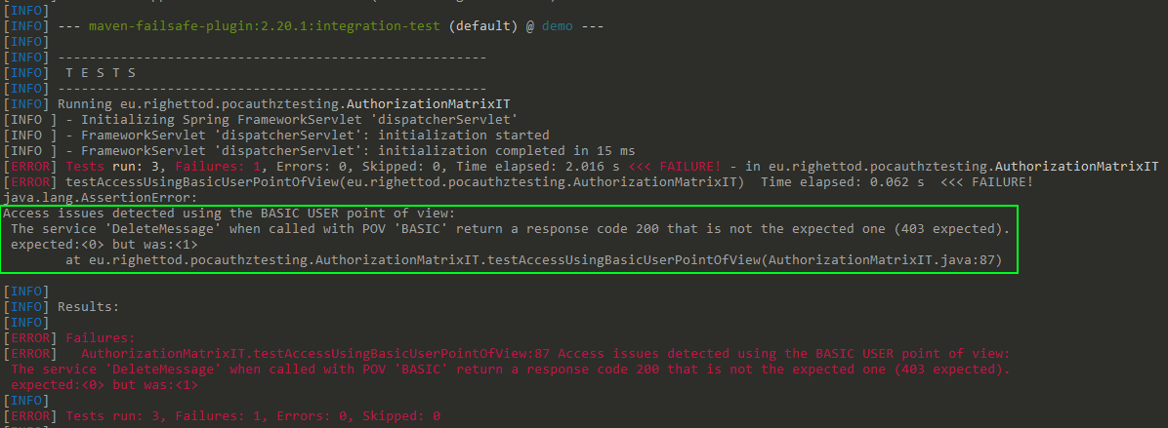
Authz testing: Tests run example with issues
Notes:
We show here what is the result when error has been found and then mean that the Authz matrix is NOT in phase with is implementation

Slide 22
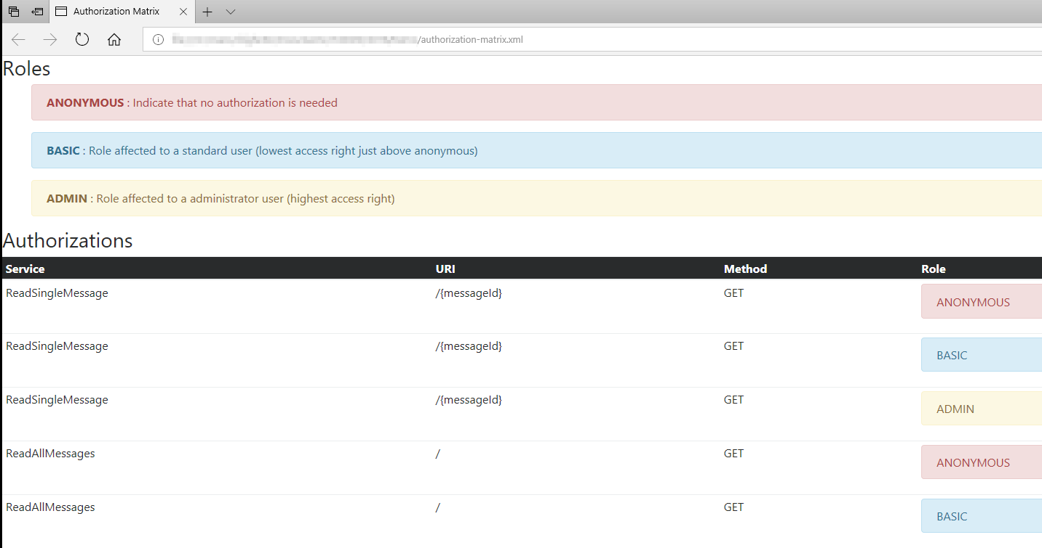
Authz matrix: HTML representation
Notes:
We explain here that this representation is directly generated via XSL from the XML Pivot file
Make a joke about my amazing design skills and many thanks to Bootstrap design feature !
Explains also the choice of the colour:
RED (danger) to anonymous because it’s the most “easy” to obtains from an attacker POV and mean there no authentication and no identification of the requester of the service
BLUE (normal) to basic user because it’s the normal access level that have access to the non sensitive features
YELLOW (warning) to admin user because it’s the most “difficult” to obtains from an attacker POV but as this profile have access to sensitive features then it must be highly tracked

Slide 23

Notes:
Run the demo, I will show the following elements in order to proof that is not only on the slides.
➔ Run the script “Exec-Demo.bat” that will perform all the demo steps in the following order:
Show the execution of a test round of the Authz matrix without any error ➔ Matrix is in sync with it’s implementation
Show the execution of a test round of the Authz matrix with error ➔ Matrix is NOT in sync with it’s implementation
Show an HTML representation of the Authz matrix directly opened in FF
Show an HTML test reports about the tests cases run that represents the Authz Matrix test round

Slide 24

Thanks you !
Demo source:
https://github.com/righettod/voxxeddays-lux-2018
Notes:
https://makeameme.org/

