Slide 1
Trap bad guys in your browser with HTTP security headers.
Mirjam Nilsson

Slide 2
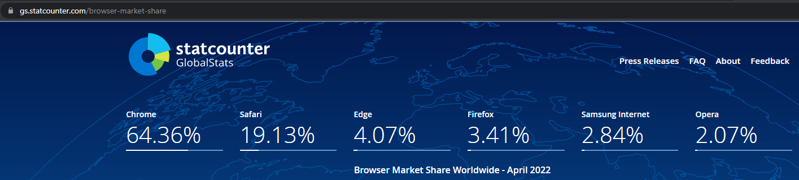
Part1 - Some introduction
All headers presented here are supported by the current version (May 2022) of modern browser including Chrome based ones, Firefox and Safari.
Elements presented are independent of the technologies used on the server side.
All test and demonstration were performed using Chrome (latest release in May 2022) because it seems to be the most popular browser even in enterprise environments (Chrome/Edge are often used in companies and Edge is chrome based like Opera):
https://gs.statcounter.com/browser-market-share

Slide 3
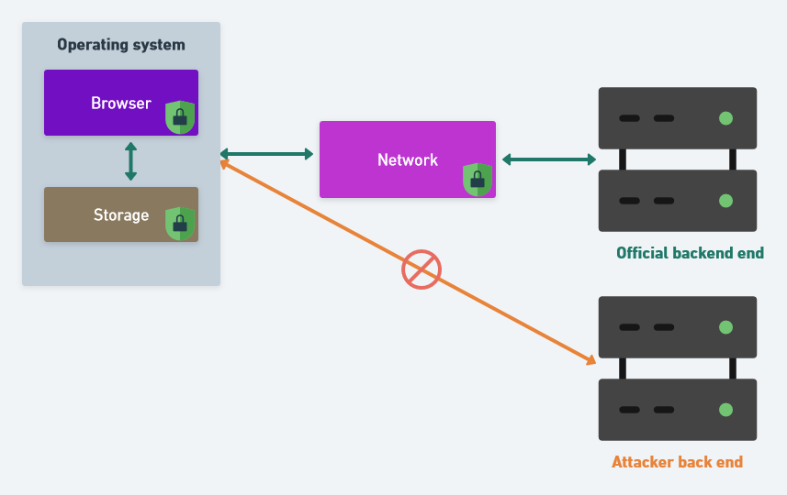
Part1 - Some introduction
What I means by “trap”?
It’s preventing an attacker or made it significantly harder for him, when possible using HTTP headers, to:
Leverage an asset of the application outside the official application domain.
Access to an information transmitted by the browser during the usage of the application.
Access to an information stored by the browser once the usage of the application is finished.
Exfiltrate from the browser an information to a domain is owning.
Infiltrate content from a domain is owning.

Slide 4
Part1 - Some introduction
What is a vulnerability?
A vulnerability is just a bug in an application having consequence from a security perspective.
What is the Exploitation of a Vulnerability?
It’s the operation of leveraging the bug to get the application act in an unintended way either to do something or to get something from it (information).
What is a vulnerability on client side?
It’s a bug in the front end (often called client-side) allowing, by exploiting the bug, to instruct the front-end to perform an action (display something, send HTTP request, modify the DOM and so on).

Slide 5
Part1 - Some introduction
Why I bother you with such vulnerability?
Nowadays, moderns' application provide rich front end mainly based on JavaScript in which interesting data (access token, personal information, etc) are stored in browser Local/Session storage.
These modern front-end consume a web API and these API are commonly well protected against direct attack (strict validation of the incoming information against the OpenAPI document API contract, authentication using OpenID Connect system provided by strongly security aware provider, Authorization using OAuth2 system, API running on read-only container hosted on a Kubernetes hardened cluster and so on).
Built-in protection in server-side technologies framework tend to be heterogenous and complete. It’s not always the same for front-end technologies framework.

Slide 6


Part 2 - Vulnerabilty common context
How can we tackle a vulnerability? We can fix it…
Option 1: Definitively
(vulnerability disappear)
Option2: Temporary
(we made it not|hardly exploitable)
Option 1 is the recommended one but it’s not always possible…

Slide 7
Part 2 - Vulnerabilty common context
How can we tackle a vulnerability?
There is 2 options:
We fix it so we remove the root cause of the problem and then the vulnerability disappear.
We made it (not|hardly) exploitable.
Option 1 is the recommended one but it’s not always possible…

Slide 8
Part 2 - Vulnerabilty common context
Behind the scene of fixing a vulnerability…
Fixing a vulnerability require to analyze and understand it to identify which modification must be performed (sometimes it require a deep refactoring because it affect the design itself).
Require to modify a feature so it imply to test the update to prevent any regression or new functional bug (side effect).
The two step above need time but sometimes we do not have this time immediately: Example of a sales online site needed to be up in the Christmas period.
It’s here that come HTTP security headers, they can allow us to “buy this time” by made the vulnerability (not|hardly) exploitable…

Slide 9
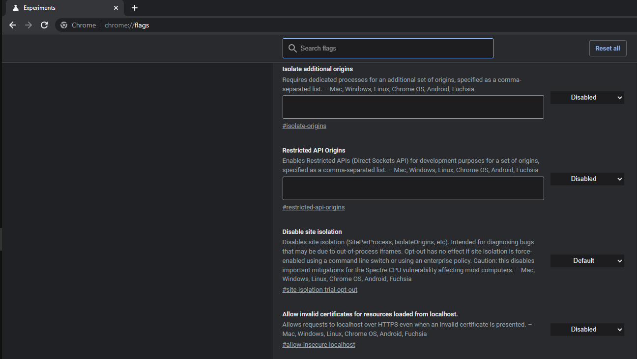
Part 3 - The browser, this ally From a security perspective
Nowadays, browsers embed a bundle of powerful security features:
Cookies attributes dedicated to security (HttpOnly, Secure, SameSite),
Page execution sandbox,
Plugins execution sandbox,
System process isolation,
Cryptographic JavaScript native API,
Auto-update of the browser itself and installed plugins,
…
HTTP headers.

Slide 10
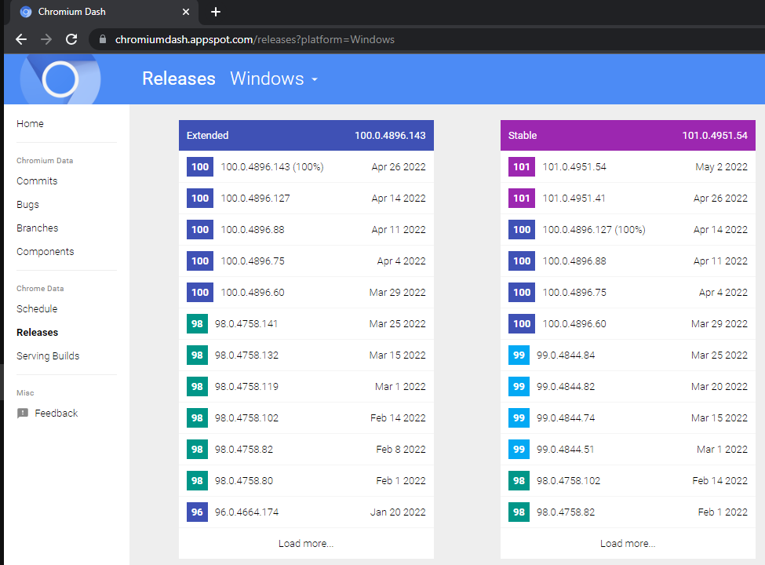
Part 3 - The browser, this ally from a security perspective
However, browsers and their web features are moving fast…
https://chromiumdash.appspot.com/schedule

Slide 11


Part 3 - The browser, this ally from a security perspective
So, how to obtain a summary of available/supported HTTP security headers?
No, not him !
http://www.picturequotes.com/who-are-you-gonna-call-ghostbusters-quote-346897

Slide 12
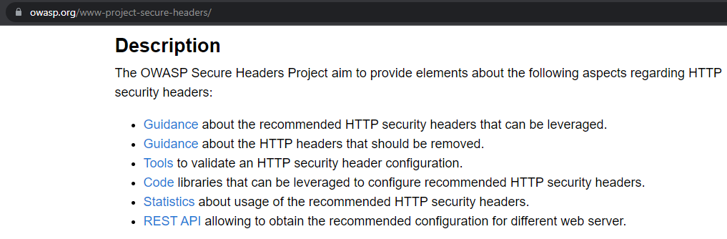
Part 3 - The browser, this ally from a security perspective
It’s the goal of the OWASP Secure Headers Project to centralize, gather and continuously search such information to always provide the more accurate information…
https://owasp.org/www-project-secure-headers/

Slide 13
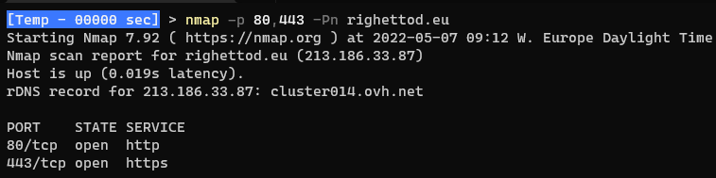
Part 4 - Focus on some situation
Context:
Our company website is exposed on the not secure HTTP port 80 on righettod.eu and www.righettod.eu
Our application is exposed on secure HTTP port 443 on myapp.righettod.eu
Both ports are open on web server to our application, so it accept not secure HTTP call too
Challenge:
How do we ensure that a secure channel is always used to access to our application to prevent an attacker to intercept and see the data exchanged?

Slide 14
Part 4 - Focus on some situation
HTTP response security header buddy is “Strict-Transport-Security”:
Indicate to the browser to always use a secure channel (HTTPS) to access to the domain on which it was delivered.
Once seen a first time, the browser will remember (until cache is cleared or max-age expire) it and update the protocol to HTTPS before to send any HTTP call even if the user (or script) use HTTP:// protocol explicitly in the URL.
Format:
Strict-Transport-Security: max-age=(time in second to apply the instruction) ; [includeSubDomains]
Example:
Strict-Transport-Security: max-age=31536000 ; includeSubDomains
https://owasp.org/www-project-secure-headers/#http-strict-transport-security

Slide 15
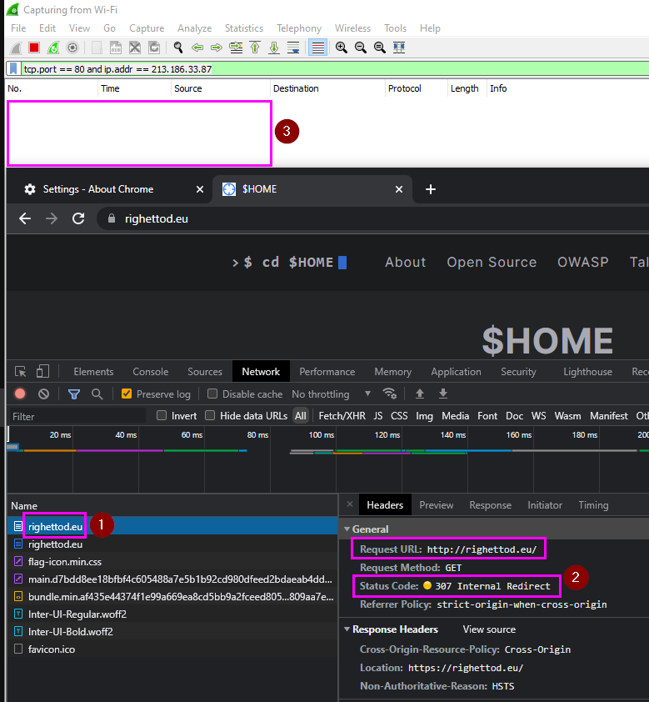
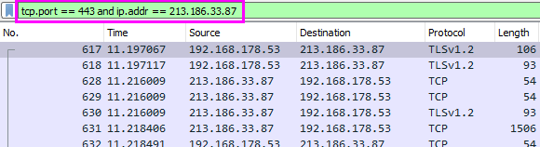
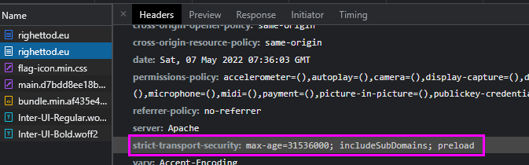
Part 4 - Focus on some situation
Even if the URL http://righettod.eu was typed in the address bar, the browser converted my call to https://righettod.eu prior to make any network connection…
So, no network call to port 80 was made.

Slide 16
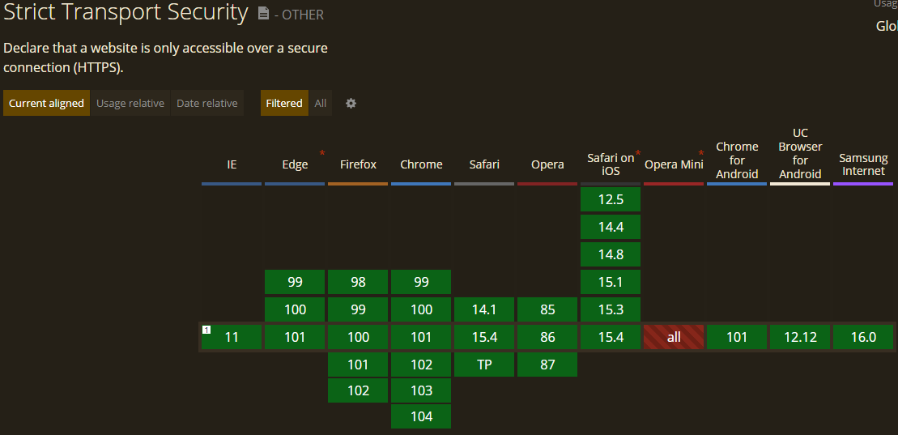
Part 4 - Focus on some situation
https://caniuse.com/stricttransportsecurity

Slide 17
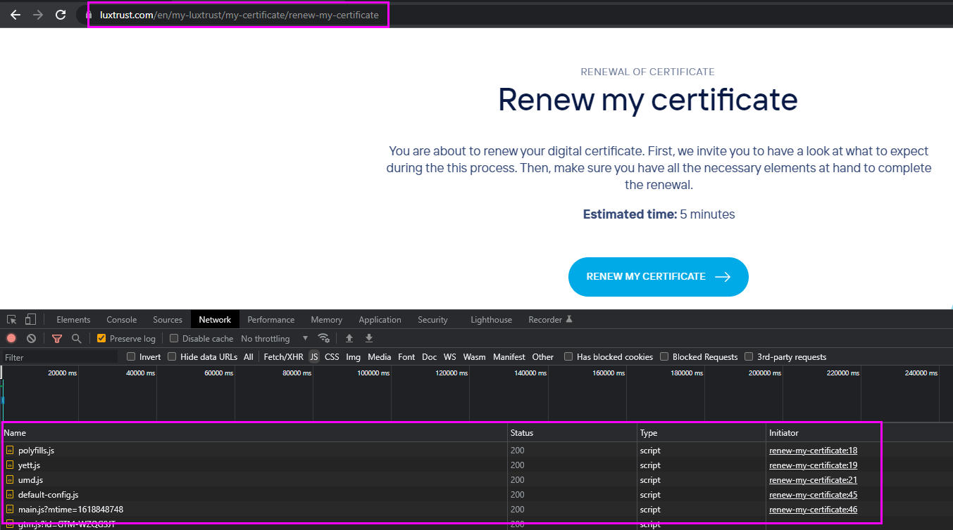
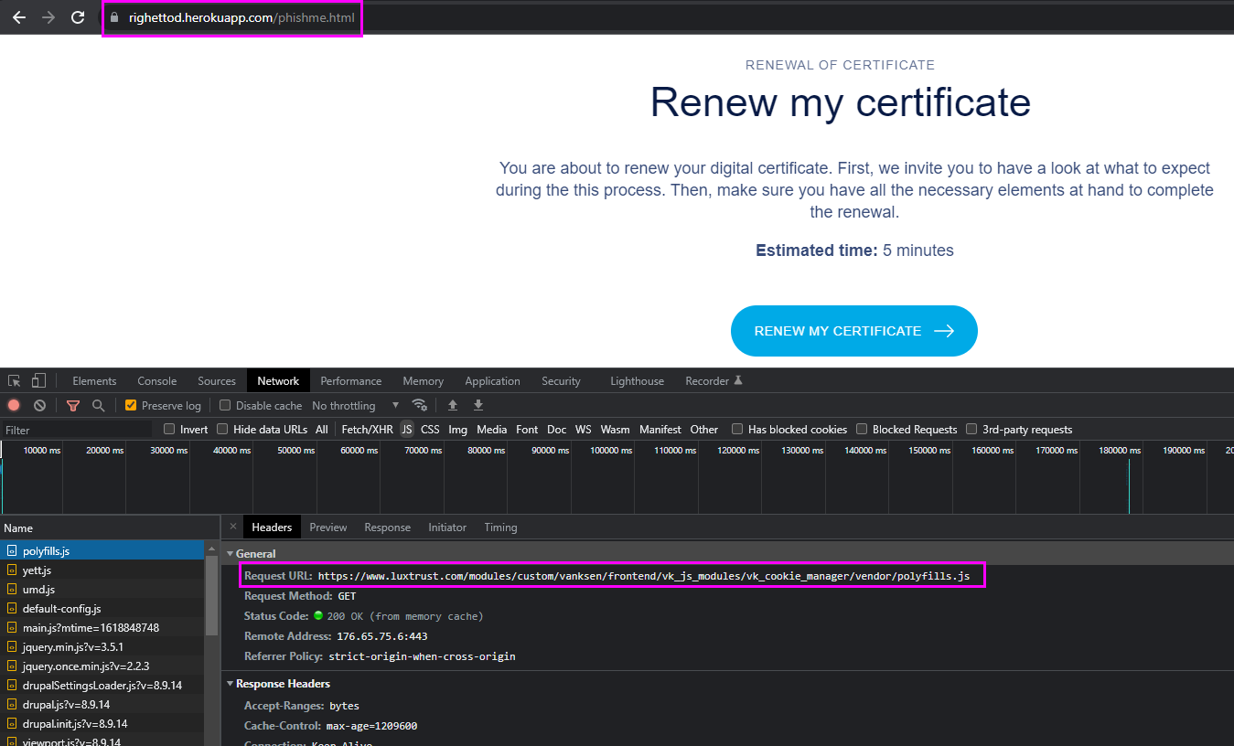
Part 4 - Focus on some situation
Context:
A phishing site (malicious clone of our official site) load resources (scripts, styles, images) from our domain to mimic our user interface:
Challenge:
Challenge:
How do we prevent any site outside our domain / sub domain to load our resources?
Official
Malicious

Slide 18
Part 4 - Focus on some situation
HTTP response security header buddy is “Cross-Origin-Resource-Policy” (also called CORP):
Allows to define a policy that lets web sites and applications opt-in to protection against certain requests from other origins (such as those issued with elements like script and img tags)
Format:
Cross-Origin-Resource-Policy: [policy-value]
Example:
Cross-Origin-Resource-Policy: same-origin
Policy value | Description
same-site | Only requests from the same Site can read the resource.
same-origin | Only requests from the same Origin (i.e. scheme + host + port) can read the resource.
cross-origin | Requests from any Origin (both same-site and cross-site) can read the resource.
https://owasp.org/www-project-secure-headers/#cross-origin-resource-policy
Notes:
Informally, a site is a website, which is a collection of web pages, served from the same domain, and maintained by a single organization.
Browsers sometimes need to distinguish precisely between different sites. For example, the browser must only send SameSite cookies to the same site that set them.
For this more precise definition a site is determined by the registrable domain portion of the domain name. The registrable domain consists of an entry in the Public Suffix List plus the portion of the domain name just before it. This means that, for example, theguardian.co.uk, sussex.ac.uk, and bookshop.org are all registrable domains.
According to this definition, support.mozilla.org and developer.mozilla.org are part of the same site, because mozilla.org is a registrable domain.

Slide 19
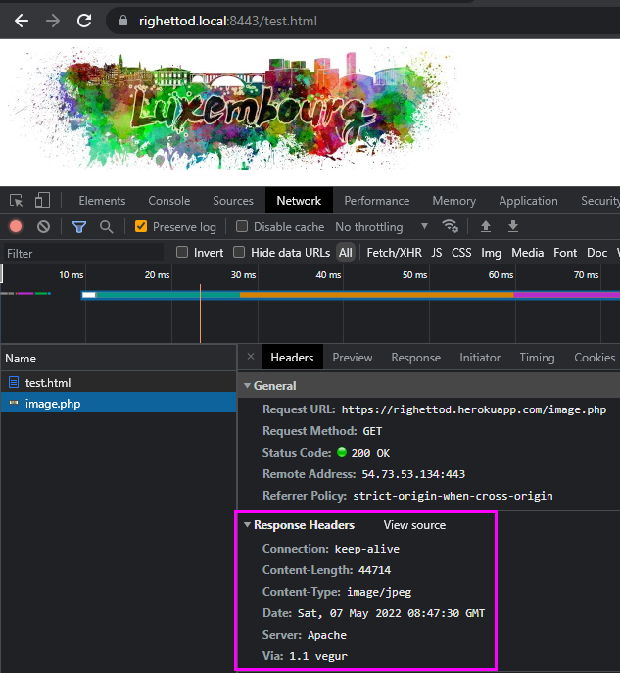
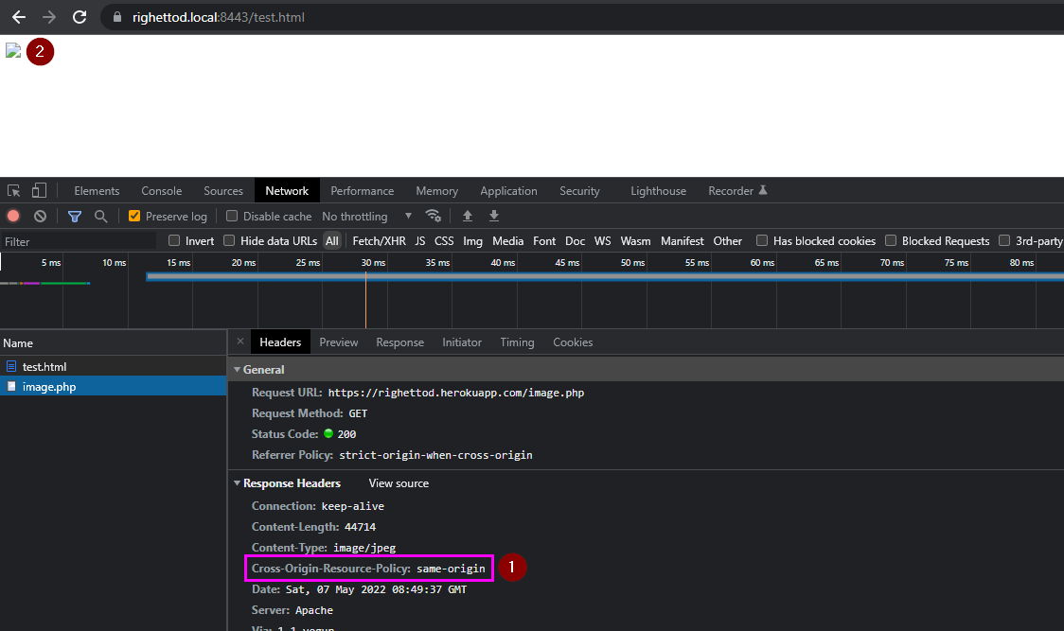

Part 4 - Focus on some situation
No CORP header specified, so, the browser allow the access to the image by the DOM.
As the CORP header specify that, [1] only the same origin can access to this resource (image here), then [2] the browser reject the access to the image by the DOM due to a policy violation.

Slide 20
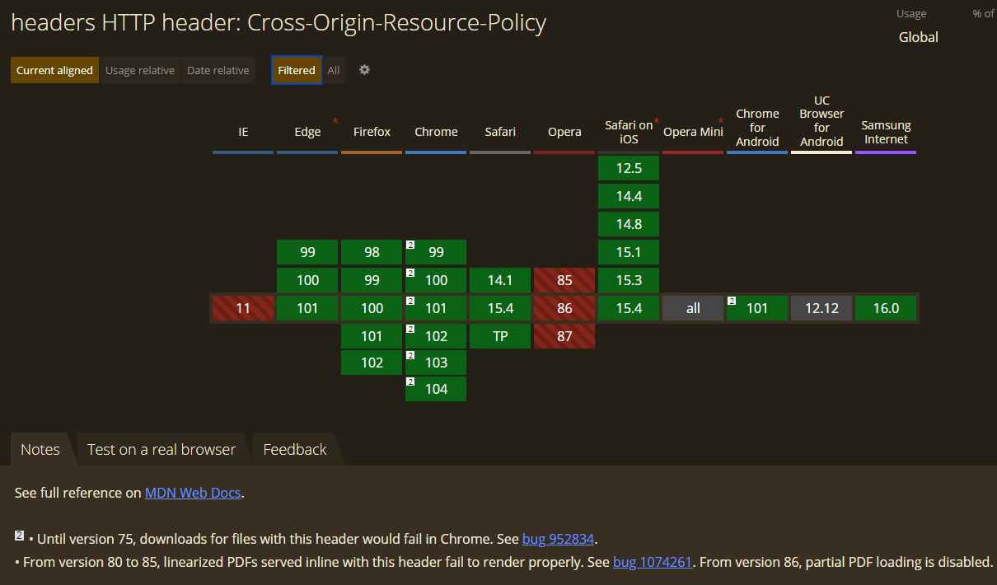
Part 4 - Focus on some situation
https://caniuse.com/mdn-http_headers_cross-origin-resource-policy
Notes:
, a site is a website, which is a collection of web pages, served from the same domain, and maintained by a single organization.
Browsers sometimes need to distinguish precisely between different sites. For example, the browser must only send SameSite cookies to the same site that set them.
For this more precise definition a site is determined by the registrable domain portion of the domain name. The registrable domain consists of an entry in the Public Suffix List plus the portion of the domain name just before it. This means that, for example, theguardian.co.uk, sussex.ac.uk, and bookshop.org are all registrable domains.
According to this definition, support.mozilla.org and developer.mozilla.org are part of the same site, because mozilla.org is a registrable domain.

Slide 21
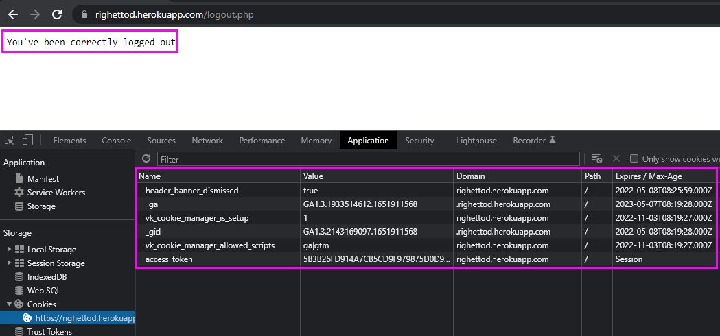
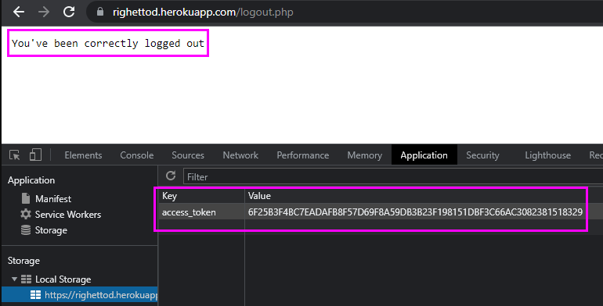
Part 4 - Focus on some situation
Context:
We logging out a user from an application / system:
Challenge:
How do we ensure that, once the logout is performed, we let the browser without any residual content (that can be access token/secrets) in storage, cookie or cache to prevent any local malicious program to access to this content?

Slide 22
Part 4 - Focus on some situation
HTTP response security header buddy is “Clear-Site-Data”:
Allows to define which data must be removed for the domain issuing the header.
Format:
Clear-Site-Data: “[data to remove]”
Example:
Cross-Origin-Resource-Policy: "cache", "cookies", "storage"
Possible value (can be combined) | Description
cache | Indicates that the server wishes to remove locally cached data for the origin of the response URL.
cookies | Indicates that the server wishes to remove all cookies for the origin of the response URL.
storage | Indicates that the server wishes to remove all DOM storage (local + session) for the origin of the response URL.
https://owasp.org/www-project-secure-headers/#clear-site-data

Slide 23
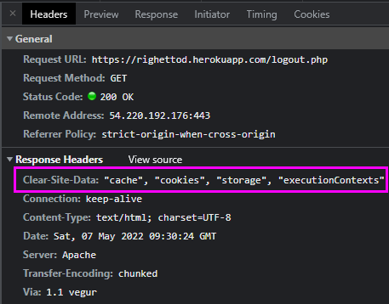
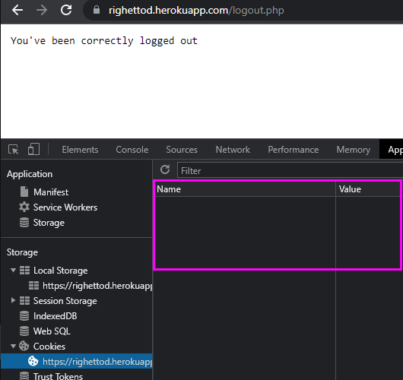
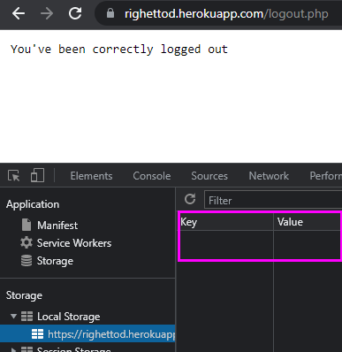
Part 4 - Focus on some situation
Cache, cookies, local storage and session storage were cleaned once the HTTP response was processed by the browser.

Slide 24
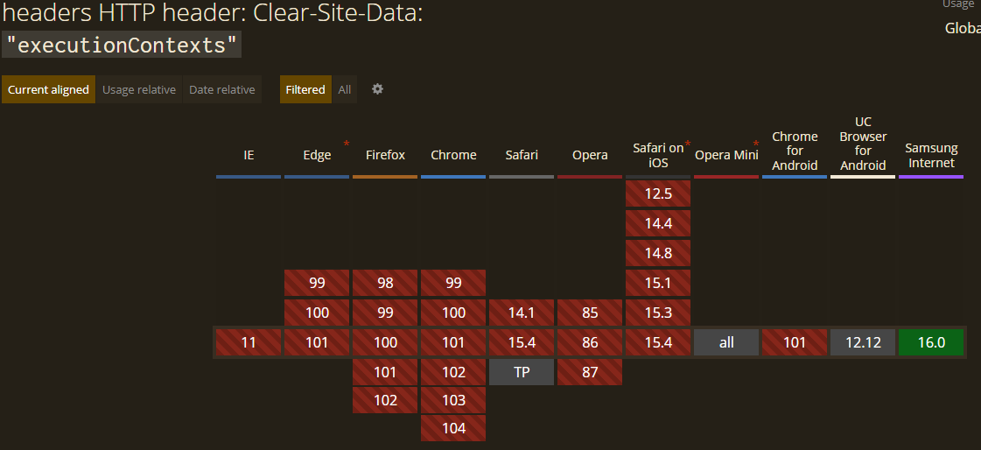
Part 4 - Focus on some situation
“executionContexts” option is not still supported by any popular browser (May 2022):
Indicates that the server wishes to reload all browsing contexts for the origin of the response.
https://caniuse.com/mdn-http_headers_clear-site-data_executioncontexts

Slide 25
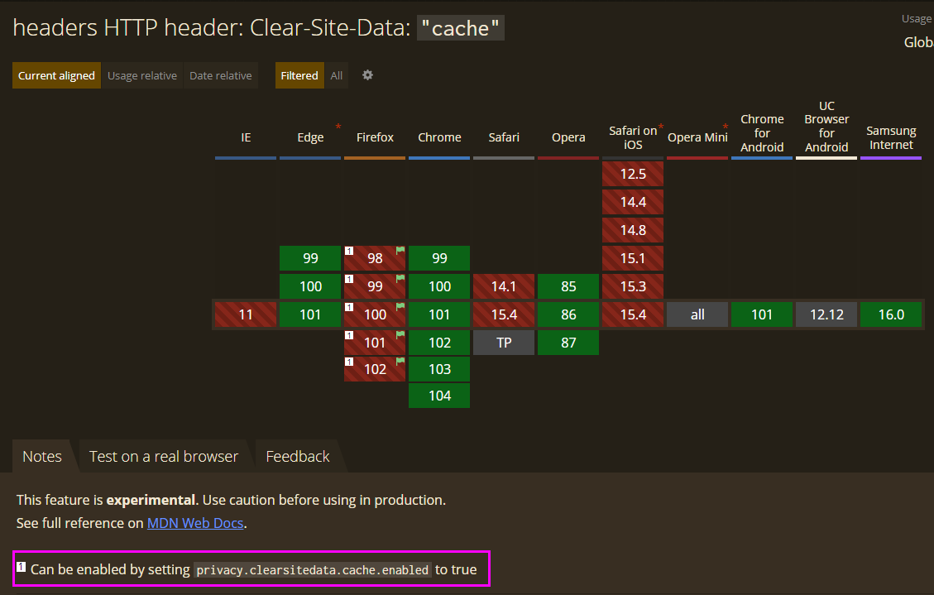
Part 4 - Focus on some situation
https://caniuse.com/mdn-http_headers_clear-site-data_cache

Slide 26
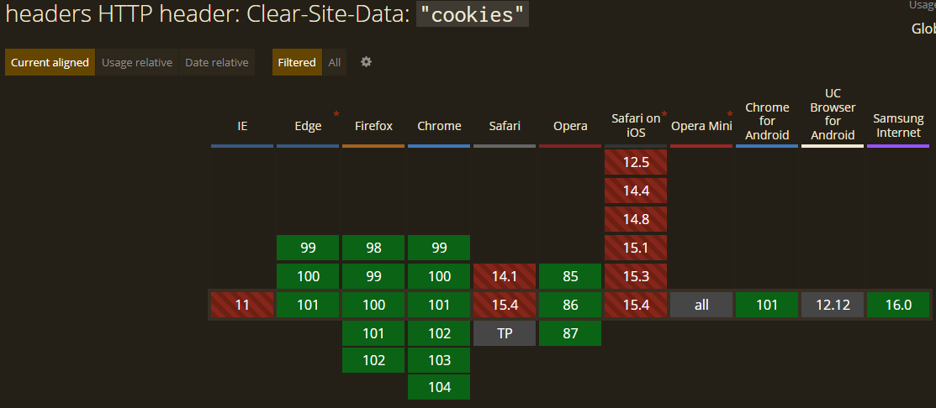
Part 4 - Focus on some situation
https://caniuse.com/mdn-http_headers_clear-site-data_cookies

Slide 27
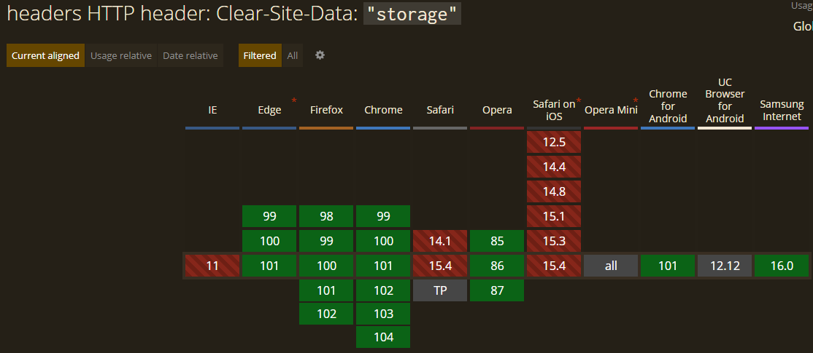
Part 4 - Focus on some situation
https://caniuse.com/mdn-http_headers_clear-site-data_storage

Slide 28
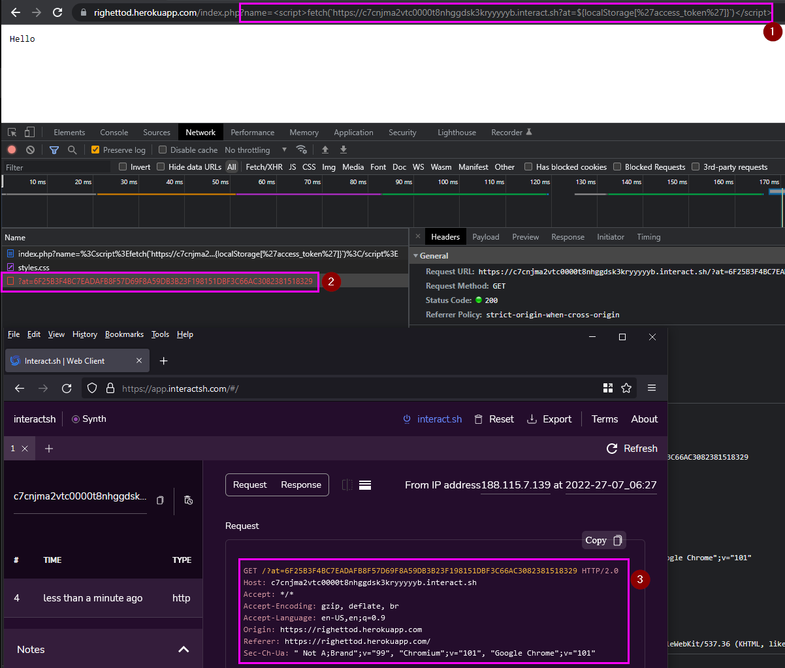
Part 4 - Focus on some situation
Context:
We have a vulnerability allowing an attacker to inject arbitrary JavaScript code and execute it in the browsing context of the targeted user.
It is a Cross-site Scripting (or XSS) category of vulnerability.
We cannot currently modify the app code base and/or redeploy the application for business not negociable reason.
Challenge:
How do we ensure that this vulnerability cannot be exploited (or with high difficulty) by an attacker in order to let us pass this “business freeze” forced period ?

Slide 29
Part 4 - Focus on some situation
https://owasp.org/www-project-secure-headers/#content-security-policy - https://content-security-policy.com/
HTTP response security header buddy is “Content-Security-Policy” (also called CSP):
Allows to define a policy instructing the bowser how it must handle the resources (script, style, image, plugin, framing, network connection and son on) returned in the HTTP response body.
Very powerful (and complex by the way) by proposing a large panel of directives to fine tune the browser behavior.
Format:
Content-Security-Policy: [directive] [instruction for the current directive] ; (N times if needed)
Example:
Policy | What is instruct?
default-src 'self'; script-src 'self' 'unsafe-inline' | Resource can only be loaded from the current domain and inline script is allowed.
default-src 'self'; font-src 'self' https://fonts.google.com; frame-ancestors 'self'; sandbox ; | Resources can only be loaded from the current domain. Fonts can also be loaded using HTTPS from fonts.google.com. Site can only be framed by itself. All frame/iframe will run in sandboxed mode.

Slide 30
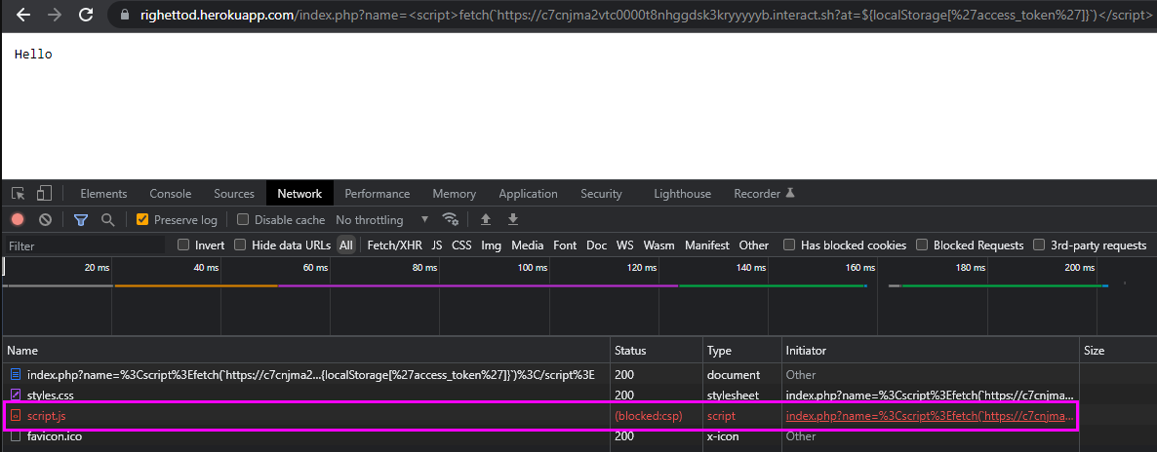
Part 4 - Focus on some situation
Back to our XSS problem, we try the following CSP policy: default-src 'self'; script-src 'self' 'unsafe-inline'
We successfully blocked the attack ☺

Slide 31
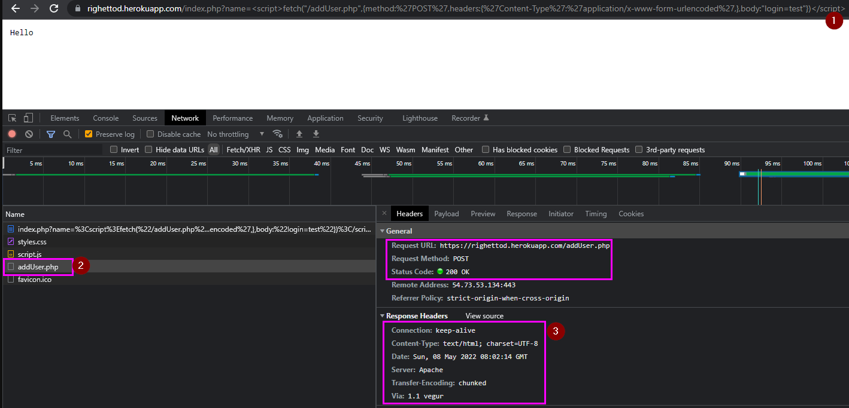
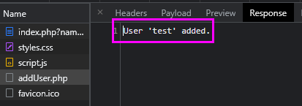
Part 4 - Focus on some situation
However, our CSP policy did not prevent the attacker to perform action inside the app on behalf of the user:
We did not block the updated attack ☹

Slide 32
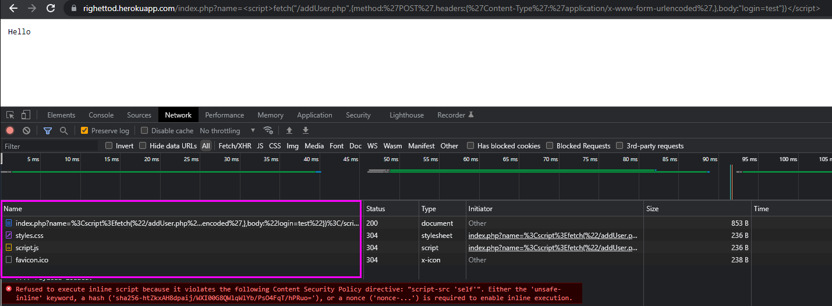
Part 4 - Focus on some situation
So, we try the following updated CSP policy: default-src 'self'; script-src 'self'
We successfully blocked the update attack ☺
No call to addUser.php was performed.

Slide 33
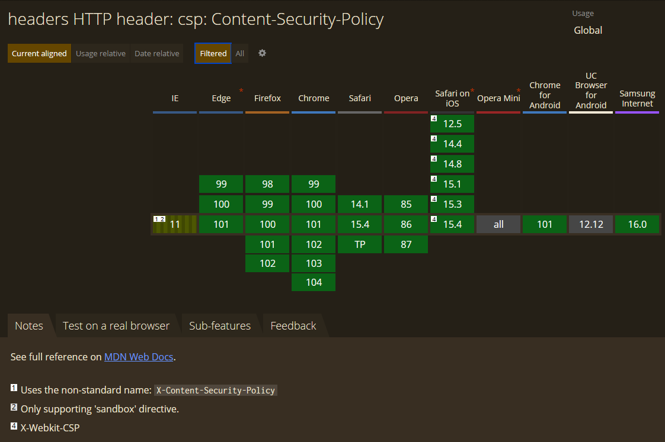
Part 4 - Focus on some situation
https://caniuse.com/mdn-http_headers_csp_content-security-policy

Slide 34
demonstration
For each header presented, a demonstration video, is available bellow:
Strict-Transport-Security
https://github.com/righettod/voxxeddays-lux-2022/blob/main/DemoSTS.mp4
Cross-Origin-Resource-Policy
https://github.com/righettod/voxxeddays-lux-2022/blob/main/DemoCORP.mp4
Clear-Site-Data
https://github.com/righettod/voxxeddays-lux-2022/blob/main/DemoCSD.mp4
Content-Security-Policy
https://github.com/righettod/voxxeddays-lux-2022/blob/main/DemoCSP.mp4

Slide 35


FINAL PART - Key points
Modern browser provide a large panel of built-in protection that we can leverage.
HTTP security headers are not a “silver bullet” to make an application any attack proof BUT they significantly help reducing the exploitability of a client-side vulnerability.
HTTP security headers can help us to “buy time” when facing a client-side vulnerability in a context in which app code base cannot be updated during a timeframe.
Other HTTP security headers can be added, look at the OWASP Secure Headers Project to get insights about them. Comment, feedback, suggestion as well as pull request are warmly welcome

Slide 36
References
Strict-Transport-Security
https://owasp.org/www-project-secure-headers/#http-strict-transport-security
Cross-Origin-Resource-Policy
https://owasp.org/www-project-secure-headers/#cross-origin-resource-policy
Clear-Site-Data
https://owasp.org/www-project-secure-headers/#clear-site-data
Content-Security-Policy
https://owasp.org/www-project-secure-headers/#content-security-policy
https://content-security-policy.com/
https://cheatsheetseries.owasp.org/cheatsheets/Content_Security_Policy_Cheat_Sheet.html
https://report-uri.com/home/generate
https://csp-evaluator.withgoogle.com/
OWASP Luxemburg Chapter
https://owasp.org/www-chapter-luxembourg/

Slide 37

Thank you !!!!
https://pixabay.com/illustrations/social-social-network-1206603/

