Slide 1


💖How the Content-Security-Policy HTTP Response Header Can Save Your Date Night.
💖Comment l’entête de réponse HTTP Content-Security-Policy peut sauver votre soirée en amoureux.
📦github.com/righettod/voxxeddays-lux-2024
🌏righettod.eu - 📡@righettod

Slide 2
📅A little bit of context…

Slide 3

📅Context
👨‍💻You work, as a Technical Leader, for a company selling online product and it’s Friday. Your team is in charge of the online sales portal.

Slide 4
📅Context
📅An important release, of the online sales portal, is planned next Tuesday around 06:00 A.M.
👀A security audit was performed on this release, until Wednesday, and the final report was expected for yesteday evening.
📢Daily team meeting (09:00 A.M.): You are informed that a security vulnerability was found. This one allow to inject a persistent Javascript code to hijack the user’s session (its is also called Cross-site scripting or XSS).

Slide 5
📅Context
🛑Due to the schedule and the importance of features provided in this release, the Product Owner (PO) do not allow any modification of the code base.
🛑The Chief Information Security Officer (CISO) refuse to let the release being performed if the security issue is not fixed due to legal consequences.
💖Today is your wedding anniversary: You booked the favorite restaurant of your loved one for 07:00 P.M. so you must leave for 04:00 P.M. maximum!
😭PO and CISO ask you if you have any idea to unlock the situation…

Slide 6
📅Context
📡During your continuous technical survey, you hear that modern browsers support a collections of HTTP response security headers providing different kind of defense.
📖You hear about one, named Content-Security-Policy, that was often associated with the terms mentioned alongside the identified vulnerability (Cross-site scripting or XSS).
🔬You decided to ask to the PO and CISO to give you some hours to allow you to dig this idea and indicates you will come back to them around 03:00 P.M. with a status.

Slide 7
👨‍🎓Content-Security-Policy header?

Slide 8
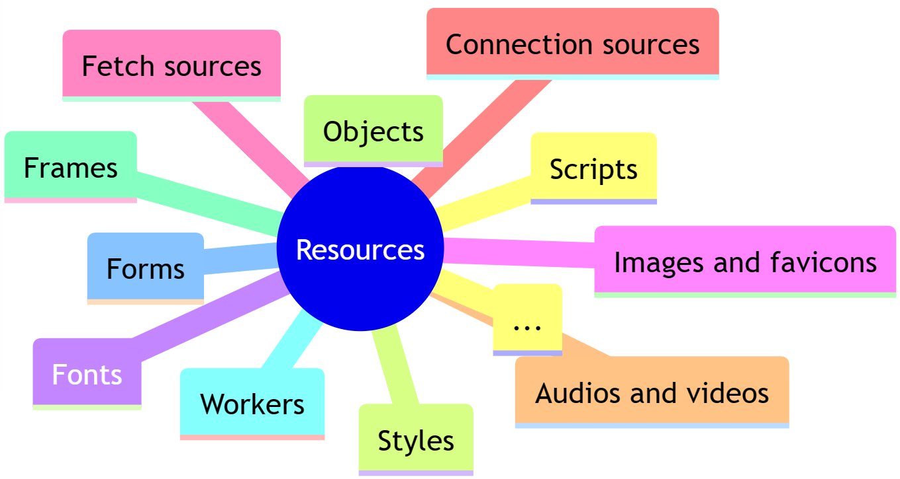
👨‍🎓Content-Security-Policy header?
📑The Content-Security-Policy (CSP) is a HTTP response header allowing to instruct the browser (user agent) on how to handle the resources present in the HTTP response body:

Slide 9
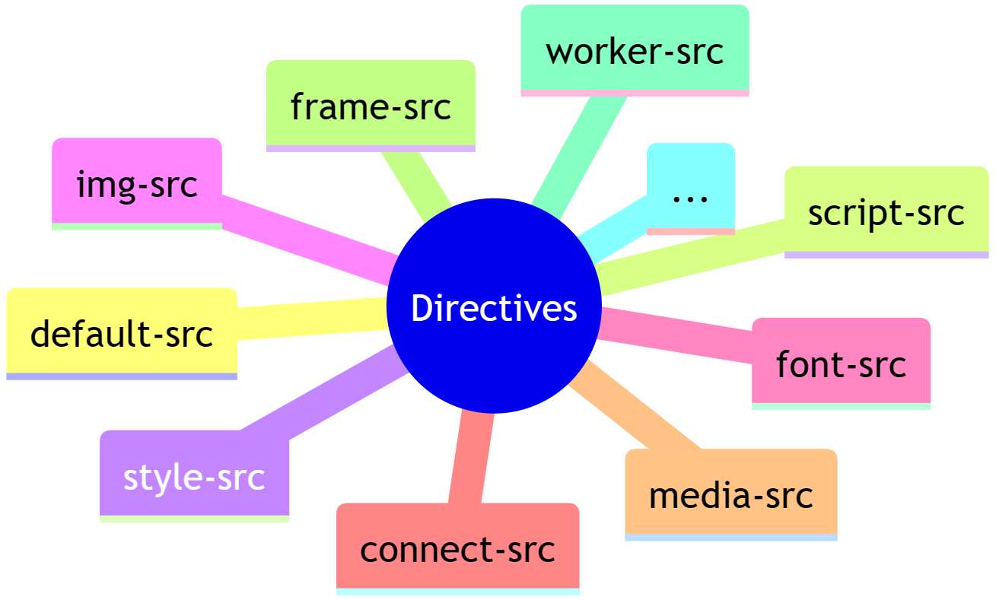
👨‍🎓Content-Security-Policy header?
📑Each type of resources controlled has a directive associated to it:

Slide 10
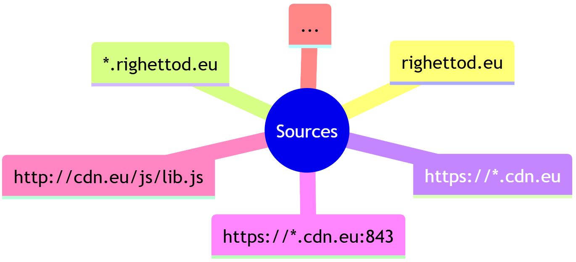
👨‍🎓Content-Security-Policy header?
📑Behavior about an allowed resources is defined using either a set of source location patterns or/and keywords depending on the type of directive:

Slide 11
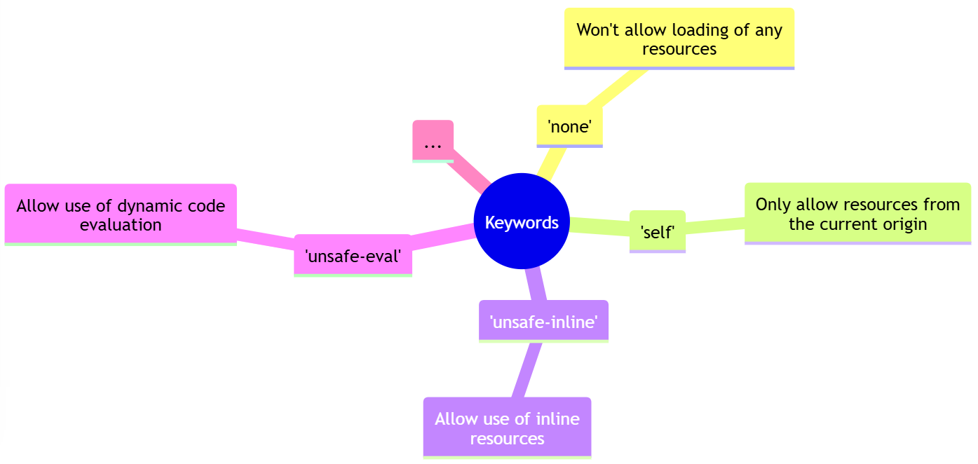
👨‍🎓Content-Security-Policy header?
📑Behavior about an allowed resources is defined using either a set of source location patterns or/and keywords depending on the type of directive:

Slide 12
👨‍🎓Content-Security-Policy header?
💻The header use the following format:
📜The collection of directives specified represent the policy defined by the CSP.
💡The policy is, in fact, the value of the CSP header.
Content-Security-Policy: [DIRECTIVE 1] [ALLOWED SOURCES OR KEYWORDS] ; [DIRECTIVE 2] [ALLOWED SOURCES OR KEYWORDS] ; [DIRECTIVE N] [ALLOWED SOURCES OR KEYWORDS]

Slide 13

👨‍🎓Content-Security-Policy header?
By default, resources can only be loaded from the current domain + protocol + port.
💻Example of a simple policy:
Scripts can only be loaded from the current domain + protocol + port and inline scripting is allowed.
Content-Security-Policy:
default-src 'self’ ;
script-src 'self' 'unsafe-inline’ ;
img-src 'self' http://flowers.com ;
font-src 'self' https://fonts.google.com
Images can only be loaded from the current domain + protocol + port and flowers.com via HTTP.
Fonts can only be loaded from the current domain + protocol + port and fonts.google.com via HTTPS.

Slide 14
👨‍🎓Content-Security-Policy header?
📑CSP offer the possibility to define, a default directive, that the browser uses to identify allowed sources if certain directives are not defined in the policy.
📑This directive is named default-src
💻Example based on our previous CSP sample: All media (audio/video) will only be loaded from the current domain + protocol + port because the directive media-src is not defined
Content-Security-Policy: default-src 'self’ ; script-src 'self' 'unsafe-inline’ ; img-src 'self' http://flowers.com ; font-src 'self' https://fonts.google.com

Slide 15
👨‍🎓Content-Security-Policy header?
📡CSP offer the possibility to not block the loading of a resource if a directive related to such resources is not respected but, instead, send a violation notification to a web endpoint.
💻A simple way to achieve this is to use the header Content-Security-Policy-Report-Only instead of Content-Security-Policy .
💻This header use the same format that the CSP but with the addition of the report-to directive to indicate where the violation report must be sent:
Content-Security-Policy-Report-Only: default-src 'self’ ; script-src 'self' 'unsafe-inline’ ; report-to [ENDPOINT_LOCATION]

Slide 16
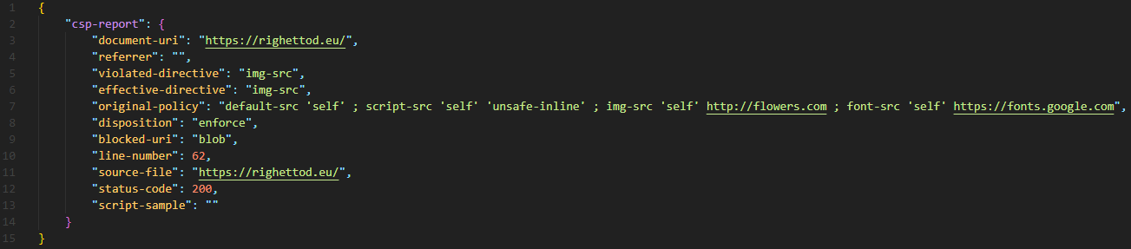
👨‍🎓Content-Security-Policy header?
🐜Important note:
Violation report is sent automatically by the browser.
Exposed listeners must validate data received to prevent vulnerability like, for example, JSON injection or JSON parser overflow.
🌏The endpoint can be a relative or an absolute URL:
report-to /csp-listener
report-to https://righettod.eu/csp-listener
📦Violation report is delivered via a HTTP POST, as a JSON object, like this:

Slide 17
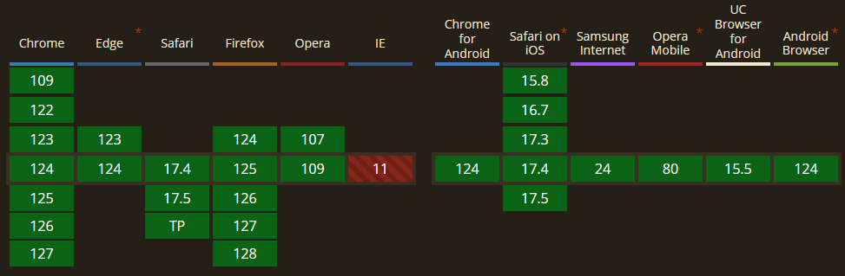
👨‍🎓Content-Security-Policy header?
🤝Level of support for the current W3C recommandation of CSP (v2), by modern browsers, in May 2024 (source: caniuse.com):
CSP v2: W3C Recommendation (15/12/2016)
CSP v3: W3C Working Draft (24/04/2024)

Slide 18
🔬Study time…

Slide 19
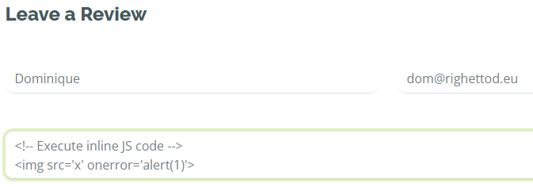
🔬Study time: The vulnerability
🐜The audit report indicates that the review features is prone to a stored XSS, via for example, the following payloads inserted into the review body:

Slide 20
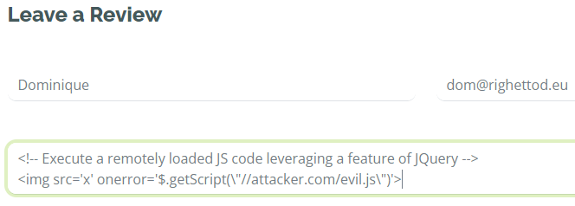
🔬Study time: The vulnerability
🐜The audit report indicates that the review features is prone to a stored XSS, via for example, the following payloads inserted into the review body:

Slide 21
🔬Study time: The constraints
Fonts
Loaded from https://fonts.googleapis.com and https://fonts.gstatic.com.
Styles
Loaded from https://fonts.googleapis.com and https://fonts.gstatic.com.
Inline styles using the <style> tag is used.
Scripts
JavaScript processing is dynamically added to event handlers on some UI components.
Images
Images using the protocol data: and blob: are used.
📍The portal have the following constraints in terms of resources:

Slide 22
🔬Study time: First try
🎯Use a CSP policy in blocking mode to prevent exploitation of the vulnerability.
👨‍💻Create a CSP with the following properties:
Allow sources from the current domain + protocol + port.
Allow sources for the constraints in the app explained previously.
Content-Security-Policy:
default-src 'self’;
script-src 'self' 'unsafe-inline';
style-src 'self' 'unsafe-inline' https://fonts.googleapis.com https://fonts.gstatic.com;
img-src 'self' data: blob:;
font-src 'self' https://fonts.googleapis.com https://fonts.gstatic.com

Slide 23
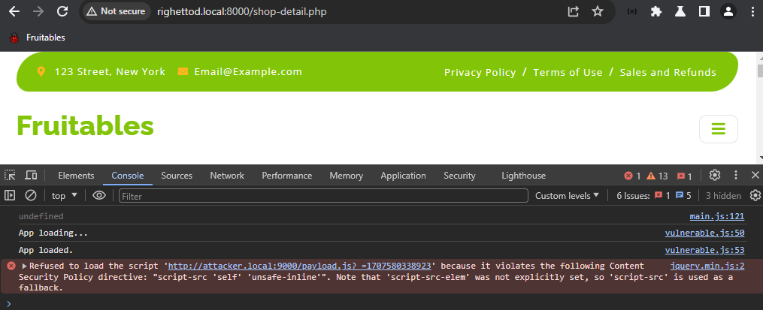
🔬Study time: First try
🤗Job done: The malicious code is executed but the loading of the script is correctly blocked by the CSP policy! Yeah! The XSS is patched in one round !!!!

Slide 24
🔬Study time: First try - The disillusion
🤔A colleague say: “We blocked the loading of a remote script but what about an attack fully embedded in the onerror event handlers?”
📜He proposes to test following payload:

Slide 25
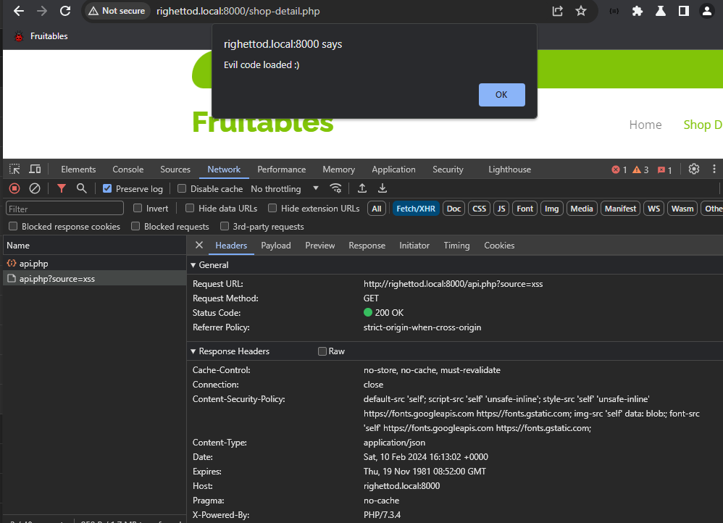
🔬Study time: First try - The disillusion
😨Payload is successfully executed!

Slide 26
🔬Study time: First try - The disillusion
😨Payload is successfully executed!

Slide 27
🔬Study time: First try - The disillusion
😨Payload is successfully executed!

Slide 28
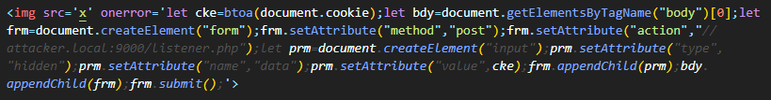
🔬Study time: First try - The deeper disillusion
😕You say: “The attacker can execute action on behalf of the current user but, at least, he cannot send data to a domain under its control!”
🤔Same colleague say “Are we sure about such statement?” and proposes to test the following payload:

Slide 29
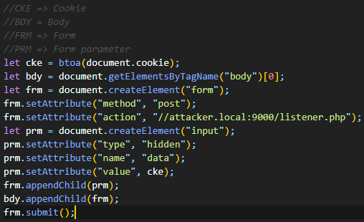
🔬Study time: First try - The deeper disillusion
👓Better overview of the JavaScript code injected:

Slide 30
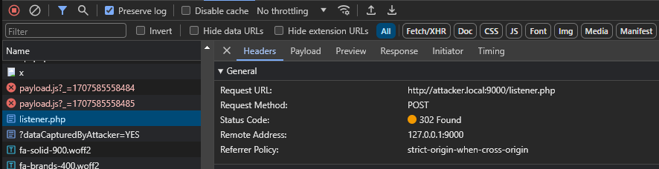
🔬Study time: First try - The deeper disillusion
😨Payload is successfully executed!

Slide 31
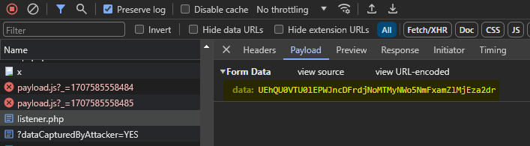
🔬Study time: First try - The deeper disillusion
😨Payload is successfully executed!
$ echo UEhQU0VTU0lEPWJncDFrdjNoMTMyNWo5NmFxamZlMjEza2dr | base64 -d
PHPSESSID=bgp1kv3h1325j96aqjfe213kgk

Slide 32
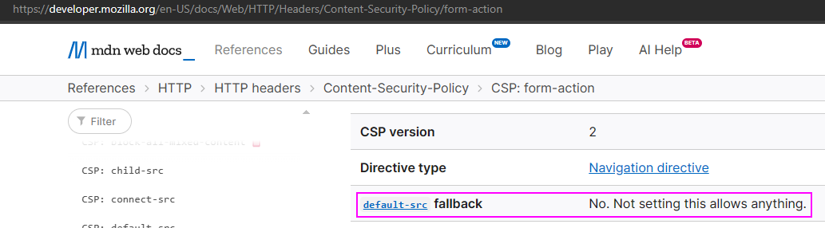
🔬Study time: First try - The deeper disillusion
👨‍🎓Time has come for you to learn another point about the different directives of a CSP: Not all directives fallback to the default-src directive!
📖The form-action directive, that specifies locations that can be used for <form> submissions, does not fallback to the default-src directive when it is not defined in a policy!

Slide 33
🔬Study time: second try
👨‍💻For this tentative, the CSP created previously is used and the form-action directive is added:
Content-Security-Policy:
default-src 'self';
script-src 'self' 'unsafe-inline';
style-src 'self' 'unsafe-inline' https://fonts.googleapis.com https://fonts.gstatic.com;
img-src 'self' data: blob:;
font-src 'self' https://fonts.googleapis.com https://fonts.gstatic.com;
form-action 'self'

Slide 34
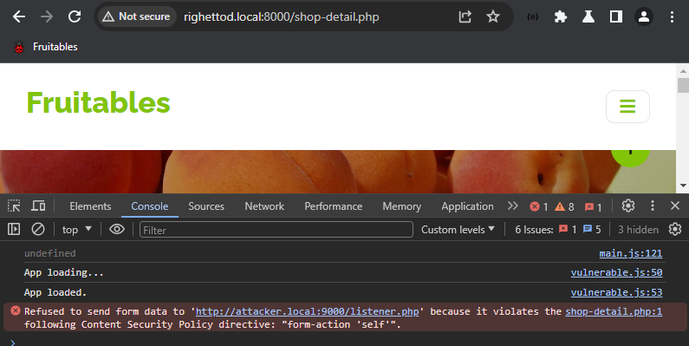
🔬Study time: second try
🤗New test confirms that, blocking sending out data, is effective:

Slide 35
🔬Study time: second try
😨However, it is still possible to execute embedded Javascript payload to perform action on behalf of the current user.
🤔Idea is to to block the execution of any injected JavaScript code, by removing the unsafe-inline instruction, from the script-src directive:
Content-Security-Policy:
default-src 'self';
script-src 'self' 'unsafe-inline';
style-src 'self' 'unsafe-inline' https://fonts.googleapis.com https://fonts.gstatic.com;
img-src 'self' data: blob:;
font-src 'self' https://fonts.googleapis.com https://fonts.gstatic.com;
form-action 'self'

Slide 36
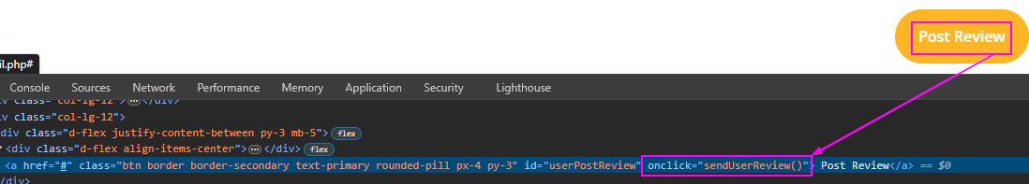
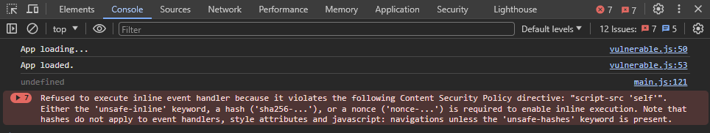
🔬Study time: second try – How to broke an app tutorial!
😱However, this breaks the review feature:

Slide 37
🔬Study time: Third try
👨‍💻For this tentative, the CSP created previously is used and the directive script-src-attr is leveraged: This directive specifies valid sources for JavaScript inline event handlers.
🤔Idea is to tune the allowed behavior on scripts:
Content-Security-Policy:
default-src 'self';
script-src 'self'; script-src-attr 'unsafe-inline';
style-src 'self' 'unsafe-inline' https://fonts.googleapis.com https://fonts.gstatic.com;
img-src 'self' data: blob:;
font-src 'self' https://fonts.googleapis.com https://fonts.gstatic.com;
form-action 'self'

Slide 38
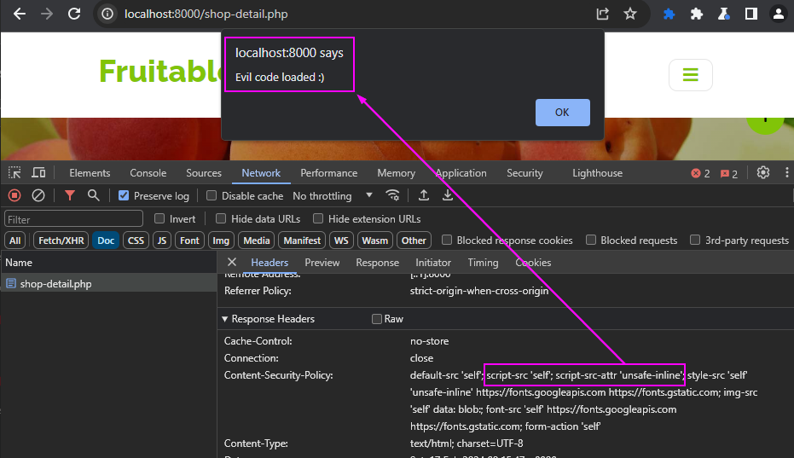
🔬Study time: Third try
😨Payloads used by the auditor are still successfully executed!

Slide 39
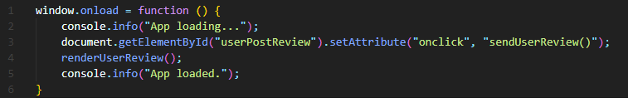
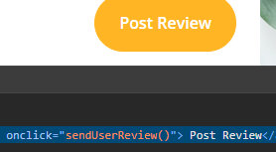
🔬Study time: Third try
🤯It is normal because the auditor is using a payload that is like the code of the app that you must keep functional: An event handler is used to execute the malicious code and not a direct <script></script> tag.
😔From a CSP perspective:
Maximum that can be performed with the constraints in place was reached.
Exploition of the XSS was constrained to action inside the app!
Code used by the app
Payloads used by the auditor

Slide 40
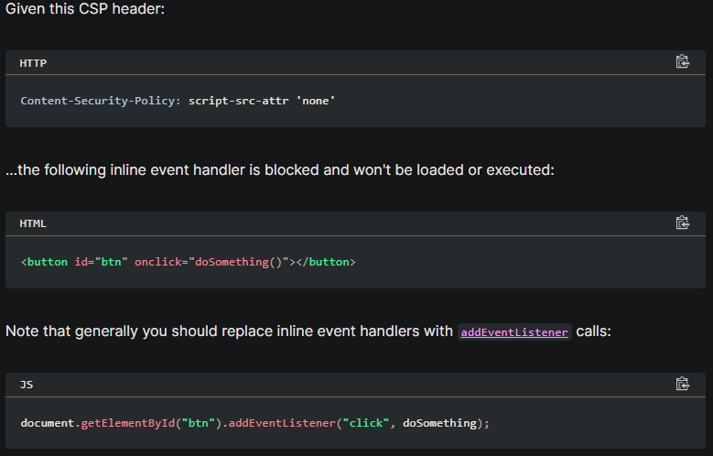
🔬Study time: Wait a second!
👨‍🎓During your study of the directive script-src-attr, you discovered this point (source) about the correct/recommended way to add an event handler in JavaScript:

Slide 41
🔬Study time: Wait a second!
👨‍🎓During your study of the directive script-src-attr, you discovered this point (source) about the correct/recommended way to add an event handler in JavaScript:
JS code used by the app

Slide 42
🔬Study time: Wait a second!
🤔You decide to break one constraint and “fix” the way used to define the event handler to use the recommended way:
🤔And test the CSP that you wanted to create during the second try:
Content-Security-Policy:
default-src 'self';
script-src 'self';
style-src 'self' 'unsafe-inline' https://fonts.googleapis.com https://fonts.gstatic.com;
img-src 'self' data: blob:;
font-src 'self' https://fonts.googleapis.com https://fonts.gstatic.com;
form-action 'self'

Slide 43
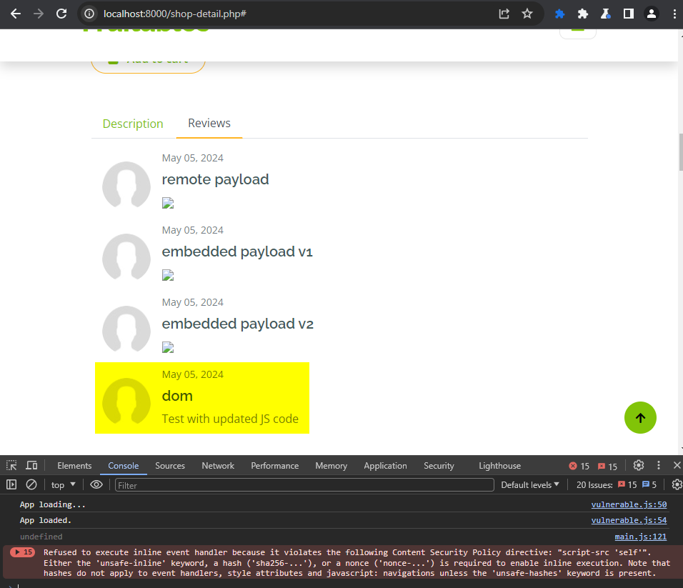
🔬Study time: Wait a second!
😊It works: Feature is functional and XSS payloads are not executed anymore!

Slide 44
🔬Study time: Wait a second!
😊It works: Feature is functional and XSS payloads are not executed anymore!

Slide 45
🔬Study time: Final status
✅You provides this feedback to the CISO/PO:
The effective CSP you created, with the help, of your team!
The little update needed: One line in a single JS file!
💖You sent the mail with the status at 03:30 P.M. with all technical details, packed your stuff and leave to prepare for your romantic evening.

Slide 46
📚Lesson learned…

Slide 47
📚Lesson learned
Content-Security-Policy (CSP) can be used to make exploitation of XSS harder.
CSP can be also used to “buy time” to fix an XSS issue in good condition.
A CSP policy is created using an iterative process that require effective testing during each iteration: It is easy to break an application using a single CSP directive.
CSP can save your date night 💖

Slide 48

🤗Thank you! 🤔Any questions?
Source: https://pixabay.com/illustrations/animal-dogs-mammals-7753445/

Slide 49
📖Resources
All technical content about this presentation.
Generate a CSP.
Evaluate a CSP.
Documentation about CSP:
Mozilla MDN
OWASP Cheat Sheet
Level of supports.
OWASP Secure Headers Project

