Slide 1
💖How the Content-Security-Policy HTTP Response Header Can Save Your Date Night.
💖Comment l’entête de réponse HTTP Content-Security-Policy peut sauver votre soirée en amoureux.
Mirjam Nilsson

Slide 2
📅A little bit of context…

Slide 3
📅Context
You work, as a Technical Leader, for a company selling online product and it’s Friday. Your team is in charge of the online sales portal.
An important release of the online sales portal is plan for release next Tuesday around 06:00 A.M.
A security audit was performed on this release, until Wednesday, and the final report was expected for yesteday evening.
Daily team meeting (09:00 A.M.): You are informed that a security vulnerability was found. This one allow to inject persistent Javascript code to hijack the user’s session (its is also called Cross-site scripting aka XSS).

Slide 4
📅Context
Due to the schedule and the importance of feature provided in this release, the Product Owner (PO) did not allow any modification of the code base.
The Chief Information Security Officer (CISO) refuse to let the release being performed if the security issue is not handled due to legal consequences.
Today is your wedding anniversary: You booked the favorite restaurant of your loved one for 07:00 P.M. so you must leave for 04:00 P.M. maximum!
🤔PO and CISO ask you if you have any idea to unlock the situation…

Slide 5
📅Context
During your continuous technical survey, you hear that modern browsers support a collections of HTTP response security headers providing different kind of defense.
You hear about one, named Content-Security-Policy, that was often associated with the terms mentioned alongside the identified vulnerability (Cross-site scripting or XSS).
🔬You decided to ask to the PO and CISO to give you some hours to allow you to dig this idea and that you will come back to them at 03:00 P.M. with a status.

Slide 6
👨‍🎓Content-Security-Policy header?

Slide 7
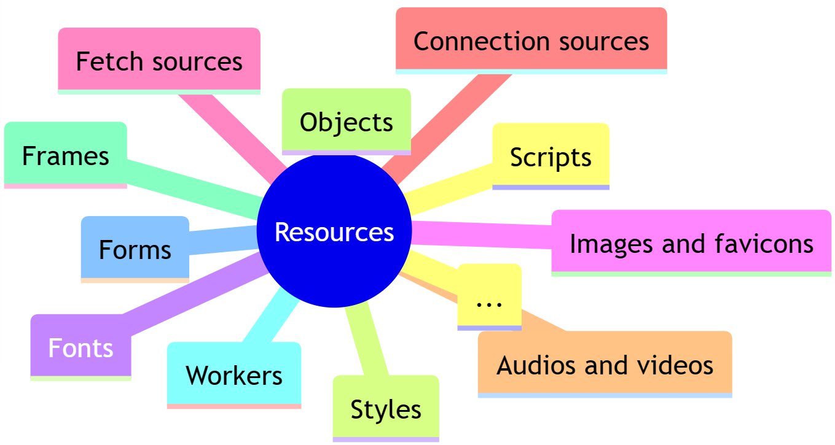
👨‍🎓Content-Security-Policy header?
The Content-Security-Policy (CSP) is a HTTP response header allowing to instruct the browser (user agent) on how to handle the resources present in the HTTP response body:

Slide 8
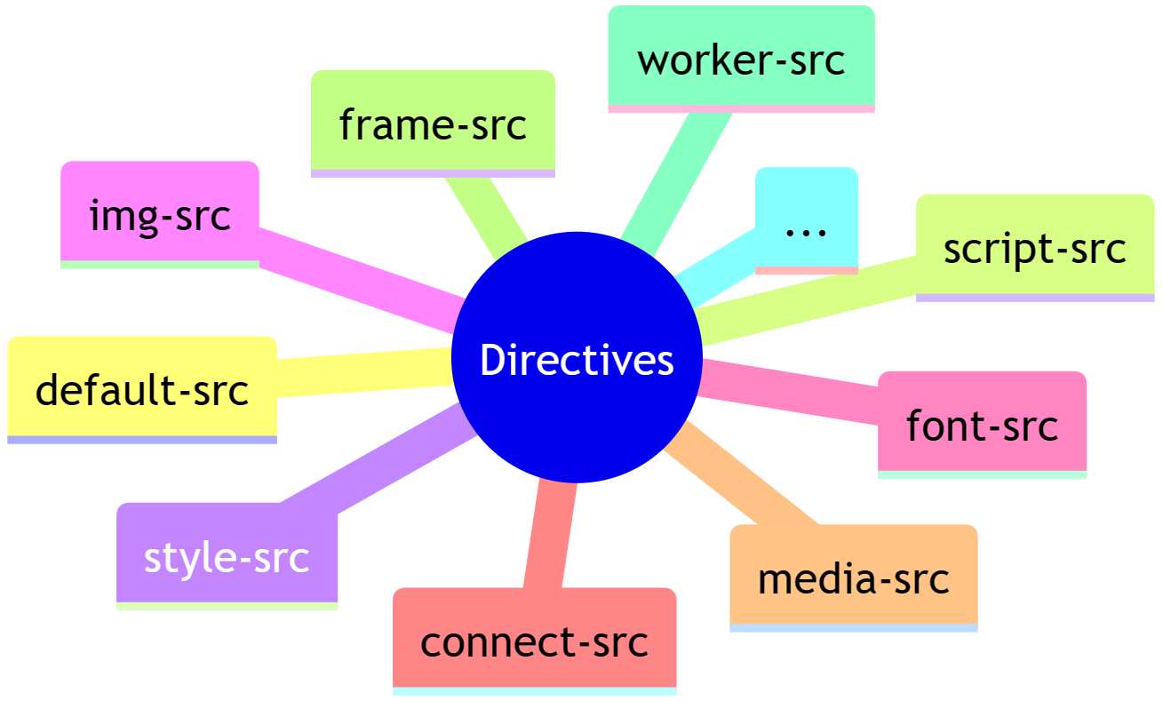
👨‍🎓Content-Security-Policy header?
Each type of resources controlled has a directive associated to it:

Slide 9
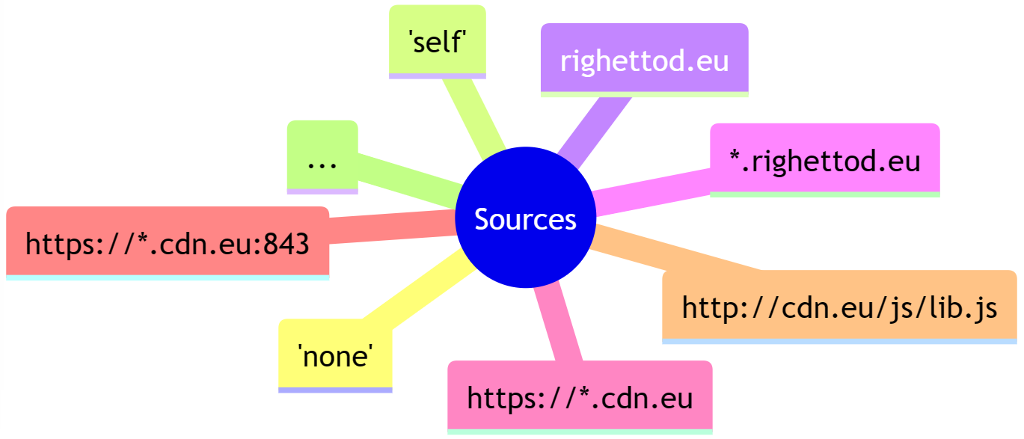
👨‍🎓Content-Security-Policy header?
Behavior about an allowed resources is defined using either a source location pattern or/and an instruction depending on the type of directive:

Slide 10
👨‍🎓Content-Security-Policy header?
Behavior about an allowed resources is defined using either a source location pattern or/and an instruction depending on the type of directive:
Instructions
'unsafe-inline'
'unsafe-eval'
Allow use of dynamic code evaluation such as eval, setTimeout(), and window.execScript.
Allow use of inline resources.
…

Slide 11
👨‍🎓Content-Security-Policy header?
The header use the following format:
Content-Security-Policy: [DIRECTIVE 1] [ALLOWED SOURCES OR INSTRUCTIONS] ; [DIRECTIVE 2] [ALLOWED SOURCES OR INSTRUCTIONS] ; [DIRECTIVE N] [ALLOWED SOURCES OR INSTRUCTIONS]

