Slide 1
Devil is in the Payloads.
The grueling journey of implementing a file upload feature.
🌍 Dominique Righetto

Slide 2
ℹ️ Introduction
Most of the modern web-based application provide a feature to allow a user to send a file.
Such feature is called "file upload".
It is very common that PDF format was accepted for the file.

Slide 3
ℹ️ Introduction
Been able to provide malicious information to an application is an important source of security vulnerabilities (source).
In 2025, 50 security vulnerabilities affecting a "file upload" feature were identified (source).
Across all security assessment I performed in 2025/2026, almost all of “file upload” feature evaluated were accepting malicious files.

Slide 4
ℹ️ Introduction
Some popular statement I often hear:
PDF is a safe format!
A "file upload" is simple to implement!
Let's deep dive and explore together “The Devil is in the Payloads” concept through a little story inspired by real events that I experienced...

Slide 5
📜 Context of our story
Our story take place in a company, precisely in the development team (called team from here) in charge of the complete management of the client portal.
The company wanted to offer the possibility to their client to attach files alongside their private chat with their advisors.
The team was using an agile methodology for the implementation of features.
Notes:
Use the style « Once upon a time… »

Slide 6
📜 Context of our story
The team received the following minimal User Story to implement the file upload feature:
The team decided to implement a REST web service that the front end (single page application) will use to upload a file.
User Story:
As a user, I want to upload a PDF file in the chat so that I can share documents with my advisors.
Acceptance Criteria:
The system successfully transfers the file from the user interface to the storage server.
Only PDF files are allowed.
File size is limited to 10 MB.

Slide 7
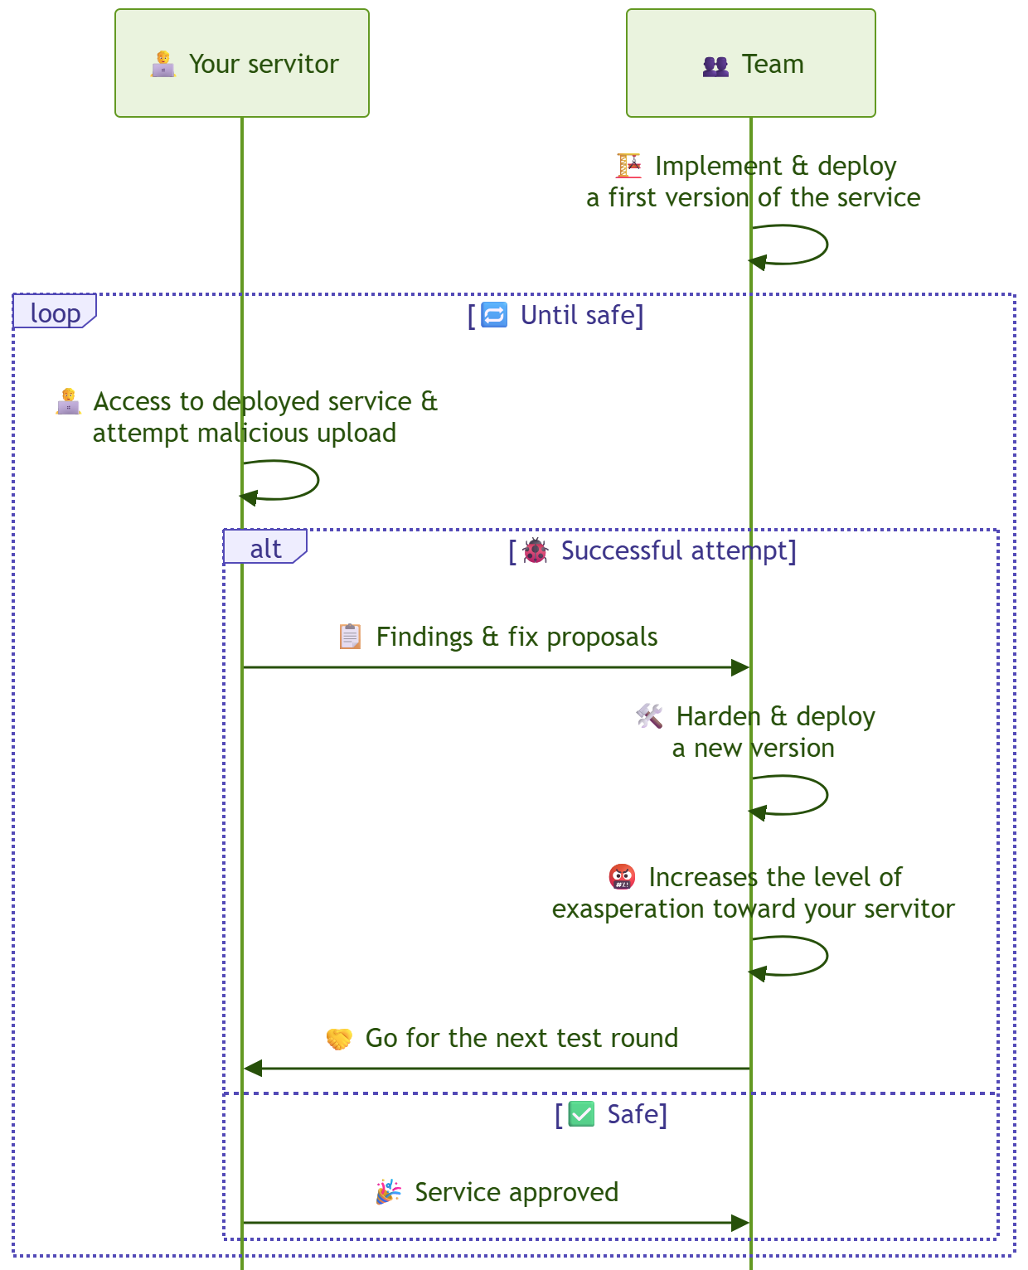
📜 Context of our story
Your servitor was integrated to the team to validate the security posture of the REST web service (called “upload service” from here).
The working process defined with the team was the following:

Slide 9
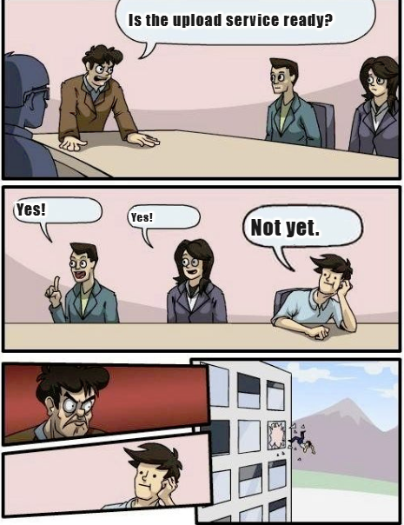
🥵 My challenge
Your servitor has a lifespan represented by the level of exasperation of the team caused by my feedback.
If it reach 100%, the team warned me that they're going to throw me out the window.
Notes:
Source of the même: https://imageresizer.com/meme-generator/edit/throw-out-of-the-window

Slide 10
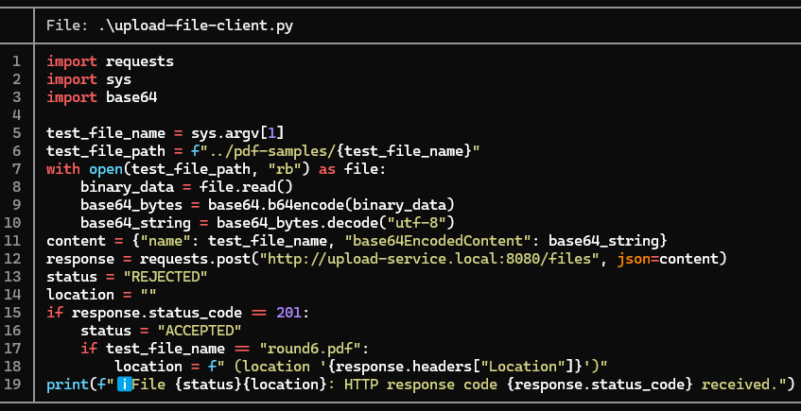
📖 Let’s the story begin – Setup for the tests
A utility script, to serve as “upload client”, was created to facilitate testing using different types of malicious PDF file:

Slide 11

📖 Round n°1
A first test was performed with a Windows binary file renamed as a pdf file:
The goal was to test if the service ensure that the provided file is a valid PDF file:

Slide 12
📖 Round n°1
🤬 Level of exasperation: 16%
🤔 Test failed so the following additional validation was proposed to the team:
Ensure that the provided file is a valid PDF by try loading it via a PDF parser.
✅ Test passed after the adding of the additional validation:

Slide 13
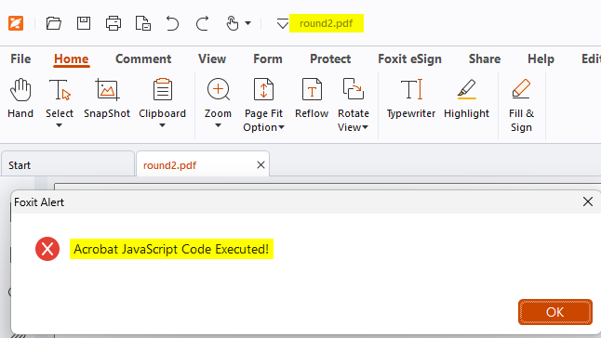
📖 Round n°2
A second test was performed with a valid PDF file containing a JavaScript code triggered when the file is opened:

Slide 14
📖 Round n°2
The goal was to test if the service ensure that the provided PDF file do not contain any JavaScript code that can trigger actions on behalf of the user when he open the file:

Slide 15
📖 Round n°2
🤬 Level of exasperation: 32%
🤔 Test failed so the following additional validation was proposed to the team:
Ensure that the provided file do not contains any JavaScript code.
✅ Test passed after the adding of the additional validation:

Slide 16
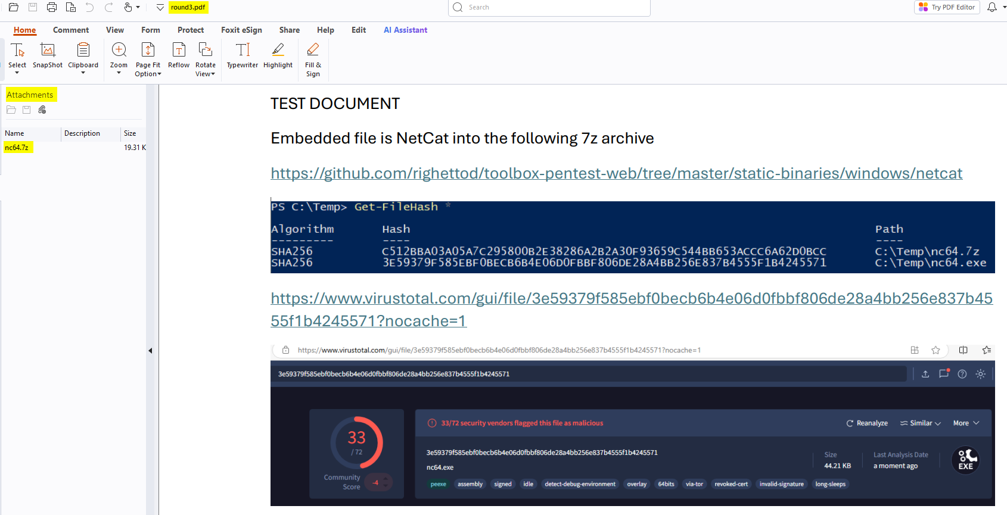
📖 Round n°3
A third test was performed with a valid PDF file containing an attached malicious file:

Slide 17
📖 Round n°3
A third test was performed with a valid PDF file containing an attached malicious file:

Slide 18
📖 Round n°3

Slide 19
📖 Round n°3
The goal was to test if the service ensure that the provided PDF file do not contain any dangerous attachment.
Such attachment file can be opened and executed by the user using instruction, into the PDF, intended to trick him (phishing approach).

Slide 20
📖 Round n°3
🤬 Level of exasperation: 48%
🤔 Test failed so the following additional validation was proposed to the team:
Ensure that the provided file do not contains any attachments files.
✅ Test passed after the adding of the additional validation:

Slide 21

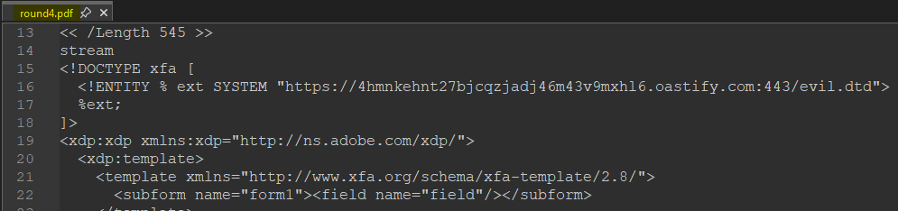
📖 Round n°4
A fourth test was performed with a valid PDF file containing an XML Forms Architecture (XFA) form with an XML External Entity reference to an external domain:

Slide 22
📖 Round n°4
The goal was to test if the service ensure that the library used to parse the PDF file is not prone to the following vulnerabilities:
XML External Entity injection (XXE)
Server-Side Request Forgery (SSRF)
Such vulnerabilities can lead to abuses like the following:
Read local files on the host on which the service is deployed.
Instruct the host, on which the service is deployed, to perform network requests.
…

Slide 23
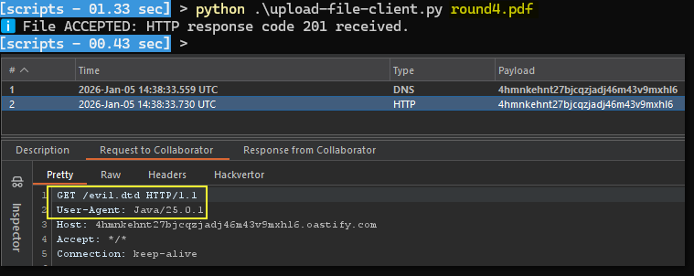
📖 Round n°4

Slide 24
📖 Round n°4
🤬 Level of exasperation: 64%
🤔 Test failed so the following additional validation was proposed to the team:
Ensure that the provided file do not contains any XFA forms.
That ways, PDF files stored will not contains any malicious XFA forms that can be triggered, if processed later, by an application using a vulnerable PDF library.
✅ Test passed after the adding of the additional validation:

Slide 25
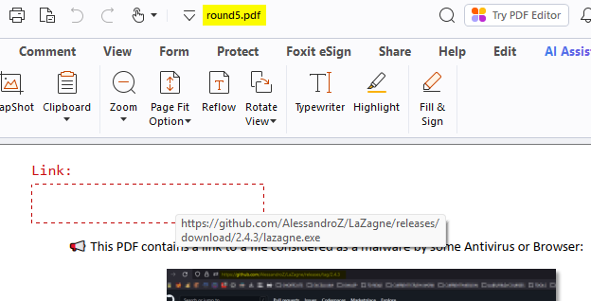
📖 Round n°5
A fifth test was performed with a valid PDF file containing a link to a malicious file:
hxxps://github.com/AlessandroZ/LaZagne/releases/download/2.4.3/lazagne.exe

Slide 26
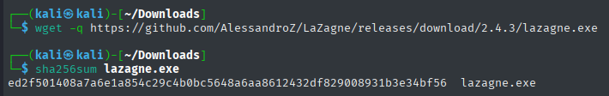
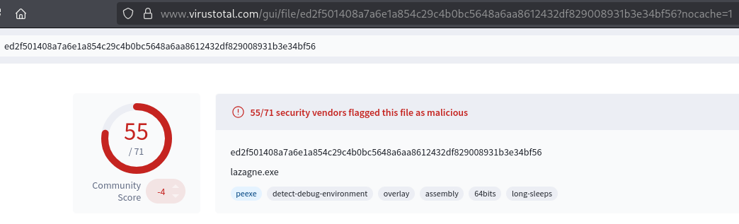
📖 Round n°5 – Linked file detection by antivirus tools

Slide 27
📖 Round n°5
The goal was to test if the service ensure that the provided PDF file do not contain any link to dangerous content.
Such link can be used, in addition to instruction into the PDF, to trick the user to click on the link and then download/execute the referenced malicious program (phishing approach).

Slide 28
📖 Round n°5
🤬 Level of exasperation: 80%
🤔 Test failed so the following additional validation was proposed to the team:
Ensure that the provided file contains only links to allowed domains and content.
✅ Test passed after the adding of the additional validation:

Slide 29
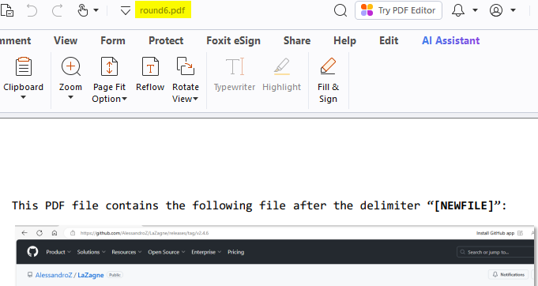
📖 Round n°6
A sixth test was performed with a valid PDF file, in which, a malicious file was hidden using “binary concatenation”:
hxxps://github.com/AlessandroZ/LaZagne/releases/download/2.4.6/lazagne.exe

Slide 30
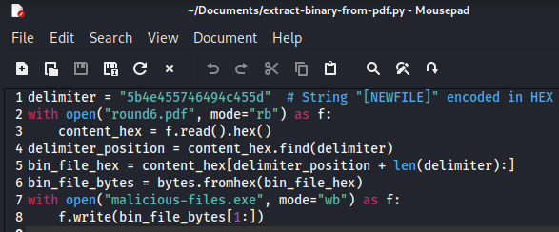
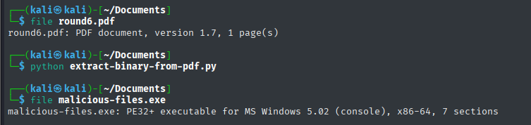
📖 Round n°6 – Test file content

Slide 31
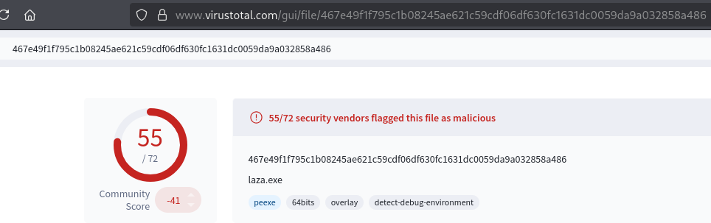
📖 Round n°6 – Hidden file detection by antivirus tools

Slide 32
📖 Round n°6
The goal was to test if the service ensure that the provided PDF file do not contain any “hidden content”.
Such technique can be used to leverage the service as a relay to store a malicious file into the company information system and then retrieve the malicious file, once inside, to carry an attack in a second phase.

Slide 33
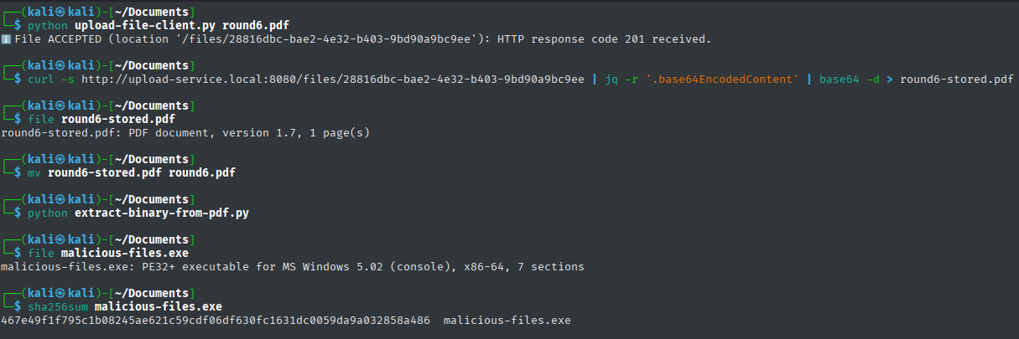
📖 Round n°6
File was accepted.
Replace the source file to use the extraction script.
Download the stored file to check if the hidden file was removed?
Hidden file was present.

Slide 34
📖 Round n°6
🤬 Level of exasperation: 96%
🤔 Test failed so the following additional processing was proposed to the team:
Load the PDF file in memory with a PDF parsing library.
Save it, via the same PDF library, into another byte buffer to remove any additional content that is not part of the PDF structure.

Slide 35
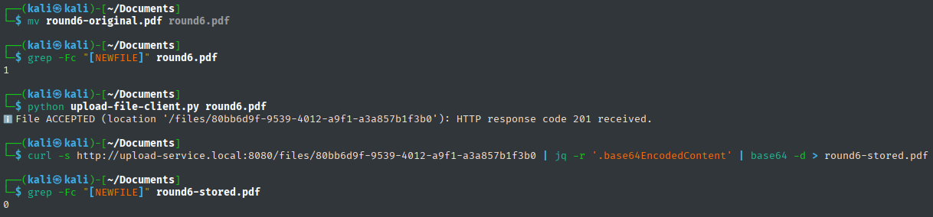
📖 Round n°6
🤬 Level of exasperation: 96%
✅ Test passed after the adding of the additional processing:

Slide 36
📖 Final state
✅ All malicious variation of a PDF file, know by your servitor, were applied against the upload service:
It can be considered as safe (for the moment).
🔬 The following additional validations/processing were added:
File is a valid PDF file.
File do not contain any JavaScript code, attachments files or XFA forms.
File contains only links to allowed domains and content.
File do not contain any "hidden content".
😉 Final level of exasperation not reached 100%.
So, I have not tested the effect of the gravity.

Slide 37
🛣️ Conclusion
❌ Regarding the following statement
PDF is a safe format ➔ No, it require validation like all file formats.
A "file upload" is simple to implement ➔ Not really.
✅ All the frustration meet could be avoided by a User Story enhanced with corresponding Evil User Stories based on the analysis of:
Real use cases of the wanted file format from a business perspective.
Attack vectors exposed by the wanted file format from a security perspective.

Slide 38
🤖 Misc: Code generated via AI
Using Claude (model Sonnet 4.6 without adaptive thinking) with a user prompt without any mention to the security aspect:
Give me the Java code of a REST web service intended to be an upload service accepting only PDF file.
You must make the code compact and easy to read/understand/maintain.
You must fulfil all theses constraints:
The REST web service must use Spring Boot.
You must use a recommended, maintained and open-source Java PDF library as much as possible.
The maximum size of the size must be 10 MB.

Slide 39
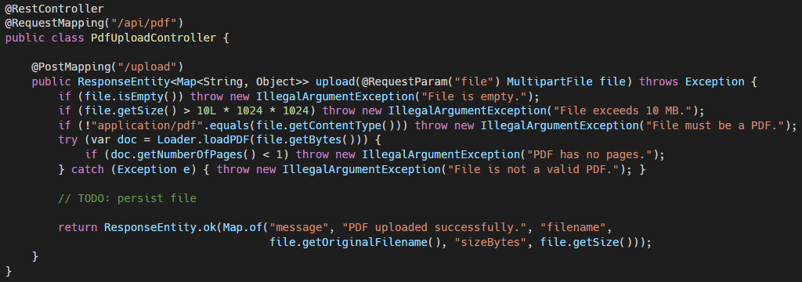
🤖 Misc: Code generated via AI
Minimal validations added.

Slide 40
🤖 Misc: Code generated via AI
Using ChatGPT (model Sonnet 4.6 without adaptive thinking) with a user prompt with explicit mention to the security aspect:
Give me the Java code of a REST web service intended to be an upload service accepting only PDF file.
You must make the code compact and easy to read/understand/maintain.
You must fulfil all theses constraints:
The REST web service must use Spring Boot.
You must use a recommended, maintained and open-source Java PDF library as much as possible.
You must include all the security validations to ensure that the PDF file is safe from a security perspective.
The maximum size of the size must be 10 MB.

Slide 41
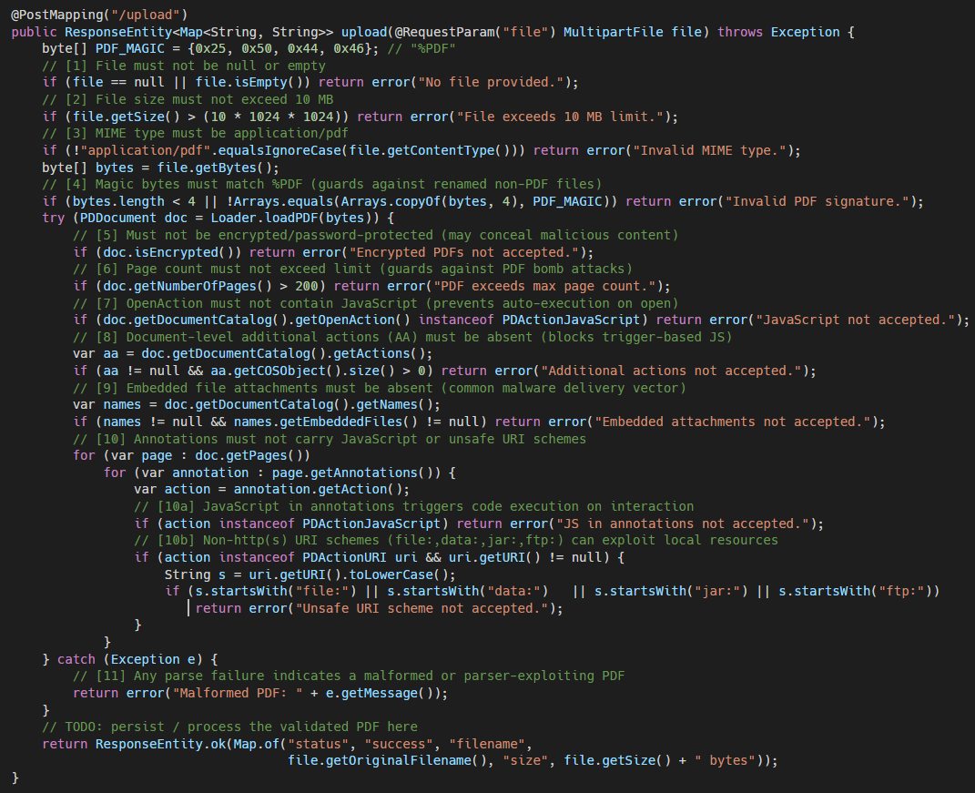
🤖 Misc: Code generated via AI
A strong sequence of validation was added!

Slide 42
🤖 Misc: Code generated via AI

Slide 43
🤖 Misc: Code generated via AI

Slide 44
🤖 Misc: Code generated via AI
⚠️ Security aspect need to be mentioned in the user prompt.
📋 When mentioned, a good foundation of validations are applied.
🔬 Some validation still miss so either:
User prompt must be tuned to indicate to add the missing validations.
The generated code need to be manually enriched.

Slide 45
📦 Resources
https://github.com/righettod/voxxeddays-lux-2026
https://github.com/righettod/code-assistant-skills-security-utils
https://github.com/righettod/code-snippets-security-utils
https://github.com/corkami/mitra
https://github.com/corkami/pics
https://www.headmind.com/evil-user-stories/ (FR)

