Slide 1
Title :HOSPITAL FINDER
PIP104 PROFESSIONAL PRACTICE-II
VIVA-VOCE
Batch Number:
Roll Number | Student Name
20201CDV0024 | Joel Cherian Williams
20201CDV0014 | Saran Silas
20201CDV0016 | Dhanush MS
20201CDV0017 | Abdul Samad
Under the Supervision of,
Dr. Pakruddin B
Professor
School of Computer Science & Engineering
Presidency University

Slide 2
Introduction
Problem Statement: During medical emergencies, common people always face problems in deciding which hospital they should visit for required treatment. They wander from one hospital to another in search of medical facilities, medicines, blood supply, etc. Hospital Finder will solve this problem by allowing people to search for nearby hospitals on the basis of medical treatment, specialist doctors, medicine/blood availability, etc
The Hospital Finder project is an Android app that allows users to find hospitals in their area and get information about them, such as location, contact information, and hours of operation. The app is designed to help users quickly and easily find the nearest hospital that can provide the care they need.

Slide 3
Literature Review
Year, Name of the journal
Paper: "ANDROID BASED HOSPITAL FINDER APPLICATION USING GLOBAL POSITIONING SYSTEM(GPS)"
Authors: Muhammad Wasim Munir, Syed Muhammad Omair, M. Zeeshan ul Haque
Journal: International Journal of Computer Applications
Publication Date: May 2015
Paper: "Hospital Locator and Bed Availability Detector for Emergency Cases"
Authors: Syed Farzana, Kanakam Sasikalyan, Jasti Manikanta, Kommalapati Manoj, Choppara Prasanth
Journal: IRJET Journal
Publication Date: Jan 19, 2023
Paper: "Implementation of Hospital-Finder"
Authors: Shivam Bajpai, Tushar Modi, Vatsalya Vinay Sinha, Vidhi Jaiswal
Journal: International Journal of Research Publication and Reviews
Publication Date: April 2023
Paper: "Hospital Real-Time Location System (A Practical Approach in Healthcare)"
Authors: Leila GHOLAMHOSSEINI, Farahnaz SADOUGHI, Aliasghar SAFAEI
Journal: Iran J Public Health
Publication Date: Apr 2019
Title of the Paper
Authors of the Paper
Methodology
Merits

Slide 4
Research Gaps Identified
Integration of real-time data: The papers highlight the challenge of limited accessibility to real-time information in hospital finder applications. A potential research gap could be the development of techniques or algorithms to integrate and update hospital data in real-time, ensuring that users have access to the most current information.
Comprehensive database management: The paper discussing the hospital locator and bed availability detector application mentions challenges in managing the database. Further research could focus on developing efficient and scalable database management systems specifically tailored for hospital finder applications, addressing issues such as data accuracy, completeness, and database maintenance.
Addressing limitations in coverage: The implementation of the hospital finder application mentioned in one of the papers highlighted limited coverage. Future research could explore strategies to enhance the coverage of hospital finder applications, such as developing methods to include a wider range of hospitals and healthcare facilities, including specialized clinics and rural healthcare centers.
Overcoming language and technological barriers: The paper on the hospital locator and bed availability detector application mentions language and technological barriers as challenges. Further research could focus on developing user-friendly interfaces and multilingual support to ensure that the application can be easily used by individuals from diverse linguistic backgrounds. Additionally, exploring technological solutions to overcome barriers, such as improving internet connectivity or addressing compatibility issues across different devices, could be areas of further investigation.

Slide 5
Proposed Methodology
The project is more user-friendly. The research paper does not provide any information on how to use the hospital finder app, while the project includes a detailed user guide.
The project is aiming for ease of use and consistent modern design.
The project design will be more aligned for use by disabled people, we are going to use high contrast colors and easily readable fonts.
The project is more up-to-date. The project is based on the latest technologies and trends.

Slide 6
Objectives
Search functionality, allowing users to find hospitals by name, location, or specialty.
Detailed profile pages for each hospital, including services, amenities, and patient reviews.
Map integration to display hospital locations.
User-friendly interface with large fonts and high-contrast colors.

Slide 7
System Design & Implementation
System Design:
Design the app using the React Native framework with Expo for cross-platform compatibility.
Utilize a modular and component-based architecture for scalability and code reusability.
Implement a client-server architecture with a backend server to handle API requests and database operations.
Design the database schema to store hospital information, user data, and search history if needed.
Ensure the app's design is intuitive and user-friendly, with easy navigation and clear information presentation.
Implement secure authentication and authorization mechanisms to protect user data.
Implementation:
Set up the project using Expo CLI and install necessary dependencies and libraries.
Develop and integrate UI components using React Native, adhering to design guidelines and best practices.
Use Expo Location and Permissions to access the device's location and handle location updates.
Integrate the Google Maps API to display maps, markers, and implement search and navigation functionalities.
Implement API calls to fetch hospital data from the server or directly from the Google Places API.
Integrate search functionality using search API to provide location suggestions and hospital search options.

Slide 8
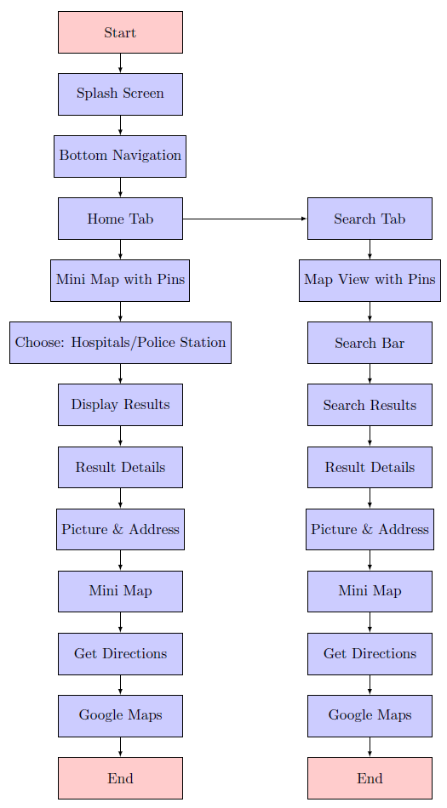
Flow Diagram

Slide 9
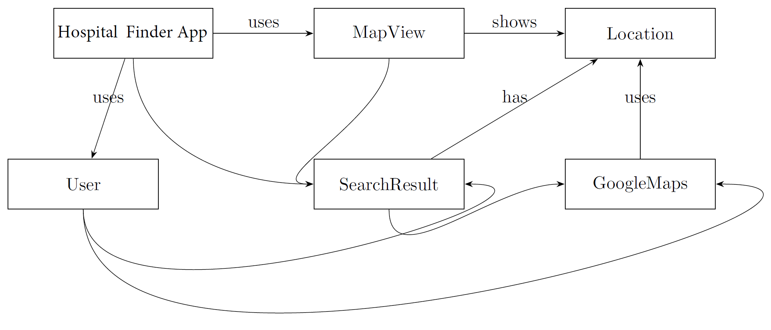
UML Diagram

Slide 10
Timeline of Project
Review(0) – Prototype of the app
Review(1) – 1st iteration of the app
Review(2) – 2nd iteration of the app with Google Maps API.
Review(3) – 3rd iteration of the app with accessibility features.
Final – Stable working app

Slide 11
Outcomes / Results Obtained
Quick and convenient hospital search and location near the user's specified location.
Detailed information for each hospital, including address, contact number, website, services provided.
Integration of interactive maps for visualizing hospital locations relative to the user's current position.
Incorporation of reviews and ratings from Google to help users gauge the quality of each hospital.
Seamless navigation with in-app directions to the selected hospital, allowing users to choose their preferred mode of transportation.

Slide 12
Conclusion
In summary, the Google Maps API integration has greatly improved the hospital finder app, offering users a seamless experience in locating healthcare facilities. The robust search, accurate location data, and dynamic map visualization enhance the app's effectiveness. Despite potential challenges, the successful implementation underscores the app's potential for future enhancements, ensuring adaptability to evolving user needs. Overall, the integration positively impacts user experience, accuracy, and real-time data updates in healthcare navigation.

Slide 13
References
[1] ANDROID BASED HOSPITAL FINDER APPLICATION USING GLOBAL POSITIONING SYSTEM(GPS)
[2] Hospital Locator and Bed Availability Detector for Emergency Cases - IRJET
[3] Implementation of Hospital Finder
[4] Hospital Real-Time Location System (A Practical Approach in Healthcare): A Narrative Review Article
[5] Hospital Location Selection: A Systematic Literature Review on Methodologies and Applications

Slide 14
Publication Details

Slide 15
Achievements (if any)
We have successfully achieved the entire working of an hospital finder app with all the integration level successfully completed.
We also completed the testing process with the app working perfectly fine to display the hospitals that are close by as per the customer’s requirement.

Slide 16

Thank You

