Slide 1




Big Data Analytics
Current Status of Electric Vehicles in Korea and Future of Battery Industry
-the correlation between related stocks.-
management information systems
2019011033 김재용

Slide 2


Contents
Research Question(s)
Dataset(s)
Motivation
Dataset(s)
Related Works
Expectations on Findings

Slide 3
Dataset(s)
Open data portal : www.data.go.kr
& python library ‘financedatareader’
DATA Description:
The first is ‘한국전력공사_지역별 전기차 현황정보’
Link is ‘https://www.data.go.kr/data/15039554/fileData.do’
Management department: Digital conversion destination

Slide 4
Dataset(s)
Open data portal : www.data.go.kr
& python library ‘financedatareader’
DATA Description:
The second is ‘한국전력공사_지역별 전기차 충전소 현황정보’
Link is ‘https://www.data.go.kr/data/15039765/fileData.do’
Management department: ICT Operations Department

Slide 5
Dataset(s)
Data Description:
The Library name is ‘FinanceDataReader’
programming language: Python

Slide 6
Motivation
I've always been interested in stocks. To understand stocks, it's important to have an outlook on related industries. I've heard that the battery industry in Korea is rapidly growing, but I couldn't easily find out how much it's growing. As batteries are a key component of electric vehicles, I want to analyze the battery industry through electric vehicle data. I believe that by combining this with studying stocks and the industry, I can increase my understanding.

Slide 7
Research Question(s)
Status of electric vehicles in South Korea
know about the current status of electric vehicle numbers and charging stations in South Korea.
Analysis of stock prices of companies related to secondary batteries listed on KOSPI
Status of the secondary battery industry in South Korea.
- with a focus on revenue
Future stock price prediction based on industry status and stock prices

Slide 8
Related Works
I first looked for reliable information to address the technical issue, so I searched on the website 'scienceon' operated by the Korea Institute of Science and Technology Information.
1. Name is ‘2차전지 사업동향’(by전자진흥= Journal of Korean electronics v.23 no.8 , 2003년, pp.17 - 21
하몽렬 (부품소재산업팀))from https://scienceon.kisti.re.kr/srch/selectPORSrchArticle.do?cn=JAKO200373879885144

Slide 9
Related Works
1. This paper elaborates on the types and technological trends of secondary batteries. Although there are some similarities in terms of the export status and focusing on revenue, there are slight differences between this paper and my research on the types of secondary batteries. This is because my research focuses more on the industry as a whole rather than just the technological capabilities of secondary batteries.

Slide 10
Related Works
2. Name is ‘현대자동차(전기차)의 중국 진출 전략 : - 현대 전기차를 중심으로 – by왕밍하오 (부산 : 동서대학교 일반대학원, 2023)
from https://scienceon.kisti.re.kr/srch/selectPORSrchArticle.do?cn=DIKO0016682089

Slide 11
Related Works
2. This paper discusses how Hyundai Motor Company's electric vehicles can grow in the Chinese market, amidst the rapid growth of Chinese electric vehicle companies. From a marketing perspective, the paper addresses the challenges and solutions that Hyundai Motor Company faces. Although the paper discusses electric vehicles, it differs from my project in that it focuses on Hyundai Motor Company as a business and is set in China, not Korea.

Slide 12
Related Works
3. Name is ‘Change in enterprise value in semiconductor, display, and battery before and after COVID-19 outbreak’
by 박선 연세대학교 경제대학원: 금융공학 2023.2
From http://www.riss.kr/search/detail/DetailView.do?p_mat_type
=be54d9b8bc7cdb09&control_no=7354e97df9c85f5bffe0bdc3ef48d419&outLink=K

Slide 13
Related Works
3. The study uses the excess earnings model, which is considered the most practical valuation method, to calculate the value of companies in the semiconductor, display, and battery industries before and after the COVID-19 pandemic. The model's explanatory power is then validated by comparing the calculated values with actual stock prices. Furthermore, the study analyzes whether the companies' values have actually changed by comparing their values before and after the pandemic.

Slide 14
Related Works
3. This paper discusses stock investment and corporate valuation, which is similar to my project. However, this paper analyzes not only second-hand batteries but also semiconductor and display companies. This is different from my project. Additionally, this paper uses the "excess earnings model" analysis technique to analyze corporate value, which is more in-depth than my project.

Slide 15
Related Works
4. Demand Analysis and Forecasting of Battery Electric Vehicles in Korea’ Kwak, J., & Kim, S. (2020, May 31). Demand Analysis and Forecasting of Battery Electric Vehicles in Korea. Journal of the Korean Society of Supply Chain Management. Korean Society of Supply Chain Management. https://doi.org/10.25052/kscm.2020.05.20.1.24
From https://scienceon.kisti.re.kr/srch/selectPORSrchArticle.do?cn=NART107459355

Slide 16
Related Works
4. In this paper, a new variable, the amount of media coverage on electric cars, which had not been previously considered, was taken into account to increase the accuracy of electric vehicle demand prediction. Multiple linear regression models and a machine learning model, random forest, were used.

Slide 17
Related Works
4. This paper analyzed data on the electric vehicle industry and secondary batteries. This is similar to my project in terms of topic and method. However, I focused on the number of electric vehicles and charging stations in Korea, while this paper analyzed not only the registration status of electric vehicles, but also many other factors such as gasoline prices, and electric vehicle driving ranges etc.

Slide 18
Related Works
5. Subsidy on Battery Electric Vehicle and Its Impact on Greenhouse Gas Emission Reduction ’ JEON, S., & KIM, S. (2019, April 30). Subsidy on Battery Electric Vehicle and Its Impact on Greenhouse Gas Emission Reduction. Journal of Korean Society of Transportation. Korean Society of Transportation. https://doi.org/10.7470/jkst.2019.37.2.092
From https://scienceon.kisti.re.kr/srch/selectPORSrchArticle.do?cn=NART110602757

Slide 19
Related Works
5. In this paper, the integrated model GCAM was used to set subsidy scenarios and analyze the achievement of the government's electric vehicle deployment plan and the impact of the government's subsidy policy on greenhouse gas reduction effects.

Slide 20
Related Works
5. Discussing the outlook for electric vehicle usage is similar to my project. However, this paper focuses on policy, specifically discussing the reduction of greenhouse gas emissions and the use of government subsidies.

Slide 21
Expectations on Findings
Based on my data and the five papers mentioned above, it is predicted that the electric vehicle and battery markets will grow.
Summaries of each paper are as follows:
Status and outlook of the battery industry in Korea
Korean companies' entry into and success strategies in the Chinese electric vehicle market
Analysis of battery company stock price changes and stock prices after COVID-19
Analysis of electric vehicle demand based on registration status, charging stations, gasoline prices, and electric vehicle driving range
Analysis of electric vehicle demand prediction and subsidies

Slide 22
Expectations on Findings - relevance
All of the above studies are related to secondary batteries and electric vehicles. After reviewing these studies, I found the following information relevant to my topic: the increasing revenue of the secondary battery industry, the growing number of electric vehicles, the increasing number of electric vehicle charging stations, and the rising stock prices of companies related to these developments, among other things. Ultimately, these findings provide a basis for addressing my research questions.

Slide 23
Expectations on Findings - Conclusion
Through these analyses, it is predicted that the electric vehicle and battery markets will grow, and the value of related stocks is also expected to rise.

Slide 24
Findings
Research Question1
- Status of electric vehicles in South Korea
know about the current status of electric vehicle numbers and charging stations in South Korea.

Slide 25
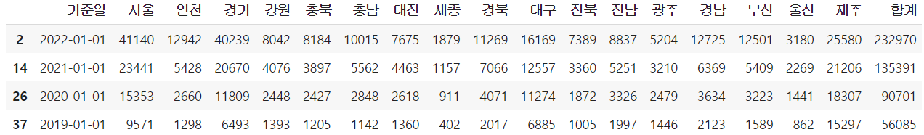
Findings
Question1 – Findings
- Status of electric vehicles in South Korea ("Collecting data for a period of four years starting from January 1st each year.) ON TABLE

Slide 26
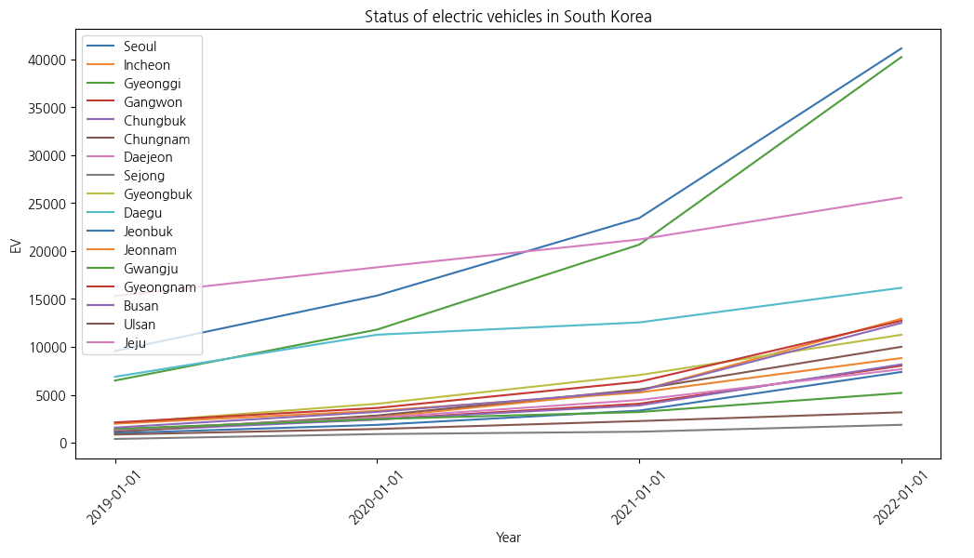
Findings
Question1 - Findings
- Status of electric vehicles in South Korea ("Collecting data for a period of four years starting from January 1st each year.) ON GRAPH

Slide 27
Findings
Research Question1
- Status of electric vehicles in South Korea
Findings
=> Looking at the tables and graphs, it can be seen that the number of electric vehicles by region is increasing every year. And it can be seen that there are many electric vehicles in Seoul and the metropolitan area, and Sejong City has the least.

Slide 28
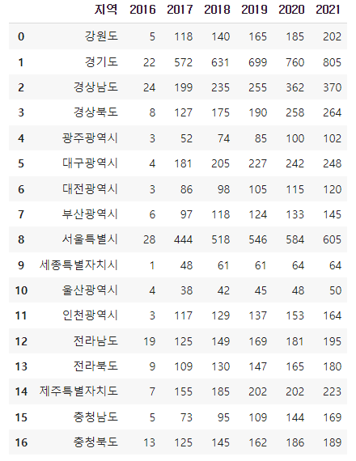
Findings
Question1 - Findings
know about charging stations in South Korea. ON TABLE

Slide 29
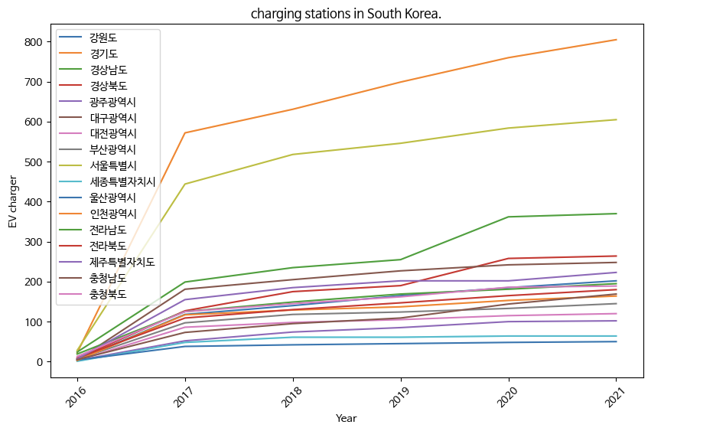
Findings
Question1 - Findings
know about charging stations in South Korea. ON GRAPH

Slide 30
Findings
Research Question1
- charging stations in South Korea
Findings
=> Looking at the graphs and tables, the number of electric vehicle charging stations in Korea is increasing every year. Like electric vehicles, charging stations in Seoul and the metropolitan area are being installed faster than charging stations in other regions.

Slide 31
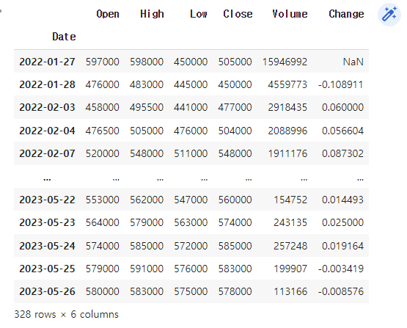
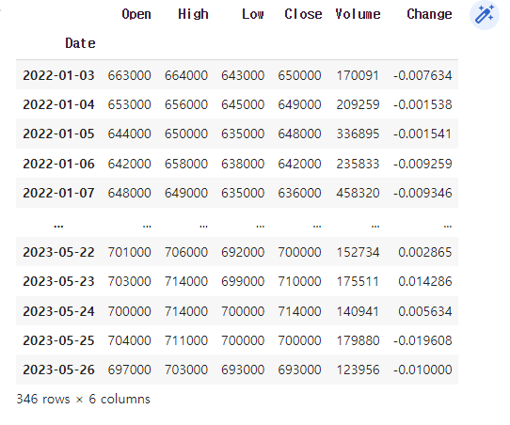
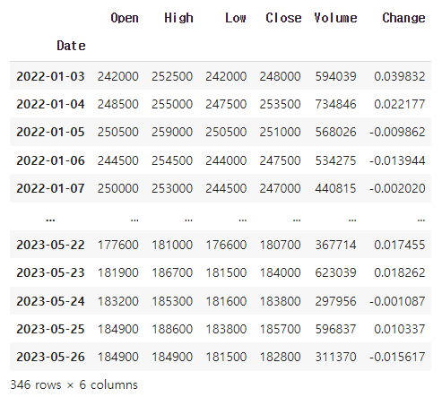
Findings
Research Question2
- Analysis of stock prices of companies related to secondary batteries listed on KOSPI(LG Energy Solution, Samsung SDI, SK Innovation)
Findings on TABLE
LG Energy Solution
Samsung SDI
SK Innovation

Slide 32
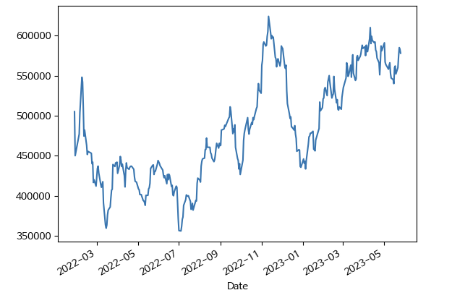
Findings
Research Question2
- Analysis of stock prices of companies related to secondary batteries listed on KOSPI
Findings on GRAPH(Visualizing stock prices based on closing prices)
LG Energy Solution

Slide 33
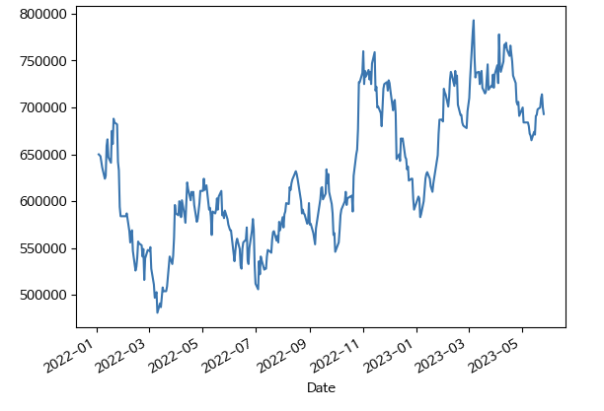
Findings
Research Question2
- Analysis of stock prices of companies related to secondary batteries listed on KOSPI
Findings on GRAPH(Visualizing stock prices based on closing prices)
Samsung SDI

Slide 34
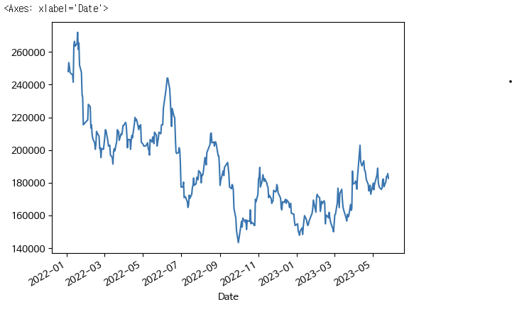
Findings
Research Question2
- Analysis of stock prices of companies related to secondary batteries listed on KOSPI
Findings on GRAPH(Visualizing stock prices based on closing prices)
SK Innovation

Slide 35
Findings
Findings 2
- Analysis of stock prices of companies related to secondary batteries listed on KOSPI
=> Referring to the table and graph, LG Energy Solution and Samsung SDI showed a rise in stock prices at the present time from May last year. However, SK Innovation's stock price fell.

Slide 36
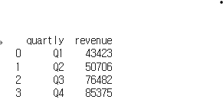
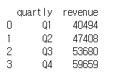
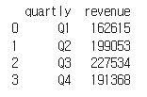
Findings
Research Question3
- Status of the secondary battery industry in South Korea.
with a focus on revenue (Source of Information - https://dart.fss.or.kr/) on TABLE
LG Energy Solution
Samsung SDI
SK Innovation

Slide 37
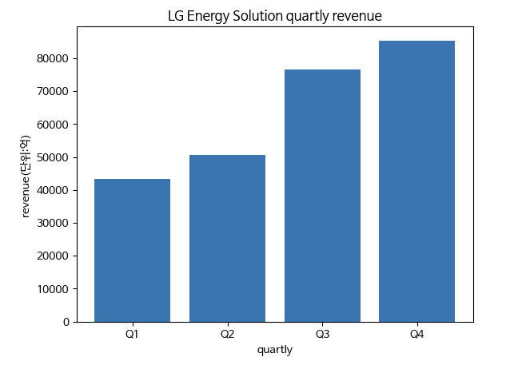
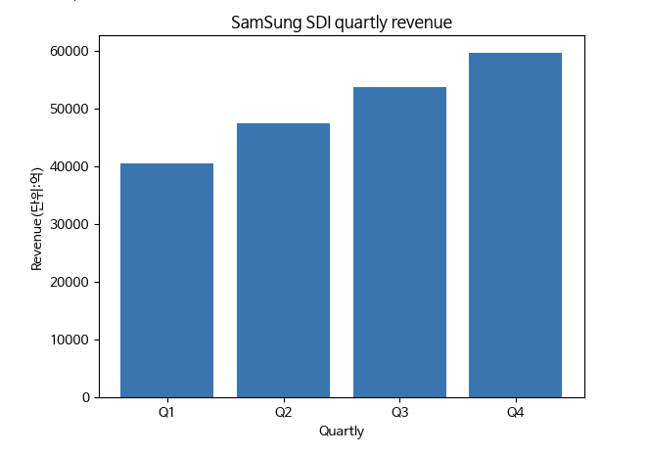
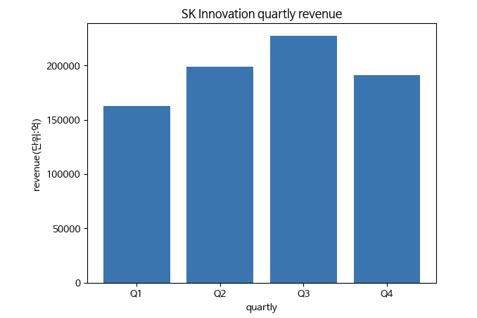
Findings
Research Question3
- Status of the secondary battery industry in South Korea.
with a focus on revenue (Source of Information - https://dart.fss.or.kr/) ON graph

Slide 38
Findings
Research Question3
Findings
=> As shown Table and graph, LG Energy solutions and SamsungSDI may be seen that the sales amount of sales in 2022.However, SK Innovation has decreased sales in the fourth quarter of 2022.Looking at the chart, it can be seen that sales and stock prices are related to sales and stock prices.

Slide 39
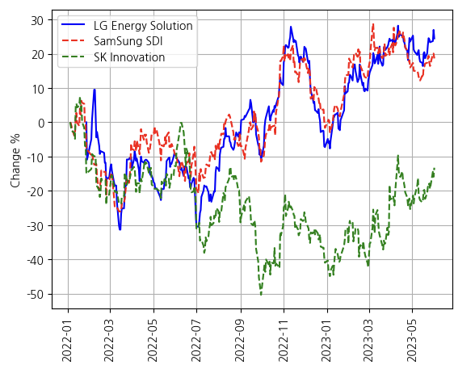
Findings
Research Question4
- Future stock price prediction based on industry status and stock prices
- The following graph shows the returns of the three companies

Slide 40
Findings
Research Question4
- Future stock price prediction based on industry status and stock prices
=> Looking at the five papers found above, the status of electric vehicles and electric vehicle charging stations in Korea, and sales of related companies, it is clear that the outlook for electric vehicle and battery-related industries is bright. LG Energy Solution and Samsung SDI saw their sales rise and stock prices rise. Therefore, the outlook for these two companies is bright. However, considering SK Innovation's decline in sales and stock prices in the fourth quarter of 2022, SK Innovation's stocks are not attractive.

Slide 41
Discussions
In fact, it is not easy to predict stock prices. Various factors such as interest rates, exchange rates, industry status, internal status of companies, and financial statements affect stock prices. But based on the above data, when analyzed I thought that the increase in the number of electric vehicles and electric vehicle charging stations by region would have naturally increased the company. As can be seen from SK Innovation, sales in the fourth quarter of 2022 decreased and stock prices fell compared to a year ago. Therefore, I think we should judge based on other additional data.

Slide 42
Discussions
There are many factors that affect a company's stock price. At first, I simply considered the status of electric vehicles and charging stations in the country. However, LG Energy Solution, Samsung SDI, and SK Innovation all collaborate with overseas electric vehicle companies and export them overseas. Looking at the current status of electric vehicles and charging stations around the world will also improve understanding of the electric vehicle industry. In addition, rather than simply focusing on sales and sales, political factors such as policies related to electric vehicle subsidies will be better understood.

Slide 43
Discussions
Electric vehicles and secondary batteries are currently the most promising industries. These are industries that adapt to environmental issues and climate change. It also plays an important role in national policy and energy strategies, with technological innovation and economic impact. I researched three representative Korean companies belonging to these industries and identified their sales figures. This predicted the price of stocks, which is the most basic behavior in stock investment and industry analysis. Through this, it is possible to analyze the stock prices of related industries and companies with objective and specific data. Also, since they are the core of the Korean industry, it is very important to understand these things, and based on this method, it is expected to be of great help in understanding other industries and investigating other companies.

Slide 44
Discussions
In fact, a lot of data is needed to analyze the stock prices of industries and companies. I judge industries and stocks with three data, but I actually have to analyze dozens of data to make a judgment. I have to put a lot of effort into my data collection ability. It also requires the ability to process and analyze the data. I visualized it with only tables and graphs, but in reality, I believe that analysis using various analysis tools will improve understanding.

Slide 45
Realization
There were many difficulties because I was not used to using Colab for the first time and doing data analysis. Representing data as a table, visualizing it as a graph with the table, and finally, I found it on the Internet because the Korean font did not come out properly. By solving these problems, I think my data analysis skills have improved with this task.

Slide 46




Thank you !

