Slide 1
Module 1
Design & Verification Methodology (Part 1)
learn_uart_spi_i2c / Module 1

Slide 2
Learning objectives
• Spec-to-RTL flow: From SPEC.md (or equivalent) to
synthesizable Verilog/SystemVerilog.
• Why verify: The cost of bugs, and how directed tests
(and later UVM) reduce risk.
• Minimal toolchain: Verilator + Make + C++ harness
for RTL simulation (no UVM in this module).
learn_uart_spi_i2c / Module 1

Slide 3
Prerequisites
• Linux/macOS/WSL2 with a terminal
• Verilator (5.x recommended)
• GNU Make
• C++ compiler (GCC or Clang)
learn_uart_spi_i2c / Module 1

Slide 4
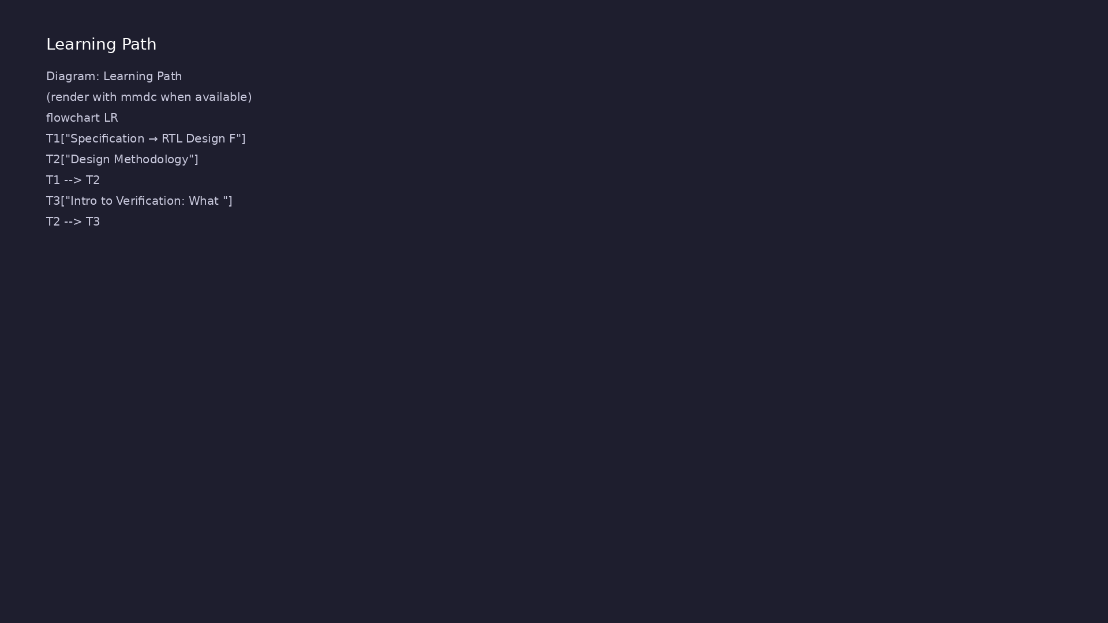
Learning path
Understand the specification → RTL design flow, design methodology, and why we verify.
learn_uart_spi_i2c / Module 1

Slide 5
Overview
• Module 1 establishes the **design and verification
mindset** you will use for UART, SPI, and I²C in…
learn_uart_spi_i2c / Module 1

Slide 6
How to learn this module
learn_uart_spi_i2c / Module 1

Slide 7
Suggested learning path
• Read UNDERSTANDING_THE_SPEC.md — how to read
interface, behavior, and timing in a spec.
• Read SPEC_TO_RTL_GUIDE.md — mapping spec sections to
RTL structure.
• Skim Design Architecture and Verification sections
below, then run the spec_to_rtl example.
• Trace one requirement in SPEC.md to a line in
`dut/counter.v` and to a check in `sim_main.cpp`.
learn_uart_spi_i2c / Module 1
Notes:
From docs/MODULE1.md — read guides before running demos.

Slide 8
Design architecture
learn_uart_spi_i2c / Module 1

Slide 9
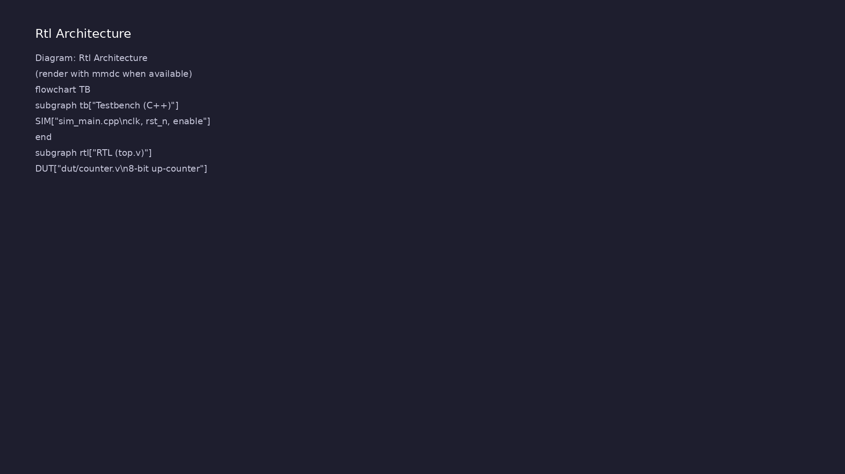
RTL / block architecture
Module 1: DUT / block hierarchy (see module1/examples/).
learn_uart_spi_i2c / Module 1

Slide 10
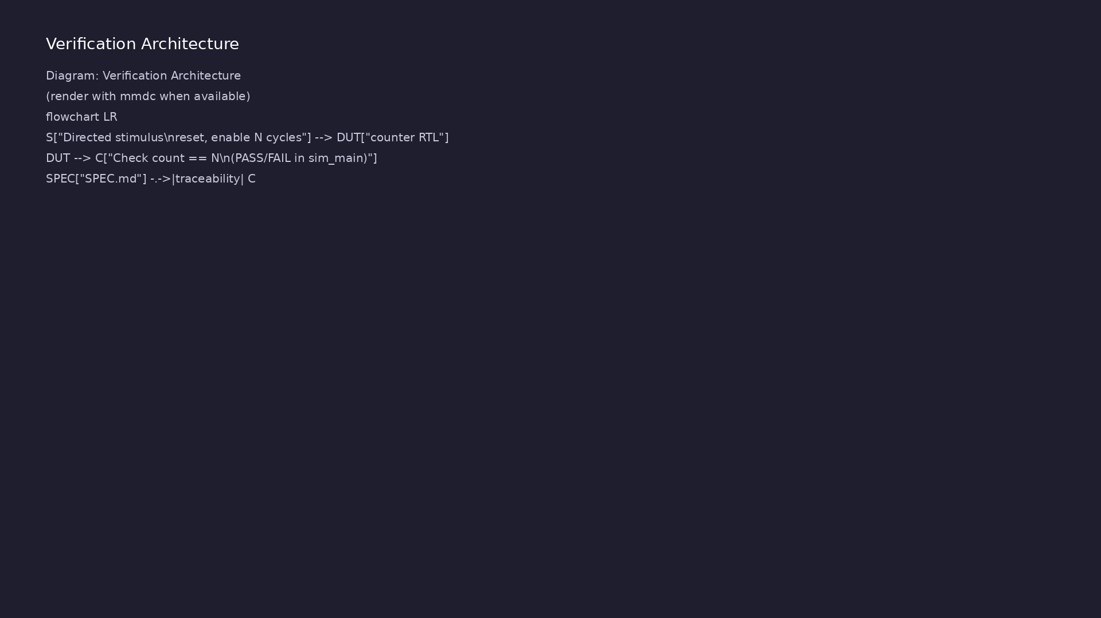
Verification environment architecture
Module 1: UVM layers, agents, and checkers for this phase.
learn_uart_spi_i2c / Module 1

Slide 11
1. Artifact flow (spec_to_rtl)
• SPEC.md → requirements in plain language (interface,
behavior, timing).
• dut/counter.v → synthesizable RTL implementing the
spec.
• top.v → wrapper connecting DUT pins to the
simulation harness.
• sim_main.cpp → clock, reset, stimulus, and result
checking outside RTL.
learn_uart_spi_i2c / Module 1
Notes:
From MODULE1 Design Architecture.

Slide 12
2. Counter DUT structure
• 8-bit up-counter: increments when `enable` is high;
holds when disabled.
• Reset: synchronous active-low `rst_n` clears `count`
to zero.
• Ports: `clk`, `rst_n`, `enable`, `count[7:0]` — map
directly from the spec interface table.
learn_uart_spi_i2c / Module 1
Notes:
From MODULE1 Design Architecture.

Slide 13
3. Simulation harness attachment
• C++ generates `clk` and drives `rst_n` / `enable`;
reads `count` each cycle.
• No SystemVerilog testbench yet — you will add
structured TB/UVM in Module 2.
learn_uart_spi_i2c / Module 1
Notes:
From MODULE1 Design Architecture.

Slide 14
Verification & testing methods
learn_uart_spi_i2c / Module 1

Slide 15
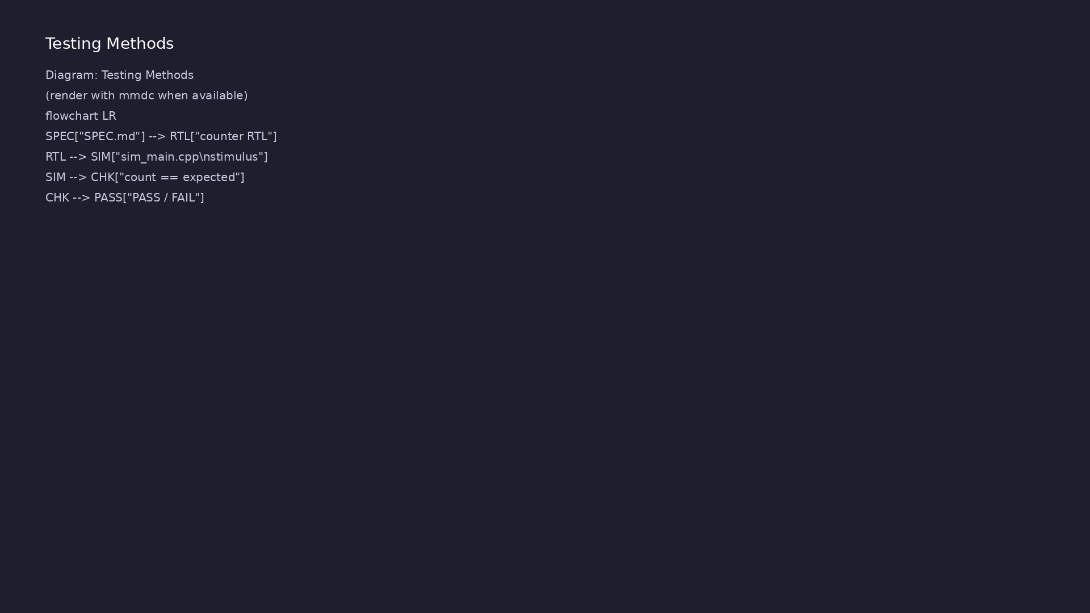
Testing and closure flow
Module 1: how tests, checks, and metrics close verification goals.
learn_uart_spi_i2c / Module 1

Slide 16
1. What we verify in Module 1
• RTL behavior matches SPEC.md (reset, enable gating,
count progression).
• Directed scenario: release reset, enable for N
cycles, expect `count == N`.
learn_uart_spi_i2c / Module 1
Notes:
From MODULE1 Verification & Testing Methods.

Slide 17
2. Stimulus and checking
• Stimulus: C++ toggles `enable` for a known number of
clock cycles.
• Check: compare `count` to expected value; print
PASS/FAIL.
• Traceability: each check should cite the spec
sentence it proves.
learn_uart_spi_i2c / Module 1
Notes:
From MODULE1 Verification & Testing Methods.

Slide 18
3. What is not covered yet
• Random stimulus, functional coverage, scoreboards —
Module 2 (UVM) and protocol modules.
• Use [UNDERSTANDING_THE_SPEC.md](../module1/UNDERSTAN
DING_THE_SPEC.md) and [SPEC_TO_RTL_GUIDE.md](..…
learn_uart_spi_i2c / Module 1
Notes:
From MODULE1 Verification & Testing Methods.

Slide 19
Syllabus topics
learn_uart_spi_i2c / Module 1

Slide 20
1. Specification → RTL Design Flow
• Specification: Document interface (ports, widths,
direction), behavior (reset, enable, state transi…
• RTL: Implement the spec in Verilog/SystemVerilog;
each requirement in the spec should map to clear…
• Traceability: Being able to point from a line in the
spec to the RTL that implements it (and vice v…
learn_uart_spi_i2c / Module 1
Notes:
From MODULE1 Topics Covered.

Slide 21
2. Design Methodology
• Single block: One spec, one (or a few) RTL files,
one testbench.
• Reuse: The same flow (spec → RTL → testbench) scales
to protocol blocks (UART, SPI, I²C) in Modules…
• Documentation: Keep SPEC.md (or similar) next to the
RTL so that reviewers and verification can che…
learn_uart_spi_i2c / Module 1
Notes:
From MODULE1 Topics Covered.

Slide 22
3. Intro to Verification: What We Verify, and Why
• What we verify: That the RTL matches the
specification (correct function, reset, enable,
boundaries…
• Why we verify: Finding bugs in RTL is far cheaper
than finding them in silicon or in system integra…
• Directed test: A simple test that drives specific
inputs (e.g., reset, then 10 enabled cycles) and…
learn_uart_spi_i2c / Module 1
Notes:
From MODULE1 Topics Covered.

Slide 23
Command reference highlights
learn_uart_spi_i2c / Module 1

Slide 24
Environment checks
• verilator --version
learn_uart_spi_i2c / Module 1
Notes:
Full detail in docs/MODULE1.md command reference.

Slide 25
Build and run spec_to_rtl
• cd module1/examples/spec_to_rtl
learn_uart_spi_i2c / Module 1
Notes:
Full detail in docs/MODULE1.md command reference.

Slide 26
Module script (from repo root)
• ./scripts/module1.sh --check # Environment only
learn_uart_spi_i2c / Module 1
Notes:
Full detail in docs/MODULE1.md command reference.

Slide 27
Hands-on examples
learn_uart_spi_i2c / Module 1

Slide 28
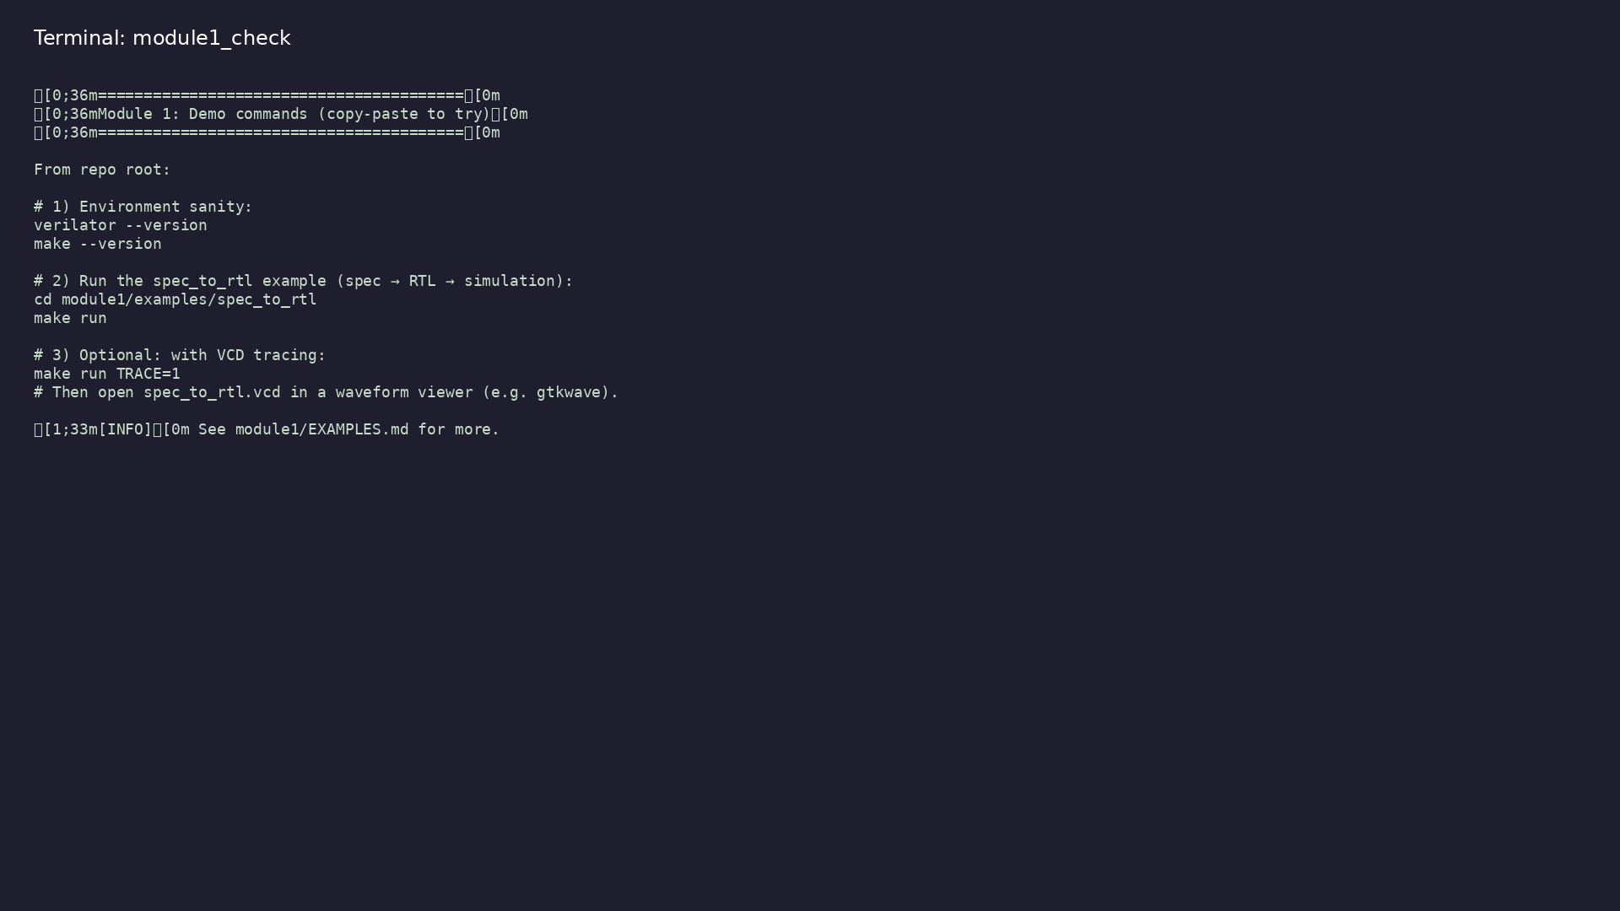
Module 1 self-check
$ ./scripts/module1.sh --help
learn_uart_spi_i2c / Module 1
Notes:
Run from course repository root.

Slide 29
Exercise scaffold
./scripts/module1.sh --scaffold
learn_uart_spi_i2c / Module 1

Slide 30
Example 1: Spec-to-RTL example
• [examples/spec_to_rtl/WALKTHROUGH.md](examples/spec_
to_rtl/WALKTHROUGH.md) — Section-by-section rea…
learn_uart_spi_i2c / Module 1
Notes:
module1/examples/examples/spec_to_rtl/README.md

Slide 31
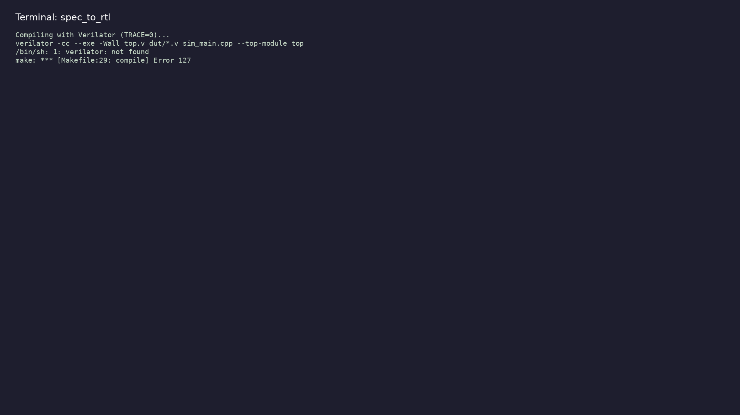
Demo: Spec-to-RTL example
$ cd module1/examples/spec_to_rtl && make run
learn_uart_spi_i2c / Module 1
Notes:
Hands-on: module1/examples/examples/spec_to_rtl/

Slide 32
Practice & assessment
learn_uart_spi_i2c / Module 1

Slide 33
What you should know
• Describe the specification → RTL flow and why a
written spec matters.
• Explain what we verify (RTL vs spec) and why (cost
of bugs, repeatability).
• Run the spec_to_rtl example (make run) and relate
SPEC.md, counter.v, and sim_main.cpp.
• Be ready for Module 2: basic testbench patterns and
UVM+SV (agents, sequences, drivers, monitors, s…
learn_uart_spi_i2c / Module 1
Notes:
From MODULE1 Learning Outcomes.

Slide 34
Exercises
• Read the spec and RTL
• Run and extend the test
• Optional: Trace
learn_uart_spi_i2c / Module 1

Slide 35
Assessment checklist
• Can explain the spec → RTL flow and the role of a
written specification.
• Can explain what we verify (RTL vs spec) and why
verification is done.
• Can run the spec_to_rtl example and describe what
SPEC.md, counter.v, and sim_main.cpp do.
• Ready to move to Module 2 (basic TB, UVM+SV,
toolchain).
learn_uart_spi_i2c / Module 1

Slide 36
Summary & next steps
• Understand the specification → RTL design flow,
design methodology, and why we verify.
• Complete module1/CHECKLIST.md
• Review module1/EXAMPLES.md and run each lab
• Next: Design & Verification Methodology (Part 2)
learn_uart_spi_i2c / Module 1

