Slide 1
Module 2
Design & Verification Methodology (Part 2)
learn_uart_spi_i2c / Module 2

Slide 2
Learning objectives
• Basic TB vs UVM: From “wiggle pins and check” to
“transaction → sequence → driver/monitor → scorebo…
• UVM building blocks: Transaction (sequence item),
sequence, driver, monitor, scoreboard, agent, env…
• Toolchain: UVM_HOME, include paths, Verilator flags
(`-sv`, `--timing`, `--trace`), and `make SIM=v…
learn_uart_spi_i2c / Module 2

Slide 3
Prerequisites
• Module 1 completed (spec → RTL flow, spec_to_rtl
example run).
• Verilator (5.036+)
• GNU Make and C++ compiler
• UVM: UVM_HOME set (must contain `src/uvm_pkg.sv`) or
vendored UVM in the repo (see uvm_smoke Makefi…
learn_uart_spi_i2c / Module 2

Slide 4
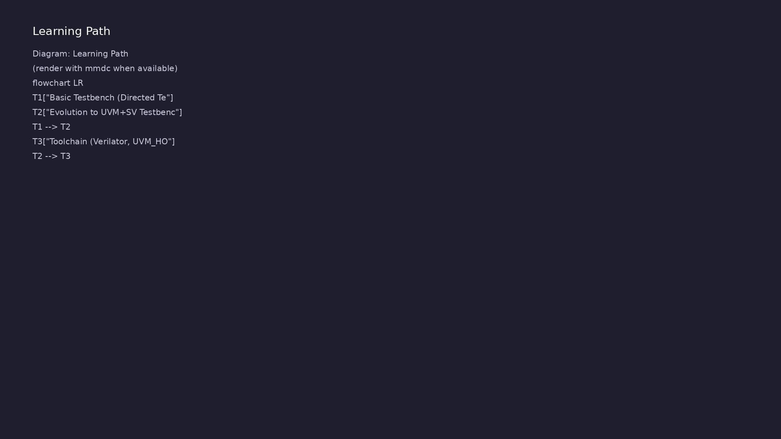
Learning path
Understand basic testbench patterns (directed tests, pin wiggling), the evolution to a UVM+SV testbench (agents, sequences, drivers, monito…
learn_uart_spi_i2c / Module 2

Slide 5
Overview
• Module 2 builds on Module 1 (spec → RTL) by focusing
on **how we verify**:
learn_uart_spi_i2c / Module 2

Slide 6
How to learn this module
learn_uart_spi_i2c / Module 2

Slide 7
Suggested learning path
• Complete Module 1 — run `spec_to_rtl` and understand
spec → RTL → directed check.
• Read this module’s Design Architecture and
Verification sections before `uvm_smoke`.
• Set UVM_HOME (or use vendored UVM under `tools/`) —
see Command Reference.
• Run `uvm_smoke` and trace one transaction from
sequence → driver → DUT → monitor → scoreboard.
learn_uart_spi_i2c / Module 2
Notes:
From docs/MODULE2.md — read guides before running demos.

Slide 8
Design architecture
learn_uart_spi_i2c / Module 2

Slide 9
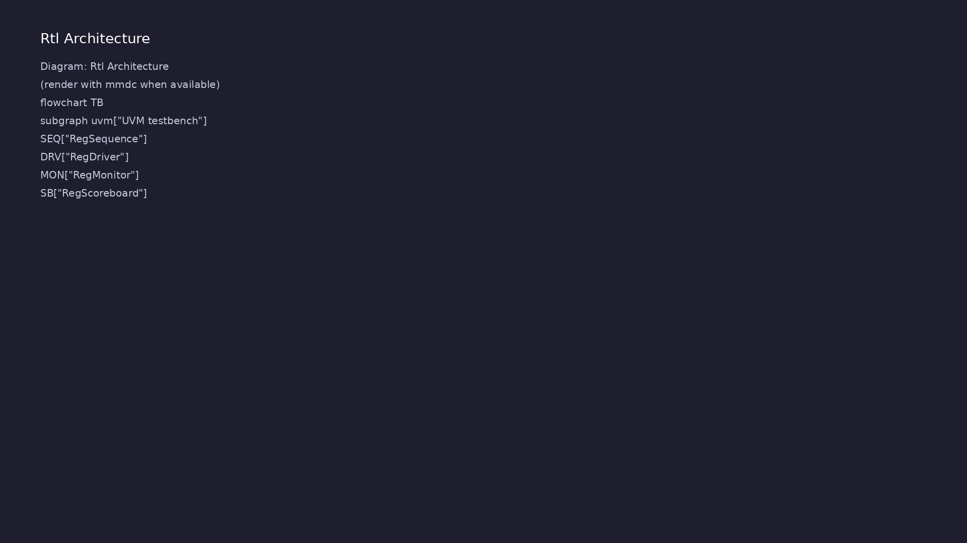
RTL / block architecture
Module 2: DUT / block hierarchy (see module2/examples/).
learn_uart_spi_i2c / Module 2

Slide 10
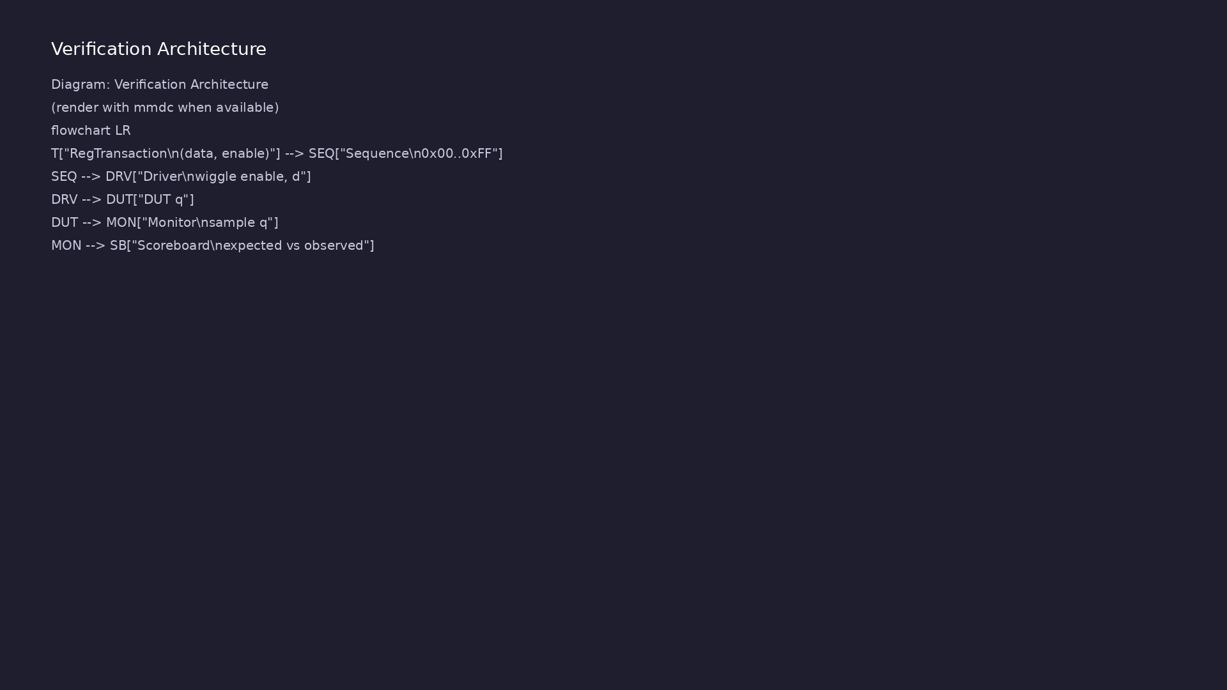
Verification environment architecture
Module 2: UVM layers, agents, and checkers for this phase.
learn_uart_spi_i2c / Module 2

Slide 11
1. DUT and interface
• simple_register.v: `enable`, `d`, `q` — minimal
storage for learning UVM data flow.
• reg_if: virtual interface bundling `clk`, `rst_n`,
`enable`, `d`, `q` for the agent.
learn_uart_spi_i2c / Module 2
Notes:
From MODULE2 Design Architecture.

Slide 12
2. UVM component hierarchy
• RegTransaction → one write operation (data + enable
+ observed q).
• RegSequence → stream of directed transactions.
• RegDriver / RegMonitor → drive pins / sample pins
each cycle.
• RegScoreboard → expected queue vs observed.
• RegAgent, RegEnv, RegTest — standard UVM layering
used again in Modules 4, 6, 8.
learn_uart_spi_i2c / Module 2
Notes:
From MODULE2 Design Architecture.

Slide 13
3. Build and simulation flow
• Verilator compiles SV + UVM + C++; `+UVM_TESTNAME`
selects the test.
• Phases: build → connect → run (objections hold
simulation until sequence completes).
learn_uart_spi_i2c / Module 2
Notes:
From MODULE2 Design Architecture.

Slide 14
Verification & testing methods
learn_uart_spi_i2c / Module 2

Slide 15
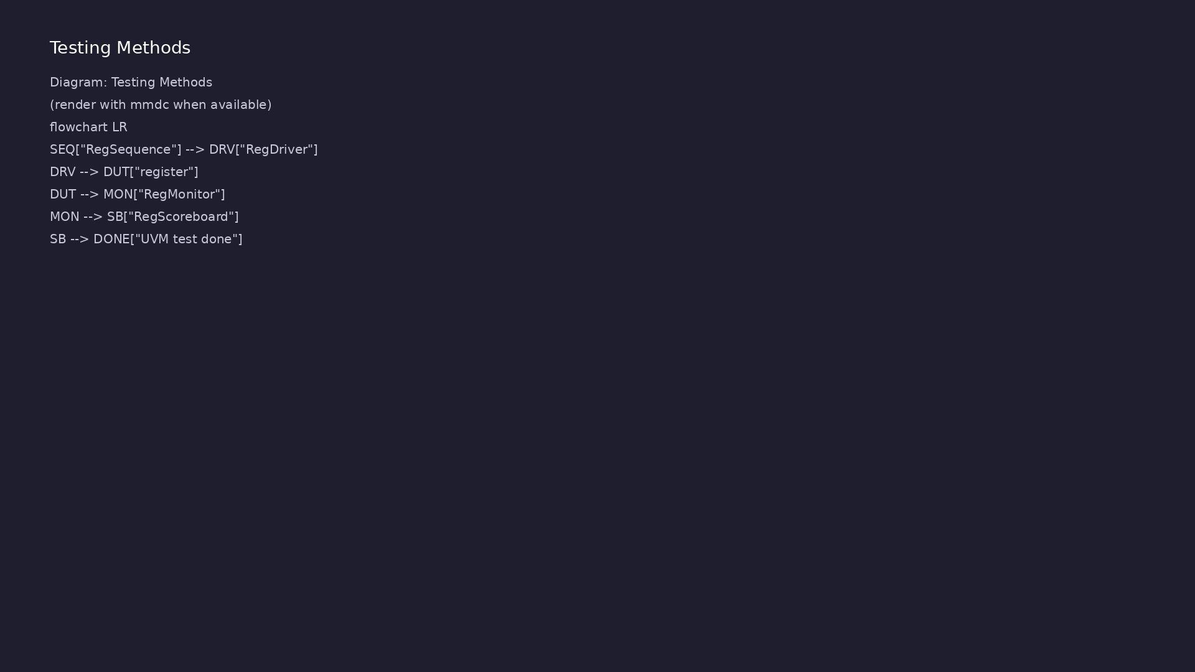
Testing and closure flow
Module 2: how tests, checks, and metrics close verification goals.
learn_uart_spi_i2c / Module 2

Slide 16
1. Transaction-level verification
• Stimulus is a transaction (what to write), not raw
pin wiggles in `initial` blocks.
• The monitor reconstructs what happened on the bus;
the scoreboard compares to expected.
learn_uart_spi_i2c / Module 2
Notes:
From MODULE2 Verification & Testing Methods.

Slide 17
2. Directed regression in uvm_smoke
• Fixed sequence: 0x00, 0x01, 0x55, 0xAA, 0xFF —
repeatable, easy to debug.
• Pass criteria: scoreboard reports matches, zero
mismatches.
learn_uart_spi_i2c / Module 2
Notes:
From MODULE2 Verification & Testing Methods.

Slide 18
3. Skills you reuse on UART/SPI/I²C
• Same agent pattern; only the transaction and
protocol timing in driver/monitor change.
• Read UVM log lines: DRIVER, MONITOR, SCOREBOARD,
final summary.
learn_uart_spi_i2c / Module 2
Notes:
From MODULE2 Verification & Testing Methods.

Slide 19
Syllabus topics
learn_uart_spi_i2c / Module 2

Slide 20
1. Basic Testbench (Directed Tests, Pin Wiggling)
• Directed test: Drive specific inputs (e.g., reset,
then a fixed sequence of data) and check expecte…
• Pin wiggling: The testbench directly drives and
samples DUT pins (clock, reset, data, enable) — no…
learn_uart_spi_i2c / Module 2
Notes:
From MODULE2 Topics Covered.

Slide 21
2. Evolution to UVM+SV Testbench
• Sequence: Produces a stream of transactions (e.g., a
few directed values: 0x00, 0x01, 0x55, 0xAA, 0…
• Driver: Gets transactions from the sequencer and
drives the DUT interface (e.g., set enable and d o…
• Monitor: Observes the DUT interface and turns pin
activity into transactions, then sends them to th…
• Scoreboard: Compares “expected” (what we sent) vs
“observed” (what the monitor saw). Reports matche…
• Agent: Groups driver, monitor, and sequencer for one
interface. Env: Contains agent(s) and scoreboa…
learn_uart_spi_i2c / Module 2
Notes:
From MODULE2 Topics Covered.

Slide 22
3. Toolchain (Verilator, UVM_HOME, Make)
• Verilator: Compiles SystemVerilog (including UVM) +
C++ into an executable. Key flags: `-sv`, `--ti…
• UVM_HOME: Points to the UVM library root; the build
uses `$(UVM_HOME)/src/uvm_pkg.sv` and `+incdir+…
• Make: One target to compile (Verilator + make in
obj_dir), one to run (`./obj_dir/Vtest_uvm_smoke +…
learn_uart_spi_i2c / Module 2
Notes:
From MODULE2 Topics Covered.

Slide 23
Command reference highlights
learn_uart_spi_i2c / Module 2

Slide 24
Environment checks
• verilator --version
learn_uart_spi_i2c / Module 2
Notes:
Full detail in docs/MODULE2.md command reference.

Slide 25
Build and run uvm_smoke
• cd module2/examples/uvm_smoke
learn_uart_spi_i2c / Module 2
Notes:
Full detail in docs/MODULE2.md command reference.

Slide 26
Module script (from repo root)
• ./scripts/module2.sh --check # Environment + UVM +
example dirs
learn_uart_spi_i2c / Module 2
Notes:
Full detail in docs/MODULE2.md command reference.

Slide 27
Hands-on examples
learn_uart_spi_i2c / Module 2

Slide 28
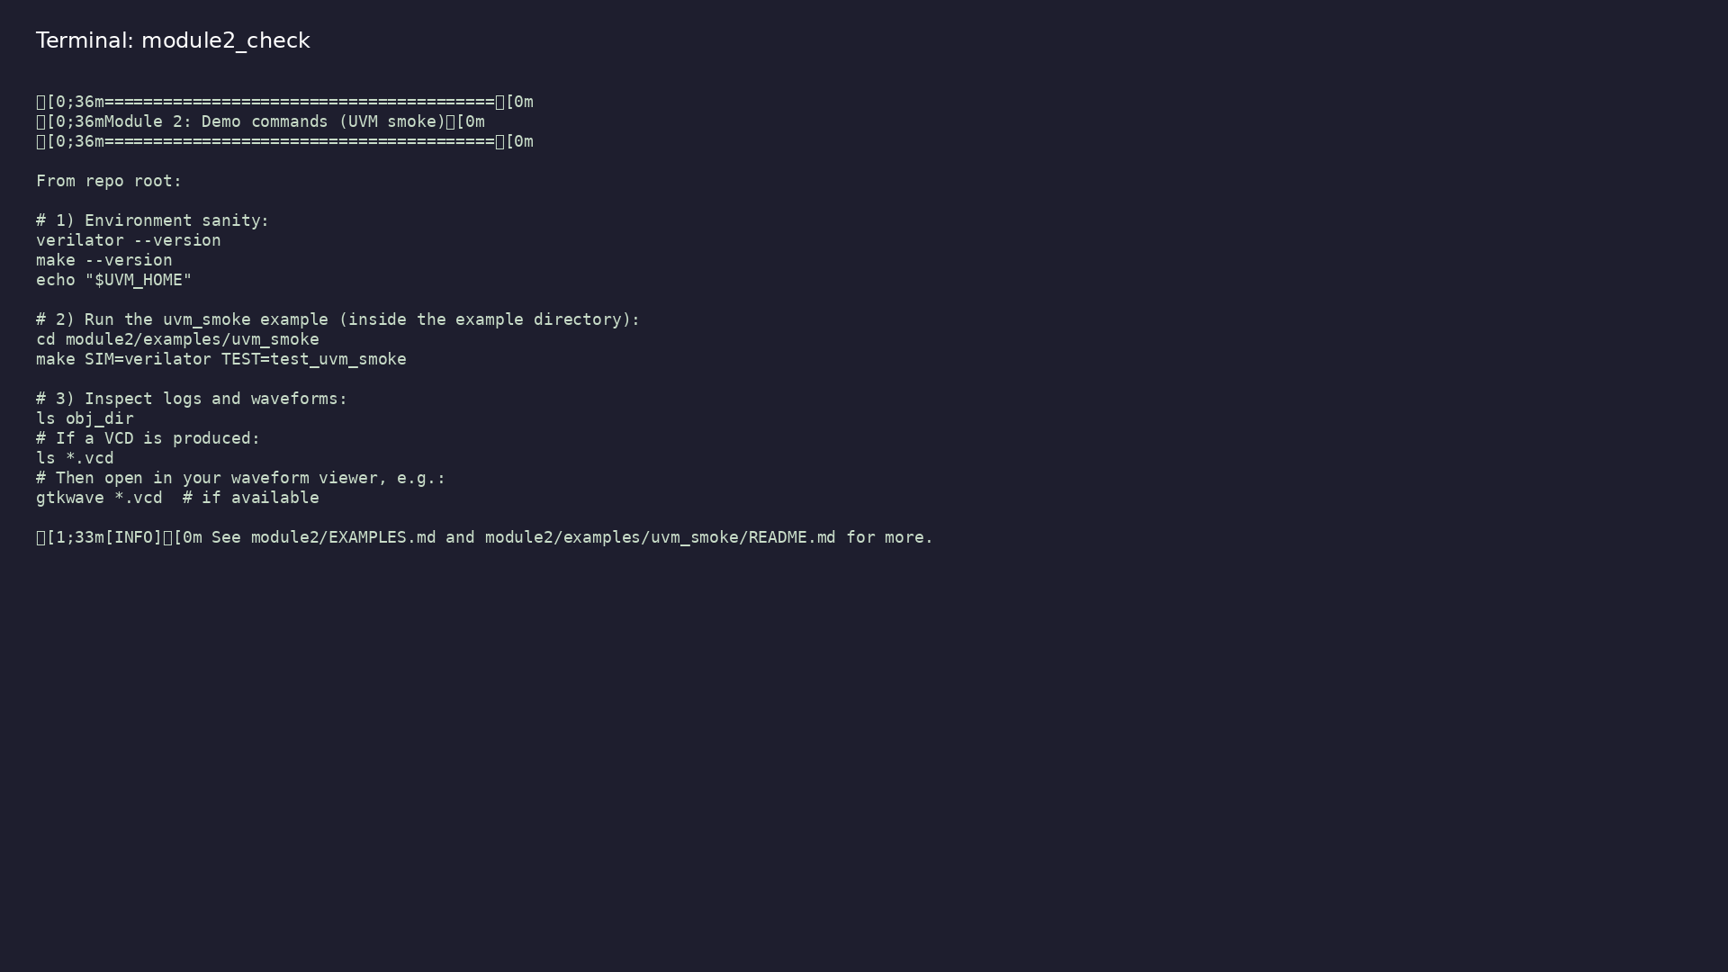
Module 2 self-check
$ ./scripts/module2.sh --help
learn_uart_spi_i2c / Module 2
Notes:
Run from course repository root.

Slide 29
Exercise scaffold
./scripts/module2.sh --scaffold
learn_uart_spi_i2c / Module 2

Slide 30
Example 1: UVM smoke test
• UVM phases and reporting (DRIVER, MONITOR,
SCOREBOARD messages).
• Directed sequence: a few data values (0x00, 0x01,
0x55, 0xAA, 0xFF) driven and checked.
• Final scoreboard summary (matches/mismatches).
learn_uart_spi_i2c / Module 2
Notes:
module2/examples/examples/uvm_smoke/README.md

Slide 31
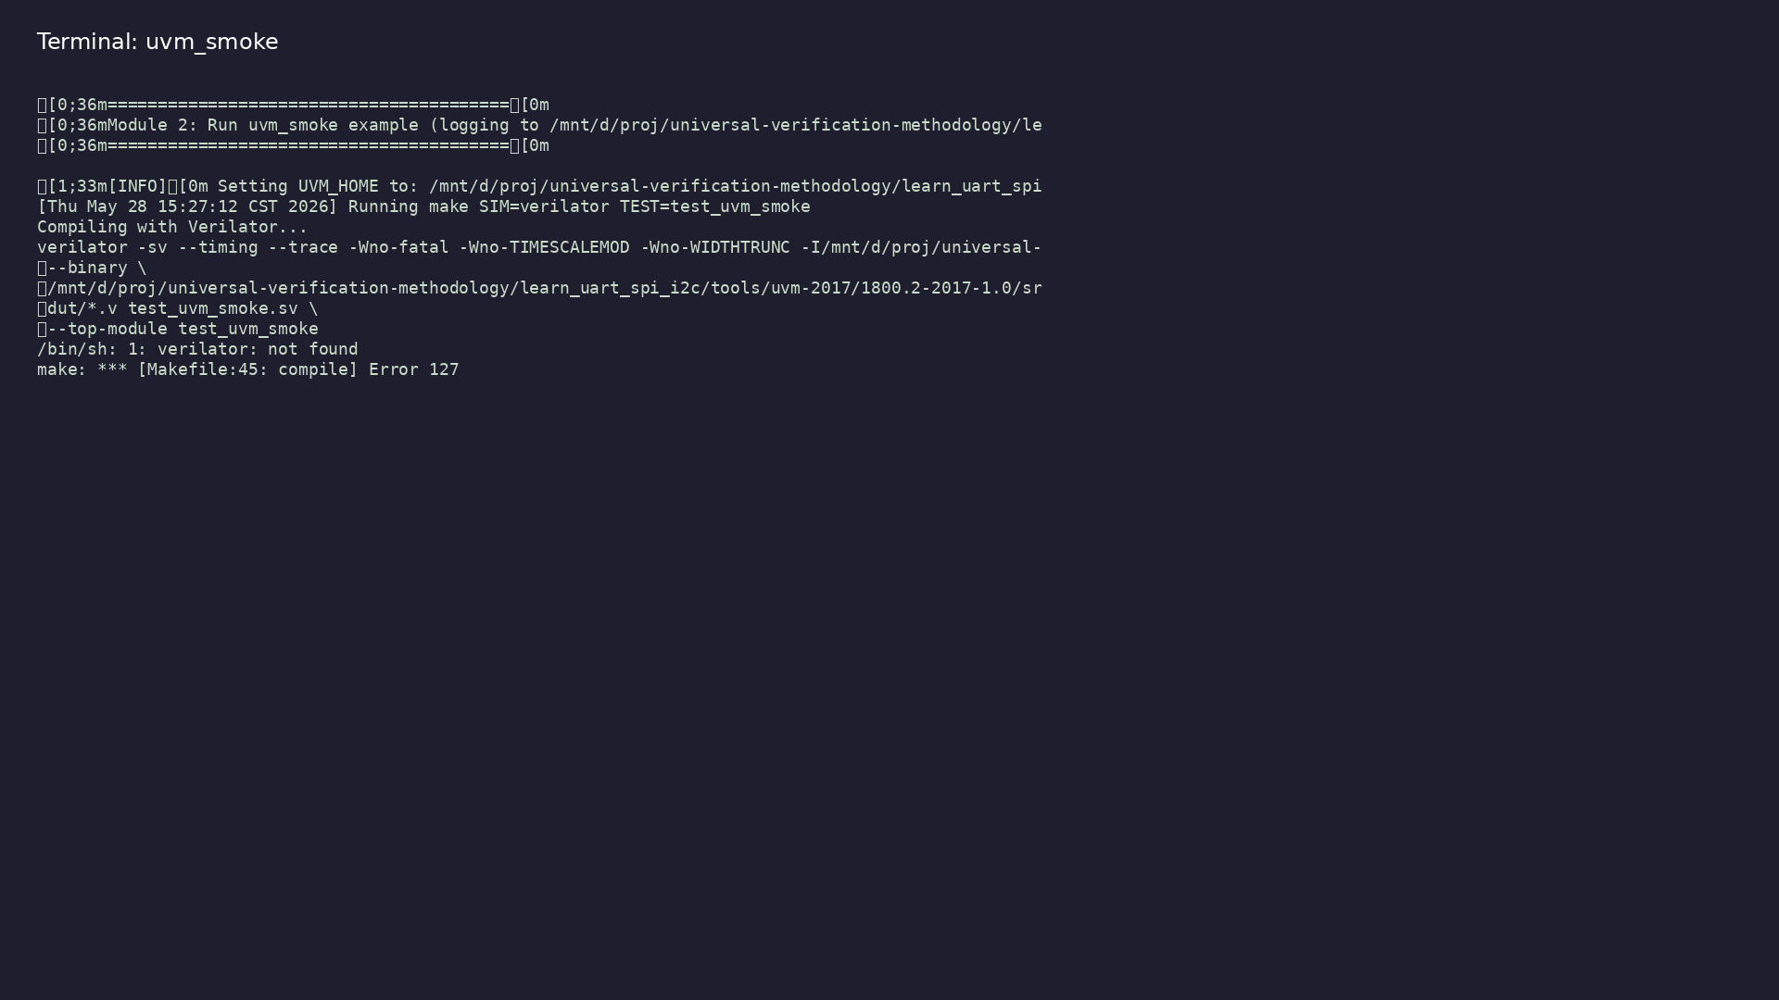
Demo: UVM smoke test
$ ./scripts/module2.sh --run
learn_uart_spi_i2c / Module 2
Notes:
Hands-on: module2/examples/examples/uvm_smoke/

Slide 32
Practice & assessment
learn_uart_spi_i2c / Module 2

Slide 33
What you should know
• Explain basic testbench (directed tests, pin
wiggling) and how it evolves into UVM (transaction,
se…
• Describe the role of transaction, sequence, driver,
monitor, scoreboard, agent, env, and test in a…
• Run the uvm_smoke example (make SIM=verilator
TEST=test_uvm_smoke) and interpret UVM output.
• Use the toolchain: Verilator, UVM_HOME, Make; know
why `-sv`, `--timing`, and include paths are nee…
• Be ready for Module 3: UART protocol + RTL + basic
(non-UVM) testbench.
learn_uart_spi_i2c / Module 2
Notes:
From MODULE2 Learning Outcomes.

Slide 34
Exercises
• Run uvm_smoke
• Traceability
• Change the sequence
• Optional: Waveforms
learn_uart_spi_i2c / Module 2

Slide 35
Assessment checklist
• Can explain basic TB vs UVM (transaction, sequence,
driver, monitor, scoreboard).
• Can describe the role of UVM_HOME, Verilator flags,
and Make in building/running a UVM test.
• Can run uvm_smoke and interpret the output.
• Ready to move to Module 3 (UART protocol + RTL +
basic testbench).
learn_uart_spi_i2c / Module 2

Slide 36
Summary & next steps
• Understand basic testbench patterns (directed tests,
pin wiggling), the evolution to a UVM+SV testb…
• Complete module2/CHECKLIST.md
• Review module2/EXAMPLES.md and run each lab
• Next: UART
learn_uart_spi_i2c / Module 2

