Slide 1
Module 3
UART — Protocol + RTL + Basic Testbench
learn_uart_spi_i2c / Module 3

Slide 2
Learning objectives
• UART 8N1: Start bit (0), 8 data bits (LSB first),
stop bit (1); idle high.
• Baud rate: Role of a baud generator (clock divider →
baud_tick).
• RTL architecture: TX (parallel→serial, shift per
baud_tick), RX (start detect, sample, data_valid),…
• Basic TB: Loopback, directed stimulus, and checking
without UVM.
learn_uart_spi_i2c / Module 3

Slide 3
Prerequisites
• Module 1 (spec → RTL) and Module 2 (basic TB → UVM,
toolchain).
• Verilator, Make, C++ compiler. No UVM required for
the uart_baseline example.
learn_uart_spi_i2c / Module 3

Slide 4
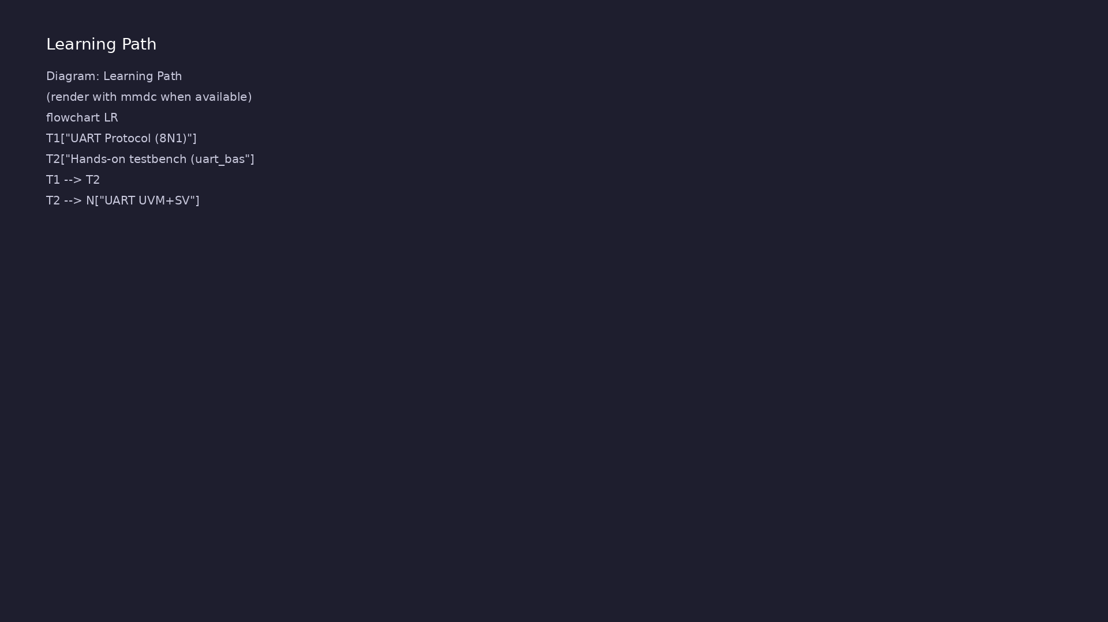
Learning path
Understand the UART protocol (8N1, baud), translate it to RTL (TX, RX, baud gen), and verify with a **basic** (non-UVM) directed testbench.
learn_uart_spi_i2c / Module 3

Slide 5
Overview
• Module 3 is the first **protocol** module:
learn_uart_spi_i2c / Module 3

Slide 6
How to learn this module
learn_uart_spi_i2c / Module 3

Slide 7
Suggested learning path
• Read the detailed UART learning guide:
UART_LEARNING_GUIDE.md — what UART is, what kind of
protocol…
• Read the protocols + UVM overview:
LEARNING_GUIDE_PROTOCOLS_AND_UVM.md — Part B § 4.
When to Use Ba…
learn_uart_spi_i2c / Module 3
Notes:
From docs/MODULE3.md — read guides before running demos.

Slide 8
Design architecture
learn_uart_spi_i2c / Module 3

Slide 9
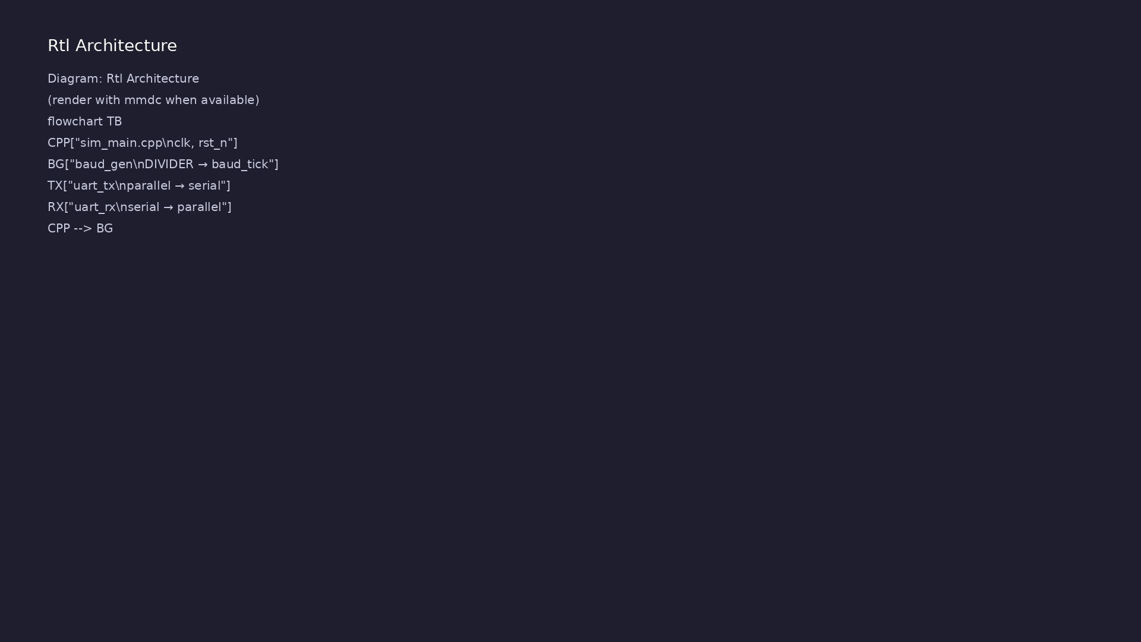
RTL / block architecture
Module 3: DUT / block hierarchy (see module3/examples/).
learn_uart_spi_i2c / Module 3

Slide 10
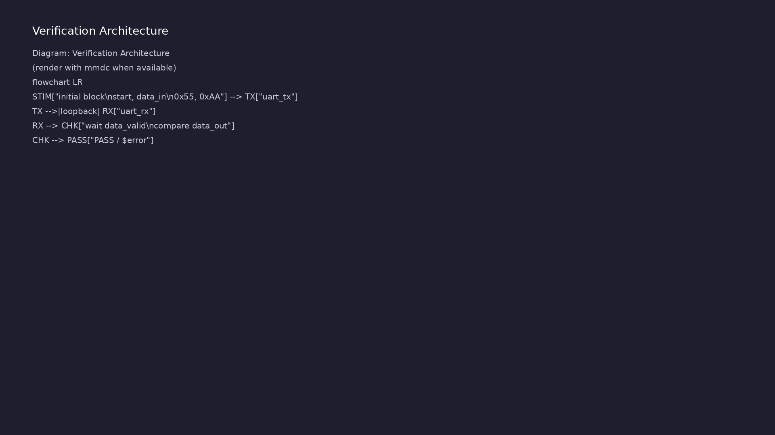
Verification environment architecture
Module 3: UVM layers, agents, and checkers for this phase.
learn_uart_spi_i2c / Module 3

Slide 11
1. Block hierarchy
• top_uart_baseline → `baud_gen`, `uart_tx`,
`uart_rx`; sim_main.cpp drives `clk`/`rst_n` only.
• Loopback: `assign rx = tx` — one wire connects
transmitter to receiver.
learn_uart_spi_i2c / Module 3
Notes:
From MODULE3 Design Architecture.

Slide 12
2. RTL blocks
• baud_gen: `DIVIDER` → `baud_tick` every N clocks;
shared by TX and RX.
• uart_tx: parallel-in / serial-out; start + 8 data
(LSB first) + stop; `busy` during frame.
• uart_rx: start detect, sample per `baud_tick`,
`data_valid` + optional `framing_error`.
learn_uart_spi_i2c / Module 3
Notes:
From MODULE3 Design Architecture.

Slide 13
3. Timing and clocking
• Single `clk` domain; async `rst_n`; all bit times
referenced to `baud_tick`.
learn_uart_spi_i2c / Module 3
Notes:
From MODULE3 Design Architecture.

Slide 14
Verification & testing methods
learn_uart_spi_i2c / Module 3

Slide 15
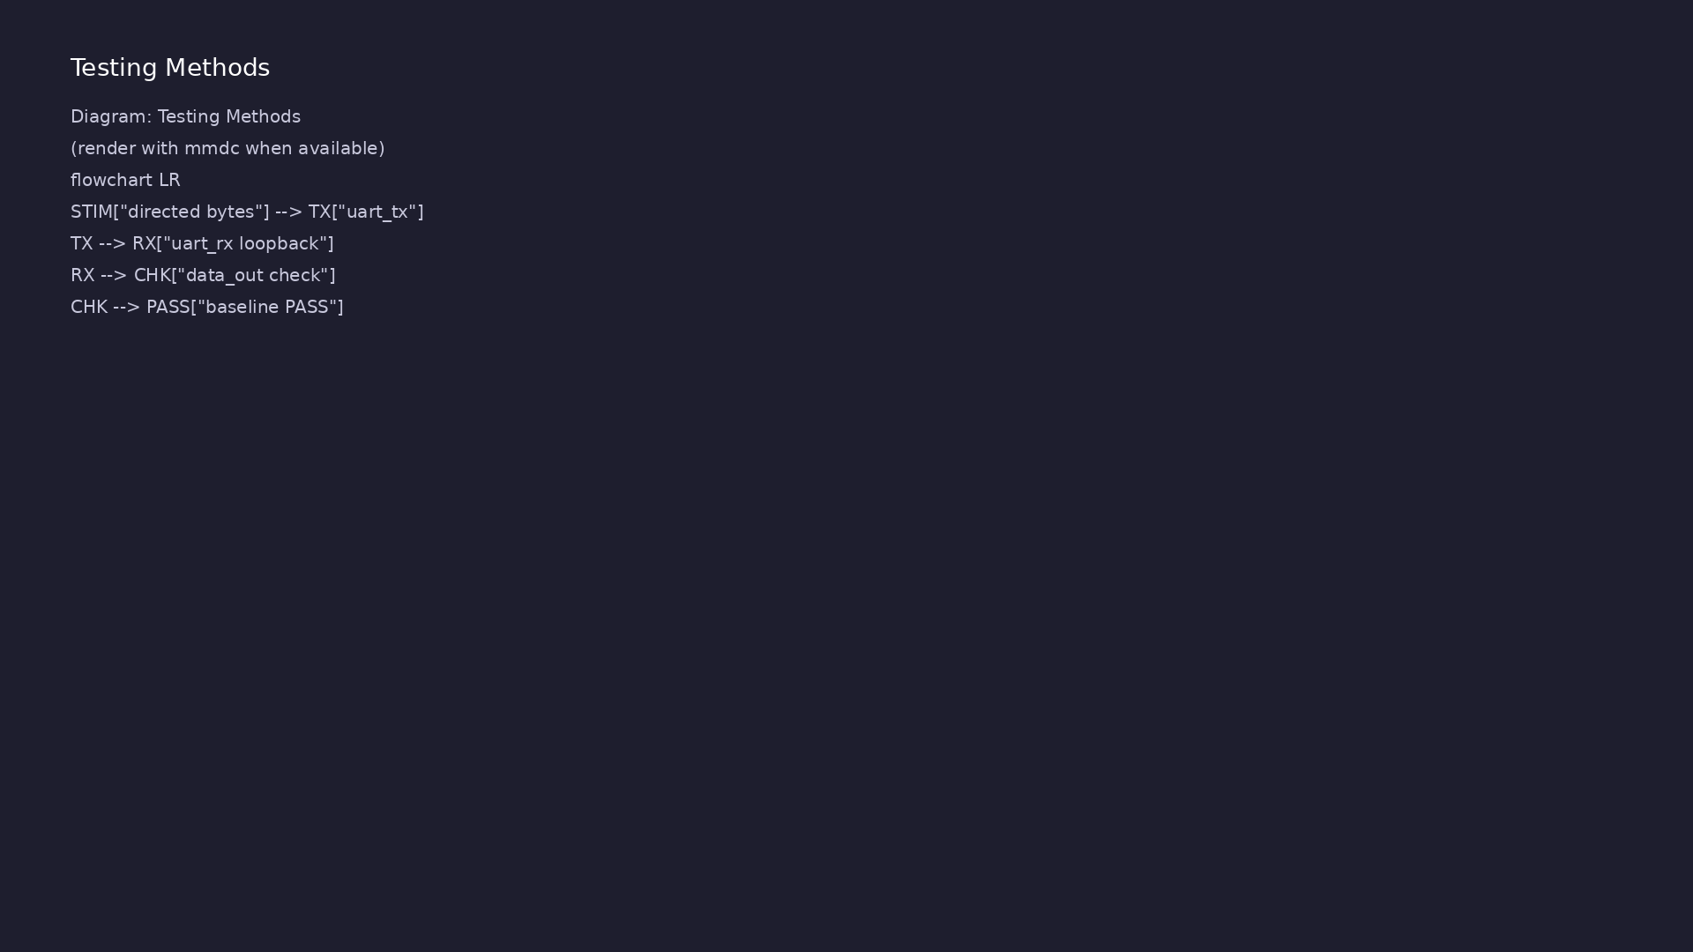
Testing and closure flow
Module 3: how tests, checks, and metrics close verification goals.
learn_uart_spi_i2c / Module 3

Slide 16
1. Verification goals
• Prove RTL implements UART 8N1 before UVM (Module 4).
• Happy-path loopback: bytes sent on TX appear
correctly on RX.
learn_uart_spi_i2c / Module 3
Notes:
From MODULE3 Verification & Testing Methods.

Slide 17
2. Baseline directed test
• Stimulus: `initial` block — `start`, `data_in`
(0x55, 0xAA).
• Check: `wait(data_valid)`; compare `data_out`;
`$error` / `$display`.
• No UVM: pin wiggling only — fastest way to learn the
protocol on real RTL.
learn_uart_spi_i2c / Module 3
Notes:
From MODULE3 Verification & Testing Methods.

Slide 18
3. Coverage gaps (defer to Module 4)
• Random baud, framing errors, `busy` back-to-back,
functional coverage.
• Map checks to
[UART_LEARNING_GUIDE.md](UART_LEARNING_GUIDE.md)
spec bullets.
learn_uart_spi_i2c / Module 3
Notes:
From MODULE3 Verification & Testing Methods.

Slide 19
Syllabus topics
learn_uart_spi_i2c / Module 3

Slide 20
1. UART Protocol (8N1) (1/4)
• Signals: Serial line (tx/rx), idle high; system
clock; baud_tick (one pulse per bit time).
• Frame: 1 start bit (0), 8 data bits (LSB first), 1
stop bit (1).
• Timing: One bit per baud_tick; baud_tick derived
from system clock via a divider (e.g. DIVIDER = cl…
• Framing: `idle=1` → `start=0` → 8 data bits (LSB
first) → `stop=1`.
• Baud math: `DIVIDER = round(clk_hz / baud)`.
Example: 50 MHz clock, 115200 baud → divider ≈ 434.
• Reset state: Line idles high, TX not busy, RX clears
internal shift register, `data_valid` low.
learn_uart_spi_i2c / Module 3
Notes:
From MODULE3 Topics Covered.

Slide 21
1. UART Protocol (8N1) (2/4)
• Errors: `framing_error` when stop bit is not high at
expected sample; optional `parity_error` if pa…
• Inputs: `clk`, `rst_n`, `baud_tick`, `start`,
`data_in[7:0]`.
• Outputs: `tx`, `busy`.
• Behavior: On `start`, latch `data_in`, drive start
bit low, then shift out bits [0:7] each `baud_ti…
• Edge cases: Ignore `start` while `busy` (or queue it
in a FIFO if you extend the design).
• Inputs: `clk`, `rst_n`, `baud_tick`, `rx`.
learn_uart_spi_i2c / Module 3
Notes:
From MODULE3 Topics Covered.

Slide 22
1. UART Protocol (8N1) (3/4)
• Outputs: `data_out[7:0]`, `data_valid` (pulse),
`framing_error`.
• Robustness options: Add metastability sync on `rx`;
add oversampling + majority vote; add `rx_ready…
• Inputs: `clk`, `rst_n`, `divisor` (constant
parameter in the baseline).
• Output: `baud_tick` high for one cycle every
`divisor` clocks.
• For synthesis, keep the counter simple (`divisor-1`
down-counter or up-counter compare). For sim, y…
• Data bits: 5–9 data bits are common.
learn_uart_spi_i2c / Module 3
Notes:
From MODULE3 Topics Covered.

Slide 23
1. UART Protocol (8N1) (4/4)
• Parity: Even/odd/mark/space; adds a parity bit
before stop.
• Stop bits: 1 or 2 stop bits.
• Flow control: RTS/CTS hardware pins (outside the
serial line) to throttle traffic.
• The baseline RTL assumes 8N1 with no parity and no
flow control.
learn_uart_spi_i2c / Module 3
Notes:
From MODULE3 Topics Covered.

Slide 24
2. Hands-on testbench (uart_baseline)
• Loopback: Connect TX output to RX input; send bytes
from TX, check they appear on RX.
• Directed test: Reset release, send 0x55 and 0xAA,
wait for `data_valid`, check `data_out`. Implemen…
• Self-check flow: `wait(rst_n)` → pulse
`start`/`data_in` → `wait(!busy)` →
`wait(data_valid)` → com…
learn_uart_spi_i2c / Module 3
Notes:
From MODULE3 Topics Covered.

Slide 25
Hands-on examples
learn_uart_spi_i2c / Module 3

Slide 26
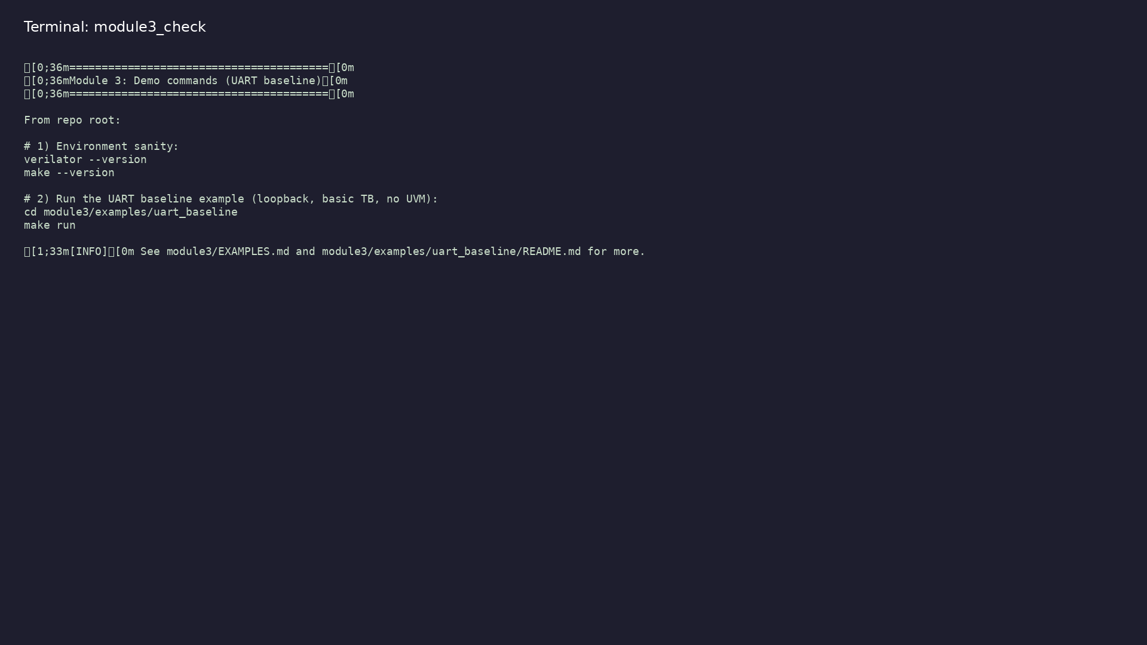
Module 3 self-check
$ ./scripts/module3.sh --help
learn_uart_spi_i2c / Module 3
Notes:
Run from course repository root.

Slide 27
Exercise scaffold
./scripts/module3.sh --scaffold
learn_uart_spi_i2c / Module 3

Slide 28
Example 1: UART baseline
• `dut/`: `uart_tx.v`, `uart_rx.v`, `baud_gen.v`
• `top_uart_baseline.sv`: Top with loopback; directed
stimulus and checks in initial blocks.
• `sim_main.cpp`: C++ harness (clock, reset);
simulation runs until `$finish`.
learn_uart_spi_i2c / Module 3
Notes:
module3/examples/examples/uart_baseline/README.md

Slide 29
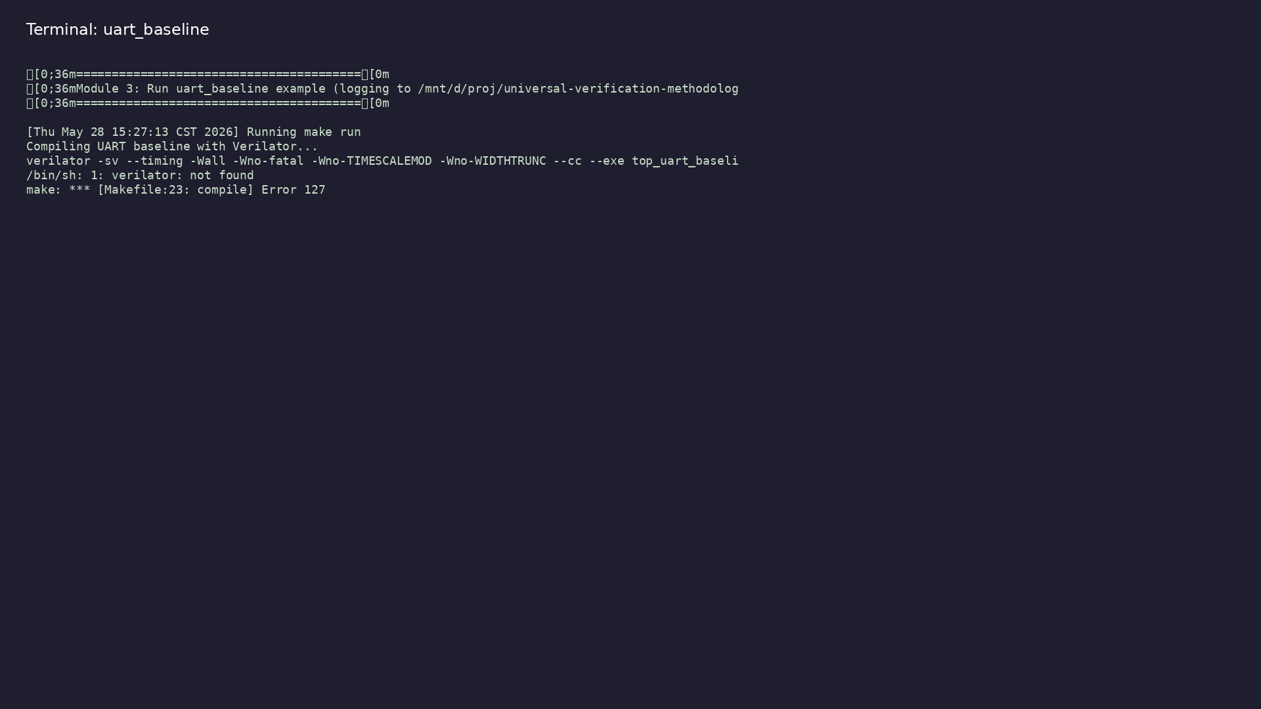
Demo: UART baseline
$ ./scripts/module3.sh --run
learn_uart_spi_i2c / Module 3
Notes:
Hands-on: module3/examples/examples/uart_baseline/

Slide 30
Practice & assessment
learn_uart_spi_i2c / Module 3

Slide 31
What you should know
• Describe UART 8N1 frame and baud timing.
• Explain the role of uart_tx, uart_rx, and baud_gen.
• Run the uart_baseline example and interpret the
loopback test.
• Ready for Module 4: UART UVM+SV verification.
learn_uart_spi_i2c / Module 3
Notes:
From MODULE3 Learning Outcomes.

Slide 32
Exercises
• Run uart_baseline
• Trace one byte
• Baud and divider
• Optional: Waveforms
learn_uart_spi_i2c / Module 3

Slide 33
Assessment checklist
• Can describe UART 8N1 (start bit, 8 data LSB first,
stop bit) and the role of baud_tick.
• Can explain the role of uart_tx, uart_rx, and
baud_gen in the RTL.
• Can run uart_baseline and interpret the loopback
test result.
• Ready for Module 4: UART UVM+SV verification.
learn_uart_spi_i2c / Module 3

Slide 34
Summary & next steps
• Understand the UART protocol (8N1, baud), translate
it to RTL (TX, RX, baud gen), and verify with a…
• Complete module3/CHECKLIST.md
• Review module3/EXAMPLES.md and run each lab
• Next: UART UVM+SV
learn_uart_spi_i2c / Module 3

