Slide 1
Module 4
UART — UVM+SV Verification
learn_uart_spi_i2c / Module 4

Slide 2
Learning objectives
• UART UVM agent: Transaction (UartTxTransaction),
sequence (UartTxSequence), driver (UartTxDriver),…
• Interface: uart_tx_if (clk, rst_n, start, data, tx,
baud_tick) connects UVM to DUT.
• Loopback check: TX path (driver → DUT → monitor →
scoreboard) and RX path (DUT rx_valid/rx_data → s…
learn_uart_spi_i2c / Module 4

Slide 3
Prerequisites
• Module 1 (spec → RTL), Module 2 (UVM+SV, uvm_smoke),
Module 3 (UART protocol + RTL + basic TB).
• Verilator, Make, C++ compiler, UVM (UVM_HOME or
vendored UVM).
learn_uart_spi_i2c / Module 4

Slide 4
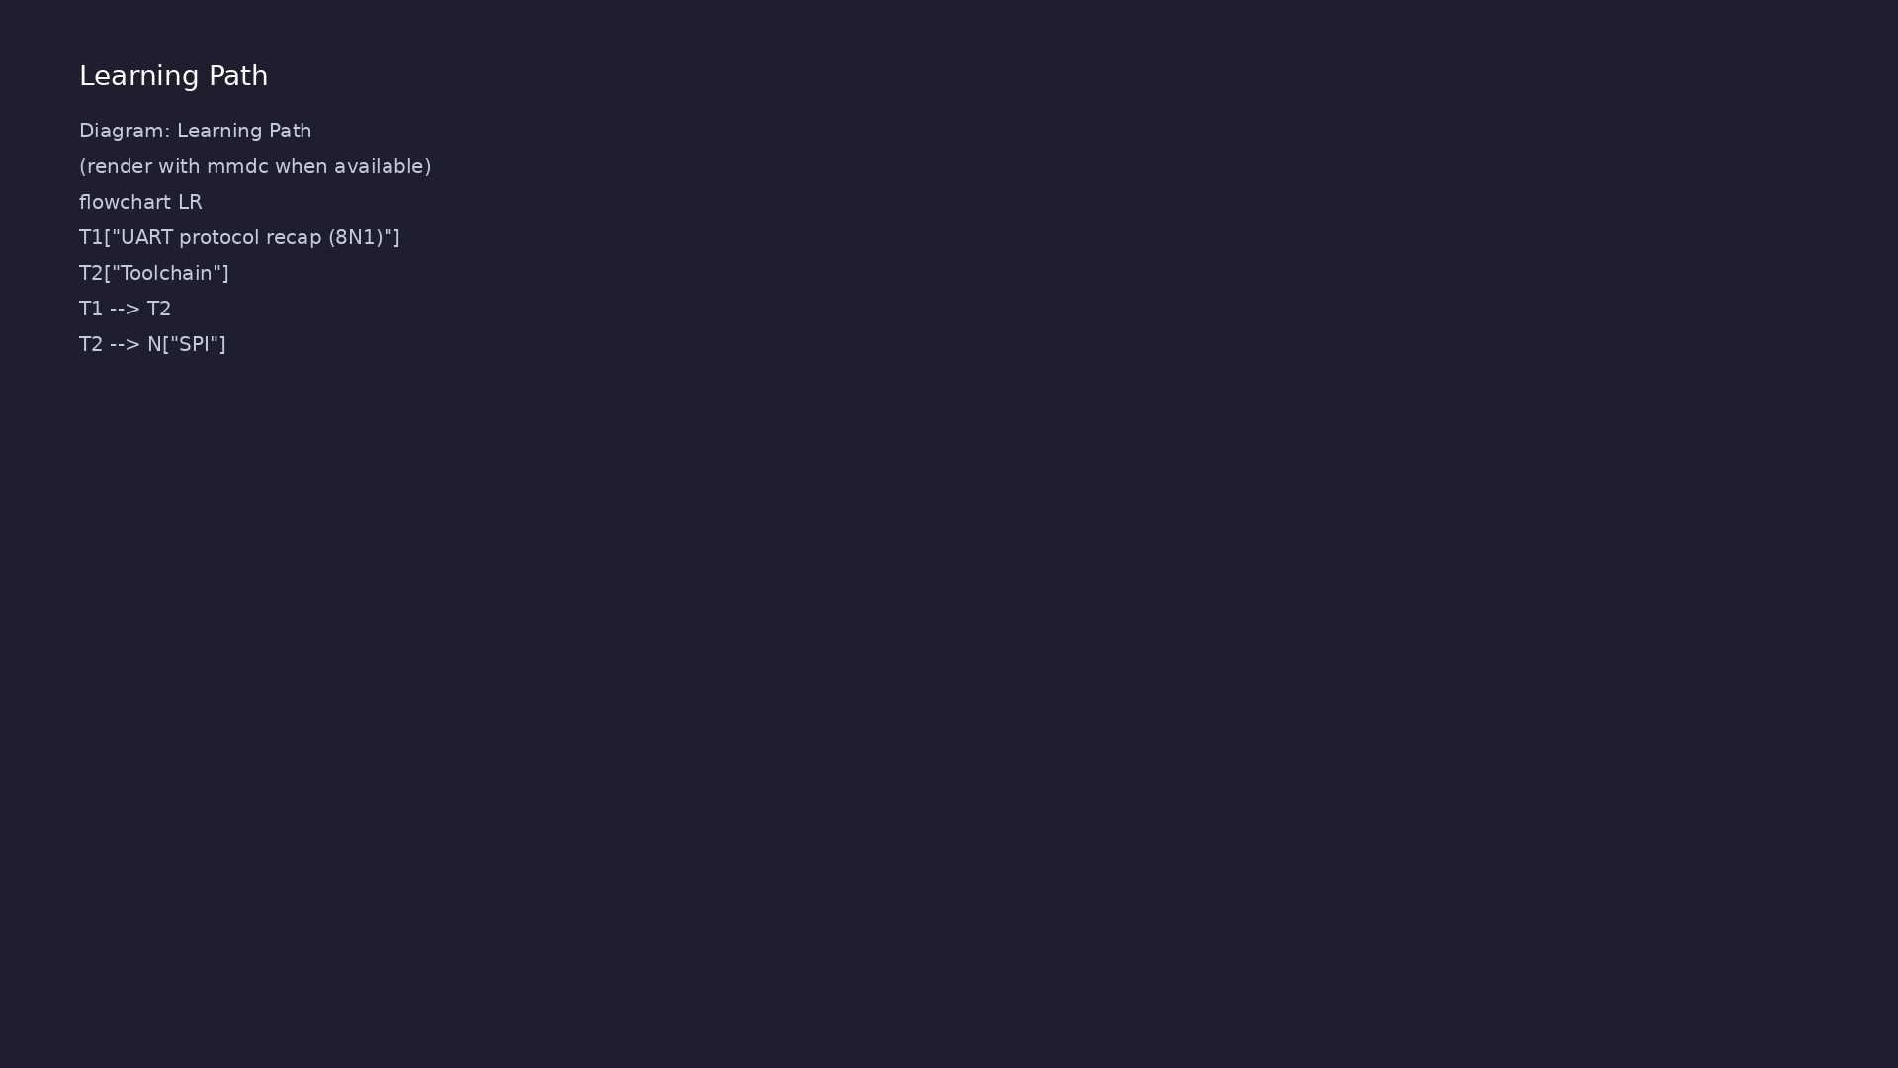
Learning path
Extend UART verification to **UVM+SV** — UART agent (transaction, sequence, driver, monitor, scoreboard); run on Verilator.
learn_uart_spi_i2c / Module 4

Slide 5
Overview
• Module 4 builds on Module 3 (UART protocol + RTL +
basic testbench):
learn_uart_spi_i2c / Module 4

Slide 6
How to learn this module
learn_uart_spi_i2c / Module 4

Slide 7
Suggested learning path
• Read the detailed UART learning guide:
UART_LEARNING_GUIDE.md — what UART is, how it works
(frame,…
• Read the protocols + UVM overview:
LEARNING_GUIDE_PROTOCOLS_AND_UVM.md — Part B § 5.
How UVM Maps t…
learn_uart_spi_i2c / Module 4
Notes:
From docs/MODULE4.md — read guides before running demos.

Slide 8
Design architecture
learn_uart_spi_i2c / Module 4

Slide 9
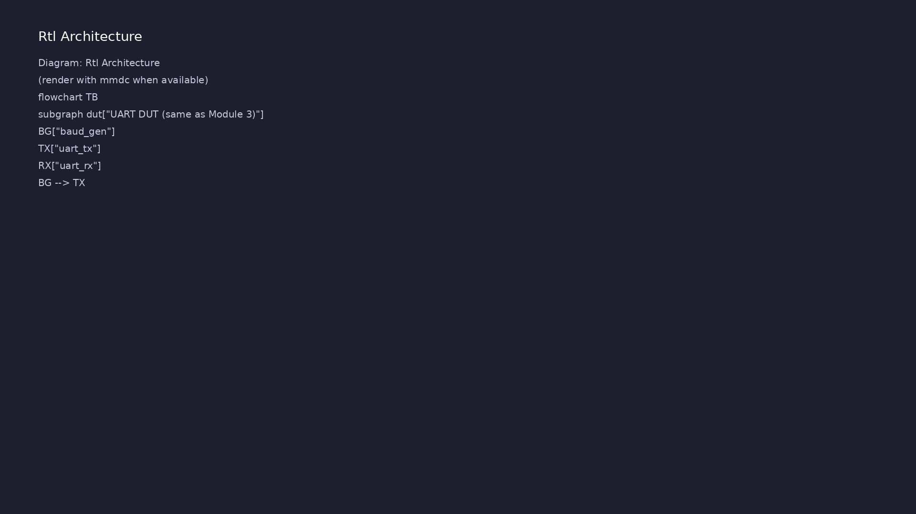
RTL / block architecture
Module 4: DUT / block hierarchy (see module4/examples/).
learn_uart_spi_i2c / Module 4

Slide 10
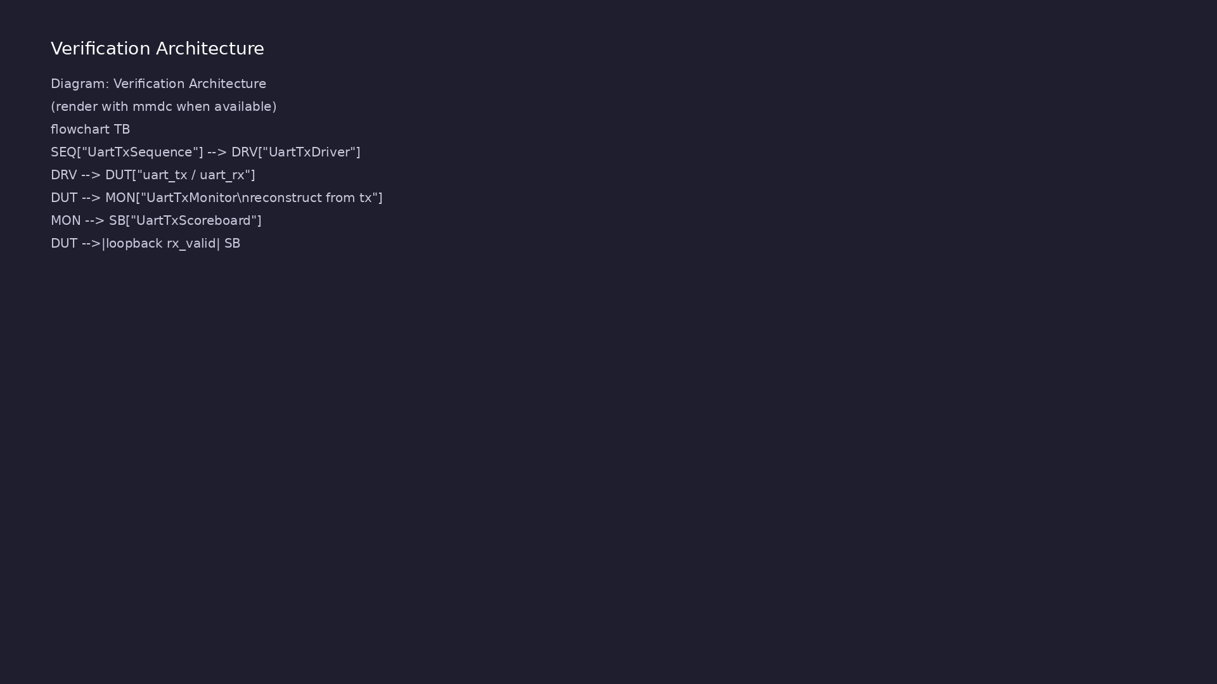
Verification environment architecture
Module 4: UVM layers, agents, and checkers for this phase.
learn_uart_spi_i2c / Module 4

Slide 11
1. UART DUT (reused from Module 3)
• dut/: `uart_tx`, `uart_rx`, `baud_gen` — identical
RTL to `uart_baseline`.
• Loopback in top: `rx = tx` for closed-loop checking.
• Why reuse: Upgrade verification (UVM) without
touching proven RTL.
learn_uart_spi_i2c / Module 4
Notes:
From MODULE4 Design Architecture.

Slide 12
2. UVM testbench hierarchy
• uart_tx_if: virtual interface for driver/monitor.
• UartTxTransaction / Sequence / Driver / Monitor /
Scoreboard / Agent / Env / Test — same pattern as…
• Monitor reconstructs bytes from the serial `tx` line
using UART 8N1 rules.
learn_uart_spi_i2c / Module 4
Notes:
From MODULE4 Design Architecture.

Slide 13
3. Dual check paths
• TX path: sequence → driver → DUT → monitor →
scoreboard (`observed_tx`).
• RX path: loopback into `uart_rx`; `check_rx_byte()`
when `data_valid` asserts.
learn_uart_spi_i2c / Module 4
Notes:
From MODULE4 Design Architecture.

Slide 14
Verification & testing methods
learn_uart_spi_i2c / Module 4

Slide 15
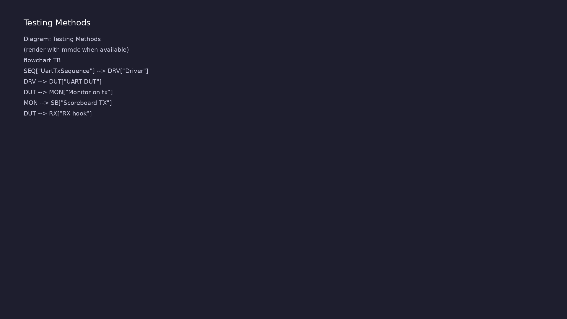
Testing and closure flow
Module 4: how tests, checks, and metrics close verification goals.
learn_uart_spi_i2c / Module 4

Slide 16
1. Directed UART regression
• Sequence sends 0x00, 0x01, 0x55, 0xAA, 0xFF —
repeatable regression before randomization.
learn_uart_spi_i2c / Module 4
Notes:
From MODULE4 Verification & Testing Methods.

Slide 17
2. Scoreboard strategy
• Expected queue loaded in test; compare to monitor-
reconstructed TX and to RX hook data.
• Fail fast on mismatch; read UVM SCOREBOARD summary
at end of run.
learn_uart_spi_i2c / Module 4
Notes:
From MODULE4 Verification & Testing Methods.

Slide 18
3. What to add next
• Random baud, framing-error injection, coverage on
`busy` / `data_valid`.
• See [LEARNING_GUIDE_PROTOCOLS_AND_UVM.md §
6](LEARNING_GUIDE_PROTOCOLS_AND_UVM.md#6-uart-uvm-
mappin…
learn_uart_spi_i2c / Module 4
Notes:
From MODULE4 Verification & Testing Methods.

Slide 19
Syllabus topics
learn_uart_spi_i2c / Module 4

Slide 20
1. UART protocol recap (8N1)
• One byte = start (0) + 8 data (LSB first) + stop
(1); `baud_tick` times each bit.
• Driver/monitor must follow the same rules as the
RTL.
learn_uart_spi_i2c / Module 4
Notes:
From MODULE4 Topics Covered.

Slide 21
2. Toolchain
• Verilator `-sv`, `--timing`, UVM includes; `make
SIM=verilator TEST=test_uart_uvm`; `+UVM_TESTNAME=…
learn_uart_spi_i2c / Module 4
Notes:
From MODULE4 Topics Covered.

Slide 22
Hands-on examples
learn_uart_spi_i2c / Module 4

Slide 23
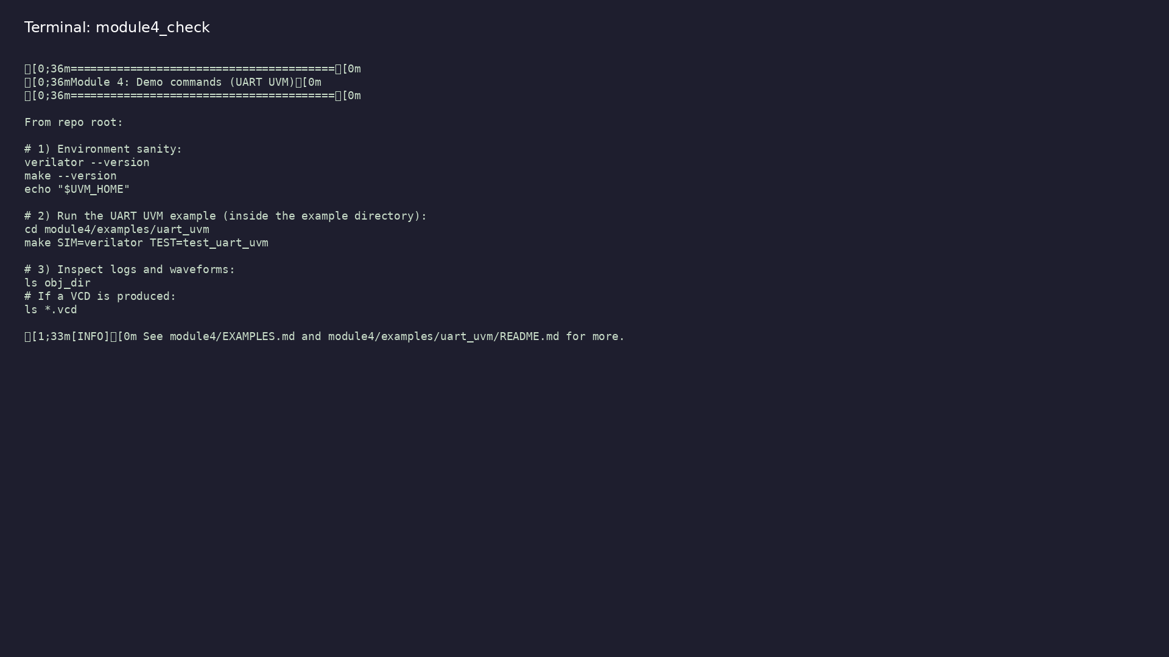
Module 4 self-check
$ ./scripts/module4.sh --help
learn_uart_spi_i2c / Module 4
Notes:
Run from course repository root.

Slide 24
Exercise scaffold
./scripts/module4.sh --scaffold
learn_uart_spi_i2c / Module 4

Slide 25
Example 1: UART UVM
• UVM phases and reporting (DRIVER, MONITOR,
SCOREBOARD).
• TX and RX scoreboard checks (TX: monitor observes
serial line; RX: loopback byte checked via scoreb…
• Final scoreboard summary (TX/RX matches and
mismatches).
learn_uart_spi_i2c / Module 4
Notes:
module4/examples/examples/uart_uvm/README.md

Slide 26
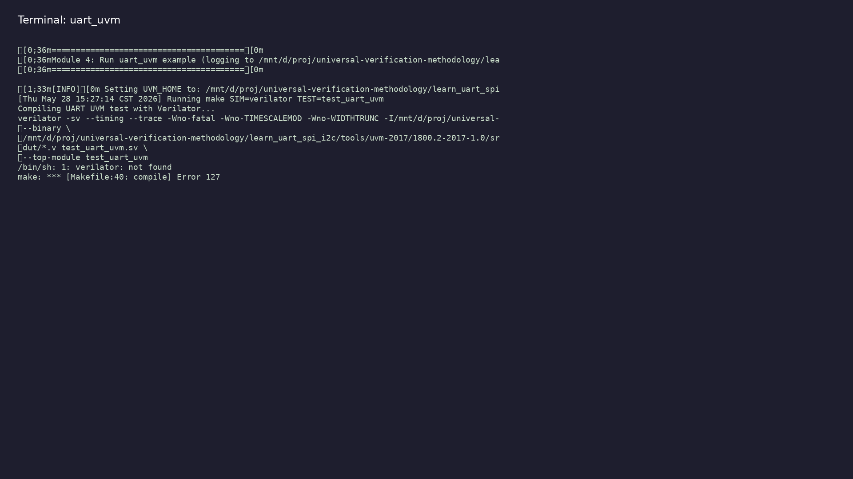
Demo: UART UVM
$ ./scripts/module4.sh --run
learn_uart_spi_i2c / Module 4
Notes:
Hands-on: module4/examples/examples/uart_uvm/

Slide 27
Practice & assessment
learn_uart_spi_i2c / Module 4

Slide 28
What you should know
• Describe the UART UVM agent (transaction, sequence,
driver, monitor, scoreboard).
• Explain loopback (TX→RX) and how TX and RX are both
checked in the scoreboard.
• Run the uart_uvm example and interpret UVM output.
• Ready for Module 5: SPI protocol + RTL + basic
testbench.
learn_uart_spi_i2c / Module 4
Notes:
From MODULE4 Learning Outcomes.

Slide 29
Exercises
• Run uart_uvm
• Trace one transaction
• Change the sequence
• Optional: Loopback path
learn_uart_spi_i2c / Module 4

Slide 30
Assessment checklist
• Can describe the UART UVM agent: transaction (one
byte), sequence, driver, monitor, scoreboard.
• Can explain loopback and how TX and RX are both
checked.
• Can run uart_uvm and interpret UVM output (phases,
scoreboard summary).
• Ready for Module 5: SPI protocol + RTL + basic
testbench.
learn_uart_spi_i2c / Module 4

Slide 31
Summary & next steps
• Extend UART verification to **UVM+SV** — UART agent
(transaction, sequence, driver, monitor, scoreb…
• Complete module4/CHECKLIST.md
• Review module4/EXAMPLES.md and run each lab
• Next: SPI
learn_uart_spi_i2c / Module 4

