Slide 1
Module 5
SPI — Protocol + RTL + Basic Testbench
learn_uart_spi_i2c / Module 5

Slide 2
Learning objectives
• SPI mode 0: SCLK idle low; capture on rising edge;
change on falling edge; CS_N active low for fram…
• RTL block architecture: `clk_div` + `spi_master`
hierarchy, FSM, and Mode 0 timing on the wire.
• Baseline verification: Directed stimulus,
`done`-based checks, and optional waveform review (8
SCLK…
• Path to Module 6: Same DUT, UVM agent with bus
monitor on SCLK/MOSI/CS_N.
learn_uart_spi_i2c / Module 5

Slide 3
Prerequisites
• Modules 1–4 (spec→RTL, UVM, UART baseline, UART
UVM).
• Verilator, Make, C++ compiler. No UVM required for
spi_baseline.
learn_uart_spi_i2c / Module 5

Slide 4
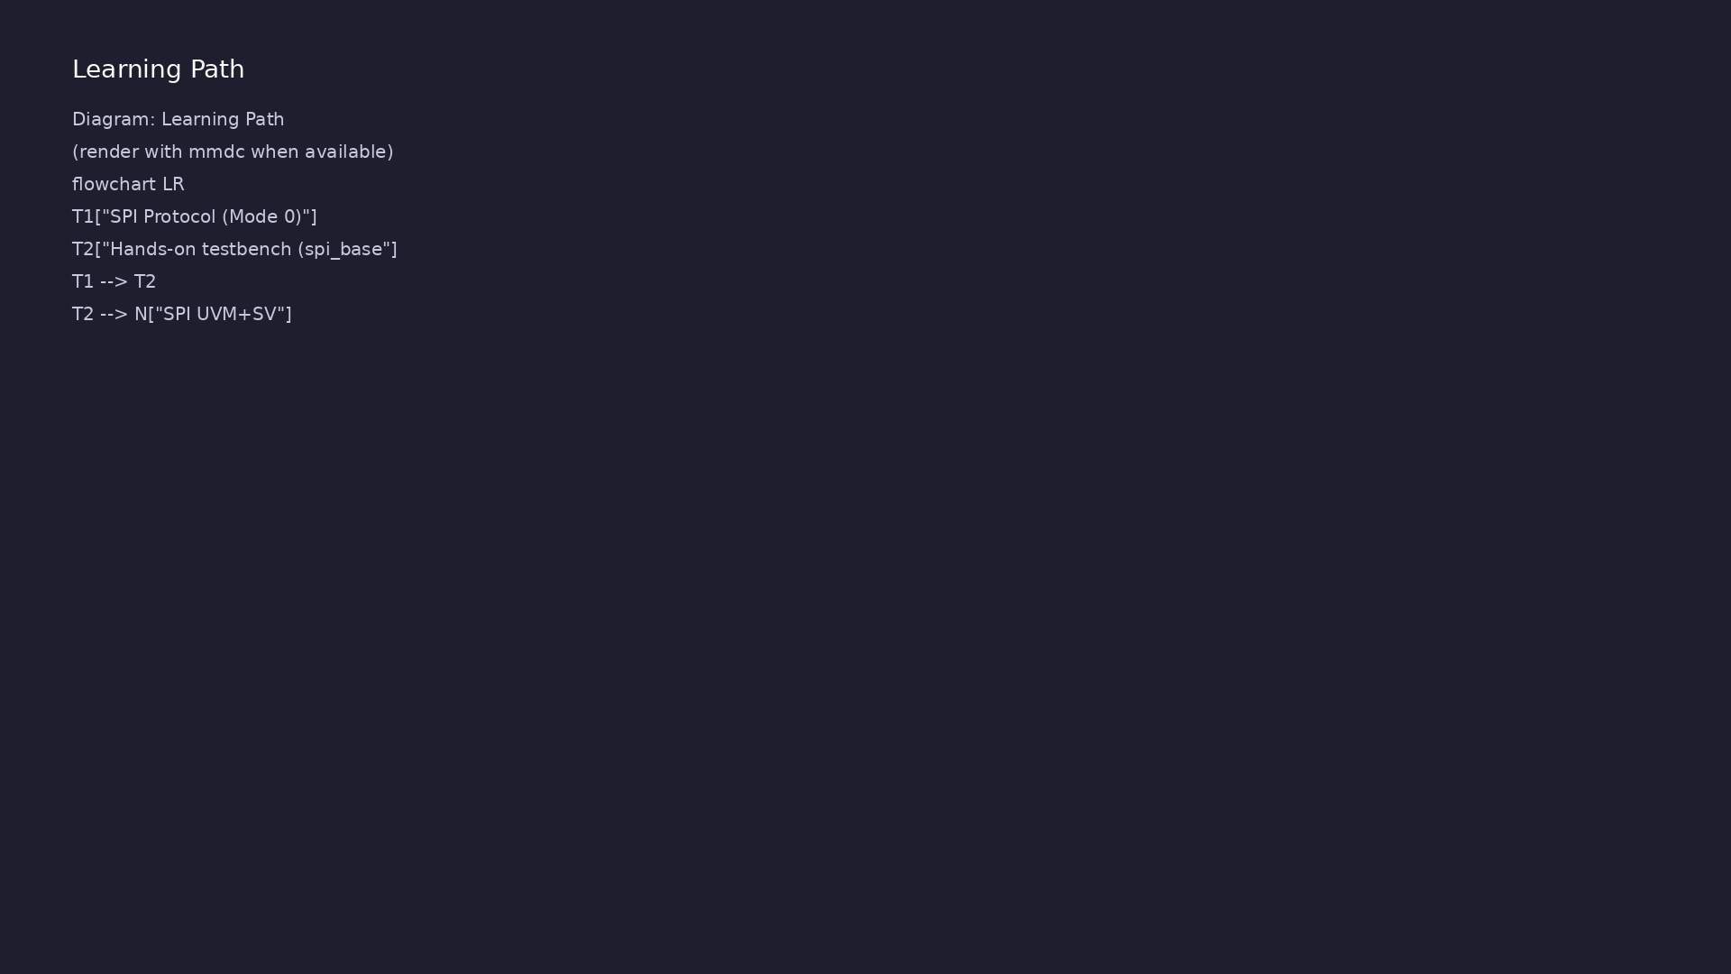
Learning path
Understand the SPI protocol (mode 0, signals), translate it to RTL (SPI master, clk_div), and verify with a **basic** (non-UVM) directed te…
learn_uart_spi_i2c / Module 5

Slide 5
Overview
• Module 5 is the second **protocol** module (after
UART):
learn_uart_spi_i2c / Module 5

Slide 6
How to learn this module
learn_uart_spi_i2c / Module 5

Slide 7
Suggested learning path
• Read the detailed SPI learning guide:
SPI_LEARNING_GUIDE.md — what SPI is, what kind of
protocol (s…
• Read the protocols + UVM overview:
LEARNING_GUIDE_PROTOCOLS_AND_UVM.md — Part B § 4.
When to Use Ba…
learn_uart_spi_i2c / Module 5
Notes:
From docs/MODULE5.md — read guides before running demos.

Slide 8
Design architecture
learn_uart_spi_i2c / Module 5

Slide 9
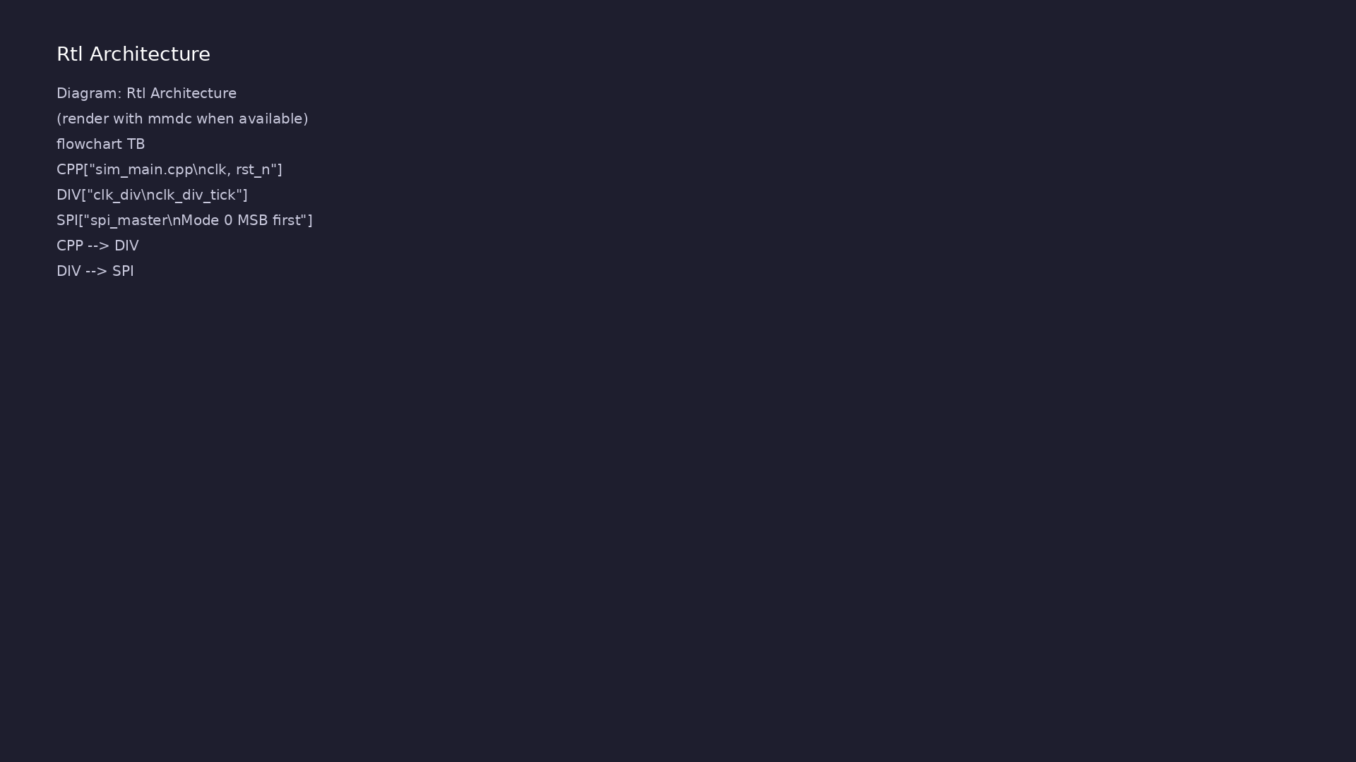
RTL / block architecture
Module 5: DUT / block hierarchy (see module5/examples/).
learn_uart_spi_i2c / Module 5

Slide 10
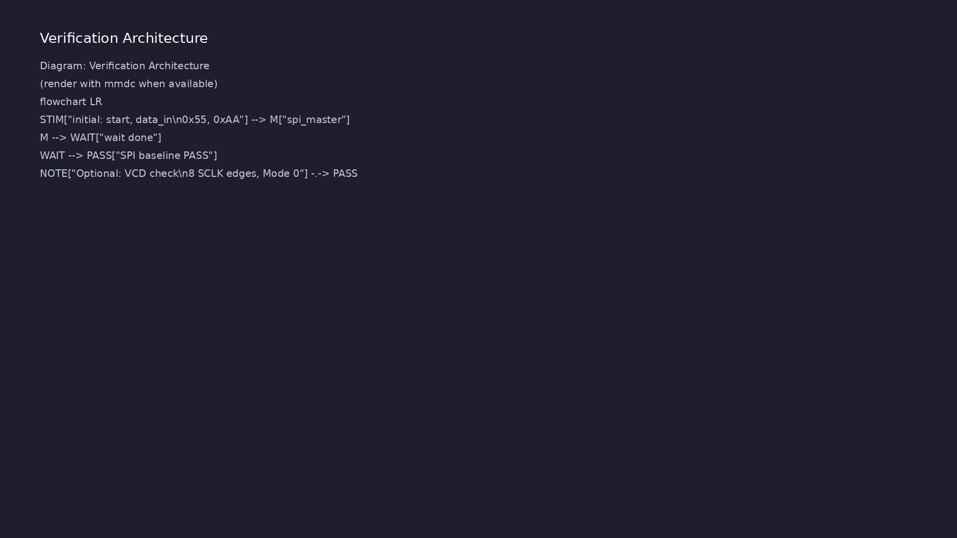
Verification environment architecture
Module 5: UVM layers, agents, and checkers for this phase.
learn_uart_spi_i2c / Module 5

Slide 11
1. Block hierarchy
• top_spi_baseline → `clk_div` + `spi_master`; C++
supplies `clk`/`rst_n`.
learn_uart_spi_i2c / Module 5
Notes:
From MODULE5 Design Architecture.

Slide 12
2. SPI master RTL
• clk_div: `clk_div_tick` every `DIVIDER` clocks.
• spi_master: Mode 0; `cs_n` frames; MSB-first on
`mosi`; `done` when complete.
• Outputs: `sclk` (idle low), `mosi`, `cs_n` — no
`miso` in baseline.
learn_uart_spi_i2c / Module 5
Notes:
From MODULE5 Design Architecture.

Slide 13
3. Mode 0 timing on the wire
• Capture on rising SCLK; change MOSI on falling SCLK;
8 edges per byte.
learn_uart_spi_i2c / Module 5
Notes:
From MODULE5 Design Architecture.

Slide 14
Verification & testing methods
learn_uart_spi_i2c / Module 5

Slide 15
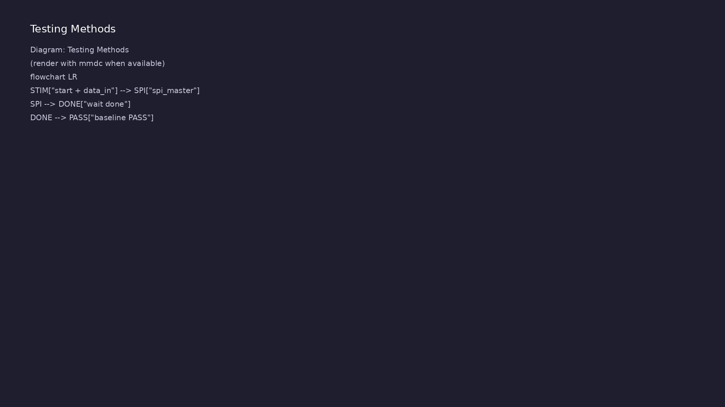
Testing and closure flow
Module 5: how tests, checks, and metrics close verification goals.
learn_uart_spi_i2c / Module 5

Slide 16
1. Baseline goals
• Confirm Mode 0 serialization before SPI UVM (Module
6).
learn_uart_spi_i2c / Module 5
Notes:
From MODULE5 Verification & Testing Methods.

Slide 17
2. Directed test flow
• Pulse `start` + `data_in` (0x55, 0xAA);
`wait(done)`; read `[PASS]` messages.
learn_uart_spi_i2c / Module 5
Notes:
From MODULE5 Verification & Testing Methods.

Slide 18
3. Waveform learning (optional)
• Count 8 SCLK cycles per frame; verify MSB-first bit
order on MOSI.
• Defer MISO, multi-slave CS, and random data to
Module 6.
learn_uart_spi_i2c / Module 5
Notes:
From MODULE5 Verification & Testing Methods.

Slide 19
Syllabus topics
learn_uart_spi_i2c / Module 5

Slide 20
1. SPI Protocol (Mode 0)
• Signals: sclk (serial clock), mosi (master out,
slave in), cs_n (active-low chip select). Optional:…
• Mode 0 (CPOL=0, CPHA=0): SCLK idles low; data
captured on rising edge; data changed on falling
edge.
• Timing: One bit per clk_div_tick; clk_div_tick
derived from system clock via divider (e.g.
DIVIDER=…
learn_uart_spi_i2c / Module 5
Notes:
From MODULE5 Topics Covered.

Slide 21
2. Hands-on testbench (spi_baseline)
• Directed test in `top_spi_baseline.sv`: `start`,
`data_in`, `wait(done)`.
• Pass: `[PASS]` lines and `SPI baseline test PASS`.
learn_uart_spi_i2c / Module 5
Notes:
From MODULE5 Topics Covered.

Slide 22
Hands-on examples
learn_uart_spi_i2c / Module 5

Slide 23
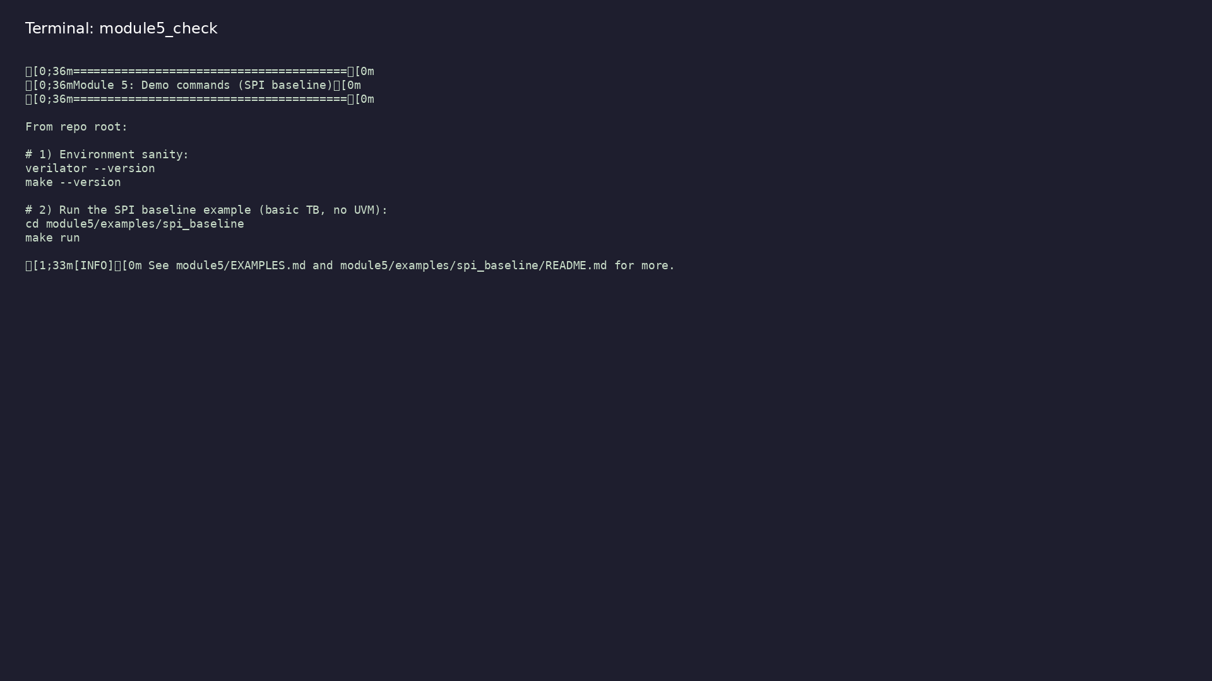
Module 5 self-check
$ ./scripts/module5.sh --help
learn_uart_spi_i2c / Module 5
Notes:
Run from course repository root.

Slide 24
Exercise scaffold
./scripts/module5.sh --scaffold
learn_uart_spi_i2c / Module 5

Slide 25
Example 1: SPI baseline
• `dut/`: `spi_master.v`, `clk_div.v`
• `top_spi_baseline.sv`: Top with clk_div, spi_master;
directed stimulus and checks in initial blocks.
• `sim_main.cpp`: C++ harness (clock, reset);
simulation runs until `$finish`.
learn_uart_spi_i2c / Module 5
Notes:
module5/examples/examples/spi_baseline/README.md

Slide 26
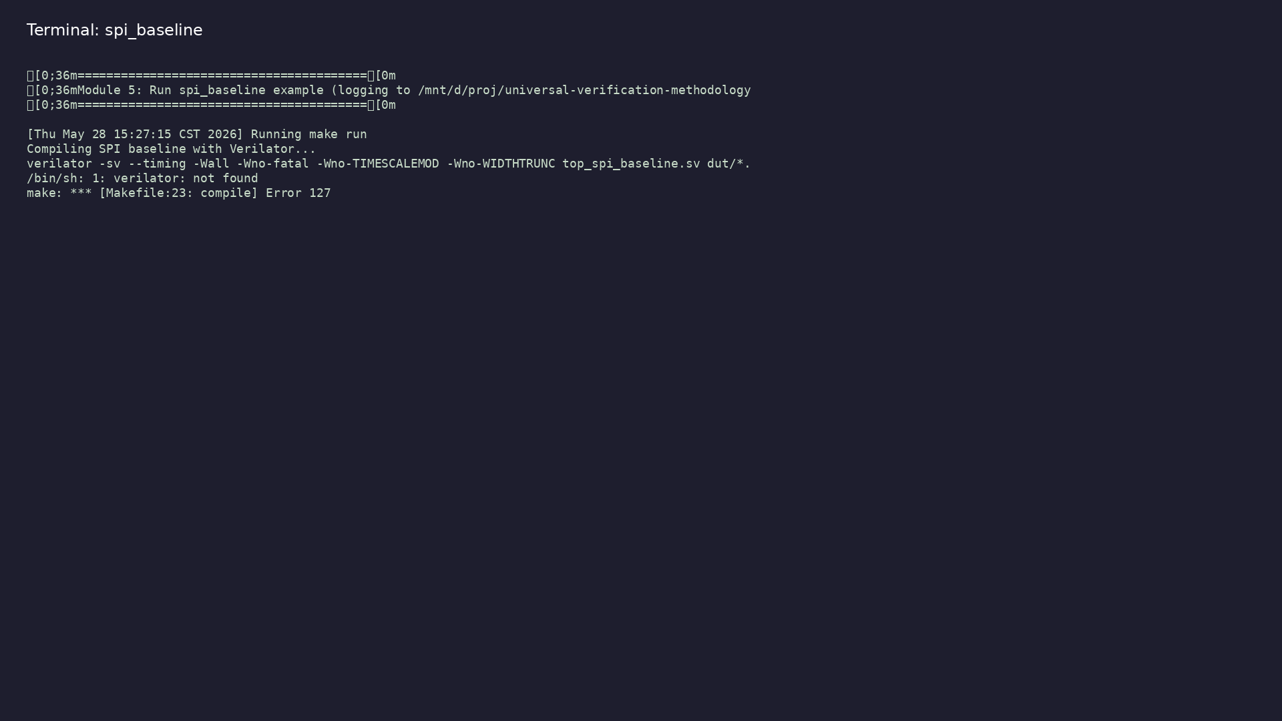
Demo: SPI baseline
$ ./scripts/module5.sh --run
learn_uart_spi_i2c / Module 5
Notes:
Hands-on: module5/examples/examples/spi_baseline/

Slide 27
Practice & assessment
learn_uart_spi_i2c / Module 5

Slide 28
What you should know
• Describe SPI mode 0 and the role of sclk, mosi,
cs_n, clk_div_tick.
• Explain the role of spi_master and clk_div.
• Run the spi_baseline example and interpret the
directed test.
• Ready for Module 6: SPI UVM+SV verification.
learn_uart_spi_i2c / Module 5
Notes:
From MODULE5 Learning Outcomes.

Slide 29
Exercises
• Run spi_baseline
• Trace one transfer
• Mode 0 timing
• Optional: Waveforms
learn_uart_spi_i2c / Module 5

Slide 30
Assessment checklist
• Can describe SPI mode 0 (idle low, capture on
rising, change on falling) and signals sclk, mosi,
cs…
• Can explain the role of spi_master and clk_div in
the RTL.
• Can run spi_baseline and interpret the directed test
result.
• Ready for Module 6: SPI UVM+SV verification.
learn_uart_spi_i2c / Module 5

Slide 31
Summary & next steps
• Understand the SPI protocol (mode 0, signals),
translate it to RTL (SPI master, clk_div), and
verif…
• Complete module5/CHECKLIST.md
• Review module5/EXAMPLES.md and run each lab
• Next: SPI UVM+SV
learn_uart_spi_i2c / Module 5

