Slide 1
Module 6
SPI — UVM+SV Verification
learn_uart_spi_i2c / Module 6

Slide 2
Learning objectives
• SPI UVM agent: Transaction (SpiTransaction),
sequence (SpiSequence), driver (SpiDriver), monitor
(S…
• Interface: spi_master_if (clk, rst_n, clk_div_tick,
start, data_in, sclk, mosi, cs_n, busy, done) c…
• Mode 0 monitoring: SCLK idle low; capture on rising
edge; monitor samples MOSI on each rising SCLK,…
learn_uart_spi_i2c / Module 6

Slide 3
Prerequisites
• Module 1 (spec → RTL), Module 2 (UVM+SV, uvm_smoke),
Module 5 (SPI protocol + RTL + basic TB).
• Verilator, Make, C++ compiler, UVM (UVM_HOME or
vendored UVM).
learn_uart_spi_i2c / Module 6

Slide 4
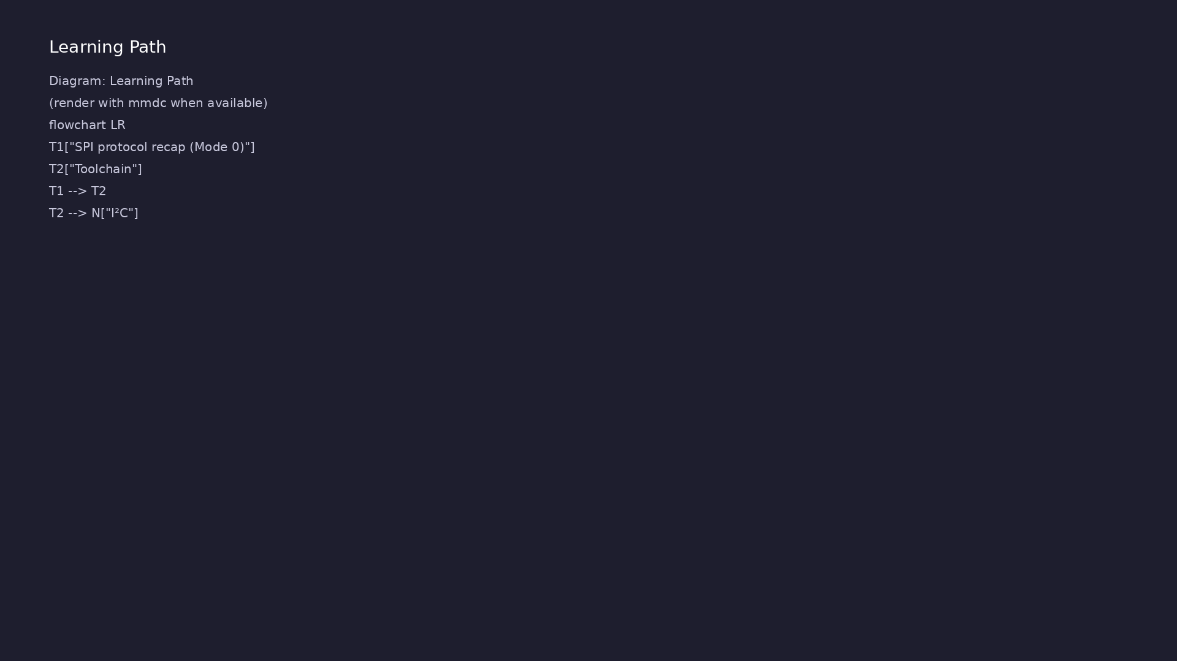
Learning path
Extend SPI verification to **UVM+SV** — SPI agent (transaction, sequence, driver, monitor, scoreboard); run on Verilator.
learn_uart_spi_i2c / Module 6

Slide 5
Overview
• Module 6 builds on Module 5 (SPI protocol + RTL +
basic testbench):
learn_uart_spi_i2c / Module 6

Slide 6
How to learn this module
learn_uart_spi_i2c / Module 6

Slide 7
Suggested learning path
• Read the detailed SPI learning guide:
SPI_LEARNING_GUIDE.md — what SPI is, how it works
(signals, M…
• Read the protocols + UVM overview:
LEARNING_GUIDE_PROTOCOLS_AND_UVM.md — Part B § 5.
How UVM Maps t…
learn_uart_spi_i2c / Module 6
Notes:
From docs/MODULE6.md — read guides before running demos.

Slide 8
Design architecture
learn_uart_spi_i2c / Module 6

Slide 9
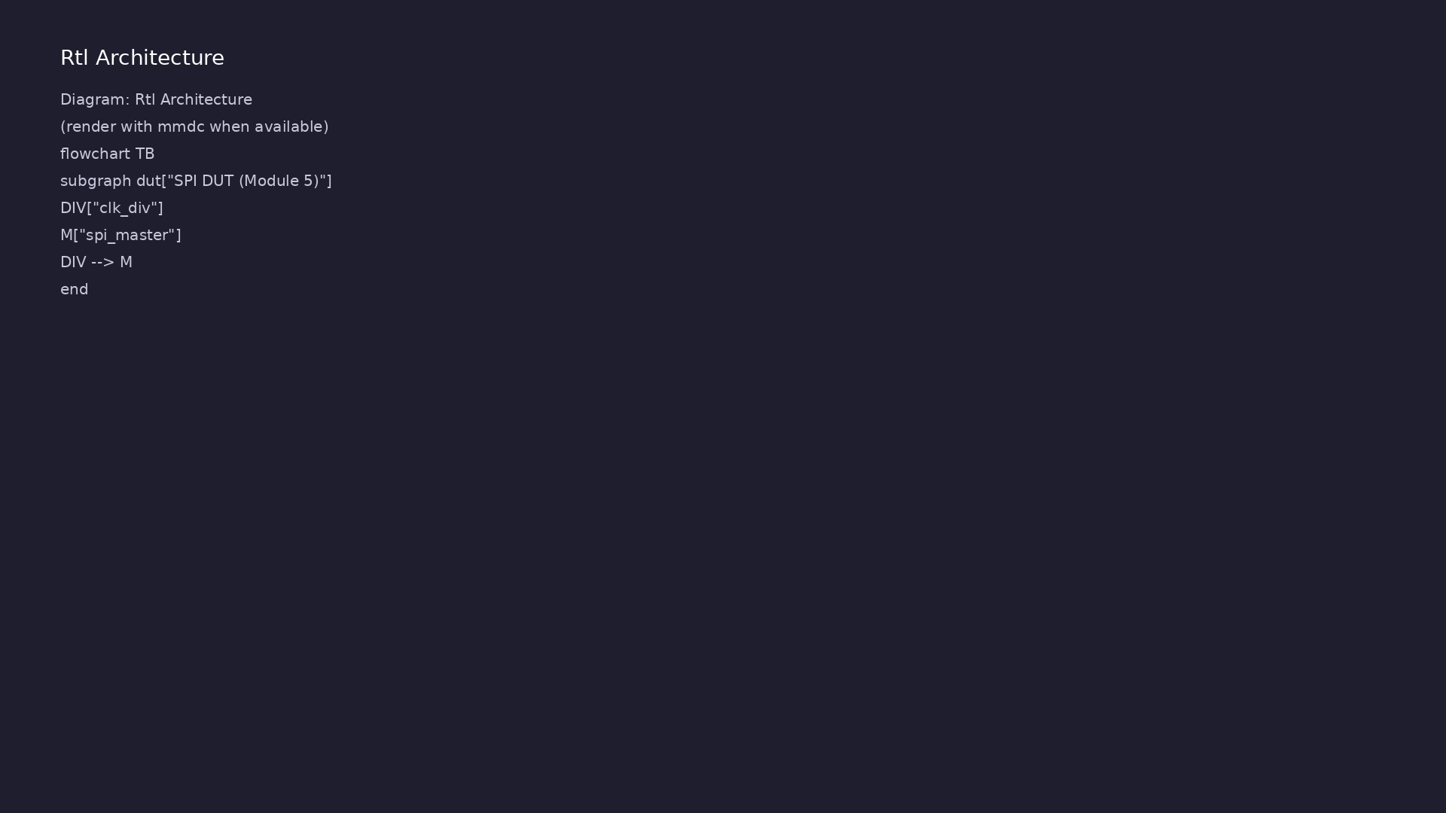
RTL / block architecture
Module 6: DUT / block hierarchy (see module6/examples/).
learn_uart_spi_i2c / Module 6

Slide 10
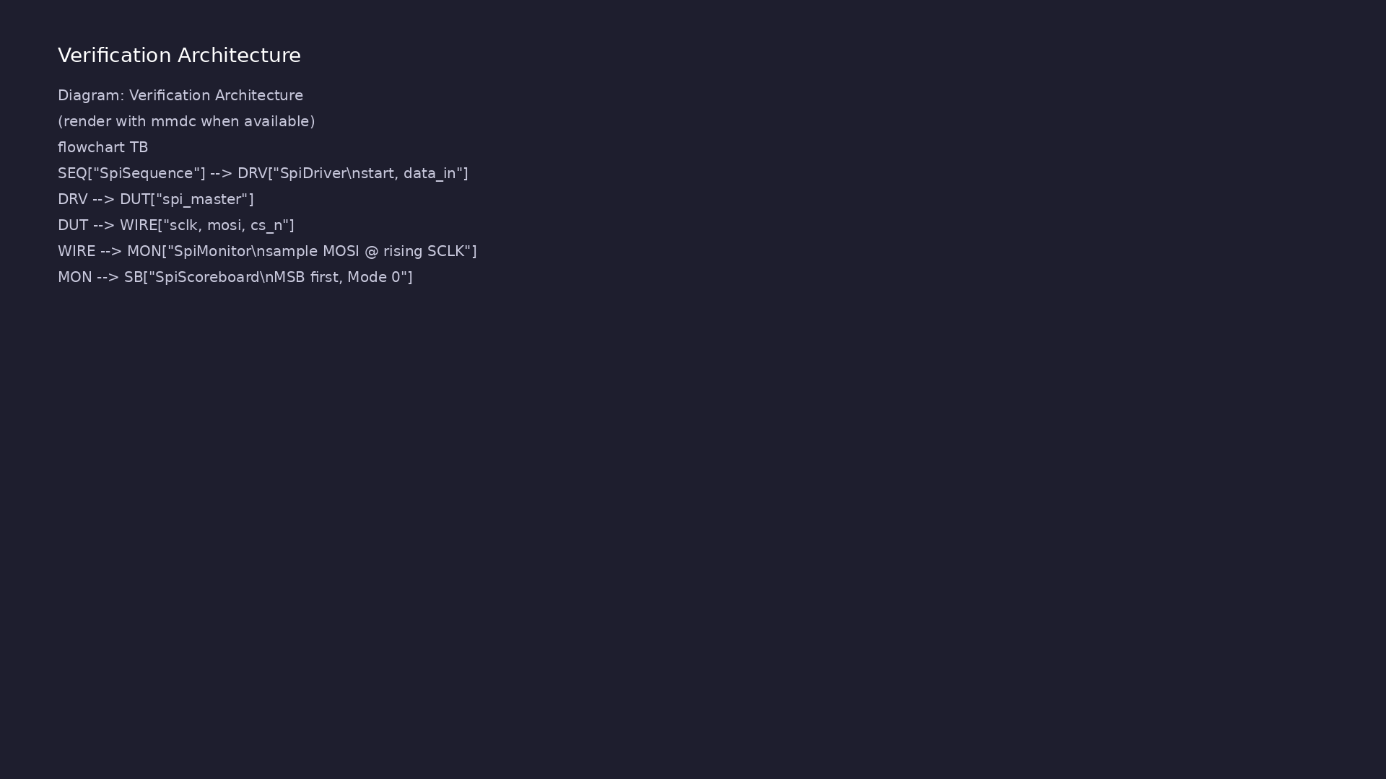
Verification environment architecture
Module 6: UVM layers, agents, and checkers for this phase.
learn_uart_spi_i2c / Module 6

Slide 11
1. SPI DUT (reused from Module 5)
• spi_master + clk_div in
`module6/examples/spi_uvm/dut/`.
• spi_master_if connects UVM to DUT pins.
learn_uart_spi_i2c / Module 6
Notes:
From MODULE6 Design Architecture.

Slide 12
2. UVM agent structure
• SpiTransaction = one byte; SpiSequence = directed
list; SpiDriver waits on `done`.
• SpiMonitor samples MOSI on rising SCLK while `cs_n`
is low (Mode 0, MSB first).
• SpiScoreboard compares expected vs `observed_mosi`.
learn_uart_spi_i2c / Module 6
Notes:
From MODULE6 Design Architecture.

Slide 13
3. Bus vs DUT checking
• Monitor validates wire behavior; `done` alone is not
sufficient for sign-off.
learn_uart_spi_i2c / Module 6
Notes:
From MODULE6 Design Architecture.

Slide 14
Verification & testing methods
learn_uart_spi_i2c / Module 6

Slide 15
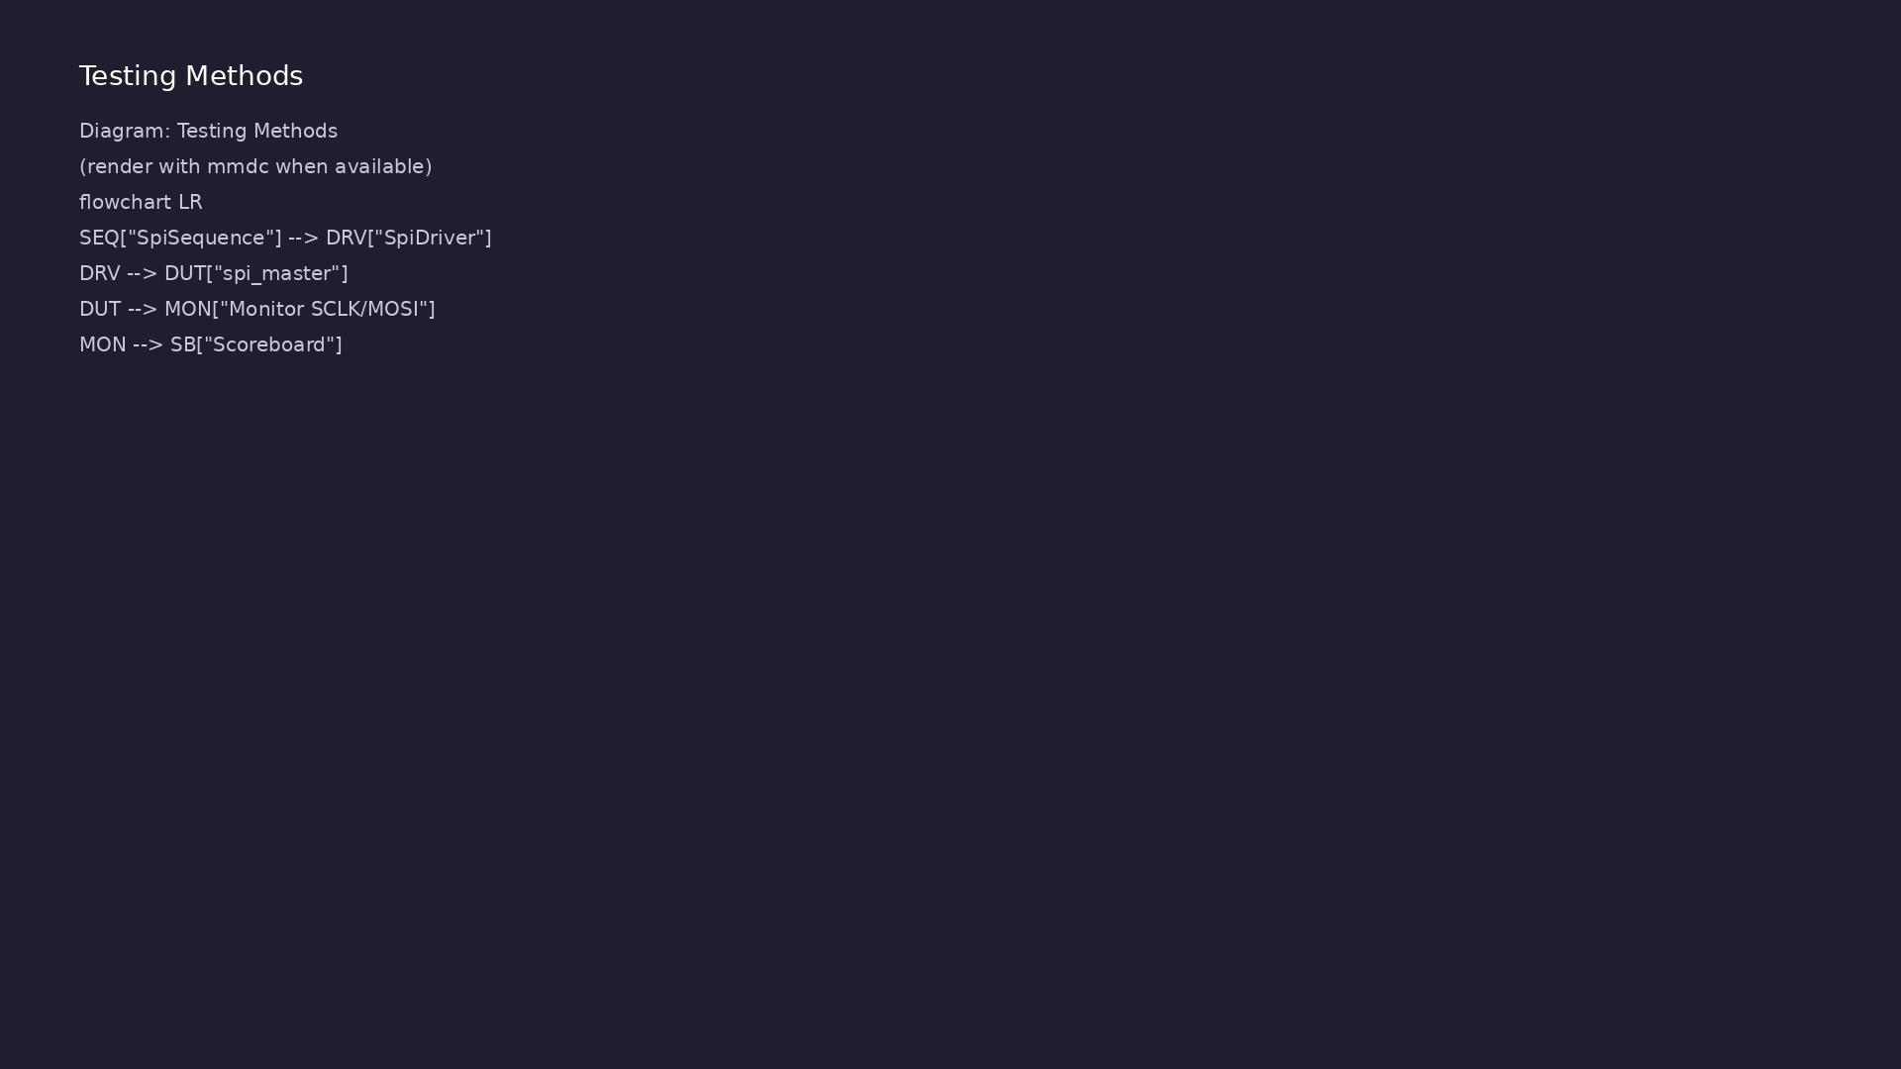
Testing and closure flow
Module 6: how tests, checks, and metrics close verification goals.
learn_uart_spi_i2c / Module 6

Slide 16
1. Mode 0 in the testbench
• Monitor must use rising-edge capture and falling-
edge change — matches CPOL/CPHA=0.
learn_uart_spi_i2c / Module 6
Notes:
From MODULE6 Verification & Testing Methods.

Slide 17
2. Directed regression
• Same byte pattern as UART UVM (0x00 … 0xFF) for
apples-to-apples learning.
learn_uart_spi_i2c / Module 6
Notes:
From MODULE6 Verification & Testing Methods.

Slide 18
3. Extensions
• MISO reads, random data, mode parameters — see
[LEARNING_GUIDE §
7](LEARNING_GUIDE_PROTOCOLS_AND_UV…
learn_uart_spi_i2c / Module 6
Notes:
From MODULE6 Verification & Testing Methods.

Slide 19
Syllabus topics
learn_uart_spi_i2c / Module 6

Slide 20
1. SPI protocol recap (Mode 0)
• `cs_n` frames; 8 SCLK cycles per byte; MSB first on
MOSI.
learn_uart_spi_i2c / Module 6
Notes:
From MODULE6 Topics Covered.

Slide 21
2. Toolchain
• `make SIM=verilator TEST=test_spi_uvm`;
`+UVM_TESTNAME=SpiTest`.
learn_uart_spi_i2c / Module 6
Notes:
From MODULE6 Topics Covered.

Slide 22
Hands-on examples
learn_uart_spi_i2c / Module 6

Slide 23
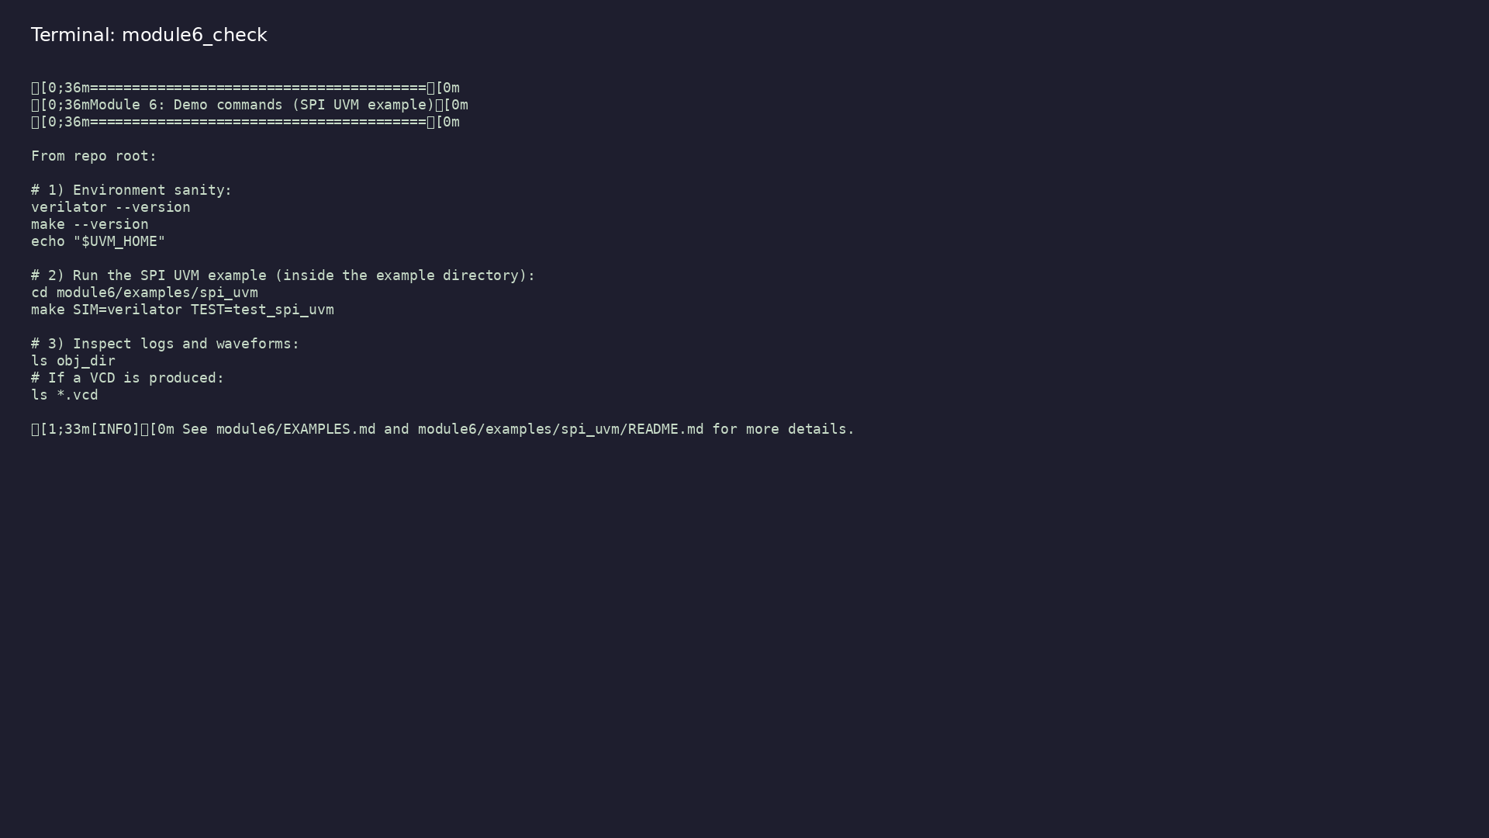
Module 6 self-check
$ ./scripts/module6.sh --help
learn_uart_spi_i2c / Module 6
Notes:
Run from course repository root.

Slide 24
Exercise scaffold
./scripts/module6.sh --scaffold
learn_uart_spi_i2c / Module 6

Slide 25
Example 1: SPI UVM
• UVM phases and reporting (DRIVER, MONITOR,
SCOREBOARD).
• Scoreboard checks (expected byte from sequence vs
observed byte on MOSI).
• Final scoreboard summary (matches and mismatches).
learn_uart_spi_i2c / Module 6
Notes:
module6/examples/examples/spi_uvm/README.md

Slide 26
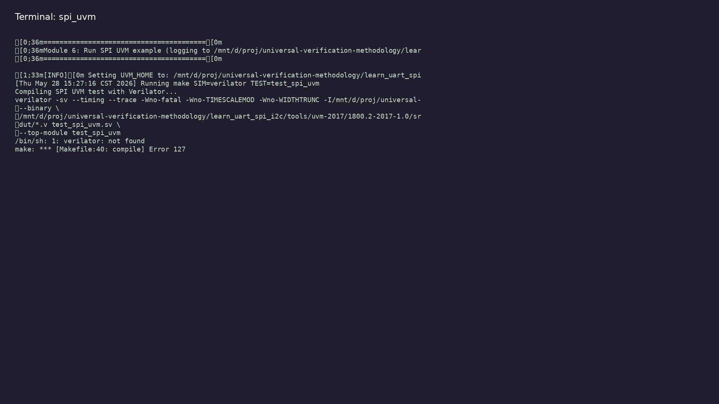
Demo: SPI UVM
$ ./scripts/module6.sh --run
learn_uart_spi_i2c / Module 6
Notes:
Hands-on: module6/examples/examples/spi_uvm/

Slide 27
Practice & assessment
learn_uart_spi_i2c / Module 6

Slide 28
What you should know
• Describe the SPI UVM agent (transaction, sequence,
driver, monitor, scoreboard) and mode 0 monitori…
• Run spi_uvm and interpret UVM output.
• Ready for Module 7: I²C protocol + RTL + basic
testbench.
learn_uart_spi_i2c / Module 6
Notes:
From MODULE6 Learning Outcomes.

Slide 29
Exercises
• Run spi_uvm
• Trace one transaction
• Change the sequence
• Optional: Compare to UART UVM
learn_uart_spi_i2c / Module 6

Slide 30
Assessment checklist
• Can describe the SPI UVM agent and how it maps to
SPI (one byte, mode 0 monitoring).
• Can run spi_uvm and interpret UVM output.
• Ready for Module 7: I²C protocol + RTL + basic
testbench.
learn_uart_spi_i2c / Module 6

Slide 31
Summary & next steps
• Extend SPI verification to **UVM+SV** — SPI agent
(transaction, sequence, driver, monitor, scoreboa…
• Complete module6/CHECKLIST.md
• Review module6/EXAMPLES.md and run each lab
• Next: I²C
learn_uart_spi_i2c / Module 6

