Slide 1
Module 7
I²C — Protocol + RTL + Basic Testbench
learn_uart_spi_i2c / Module 7

Slide 2
Learning objectives
• RTL block architecture: `clk_div` + `i2c_master` FSM
(START → addr → data → STOP).
• Baseline verification: Directed writes plus inline
bus monitor (sample SDA on rising SCL).
• Protocol vs simplification: Real open-drain/ACK vs
this repo’s push-pull teaching model.
• Path to Module 8: Same DUT with UVM
monitor/scoreboard on address and data phases.
learn_uart_spi_i2c / Module 7

Slide 3
Prerequisites
• Modules 1–6.
• Verilator, Make, C++ compiler. No UVM required for
this baseline.
learn_uart_spi_i2c / Module 7

Slide 4
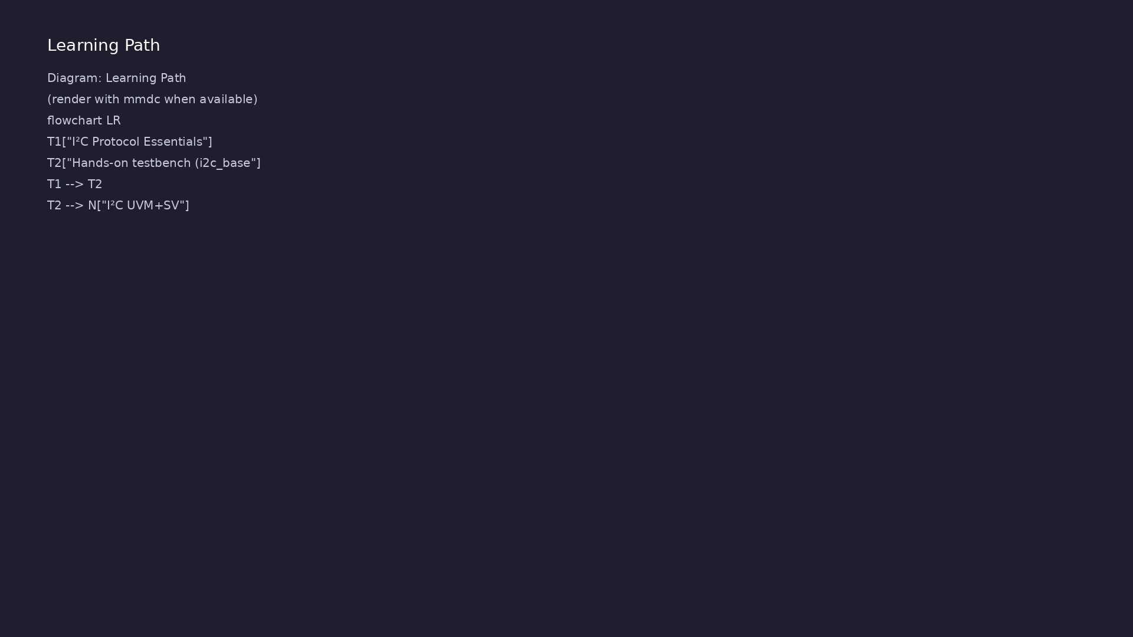
Learning path
Understand the I²C protocol (start/stop, addressing, ACK/NACK), translate it to RTL (simple master + timing), and verify with a **basic** (…
learn_uart_spi_i2c / Module 7

Slide 5
Overview
• Module 7 is the I²C **protocol + RTL + basic
testbench** module (UVM comes in Module 8).
learn_uart_spi_i2c / Module 7

Slide 6
How to learn this module
learn_uart_spi_i2c / Module 7

Slide 7
Suggested learning path
• Read the detailed I²C learning guide:
I2C_LEARNING_GUIDE.md — what I²C is, what kind of
protocol (s…
• Read the protocols + UVM overview:
LEARNING_GUIDE_PROTOCOLS_AND_UVM.md — Part B § 4.
When to Use Ba…
learn_uart_spi_i2c / Module 7
Notes:
From docs/MODULE7.md — read guides before running demos.

Slide 8
Design architecture
learn_uart_spi_i2c / Module 7

Slide 9
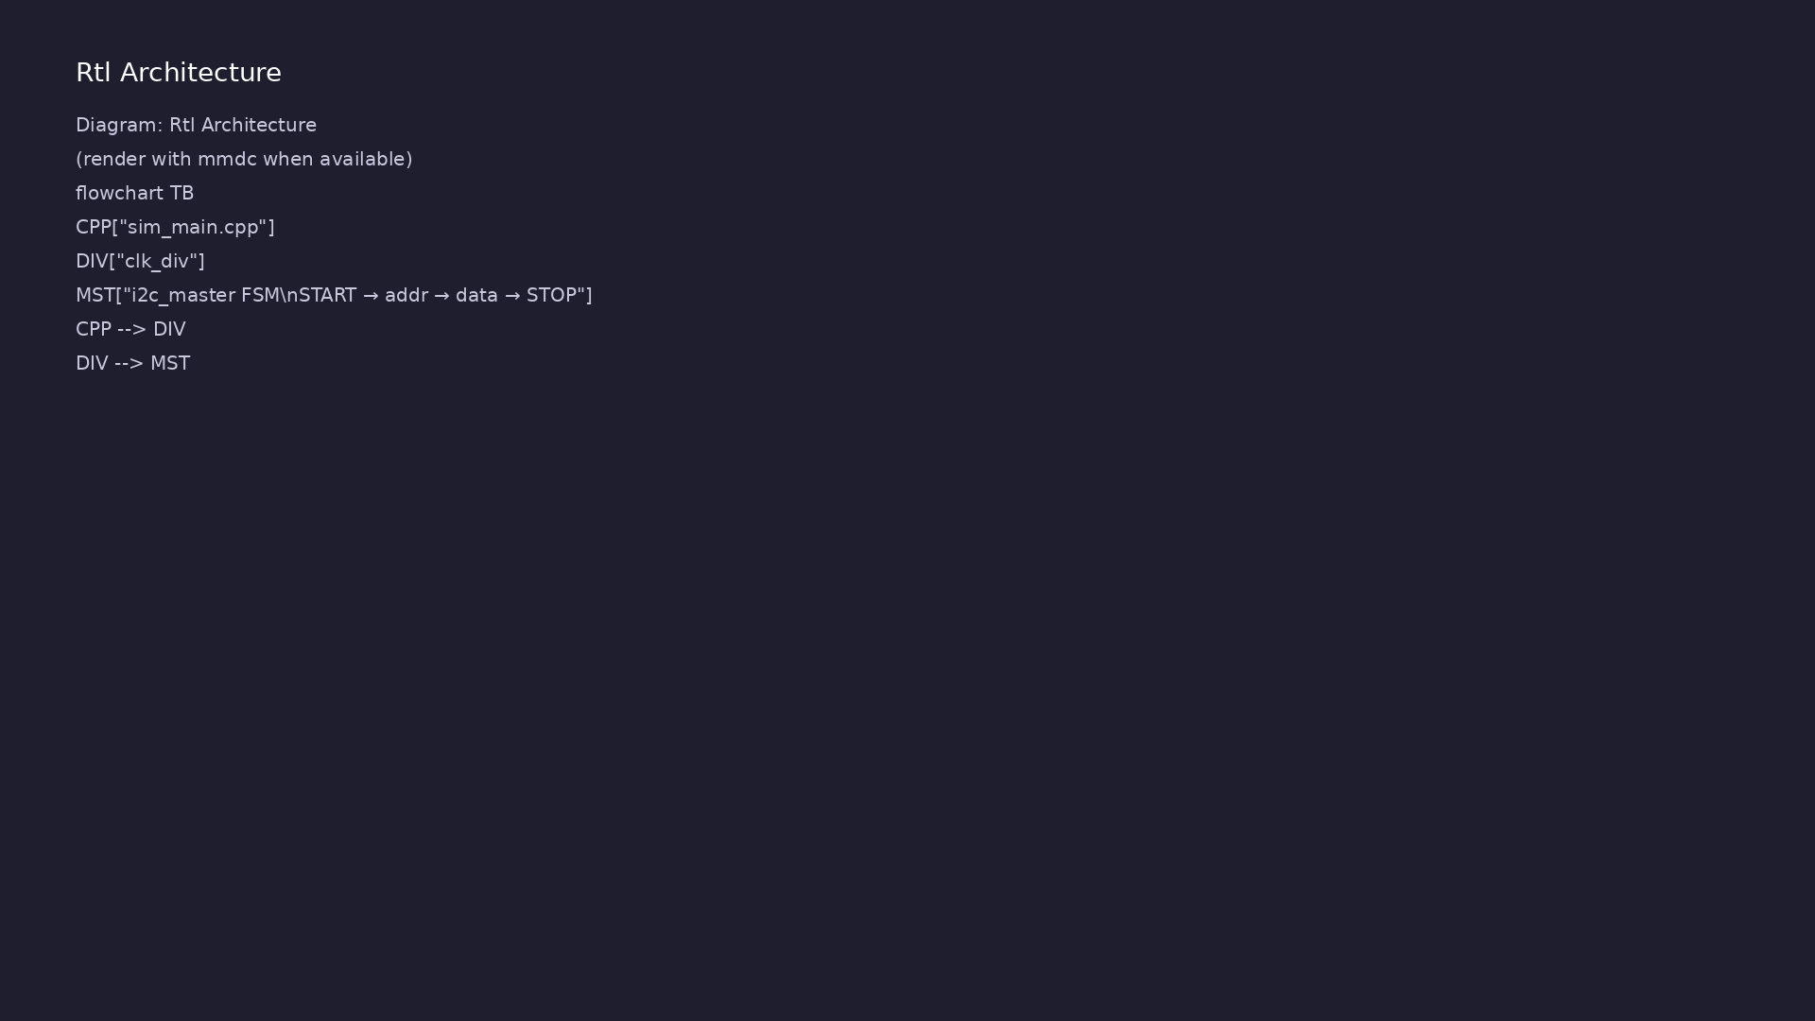
RTL / block architecture
Module 7: DUT / block hierarchy (see module7/examples/).
learn_uart_spi_i2c / Module 7

Slide 10
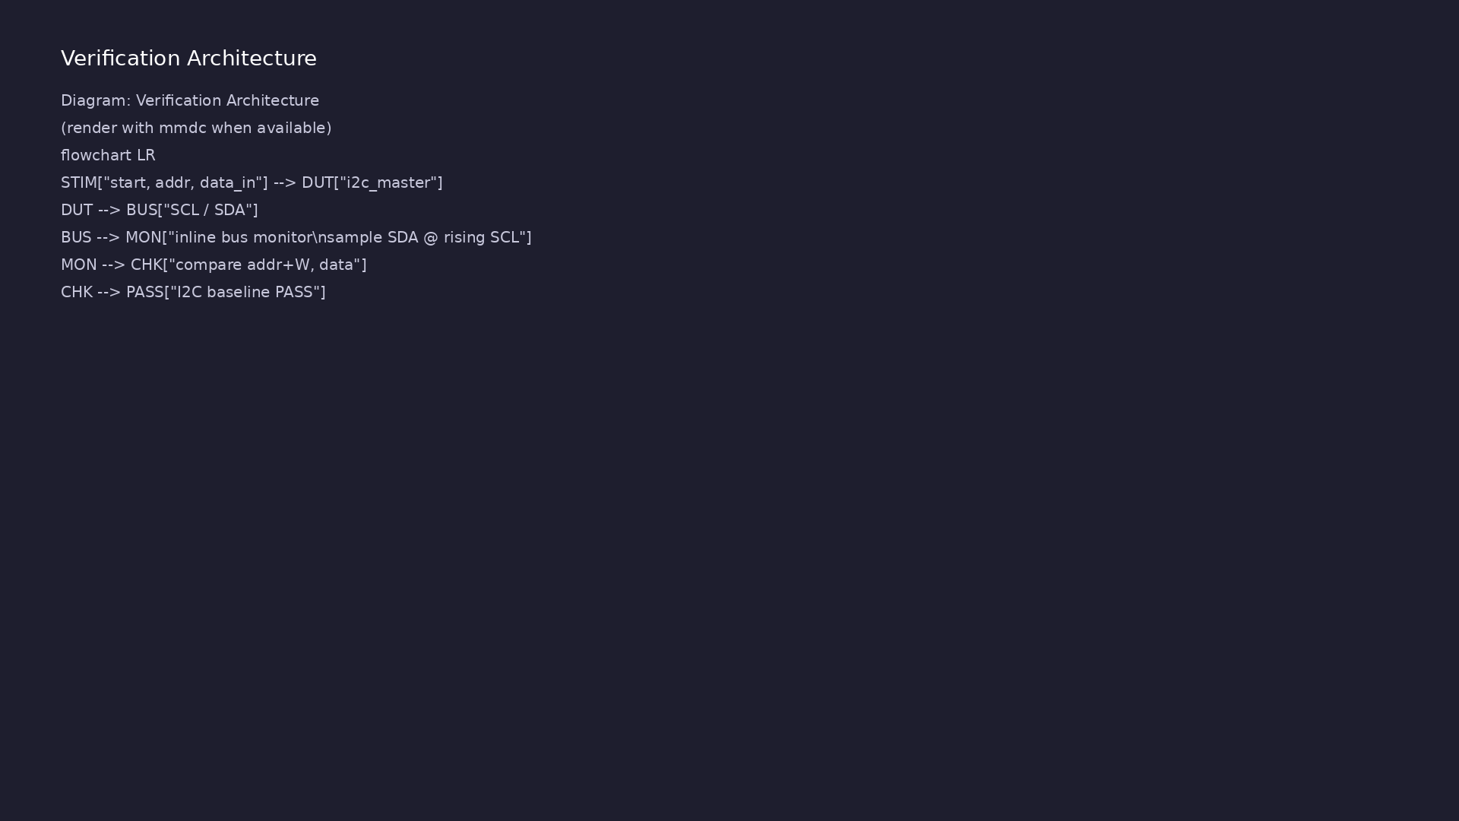
Verification environment architecture
Module 7: UVM layers, agents, and checkers for this phase.
learn_uart_spi_i2c / Module 7

Slide 11
1. Block hierarchy
• top_i2c_baseline → `clk_div` + `i2c_master`; C++
drives `clk`/`rst_n`.
learn_uart_spi_i2c / Module 7
Notes:
From MODULE7 Design Architecture.

Slide 12
2. I²C master FSM
• States: IDLE → START → ADDR_BITS → DATA_BITS → STOP.
• One teaching write: 7-bit `addr` + data byte on
`scl`/`sda` (push-pull model).
learn_uart_spi_i2c / Module 7
Notes:
From MODULE7 Design Architecture.

Slide 13
3. Teaching vs real I²C
• No open-drain, ACK/NACK, or arbitration in baseline
— learn sequencing first.
learn_uart_spi_i2c / Module 7
Notes:
From MODULE7 Design Architecture.

Slide 14
Verification & testing methods
learn_uart_spi_i2c / Module 7

Slide 15
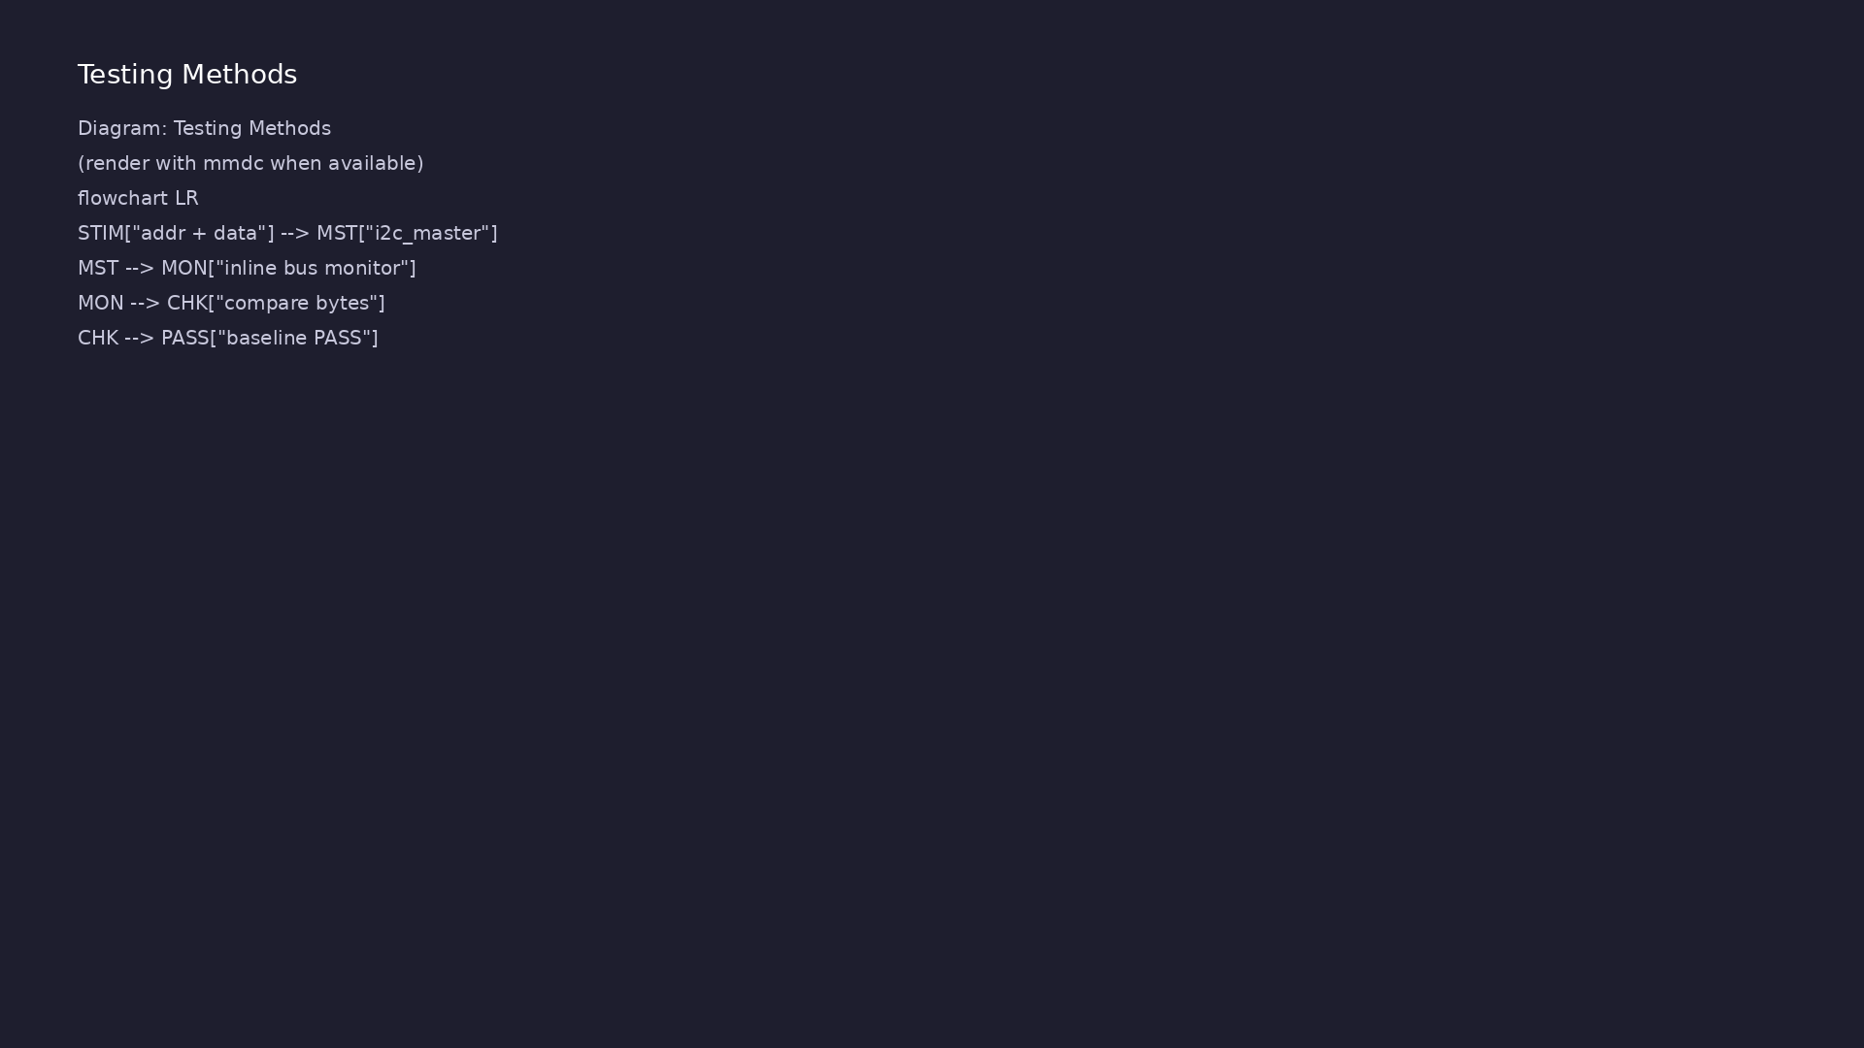
Testing and closure flow
Module 7: how tests, checks, and metrics close verification goals.
learn_uart_spi_i2c / Module 7

Slide 16
1. Inline bus monitor
• Top module detects START; samples SDA on rising SCL;
rebuilds addr+W and data.
learn_uart_spi_i2c / Module 7
Notes:
From MODULE7 Verification & Testing Methods.

Slide 17
2. Self-check flow
• Compare captured bytes to driven `addr`/`data_in`;
print `I2C baseline test PASS`.
learn_uart_spi_i2c / Module 7
Notes:
From MODULE7 Verification & Testing Methods.

Slide 18
3. Path to Module 8
• Move monitor into I2cMonitor; scoreboard splits
address and data phases.
learn_uart_spi_i2c / Module 7
Notes:
From MODULE7 Verification & Testing Methods.

Slide 19
Syllabus topics
learn_uart_spi_i2c / Module 7

Slide 20
1. I²C Protocol Essentials
• Bus idle: SCL=1, SDA=1.
• START: SDA goes 1→0 while SCL is 1.
• STOP: SDA goes 0→1 while SCL is 1.
• Address phase: 7-bit address + R/W bit (0=write,
1=read) sent MSB first.
• Data phase: 8-bit data bytes sent MSB first.
• ACK/NACK (concept): receiver pulls SDA low for ACK
on the 9th clock; high means NACK.
learn_uart_spi_i2c / Module 7
Notes:
From MODULE7 Topics Covered.

Slide 21
2. Hands-on testbench (i2c_baseline)
• Stimulus: `start`, `addr`, `data_in`, `wait(done)`.
• Monitor/self-check: reconstruct address+W and data
from SCL/SDA; compare to expected.
learn_uart_spi_i2c / Module 7
Notes:
From MODULE7 Topics Covered.

Slide 22
Hands-on examples
learn_uart_spi_i2c / Module 7

Slide 23
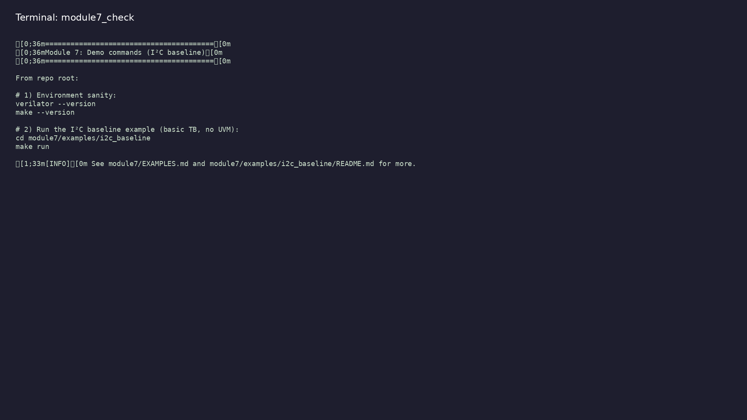
Module 7 self-check
$ ./scripts/module7.sh --help
learn_uart_spi_i2c / Module 7
Notes:
Run from course repository root.

Slide 24
Example 1: I²C baseline
• Drives a single write transaction (START → address+W
→ data → STOP)
• Includes a simple bus monitor that samples SDA on
SCL rising edges to reconstruct bytes
• No UVM
learn_uart_spi_i2c / Module 7
Notes:
module7/examples/examples/i2c_baseline/README.md

Slide 25
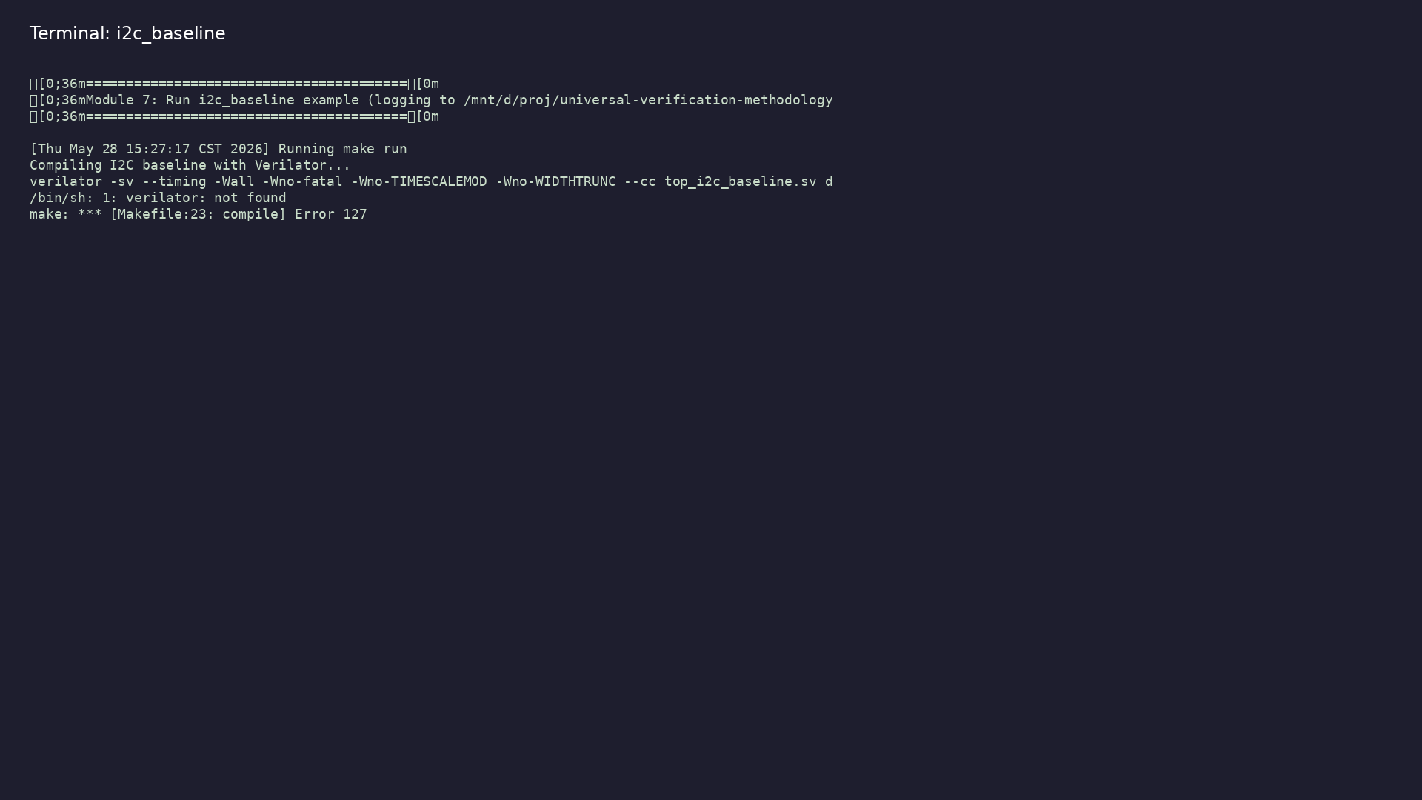
Demo: I²C baseline
$ ./scripts/module7.sh --run
learn_uart_spi_i2c / Module 7
Notes:
Hands-on: module7/examples/examples/i2c_baseline/

Slide 26
Practice & assessment
learn_uart_spi_i2c / Module 7

Slide 27
Exercises
• Run i2c_baseline
• Trace one transfer
• Bus monitor
• Optional: Waveforms
learn_uart_spi_i2c / Module 7

Slide 28
Assessment checklist
• Can describe I²C START, STOP, address+R/W, and data
phase (and ACK/NACK concept).
• Can explain the role of i2c_master and clk_div; know
the baseline uses push-pull (simplified).
• Can run i2c_baseline and interpret the test result.
• Ready for Module 8: I²C UVM+SV verification.
learn_uart_spi_i2c / Module 7

Slide 29
Summary & next steps
• Understand the I²C protocol (start/stop, addressing,
ACK/NACK), translate it to RTL (simple master…
• Complete module7/CHECKLIST.md
• Review module7/EXAMPLES.md and run each lab
• Next: I²C UVM+SV
learn_uart_spi_i2c / Module 7

